Slide 1
SIDIS with JLab at 22 GeV
Harut Avakian (JLab)
JLab22 Upgrade meeting, Aug 26, 2024
  Current status of SIDIS at JLab
  Understanding physics backgrounds
    longitudinal photons
    diffractive vector mesons
  Handling the breaking down of “factorization” in leptoproduction (ep→e’πX)
    Studies of ep→e’ππX
  Target fragments and “ρ free SIDIS”
    Studies of ep→e’pπX
  Opportunities with 22 GeV
  Simulations and validation procedures
  Summary

Slide 2
Main focus in building the support for upgrade
Identify the flagship measurements that can be done only with 20+ GeV and its science impact (Uniqueness)
impact of JLab measurements on overall 3D studies
Identify the flagship measurements with 20+ GeV that can extend and improve the 11 GeV measurements, helping the physics interpretation through multidimensional bins in extended kinematics (Enrichment)
for SIDIS major impact from wider Q² and P_{T} of hadrons
Identify the measurements with 20+ GeV that can set the bridge between JLab12 and EIC (Complementarity)
→ complementarity & uniqueness

Slide 3
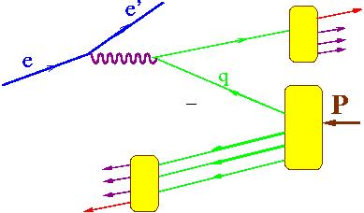
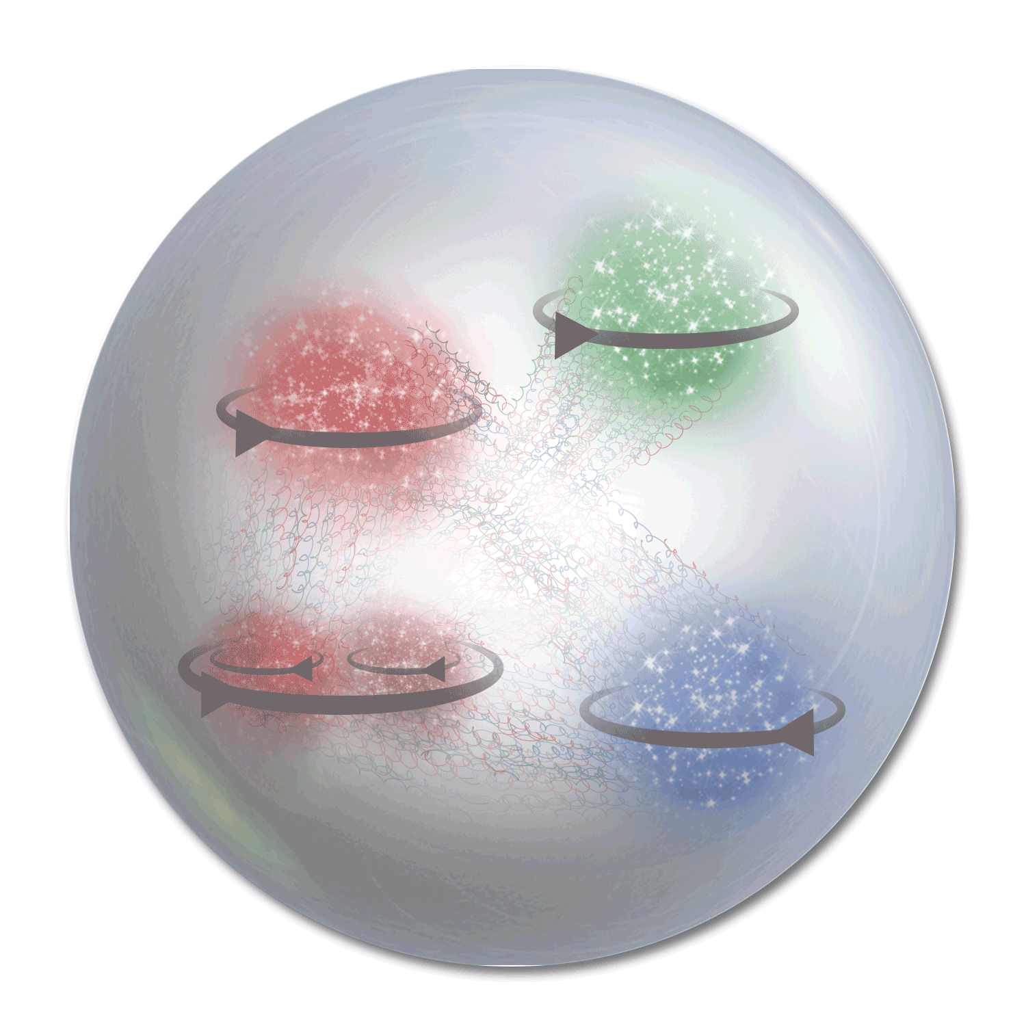

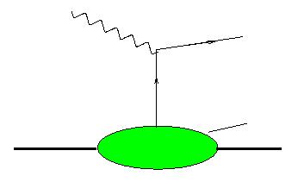
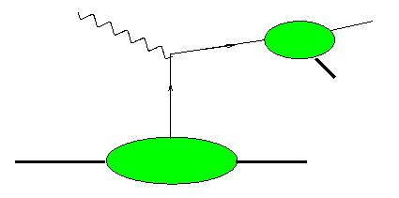
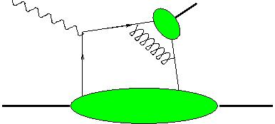

Electroproduction: extending 1D PDFs
x_{F} – fractional momentum in the CM frame
h
x_{F}>0 (current fragmentation, CFR)
x_{F}<0 (target fragmentation,TFR)
Target fragmentation
Current fragmentation
h
h
h,γ
X
X
FF
N,N*
N
h
X
N,N*
M
TMD
GPD
-1
0
1
Semi-exclusive (GPD/GTMD)
x_{F}
Fracture Functions
k_{T}-dependent PDFs
Generalized PDFs
arXiv:2312.01008
Wide kinematic coverage of large acceptance detectors allows studies of semi-inclusive and exclusive processes simultaneously

Slide 4
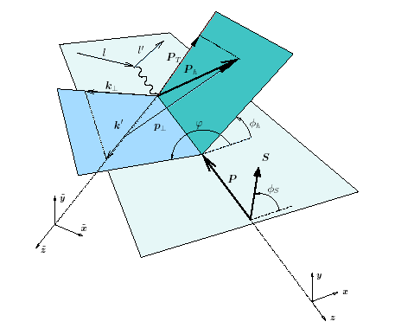
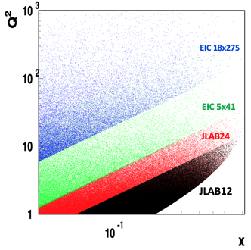



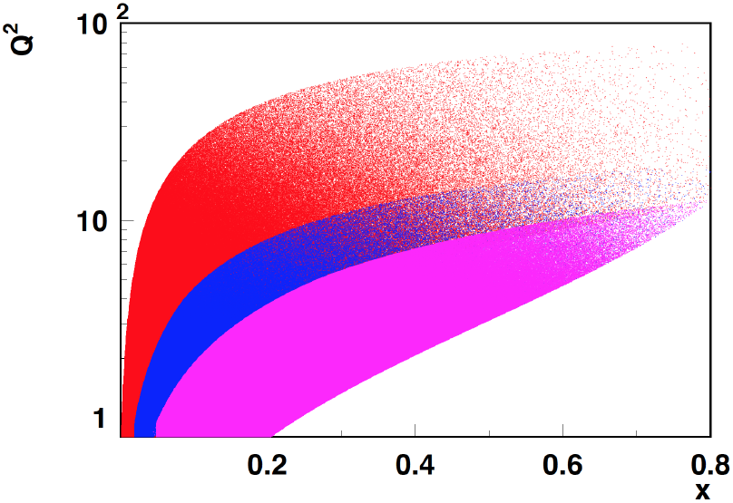

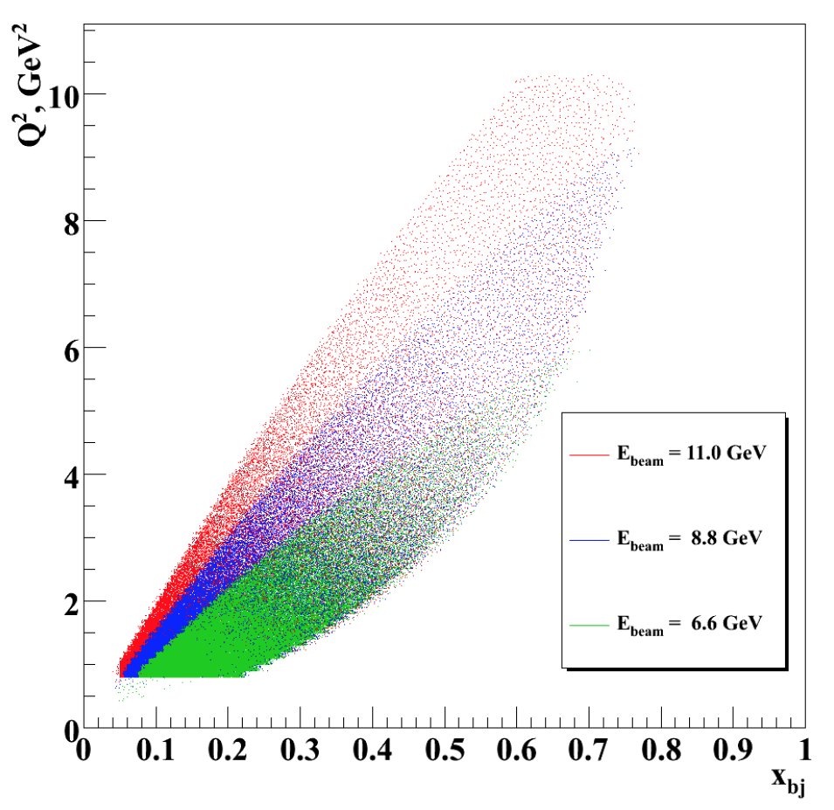
SIDIS kinematical coverage and observables
p┴
P_{hT} = p┴ +z k┴
COMPASS
HERMES/JLab24
EIC
JLab12
Experiments measure the full azimuthal dependence of the cross section!!!
JLab7/9/11
Studies of azimuthal modulations in 6D (x,Q²,z,P_{T},φ,φ_{S}) space give access to underlying 3D partonic distributions
QCD predicts only the Q²-dependence of 3D PDFs

Slide 5
Understanding the QCD: from observables to QCD dynamics
Main goal to study the non-perturbative QCD dynamics in 3D space in details
SIDIS, with hadrons detected in the final state, from experimental point of view, is a measurement of observables in 5D space (x,Q²,z,P_{T},φ), 6D for transverse target, +φ_{S}
  Collinear SIDIS, is just the proper integration of observables, over P_{T},φ,φ_{S}
To get a realistic physics interpretation, it is required to separate certain structure functions experimentally in a given multidimensional space, with controlled systematics, evaluate the impact of various theory assumptions on the systematics of extracted non-perturbative objects or dynamical quantities
JLAB uniqueness:
The superior luminosity of CEBAF, high resolutions of detectors, and ability for multidimensional and multiparticle detection, makes the JLab unique in disentangling the genuine intrinsic transverse structure of hadrons encoded in 3D partonic distributions (TMDs and GPDs) with controlled systematics in the kinematics dominated by valence quarks.

Slide 6
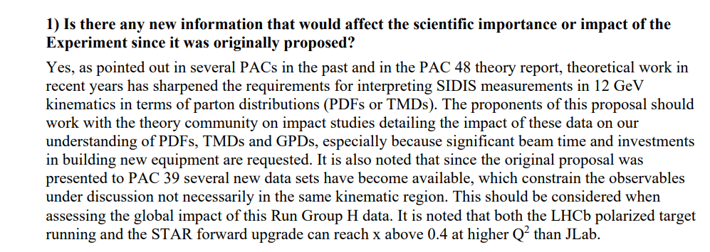
PAC52 comments
The request is very valid, and could/should be extended to other studies where much more significant investments were requested

Slide 7
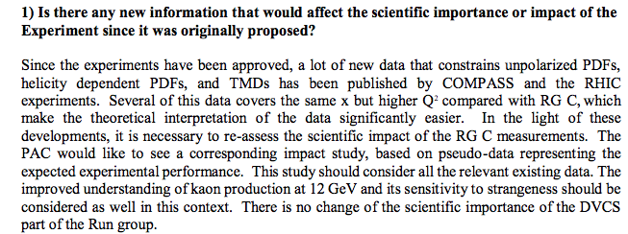
PAC48 comments

Slide 8

PAC48 comments and consequences
Statement:
“Several of this data covers the same x but higher Q² compared with RG C, which
make the theoretical interpretation of the data significantly easier”.
Meaning:
THE Theory will work at much higher energies also in the valence region→
no need in digging in “low energy” data where factorization is likely broken
May not be worth spending resources now, instead the 3D community can focus on analysis of measurements of GPDs and TMDs of quarks in the “bright future”
Consequences:
Redirection of resources to “Physics analysis of EIC data”, pushing most SIDIS groups to be involved in EIC, with little focus on huge amount of precious data already accumulated or planned from incoming JLab experiments

Slide 9

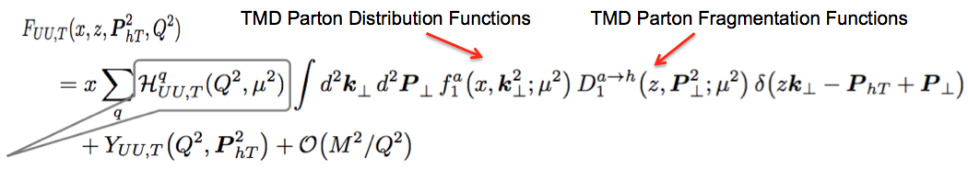
SIDIS as THE theory describes it
Probability to produce 1 or 2 hadrons in single photon exchange
can be measured from e+e-
h
can be measured from DY
X
+Radiative Corrections
hard part
Factorization allowing description using distribution functions (TMD-PDF) and fragmentation functions (TMD FF)
X→ multiplicity of unobserved hadrons LARGE, and x-section doesn’t depend on X (independent fragmentation)
Leading twist dominates,
p┴
P_{hT} = p┴ +z k┴
Conclusions in case of apparent disagreement:
factorization is broken?
unaccounted terms may contribute (assumptions are not good in certain kinematics,…)
“much bigger/smaller” defined in comparison with experiment
Dealing with unaccounted terms:
Theory accounts for them
Experiment measures and excludes them!!!

Slide 10
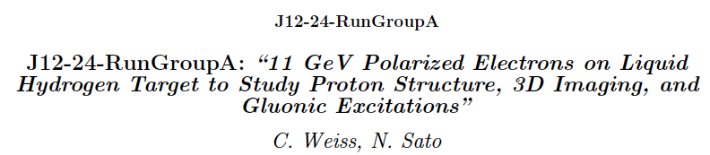
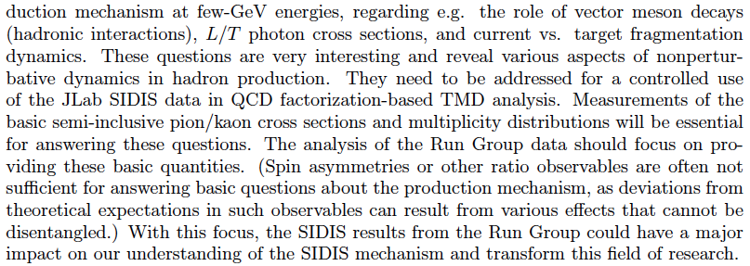
PAC comments

Slide 11

PAC52 comments/conclusions
Statement:
“… SIDIS data has shown that there are basic open questions concerning the semi-inclusive pion/kaon production mechanisms at few-GeV energies....
Meaning:
JLab has problems specific for low energies, which should be solved, before THE theory of TMDs could be applied
Possible conclusion:
All problems will vanish at higher energies, and TMDs can be studied in the valence region [in multidimensional space] at higher Q² using THE theory [no need to deal with higher twists]

Slide 12

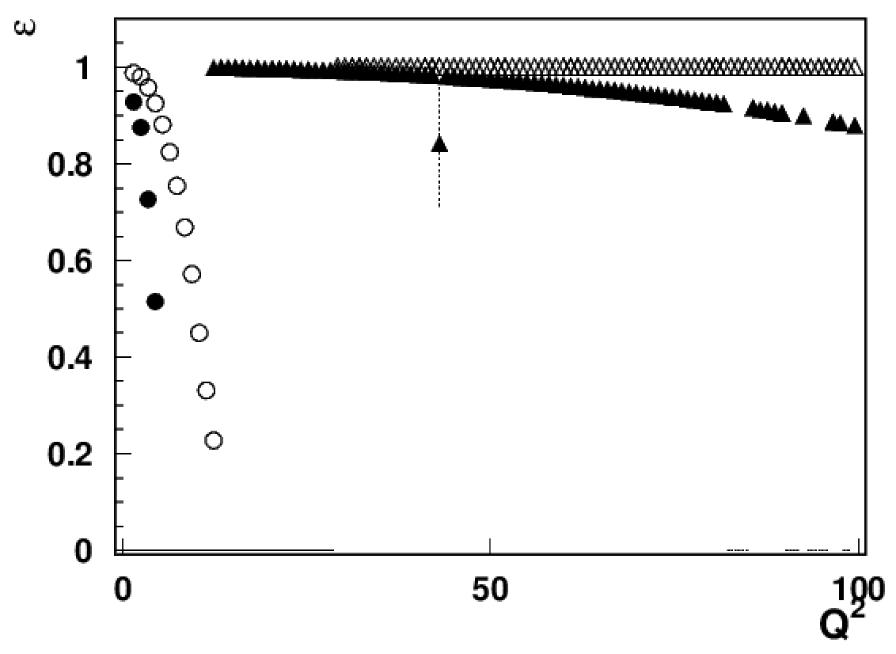
Addressing PAC/theory comments
What exactly are identified so far sources of “factorization breakdown” in SIDIS and where is the evidence that “few GeV” matters?
1) Longitudinal photon
EIC18x275
EIC5x41
For a given x&Q² the contribution from longitudinal photon increases at higher energies (ex. at EIC 5 times bigger at Q²~10, x~0.3 than at JLab )
JLab studies of impact of longitudinal photons critical for interpretation of polarized SIDIS, including EIC data
JLAB12
JLab24/HERMES
x=0.3

Slide 13
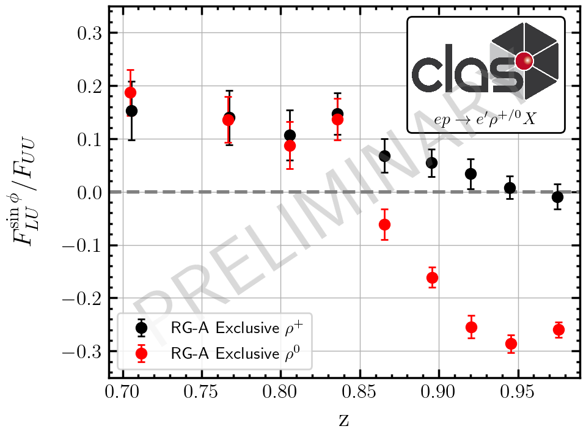
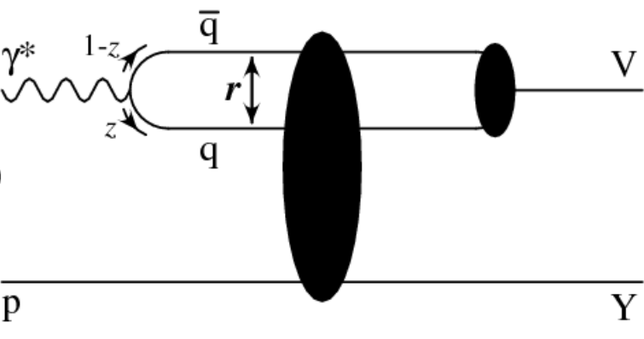
Addressing PAC/theory comments
What exactly are identified so far sources of “factorization breakdown” in SIDIS and where is the evidence that “few GeV” matters?
2) Diffractive VMs (ρ⁰)
Comparison with exclusive rho+, clearly indicates the kinematics where the “diffractive rho0” shows up (increases at higher energies)
JLab provides possibility of detailed studies of those rhos, crucial for interpretation in terms of TMDs of SIDIS data in general, and for EIC in particular.
Beam SSA provides a tool for clear separation of quark-exchange VMs and “non-quark/diffractive” exchange VMs!

Slide 14

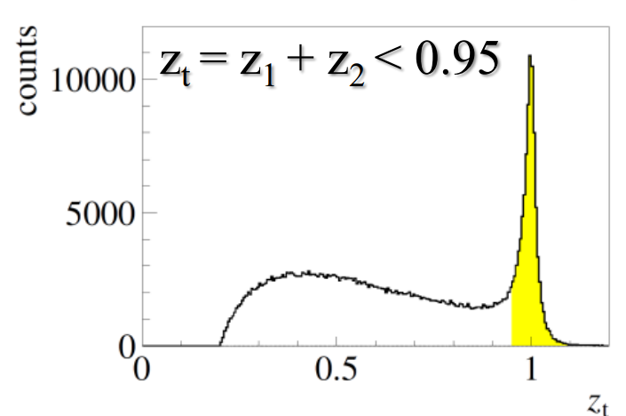
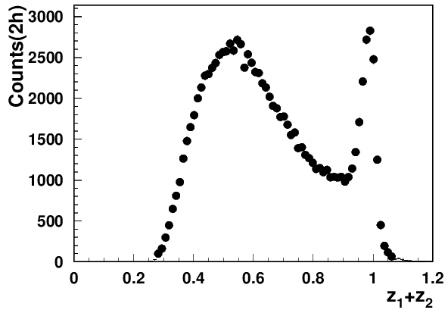
Quark-gluon correlations: impact of VMs
Different dynamical contributions
G.Matousek (Duke) & N.Trotta (UCONN)
What are those contributions?
Other DSAs and SSAs?
How and in which kinematics they affect inclusive pions and dihadrons?
longitudinal photons?
Is it going away at high energies?
Need theory (ex. involving HT GPDs to describe the SSA)
Q²=3 GeV²
COMPASS 2h
Understanding of SSAs of VMs is critical in interpretation of the pion SIDIS
A_{LU} sign change can define the dominating process!!!
At large x the diffractive processes are suppressed by the minimum t
CLAS 2h
Notes:
Lorenz invariant amplitudes

Slide 15
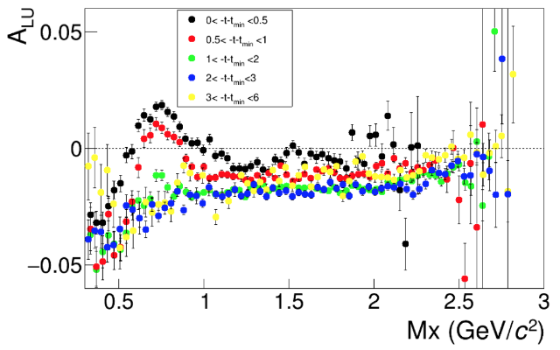
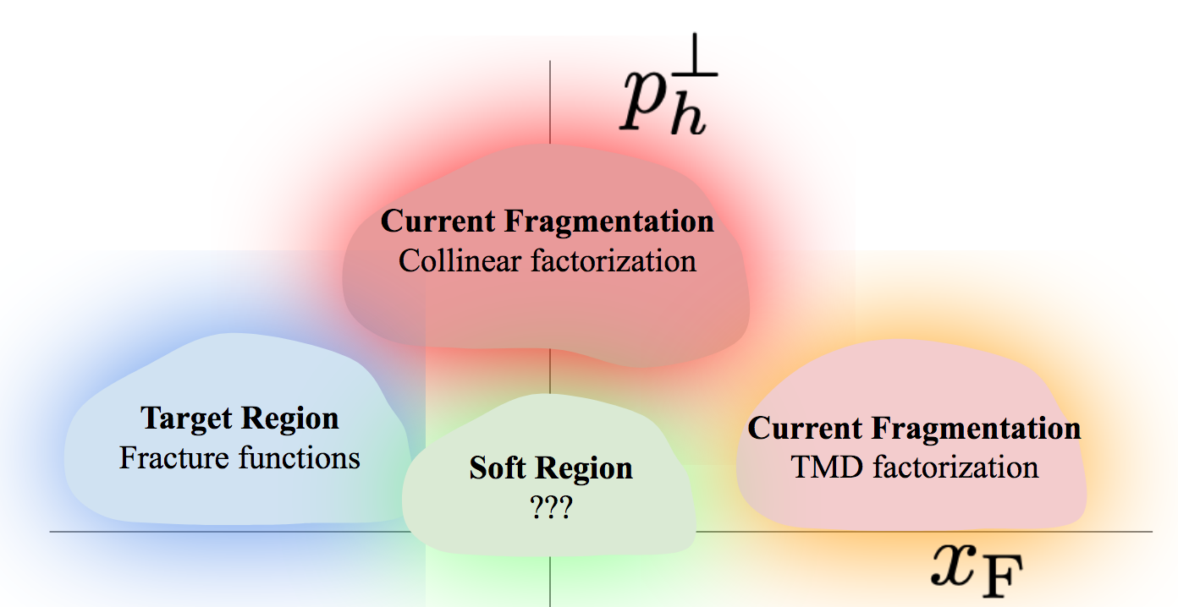
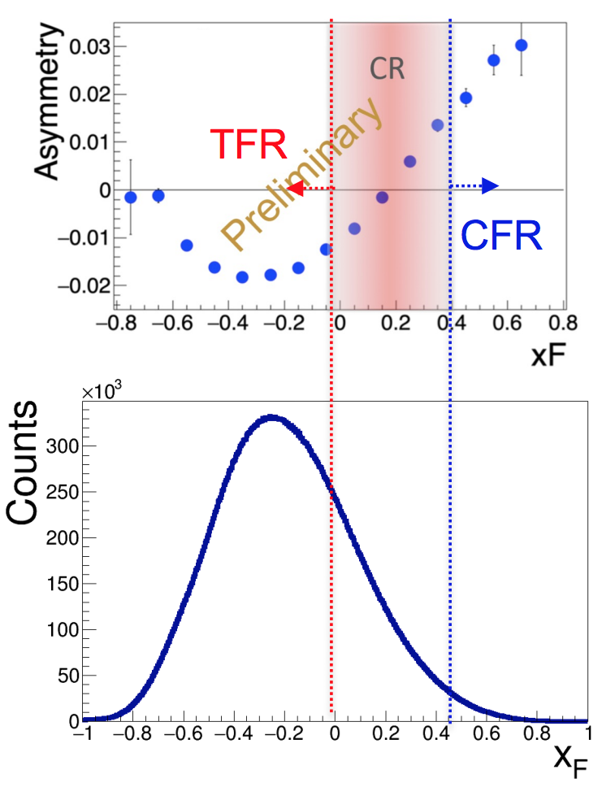
Beam SSAs as a tool to separate regions and contributions
3) Separating Target Fragmentation Region TFR from Current fragmentation region (CFR)
F. Benmokhtar & Duquesne U.
ep→e’pX
Major difference only for protons at small t!
With beams in polarized SIDIS typically always polarized, beam SSA can serve as a tool to separate
kinematical regions (CFR/TFR)
dynamical contributions
cut on M_{X} eliminate exclusive VMs
Negative sign of the SSA (plateau) defines the TFR dominance

Slide 16
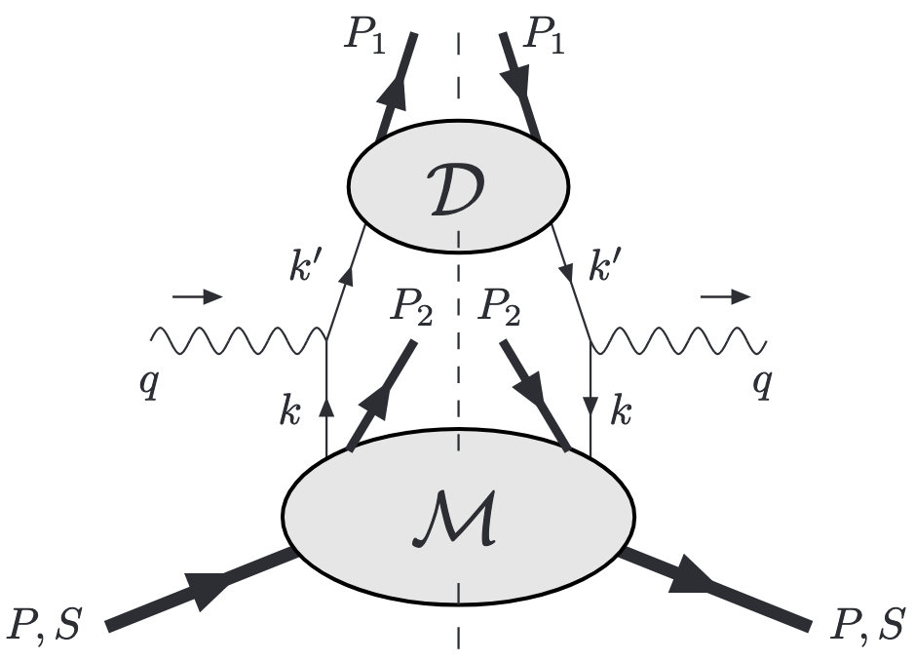
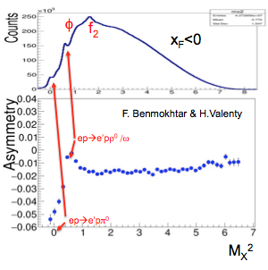
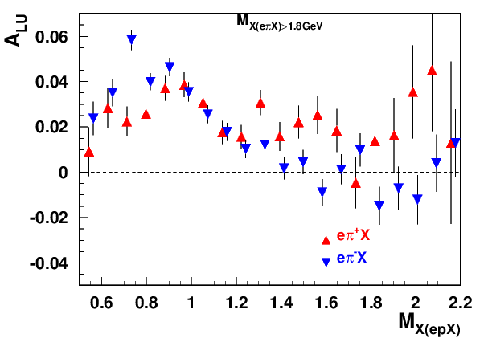
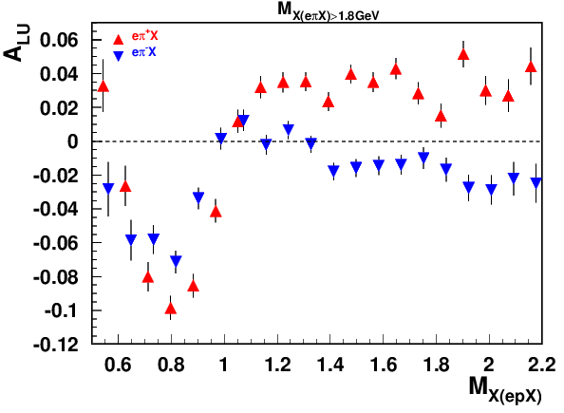
Unique ability to measure target fragments
Detection of the target nucleons (B2B SIDIS) provide a powerful tool to control the contributions in CFR
ep→e’pπX
3 processes:
ep→e’hX (regular SIDIS)
ep→e’NhX (SIDIS+ TFR nucleon, B2B SIDIS)
ep→e’NhX (SIDIS+ TFR Nucleon + cut on M_{X}(ep→e’NX)>1.35 GeV
“ρ-free” SIDIS
“ρ-free” SIDIS
0.1<P_{T}<0.3, 0.4<z<0.6
0.5<P_{T}<0.7, 0.4<z<0.6
ep→e’pX
Exclusive ρ (possibly f₂) have very significant contributions to all SIDIS observables (ex. beam SSA), which can be completely eliminated with detection of the TFR proton

Slide 17
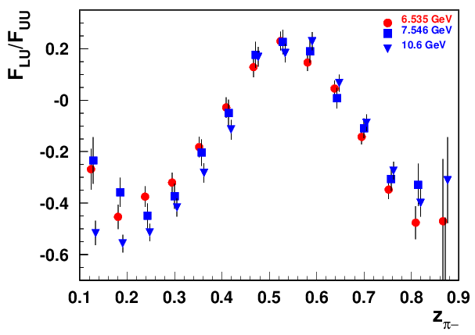
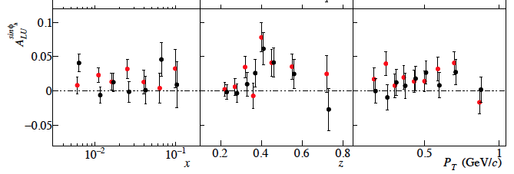

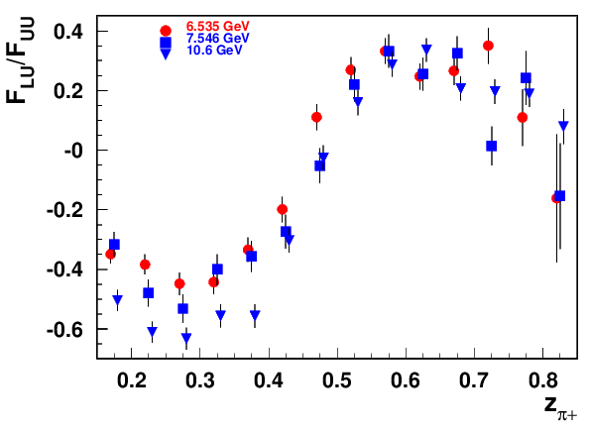
Exclusive ρ contributions to π: z-dependence
COMPASS (proton)
π− and π+ show similar behavior
Diffractive rho can change significantly observed pion SSAs
The same sign and size of π+ and π- SSA indicates the rho0 may not be properly subtracted

Slide 18
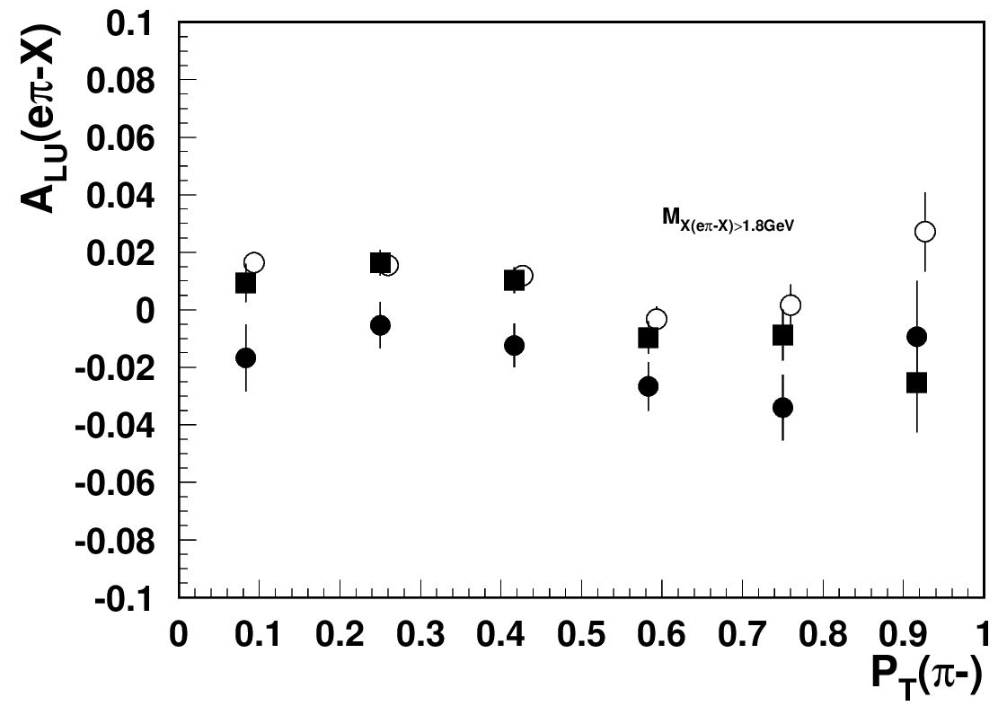
Impact of diffractive rho0s on SSA
Use sample of ep→e’p π- X and and make plots with and without M_{X} cut(epX) 1.35 GeV
All point include
M_{X}(e’π-X)>1.8 GeV
→out of resonance region
Filled circles with
M_{X}(epX) >1.35 GeV (rho-free), significantly different and will impose much less challenge for phenomenology
ep→e’π⁻X
M_{X}(epX)>1.35
CLAS12 Preliminary
ep→e’pπ-X
Exclusive rho-0s have very significant impact on kinematic dependences of SIDIS SSAs, in particular at low P_{T}
Detection of the target proton introduces much smaller bias on the inclusive SSA, than the exclusive rho
The procedure can be validated using direct subtraction of rho (like DVCS/π⁰)

Slide 19
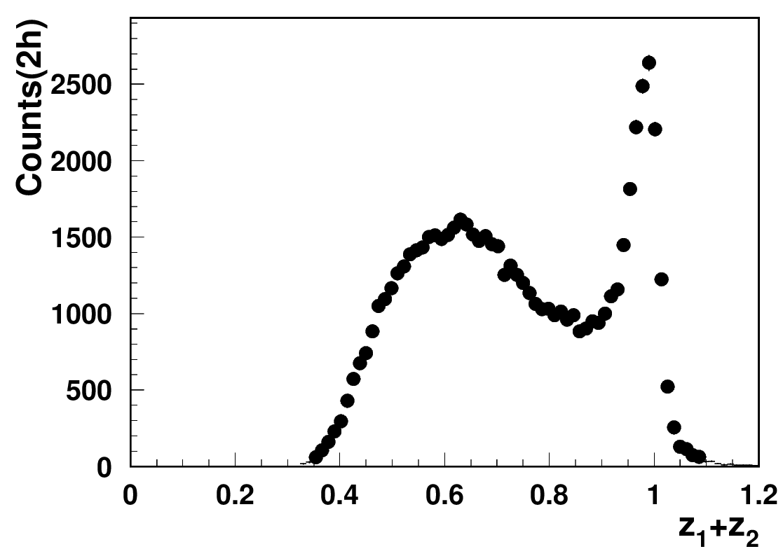
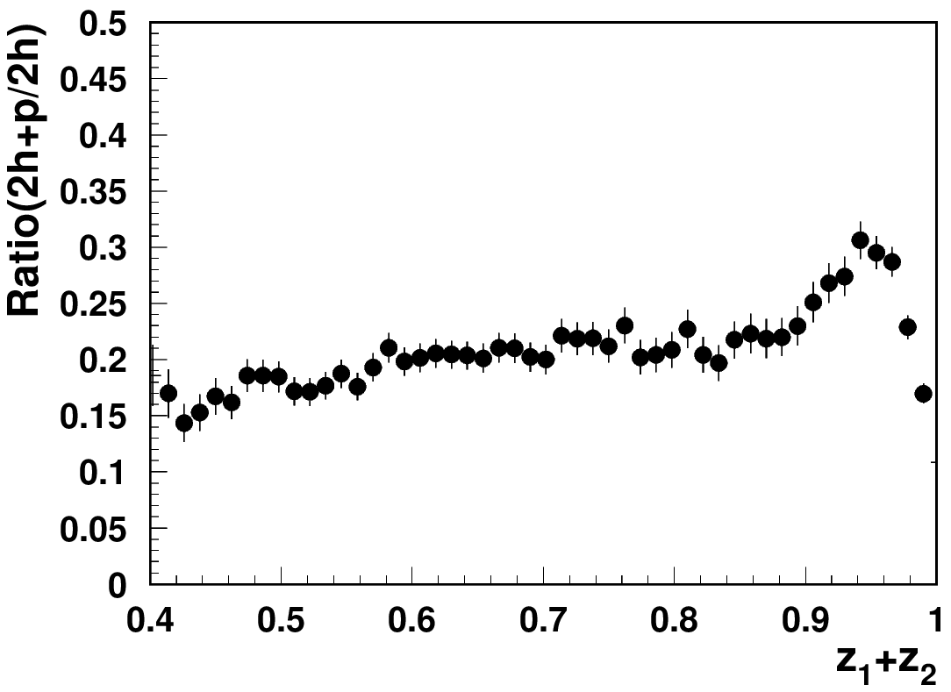
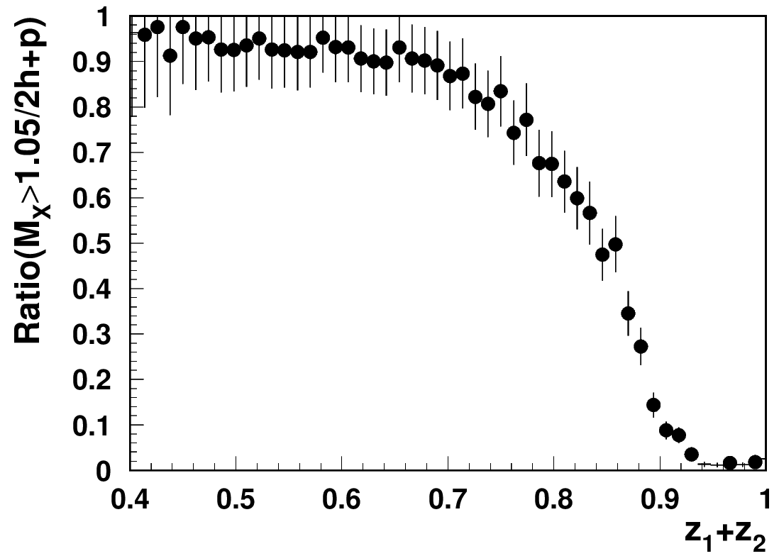
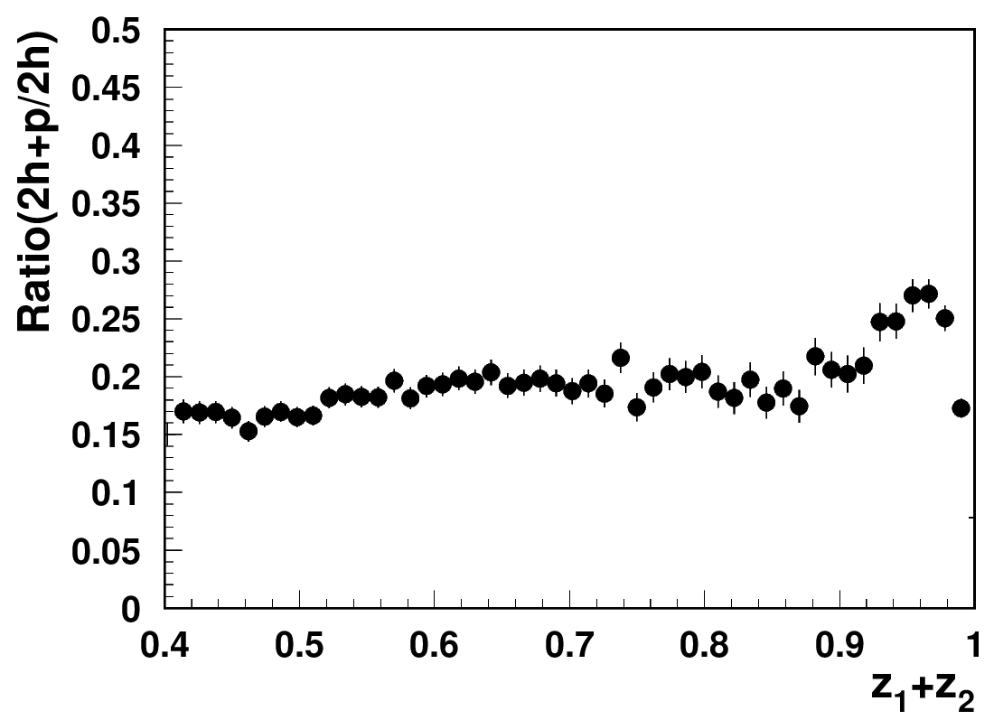
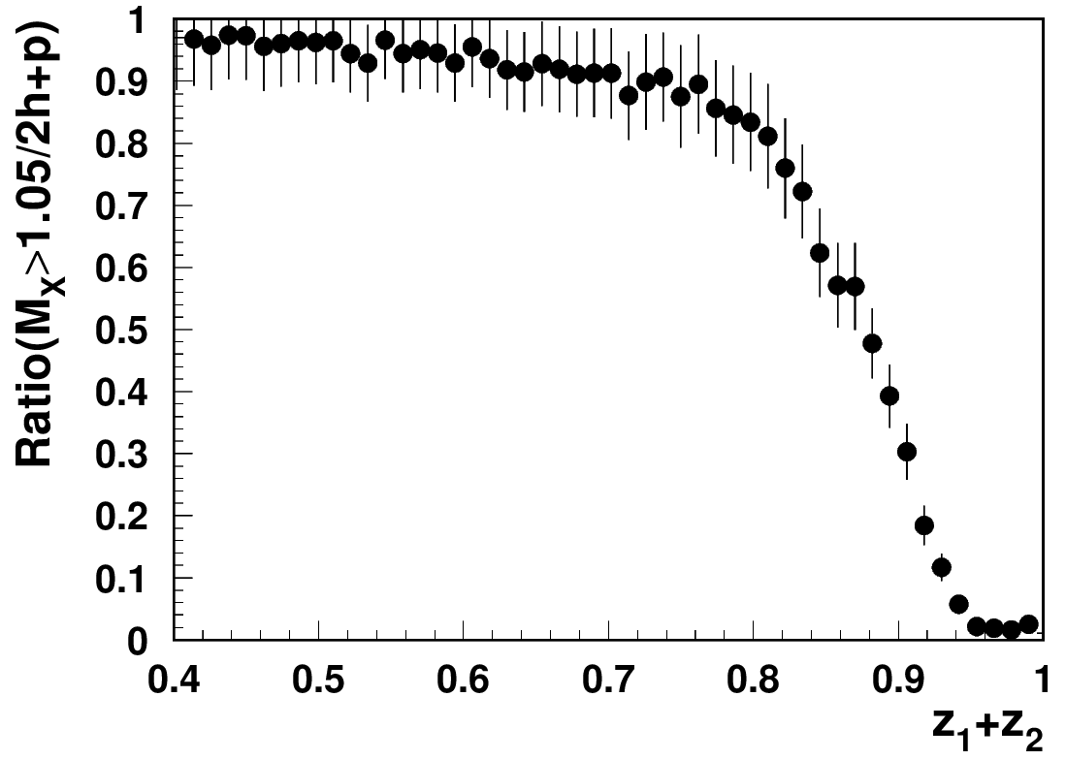
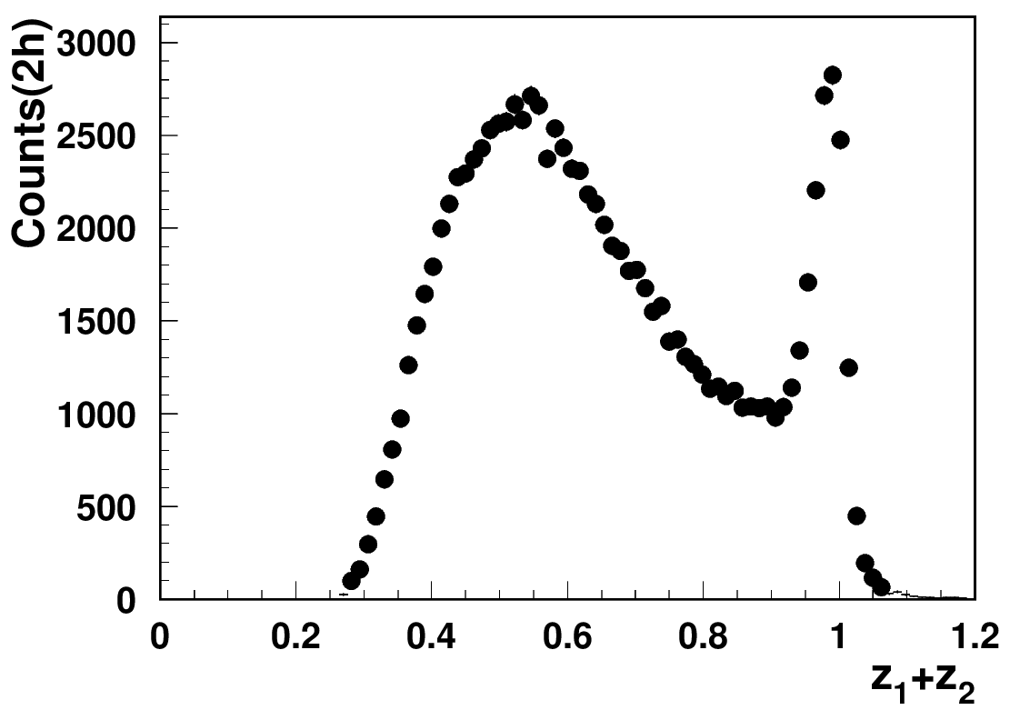
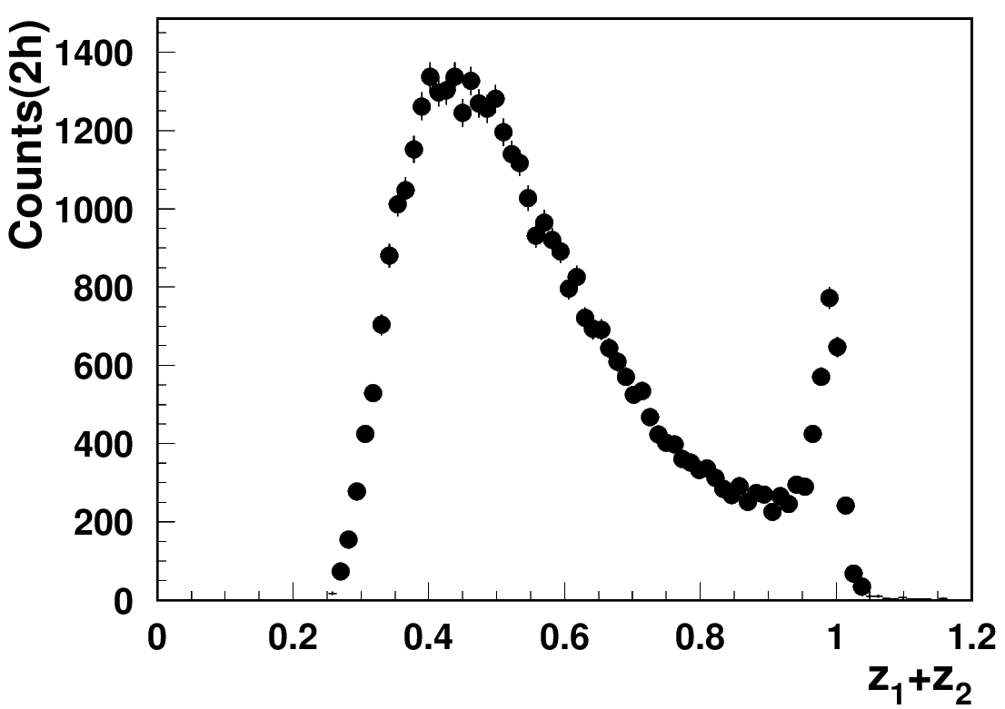
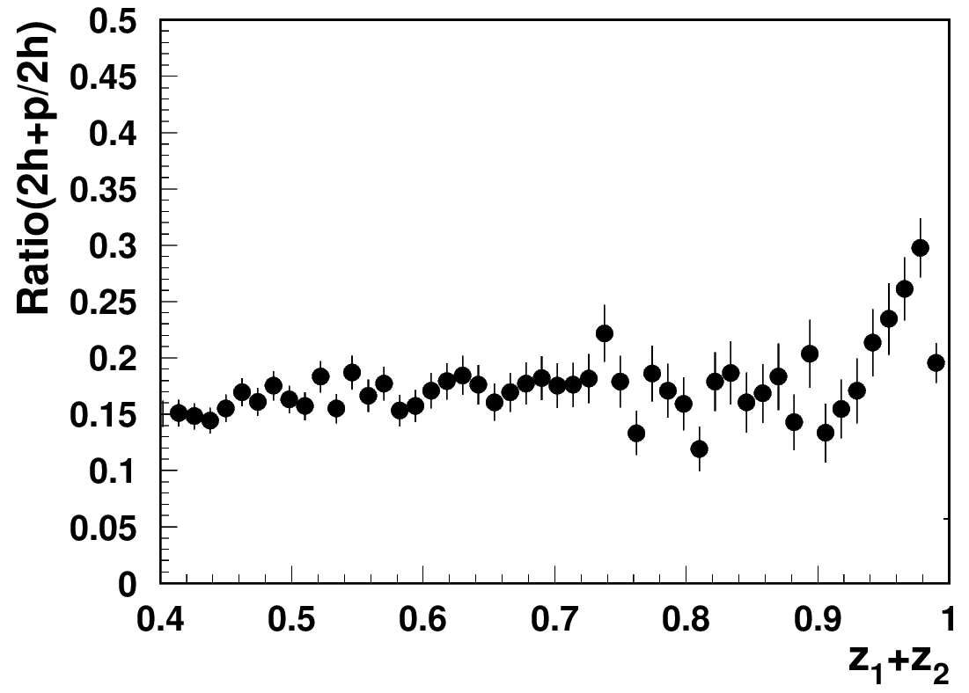
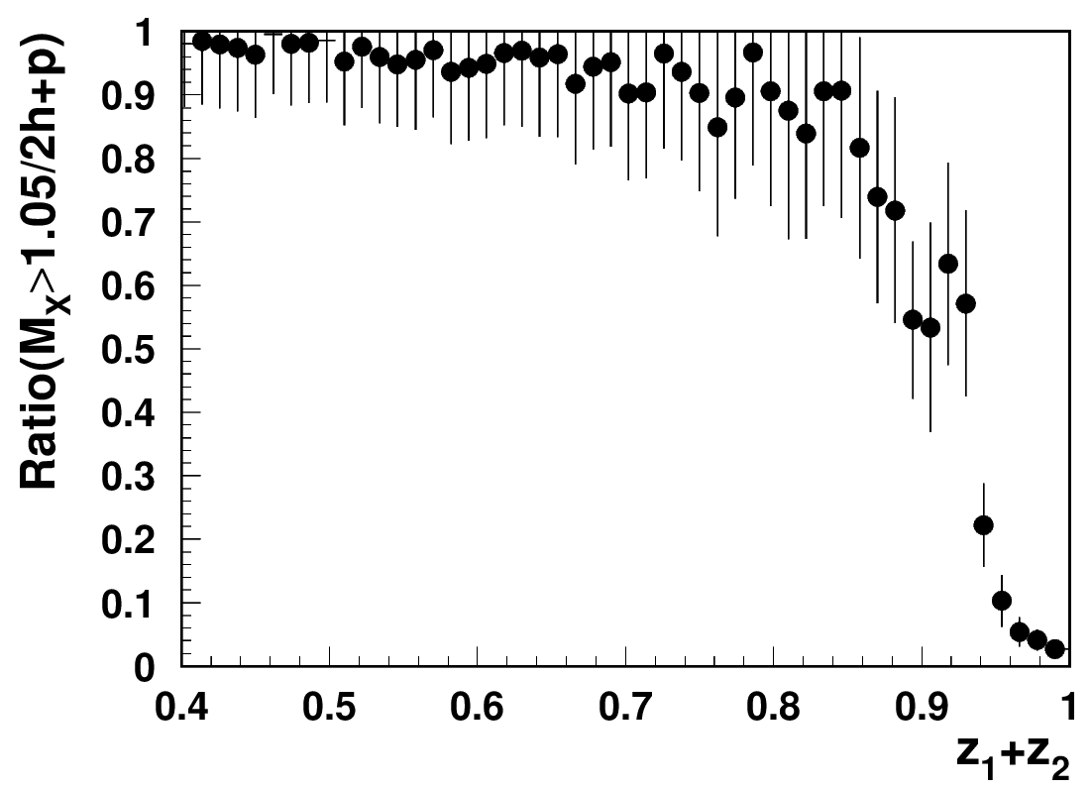
“ρ-free SIDIS” free: target proton bias
ep→e’ππX
ep→e’pππX
+ x_{Fproton}<0
ep→e’pππX
+ x_{Fproton}<0
+ M_{X}(epX)>1.05 GeV
x=0.3(0.25<x<0.35)
Q²=2 GeV²
Q²=3 GeV²
Q²=4 GeV²
While the detected proton introduces slight difference in the kinematic distributions, the cut on the proton missing mass makes significant impact (clear at large z).
Notes:
Lorenz invariant amplitudes

Slide 20
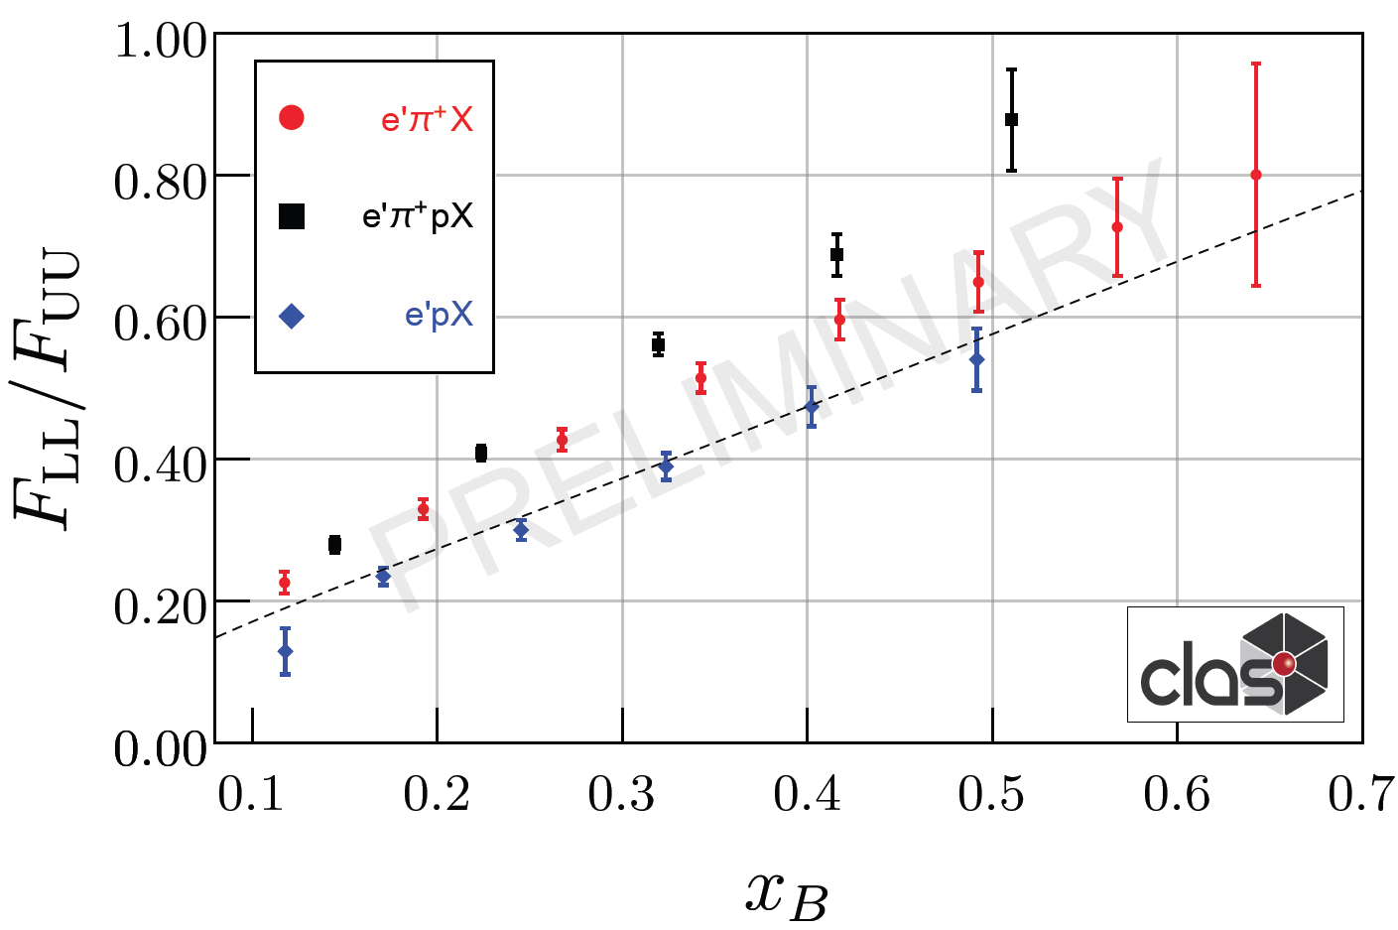
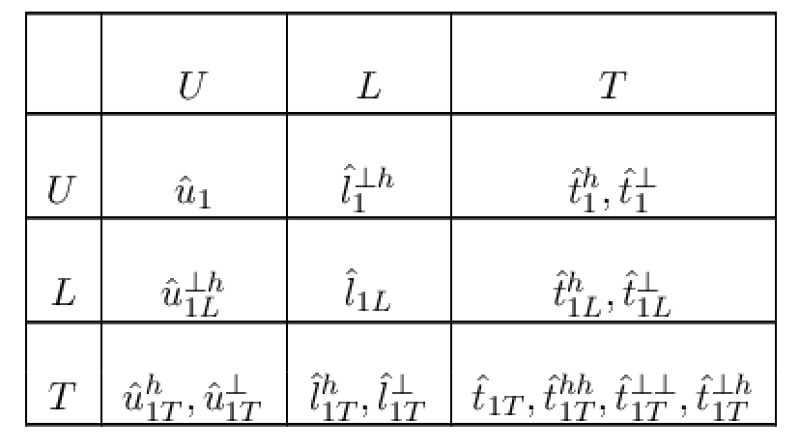
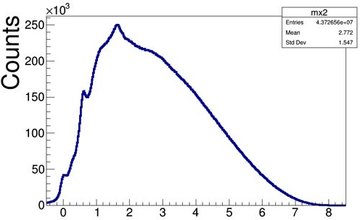
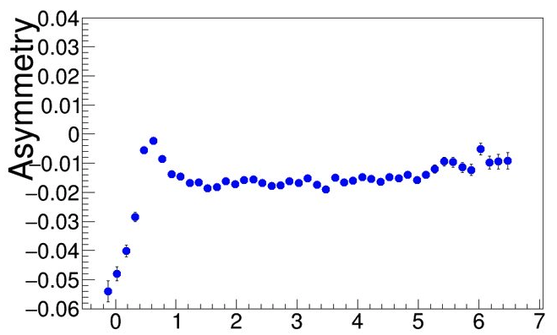
Longitudinally polarized quarks in B2B SIDIS
ep→e’pπX
N/q
Detection of proton allows elimination of exclusive rho!
Possible theory formalisms:
φ
f₂
Formalism based on fracture functions (Anselmino, Barone, Kotzinian (back-to-back, b2b, hadron production, DSIDIS)
Semi-exclusive processes, involving GPDs/GTMDs on proton side (TFR) and FFs on pion side (CFR) Yuan and Guo
HEMP
SIDIS (“ρ free”)
Differences in A_{LL} , due to different weights on PDFs can provide additional info on impact of possible ingredients
Measurements of A_{LL} for ρ⁰ indicate very small values, and can be one of the reasons for higher A_{LL} with protons with a M_{X} cuts above 1.5 GeV (excluding exclusive ρ⁰ )
ep→e’pρ⁰ /ω
x_{F}<0
Beam SSA
M_{X}²(ep→e’pX)
ep→e’pπ⁰

Slide 21
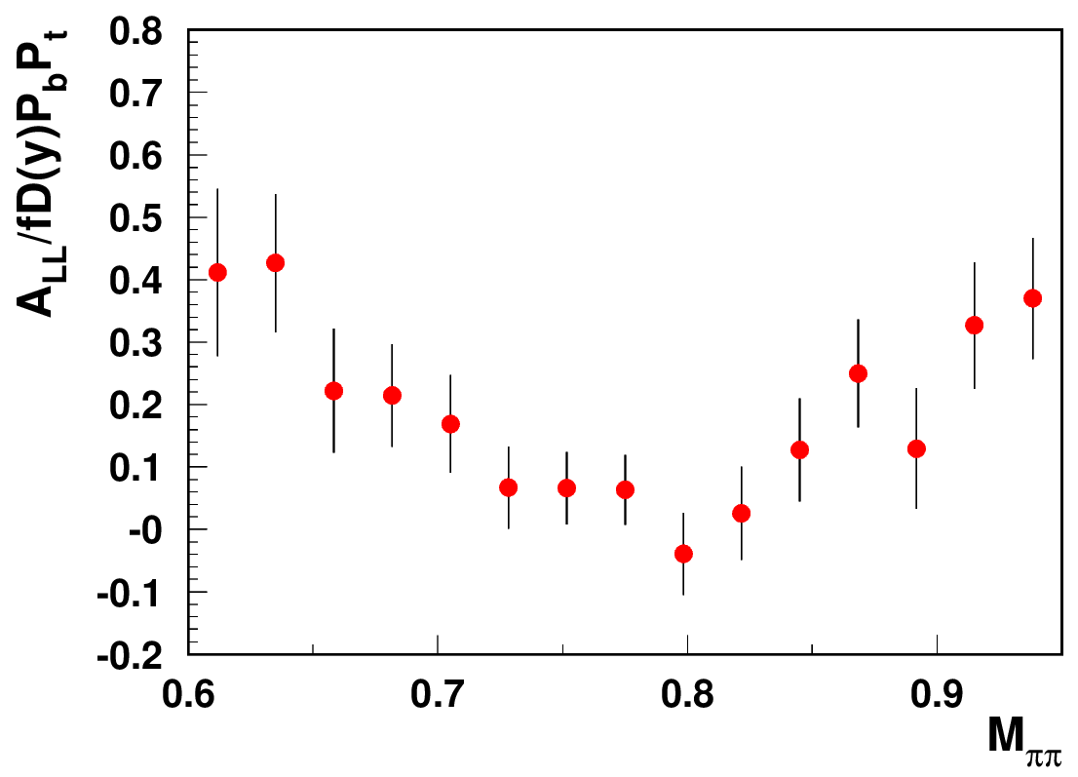
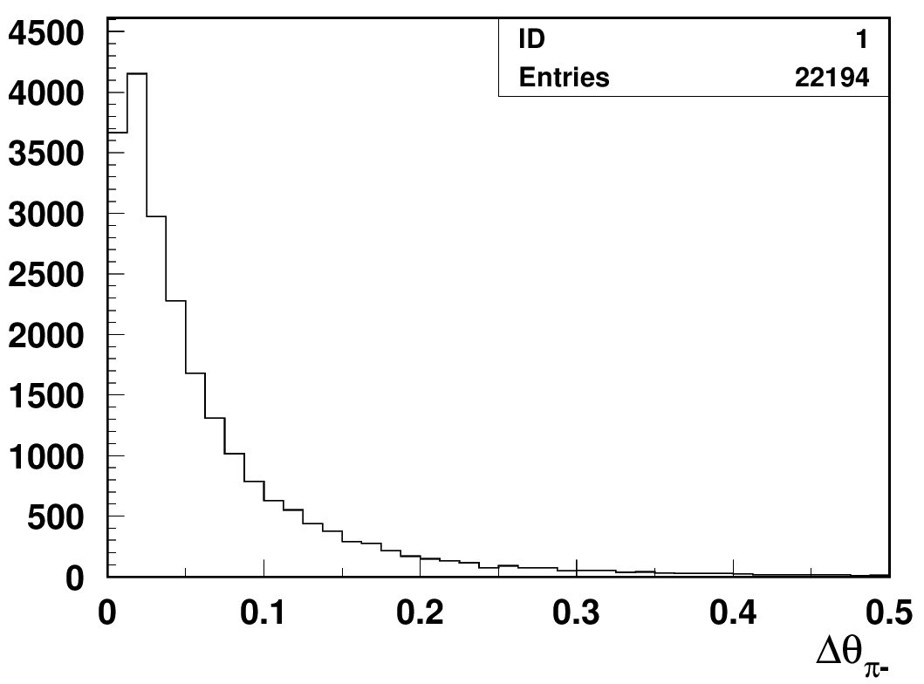
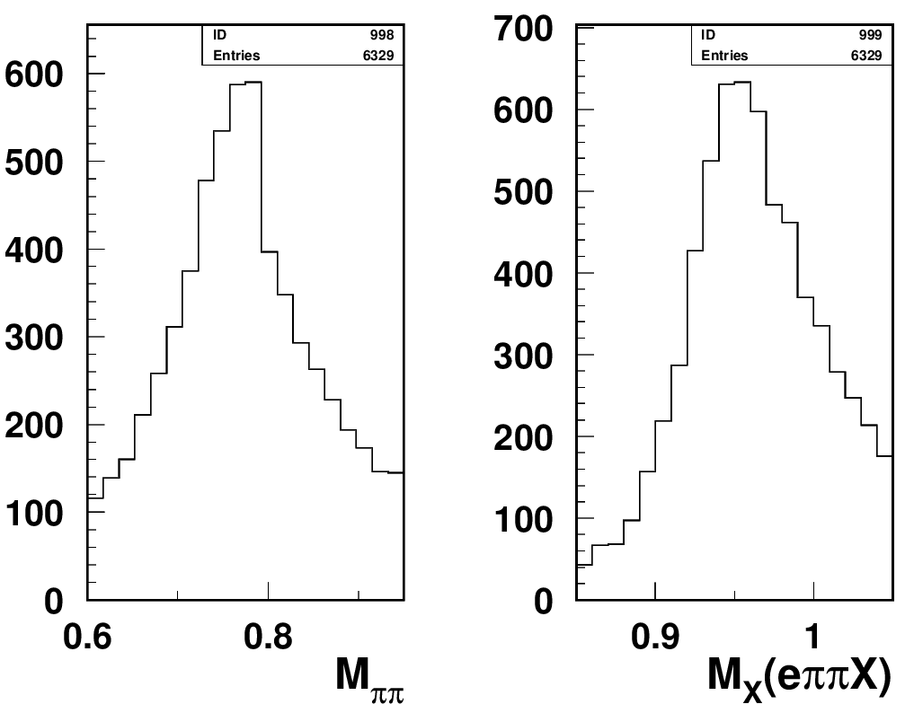
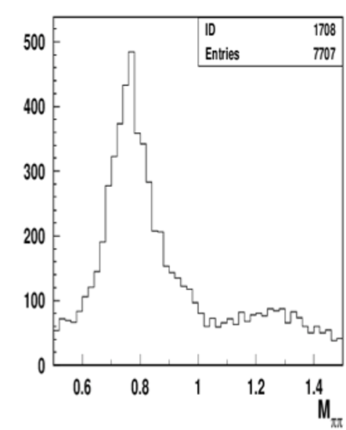
Studies of ρ⁰ impact with longitudinally polarized NH₃ target
Separating exclusive dihadrons
CLAS12 Preliminary
calculated
θ
measured
cut on Δθ <1º beetween measured and calculated π−
ep->e’p’π⁺π⁻
Require the angle of negative pions is within a degree from calculated from e’,p,π+ assuming exclusive e’,p,π+π- event.
Measurements of A_{LL} for ρ⁰ indicate very small values (with ~10-20% bck, likely negative ~ -2-10% ), and can be one of the reasons for higher A_{LL} with protons with a M_{X} cuts above 1.35 GeV (excluding exclusive ρ⁰ )
Need clear separation of hydrogen from NH₃
and diffractive exclusive ρ0s from exclusive π+π−

Slide 22
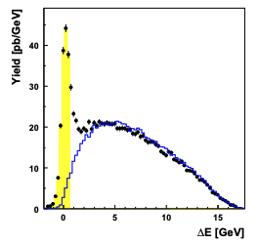
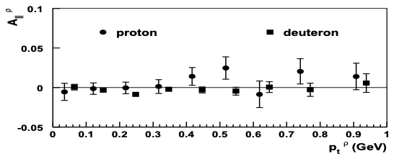
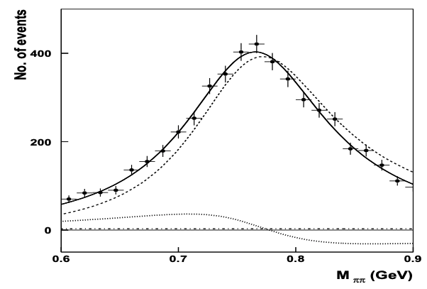

A_{LL} studies of exclusive ρ⁰ : HERMES
At low P_{T}, where the background is smaller, the asymmetry indeed tend to be negative
A_{1ρ}=0.23 ± 0.14±0.02
For a proper extraction of multiplicities and spin-azimuthal modulations of exclusive ρs, clean separation is needed for ρ⁰, and longitudinally polarized ρ⁰ signal, in particular
For a proper account of the impact on SIDIS, need a realistic MC (with validated SDMEs) for proper separation of “diffractive” exclusive ρ⁰s in multi-D

Slide 23




Study helicity TMDs with JLab22
CLAS12
X=0.3
CLAS24
JLab22
EIC 5x41
JLab11
EIC 5x41
EIC 18x275
  Accessing the quark k_{T} from hadron P_{T}
  Why helicity TMD, g₁(x,k_{T}), matters?
  How we measure the g₁(x,k_{T})
  Why JLab is unique for studies of g₁ in valence region
  Why 22 GeV is critical
  Challenges at large P_{T}

Slide 24


Measurements with transverse target
x-section for eN→e’hX
1) Measurements of F_{UU,T} and Sivers requires separation, evaluation of longitudinal photon (JLab)
2) Meaningful interpretation of SSAs (Collins effects,…) requires separation of VMs (JLab)
JAM3D
Transversely polarized case involves most modulations to separate
EIC18x275
u-quark
EIC5x41
JLab22/HERMES
Separation of exclusive contributions would allow large z measurements of Sivers/Collins effects
JLAB12
x=0.3
P_{T}(GeV)

Slide 25
JLab22 white paper: Hadronization and Transverse Momentum
Studies of Transverse Momentum Distributions (TMDs) require studies of transverse momentum dependences of SIDIS observables (multiplicities/asymmetries) in multidimensional space.
  Understanding the systematics in SIDIS studies
  Reforming SIDIS: what we need to apply THE theory with controlled systematics?
    separate different contributions to x-section (locate SF of interest)
    separate different contributions to a given SF from different mechanisms (ex. longitudinal photon contributions, exc. VMs)
    separating the kinematics of current and target fragmentation
    understanding the role of hadron correlations in SIDIS (impact of VMs)
    use Q²-dependent measurements as a unique tool to validate the interpretation of results
Important advantages of JLab: high luminosity, high precision, multiparticle detection

Slide 26
3D PDF Extraction and VAlidation (EVA) framework
Extraction of observables, such as 3D PDFs, FFs, SDMEs,… should be validated using realistic MC
All input/output stored in /work/cebaf24gev
SIDIS,DY,e+/e-)
experiments
Hard Scattering MC (GEANT, FASTMC,…)
event selection
e’hX, e’hhX,..
Grid operations
QCD fundamentals
Library for Structure Function (SF) calculations
3D PDF and FF (models,
parametrizations)
Radiative
x-section
x-section calculations
SF calculations
Data Counts
(x-sections, multiplicities,….)
Defined set of assumptions
Defined set of assumptions
Extract 3D PDFs
extract
x-section
Extract SFs
Validation of extracted SFs or 3D PDFs (for a given set of assumptions)
Development of a reliable techniques for the extraction of 3D PDFs and fragmentation functions from the multidimensional experimental observables with controlled systematics requires close collaboration of experiment, theory and computing

Slide 27
SUMMARY
Studies of QCD dynamics with controlled systematics involving Semi-Inclusive DIS, requires multidimensional measurements of cross sections/multiplicities/asymmetries as a function of all involved kinematical variables (including P_{T} and φ)
For interpretation of the SIDIS data it is critical to separate contributions from different structure functions, as well as separation of different production mechanisms in a given structure function (including VMs)
The diffractive VM contributions, violate the factorized picture of SIDIS based on the dominance of the leading twist contributions, and the “rho free SIDIS” may help to address the challenges of phenomenology
Detection of target fragment baryon opens a new avenue for studies of the partonic structure of nucleon, allowing separation of VM contributions.
JLab22 will set the bridge between JLab12 and EIC, providing measurements of relevant observables, critical for interpretations of SIDIS at large x in general, and EIC data in particular (collaboration with EIC physics analysis group on MC development will be important)

Slide 28
Support Slides
Notes:
precision measurement of azimuthal moments (sin2φ, cos2φ, sinφ) in semi-inclusive pion production in DIS with CLAS12 will allow to

Slide 29



FUU,L studies at Hall-C
EIC
JLab22
JLab12
Projections for E12-06-104 vs existing Cornell Data (projections
assume RSIDIS = RDIS)
Comparable 1.6% systematic uncertainties not indicated
Projections: Solid Black H, Open Black D 𝜋
Cornell:
Top panel: solid red (open blue) 𝜋! (𝜋") on LH2
Middle : solid red (open blue) dots are 𝜋! (𝜋") on LH2
solid red (open blue) squares are 𝜋! (𝜋") on LD2
Bottom : solid red (open blue) dots are for 𝜋! (𝜋") on LH2
Kinematic ranges accessible in Hall C with
existing HMS and SHMS spectrometers and that
can achieve two ε values separated by 0.2 with a
minimum ε of 0.1

Slide 30









SIDIS cross section: separating F_{UU,L}
Semi-Inclusive:
ratio of longitudinal and transverse photon flux
Hall-C E12-06-104
E12-23-014
Hall-B E12-16-010C
Separation of contributions from longitudinal and transverse photons critical for interpretation
EIC18x275
Wide ε-coverage needed!!!
EIC5x41
CLAS12
JLab24/HERMES
ep→e’πX
JLAB12
x=0.3
ep→e’π⁺π⁻X
At higher energies longitudinal photon contributions kinematically enhanced (at EIC 5 times bigger at Q²~10 )
JLab studies critical for EIC data interpretation
R=F_{UU,L}/F_{UU,T} depend on the process,
need for all relevant ones, in all kinematics!

Slide 31


Contributions for 3D structure studies: Sivers
y>0.05,100 days (corrected for EIC official lumi)
H.A./C.Pecar/A.Vossen
Pavia grids
Sivers
x=0.3
z=0.7
P_{T}=0.3
Measurements of Q²-dependence of SSAs will be crucial in validation of the theory
JLab24 will be crucial to bridge the TMD studies between JLab12 and EIC in the valence region
31
Notes:
To summarize the current status some observations and items that will be discussed are listed here
It is important that theory, which is more flexible will move in the direction of kinematics accessible in current experiments, where large effects were observed.

Slide 32



B2B correlations with longitudinally polarized target
N/q
Lumi: JLab 10³⁵, EIC4x51/5x100/10x275 0.044,0.6,1x10³⁴)
y>0.05,100 days
CL AS12 proposals
NH3/ND3
E12-09-009
E12-07-107
E12-09-007A
A. Kotzinian et al, arXiv:1107.2292
³He
C12-20-002
⁷LiD
E12-14-001
No depolarization, like Sivers!
Target SSA can be measured in the full Q² range, combining different facilities
Advantages: Higher Lumi for JLab, no kinematical suppression at high Q² for EIC
JLab24 will be crucial to bridge the studies of FFs between JLab12 and EIC in the valence region
Notes:
To summarize the current status some observations and items that will be discussed are listed here
It is important that theory, which is more flexible will move in the direction of kinematics accessible in current experiments, where large effects were observed.

Slide 33




Accessing CS-kernel directly or through extraction of SFs
CLAS12
CLAS22
EIC 5x41
CLAS22
Use slices in Q² (good resolution needed)
Wide Q² range and high luminosity is the key for a validating separation of twist-2 contributions
A. Vladimirov
Q² evolution studies possible, provide superior access to critical Collins-Soper (CS) kernel
CLAS12 at JLab20+ can provide a wide range in Q²
combined with high lumi and superior resolution
Test the CS-kernel from different experiments, and for different kinematics in a given experiment
Evaluate the systematics due to factorization violation and define possible reasons (some can be easy to fix)

Slide 34


TMD theory problems
Perturbative approach: TMD region = where the log divergence of the fixed-order calculation dominates (resummation is required)
Significant fraction of polarized SIDIS data is currently considered by phenomenology to be outside of the TMD region
What data input exactly drives down the nonperturbative part?
TMD region we currently have
i
How far in P_{T} or q_{T} extends the TMD region

Slide 35

TMD theory problems
Perturbative approach: TMD region = where the log divergence of the fixed-order calculation dominates (resummation is required)
Significant fraction of polarized SIDIS data is currently considered by phenomenology to be outside of the TMD region
What data input exactly drives down the nonperturbative part?
TMD region we currently have
TMD region we expect to be extended
i
A. Bacchetta
How far in P_{T} or q_{T} extends the TMD region
“they know not what they do” Luke 23:34

Slide 36





q_{T}-crisis or misinterpretation
The q_{T}=P_{T}/z theory “trustworthy” cut:
Suppresses moderate Q² and large P_{T} (sensitive to k_{T}), where all kind of azimuthal modulations are most significant
Enhances large z region (ex. Exclusive Events) in TMD and low z in FO calculations
3) Cuts not only most of the JLab data, but practically all accessible in polarized SIDIS large P_{T} samples , including ones from HERMES COMPASS, and even EIC.
https://arxiv.org/pdf/1709.07374.pdf
at higher Q² the slope in P_{T} changes, why?
possible reason → less diffractive rho at higher Q² filling the low P_{T} in pion SIDIS (what about π⁰?)
Challenging for theory to explain the correlation of P_{T} and Q
need experimental subtraction of rhos (proton detection will help)
P_{T}²
Notes:
Some impact of the limitation on the experimental data you can see from the two plots for JLab and COMPASS at lower and higher energy ranges. The cut excludes practically all PTs starting from ~1GeV the region, where the effects are large and measurable

Slide 37
Possible sources of large P_{T} behaviour
Perturbative contributions and p_{T}-dependence of unpolarized FFs (so far unlikely...)
2) Significantly wider in k_{T} distributions of u-quarks with spin opposite to proton spin (possible sign flips in asymmetries related to polarization of partons)
3) Significantly wider in k_{T} distributions of d-quarks (possible sign flips in asymmetries related to polarization of partons)
4) Significantly wider in k_{T} sea quark distributions (study contributions dominated by sea, K-,..)
5) Increasing fraction of hadrons due to F_{UU,L} (needed for proper interpretation
separation of F_{UU,L} from total)
6) Significant contributions from VMs to low P_{T} pion multiplicities, with direct pions showing up at large P_{T} (needed for proper interpretation → much wider in k_{T} original parton distributions)
7) Radiative corrections (need the full x-section, typically applied to pions, while may be needed for underlying VMs,...)
8) Two photon exchange (will need positron beam)
...............

Slide 38

Understanding exclusive rhos and SDME validations

Slide 39

Understanding exclusive rhos and SDME validations

Slide 40

Understanding exclusive rhos and SDME validations

Slide 41

Understanding exclusive rhos and SDME validations

Slide 42

Understanding exclusive rhos and SDME validations

Slide 43

Understanding exclusive rhos and SDME validations

Slide 44

Understanding exclusive rhos and SDME validations

Slide 45

  Parameterization used in extraction of TMDs will have practically unconstrained systematics

Slide 46

From JLab to EIC: complementarity
The ratio of radiative cross (σ_{RC}) section to Born (σ_{B}) in SIDIS
T. Liu et al
JHEP 11 (2021) 157
Gaussian F_{UU} (φ_{h}=0)
Cross section at low Q² suppressed at higher CM energies
The radiative effects in SIDIS may be very significant and measurements in multidimensional space at different facilities will be crucial for understanding the systematics in evolution studies.
Most sensitive to RC will be all kind of azimuthal modulations sensitive to cosines
Notes:
Last 3 slides are dedicated to future projects, where measurements of Q^2-dependence of observables, and their P_T-dependence will be the main focus.
Main contributors of polarized SIDIS, in addition to very valuable data accumulated by COMPASS collaboration (currently running) will the the future Electron-Ion Collider and the JLab data at 12 GeV, and in future measurements at upgraded to 24 GeV JLab.
Cross sections for different configurations of JLab and EIC are shown in the left plot.
We note that that is just the x-section the real luminosities, which are higher at jlab by 1-2 orders of magnitude will change the relative contributions.
Another important factor to clarify, is the set of events used in the EIC simulations. As you can see from the left plot, there are a lot of counts at large x expected at EIC, and more at higher s, however all those events are all in the tiny kinematical region of very small y, which is normally being cut to ensure the reliability of measured kinematics.
A typical cut may be y>0.05, or even y>0.1. “In fact COMPASS is using even higher y cuts”. At smaller y there are bunch of problems including the challenging to control resolutions and radiative corrections. The symbols in the left plot with y>0.05 cut applied are shown for EIC with different color. As you can see that reduces the total statistics by 3-7 orders of magnitude. Another important factor is obviously the size of the measured effects, and the right plots shows the example of the Sivers SSA vs Q^2.
Production of realistic projections will be crucial for optimization of efforts and defining the complementarity between two facilities.
While Major advantage of the JLab24 will obviously be the valence region, the EIC data can provide valuable information on gluon distributions.

Slide 47


From JLab to EIC: complementarity
Pavia grids
x=0.3
z=0.7
P_{T}=0.3
x=0.3
z=0.7
P_{T}=0.3
JLAB24
Sivers
x=0.3
z=0.7
P_{T}=0.3
JLAB12
EIC 18x275
EIC 18x275
EIC 5x41
y>0.05
L=0.5*10³⁴
The counts in a given bin, and the size of the effect will define the expected sensitivity.
Proper evaluation of systematics, will require definition of fiducial kinematics, and the impact of the multidimensionality
JLab at 24 GeV will provide critical input in evolution studies of TMDs
Higher Q²-coverage of “Low s” EIC running will provide validation of evolution studies at JLab at large x (will require high luminosity)
Notes:
Last 3 slides are dedicated to future projects, where measurements of Q^2-dependence of observables, and their P_T-dependence will be the main focus.
Main contributors of polarized SIDIS, in addition to very valuable data accumulated by COMPASS collaboration (currently running) will the the future Electron-Ion Collider and the JLab data at 12 GeV, and in future measurements at upgraded to 24 GeV JLab.
Cross sections for different configurations of JLab and EIC are shown in the left plot.
We note that that is just the x-section the real luminosities, which are higher at jlab by 1-2 orders of magnitude will change the relative contributions.
Another important factor to clarify, is the set of events used in the EIC simulations. As you can see from the left plot, there are a lot of counts at large x expected at EIC, and more at higher s, however all those events are all in the tiny kinematical region of very small y, which is normally being cut to ensure the reliability of measured kinematics.
A typical cut may be y>0.05, or even y>0.1. “In fact COMPASS is using even higher y cuts”. At smaller y there are bunch of problems including the challenging to control resolutions and radiative corrections. The symbols in the left plot with y>0.05 cut applied are shown for EIC with different color. As you can see that reduces the total statistics by 3-7 orders of magnitude. Another important factor is obviously the size of the measured effects, and the right plots shows the example of the Sivers SSA vs Q^2.
Production of realistic projections will be crucial for optimization of efforts and defining the complementarity between two facilities.
While Major advantage of the JLab24 will obviously be the valence region, the EIC data can provide valuable information on gluon distributions.

Slide 48


Goals, observables,statements….
The valence region (x>0.02), where the non-perturbative effects, SSAs in particular, were measured to be significant, most critical for non-perturbative QCD studied
Understanding of P_{T}-distributions of hadrons in SIDIS is critical for extraction of k_{T}-dependence/distributions of partons and transverse momentum dependence of the hadronization (fragmentation functions)
2) Measurements with longitudinally polarized target are critical for understanding of the systematics of TMD measurements in multidimensional space, including the unpolarized TMDs
3) Multidimensional measurements of different hadrons are critical for understanding of measurements of hadronic P_{T}-dependent observables
Higher energy experiments, colliders in particular will have major challenges in studies of longitudinal single and double spin asymmetries
5) JLab is the unique place to measure the g₁(x,k_{T}) in the valence region
6) Upgrade to 22 GeV, is critical for studies of TMDs, increasing the critical range of P_{T} of pions not dominated by VM decays by an order of magnitude

Slide 49





Attempts to understand Q²-dependence of HT
CLAS12(preliminary)
J. Matousek COMPASS
We always measure ratio to
The moments defined as a ratio to φ-independent x-section(to F_{UU,T}), are not decreasing with Q!!!
The HT observables, don’t look much like HT observables, something missing in understanding
Understanding of these behavior can be a key to understanding of other inconsistencies
Checking the Q² and P_{T}-dependences of the F_{UU,L} may provide crucial input for validation

Slide 50

PAC48 comments
Luke 23:34 “they know not what they do”
Timeo Danaos et dona ferentes

Slide 51






CLAS12 RGC experiment with longitudinally polarized target
CLAS12
Electroproduction on longitudinally polarized NH3 and ND3
Monitoring Target polarization with DIS DSA
Tpol-
P_{B}P_{T} +=0.75+/-0.03
P_{B}P_{T}-=0.66+/-0.03
E12-06-109, E12-06-119, E12-07-107, E12-09-009
Dynamic Nuclear Polarization (DNP)
Double spin asymmetries consistent with world data
Notes:
5 mm Radial Clearance inside the SVT
The actual time for swapping the Target Cell is ~15 min
The Target Cell is comprised of a 50 mm long perforated PCTFE (polytetrefluoroethylene) cylinder with a wall thickness of 0.5 mm and sealed with 20 μm thick Al foil beam windows upstream and downstream. These cells are made in two diameters, 15 and 20 mm. The cell is supported in the bath my an Al frame with a removable foil window upstream and fixed foil down stream.
NH₃, ND₃, CH₂, CD₂, C, Empty and Optical Targets

Slide 52

Target fragmentation and control over rhos
Collaboration with F.Benmokhtar & Duquesne U.
ep→e’pπ−X
ep→e’pX
“ρ-free” SIDIS
Exclusive rhos (possibly f2) have very significant beam SSA, which can be eliminated with detection of the TFR proton

Slide 53

Target fragmentation and control over rhos
Collaboration with F.Benmokhtar & Duquesne U.
ep→e’pπX
0.1<P_{T}<0.3, 0.2<z<0.4
0.1<P_{T}<0.3, 0.4<z<0.6
0.5<P_{T}<0.7, 0.4<z<0.6
“ρ-free” SIDIS
Above the f2 “rho free region, ” the asymmetries for π+, π- are different, introducing much less challenge for the TMD based phenomenology
Apply the cut on proton/neutron missing mass for all SIDIS observables!!!

Slide 54



SIDIS SSAs
S. Diehl
Fraction of direct π increases with P_{T}
Biggest contributions from exclusive rhos in low P_{T}, large z
Large fractions of low z pions from semi-inclusive VM decays
π+
π−
π− from exclusive rho decays
−
-
Interpretation of SSAs can be very challenging in certain kinematics
For low P_{T} the impact of rho can be critical even for small fractions

Slide 55






Quark distributions at large k_{T}: lattice
q
JMR model
M_{R}, R=s,a
Dq
B.Musch et al arXiv:1011.1213
Sign change of Δu/u consistent between lattice and diquark model
Δu/u
More quarks with opposite to proton spin at large transverse momentum
55

Slide 56



Structure functions and depolarization factors
x-section for eN→e’hX
At large x fixed target experiments are sensitive to ALL Structure Functions
At higher energies (EIC), observables surviving the ε→1 limit (F_{UU}, F_{UL}, Transversely pol. F_{UT})
x-section from Bacchetta et al, 1703.10157
Combination of statistics and depolarization factors defines measurable SFs
SIDIS, with hadrons detected in the final state, from experimental point of view, is a measurement of observables in 5D space (x,Q²,z,P_{T},φ), 6D for transverse target, +φ_{S}

Slide 57










Exclusive dihadrons from CLAS12
Q²=2 GeV²
Q²=3 GeV²
Q²=4 GeV²
x=0.2
Fraction of rho decreases with Q²
Q²=2 GeV²
Q²=3 GeV²
Q²=4 GeV²
Q²=5 GeV²
x=0.3
Q²=2 GeV²
Q²=3 GeV²
Q²=4 GeV²
Q²=5 GeV²
x=0.4
Notes:
Lorenz invariant amplitudes

Slide 58


Sivers effect: P_{T}-dependence
Significant Sivers effect measured so far for charged hadrons
CLAS12 RGH experiment with Transversely polarized target
JAM3D
Pavia
Sivers effect, one of the most exciting and complicated measurements (with several overlapping azimuthal modulations, VM and longitudinal photon contributions will be critical to understand)
Neutral pion measurements, with less impact from VMs and longitudinal photons, will be critical for validation of Sivers measurements
Higher statistics + neutral pions would allow extraction of asymmetries for dihadron sample, also needed to control systematics from VMs

Slide 59



Radiative effects: impact on missing mass
Claim RC is negligible
solid→ reconstructed values
dashed→ e- generated
dotted/dash-dotted
→π generated
HERMES
LUND-MC description of the exclusive limit will be important in evaluation of the tail.
Energy loss of final state particles creates a shoulder (mainly e- for CLAS12)

Slide 60
Impact of Radiative corrections
Proper RC involves the full x-section
Simplest rad. correction
L/T interference
Not suppressed at high energies
Measured to be huge in exclusive limit ~100%
May couple to radiative cos\phi producing bck SSAs
Ex. Correction to SSA

Slide 61

Studies of rhos at COMPASS
tails may be significant, also because of RC

Slide 62

Studies of ρ⁰ impact with longitudinally polarized target
ep->e’ππX
Separating exclusive dihadrons
CLAS12 Preliminary
ep->e’pπ+X
Measurements of A_{LL} for ρ⁰ indicate very small values (most likely negative with ~10-15% bck), and can be one of the reasons for higher A_{LL} with protons with a M_{X} cuts above 1.5 GeV (excluding exclusive ρ⁰ )
significant suppression of DSA ~rho mass

Slide 63


Possible impact of diffractive rho0s
Use sample of ep→e’p π- X and and make plots with and without M_{X} cut(epX) 1.5 GeV
SIDISep→e’π- X
All π- SIDIS cuts
0.4<z<0.6
SIDISep→e’p π- X (M_{X}>1.5)
In multidimensional binning impact may be more significant (filled symbols (with M_{X}>1.5 GeV) significantly different and will impose much less challenge for phenomenology
The procedure can be validated using direct subtraction of rho

Slide 64



SFs up to twist 3
For SIDIS we have the full set of contributions from twist-2 and twist-3
including (Twist-2TMD x Twist-3FF) and (Twist-3TMD x Twist-2 FF)
ex.
Higher Twist TMDs
Twist-3 TMD
Most likely dominant in SSA
Twist3 GPDs (also calculated on lattice)
Request to theory to provide similar contributions for the exclusive hadron production. So far only Twist-3 contributions from Twist-2 GPDs (Kroll&Goloskokov,…)

Slide 65



Azimuthal modulations in B2B production
N/q
→ No suppression at higher energies
Full RGC polarized target set (x4) will provide a significant measurement of the target single spin asymmetry A_{UL} ^{sinΔφ} , which has no suppression at higher energies and can be measured at colliders!

Slide 66




CLAS12 Studies: Data vs MC
Using PEPSI (LUND) generator
Filled symbols data
Open symbols MC
Kinematic distributions, z,x_{F},P_{T}-distributions of protons, and widths are in good agreement with LEPTO
TFR may be a valuable source for studies of widths in hadronization
Expect significantly better separation of TFR and CFR at JLab24
Notes:
One more slide showing perfect agreement between data and experiment for inclusive protons, which are predominantly produced in the target fragmentation region.

Slide 67



MC simulations: Why LUND works?
A single-hadron MC with the SIDIS cross-section where widths of k_{T}-distributions of pions are extracted from the data is not reproducing well the data.
LUND fragmentation based MCs were successfully used worldwide from JLab to LHC, showing good agreement with data.
So why the LUND-MCs are so successful in description of hard scattering processes, and SIDIS in the first place?
The hadronization into different hadrons, in particular Vector Mesons is accounted (full kinematics)
Accessible phase space properly accounted
The correlations between hadrons, as well a as target and current fragments accounted
….
subsamples
To understand the measurements we should be able to simulate, at least
the basic features we are trying to study (P_{T} and Q²,-dependences in particular)
The studies of correlated hadron pairs in SIDIS may be a key for proper interpretation !!!
Notes:
In order to understand such effects we decided to start by looking at MC simulations. We developed a single-hadron MC generator with the SIDIS cross section in which the transverse momentum follow the Gaussain Ansatz, the widths of the kperp distributions of pions are extracted from the data. However these MC aren’t capable to reproduce the data. Instead, the LUND fragmentation based MC are able to successfully reproduce the data from Jlab to LHC. So why the LUND MC are so successful? In our view the fact that the hadronization account for different hadrons especially for vector mesons (as will discuss in the next slides), the phase space is properly accounted and correlations between hadrons and target and current are accounted. Our idea is that if we want to understand what we measure and extract from measurement one should be able to simulate at least the basic feature we are trying to study. The incapability of reproduce the data by single hadron MC can be in the absence of the features with discuss. This is also suggested by studies of correlated hadron pair in SIDIS. This has been the first publication we produced with the CLAS 12.

Slide 68






Exclusive π+π−: missing mass dependence
Rhos dominate both exclusive dihadron sample, contributing differently depending on z

Slide 69









SIDIS at JLab12
E12-16-010C
E12-06-104
E12-23-014
E12-16-010C
C12-20-002
π⁺,π⁻.π⁰,Κ+
Notes:
The list of TMD related observables in 3 JLab Halls with different types of targets 4 detectors involved. Colors orange/green/blue correspondingly for unpolarized, longitudinally polarized and transversely polarized proposals.
The latest one is the proposals with H3 at CLAS12.
-------
Hall C requires three superconducting quadrupole magnets (Q1, Q2, and Q3), an HB dipole and a superconducting dipole magnet for the Super High Momentum Spectrometer (SHMS) to be installed within its Continuous Electron Beam Accelerator Facility (CEBAF).

Slide 70

Sivers effect: P_{T}-dependence
JAM3D
Higher statistics measurement with pions in the valence region can check the predictions of large π- SSAs (blue lines u-quark dominance)

Slide 71

Possible impact of diffractive rho0s
Exclusive rhos in “diffractive” kinematics have very significant beam SSA, which can affect the SIDIS interpretation

Slide 72



VM contributions
A. Kerbizi (Trieste U.)
CLAS22
Counts
Understanding VMs is critical for interpretation even for unpolarized data
Strong dilution of SSAs(3-5 for pions 2-3 for Kaons) due to VM decays
Significant differences in pions vs Kaons from VMs(JLab can measure also K*, and their SSAs)

Slide 73

q_{T}-crisis or misinterpretation
https://arxiv.org/pdf/1709.07374.pdf
The q_{T}=P_{T}/z theory “trustworthy” cut:
Suppresses moderate Q² and large P_{T} (sensitive to k_{T}), where all kind of azimuthal modulations are most significant
Enhances large z region (ex. Exclusive Events) in TMD and low z in FO calculations
3) Cuts not only most of the JLab data, but practically all accessible in polarized SIDIS large P_{T} samples , including ones from HERMES COMPASS, and even EIC.
P_{T}²
What is the origin of the
“high” P_{T} (0.8-1.8) tail?
1) Perturbative contributions?
2) Non perturbative contributions?
JLab: not enough energy to produce large P_{T}
HERMES: not enough luminosity to access large P_{T}
Notes:
Some impact of the limitation on the experimental data you can see from the two plots for JLab and COMPASS at lower and higher energy ranges. The cut excludes practically all PTs starting from ~1GeV the region, where the effects are large and measurable

Slide 74



Deeply Virtual Meson Production
V. Kubarovsky, A.Kim
y>0.01
Large Q² accessible at JLab24 will be crucial to sort out different contributions to DVMP x-section
Lower energy EIC could extent further the Q² range
y>0.05

Slide 75
Beam SSAs: impact of exclusive rho0
ep→e’pX
Negative sign of the SSA (plateau) for TFR particles, means positive for CFR (ex. K+)
kick out of polarized u-quark most likely responsible for the negative SSA in the target fragment

Slide 76




VM contributions
A. Kerbizi (Trieste U.)
CLAS22
Counts
All pions
Gaussian width
Decay pions
Direct pions/VMs
Strong dilution of SSAs(3-5 for pions 2-3 for Kaons) due to VM decays
Significant differences in pions vs Kaons from VMs(JLab can measure also K*, and their SSAs)
Understanding VMs is critical for interpretation even for unpolarized data

Slide 77
Goals, observables,statements….
The valence region (x>0.02), where the non-perturbative effects, SSAs in particular, were measured to be significant, most critical for non-perturbative QCD studied
Understanding of P_{T}-distributions of hadrons in SIDIS is critical for extraction of k_{T}-dependence/distributions of partons and transverse momentum dependence of the hadronization (fragmentation functions)
2) Measurements with longitudinally polarized target are critical for understanding of the systematics of TMD measurements in multidimensional space, including the unpolarized TMDs
3) Multidimensional measurements of different hadrons are critical for understanding of measurements of hadronic P_{T}-dependent observables
Higher energy experiments, colliders in particular will have major challenges in studies of longitudinal single and double spin asymmetries
5) JLab is the unique place to measure the g₁(x,k_{T}) in the valence region
6) Upgrade to 22 GeV, is critical for studies of TMDs, increasing the critical range of P_{T} of pions not dominated by VM decays by an order of magnitude

Slide 78





Hadron production in TFR
l
l’
arXiv:2308.11251
unpolarized quarks in the longitudinally polarized proton
The Twist-3 Fracture Functions responsible for SSAs A_{LU} and A_{UL}
q
h
longitudinally polarized quarks in the unpolarized proton
FF
Conditional probability to produce a hadron h, when kicking out quark q
ep→e’pX
ep→e’pX
Asymmetries in epX are generated by unpolarized quarks in the longitudinally polarized target (RGC) F_{UL} or longitudinally polarized quarks in the unpolarized target (RGA) F_{LU} (consistent with each other)
Note: F_{LU} for Nitrogen practically the same as for proton → no medium modification

Slide 79

Accessing CS-kernel directly or through extraction of SFs
CLAS12
CLAS22
EIC 5x41
CLAS22
Use slices in Q² (good resolution needed)
Wide Q² range and high luminosity is the key for a validating separation of twist-2 contributions
A. Vladimirov
Q² evolution studies possible, provide superior access to critical Collins-Soper (CS) kernel
CLAS12 at JLab20+ can provide a wide range in Q²
combined with high lumi and superior resolution
Sensitive to different ranges in b
JLab ~1<b<4
EIC ~0.5<b<1.2, LHC b<<0.5COMPASS overlaps
Test the CS-kernel from different experiments, and for different kinematics in a given experiment
Evaluate the systematics due to factorization violation and define possible reasons (some can be easy to fix)

Slide 80
What we learned: missing parts of the mosaic
SIDIS, with hadrons detected in the final state, from experimental point of view, is a measurement of observables in 5D space (x,Q²,z,P_{T},φ), 6D for transverse target, +φ_{S}
Collinear SIDIS, is just the proper integration, over P_{T},φ,φ_{S}
SIDIS observations relevant for interpretations of experimental results:
  Understanding the kinematic domain where non-perturbative effects of interest are significant (ex. x,P_{T}-range)
  Understanding of P_{T}-dependences of observables in the full range of P_{T} dominated by non-perturbative physics is important
  Understanding of phase space effects is important (additional correlations)
  Understanding the role of vector mesons is important
  Understanding of evolution properties and longitudinal photon contributions
  Understanding of radiative effects may be important for interpretation
  Overlap of modulations (acceptance, RC,…) is important in separation of SFs
  Multidimensional measurements with high statistics, critical for separation of different ingredients
QCD calculations may be more applicable at lower energies when 1)-7) clarified

Slide 81

Trnaverse & Longitudinal photons
Very few pure transverse

Slide 82


COMPASS transversity
https://arxiv.org/pdf/1408.4405.pdf
x>0.03
No significant effects for x<0.05, and P_{T}<0.5

Slide 83


COMPASS Sivers
https://arxiv.org/pdf/1408.4405.pdf
x>0.03
No significant effects for x<0.05, and P_{T}<0.5

Slide 84







Exclusive π/ρ production at large x/t
?
p,n
Implications
x-section of measured exclusive process at large t exhibit similar pattern
ρ+>ρ⁰ →Diffractive production suppressed
at large t production mechanism most likely is similar to SIDIS
Slightly higher rho x-sections indicate the fraction of SIDIS pions from VM > 60%
consistent with LUND-MC in fraction of pions from VMs
Integrating in total counts (different Q²-dependence)?
…......

Slide 85

COMPASS vs q_{T}-cuts
q_{T}/Q<0.25

Slide 86


Slide 87


Beam SSAs: Separating kinematic regions
Polarized u-quark, dominates
→ SSA positive
arXiv:1904.12882
Theory works well for P_{T}/zQ<0.25
ep→e’π⁺n
π+ from u-quark
A_{LU}^{sinφ}
negative SSA
struck u-quark in neutron
ep→e’pX
S. Diehl (CLAS12)
zπ+
ep→e’π⁻Δ⁺⁺
S. Diehl (CLAS12)
zπ−
Negative sign of the SSA (plateau) defines the TFR dominance (use to separate!!!)
Polarized d-quark, is hard to locate, and one obvious process where we can guarantee it was hit, is the production of Δ++ (negative SSA)

Slide 88




TMDs in Semi-Inclusive DIS
TMD Parton Distribution Functions
TMD Parto Fragmentation Functions
Major advance in theory in last years
CS-kernel→independent on any other variables

Slide 89
Impact of Radiative corrections
Proper RC involves the full x-section
Simplest rad. correction
L/T interference
Not suppressed at high energies
Measured to be huge in exclusive limit ~100%
May couple to radiative cos\phi producing bck SSAs
Ex. Correction to SSA

Slide 90




Does it matter if the pion comes from correlated pairs?
quark transverse momentum
q_{T} =P_{T}/ z_{ρ}
Q²>2
perturbative?
q_{T}=P_{T}/ z_{π}
The measurements disagree with leading order and next-to-leading order calculations most significantly at the more moderate values of x close to the valence region.
understanding the fraction of pions from “correlated dihadrons” will be important to make sense out of q_{T} distributions
Gonzalez-Hernandez et al, PRD 98, 114005 (2018)

Slide 91


Attempts to understand Q²-dependence of HT
CLAS12(preliminary)
COMPASS
We always measure ratio to
The moments defined as a ratio to φ-independent x-section(to F_{UU,T}), are not decreasing with Q!!!
The HT observables, don’t look much like HT observables, something missing in understanding
Understanding of these behavior can be a key to understanding of other inconsistencies
Checking the Q² and P_{T}-dependences of the F_{UU,L} may provide crucial input for validation

Slide 92





Current hadrons: exclusive limit
S. Diehl
A_{LU}
CLAS12
N. Trotta & A. Kim
ep→e’pρ⁰
A_{LU}
PRELIMINARY
A_{LU}=-0.084+/-0.038
SSA negative→ΔG negative?
-t(GeV²)
CLAS can measure all final states in exclusive production
Hadrons produced from u-quark have positive SSA, d-quarks and gluons negative.

Slide 93



Sources of inclusive pions: CLAS12 MC
Detection of π⁰s allows also studies of
High P_{T} pions at large Mππ
π+ from string
ρ+
ρ⁰
ρ−
string
string
π+&π− from string
ω
ρ⁰
ρ⁰
ρ+
Dominant fraction of 2 pion combinations come from VM decays
ρ
All measured 2 pion combinations are dominated by VM decays, indicate that all inclusive pions are dominated by VM decays at small P_{T}s, and in particular at lower z!!!
string
ω
Notes:
The same picture you can see here for pi- and pi0 pairs, now dominated by the rho-

Slide 94



b2b protons and pions
bin2
ep->e’pπ+X Counts and asymmetries
Constant term corresponds to A_{LL}

Slide 95



Finite energy: Kinematic limitations
CLAS@22
x>0.2
x>0.5
x>0.7
May be smeared further for different z,P_{T} bins
Kinematic correlations, (P_{T} and Q², in particular) due to trivial energy and momentum conservation, may mask the real dependences
Can be easily accounted

Slide 96

MC simulations: Why LUND works?
A single-hadron MC with the SIDIS cross-section where widths of k_{T}-distributions of pions are extracted from the data is not reproducing well the data.
LUND fragmentation based MCs were successfully used worldwide from JLab to LHC, showing good agreement with data.
So why the LUND-MCs are so successful in description of hard scattering processes, and SIDIS in the first place?
The hadronization into different hadrons, in particular Vector Mesons is accounted (full kinematics)
Accessible phase space properly accounted
The correlations between hadrons, as well a as target and current fragments accounted
….
subsamples
To understand the measurements we should be able to simulate, at least
the basic features we are trying to study (P_{T} and Q²,-dependences in particular)
The studies of correlated hadron pairs in SIDIS may be a key for proper interpretation !!!
Notes:
In order to understand such effects we decided to start by looking at MC simulations. We developed a single-hadron MC generator with the SIDIS cross section in which the transverse momentum follow the Gaussain Ansatz, the widths of the kperp distributions of pions are extracted from the data. However these MC aren’t capable to reproduce the data. Instead, the LUND fragmentation based MC are able to successfully reproduce the data from Jlab to LHC. So why the LUND MC are so successful? In our view the fact that the hadronization account for different hadrons especially for vector mesons (as will discuss in the next slides), the phase space is properly accounted and correlations between hadrons and target and current are accounted. Our idea is that if we want to understand what we measure and extract from measurement one should be able to simulate at least the basic feature we are trying to study. The incapability of reproduce the data by single hadron MC can be in the absence of the features with discuss. This is also suggested by studies of correlated hadron pair in SIDIS. This has been the first publication we produced with the CLAS 12.

Slide 97

SIDIS ehhX: CLAS12 data vs MC
CLAS12 dihadron production ep→ehhX
CLAS12 MC, based on the PEPSI(LEPTO) simulation with most parameters ”default” is in a good agreement with CLAS12 measurements for all relevant distributions
Notes:
A similar picture for dihedron production distributions over all relevant variables are perfectly described (black are the data and red MC)

Slide 98

SIDIS ehhX: CLAS12 data vs MC
π+
CLAS12 dihadron production ep→ephX (CFR/TFR)
p
CLAS12 MC, based on the PEPSI(LEPTO) simulation with most parameters ”default” is in a good agreement with CLAS12 measurements for all relevant distributions
Notes:
A similar picture for dihedron production distributions over all relevant variables are perfectly described (black are the data and red MC)

Slide 99



Hadron production in TFR
l’
opposite modulations in CFR and TFR
X. Tong (ECT* 2022)
l
initial spin
final spin
main difference between CFR and TFR → scattering
l-l’ plane
Collins SSAs, sin(φ+φ_{S}),sin2φ
spin-flip causing Collins contributions in CFR
Target fragmentation provides complementary information on proton structure and is simpler in interpretation (no Collins effect, both in leading and subleading contributions)
4 contributions for each in CFR!!!

Slide 100











Hadron production in hard scattering: SIDIS
polarized quark
x_{F}>0 (current fragmentation)
X. Artru (Collins effect)
x_{F} – fractional momentum in the CM frame
h
z
q’
L
L
h
orphan quark
TMD
Transverse Momentum Distributions
X
CFR/Current Fragmentation Region
→hadrons produced from struck quark
X
Correlations of the spin of the target or/and the momentum and the spin of quarks, combined with final state interactions define the azimuthal distributions of produced particles in SIDIS
M. Burkardt (Sivers effect)

Slide 101



Exclusive hadron production in hard scattering
polarized quark
x_{F}>0 (current fragmentation)
h
DA
h
x_{F} – fractional momentum in the CM frame
h
h
q’
GPDs
GPDs
sensitive to flavor
N/q
X
X
X
X
L
Current Fragmentation Region
→ nucleon and transition GPDs, access to properties like “pressure”,….
space distributions
Correlations of the spin of the target or/and the momentum and the spin of quarks define the azimuthal distributions of produced particles in hard exclusive production of hadrons

Slide 102

Hadron production in hard scattering: SIDIS
polarized quark
x_{F}>0 (current fragmentation)
x_{F} – fractional momentum in the CM frame
q’
q
h
M
FSI
Fracture Function→ conditional probability
x_{F}<0 (target fragmentation)
L
X. Zhao
T. Hayward
Anselmino, Barone, Kotzinian
TFR/Target Fragmentation Region
→hadrons produced from remnant, access to entanglement,…
Correlations of the struck quark and the target remnant combined with final state interactions define the azimuthal distributions of particles in the backward hemisphere (TFR), providing complementary information on nucleon structure

Slide 103

Exclusive hadron production in hard scattering
polarized quark
x_{F}>0 (current fragmentation)
x_{F} – fractional momentum in the CM frame
Twist3 GPDs
M.Constantinou
h
q’
FSI
x_{F}<0 (target fragmentation)
OAM
M.Engelhardt
L
Lorce&Pasquini, arXiv:1208.3065
Quark qluon correlations described by higher twist 3D PDFs
Correlations of the spin of the target or/and the momentum and the spin of quarks, combined with final state interactions define the azimuthal distributions of produced particles in exclusive limit

Slide 104
Hadron production in hard scattering: SIDIS
polarized quark
x_{F}>0 (current fragmentation)
X. Artru & Z. Belghobsi
x_{F} – fractional momentum in the CM frame
h
q’
L
Higher Twist TMDs
FSI
X
x_{F}<0 (target fragmentation)
X
L
Quark qluon correlations described by higher twist 3D TMD PDFs, access to details of the QCD dynamics “forces”,….
Final state interactions and quark-gluon correlations give rise to detectable spin-azimuthal modulations of produced particles

Slide 105

QCD: from testing to understanding
Testing stage:
pQCD predictions, observables in the kinematics where theory predictions are easier to get (higher energies, 1D picture, leading twist, IMF)
parton distributions
hadronization
nucleon in 3D
evolution,
factorization
strong interactions
&
quark gluon dynamics
quark-gluon correlations
Understanding stage:
non-perturbative QCD, observables in the real life kinematics where most of the data is available and interactions are strong (more complex observables revealing details of the dynamics,…)
medium modification
spectroscopy,
excited states
spin-orbit correlations
target fragmentation entanglement
hadron structure

Slide 106
A_{LL} studies of exclusive ρ⁰ : HERMES
At low P_{T}, where the background is smaller, the asymmetry indeed tend to be negative
A_{1ρ}=0.23 ± 0.14±0.02
Need a realistic MC (with validated SDMEs) for proper account of the impact on SIDIS
For a proper extraction of multiplicities and spin-azimuthal modulations of exclusive ρs, clean separation of ρ⁰, and longitudinally polarized ρ⁰ signal, in particular, is needed

Slide 107

Make
Great with 22 GeV

