Slide 1
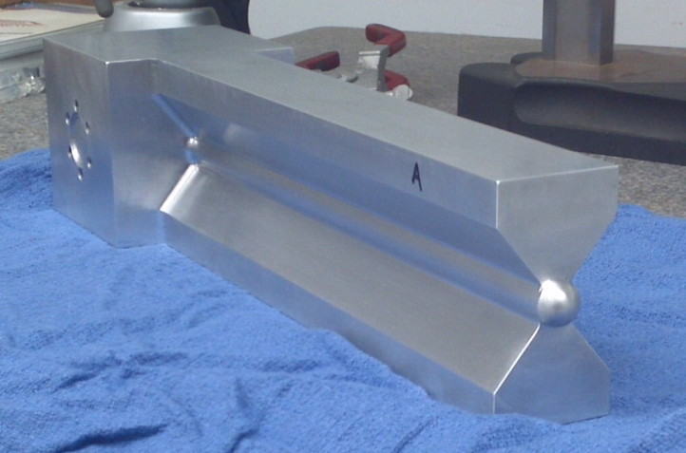

Introduction to the tritium target design
Roy J. Holt
Tritium Target Review
Jefferson Lab, Newport News
15 September 2015

Slide 2
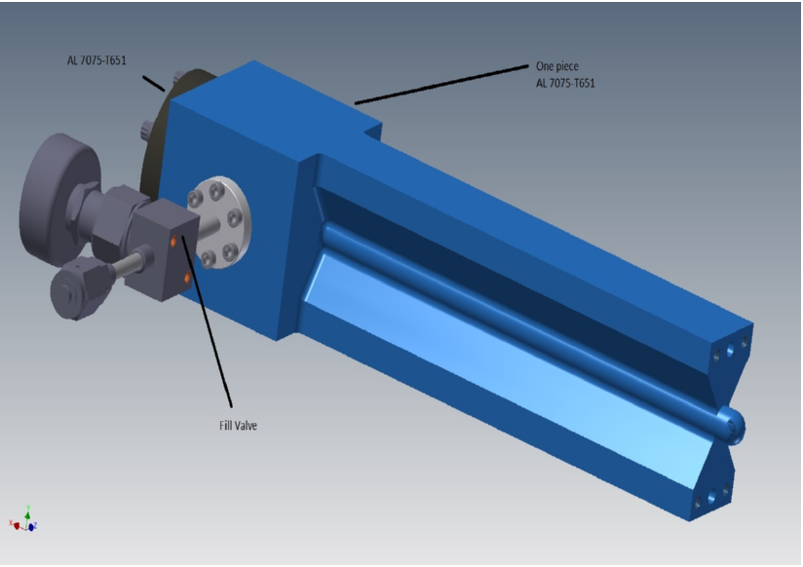
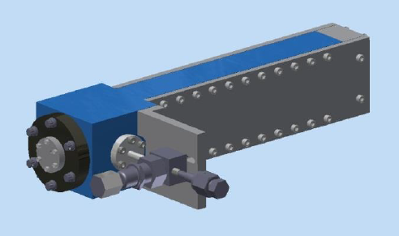
JLab ³He & ³H Measurements
E12-06-118: Marathon d/u ratios from ³H(e,e’)/³He(e,e’) DIS measurements
E12-11-112: x>1 measurements of correlations
E12-14-009: elastic: ³H – ³He charge radius difference [³H “neutron skin”]
E12-14-011: Nucleon Momentum Distributions in A = 3 Asymmetric Nuclei
Thermo-mechanical design of a static gas target for electron accelerators
B. Brajuskovic et al., NIM A 729 (2013) 469

Slide 3
Tritium Gas Targets at Electron Accelerators
Lab | Year | Quantity (kCi) | Thickness (g/cm²) | Current (μA) | Current x thickness (μA-g/cm²)
Stanford | 1963 | 25 | 0.8 | 0.5 | 0.4
MIT-Bates | 1982 | 180 | 0.3 | 20 | 6.0
Saskatoon | 1985 | 3 | 0.02 | 30 | 0.6
JLab | (2016) | 1 | 0.08 | 20 | 1.6
JLab Luminosity ~ 2.0 x 10³⁶ tritons/cm²/s
Large acceptance spectrometers at JLab

Slide 4
Design Criteria
Gas targets for accurate comparison of ³He and ³H
Minimize risk in terms of pressure, Curies, beam current, days of operation, on/off cycles ( 0.9-2.0 kCi and 15-24 μA)
Detailed thermo-mechanical design of the target cell including FEA
³He, ²H₂ and H₂ targets at more than twice the pressure of the ³H₂ target (500 psi/200 psi)
Minimize tritium handling at JLab – fill/decommission offsite
Completely sealed cell design
Secondary containment – isolated scattering chamber
Handling hut and ventilation system
Tritium, vacuum, temperature, raster, coolant monitors/interlocks
The target cell can be safely used with all required target gases:
³H₂, ³He, ²H₂, H₂ and Ar

Slide 5
Tritium Gas Target Safety Algorithm for JLab
Risk_{P} = (1 – exp(-P/C_{P}))exp(P/C_{P}),
Risk = Σ_{p} Risk_{P}

Slide 6
Risk vs. Beam current
Relative risk vs. beam current when target is 1000 Ci. The optimum current is 21 μA. This assumes that the high risk value for time is 365 days.

Slide 7

Tritium target technical reports
Hall A Tritium Target System, D. Meekins et al, September, 2015
A Tritium Gas Target for Jefferson Lab, R. J. Holt et al, July 13, 2015.
Jefferson Lab Tritium Target Cell, D. Meekins, November 28, 2014
Activation of a Tritium Target Cell, G. Kharashvili , June 25, 2014
Thermomechanical Design of a Static Gas Target for Electron Accelerators, B. Brajuskovic et al., NIM A 729 (2013) 469.
Absorption Risks for a Tritium Gas Target at Jefferson Lab, R. J. Holt, August 13, 2013.
Beam-Induced and Tritium-Assisted Embrittlement of the Target Cell at JLab, R. E. Ricker (NIST), R. J. Holt, D. Meekins, B. Somerday (Sandia), March 4, 2013.
Activation Analysis of a Tritium Target Cell for Jefferson Lab, R. J. Holt, D. Meekins, Oct. 23, 2012.
Tritium Inhalation Risks for a Tritium Gas Target at Jefferson Lab, R. J. Holt, October 10, 2012.
Tritium Permeability of the Al Target Cell, R. J. Holt, R. E. Ricker (NIST), D. Meekins, July 10, 2012.
Scattering Chamber Isolation for the JLab Tritium Target, T. O’Connor, March 29, 2012.
Hydrogen Getter System for the JLab Tritium Target, T. O’Connor, W. Korsch, February 16, 2012.
Tritium Gas Target Safety Operations Algorithm for Jefferson Lab, R. J. Holt, February 2, 2012.
Tritium Gas Target Hazard Analysis for Jefferson Lab, E. Beise et al, January 18, 2012.
Analysis of a Tritium Target Release at Jefferson Lab, B. Napier (PNNL), R. J. Holt, January 10, 2012.
Estimating the X-ray Dose Rate from the MARATHON Tritium Target, J. Singh, February 22, 2011.
Task force: R. J. Holt, A. Katramatou, W. Korsch, D. Meekins, T. O’Connor, G. Petratos, R. Ransome,
J. Singh, P. Solvignon, B. Wojtsekhowki

Slide 8
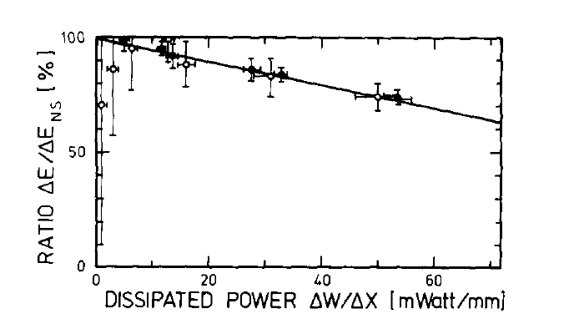
Static gas target density and energy loss
J. Gorres et al, NIM 177 (1980) 177
H. Yamaguchi et al, NIM A589(2008) 150
Threshold for density fluctuations
10 mW/mm
Lab | Year | Quantity (kCi) | Thickness (g/cm²) | Current (μA) | Power loss (mW/mm)
Stanford HEPL | 1963 | 25 | 0.8 | 0.5 | 3.2
MIT-Bates | 1982 | 180 | 0.3 | 20 | 47.7
SAL | 1985 | 3 | 0.02 | 30 | 4.8
JLab | (2016) | 1 | 0.08 | 20 | 12.7
Density vs. current scan will be performed for the targets.

Slide 9
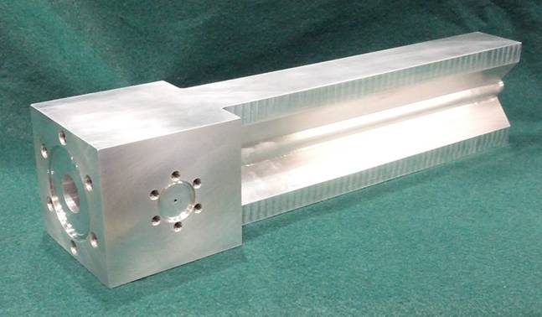
JLab Tritium Target
Thin Al windows
  Beam entrance: 0.010”
  Beam exit: 0.011”
  Side windows: 0.018”
  25 cm long cell at ~200 psi T₂ gas
Tritium cell filled and sealed at Savannah River (SRTE)
  Pressure: accuracy to <1%,
  Purity: 99.8% T₂ gas, main contaminants are ³He and D₂
  12.32 y half-life: after 1 year ~5% of ³H decayed to ³He
Administrative current limit: 20 μA
Design Authority and Project Manager: Dave Meekins

Slide 10
Summary
Experiments with ³H at JLab can safely provide:
  First DIS measurements
  First x > 1 measurements
  First (e,e’p) measurements
  First precision charge radius measurements
  First …..
Textbook physics experiments – benchmark data

Slide 11
Extra slides

Slide 12
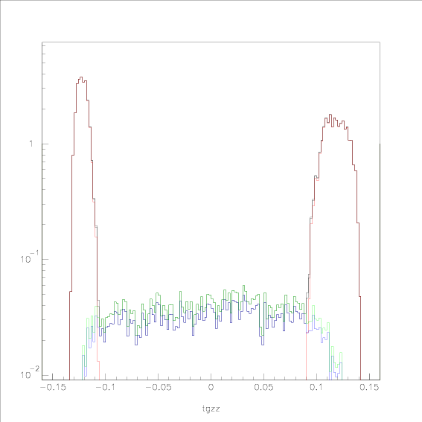
E12-10-103: DIS kinematics with an HRS (simulation)
11 GeV, 23.4 deg.
10 atm ³H, 20 atm ³He
0.018” Al windows
Present design:
13.6 atm ³H, 30 atm ³He
0.010” upstream window
0.011” downstream window
Target luminosity comparable
to window luminosity
BB at larger angles
BB comparable z_targ resolution
Al windows
³He
³H
P. Solvignon
Target_z (m)

Slide 13
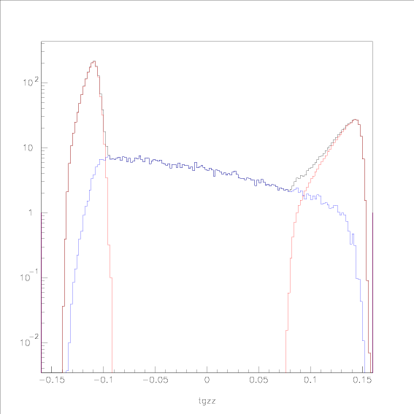
E12-11-112: x>1 kinematics with an HRS (simulation)
Worst case- other cases are:
  larger angles (larger
  window separation)
  higher energies (better
  resolution)
  Lower x (larger cross section)
4.4 GeV, 17.0 deg, p=3.98 GeV
13.6 atm ³H
0.010” Al upstream window
0.011” downstream window
Al windows
³H
P. Solvignon
Target_z (m)

Slide 14
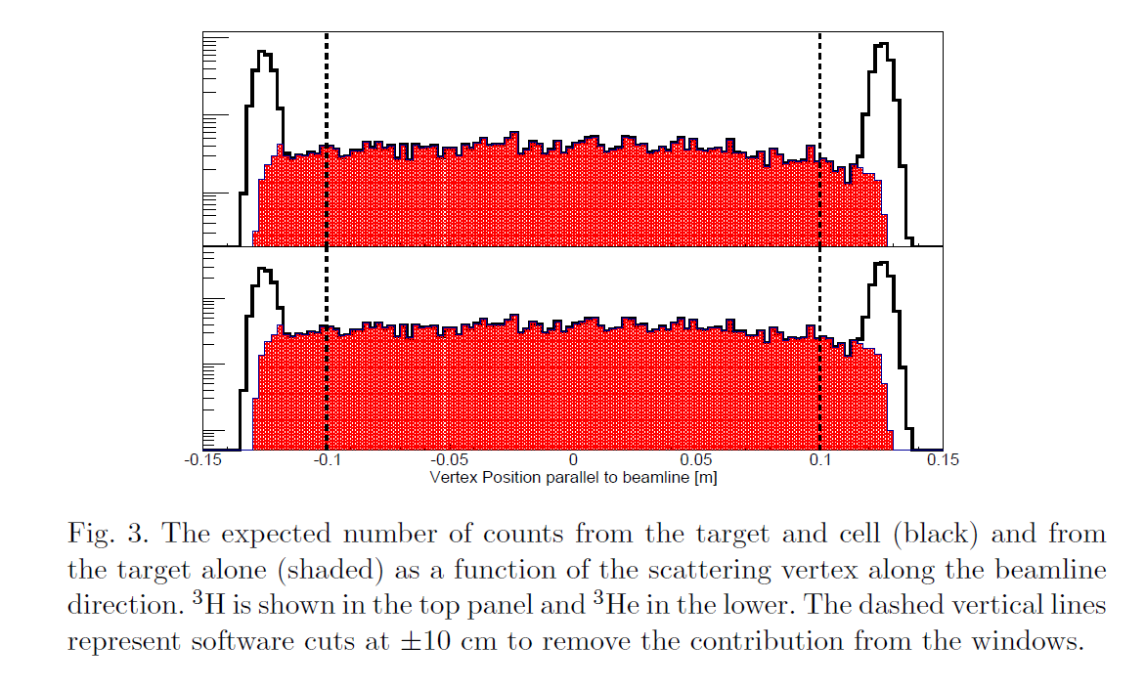
E12-14-009: Elastic scattering from A=3 nuclei

Slide 15
Beam and Tritium-assisted Embrittlement
Beam-induced corrosion of Al, threshold at 180 K
  Beam dissociates hydrogen molecules into atoms – atomic fraction = 10 ppm
  Cryo-cool target when beam is on – keep windows below 180 K.
  H. M. Flower, “Electron Irradiation Induced Aqueous Corrosion of Aluminum and Magnesium,” Radiation Effects 33 (1977) 173; G. Bond et al., Scripta Metallurgica 20 (1986) 653.
Tritium-assisted embrittlement of Al
  Swelling threshold = 0.0045 He/Al
  Tritium diffusion into cell for one year -> ³He/Al = 1.8E-10
  M. R. Louthan, “Aluminum-Lithium Technology and Savannah River’s Contribution to Understanding Hydrogen Effects in Metals,” WSRC-2000-00061

Slide 16
Special issues for tritium
Tritium permeation through Al (J. Scully et al, Mat. Sci. For. 331-337 (2000) 1583)
  n_{Al} = 6E22 cm⁻³, C_{H}=1.6E-11, D=2.3E-7 cm²/s, J=n_{Al}C_{H}D/d
  Ambient temperature -> 142 mCi in one year, diffusion; 371mCi/y for seals and valve
X-rays from the target cell (J. Singh)
  18.6 keV beta endpoint -> < 3.6 mrem/hr/cm² at window surfaces
Radiation damage of target cell
  10⁵-10⁶ orders of magnitude – Al cells routinely used for target cells
Hydrogen embrittlement of the target cell
  7000 series Al tested at Sandia up to 15000 psi, target at 200 psi (B. Somerday)
Energy stored in pressurized gas cell (JLab ESH 6151 Appendix T4)
  125 and 250 J ~ to polarized ³He target
Chemical energy in the gas cell
  ~0.4 liters STP, 17 kJ, strongly diluted in scatt. chamber or Hall, 10 ppb
  ~1E-4 of hydrogen gas in standard cryotargets
Activation of the Al target cell (7075)
  Target windows: 1.7 mR/hr; after 2 days: 0.07mR/hr @ 1 m
Full tritium release in Hall A
  0.2 mrem/hour for a worker

Slide 17
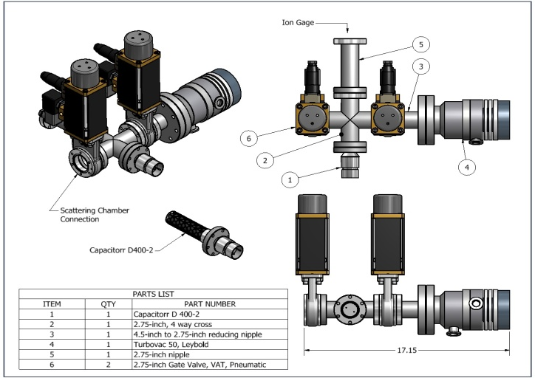
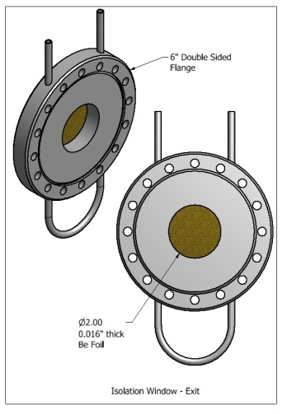
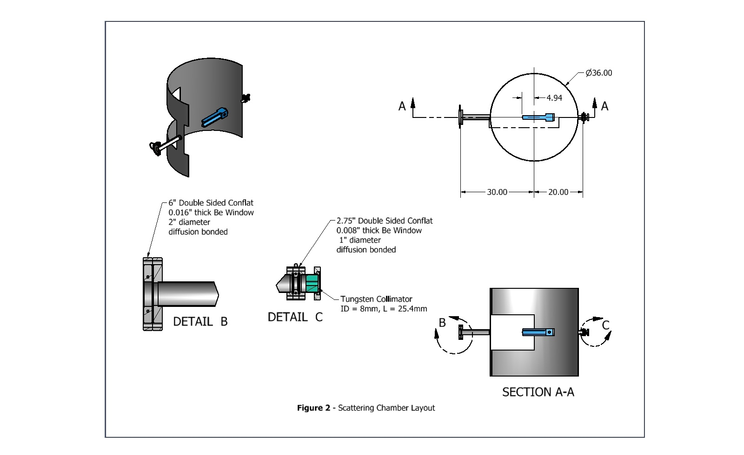
Secondary Containment – scattering chamber
May 30, 2012 meeting -> Use BB scattering chamber
Completely isolated from beam line
  Water cooled isolation windows
  Rad-hard RGA’s to detect tritium
  Activated getter pump
  Ventilation system with stack (design?)
T. O’Connor

Slide 18
Contamination of scattering chamber?
10,000 dpm actionable limit not exceeded if 250 l/s speed is available within 1 second of losing the primary containment.
Two 1000 l/s turbos on chamber,
vented to stack
>100 l/s NEG pump available
A_{i} = A_{poly}T_{i}
where A_{poly} is the absorption rate in CH₂, and T_{i} is the time at step i. The pump with speed, S,
is turned on after delay T_{d}, the absorption rate is given by:
A_{i} = A_{i-1} + A_{poly}exp(-(T_{i}-T_{d})/(V_{C}/S))

Slide 19
Stack height and maximum dose
HotSpot calculations by
Bruce Napier, Pacific Northwest National Lab
Assumptions: 100% HTO, 60 minute sampling time, class F weather (minimal dispersion)
Stack height (m) | Dose at 300 m 600 Ci (mrem) | Distance at max dose (m) | Max dose 600 Ci (mrem) | Max dose 1000 Ci (mrem)
0 | 160 | <100 | 890 | 1483
5 | 54 | 200 | 67 | 112
10 | 6.5 | 500 | 9.7 | 16
15 | 0.28 | 750 | 3.2 | 5.3
20 | 0.0036 | 1000 | 1.4 | 2.3

Slide 20
Dose vs. distance for a 20 m stack (600 Ci, 100% HTO, class F weather, 60 min sampling time)

Slide 21
Algorithm for number of days and beam trips
The total number of days for experiments is 61 at 1000 Ci and 25 μA:
ndays = (61 days)(1000 Ci)(25 μA)/((nci)(ib))
where nci = no. of Ci and ib = beam current.
Cycling risk (beam trips):
Risk_{cyc} = (1 – exp(-ncyc/cychi))exp(ncyc/cychi)exp(press/presshi)exp(ib/ibhi),
Where ncyc = no. of cycles and press = gas pressure.

Slide 22
Risk vs. Target Activity
Relative risk vs. curies when the beam current is 21 μA. The optimum target activity is 1350 Ci. This assumes that the high risk time is 365 days.

Slide 23
F₂^{n}/F₂^{p}, d/u ratios and A₁ for x→1
 | F₂^{n}/F₂^{p} | d/u | A₁^{n} | A₁^{p}
SU(6) | 2/3 | 1/2 | 0 | 5/9
Diquark/Feynman | 1/4 | 0 | 1 | 1
Quark Model/Isgur | 1/4 | 0 | 1 | 1
Perturbative QCD | 3/7 | 1/5 | 1 | 1
Dyson-Schwinger | 0.49 | 0.28 | 0.17 | 0.59
C. D. Roberts, RJH, S. Schmidt, PLB 727 (2014) 249

Slide 24
Present status: Neutron to proton structure function ratio
C. D. Roberts, RJH, S. Schmidt, PLB 727(2013) 249;
RJH, C. D. Roberts, RMP 82 (2010) 2991

Slide 25
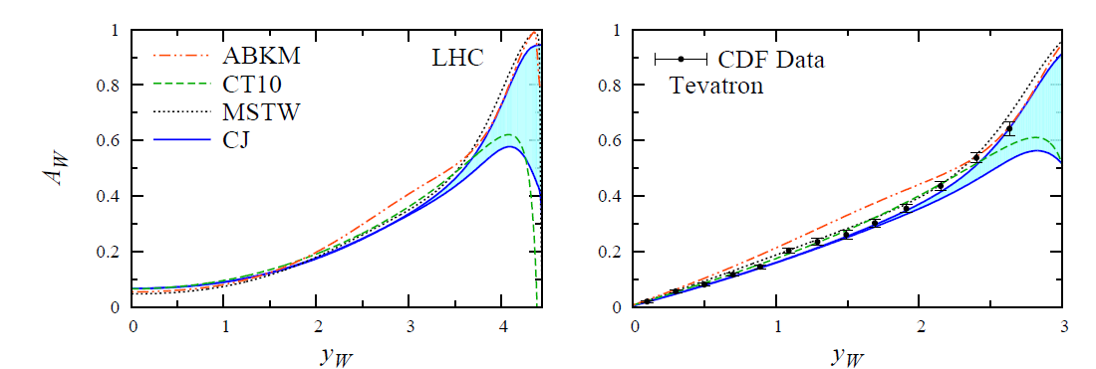
High x impacts high energy physics
W charge asymmetry vs. W rapidity
High x and low Q² evolves to low x and high Q²
Accardi, Mod. Phys. Lett. A28 (2013) 35; arXiv 1308.2906v2

Slide 26
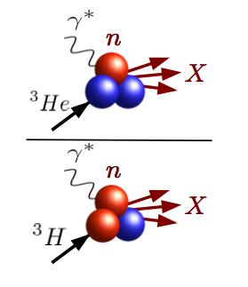

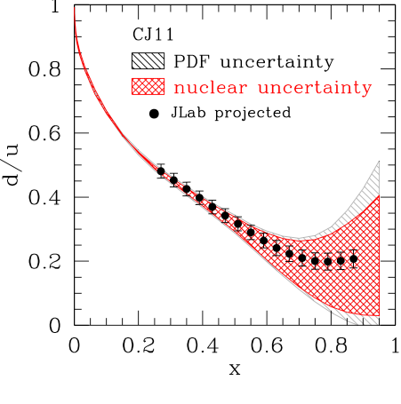
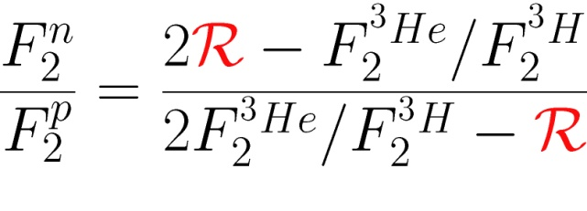
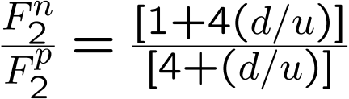
From three-body nuclei to the quarks
Mirror symmetry of A=3 nuclei
  Extract F₂^{n}/F₂^{p} from ratio of measured ³He/³H structure functions
R = Ratio of “EMC ratios” for ³He and ³H
Relies only on difference in nuclear effects
Calculated to within 1.5%
Most systematic, theory uncertainties cancel
  JLab E12-06-118: Marathon
G. Petratos, RJH, R. Ransome, J. Gomez
Parton model ->

Slide 27
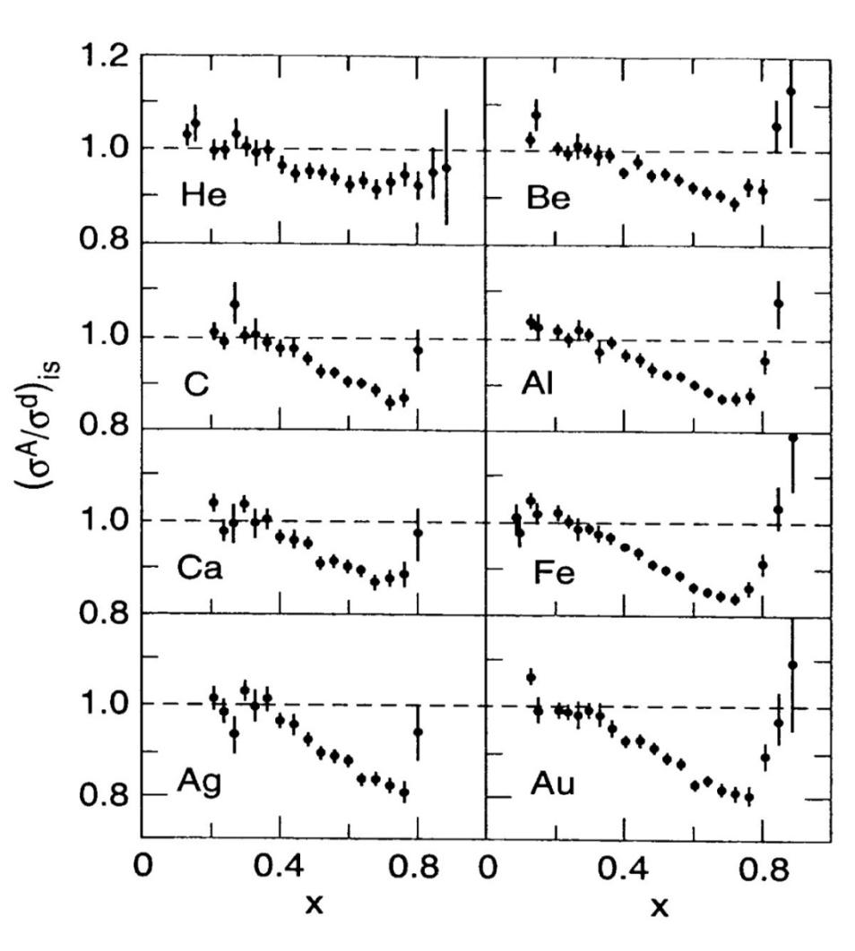
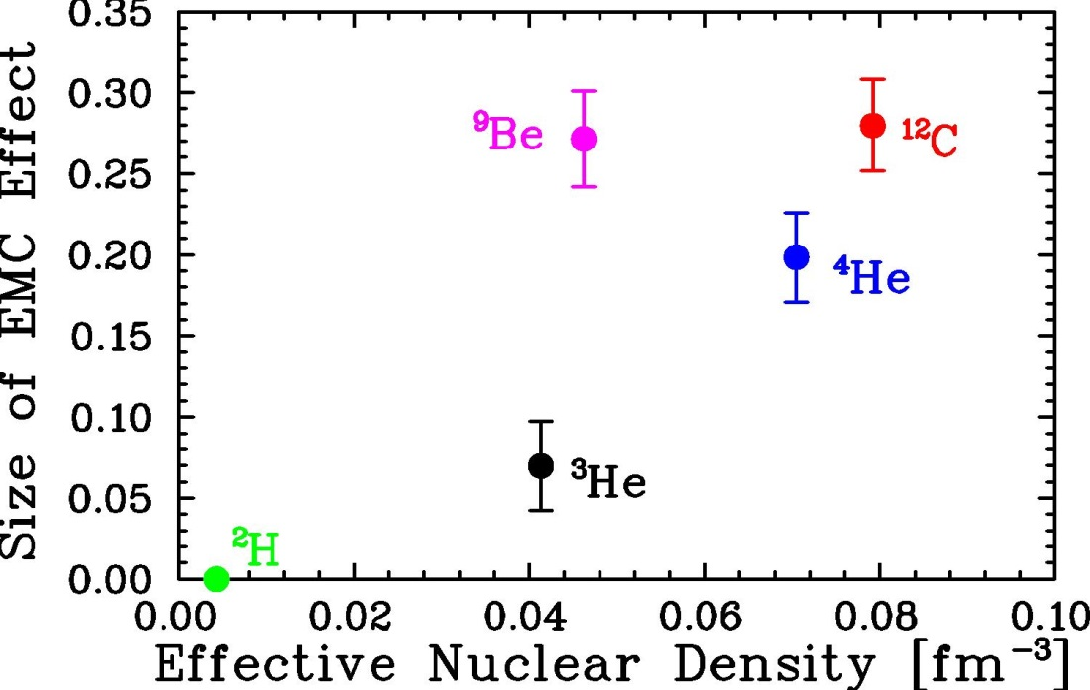
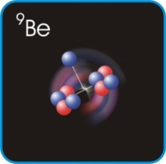
A look at quarks in the nucleus: the EMC effect
EMC effect discovered 1982 (H. Montgomery et al.), remains a mystery today
Scattering from quarks in a nucleus is not just a superposition of scattering from quarks in nucleons
  Dependence on nuclear density, short range correlations, flavor, spin, isospin?
SLAC E-139, 1984, J. Gomez et al.
J. Seeley et al, PRL 103 (2009)

Slide 28
Isospin structure of 2N-SRCs (JLab E12-11-112)
P. Solvignon, J. Arrington, D. Day, D. Higinbotham
³He/³H is simplest asymmetric case:
Simple estimates for 2N-SRC
Isospin independent
Full n-p dominance (no T=1)
40% difference between full isosinglet dominance and isospin independent
Few body calculations [M. Sargisan, Wiringa/Peiper (GFMC)] predict n-p dominance, but with sizeable contribution from T=1 pairs
Goal is to measure ³He/³H ratio in 2N-SRC region with 1.5% precision
  → Extract R(T=1/T=0) with uncertainty of 3.8%
Extract R(T=1/T=0) with factor of two improvement over previous triple-coincidence, smaller FSI

Slide 29
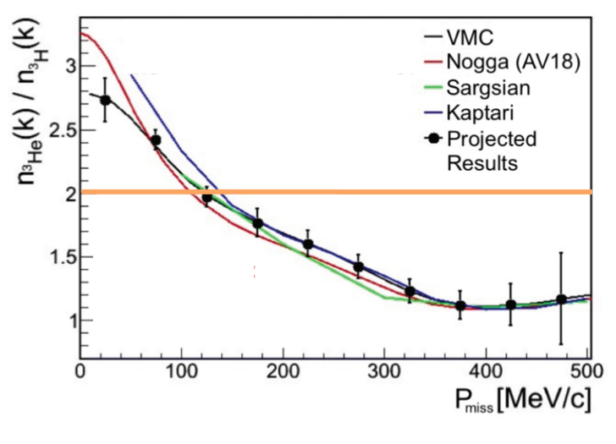
³He(e,e’p)/³H(e,e’p)
JLab E12-14-011 Proton and Neutron Momentum Distributions in A = 3 Asymmetric Nuclei
L. Weinstein, O.Hen,
W. Boeglin, S. Gilad
³He/³H ratio for proton knockout yields n/p ratio in ³H
np-dominance at high-P_{m} implies n/p ratio → 1
n/p at low P_{m} enhanced
No neutron detection required
arXiv:1409.1717

Slide 30
Charge radii: ³He and ³H
First opportunity for ³H at JLab (E12-14-009)
Precise theoretical calculations of <r²_{rms}>_{3H}, <r²_{rms}>_{3He}
Experimental results: large uncertainties, discrepancies
L. Meyers, J. Arrington, D. Higinbotham
 | <r²_{rms}>_{3H} | <r²_{rms}>_{3He}
GFMC | 1.77(1) | 1.97(1)
χEFT | 1.756(6) | 1.962(4)
SACLAY | 1.76(9) | 1.96(3)
BATES | 1.68(3) | 1.87(3)
Atomic | -------- | 1.959(4)
ΔR_{RMS} = 0.20(10)
ΔR_{RMS} = 0.19(04)
With new tritium target -> improve precision on ΔR_{RMS} by factor 3-5 over SACLAY results

