Slide 1
Tritium Hazards in Hall A
SAF 110T

Slide 2
Objectives of SAF 110T
Reason for this training
Understand what Tritium is and associated hazards
Specifics of the Hall A Tritium Target (HATT) System
Engineering and administrative controls in Hall A
  Access controls
How to respond to alarms
What to do in emergencies

Slide 3
Motivation
There are several experiments planned in Hall A that require a tritium target.
The target is of a sealed cell design but will contain 1075 Ci of tritium
Because the target itself is radioactive and of relatively high activity, you are being provided with this special training.
This course is intended to familiarize you with the properties and exposure hazards of tritium, as well as the monitoring and safety protocols which will be followed throughout the time the target is used in Hall A.

Slide 4
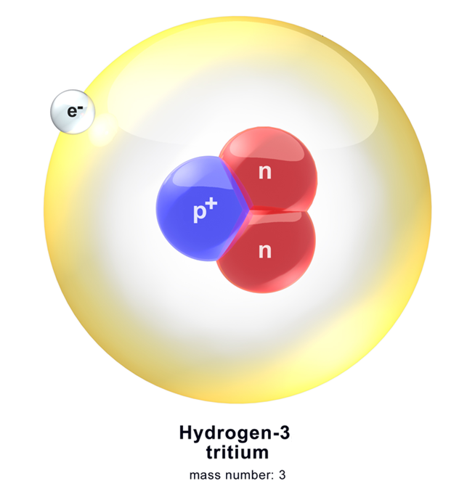
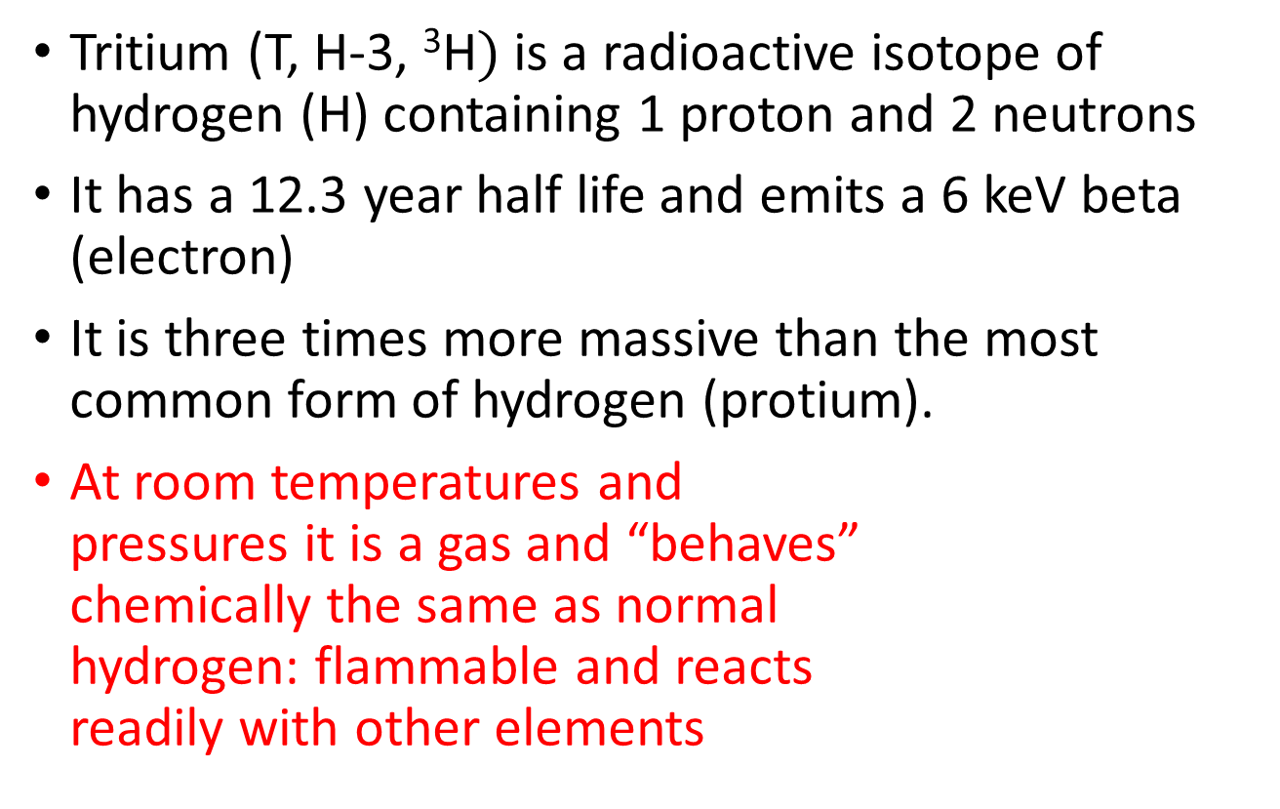
What is Tritium?
Tritium (T, H-3, ³H$)$is a radioactive isotope of hydrogen (H) containing 1 proton and 2 neutrons
It has a 12.3 year half life and emits a 6 keV beta (electron)
It is three times more massive than the most common form of hydrogen (protium).
At room temperatures and
pressures it is a gas and “behaves”
chemically the same as normal
hydrogen: flammable and reacts
readily with other elements
Notes:
Tritium is a radioactive isotope of hydrogen, the lightest and most abundant element in the universe.
Normal hydrogen has only one proton in its nucleus, whereas tritium has, in addition to the single proton, two neutrons. This makes it three times heavier than the most common form of hydrogen.

Slide 5
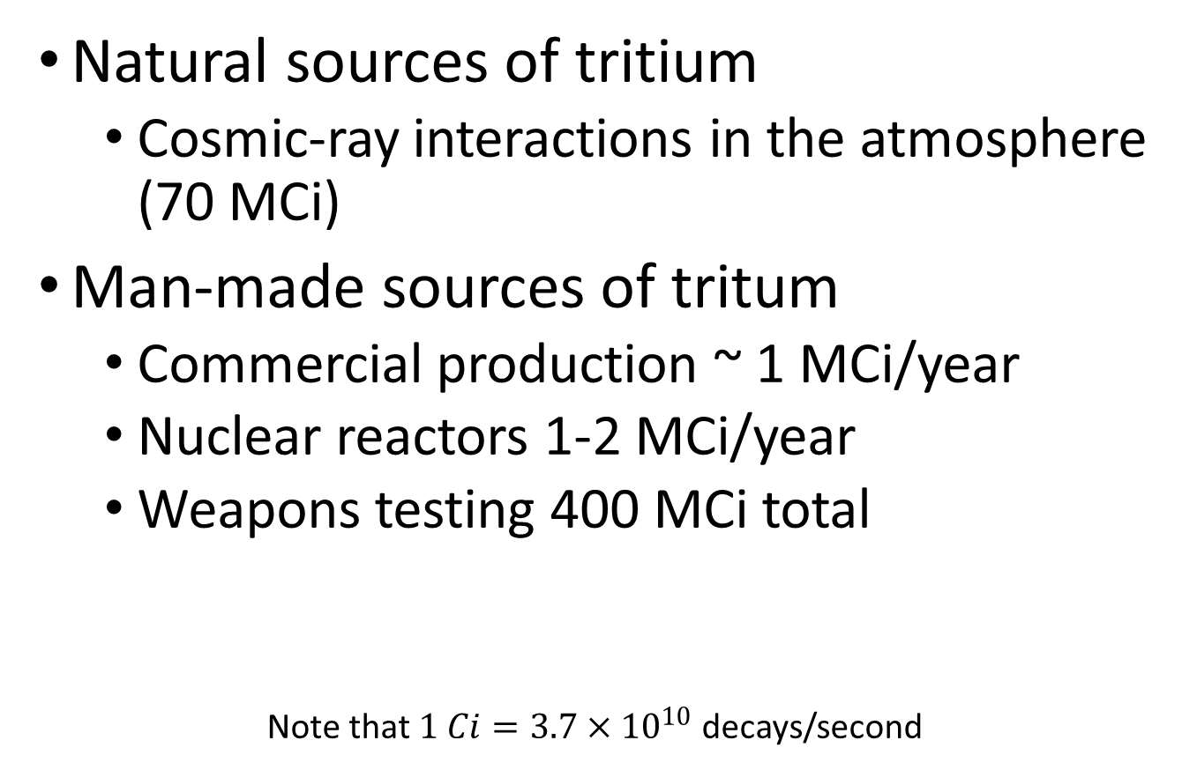
Sources of Tritium
Natural sources of tritium
  Cosmic-ray interactions in the atmosphere (70 MCi)
Man-made sources of tritum
  Commercial production ~ 1 MCi/year
  Nuclear reactors 1-2 MCi/year
  Weapons testing 400 MCi total
Note that $1 Ci=3.7×{10}^{10}$ decays/second
Notes:
There are three primary sources of tritium in our environment:
Natural Tritium is formed by the reactions between cosmic rays and the nitrogen in the upper atmosphere. Nitrogen makes up 80% of the earth’s atmosphere. Cosmic rays generate approximately 4 million curies of tritium per year. With tritium being continually produced and at the same time decaying, the equilibrium level of natural tritium in our environment is about 70 million curies.
In addition, the DOE has produced tritium at the Savannah River Site with the use of a reactor and Tritium is commercially available from Canada and the European Community for non-weapons use.

Slide 6
Physical and Chemical Properties
Chemically, Tritium is the same as Hydrogen because it has one proton and one electron
  Flammable with concentrations in air from 4% to 75%
  Absorbs readily onto many surfaces and in liquids
Substitution:
  Tritium atoms can easily substitute for hydrogen atoms in elemental gas or water molecules, resulting in tritium gas or tritium oxide
Permeation: Tritium permeates though most materials
Dispersive: T2 and HT rapidly diffuse in air
Conversion: Tritium (T2 or HT) will convert to Tritium Oxide or tritiated water (T2O or HTO) at a rate of 4 to 10% per day in the atmosphere.
Notes:
Chemically, tritium behaves just like ordinary hydrogen because it has one proton and one electron.

Slide 7

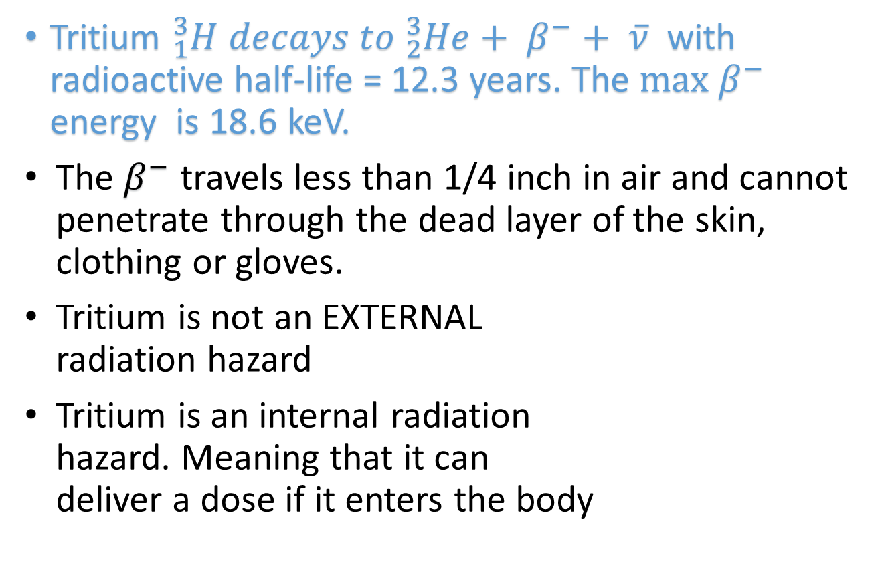
Radioactive Properties
Tritium ${}_{1}^{3}{H decays to {}_{2}^{3}{He+ β^{−}+ \overline{ν}}}$ with radioactive half-life = 12.3 years. The $max β^{−}$ energy is 18.6 keV.
The $β^{−}$ travels less than 1/4 inch in air and cannot penetrate through the dead layer of the skin, clothing or gloves.
Tritium is not an EXTERNAL
radiation hazard
Tritium is an internal radiation
hazard. Meaning that it can
deliver a dose if it enters the body

Slide 8
Tritium Dose
Modes of entry include:
  Inhalation and absorption through the skin
  Injection (cuts/wounds) and ingestion
Exposure to tritium gas (T2 or HT):
  Tritium gas is only slightly incorporated into the body when inhaled because most of what is inhaled is subsequently exhaled.
In contrast nearly 100% of tritiated water vapor inhaled is incorporated into body fluids and tissues. Tritiated water can also be absorbed relatively easily through the skin.
Exposure to tritiated water is ~25,000 times more hazardous than exposure to elemental tritium gas.
Exposure to tritium gas can lead to absorption through the skin. In certain situations, 1/3 of an individual’s uptake may be from absorption through the skin.
Generally, the assumption is that in an inhalation event, an additional 50% of the inhalation intake is absorbed through the skin.

Slide 9
Tritiated Water
Tritiated water in the body acts just like water.
rapidly and uniformly distributed throughout the entire body.
Committed Effective Dose (CED) from an uptake of 1 Ci of tritiated water is 63 rem.
Notes:
The biological exchange of tritium with hydrogen in the body can be of concern.
Once Tritium gets into the body, it quickly becomes uniformly distributed throughout.

Slide 10
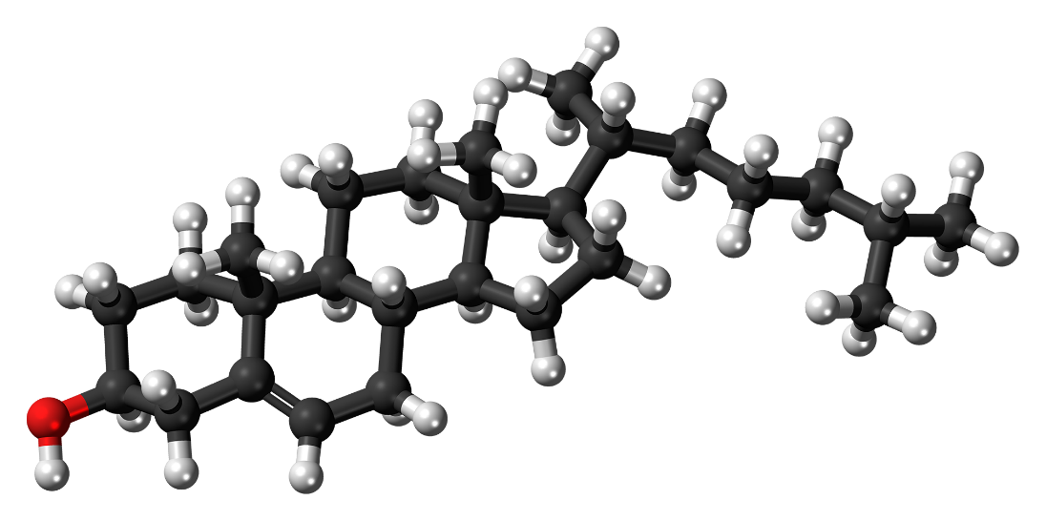
Tritium absorption
Tritium can also replace a loosely bonded hydrogen atom of an organic molecule.
Organically bound tritium and metal tritides (compounds made of tritium and metal) may result in more dose per intake than tritiated water. Accordingly, additional controls may be needed, such as special air monitoring or enhanced personnel protective equipment.

Slide 11
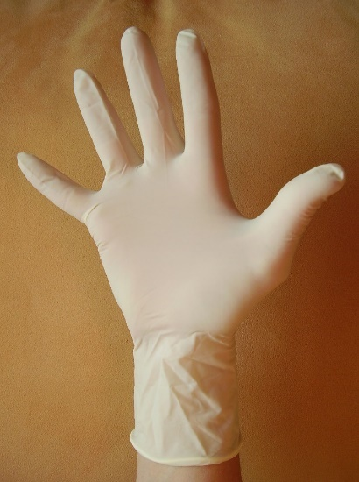



Tritium Ingestion
Ingestion may occur by eating, drinking, chewing tobacco, and applying makeup where tritium contamination is present.
Appropriate PPE such as rubber gloves should always be worn while working near any radioactive contamination.
It is always prudent to wash your hands after working near any radioactive contamination.
Notes:
Ingestion may occur by eating, drinking, chewing tobacco, and applying makeup where tritium contamination is present. It is always prudent to wash your hands after working near any radioactive contamination.

Slide 12

Biological Half-Life
Half of the tritiated water is eliminated from the body in about 10 days. It would take 70 days or more to eliminate 99% of assimilated tritiated water through normal biological processes. The biological half-life can be shortened by increasing water elimination from the body.
Stable tritium particulate aerosols and insoluble organically bound tritium behave in the body in a similar manner as the particulate to which the tritium is bound and would have a longer half-life.
Notes:
Half of the tritiated water is eliminated from the body in about 10 days. It would take 70 days or more to eliminate 99% of assimilated tritiated water through normal biological processes.
Stable tritium particulate aerosols and insoluble organically bound tritium behave in the body in a similar manner as the particulate to which the tritium is bound and would have a longer half-life.

Slide 13
Personnel Monitoring
Dosimeters are not typically used to monitor for radiological doses resulting from tritium. However, work in all experimental halls posted as RCAs will continue to require dosimetry due to exposure from activated materials.
The best method used to determine if an individual has an uptake of tritiated water or soluble organically bound tritium is by urinalysis. Routine urine samples, collected at some predetermined frequency and counted for the tritium content, provide a very sensitive measurement of tritium in the body. This is especially true if the time of an intake is known.
Notes:
Dosimeters are not typically used to monitor for radiological doses resulting from tritium. The weak energy beta radiation will not penetrate the dosimeter. However, work in all experimental halls posted as RCAs will continue to require dosimetry due to exposure from activated materials.
The best method used to determine if an individual has an uptake of tritiated water or soluble organically bound tritium is by urinalysis. Routine urine samples, collected at some predetermined frequency and counted for the tritium content, provide a very sensitive measurement of tritium in the body. This is especially true if the time of an intake is known.
Air sampling results may also be used to assess dose from other types of special tritium compounds.

Slide 14
Personnel monitoring
In the absence of a failure of the tritium target, there should be no significant tritium in the air or on surfaces around the target, and there is no expectation of uptakes or dose to workers.
However, we will be implementing routine tritium screening for individuals involved in the tritium target experiment. Urinalysis samples will be collected on a preset periodic basis. You will be informed if and when you need to provide a sample. All urine samples will be handled through Jlab’s Occupational Medicine Office.
Special additional bioassays will be conducted only if exposure to tritium is suspected.
Notes:
In the absence of a failure of the tritium target, there should be no significant tritium in the air or on surfaces around the target, and there is no expectation of uptakes or dose to workers.
However, we will be implementing routine tritium screening for individuals involved in the tritium target experiment. Urinalysis samples will be collected on a preset periodic basis. You will be informed if and when you need to provide a sample. All urine samples will be handled through Jlab’s Occupational Medicine Office.
Special additional bioassays will be conducted only if exposure to tritium is suspected.

Slide 15
Summary of Tritium Basics
Tritium is a radioactive isotope of hydrogen
It behaves chemically just like hydrogen
  It can replace hydrogen atoms in chemical compounds
  This is especially true for water
Tritium is an internal exposure hazard
  The dose from tritiated water is ~25,000 times higher than that of elemental tritium
Tritium can, more or less, get “into” anything.

Slide 16
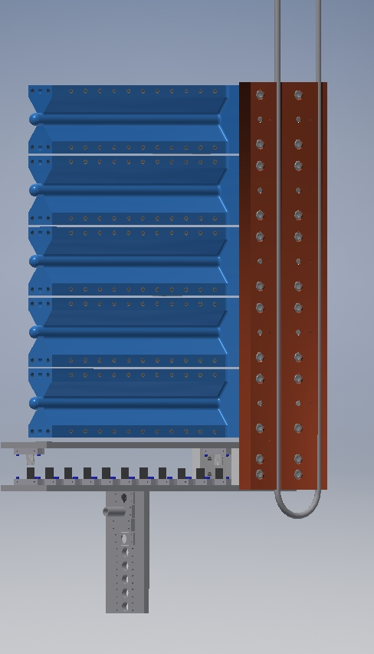
The Hall A Tritium Target
The Hall A Tritium Target is a multiple cell target with several target materials.
  Very similar to the cryotargets
  One cell is filled with tritium
The tritium cell is a sealed gas cell.
  Filled with pure T2 gas at Savannah River Site (SRS)
  Shipped to JLAB and will be returned to SRS
  JLAB will not be “handling” tritium gas
The target is installed in the standard Hall A scattering chamber

Slide 17
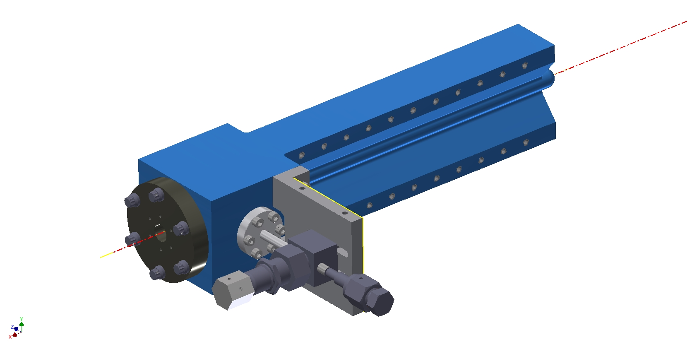
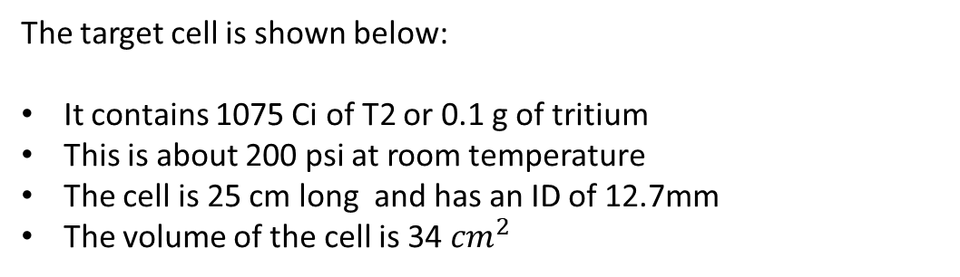
Target Cell
The target cell is shown below:
It contains 1075 Ci of T2 or 0.1 g of tritium
This is about 200 psi at room temperature
The cell is 25 cm long and has an ID of 12.7mm
The volume of the cell is 34 ${cm}^{2}$

Slide 18
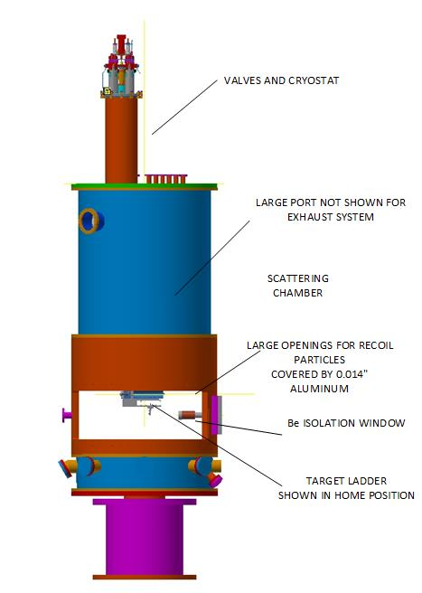
The target design provides for triple containment/
confinement for all but the last steps of the installation and removal of the cell
A release of tritium from this target is considered to be very unlikely

Slide 19
Hazard Controls
There are several controls in place to ensure safe operation of the system:
Administrative
  Limited access to Hall A when the tritium cell is installed
  Very limited access to the pivot area near the target
  CANS activated doors
  Trained and qualified personnel (including this training)
  Procedures
Engineered
  There are three or more layers providing containment and/or confinement of the tritium. Under normal conditions these are:
    1) The cell 2) The scattering chamber 3) Hall A
  An exhaust system has been installed which also provides slight negative pressure to the Hall. It exhausts to a stack on the Hall A dome. This provides the final confinement layer.
  Tritium detectors and alarms

Slide 20
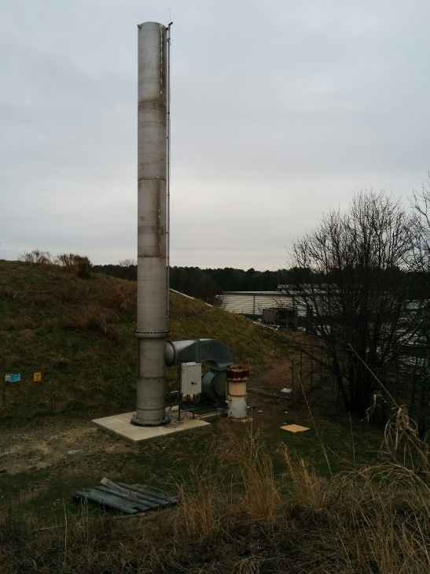
Exhaust System
The exhaust system schematic is shown below. The system provides a slight negative pressure in the Hall when activated provided the truck ramp doors are closed.
Stack and blower on top of Hall A dome
Tritium exhaust system schematic

Slide 21
Hall A Access
When the tritium cell is installed:
Signage will be posted on all entrances to the Hall
The CANS system will be activated
  Badges are required for entry
Access to Hall A will be limited to:
  Personnel with required training who are also on the CANS access list
  All personnel entering the Hall must swipe their badge
  Personnel not on the access list are not allowed without prior approval from RadCon and fully trained escort.
A restricted zone has been setup near the target and beam dump (see following slides)
The door between the accelerator tunnel and Hall A will be locked closed. Only emergency (via crash button) egress through this door shall be allowed.
Normal requirements for “Restricted” or “Controlled Access” still apply.

Slide 22
Restricted Zone
Restricted Zone shown in yellow
Limited to authorized personnel on access list
Access is linked to activity
Personnel needing to perform work in this area shall contact the Hall A work coordinator
Hall A work coordinator and RadCon shall approve all work in this zone
Zone is marked by physical boundaries and signage
An example of a physical barrier is shown in the next slide
Hall A Top View

Slide 23
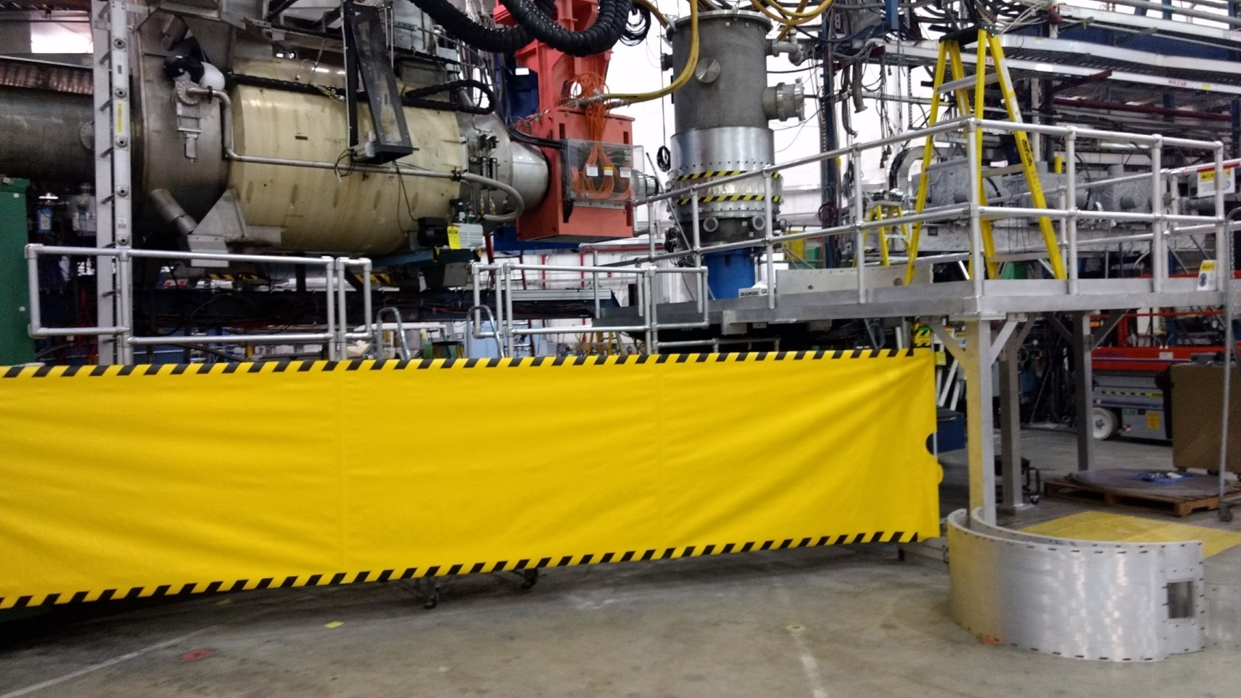
Retractable Barrier

Slide 24
Tritium Detectors and Alarms
Two redundant Tritium Air Monitors (TAMS) have been installed to sample air in Hall A.
Should tritium be detected by one of these monitors alarms will sound in the Hall and EPICS screens on both target controls and in the MCC.
Personnel suspecting a tritium leak due to accidental breach of the chamber vacuum should:
  Exit the Hall via the truck ramp personnel door or the labyrinth door and press the crash button located at that door.
  This activates the alarm system.

Slide 25
What should I do in an emergency involving tritium?
When the Tritium Alarm Sounds: (see next slide)
Stop all work and turn off dangerous equipment
  Machine tools, propane torches, etc.
Calmly and promptly exit the Hall
Leave all tools and equipment in the Hall
Inform the MCC crew chief, security guard (post 2) and RadCon tech on call of the alarm
Muster in the Hall A counting house and await further instructions from RadCon

Slide 26
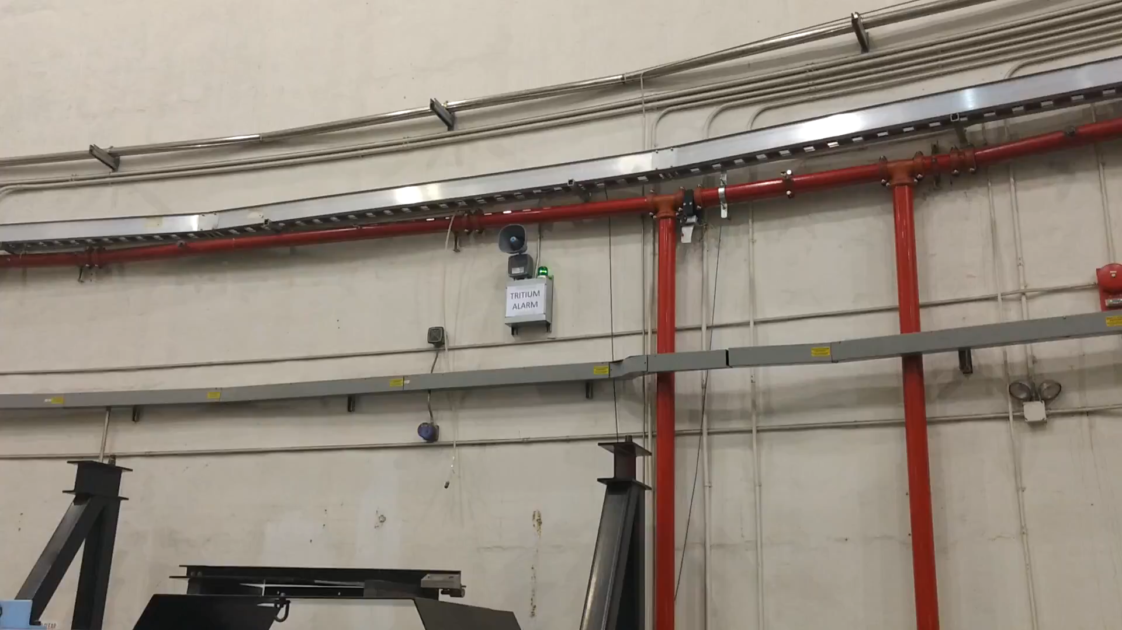
Tritium Alarm
Click play to activate video

Slide 27
OTHER EMERGENCIES
Medical
Fire
This slide should be the same as the one from RAD worker I

Slide 28
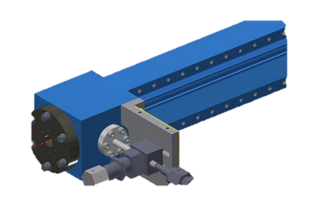
Tritium target
Target contains
1080 Ci of H-3 gas
Notes:
As you know, a new set of experiments involving a tritium gas target is scheduled in Hall A. Because the target itself is radioactive and of relatively high activity, you are being provided with this special training. This course is intended to familiarize you with the properties and exposure hazards of tritium, as well as the monitoring and safety protocols which will be followed throughout the time the target is used in Hall A.
Special access procedures for Hall A while the tritium target cell is installed.

Slide 29
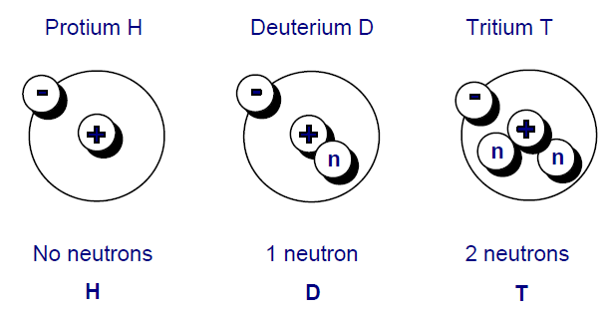
Isotopes of Hydrogen
Notes:
Regular hydrogen, also known as protium makes up 99.985% of all natural hydrogen.
Deuterium is a hydrogen atom with one extra neutron in the nucleus, its natural abbundance is 0.015%.
Tritium, which is produced both naturally and by man, is radioactive.

Slide 30
Symbols for Tritium
T H-3 ³H
Notes:
Tritium can be designated in several ways, including those shown here

Slide 31

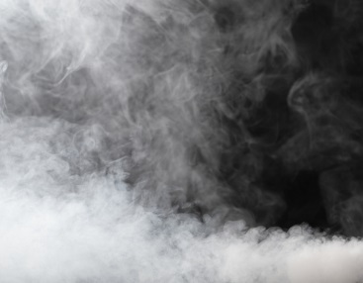
Chemical Properties: substitution
Normal hydrogen gas = H₂
Tritiated gas = HT
Tritium gas = TT or T₂
Normal water = H₂O
Tritiated water = HTO or T₂O
(tritium oxide)
Notes:
For example, Tritium atoms can easily substitute for hydrogen atoms in elemental gas or water molecules, resulting in tritium gas or tritium oxide.

Slide 32
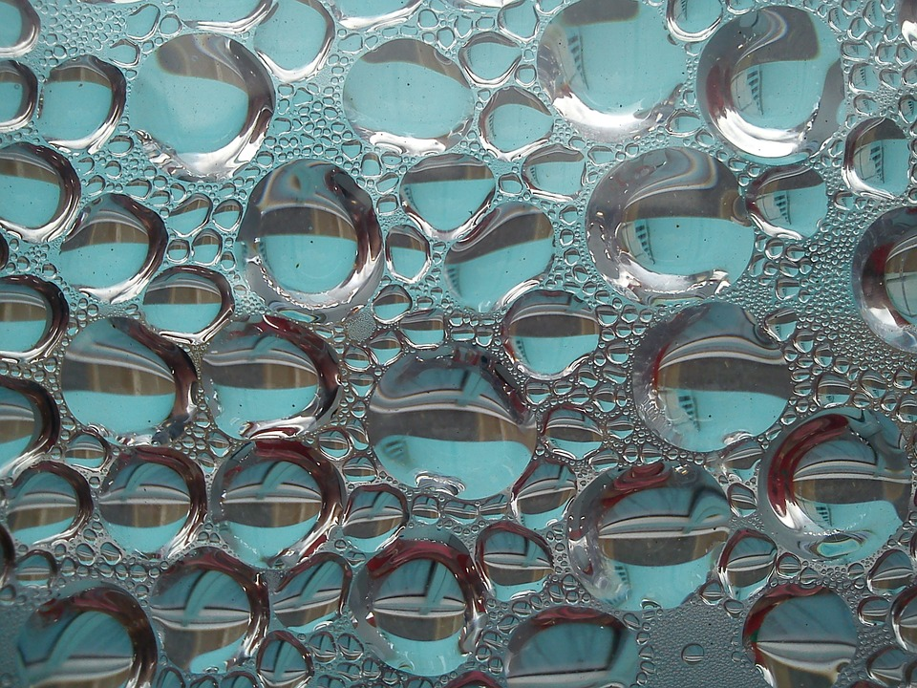
Conversion
Tritium
Gas
4-10%
Tritium
Oxide
Notes:
The normal conversion of tritium gas to tritium oxide is 4-10% per day for atmospheric releases, so there isn’t much of an exposure issue after a release of tritium gas unless there’s a heavy rain and the tritium washes out.

Slide 33
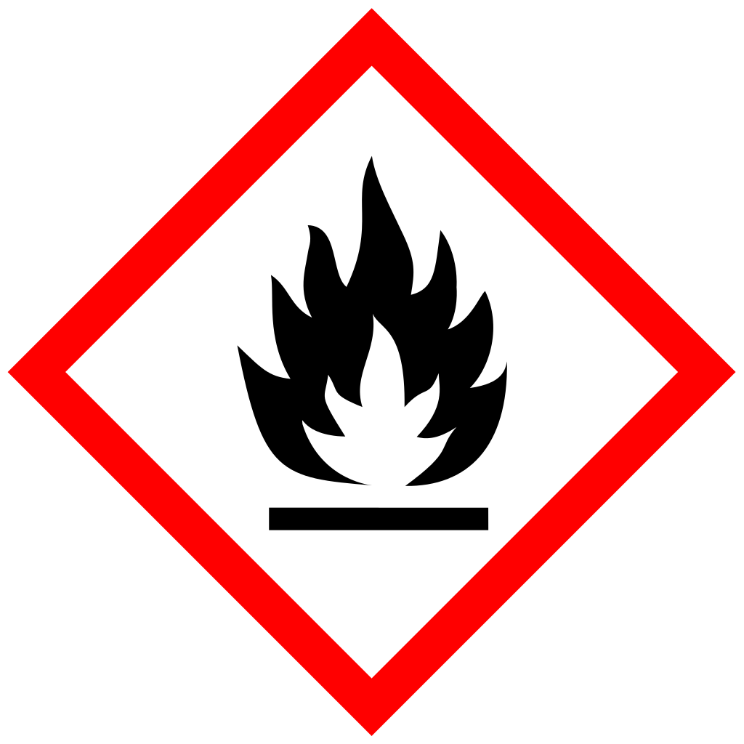
Chemical Properties: flammability
Flammable At concentrations in air between 4% and 75% by volume
Notes:
Tritium gas, just like normal hydrogen gas, is flammable and can explode under certain conditions.
The range of the flammable concentrations in air is between 4% and 75% by volume.

Slide 34
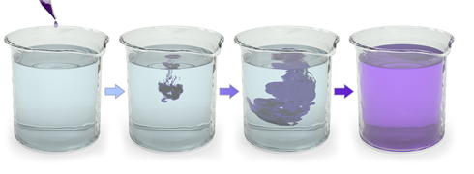
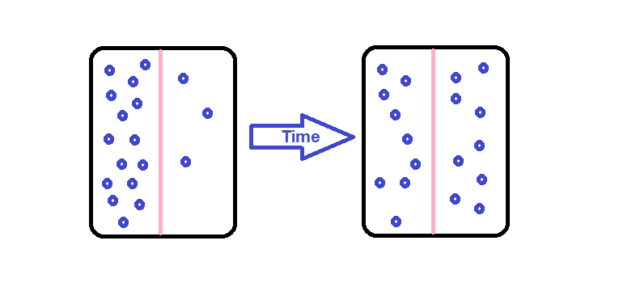
Physical Properties
Diffusion - Tritium gas is lighter than air and diffuses rapidly in air.
Permeability - Tritium gas permeates through most materials, that is, it travels through them by way of spaces or interstices in them. The rate depends upon the material and its thickness.
Notes:
Like regular hydrogen gas, Tritium gas is also lighter than air and diffuses rapidly. It also permeates through most materials at various rates.

Slide 35
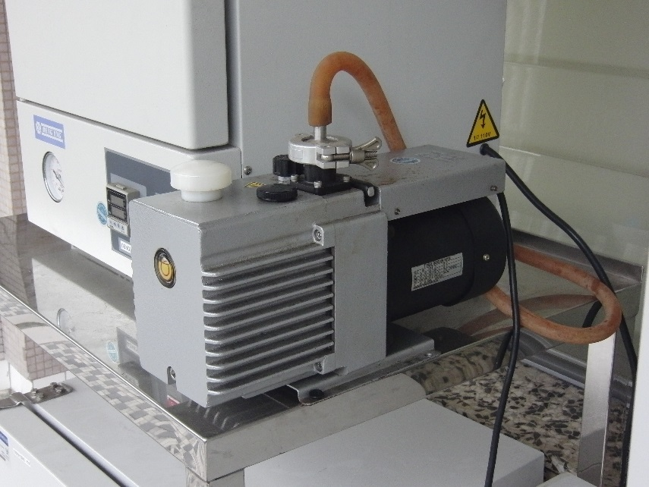
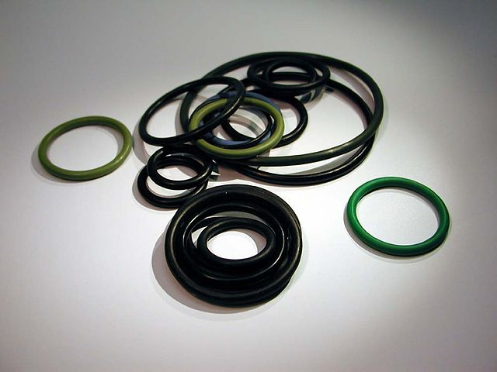

Notes:
Tritium's radioactive and chemical properties result in degradation of many useful polymeric materials, pump oils, plastics, and o-rings. This can cause loss of mechanical functions; sometimes within a short period of time.

Slide 36

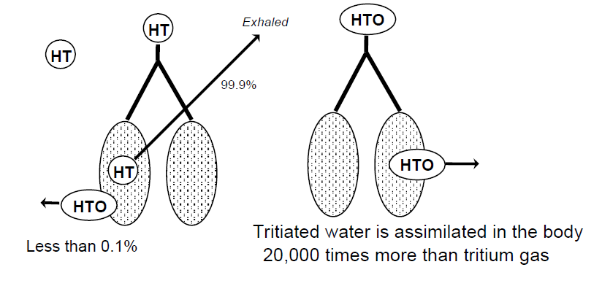
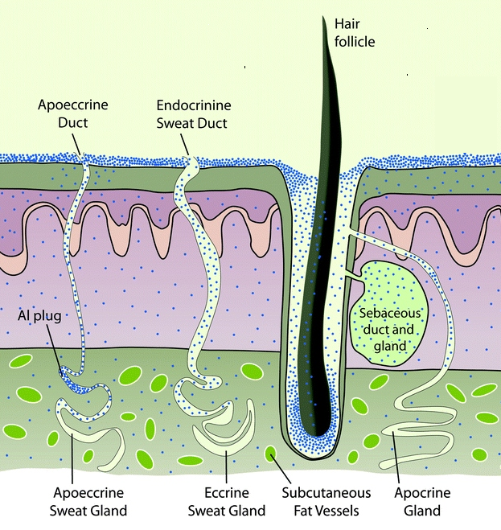
Tritium inhalation vs Absorption
Notes:
Tritium gas is only slightly incorporated into the body when inhaled because most of what is inhaled is subsequently exhaled. There are, however, chemical and physical processes to convert tritium gas to tritiated water, and nearly 100% of tritiated water vapor inhaled is incorporated into body fluids and tissues.
Only about 0.005% of tritium gas inhaled is converted to tritiated water prior to being exhaled; however, exposure to tritiated water is ~25,000 times more hazardous than exposure to elemental tritium gas.
In addition, exposure to tritium gas can lead to absorption through the skin. In certain situations, 1/3 of an individual’s uptake may be from absorption through the skin. Absorption through the skin of tritium gas is negligible, but Tritiated water can be absorbed relatively easily.
Generally, the assumption is that in an inhalation event, an additional 50% of the inhalation intake is absorbed through the skin.

Slide 37

Biological Half-Life
Notes:
The biological half-life can be shortened by increasing water elimination from the body. The best way to do so is by drinking lots of water under the guidance of a physician.

Slide 38
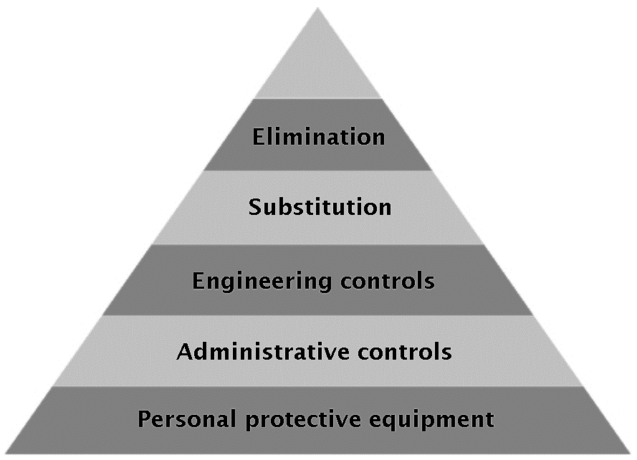
Controlling Tritium
Notes:
As we just learned, Tritium can be present in a variety of chemical forms. The one which gives the highest dose per unit intake is tritium particulate aerosols. These compounds will not be a factor at Jlab considering the nature of the gaseous tritium target. For us, the routes of exposure from the target involve the gaseous form of tritium, and possibly oxidized water, which we treat as the biggest hazard issue. As with any hazard, the preferred hierarchy for any controls is to start with engineered controls such as containment, and then implement administrative ones, including PPE.

Slide 39
Workplace Monitoring
Notes:
Air monitoring and surface contamination surveys are used to verify that loose contamination is not present. They provide an early indication of potential problems. Despite contamination control measures, tritium is easily spread.
All workplaces are surveyed for contamination levels on a regularly scheduled basis.
Airborne tritium monitoring is used for:
Prompt detection of airborne contamination for worker protection;
Determination of the status of processes; and
Identification of any leaks in primary or secondary containments or confinements

Slide 40
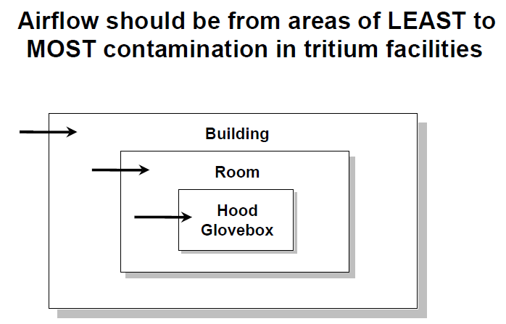
Engineered Controls
Local Exhaust Ventilation
The primary advantage of local exhaust ventilation techniques is the removal of airborne tritium, regardless of its release rate or chemical or physical form.
Dilution Ventilation
Dilution ventilation is the once through flow technique of exchanging outside air for inside air for comfort and the reduction of airborne sources.
Notes:
In addition, maintaining negative ventilation is essential for the safe operation of a tritium facility. Airflow should be from areas of LEAST to MOST contamination.

Slide 41
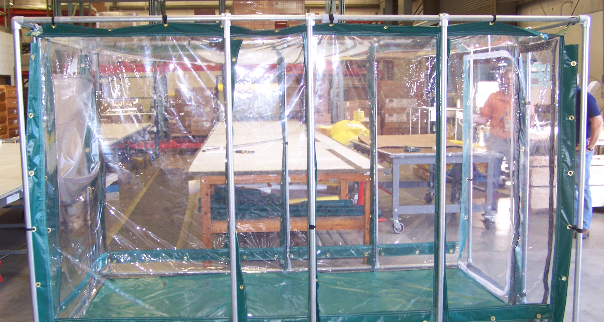
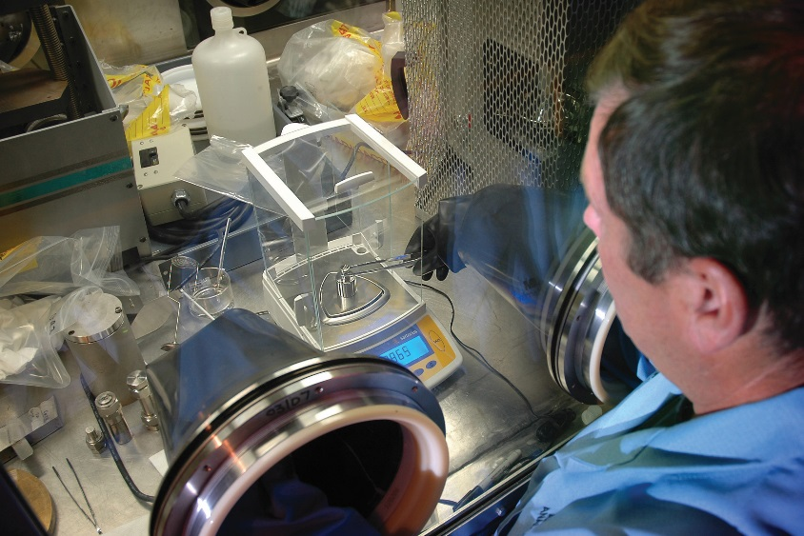
Engineered Controls
Notes:
Containment should consist of a series of physical barriers, thus minimizing exposure of workers.
Confinements such as glove boxes are almost always used when handling large quantities of tritium. Hoods may also be acceptable.

Slide 42


Administrative Controls
For tritium and tritium compounds, 10 CFR 835 Appendix D requires posting contamination areas based on removable contamination values of 10,000 dpm/100cm².
Tritium is like sand at the beach, it gets into everything…
Notes:
There are many administrative controls to reduce doses. The following are just a few that should always apply:
CANS restrictions etc
Limit the time you spend around sources
Use the proper procedures/RWPs
Obey signs and postings
This Training

