Slide 1
Tritium Target
9 December 2014

Slide 2
Overview
Design and major subsystems
Thermal/structural analysis
Cell filling
Vent and stack
T2 detection and monitoring
Outstanding issues

Slide 3
Subsystems
Target assembly
  Cells
  HX, positioner etc
Scattering chamber
  Pump systems
  Getter system
Stack
Beamline
Detectors/monitors

Slide 4
Basic Design
Target cell
  Sealed cell with no circulation
  25 cm of active length
  5 total gas cells
  No T2 gas handling by JLAB
Reuse the Hall A Cryotarget (without loops/cells)
  Positioning system and controls are the same
  Cryostat and scattering chamber used
Vent system
  Safely remove T2 from scattering chamber/hall
  Operated in (2) modes: operations/handling
Beamline
  Isolation windows and collimators
  FSD on raster system

Slide 5
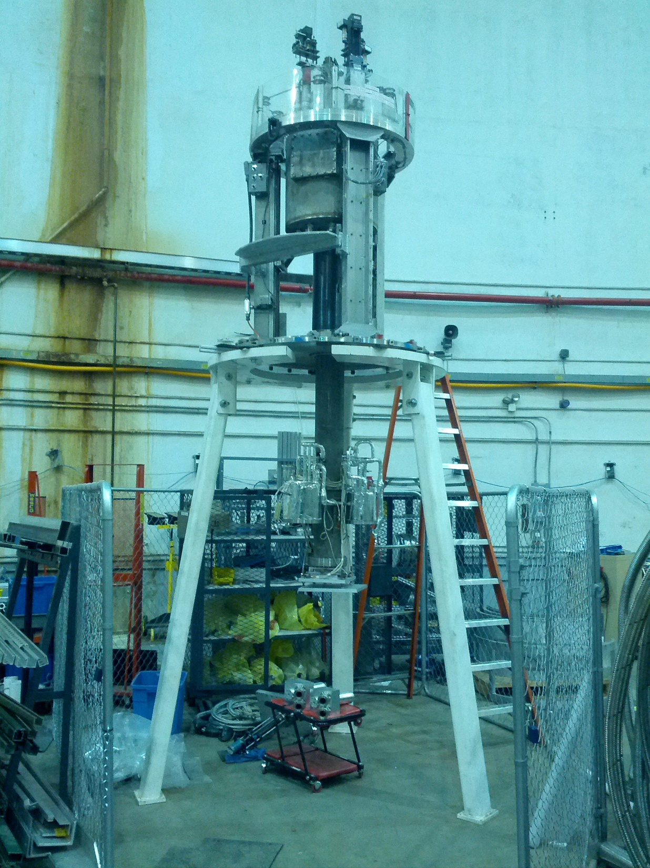
Current Hall A Target
Mount target stack where normal cryotarget cells go
Lift system remains the same
Mounts in current scattering chamber
Saves money
Controls nearly identical to cryotarget
Mount cells here

Slide 6
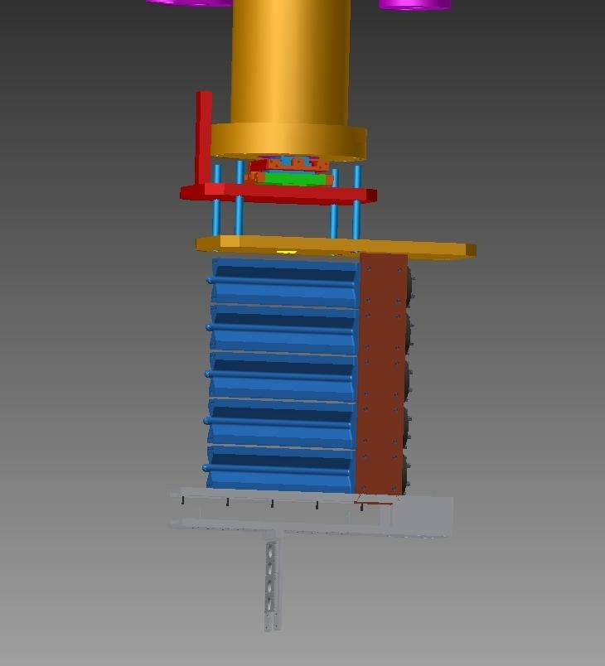
Adjuster
Cu Heat sink
Cells
Solid Targets

Slide 7
Target Cells
Target cell design is complete
  Prototypes have been machined
  Machine work is challenging but we now have consistent methods for fabrication
  Cell to be filled with 1099 Ci
Testing
  Cells have been tested and yield an acceptable level of safety for operations
  Filling requires a design pressure 5x higher than operation pressure
Adding covers with integrated supports
  These are still being machined and have not been tested
Operational limits
  200 psi room temperature fill pressure max
  1099 Ci max T2 amount
  20 µA current max

Slide 8
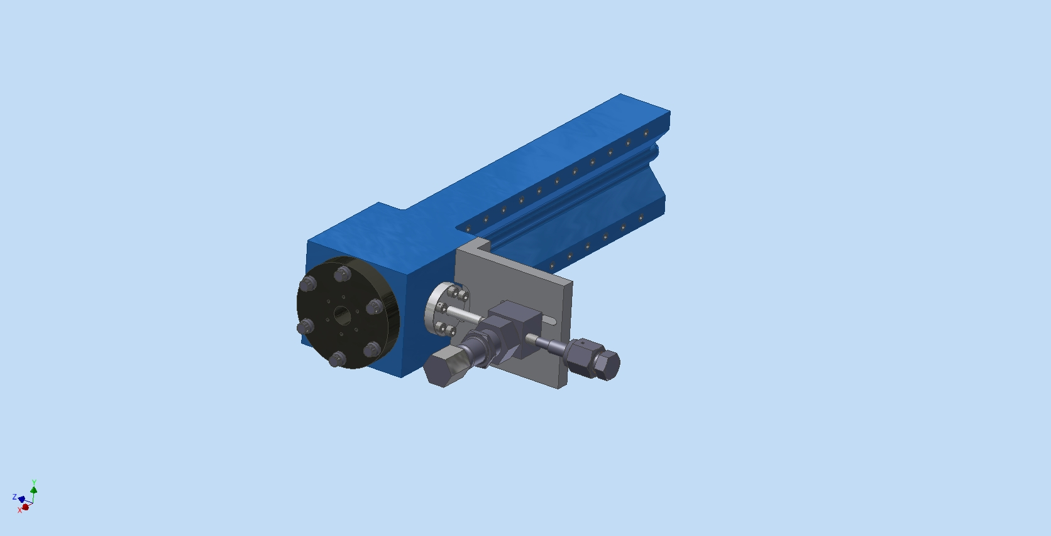
Cell – Operational Configuration

Slide 9
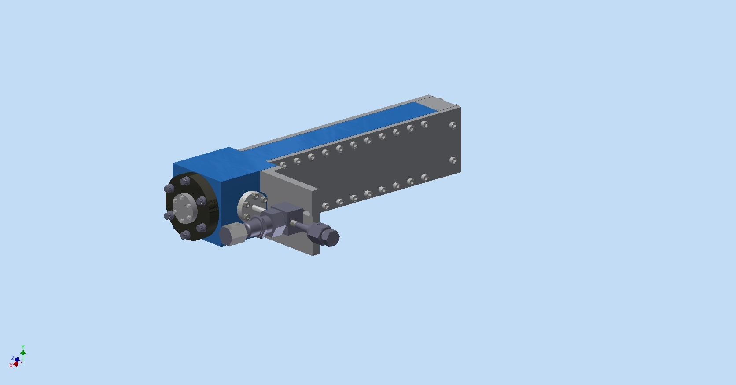
Cell – Shipping/filling Configuration

Slide 10
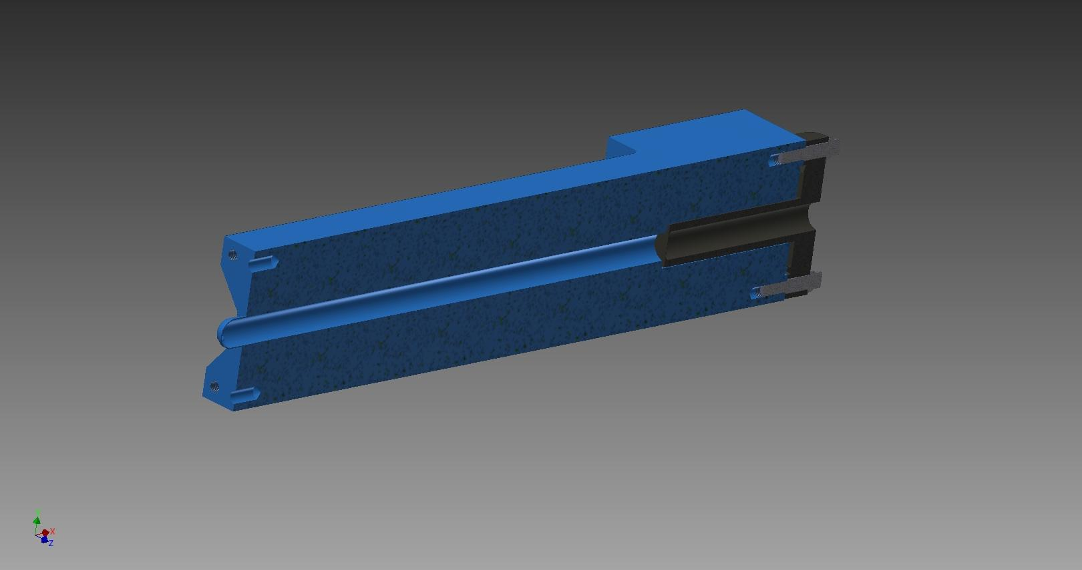
Section View of Cell
Entrance window

Slide 11
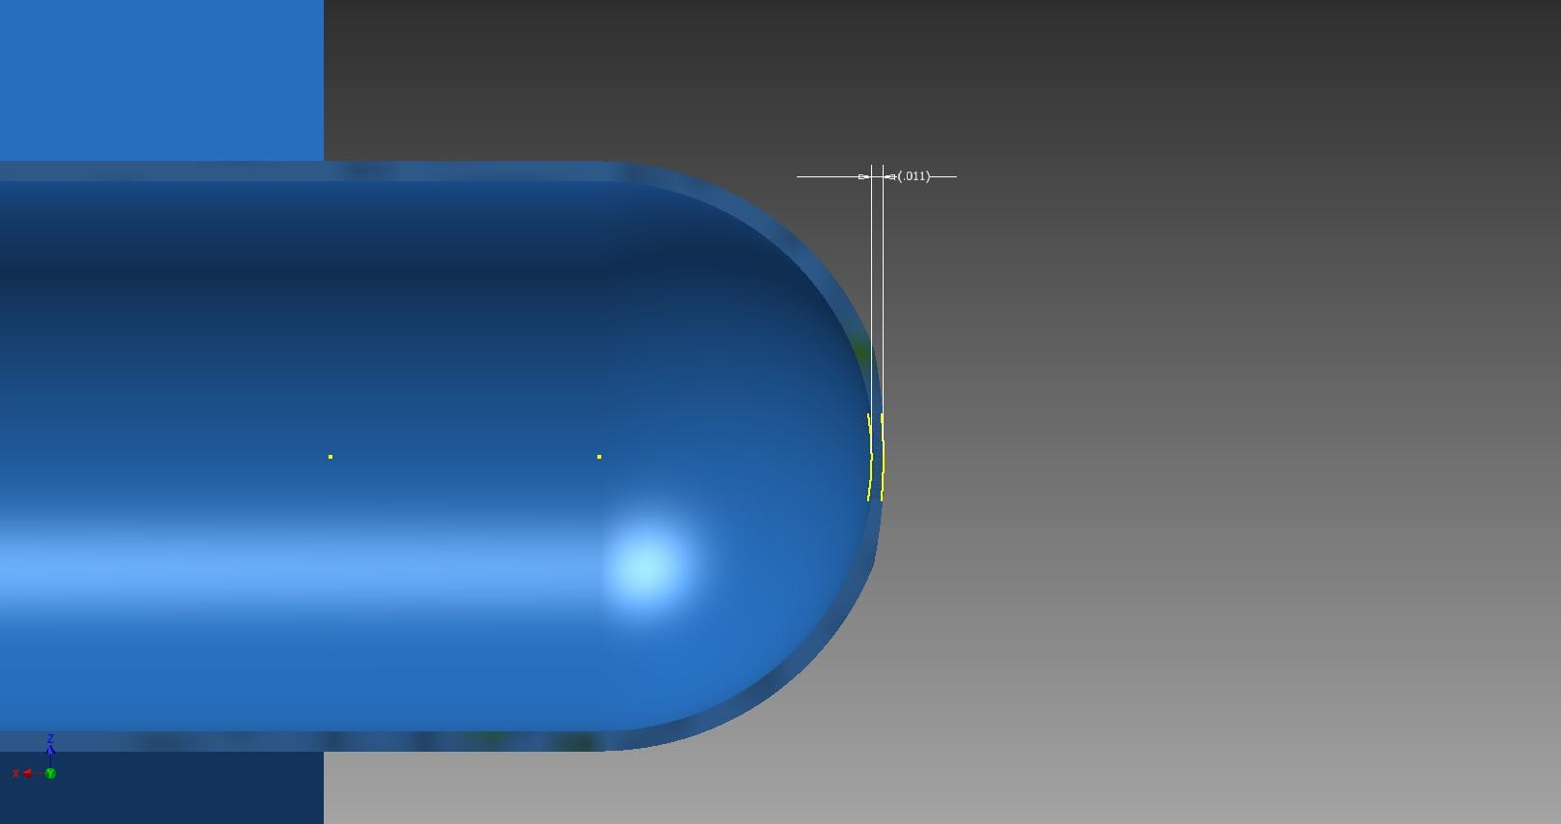
Thin Section
Thin section at tip
0.011 in
5 mm OD

Slide 12
Thermo-mechanical Design
Design must meet the following standards
  ASME B31.3 (using 304.7.2)
    Elastic plastic analysis ASME BPVC Section VIII D2 Part 5.2,3,4 using design basis from B31.3
    SRS Safety basis
    JLAB Pressure System
Criteria
  Meet experiment requirements
  Machinable
  Materials must be proven compatible with T2
  Max metal temperature at beam interaction below 150K
  Compatible with SRS filling station 1000 psi
Density of gas along beam direction will change with beam current

Slide 13
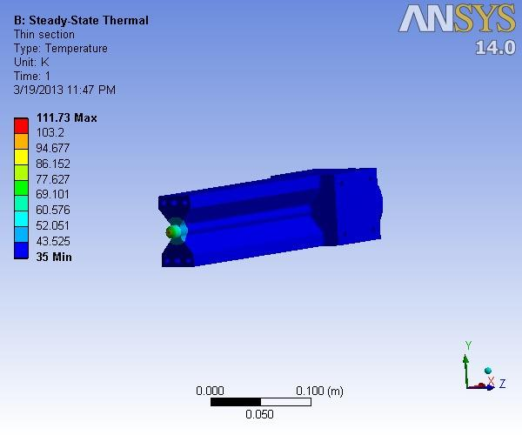
Thermal model for thinned cell 25 uA

Slide 14
Getter System
Activated if T2 leak is detected
Design is complete
All components have been purchased and received

Slide 15
Tritium Stack
Remove T2 from scattering chamber and hall during event
  Handle normal operations and installation/removal
Remove T2 from scattering chamber during normal operations
Stack height is 20m above grade at site boundary
  Modeled using Hot Spot etc. and is acceptable
Design is mostly complete
  Design and calculations must be approved by JLAB FML
Uses existing smoke removal access
  No additional penetrations to hall

Slide 16
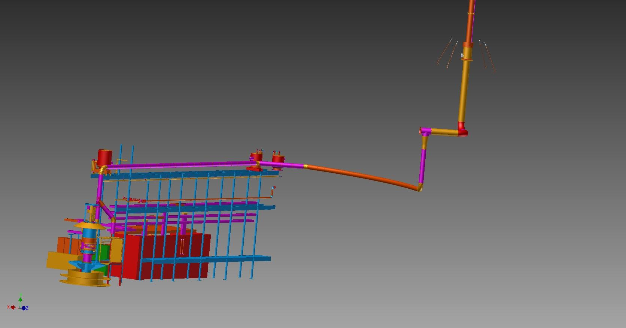
Vent and Stack (J. Miller)

Slide 17
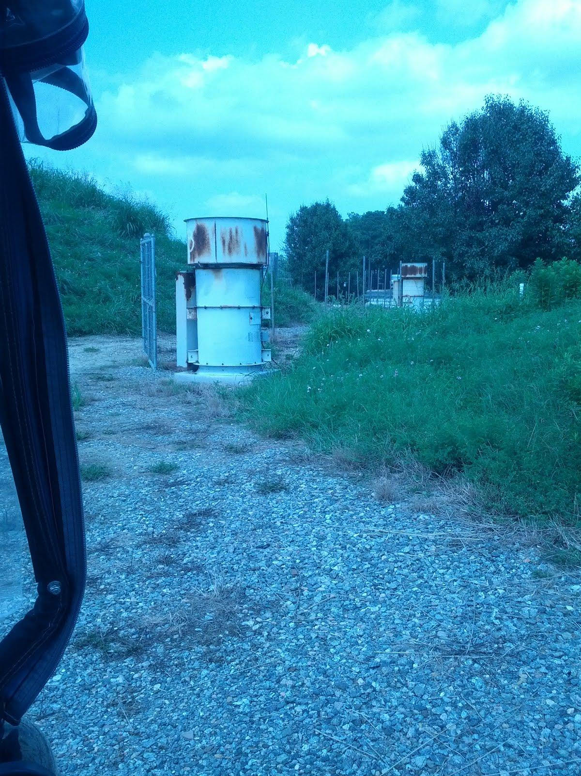

Slide 18
Beamline
Require FSD on Raster
Beamline isolation
  Design by accelerator personnel
  Collimator/Window
Collimator
  Prevent miss steer and cell damage
  Design by accelerator
Best place for extra components
  last girder before chamber
Isolation window at scattering chamber entrance
Hall A beamline liaison: Yves Roblin
  feels that these requests are reasonable
  Offered design help

Slide 19
NEPA
National Environmental Protection Act
  Applies to Federal Facilities
  Possible Tritium release is under purview of this law
Gina Dixon leading effort to meet requirements of NEPA
DOE Site office is working with us
DOE Oak Ridge for actual compliance officer
  Approval from DOE is required
A T2 release of 1099 Ci is reportable to public

Slide 20
Technical Reports for Other Issues
Preliminary design report
Tritium Gas Target Safety Algorithm for Jefferson Lab
Tritium Permeability of the Aluminum Target Cell
Beam-induced and Tritium-Assisted Embrittlement of the Target Cell at Jefferson Lab
Scattering Chamber Isolation for the Jefferson Lab Tritium Target
Hydrogen Getter System for the Jefferson Lab Tritium Target
Absorption Risks for a Tritium Gas Target at Jefferson Lab
Estimating the X-Ray Dose Rate from the MARATHON Tritium Target
Activation Analysis of a Tritium Target Cell for Jefferson Lab
Analysis of Tritium Target Release at Jefferson Lab
Tritium Inhalation Risks for a Tritium Gas Target at Jefferson Lab
Tritium Gas Target Hazard Analysis for Jefferson Lab
Tritium Cell Activation (FLUKA) Analysis
Tritium Target Cell Design

Slide 21
Progress in 2014
SRS and JLAB now working in collaboration
    Met with SRS T2 experts in May 2014 at JLAB
  Contracts for work to be performed by SRS have been released
    Cell filling and recovery
    Consulting on T2 detection/monitoring
    Consulting on safety reviews
    Material testing for T2 compatibility
  Meeting scheduled for next week
    Discuss details of shipping and T2 handling
    T2 safety program
Vent stack design is nearing completion

Slide 22
Progress cont.
NEPA compliance process is underway
Target design and prototyping is complete
Shipping issues are being addressed
DeCon Procedures are being addressed
Cell handling procedures are being addressed

Slide 23
Summary
The project is so far on budget
Progress has been made in key areas of the project
  Cell design
  Fill/recovery/shipping
  Detection/safety
  Stack design
Outstanding issues
  Shipping/receiving by JLAB
  NEPA compliance
  Stack system
  Beamline design and fabrication
Next review scheduled for March/April of 2015
Run scheduled for Oct of 2015

Slide 24
Temporary cell handling hut
Hut needs to be connected to the vent
Needs a seal on the chamber
  Maybe tape
enclosed when handling the cell
  install
  removal
negative air pressure so T2 will go out vent in case of accident
Maybe something like the pictures
  commercial?

Slide 25
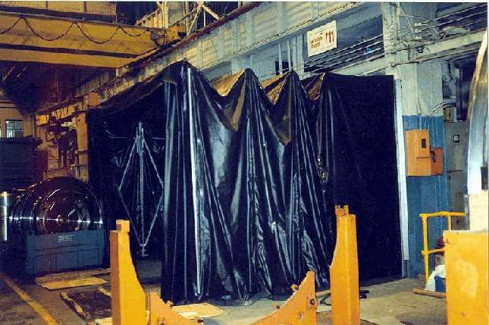

Slide 26
Alarms/Failure modes
Fan flow/power fail
T2 in stack
T2 in Hall triggers “scram” button/smoke removal system
T2 in scattering chamber
  high pressure
  low pressure
Vacuum failure
T2 cell failure
  Getter system to absorb catastrophic cell fail

Slide 27
Outstanding Issues
Stack design finalized
plan for handling tritium cell needs to be formalized
Requirements for beamline and scattering chamber must be formalized
Detection of T2 in the Hall must be formalized
  Baseline for T2 already in Hall
  Low pressure we have
Review
  Another safety review will be required

