Slide 1
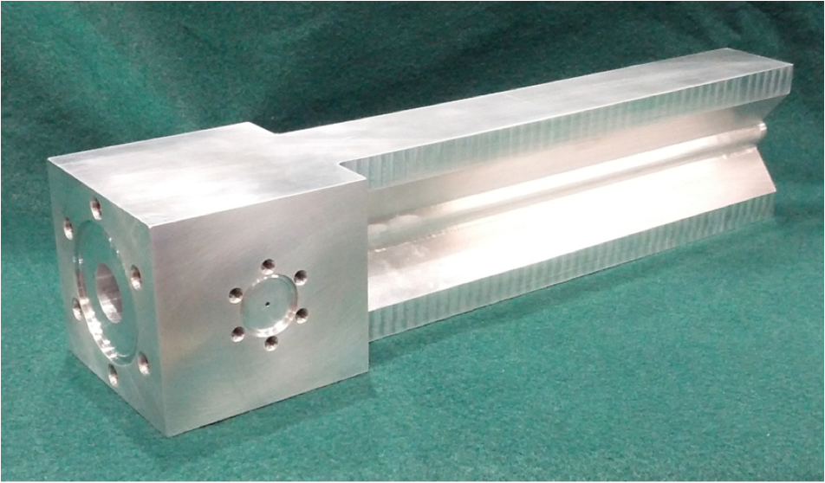


New Insights Into the EMC Effect
Summary of Jefferson Lab’s Tritium Target Physics Program
by Douglas W. Higinbotham
Douglas W. Higinbotham

Slide 2
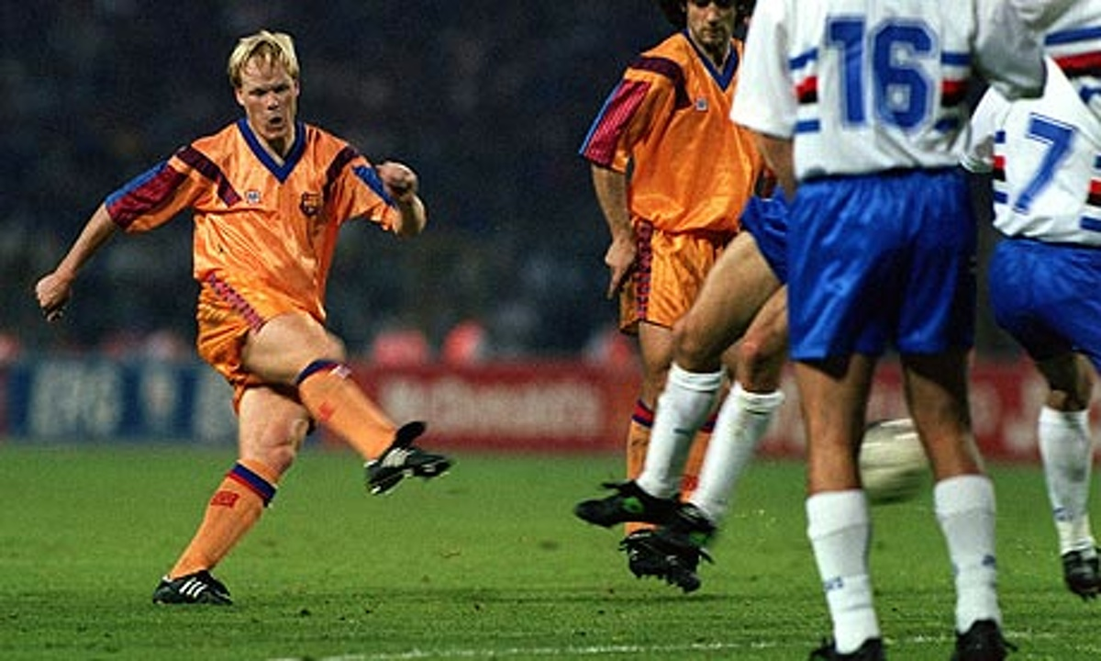
Elastic Scattering (nucleons stay together)

Slide 3
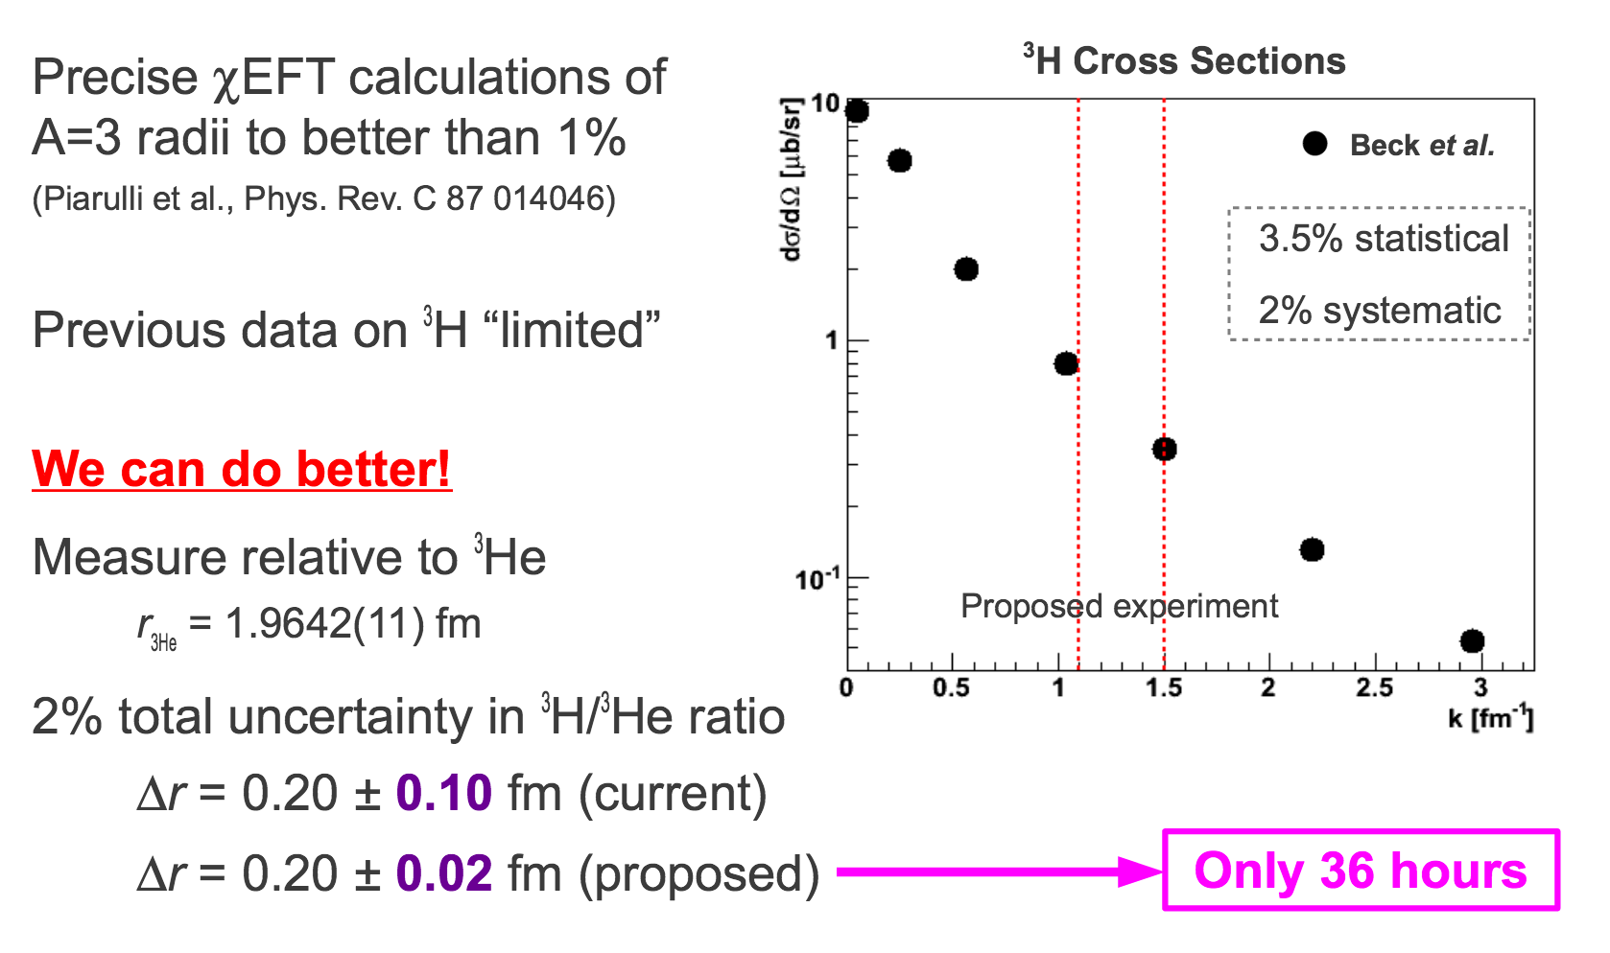
Elastic 3He/3H Ratio
Spokespersons: J. Arrington, L. Myers, D. Higinbotham

Slide 4
Quasi-Elastic Scattering (knock nucleon out)

Slide 5
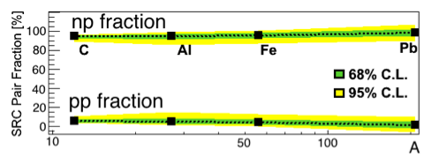
Quasi-Elastic Knock-out Measurement
Ratio of 3He(e,e’p) to 3H(e,e’p) is two . . . isn’t it?!
But when looking at heavy nuclei we have seen np pair dominance at high momentum.
O. Hen et al., Science 346 (2014) 614 .

Slide 6
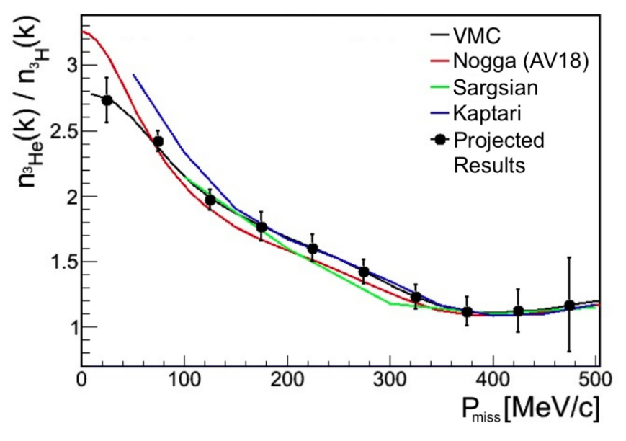
Proton and Neutron Momentum Distributions in A=3 Asymmetric Nuclei (JLab-12-13-012)
Spokespersons: O. Hen, L. Weinstein, S. Gilad, W. Boeglin
First direct test
of calculated
distributions.

Slide 7
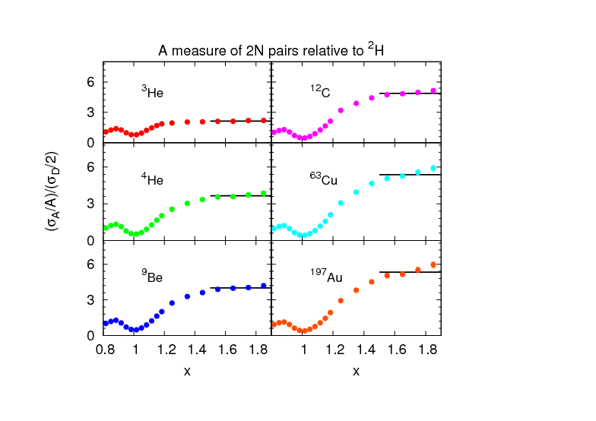
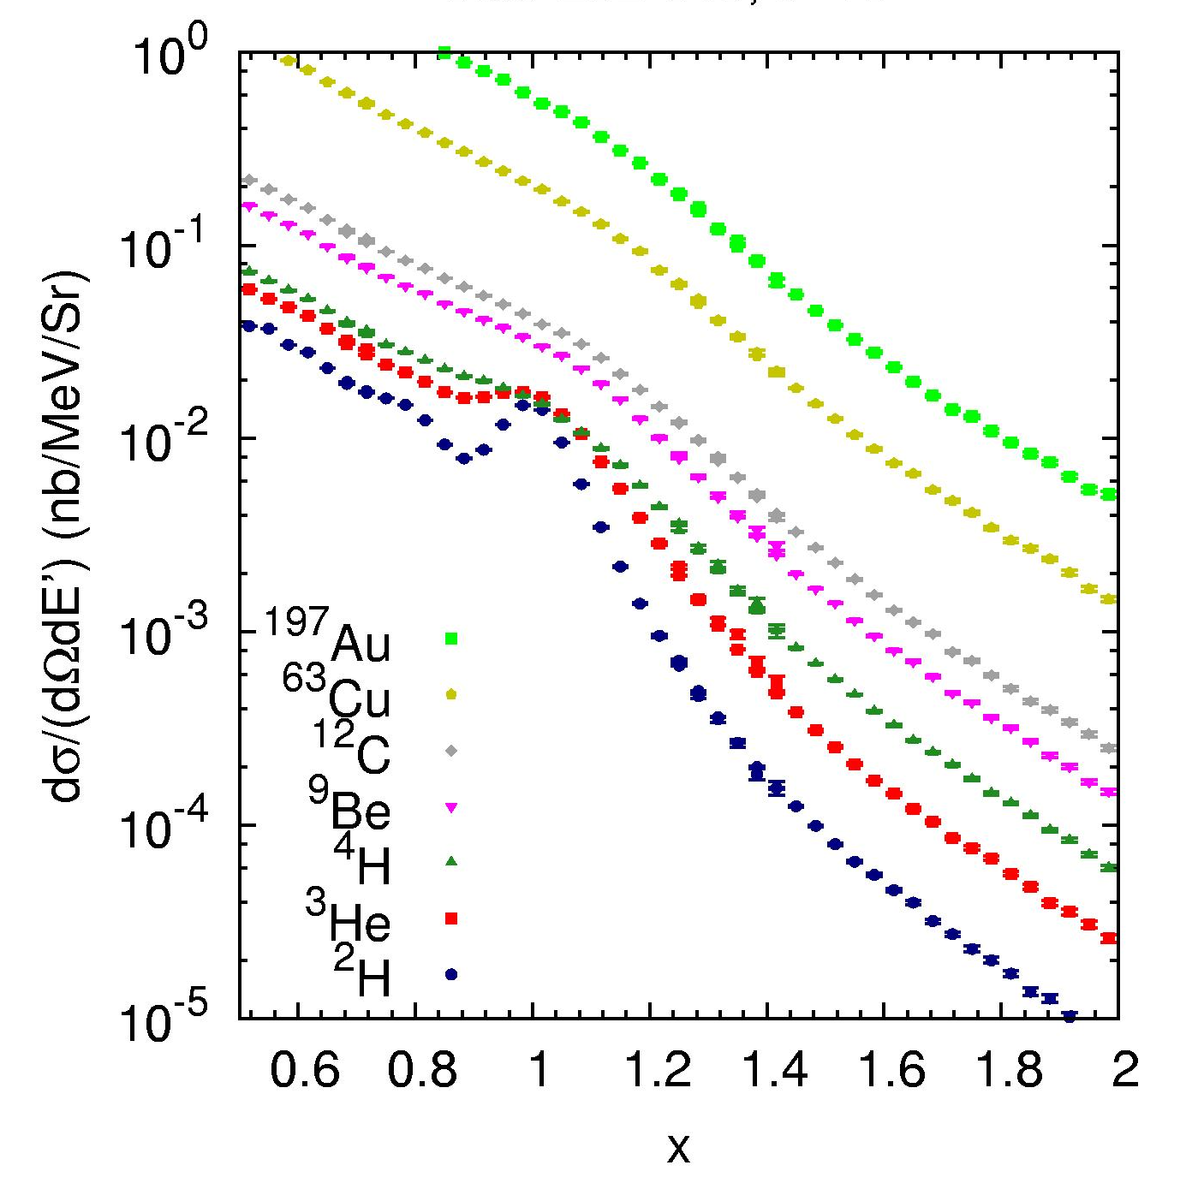
Evidence for short-range correlations
QE
Ratio of cross sections shows a (Q²-independent) plateau above x ≈ 1.5, as expected in SRC picture
High momentum tails should yield constant ratio if SRC-dominated
N. Fomin, et al., PRL 108 (2012) 092052

Slide 8
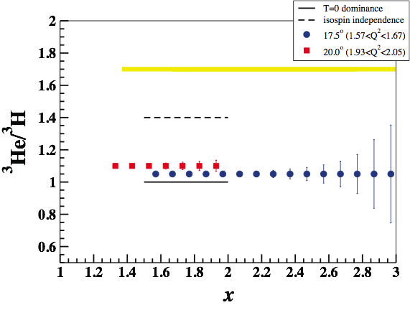
Isospin structure of 2N-SRC (JLab E12-11-112)
Spokespersons: P. Solvignon, J. Arrington, D. Day, D. Higinbotham
Simple estimates for 2N-SRC
Isospin independent
Full n-p dominance (no T=1)

Slide 9
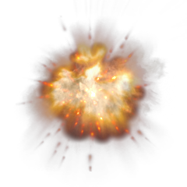
Deep Inelastic Scattering (probing partons)

Slide 10
F₂^{n}/F₂^{p}, d/u ratios and A₁ for x→1
 | F₂^{n}/F₂^{p} | d/u | A₁^{n} | A₁^{p}
SU(6) | 2/3 | 1/2 | 0 | 5/9
Diquark/Feynman | 1/4 | 0 | 1 | 1
Quark Model/Isgur | 1/4 | 0 | 1 | 1
Perturbative QCD | 3/7 | 1/5 | 1 | 1
Dyson-Schwinger | 0.49 | 0.28 | 0.17 | 0.59
C. D. Roberts, RJH, S. Schmidt, PLB 727 (2014) 249

Slide 11
Current neutron to proton structure function ratio
C. D. Roberts, RJH, S. Schmidt, PLB 727(2013) 249;
RJH, C. D. Roberts, RMP 82 (2010) 2991

Slide 12

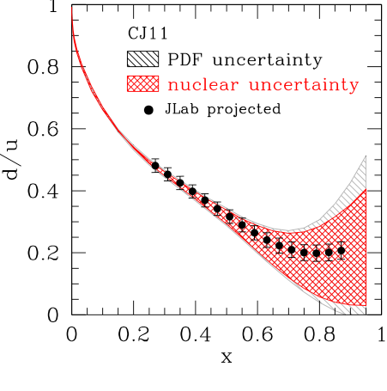
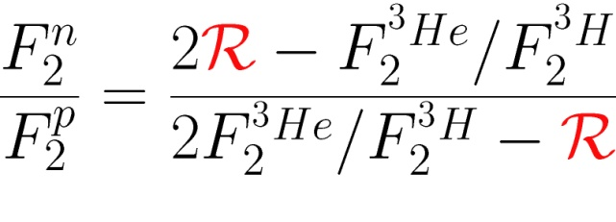
Measurement of the deep inelastic ratios from A=3 nuclei
(JLab-E12-06-118)
Spokespersons: G. Petatos, R. Holt, R. Ransome, J. Gomez
Mirror symmetry of A=3 nuclei
  Extract F₂^{n}/F₂^{p} from ratio of measured ³He/³H structure functions
R = Ratio of “EMC ratios” for ³He and ³H
Relies only on difference in nuclear effects
calculated to within 1.5%

Slide 13
Summary
Four Experiments Have Been Proposed To Use 3H & 3He
Elastic Scattering 3He/3H Ratios (one experiment)
  Make use of our 3He knowledge to better constrain the radius of 3H
  Test of modern two- and three-nucleon potentials
Quasi-Elastic Knock-Out (E12-11-112)
  Distribution of the momentum of the proton(s) in 3H vs. 3He via (e,e’p)
  Extreme Kinematics with (e,e’) to probe short-range correlations
Deep Inelastic Scattering (one experiment)
  Ratios of Deep Inelasltic Structure Functions
  Learning about the Quark Properties of Proton & Neutron
Taken together, the elastic and quasi-elastic results will help constrain the nuclear corrections for the deep inelastic experiment and thus ensure the best possible extraction of the quark u/d ratios.

Slide 14
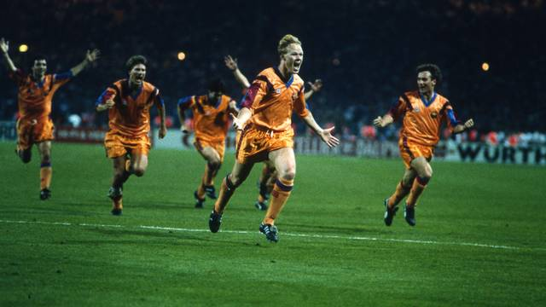
Ronald Koeman After His 1992 Game Winning Score European Cup Final
And yes, we have that kind of excitement for this family of physics experiments!

