Slide 1
Hall A Tritium Target Part 1
Dave Meekins
September 15, 2015

Slide 2
Overview
Part 1: Target Design
Introduction
Target system design
Cell Design
Vacuum System
Exhaust system
Beamline Alterations
Control system
Expected Performance
Part 2: Safety systems and failure modes
Tritium detection and monitoring
Tritium containment and release
Response to the prior review

Slide 3
Design Philosophy
Safety
Minimize impact from any release scenario
Design shall be simple
Minimize amount of tritium
Do not “handle” tritium
Three layers of containment
Operations
Installation/removal
Transport
Perform well enough to run physics

Slide 4
CEBAF at JLAB
Continuous e Beam Accelerator
Pair of SRF LINACs with arcs
Delivers beam to 4 Halls
$$E_{max}=\sim 11 GeV \\ I_{max}>\sim 150µA$$
Experiment located in Hall A
$$E_{max}=\sim 11 GeV \\ I_{max}=20−25 µA$$

Slide 5
Hall A
Dimensions:
Diameter = 175 ft
Height = ~ 60 ft
Volume $40000 m^{2}$
Multiple access ports
include Truck Ramp
Target
HRS: High Res Spectrometers

Slide 6
Arial View of Hall A

Slide 7
Target Chamber at Pivot
Target/Chamber
e Beam
Pivot (Hall center)

Slide 8
Target System
Repurposed Qweak H2 Target
Alter existing Cryostat
Alter internal piping
Add two valves
H2 Loop piping and cell removed
Alter cryo piping and instruments
15 K He from ESR
Motion in “X” and “Y” directions
Control system is similar to Hall A cryotarget
“New Construction” pressure system

Slide 9
Target Ladder
Heat sink cooled by ESR to 40K
Stabilized by heater

Slide 10
Target Cell
Main Body and Entrance Window
ASTM B209 AL 7075-T651
Valve assy:
SST 316 and 304
1090 Ci of T2 (0.1 g)
~200 psi at 295K
25 cm long
ID of 12.7mm
Volume = 34 cc
Aluminum CF seals

Slide 11
Cell Cross Section
0.018” wall

Slide 12
Features
Cell is “sealed”
No recirculation
JLAB does not “handle” the T2 gas
Make Al-SST transition with CF flanges
Many years of successful experience at JLAB
Work well with H2, He, etc. at low temp < 1K
Modular design
Can be installed as the final component of the system

Slide 13
Materials
Main Body and Entrance
Aluminum 7075-T651 ASTM B209
Extensive use of this allow for 15 years
Strong, ductile, hard, non weldable
Seals are Al 1100
Valve assembly
SST 304/304L Fitting
Swagelok valve all metal bellows sealed (316L)
Butt welded ER316L (100% VT in process and RT)

Slide 14
Materials-2
Al 7075 is unlisted
Design basis
$S­_{ut}=72 ksi$
$S_{y}=61 ksi$
$S_{a}=\min\left(\frac{1}{3}S_{ut},\frac{2}{3}S_{y}\right)=24 ksi$ for tension
= 80% of 24 ksi for shear
= 150% OF 24 ksi bending
Other wetted materials are SST
304/304L
316/316L
ER316L Filler for welds

Slide 15
Materials 3
Tritium and Hydrogen Compatibility
Extensive experience with H2
Beam induced corrosion not expected above 180K (Flower et. al.)
Beam assisted embrittlement
$T_{2}→T+T$ Increases fugacity
Atomic tritium recombines rapidly
Modeled room fugacity ~3100 psi
Below threshold for H2 embrittlement
Many orders of magnitude below He-3 swelling threshold (Louthan)
Test SRNL/SRTE using precracked coupons exposed to 2500 psi T2 underway
Test follows ASTM 1820 G168 (Precracked Stress Corrosion Testing)
Samples exposed for 4, 8, 12 months
M. Morgan, A. Duncan (SRNL)
Tritium is expected to permeate through the cell and seals
~0.5 Ci /year very conservative
Calculations given in TGT-CALC-103-010

Slide 16
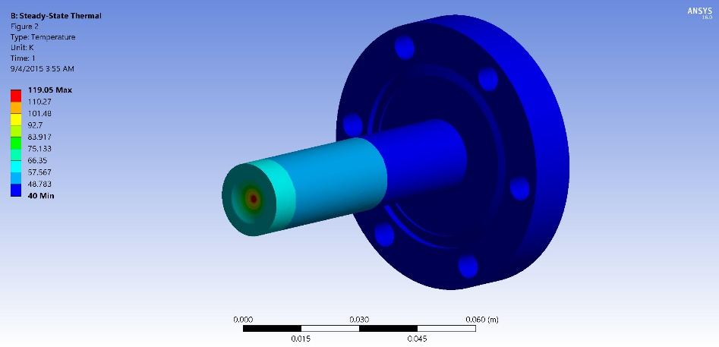
Beam Heating
$I_{beam}=20μA$ Max beam current $A_{raster}=2x2mm^{2}$ min raster
3W in Entrance
3.3 W in Exit
$T_{max}=125K$ on exit $T_{max}=120K$ on entrance

Slide 17
Load Conditions
At room temp
P = 200 psi
At 40K Beam Off
Pressure = ~30 psi
Max Temperature = 40K
Beam On
Pressure = 36 psi (avg temp of T2 = 53K)
Max Temperature = ~125K
Cyclic loads
Cool down/warm up operating cycles = 20
17800 beam trips (cycles between Beam On and Off)
150 days, 33% duty factor, 15 trips/hr

Slide 18
Analysis
Applicable Code ASME B31.3 (2014)
Section 304.7.2 because of odd geometry
Used both Hand Calculations and FEA
Analysis conforming to ASME BPVC VIII D2 with load factors from B31.3 (i.e. 3 instead of 2.4 on P)
Used cyclic screening analysis from D2
Depth of loads do not require a fatigue analysis
175 psi pressure cycle (it is closer to 10 psi)
Considers temperature cycle from 40K to 125K
Design pressure 675 psi
No source of overpressure
Calculations: TGT-CALC-103-002, 7, 8, 12, 13, 14, 15, 17.

Slide 19
Thermo-Mechanical Model-1
Full temperature load
Beam on at 20 µA 2x2 mm raster
Pressure load 400 psi internal (more than 10x)
Cooling using 40K heat sink
Using an elastic-plastic model
Model solves and stresses are still below allowable even for over conservative case
Local plastic failure requirements met
Analysis not required because of screening analysis

Slide 20
Thermo-Mechanical Model-2

Slide 21
Thermo-Mechanical Model-3

Slide 22
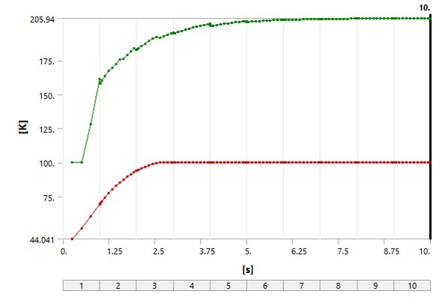
Raster Off
Initial conditions:
Beam on full raster
20 microA
Exit window is worst case
Beam spot no raster
0.150 mm diameter
Square profile
For high energy beam this spot size is very conservative
Tune shall be checked at each energy
Long term operations at these conditions are forbidden
Typical FSD for raster failure
< 10 ms
Red curve is upstream section temperature

Slide 23
Raster Off Time Dependence

Slide 24
Mech Therm Model of Raster Off

Slide 25
Commissioning Plan For Target Thickness
Ensure beam profile is correct and BCM/Optics calibrated
Step current 0-20 µA
Collect data T2, H2, D2, He-3
Collect data on Carbon
Develop function for $L_{target}=L_{target}\left(I\right)$

Slide 26
Filling/Shipping
Fill at Savannah River Tritium Enterprises SRTE
Different load conditions
Design pressure of 1000 psi required
Changing this (e.g. new relief device) not realistic
Thin sections need to be protected during shipping
Solution:
Shipping covers that act as stays

Slide 27
Filling Covers

Slide 28
Valve Covers

Slide 29
Covers on Test Cell

Slide 30
FEA Covers On

Slide 31
Filling Cover Analysis
Stayed sections
D2 Part 5 Elastic-Plastic
Pressure load = 3000 psi
Covers bonded on bolted surfaces
Reaction loads Used to determine bolt loads.
Model solved (local failure checked)
A design pressure of 1000 psi may be assigned in compliance with B31.3

Slide 32
Summary of Test Results
Multiple hydrotests on components and assemblies
Entrance: Minimum burst above 2900 psi
Main body: Minimum burst above 3400 psi (0.014” section)
Assembly with covers
Leaked above 4000 psi (seal was damaged)
Failed above 5500 psi

Slide 33
Entrance window hydro

Slide 34
Exit window hydro
0.014” section
Failed above 3400 psi

Slide 35
Vacuum System
Scattering chamber (standard Hall A)
1900 liters
Thin sections for recoil particles (0.014” aluminum)
Two 800 l/s turbos backed by Leybold D60 Mech pump
NEG Pump with backing turbo and mech pumps
Vacuum exhaust part of Tritium Exhaust System and is continuously purged with N2 (1 cfm)
Isolated from upstream beamline vacuum (Be window)
Remote RGA may help diagnose leaks. Serve as leak detector.

Slide 37
Exhaust System
24” OD 20m tall Stack
12000 cfm blower multispeed
2” pump exhaust
Run parallel to stack
Stack must also serve as smoke removal
Provides controlled release of secondary and tertiary containment
Pump exhaust is continuous
Blower activated:
Manual
Interlocks

Slide 38
Stack
STACK LOCATION

Slide 39
Exhaust Routing

Slide 40
Exhaust Routing in Hall A

Slide 41
General Requirements
Collect T2 from any release inside Hall A and exhaust in a controlled fashion
Exhaust point shall be 20 m above grade at site boundary
Must serve as part of the smoke removal system (at least 1/3 of the 36000 cfm required)
Must have at least two modes to service hut and to exhaust from Hall A. (500 and 12000 cfm)
Must stack vacuum pump exhaust
Scattering chamber, dump line, getter system
Makeup air comes from new louvered door at bottom of ramp.
Prevents overpressure no ramp door.
Test required for louver system
Air from outside from smoke removal system on ramp with damper removed

Slide 42
Transfer Hut
Installed on purpose built platform
Only in place for installation/removal
Clear plastic hung from frame
“Standard” design
Directly attached to chamber adapter
Air is drawn from Hall into hut then chamber and out exhaust system
Air flow across opening 150 fpm ensure T2 containment
Design and fabrication is underway at SRTE
Test installation and air flow in June 2016
Makeup air 500 cfm supplied existing penetrations

Slide 43
Exhaust Summary
Exhausts secondary (vacuum chamber) and tertiary (Hall A) containment to 20 m stack
Two speed
~500 cfm
12000 cfm
Exhaust system activated
Vacuum switch failure (interlock)
Truck ramp lower door (interlock)
Manual activation (Hall and Counting House) (manual)
Low speed activated manually for hut (manual)
T2 monitor (interlock)

Slide 44
Beamline Alterations
No plans to substantially alter beamline
Upstream beamline shall be isolated by a Be window
0.008” thick 1” ID.
Water cooled (3W beam power 25 µA)
Reentrant (Resides in chamber)
Window is 15 cm from entrance to cell
Densimet collimator 10 cm long installed in tube upstream of window. (W 90% , Cu 8%, Ni 2%)
Maintenance is possible if required.
12 mm thick collimator attached to cells
Collimators should prevent steering error from affecting cell
Last steering element is 8 m upstream and 2” radius beam pipe.

Slide 45
Be Isolation Window
0.008” Be window
Cooled by self contained water chiller to 10C
Integrated collimator Densimet

Slide 46
Be Window Heating
30 µA
2x2 mm raster
Steady state
Chiller set to 10C

Slide 47
Control System
Use EPICS (distributed I/O)
Temperature/motion/valve control
User Interface (UI) through EDM
FSD on high temperature
Uses interlocks from redundant 718s
UI has integrated alarm handler
EPICS data logger runs continuously
Communications failures Alarm as well

Slide 48
EPICS Controls
Monitor various temperature and vacuum levels associated with the target system;
Maintain a constant target temperature using an automatic, feedback-driven heater;
Monitor and control the flow of cryogenic helium coolant to the target;
Control both the vertical and horizontal motion of the target cells;
Provide a set of alarms to alert users to off-normal target conditions;
Provide a set of strip charts to track the target performance;
Archive target performance data;
EPICS is not used for safety or integrity

Slide 49
Cryo-System
ESR 15K He for cooling
Must return ~25K
PID Control heater
40K
Return mixed with bypass.
Bypass valve on PID
Alarms/interlocks on TS-5 (a/b) and TS-6 (a/b)

Slide 50
Operations
Dedicated target operator while target is cold
100% Shift coverage
Target to be moved to “home” position during any access
Operator responds to alarms
Calls experts if needed
Emergencies are handled by MCC or guards when machine is down.

Slide 51
Performance Characteristics
½ life for tritium is ~12 .5 years
5% conversion to He-3 over 1 year run
Conversion starts immediately
Fill as close to run date as possible
Fill purity 99.8% T2 +/- 0.02%
Quantity of T2 from $PV=nRTZ$
Where $Z=1.01$ is the compressibility of tritium at the fill pressure of 200 psia.
The uncertainties on the quantities above are:
$$δP=0.2 psia \\ δV= 0.5 cm^{3} \\ δT=0.025K$$
This gives an uncertainty of
$δn=1.5\%$

Slide 52
Density Change in Beam

Slide 53
Density Model
T2 properties derived from H2
Viscosity, Thermal Conductivity, Heat Capacity, etc.
Assumed a Real Gas model
Buoyancy, convection on wall included
Assumed fixed 2.8W from 20 µA and 2x2 mm raster (11 mW/mm linear power density)
Did not correct heat load for density
Averaged 20% reduction in density along beam path

