Slide 1
Hall A Tritium Target Safety
Dave Meekins
December 7, 2015

Slide 2
Overview
Tritium containment
Procedures
Tritium Release
Tritium Detection/Monitoring
Interlocks
Training
Reviews

Slide 3
Tritium Containment/Confinement
Three levels of containment for all conditions
Except short period while chamber is being closed
Shipping
1) Cell with covers installed
2) Intermediate vessel
3) Shipping container
Installation/removal
1) Cell with covers
2) Transfer Hut
3) Hall A
General Operations
1) Cell (no covers)
2) Scattering chamber
3) Hall A

Slide 4
Procedures to be Developed
FSD checkout procedure
Modified to include FSDs from tritium target which are additional to the standard cryogenic target FSDs.
Hall checklist
Hut installation and removal
Tritium target installation and removal
Tritium cell inspection and assembly procedure.
Procedure is complete and shall be filed in Document Control
Component cleaning procedure
This procedure is complete and shall be filed in Document Control.
T2 Exhaust testing procedure
This procedure is required to ensure that the exhaust system is functioning correctly in all modes. It shall be filed in Document Control.
Access to Hall A
Restricted access to Hall A shall be limited to personnel with specific tritium training.
Controlled access to Hall shall be similar to the current Controlled Access protocols.
These procedures shall be filed as part of the Experimental Physics Documents (e.g. COO, ESAD, RSAD, etc.).
Target operating procedures.
T2 alarm checkout procedures

Slide 5
Truck Ramp Protocols
At the start of this procedure all ramp doors shall be closed.
For loads entering the Hall:
The top ramp door shall be opened by personnel located on the inside of the ramp.
The vehicle carrying this load shall enter the truck ramp.
The upper door shall be closed and the load carried to the bottom of the ramp.
The lower door shall be opened.
This activates the high speed exhaust system which should provide sufficient noise to ensure a strong desire to reclose the lower door.
If the lower door can be closed (i.e. the truck is not stuck half way) then it shall.
The load shall be brought into the Hall and unloaded promptly and safely.
Once the load is removed the truck shall exit the Hall Promptly and the lower door closed.
The truck may proceed to the top of the ramp where the upper door is opened temporarily to allow its passage.
For loads leaving the Hall the truck shall enter as above. Upon reaching the interior of the Hall it shall be loaded promptly and exit the Hall forthwith using the same procedure as above.

Slide 6
Controlled Access Procedure Outline
Ensure Target is in Home Position
Make entry as required with the additional training requirements for tritium.
Ensure that ARM/RadCon has handheld TAM (tritium air monitor). The maintenance of these monitors is the purview of the RadCon group.
All large truck ramp doors shall remain closed during this access
Access is allowed to the Hall if an acceptable level of tritium is detected. Note that it is assumed that there will be some airborne tritium from normal beam operations present in the Hall.
If unacceptable levels of tritium are found then exit immediately and inform RadCon. Activate the exhaust system and await further instructions. All personnel on the access team shall be enrolled in the bio-assay program.
The following activities are not allowed during a controlled access:
Forklift operations
Lift operations within 20 ft of the pivot
Crane operations
Heavy work (other than diagnostic and tuning) within 20 ft of the pivot.
Should the TAM alarm at any point during the access, all personnel shall promptly leave the Hall and activate the exhaust system. Notify RadCon for further requirements.
Should power fail, all personnel shall promptly leave the Hall.

Slide 7
Restricted Access Procedure Outline
The access to the Hall shall be controlled through the CANS system.
Truck ramp protocols as described above shall be followed.
To change to or from controlled access the scattering chamber window covers shall be removed/installed.
All work within 20 ft of the pivot shall be “covered” by a handheld TAM monitor.
At least one TAM shall be available at the entrance of the Hall for access.
When personnel are in Hall this TAM must remain located near the pivot. It shall be maintained by the RadCon group.
Should power fail, all personnel shall promptly leave the Hall.
Heavy work (crane operations, operations requiring hand tool work directly on the chamber, fork lift operations etc.) performed within 20 ft of the chamber shall be governed by an RWP and specific procedures. Specialized training/briefings required.

Slide 8
Tritium Release Models
3 scenarios have been developed
1) Cell/chamber failure with worker fully exposed in Hall (outside Hall A exposures in Case 2 and 3)
2) Cell failure with no containment and release to Hall A truck ramp
3) Contained release with Tritium stacked
4) Release while handling cell
All scenarios consider 1090 Ci
Immediate 10% conversion of T2 to HTO in atmosphere is assumed (Pan and Rigdon)
Dose from HTO is 10000 times HT
Immediate 5% conversion to HTO is assumed for in Hall release
Case (3) is discussed here. Other cases can be found on wiki

Slide 9
Case 3: Controlled Through Stack
Assumes that the release is 1100 Ci of HT with 10% HTO
Can come from chamber or Hall but does go through the exhaust.
Release is at 20m above grade at boundary
Modeled using HotSpot
Stability Class F
Wind directed at closest boundary
1 day exposure time
Max expected dose 1 mrem.

Slide 10
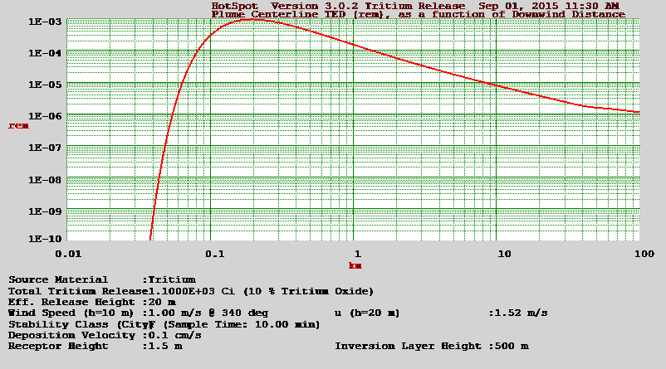
TED Plume Centerline with Distance

Slide 11
Stack Release (20m)

Slide 12
Tritium Release Summary
Extensive measures have been taken to prevent releases.
Case 3) Presents a controlled release
Operational containment levels 2 and 3 only catch T2 for a controlled release.
All cases lower than required limits.
5 rem to workers
10 mrem at 300m
Case 2 release will not happen if Hall A ramp protocols are in place and followed.

Slide 13
Tritium Monitors
Flow through ion chamber design
Cannot be located in Hall with beam on
Fixed monitor must be located remotely
Draw air from Hall A
Response time ~10 s
Portable/hand held monitors required for all accesses.
Program for calibration and maintenance
Training for operation of handheld monitors steps to take if alarms

Slide 14
Machine Fast Shut Down (FSD)
Multiple FSDs
Target control system (motion/temperature)
Beamline protection (ION chambers
Tritium monitoring system
Steering and raster
Typical time for FSD to act is less than 10 ms
Target system has only “new” FSDs

Slide 16
Exhaust System Activation

Slide 17
Vacuum Fault System
FSD issued on all faults
Getter operates on cold cathode failure
Pressure switch closes main turbo valves
Flow switch on water cooling for Be window
All faults trip alarms on UI
Pressure events trip heater power.

Slide 18
Training
Collaborators on shift
Specialized T2 training
Target operators need specific training
Collaborators entering the Hall
T2 access training
Possibly Rad Worker II
Specific task training may be required (e.g. work on Big Bite)

Slide 19
Reviews
Initial review of target concept - 6/3/2010
Review of target – 9/15/2015
ERR – 3/16/2016
Checkout review – 9/1/2016
PS calculations complete 2/1/2016
Peer review/Tech review

Slide 20
Failure Modes
The following Failure Modes are identified
Containment failure levels 1,2,3
Power Failure
Beam Steering Failure
Raster Failure
Tritium Monitor Failure
Control System Failure
ESR Failure
Exhaust System Failure
Fire

Slide 21
Effects of Power Failure
Beam FSD is issued
Control system in Counting House allows
closure of JT valves open warm return
Disables heater power
Exhaust system is on backup power
Tritium monitors on backup power
At least on ramp door is closed.
Target slowly warms up
Vacuum in chamber slowly rises
NEG pump needs to be regenerated on startup
Power to vacuum gauges trip
3 layers of containment intact

Slide 22
Fire
Cells in chamber have less than 10 stp liters of flammable gas
Flammable material near chamber is very limited.
Flammable material in Hall is limited
Chamber isolates (for some time) cells from possible flames
Emergency crews can access Hall
Smoke removal system shall be activated as required.
May loose containment for long term exposure to fire

Slide 23
Effects from ESR Failure
Minimal effects
Target system alarms
Redundant Temp monitors trip FSD
Operator will receive instructions from ESR on call
Operator calls experts
Target slowly warms up
System shall be placed in standby until ESR recovery process is complete
Vacuum may rise and activate NEG pump

Slide 24
Effects of Beam Steering Failure
Small errors only effect data
Larger errors:
Beam will impact the collimator(s)
Trip ION chambers and issue FSD
Collimators may heat unacceptably if steering is not corrected (beam removed)

Slide 25
Effects of Raster Failure
Short term effects on cell are acceptable
Raster comparator card trip FSD on any parameter no inside acceptable limits
Current (over/under)
Size (over/under)
Algorithm programs card for
Size
Energy etc.

Slide 26
Control System Failure
Computer control (EPICS) may fail from power failure or network failure or IOC failure
Hardware interlocks are redundant and independent of control system
Operator shall reboot and call experts if needed
Target may “freeze”
Backup “manual” controls in counting house operator can prevent freezing by closing JT.
Beam FSD is tripped for temperatures out of limits

Slide 27
Exhaust system failure
Exhaust system is integral part of containment layer 3.
Slow ground level release is possible should Layer 1 and 2 fail simultaneously.
Shall be on backup power
System to be tested once/month
Mechanical failure
Spare motor replacement may take days.
Smoke removal system can clear Hall but stack height is low (exit velocity will be high)

Slide 28
Tritium Monitor Failure
Both handheld and fixed monitoring in place during access.
Power to fixed monitor is on backup
Failure will activate the exhaust system
The failure shall be addressed and corrected as needed.
Beam operations shall be suspended while monitor is repaired.

Slide 29
Containment Level 1 Failure
Cell failure while in chamber
Vacuum monitor trips
NEG pump is activated (some T2 captured)
Recovery by SRS may be possible.
FSD is tripped
T2 is piped to stack for a period before large valves close
Stacked release
Cell failure while installing/removing
Exhaust system is on, T2 is carried through the hut into the chamber and out stack.
Stacked release
Cell failure while shipping
Intermediate vessel will capture T2. Space is sampled prior to opening for cell removal.
Vessels are sent to SRS for recovery
Minimal T2 release.

Slide 30
Containment Level 2 Failure
Chamber failure:
Vacuum alarms will trip FSD and activate exhaust system for a full failure
Low pressure failure will trip FSD and activate alarms on UI.
Fails for a brief time during installation/removal prior to closing chamber
Tritium Not released
Hut failure (while installing/removing cell)
Can happen when exhaust fails or breach
Breach can be quickly repaired
Cell shall be returned to intermediate vessel promptly
Tritium Not released
Intermediate vessel failure (while shipping)
Tritium Not released
Extremely unlikely

Slide 31
Containment Level 3 Failure
Hall A containment failure
Exhaust system failure
Backup power and motor
Procedural failure with truck ramp doors
CANS systems and procedures/training
Can be rapidly detected and repaired
Tritium Not released
Fire Conditions:
Tritium may be released with long term fire exposure
Shipping container failure
Should be obvious from physical condition
T2 should not be released

Slide 32
Multiple Containment Level Failure
Vessel, chamber and Hall A fail
Worst case ground level release
1.5 rem for workers 0.4 mrem at 300m
Vessel and chamber fail
Foreign object puncture
Release to Hall worker exposure 1.2 rem
Controlled release of T2 through stack
24 hr to remove T2 in Hall to levels below 1% of DAC (TGT-CALC-103-004)

Slide 33
Acknowledgements
JLAB: K. Welch, V. Vylet, Y. Roblin
SRS/SRNL: T.McGee, J. Novajosky, H. Nigg, M Morgan, A Duncan, G. Howard…
NIST: R. Ricker
Sandia: B. Somerday

Slide 34
Pre-Installation Plan
Test/assemble per procedure
Perform all examinations and tests required by B31.3 on cryosystem
Install and test exhaust system (all speeds)
Interlock testing not required until Aug 2016.
Install backup power/test
Install access platform
Test install Hut (June 2016)
Check flow train and remove hut
Install target on pivot as usual and align
Check/test T2 alarm system
Check/test vacuum fault system
Test all interlocks on exhaust system
Check/test FSD system
Install Hut and check flow (low speed)
Install cell

Slide 35
Installation Procedure Outline
All pre-installation tasks shall be performed including the placement of tools and materials in preparation for cell installation or removal. A special tritium target tool box shall be maintained for this specific purpose and no other, by the JLAB Target Group.
The exhaust system shall be activated at low speed and flow shall be verified.
The shipping container holding the cell shall be placed in the handling hut.
The Hall shall be placed in controlled access. This includes a full sweep and key access.
Entrance to the Hall shall only be allowed for personnel directly involved in the installation/removal process.
These activities shall be 100% covered by RadCon operating under a specific RWP.
Upon completion of the cell installation, the team closing the chamber may enter the hall to perform this specific task while being supported by RadCon and the Target Group.
The JLAB DA shall be responsible for the cell installation removal.
Once the chamber is sealed and vacuum is established the Hall may be returned to restricted access.

Slide 36
Installation Procedure
Assemble and attach the large access platform to the beam left of the scattering chamber.
Attach the hut adapter to the chamber.
Ensure that the motion system set for “tritium in” position and deenergize system.
Assemble the handling hut and attach to the adapter.
Connect the scattering chamber large access port located above the beam left thin window to the tritium exhaust system.
Activate the tritium exhaust system into the flow such that the air velocity at the face of the hut adapter is at least 140 fpm.
Ensure that Hall A is placed in controlled access.
At this point only essential personnel shall be allowed in the hall.
Move the tritium cell and it shipping containers to the inside of the handling hut.
Remove the intermediate vessel from the Type A shipping container.
Remove the Type A shipping container from the handling hut.
Sample the space inside the intermediate vessel to ensure tritium has not been released from the primary containment, the tritium cell.
If the sample tritium level is acceptable continue. Otherwise, return the intermediate vessel Type A shipping container and return to SRTE.
Install the tritium cell in the scattering chamber by following the next steps.
Remove the valve in covers and screws from the beam left main body shipping cover.
Remove the entrance window plug.
Install the small cell mounted collimator.
Install alignment pins in the cell.
Attach a cell to the copper heat sink in the appropriate location and secure with bolts tightened to 140 in-lbf.
Remove the beam left shipping cover and the cover on the exit of the main body.
Once a cell is installed inside the scattering chamber the hut and adapter may be removed from the side of the chamber.
The ventilation system shall be kept on until the window cover rollup system is attached.
Initiate the vacuum system ensure that pump down progressing appropriately.
The Hall may now be taken into restricted access.

Slide 37
Case 1: Maximum Expected Dose to Worker in Hall
Primary (cell) and Secondary (chamber) containment breached 1100 Ci release to Hall
Exhaust system does not function
Tritium alarm/leak detected workers leave in ten minutes
5% conversion to HTO
T2 is assumed to expand to chamber (1900 L)
Worker exposed to this concentration for full 10 min.
Calculation details given in TGT-CALC-103-004
Maximum expected dose to worker is 1.2 rem

Slide 38
Case 2: Uncontrolled Release Ground Level (Truck Ramp Exit)
Assumes that the release is 1100 Ci of HT with 10% HTO
Release is at ground level
Modeled using HotSpot
Stability Class F
Wind directed at closest boundary
1 day exposure time
Max expected dose at top of ramp 1.5 rem
Max expected dose at 300m 4.8 mrem

Slide 39
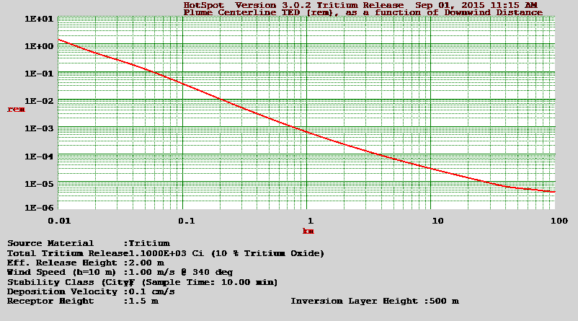
TED plume centerline with distance

Slide 40
Ground level release at ramp

Slide 41
Case 4) Cell handling release
Hut is installed on chamber adapter
Exhaust is continuously on low for all handling operations
150 fpm across all openings prevents T2 loss
T2 drawn from workers through chamber up stack
Exposure less than Case 1 and Case 3 applies.

Slide 42
Assembly and Testing at JLAB
Each component shall be cleaned and inspected for defects and dimensional tolerance
The cell shall be assembled (no covers) documented on assembly/test form
Leak testing (per Code) at 550 psi He reverse mode.
Close valve and check leak thru in reverse mode.
Install covers and test to 1100 psi
Meets Code requirements
110% design pressure
Assemble with valve covers insert into intermediate vessel (IV)
Load IV into shipping container

Slide 43
Filling/Shipping
Filling to occur at SRTE in glove box with covers installed
Decon and package per SRTE requirements
Process can take 2-3 weeks.
Ensure heat strapping in place
Ship to JLAB

Slide 44
Intermediate Vessel
SAMPLE PORTS
10 inch Pipe
Cell hangs from top flange
Filled with foam
Sample ports for testing internal space
Provides secondary containment while shipping.
Not DOT certified
CELL
CF FLANGE

Slide 45
Shipping Container
Alloy Product Corp.
55 Gal DOT/UN vessel
24 in ID
Flanged top
Can this be made a Type A container?
Containment Level 3
Working with DOE SRS ORNL for other solutions

