Slide 1
$$K_{L}p→K^{+}n$$
Mikhail Bashkanov

Slide 2
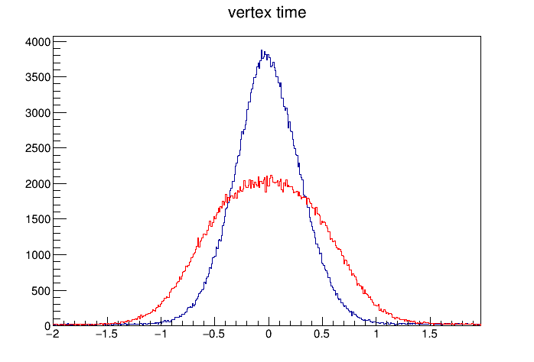
$K_{L}$time resolution
Vertex time
Beryllium target
$Δt$ [ns]

Slide 3
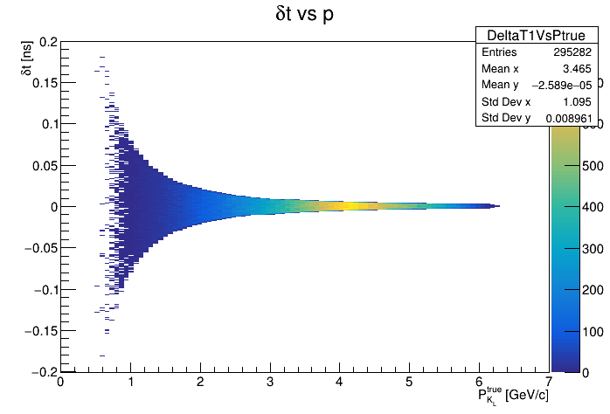
$K_{L}$time resolution due to position in Be

Slide 4
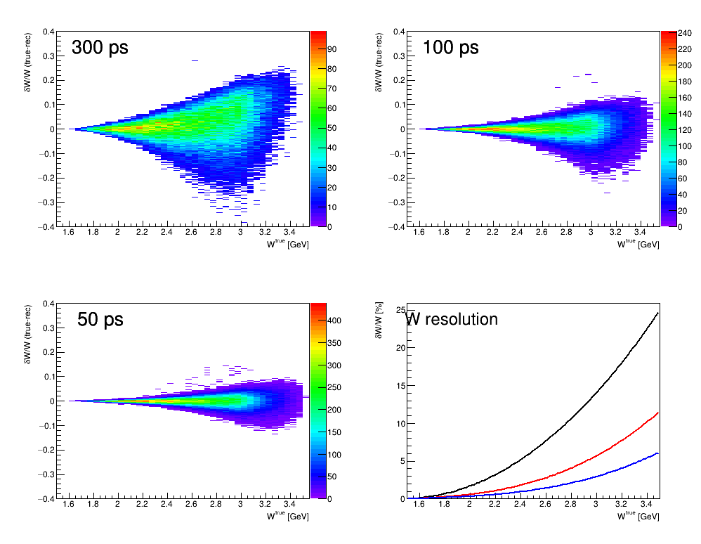
$K_{L}$time resolution

Slide 5
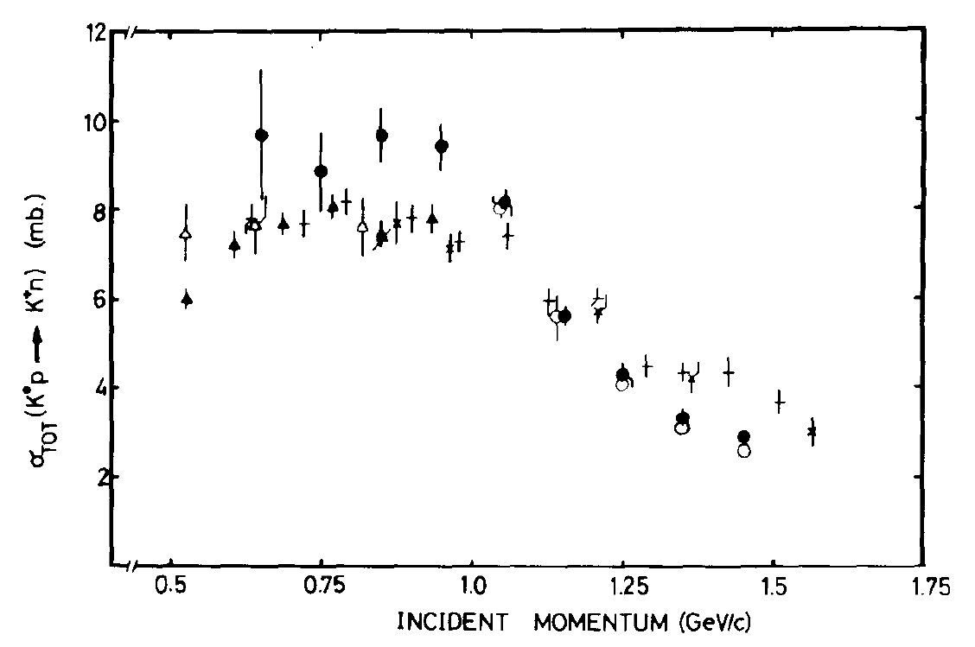
$K_{L}p→K^{+}n$ countrate estimates

Slide 6
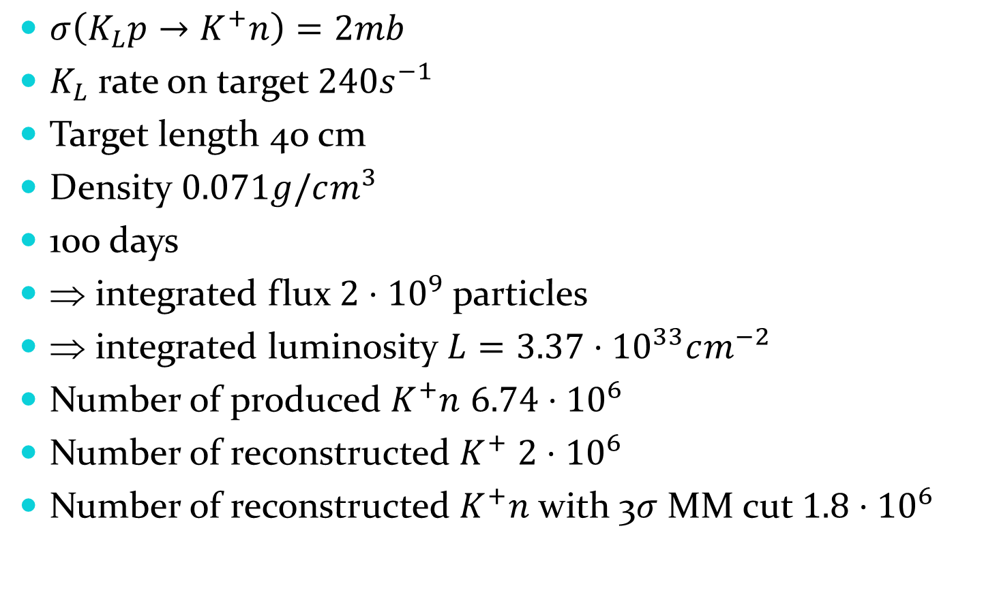
$K_{L}p→K^{+}n$ countrate estimates
$σ\left(K_{L}p→K^{+}n\right)=2mb$
$K_{L}$ rate on target $240s^{−1}$
Target length 40 cm
Density $0.071g/cm^{3}$
100 days
⇒ integrated flux $2⋅{10}^{9}$ particles
⇒ integrated luminosity $L=3.37⋅{10}^{33}cm^{−2}$
Number of produced $K^{+}n$ $6.74⋅{10}^{6}$
Number of reconstructed $K^{+}$ $2⋅{10}^{6}$
Number of reconstructed $K^{+}n$ with 3$σ$ MM cut $1.8⋅{10}^{6}$

Slide 7
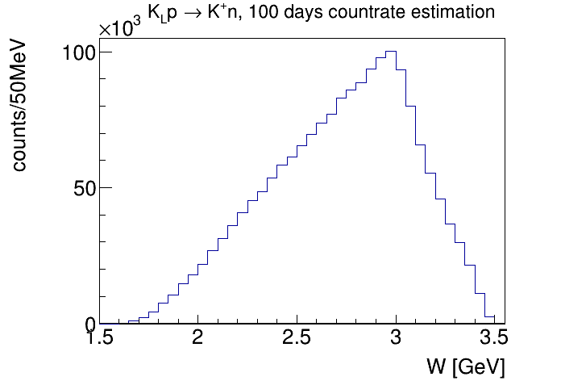
$K_{L}p→K^{+}n$ countrate estimates

Slide 8
$K_{s}$angle

Slide 9
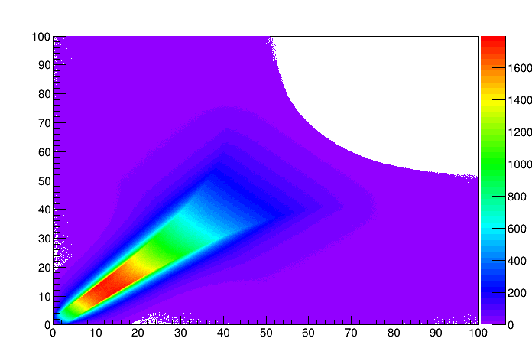
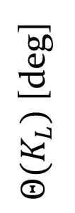
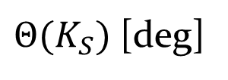
$K_{s}$angle
${Θ(K}_{L})$ [deg]
$$γp→φ+p$$
$$φ→K_{L}K_{S}$$
${Θ(K}_{S})$ [deg]

Slide 10
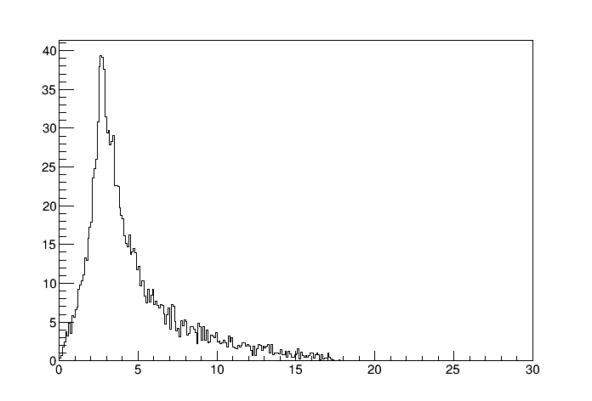
$K_{s}$angle
Phase Space, K_L in the hydrogen target
${Θ(K}_{S})$ [deg]

Slide 11
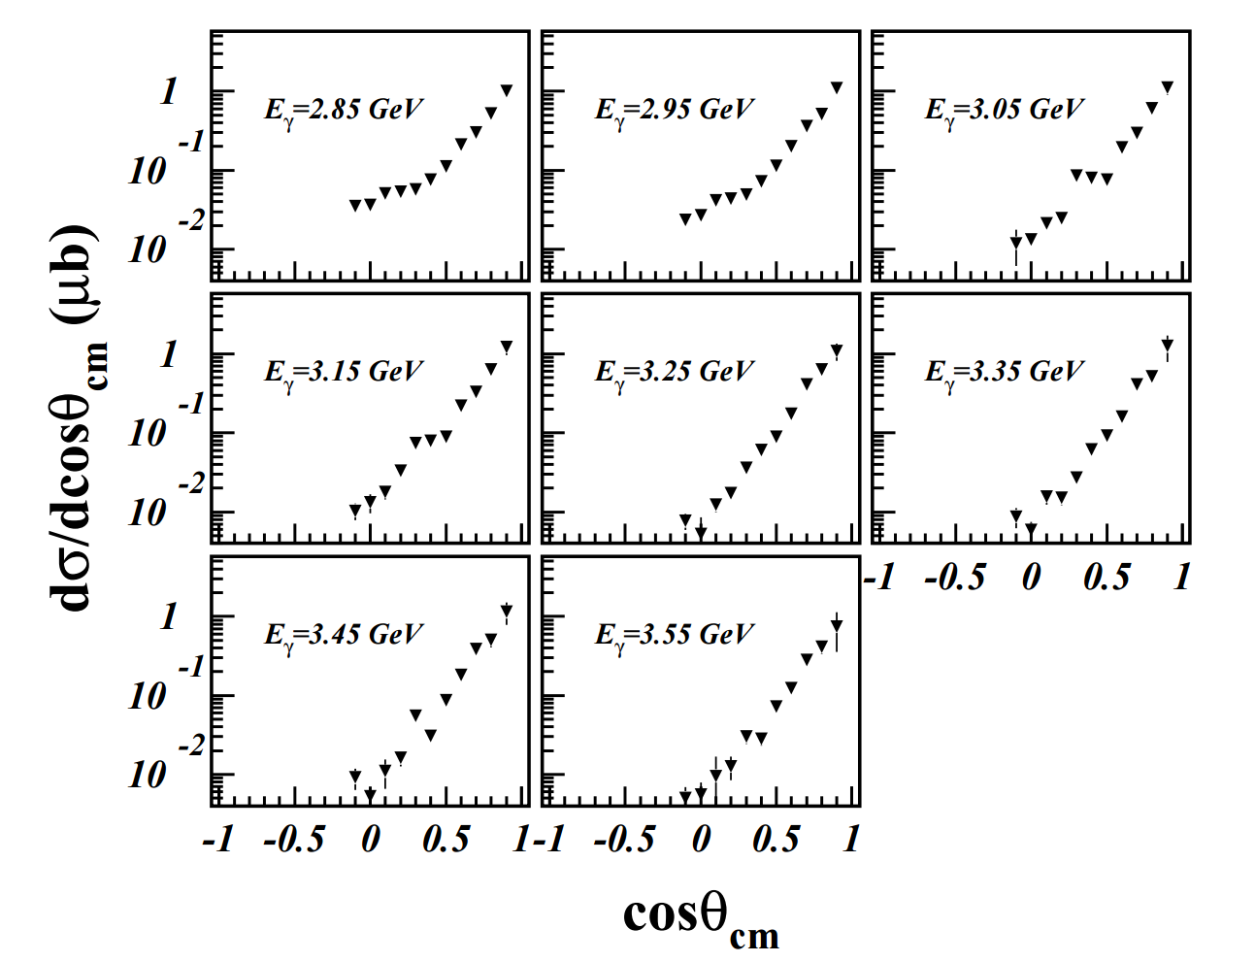
$φ$angle to $K_{s}$angle

Slide 12
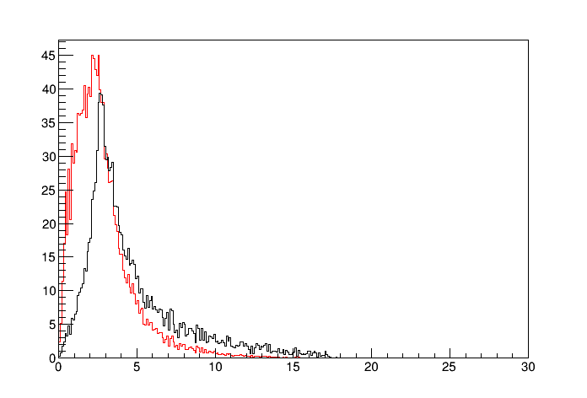
$K_{s}$angle
Phase Space, K_L in the hydrogen target
+ phi Xsection + phi decay angle
${Θ(K}_{S})$ [deg]

