Slide 1
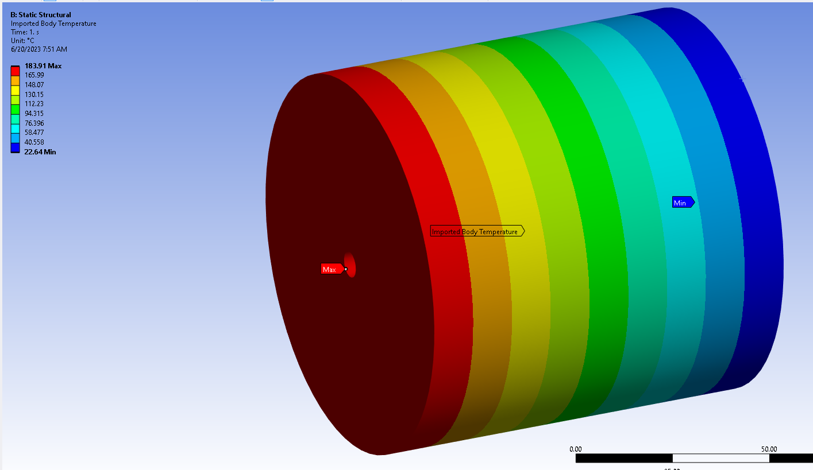
Test with 5KW at near end face and convection cooling at far end face

Slide 2
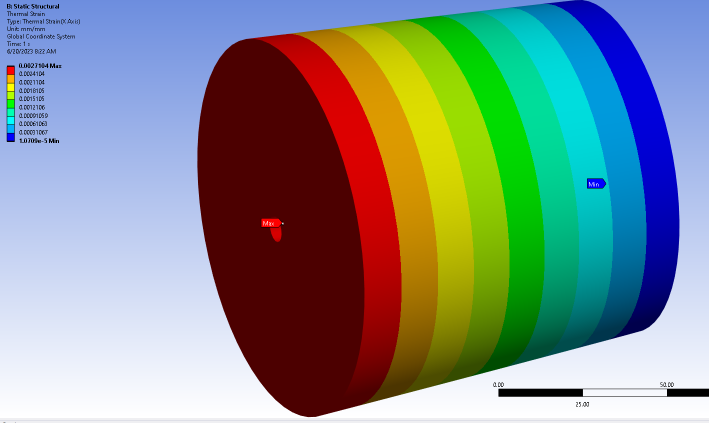
Test with 5KW at near end face and convection cooling at far end face – thermal strain – fixed at far end outer edge

Slide 3
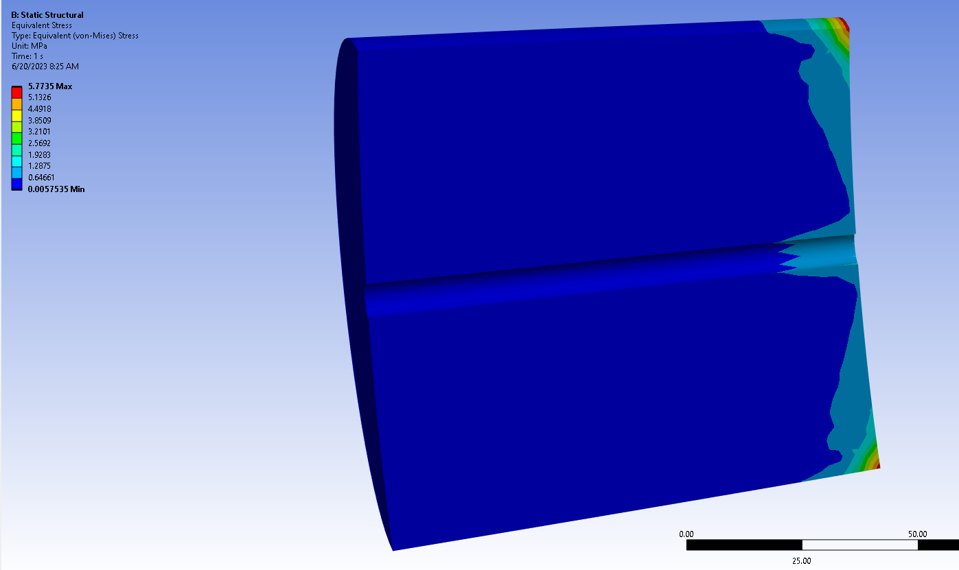
Test with 5KW at near end face and convection cooling at far end face– fixed at far end outer edge – total stress

Slide 4
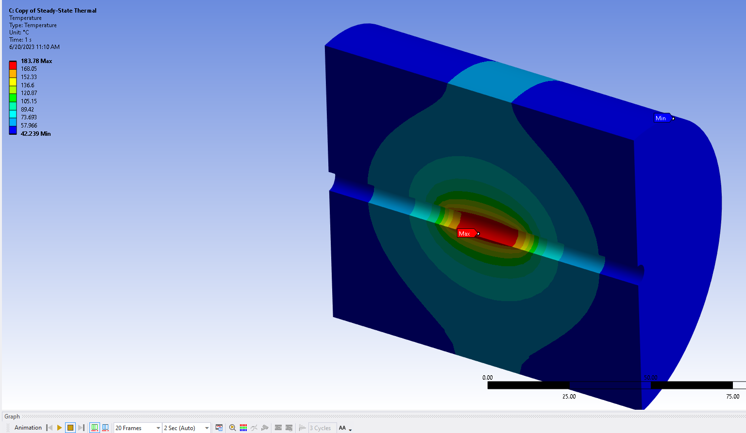
Test with 5KW at center hole and convection cooling outer surfaces –fixed at far end outer edge – Temperatures

Slide 5
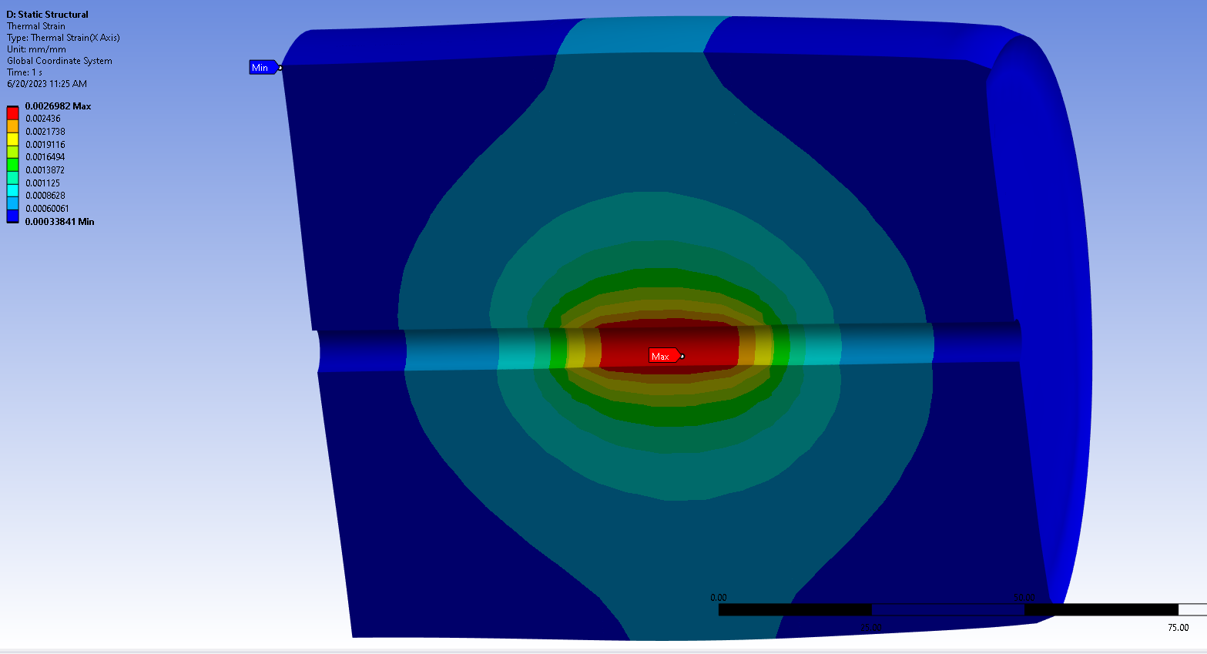
Test with 5KW at center hole and convection cooling outer surfaces –fixed at far end outer edge – Thermal Strain

Slide 6
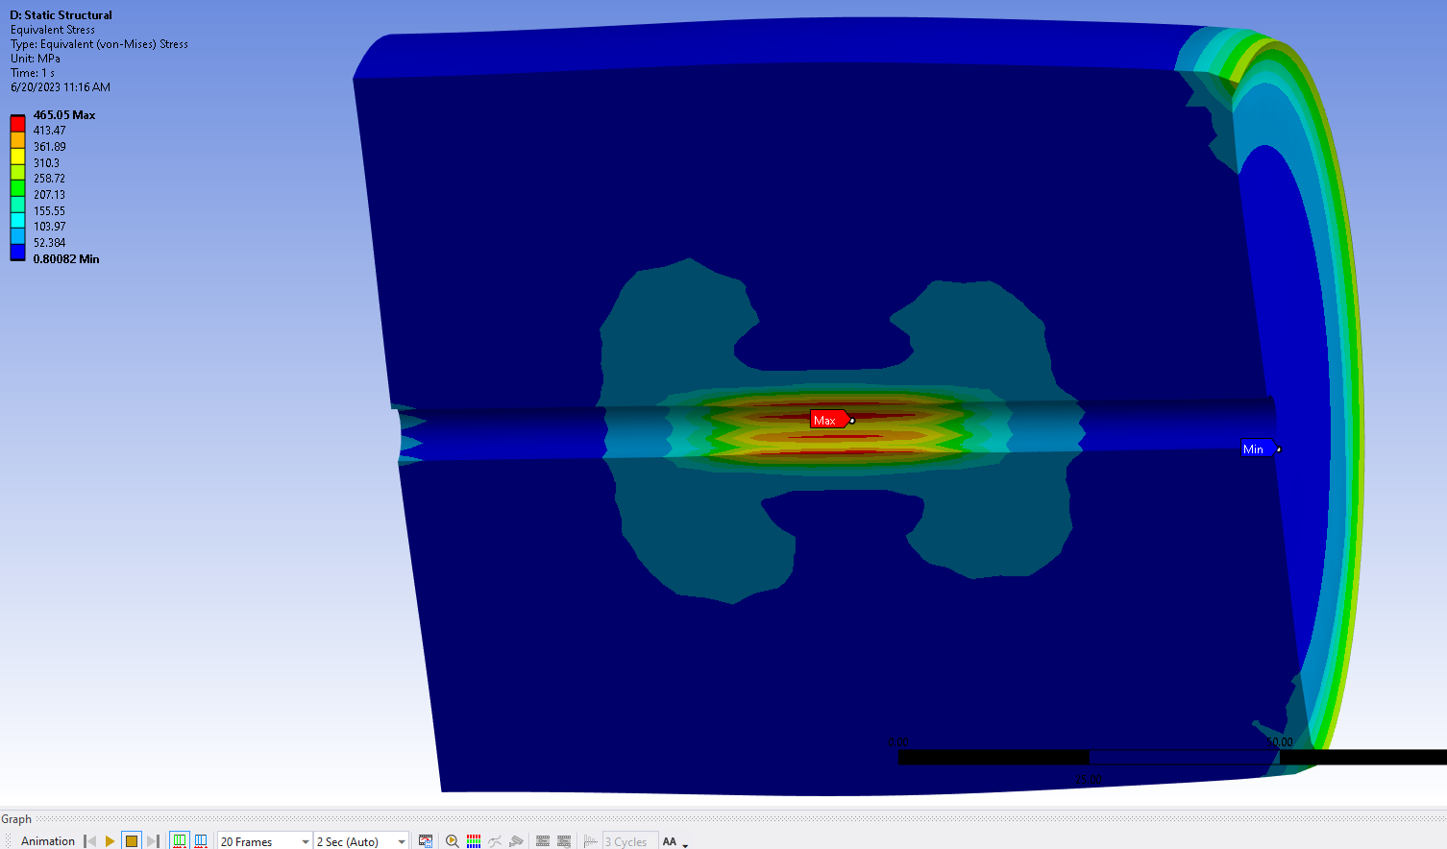
Test with 5KW at center hole and convection cooling outer surfaces –fixed at far end outer edge – total stress

Slide 7
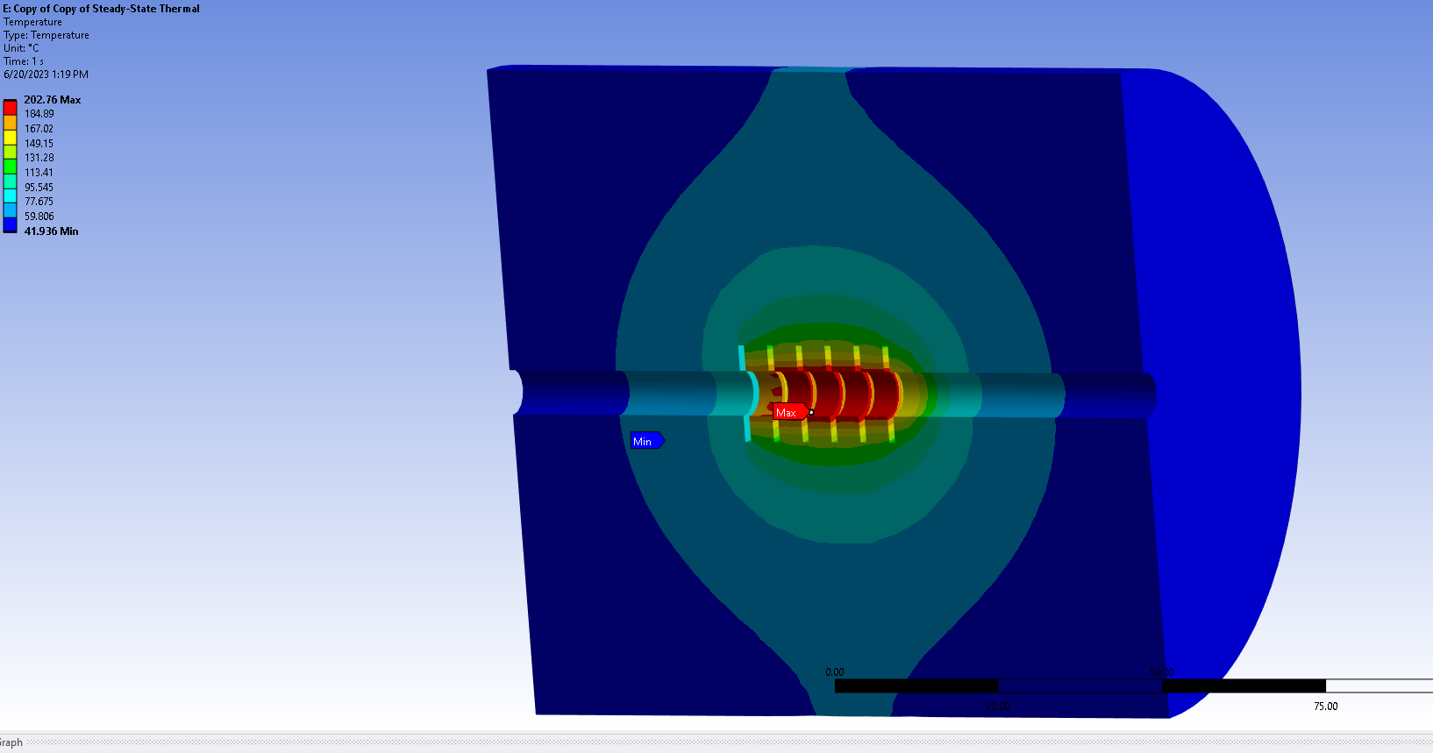
Test with 5KW at center slotted holes and convection cooling outer surfaces –fixed at far end outer edge – Temperatures

Slide 8
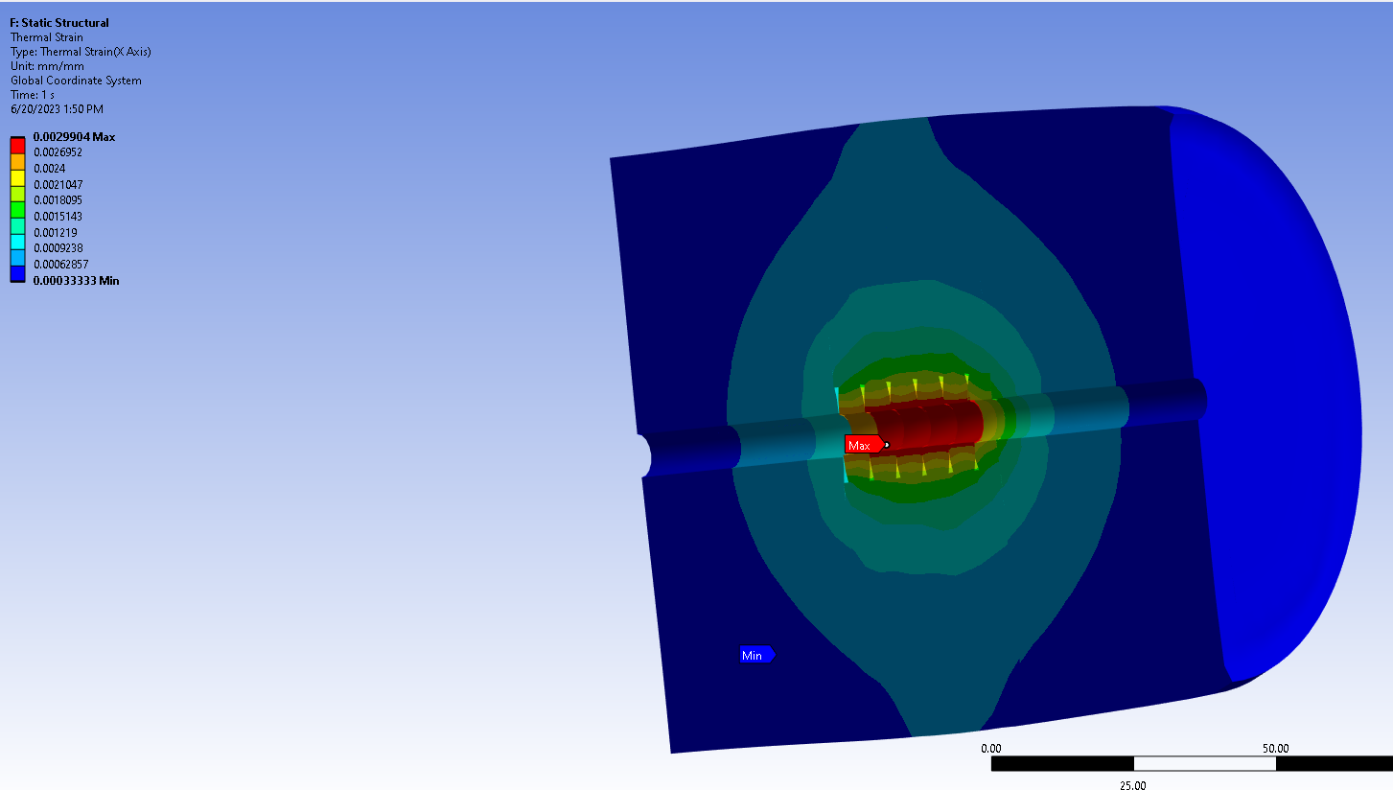
Test with 5KW at center slotted holes and convection cooling outer surfaces –fixed at far end outer edge – Thermal Strain

Slide 9
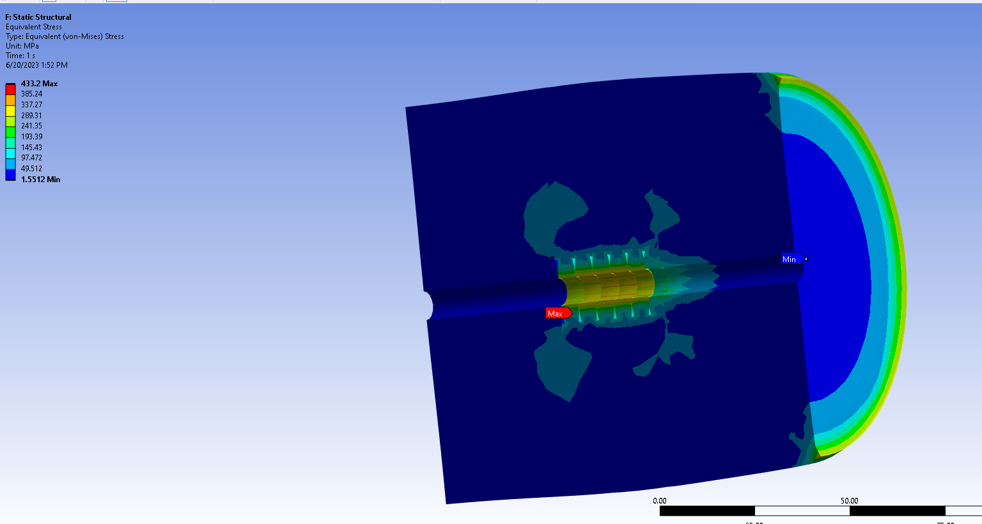
Test with 5KW at center slotted holes and convection cooling outer surfaces –fixed at far end outer edge – Total Stress

