Slide 1
K⁰L CPS Meeting May 1, 2023
P. Degtiarenko

Slide 2
Original Features – Fall’2022
First magnet is away from high radiation
Distance to allow main beam to get away from the photon line
Beam entry chamber, direct cascade products not visible in the photon line
Second magnet not used
Essentially full energy absorption in the dump
Dense CuW shielding material to minimize total weight
New Features – December 2022
Shorter design with higher BdL in the first magnet
Wedge shape of the beam entry chamber to better dissipate beam power
Combination of the shielding materials to optimize between the cost and weight (lower densities result in larger total weight)

Slide 3
Absorber Design Update – December 2022
The proposed solution for the Absorber combines:
The entrance chamber in the shape of a wedge
The main beam energy deposition is along the tip of the wedge
The first part of the photon beam channel follows the wedge chamber
First-order E-M cascade products in the dump chamber cannot go along the photon channel, limiting the radiation streaming along the channel
Suggested to be built out of two left/right symmetric half-cylinders
The entrance cavity and the photon line machined out of flat surfaces
When assembled, the absorber operates similarly to JLab beam dumps
Absorbs bulk of the power (currently over 98% of all CPS power)

Slide 4
Design Update – April 2023
Replacing the first dense CuW layer with lead
Use rectangular outer shape of the absorber to fill the rectangular space in the steel baseplate and rectangular enclosure
Implement longer magnet with lower field at 12 GeV, with the option to increase the field for runs at 20-24 GeV
Expanding rectangular photon exit channel for simpler machining and to avoid local scattering of the very forward energetic photons originating in the radiator – decreasing local radiation loads
Modified FLUKA model implemented and run at 12 and 24 GeV

Slide 5
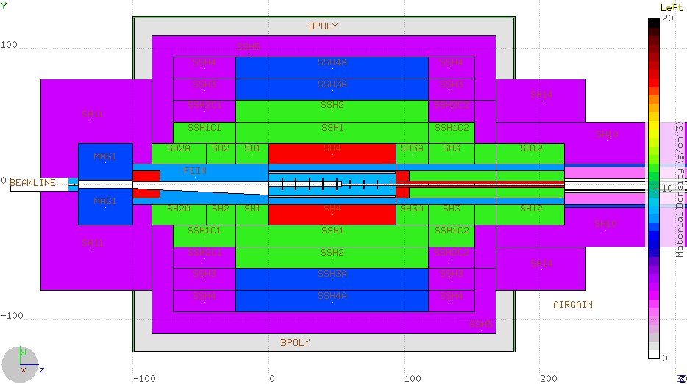
December 2022 Conceptual Design Update
Density Color Map WPowder Iron Barite Sr/Fe/O/Al
Lead
Stainless
Iron
Copper
CuW alloy
Water
Borated Poly
1m
1 m

Slide 6
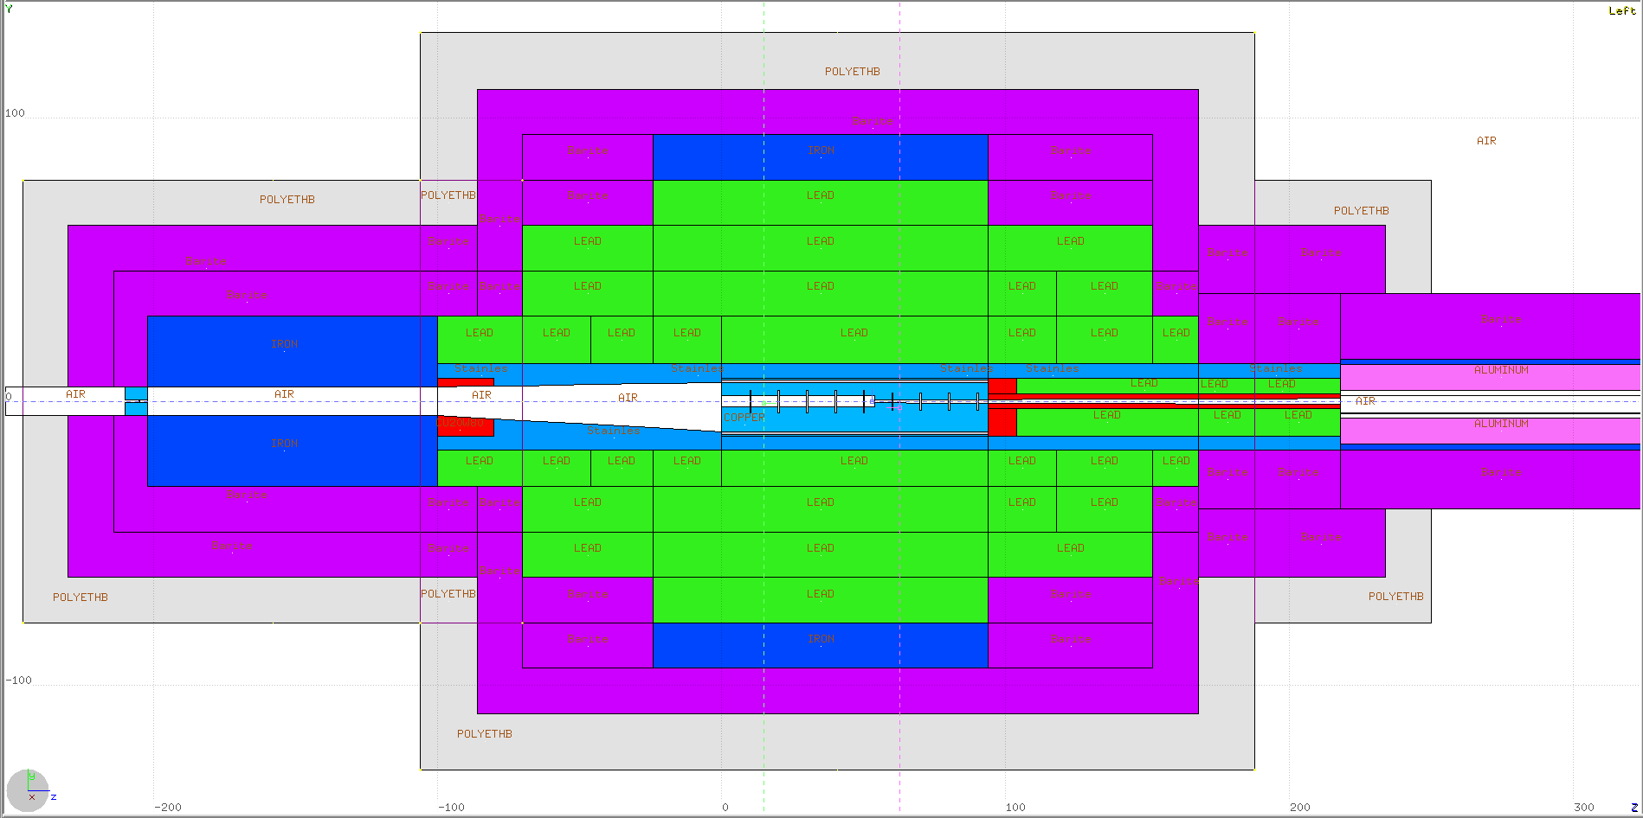
April’2023 Conceptual Design Update
Density Color Map Lead Iron Barite Sr/Fe/O/Al
Lead
Stainless
Iron
Copper
CuW alloy
Water
Borated Poly
1m
1 m

Slide 7
CPS Assembly: Beam Line

Slide 8
CPS Assembly: Beam Line + Core Layers

Slide 9
CPS Assembly: All layers

Slide 10
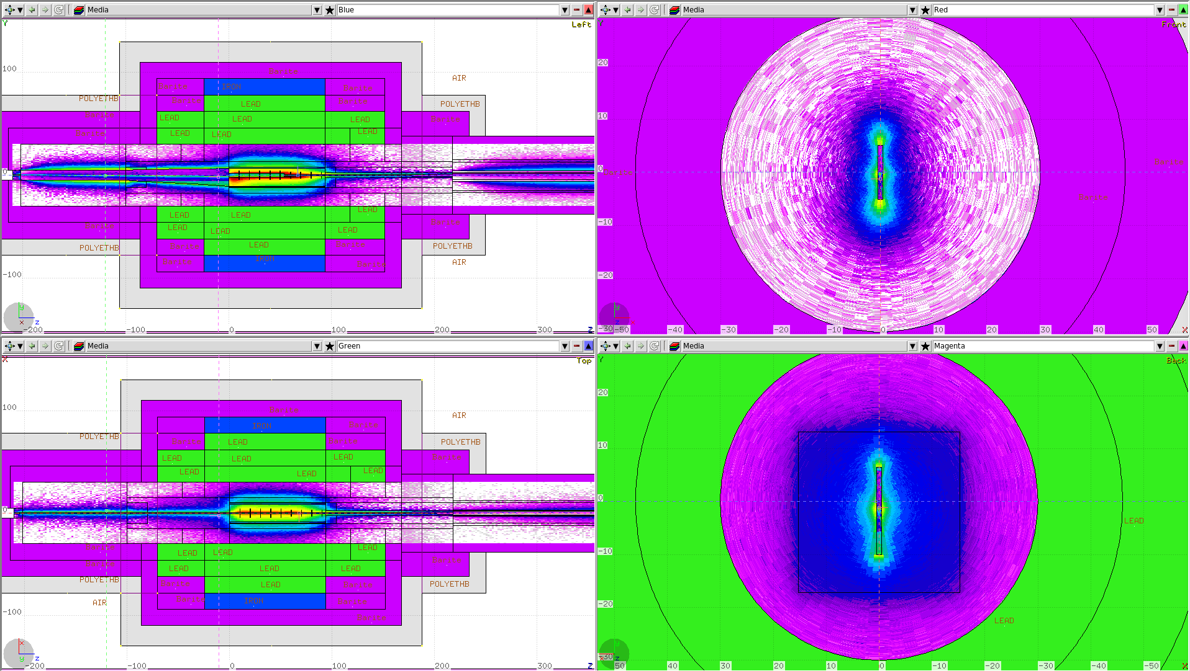
Dose Rates Inside the CPS
Power deposition along the CPS core

Slide 11
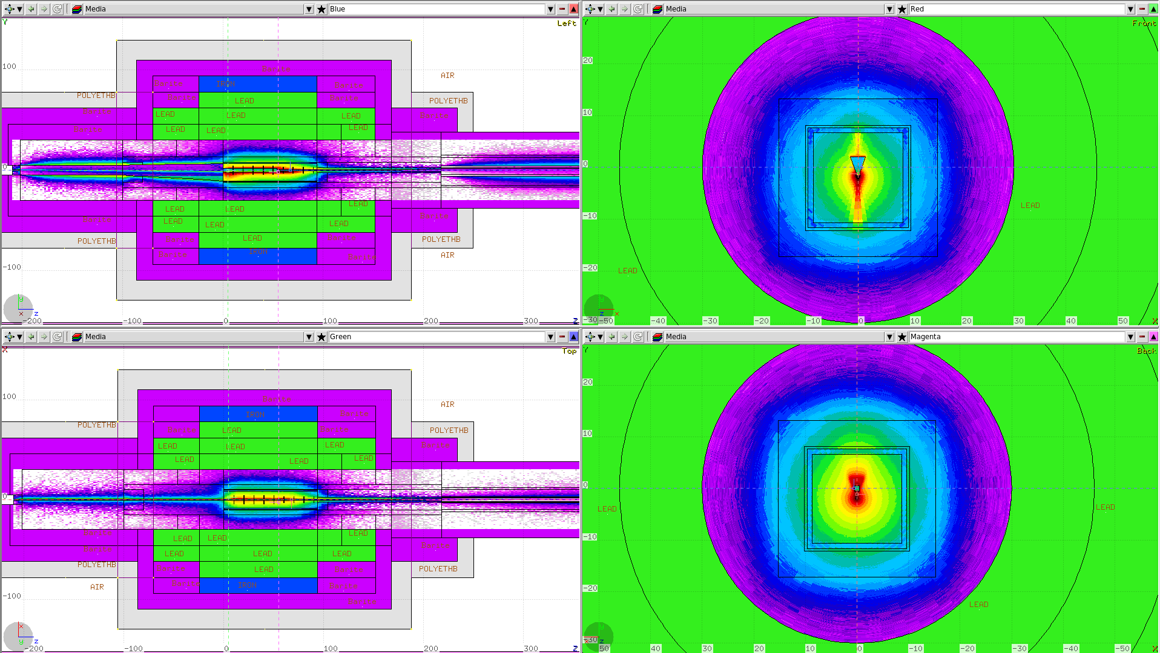
Dose Rates Inside the CPS
Power deposition along the CPS core

Slide 12
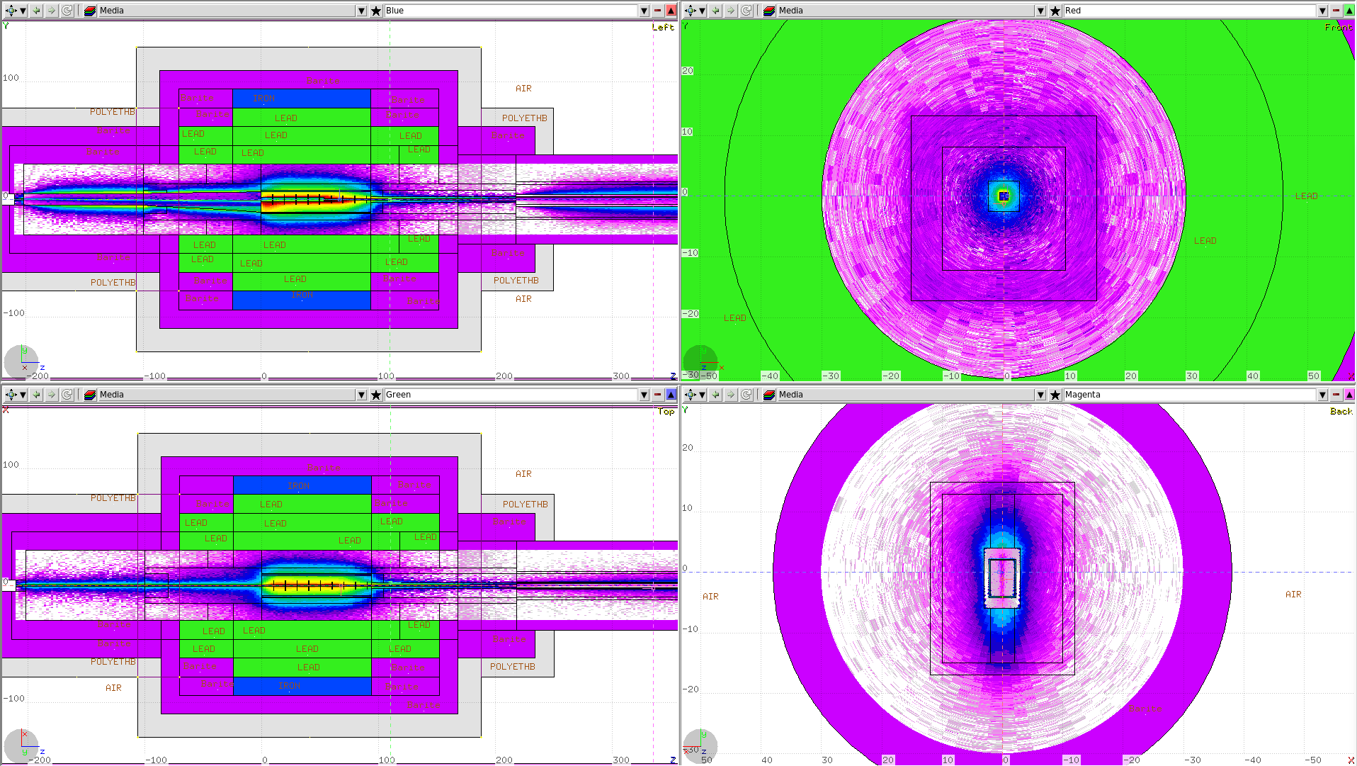
Dose Rates Inside the CPS
Power deposition along the CPS core

Slide 13
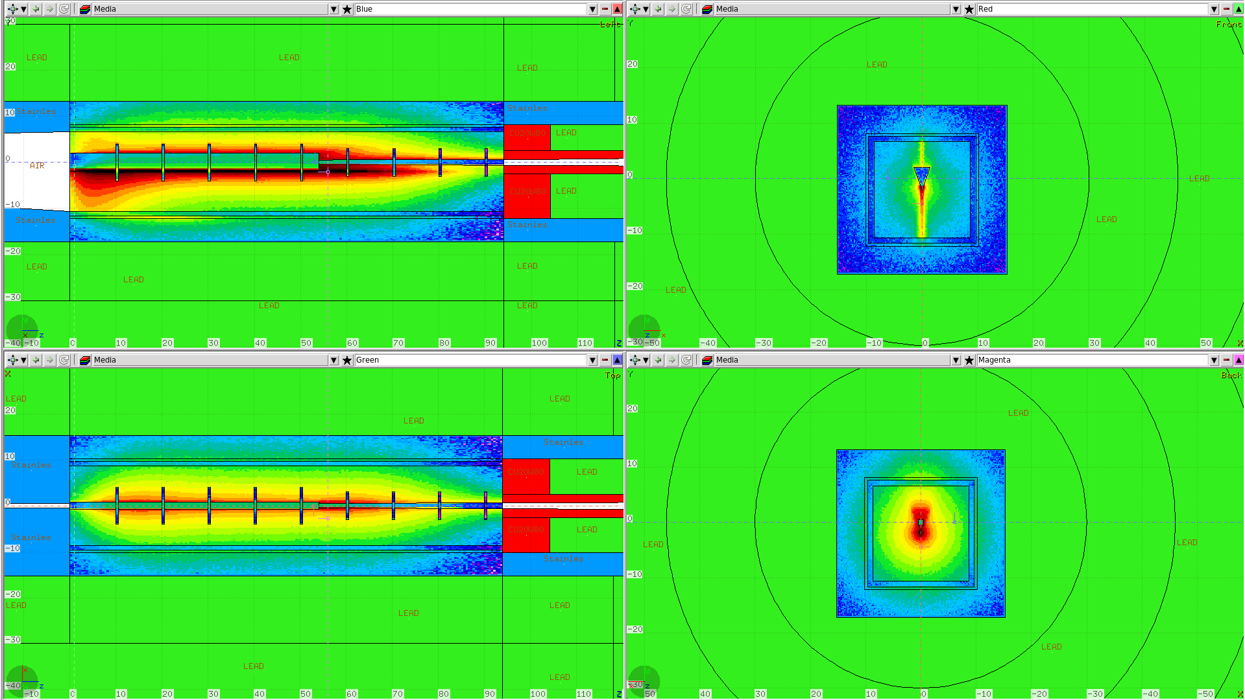
Dose Rates Inside the CPS
Power deposition along the CPS core

Slide 14
Dose Rates inside the CPS along Beam

Slide 15
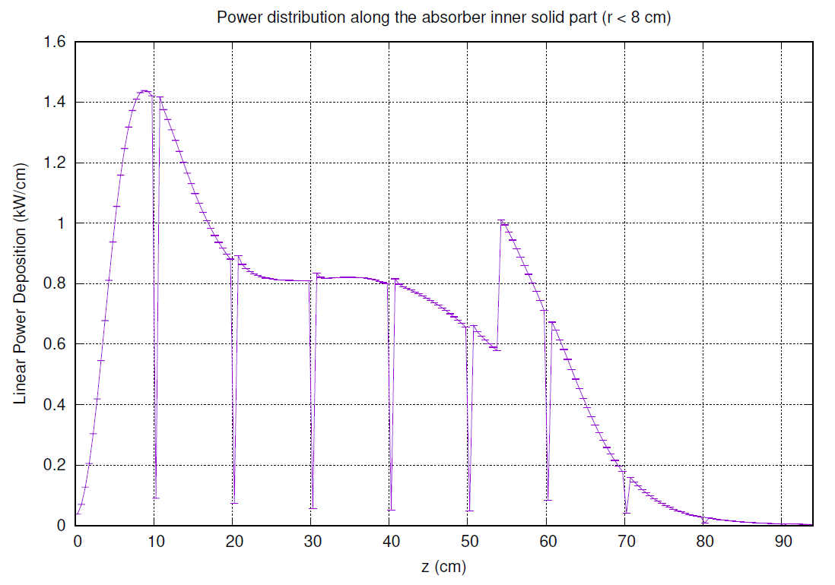
Over 98% of the full CPS power left in absorber
~Uniform along z
Concentrated at the wedge tip
No first-order cascade products go along the photon beam line
Symmetric power deposition in x,y below and around the tip
Uniformity can be fine tuned using magnetic field

Slide 16
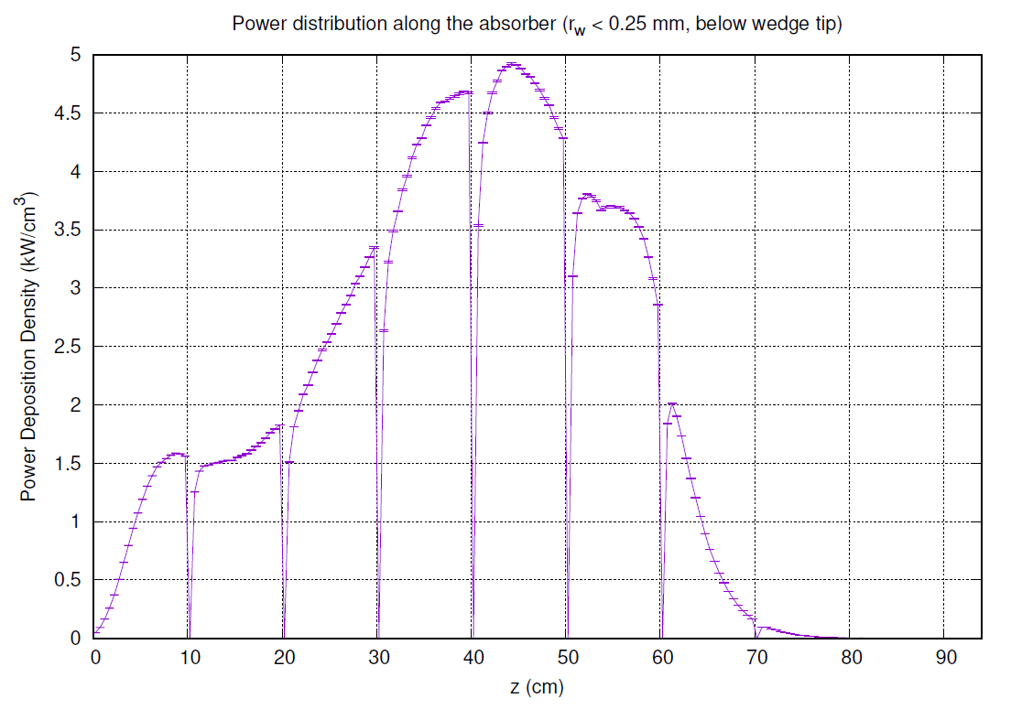
Maximum power density, y < -2 cm , r_{w} < 0.25 mm
Max ~5 kW/cm³
Location z ~45 cm
Radial (around the wedge tip) distribution can be used for the temperature evaluation
Max. power density at the tip doesn’t necessarily correspond to max. temperature

