Slide 1
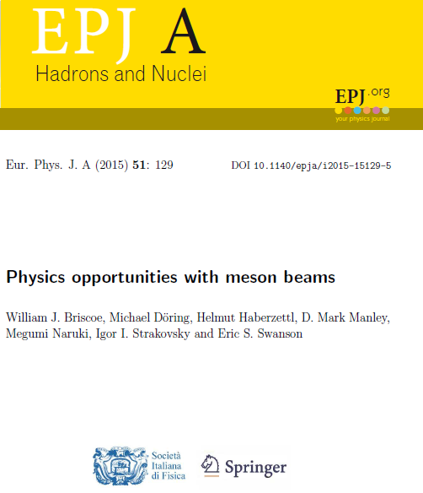
Physics Opportunities with Meson Beams
William Briscoe
The George Washington University
• Hadron Spectroscopy.
• Opportunities with pion beams.
• Spectroscopy of hyperons.
• Meson spectroscopy.
• Lattice QCD.
• Physics opportunities.
• Summary.
• K-long Facility at Jlab.
135 endorsers from 77 labs worldwide
6/2/2018
MESON 2018, Krakow, Poland, June, 2018
William Briscoe 1

Slide 2
Hadron Spectroscopy
• To reap the full benefit of high-precision
EM data, new high-statistics data from
measurements with meson beams, with
good angle & energy coverage for wide
range of reactions, are critically needed to
advance our knowledge in Baryon &
Meson Spectroscopy.
• To address this situation, state-of-the-art
Meson Hadron Facility needs to be constructed.
Forum for MAX-IV Ring, Lund, Nov 2011
6/2/2018
MESON 2018, Krakow, Poland, June, 2018
William Briscoe 2

Slide 3
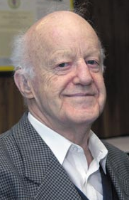
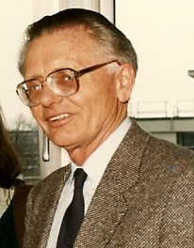
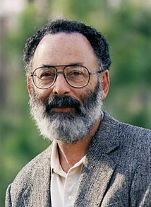
Spectroscopy of Baryons
``It is clear that we still need much more information about the existence
and parameters of many baryon states, especially in the N=2 mass region,
before this question of non-minimal SU(6) x O(3) super-multiplet can be
settled.” Dick Dalitz, 1976.
``The first problem is the notion of a resonance is not well defined. The ideal
case is a narrow resonance far away from the thresholds, superimposed on
slowly varying background. It can be described by a Breit-Wigner formula
and is characterized by a pole in the analytic continuation of the partial wave
amplitude into the low half of energy plane.’’ Gerhard Höhler, 1987.
``Why N*s are important – The first is that nucleons are the stuff of which
our world is made. My second reason is that they are simplest system
in which the quintessentially non-Abelian character of QCD is manifest.
The third reason is that history has taught us that, while relatively simple,
Baryons are sufficiently complex to reveal physics hidden from us in the
mesons.” Nathan Isgur, 2000.
6/2/2018
MESON 2018, Krakow, Poland, June, 2018
William Briscoe 3

Slide 4
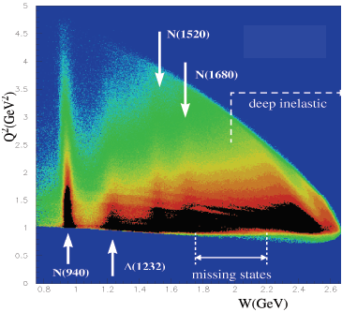
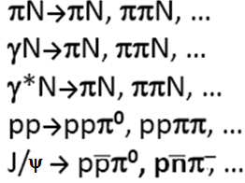
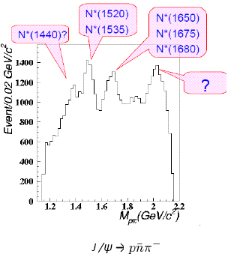
There are Many Ways to Study N*
• Prolific source of N* & Δ* baryons is to measure many
channels with different combinations of quantum numbers.
ep→epX
• Most of PDG Listings info comes from these sources.
• πN elastic scattering is highly constrained.
• Resonance structure is correlated.
• Two-body final state, fewer amplitudes.
Forum for MAX-IV Ring, Lund, Nov 2011
6/2/2018
MESON 2018, Krakow, Poland, June, 2018
William Briscoe 4

Slide 5
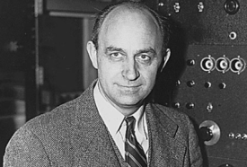
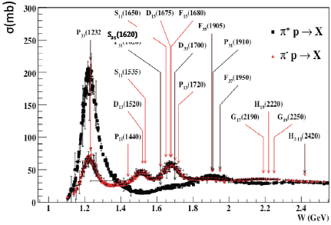
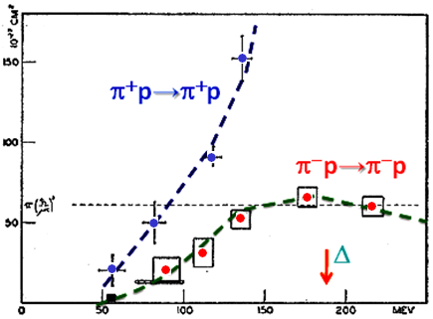
The First Baryon Resonance Discovery
Δ(1232)3/2⁺
• Then, since 1952 many states
were discovered in πN→πN.
Columbia
BNL
6/2/2018
MESON 2018, Krakow, Poland, June, 2018
William Briscoe 5

Slide 6
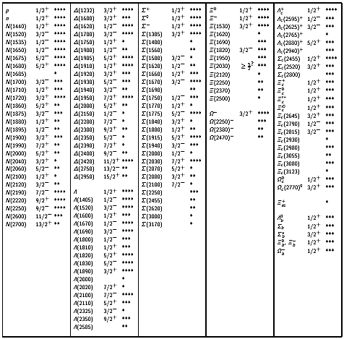
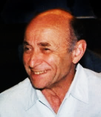
Baryon Sector at PDG16
GW Contribution
C. Patrignani et al, Chin Phys C 40, 090001 (2016)
Ξ
Δ
N
Σ
Ω
• PDG16 has 109 Baryon
Resonances
(58 of them are 4* & 3*).
• In case of SU(6) X O(3),
434 states would be
present if all revealed
multiplets were fleshed
out (three 70 and four 56).
Λ
• First hyperon
was discovered
in 1947.
• Pole position in complex energy
plane for hyperons has been
made only recently, first of all
for Λ(1520)3/2⁻.
Y. Qung et al, Phys Lett B 694, 123 (2010)
6/2/2018
MESON 2018, Krakow, Poland, June, 2018
William Briscoe 6

Slide 7
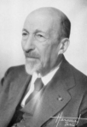
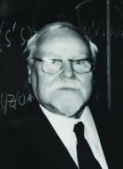
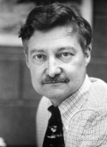
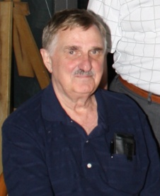
PWA for Baryons
Originally PWA arose as the technology to determine amplitude of
reaction via fitting scattering data.
That is non-trivial mathematical problem – looking for solution
of ill-posed problem following to Hadamard and Tikhonov.
Resonances appeared as by-product
[bound states objects with definite quantum numbers, mass, lifetime
& so on].
Most of our current knowledge about bound states of three light
quarks has come mainly from πN→πN PWAs:
Karlsruhe-Helsinki,
Carnegie-Mellon-Berkeley,
and GW.
Main source of EM couplings is GW & BnGa analyses.
6/2/2018
MESON 2018, Krakow, Poland, June, 2018
William Briscoe 7

Slide 8
Opportunities with
Pion Beams
6/2/2018
MESON 2018, Krakow, Poland, June, 2018
William Briscoe 8

Slide 9
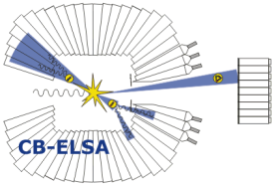
Why We Need Meson Beams
• Great strides have been made over last two decades to increase our knowledge of Baryon
& Meson Spectroscopy with help of meson photo- and electroproduction data of
unprecedented quality and quantity coming out of major EM facilities such as JLab, MAMI,
ELSA, SPring-8, BEPC, & others.
• Regrettably, meson-beam data for different final states are mostly outdated & largely of
poor quality, or even non-existent, & thus limit us in fully exploiting full potential of
new EM data.
• CM energy range up to 2.5 GeV is rich in opportunities for physics with pion & Kaon beams
to study Baryon & Meson Spectroscopy questions complementary to EM programs
underway at EM facilities.
• This talk highlights some of these opportunities & describes how facilities with high-energy
& high-intensity meson beams can contribute to full understanding of high-quality data
now coming from EM facilities.
• We emphasize that what we advocate here is not competing effort, but experimental
program that provides hadronic complement of ongoing EM program, to furnish
common ground for better & more reliable phenomenological & theoretical analyses
based on high-quality data.
Forum for MAX-IV Ring, Lund, Nov 2011
6/2/2018
MESON 2018, Krakow, Poland, June, 2018
William Briscoe 9

Slide 10
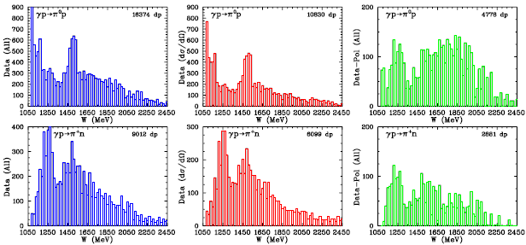
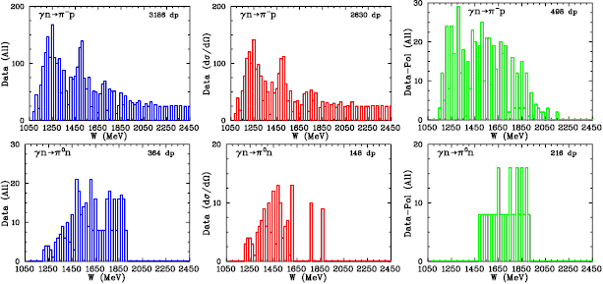
World Neutral & Charged PionPR Data
W < 2.5 GeV
SAID: http://gwdac.phys.gwu.edu/
Full
UnPol
Pol
γp→π⁰p
γp→π⁺n
γn→π⁻p
• The existing γn→π⁻p
data contains mainly
dσ/dΩ, 15% of which
are from polarized
measurements.
γn→π⁰n
6/2/2018
MESON 2018, Krakow, Poland, June, 2018
William Briscoe 10

Slide 11
World Pion-Nucleon Elastic Data
W < 2.5 GeV
SAID: http://gwdac.phys.gwu.edu/
Full
UnPol
Pol
π⁺p→π⁺p
π⁻p→π⁻p
π⁻p→π⁰n
6/2/2018
MESON 2018, Krakow, Poland, June, 2018
William Briscoe 11

Slide 12
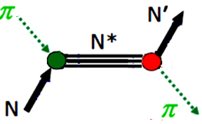
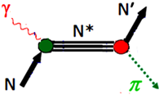
Status of Data for specific Reactions
• Measurements of final states involving single pseudoscalar meson &
spin-1/2 baryon are particularly important.
• Reactions involving πN channels include:
• πN elastic scattering data allowed establishment of 4-star resonances.
• Many of data were taken long ago & suffer from systematic uncertainties.
• Available data for πN elastic scattering are incomplete.
• Measurements of A & R observables (limited number of data available) are needed
to construct truly unbiased PW amplitudes.
Forum for MAX-IV Ring, Lund, Nov 2011
6/2/2018
MESON 2018, Krakow, Poland, June, 2018
William Briscoe 12

Slide 13
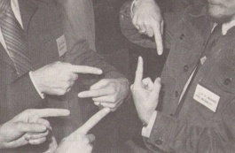
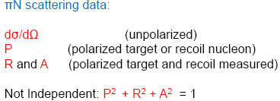
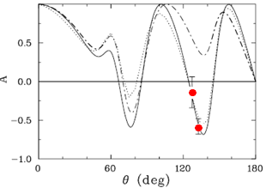
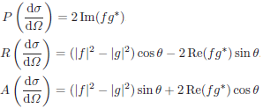
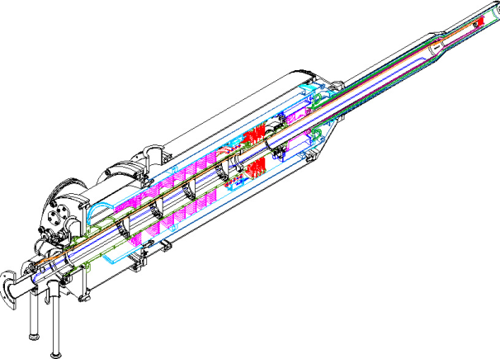
New Observables
R. Arndt, W. Briscoe, IS, R. Workman, Phys Rev C 74, 045205 (2006)
•
• Old PWA solutions may be not able
to reproduce New measurements.
KA84
SP06
π⁺p: 1300 MeV
Data:
ITEP: π⁺p→π⁺p @ 1300 MeV
I. Alekseev et al, Phys Lett B 351, 585 (1995)
PWA:
KA84: Karlsruhe-Helsinki fit, 1984
KB84: KH Barrelet corrected solution, 1997
SP06: GW fit, 2006
• Polarized measurements would also be
important part of hadron program.
6/2/2018
MESON 2018, Krakow, Poland, June, 2018
William Briscoe 13

Slide 14
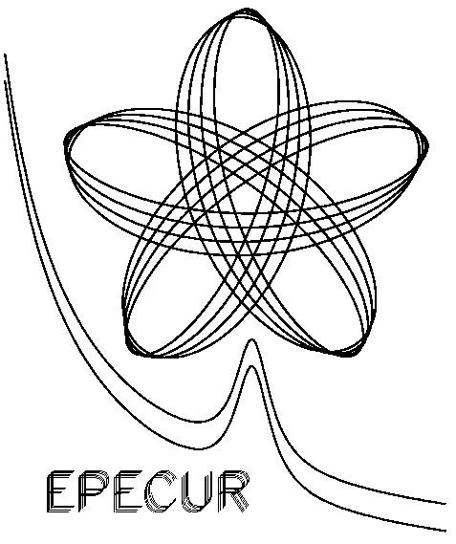
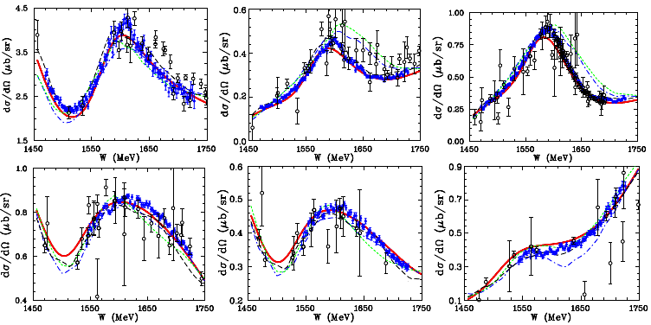
Recent ITEP for π⁻⁺p→π⁻⁺p
• New precise cross section measurements:
Δσ = 0.5% stat, Δp = 1 MeV, Δθ = ±1^{ο}
θ = 40◦
θ = 100◦
θ = 110◦
π⁻p→π⁻p
4277 dσ/dΩ:
800 – 1243 MeV/c
40 – 122 deg
θ = 70◦
θ = 80◦
θ = 120◦
π⁺p→π⁺p
2638 dσ/dΩ:
918 – 1240 MeV/c
40 – 122 deg
• CMB analysis significantly more predictive
when compared to versions of KH analyses.
Predictions: WI08, KH80, KA84, CMB
I. Alekseev et al, Phys Rev C 91, 025205 (2015)
Forum for MAX-IV Ring, Lund, Nov 2011
6/2/2018
MESON 2018, Krakow, Poland, June, 2018
William Briscoe 14

Slide 15
Status of Data for specific Reactions
• Reactions that involve the ηN and KΛ channels are notable because they have pure
isospin-1/2 contributions:
• Analyses of photoproduction combined with pion-induced reactions permit
separating EM & hadronic vertices.
• It is only by combining information from analyses of both πN elastic scattering
& γN→πN that make it possible to determine A_{1/2} & A_{3/2} helicity couplings
for N* & Δ* resonances.
Forum for MAX-IV Ring, Lund, Nov 2011
6/2/2018
MESON 2018, Krakow, Poland, June, 2018
William Briscoe 15

Slide 16
π –p→ηn Revival
• γp→ηp is one of key reactions for which colleagues in EM community hope to
do ``complete measurement” & determine PW amplitudes directly.
• Any coupled-channel analysis of those measurements will need precise data for π–p→ηn .
• Most of available data for that reaction come from measurements published in 1970s,
which have been evaluated by several groups as being unreliable above W = 1620 MeV.
• Precise new data were measured by Crystal Ball Collaboration, but these extend only up
to peak of first S₁₁-resonance.
S. Prakhov et al, Phys Rev C 72, 015203 (2005)
• Very few polarization data for this reaction exist out of range of dσ/dΩ.
• Available data for π⁻p reactions with KY, η’N, ωN, & φN final states are generally as bad or worse.
6/2/2018
MESON 2018, Krakow, Poland, June, 2018
William Briscoe 16

Slide 17
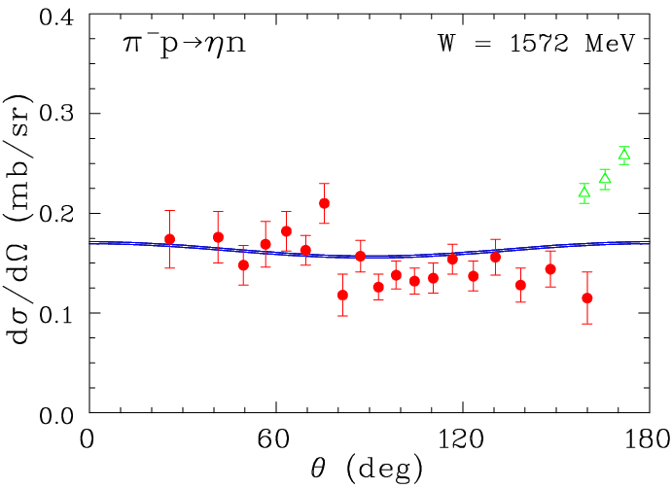
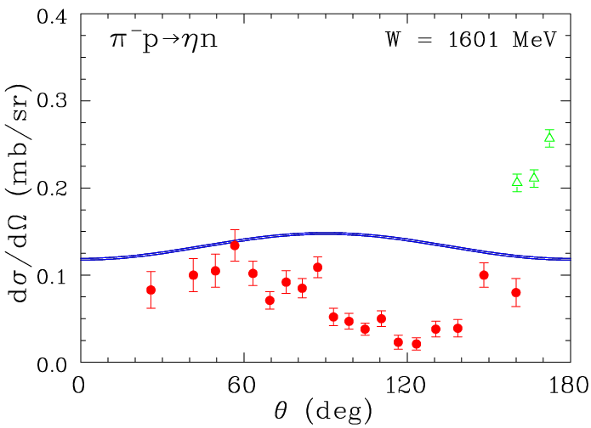
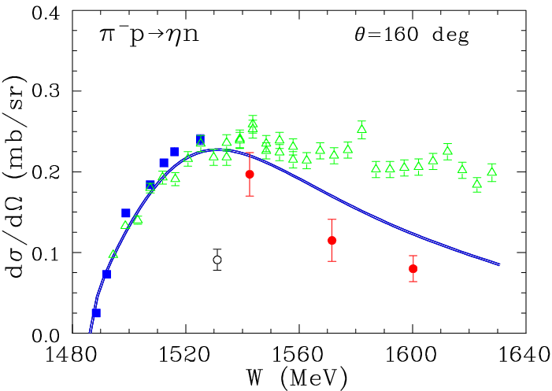
Where we are in π –p→ηn
• There were several independent evaluations:
− Arndt et al, Phys Rev C 69, 035213 (2004)
− Clajus & Nefkens, πN News Lett 7, 76 (1992)
− Wighman et al, Phys Rev D 38, 3365 (1988)
− Koch & Pietarinen, Nucl Phys A336, 331 (1980)
− Cutkosky et al, Phys Rev D 20, 2804 (1979)
There are 27 σ^{tot} & 37 P reliable data
above T = 800 MeV → 0.03 data/MeV
RHEL: Brown et al, Nucl Phys B153, 89 (1979)
RHEL: Debenham et al, Phys Rev D 12, 2545 (1975)
Saclay: Feltesse et al, Nucl Phys B93, 242 (1975)
BNL: Prakhov et al, Phys Rev C 72, 015203 (2005)
• Most of previous data do not satisfy requirements
[systematics (10% or more),
momentum err (up to 50 MeV/c), and so on].
• Evaluation for reactions with KY, η’N, ωN, φN, & so on final states
are not possible now because of small/limited databases.
6/2/2018
MESON 2018, Krakow, Poland, June, 2018
William Briscoe 17

Slide 18
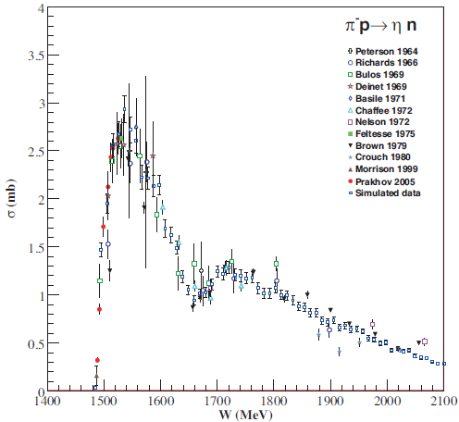
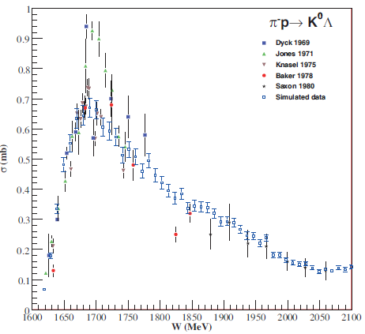
Possible Improvement of π –p→ηn & π⁻p→K⁰Λ Data
• Large discrepancy
in exp data around
1.7 GeV.
• Projection data with 5% uncertainties & with energy scan at 10 MeV
intervals, which is comparable to modern photoproduction measurements.
• More precise data for reaction π⁻p→K⁰Λ (in combination with K⁻p→K⁰Σ⁰)
would also enable the study of SU(3) flavor symmetry & its breaking.
6/2/2018
MESON 2018, Krakow, Poland, June, 2018
William Briscoe 18

Slide 19
Status of Data with Strangeness Production
• Another group of related reactions involve KΣ channel:
• Except for π⁺p→K⁺Σ⁺, these reactions involve mixture of isospin 1/2 & 3/2.
• Although there have been number of recent high-quality measurements involving KΣ
photoproduction, status of complementary reactions measured with pion beams is rather
dismal.
• There are generally fewer available data for π⁻p reactions with KΣ, η’N, ωN, & φN
final states than for π–p→ηn .
K. Shirotori et al, Phys. Rev Lett 109, 132002 (2012)
• Measurements like these, over more comprehensive energy range, will greatly improve PWAs
of KΣ final state &, in return, help to extract the S-wave contribution needed, e.g.,
in approaches based on unitarized chiral perturbation theory.
Forum for MAX-IV Ring, Lund, Nov 2011
6/2/2018
MESON 2018, Krakow, Poland, June, 2018
William Briscoe 19

Slide 20
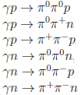
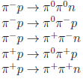
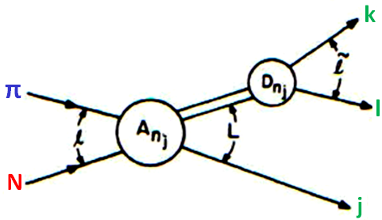
Status of Data for multi-pion Reactions
• Other important reactions that can be studied are those with ππN final states:
• Analysis & interpretation of data from these reactions is more complicated because
they involve three-body final states.
• However, πN→ππN reactions have the lowest energy threshold of any inelastic hadronic
channel & some of largest cross sections.
• For most established N* & Δ* resonances, dominant inelastic decays are to ππN final states.
• Our knowledge of πΔ, ρN, & other quasi-two-body ππN channels comes mainly from
Isobar-model analyses of πN→ππN data.
• Large experimental database (including pol measurements) is needed to determine precisely
PW amplitudes because so many amplitudes are needed to describe three-body final states.
Forum for MAX-IV Ring, Lund, Nov 2011
6/2/2018
MESON 2018, Krakow, Poland, June, 2018
William Briscoe 20

Slide 21
πp→ππN Measurements
π⁻p→π⁺π⁻n
• 241,214 Bubble Chamber events for πp→ππN
have been analyzed in Isobar-model PWA at
W = 1320 to 1930 MeV.
• Post-Bubble Chamber measurements: • 349,611 events for π⁻p→π⁰π⁰n from
CB@BNL at W = 1213 to 1527 MeV.
• 20,000 events for π⁺⁻p→π⁺⁻π⁻⁺n from
CHAOS@TRIUMF at W = 1257 to 1302 MeV.
• 40,000 events for π⁻p→π⁻π⁺n from ITEP at
W = 2060 MeV.
Manley, Arndt et al, Phys Rev D 30, 904 (1984)
π⁻p→π⁰π⁻p
π⁺p→π⁰π⁺p
CB@BNL
Prakhov et al, Phys Rev C 69, 045202 (2004)
π⁺p→π⁺π⁺n
Kermani et al, Phys Rev C 58, 3431 (1998)
→
CHAOS
Alekseev et al, Phys At Nucl 61, 174 (1998)
ITEP
6/2/2018
MESON 2018, Krakow, Poland, June, 2018
William Briscoe 21

Slide 22
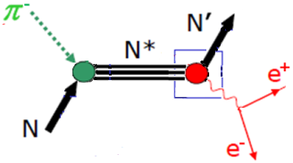
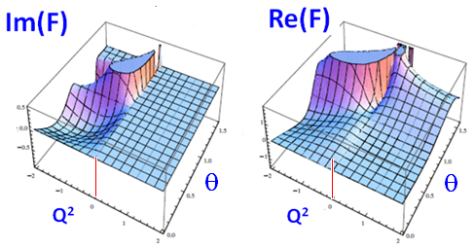
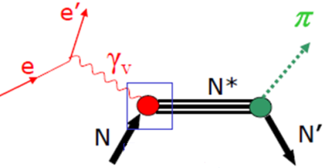
Form-Factor Measurements
• Inverse Pion Electroproducion is only process which allows determination of EM
nucleon & pion form factors in intervals:
0 < k² < 4 M² 0 < k² < 4 m_{π}²
which are kinematically unattainable from e⁺e⁻ initial states.
Im=0
Time-like
MEIC
CLAS
Space-like
• π⁻p→e⁺e⁻n measurements will significantly complement current electroproduction.
• γ*N→πN study for evolution of baryon properties with increasing momentum transfer
by investigation of case for time-like virtual photon.
Forum for MAX-IV Ring, Lund, Nov 2011
6/2/2018
MESON 2018, Krakow, Poland, June, 2018
William Briscoe 22

Slide 23
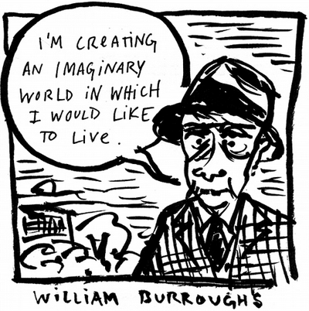
Spectroscopy of Hyperons
6/2/2018
MESON 2018, Krakow, Poland, June, 2018
William Briscoe 23

Slide 24
Spectroscopy of Strange Sector Resonances
• Our current experimental knowledge of Λ∗ & Σ∗ resonances is far worse than our knowledge
of N* & Δ* resonances; however, within quark model, they are no less fundamental.
• First determinations of pole positions, for instance for Λ(1520), were obtained only recently.
• Clearly, there is need to learn about baryon resonances in
``strange sector” to have complete understanding of
three-quark bound states.
Y. Qiang et al, Phys. Lett. B 694, 123 (2010)
• One of secondary beam problem is that Kaon yield has factor of about 500+ less than
pion one.
• This is the main reason why there are limited exp data for Kaon induced measurements
& there are limited pol measurements.
• Line shape of Λ(1405)1/2⁻ can be studied in K⁻p and K⁻d (K⁻n) reactions.
Comparison between pion- & Kaon-induced reactions together with photoprod is important.
• H-dibaryon, which has quark configuration of uuddss, will be searched for in (K⁻, K⁺).
• Measured πΣ/ππΣ BR for Σ(1670) produced in reaction K⁻p→π⁻Σ(1670)⁺ depends
strongly on momentum transfer, & it has been suggested that there exist two Σ(1670)s with
same mass & quantum numbers, one with large ππΣ branching fraction & the other
with large πΣ BR.
Forum for MAX-IV Ring, Lund, Nov 2011
6/2/2018
MESON 2018, Krakow, Poland, June, 2018
William Briscoe 24

Slide 25
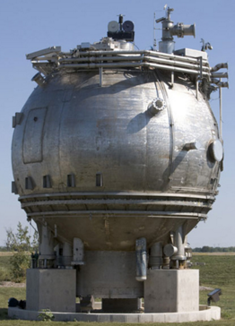
Status of Data for Kaon Induced Reactions
• Hyperons Λ*& Σ* have been systematically studied in following formation processes:
• Most of our knowledge about multi-strange baryons was
obtained from old data measured with Bubble Chambers.
• Cascade baryons could be studied with high-momentum
Kaon beams & modern multi particle spectrometers.
• Lack of appropriate beams & detectors in past greatly limited our knowledge.
• Currently only the cascade ground states of spin-1/2 & spin-3/2 are well identified.
• For excited states, possible production reactions with Kaon beams are following:
• There are other production processes with single or multi pions:
Forum for MAX-IV Ring, Lund, Nov 2011
6/2/2018
MESON 2018, Krakow, Poland, June, 2018
William Briscoe 25

Slide 26
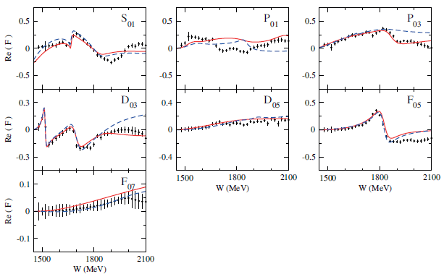
Samples of Analyses of KN→KN Data
• Real part of KN→KN amplitude in isospin channel of Λ(1405)1/2⁻ (I = 0).
• Current PWAs disagree on near-threshold
S-wave components.
• Data situation clearly does not allow to
further pin down partial-wave content.
ANL/Osaka: H. Kamano et al, Phys Rev C 90, 065204 (2014)
Kent State: H. Zhang et al, Phys Rev C 88, 035204 (2013)
6/2/2018
MESON 2018, Krakow, Poland, June, 2018
William Briscoe 26

Slide 27
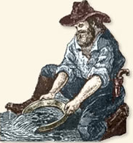
Meson Spectroscopy
6/2/2018
MESON 2018, Krakow, Poland, June, 2018
William Briscoe 27

Slide 28
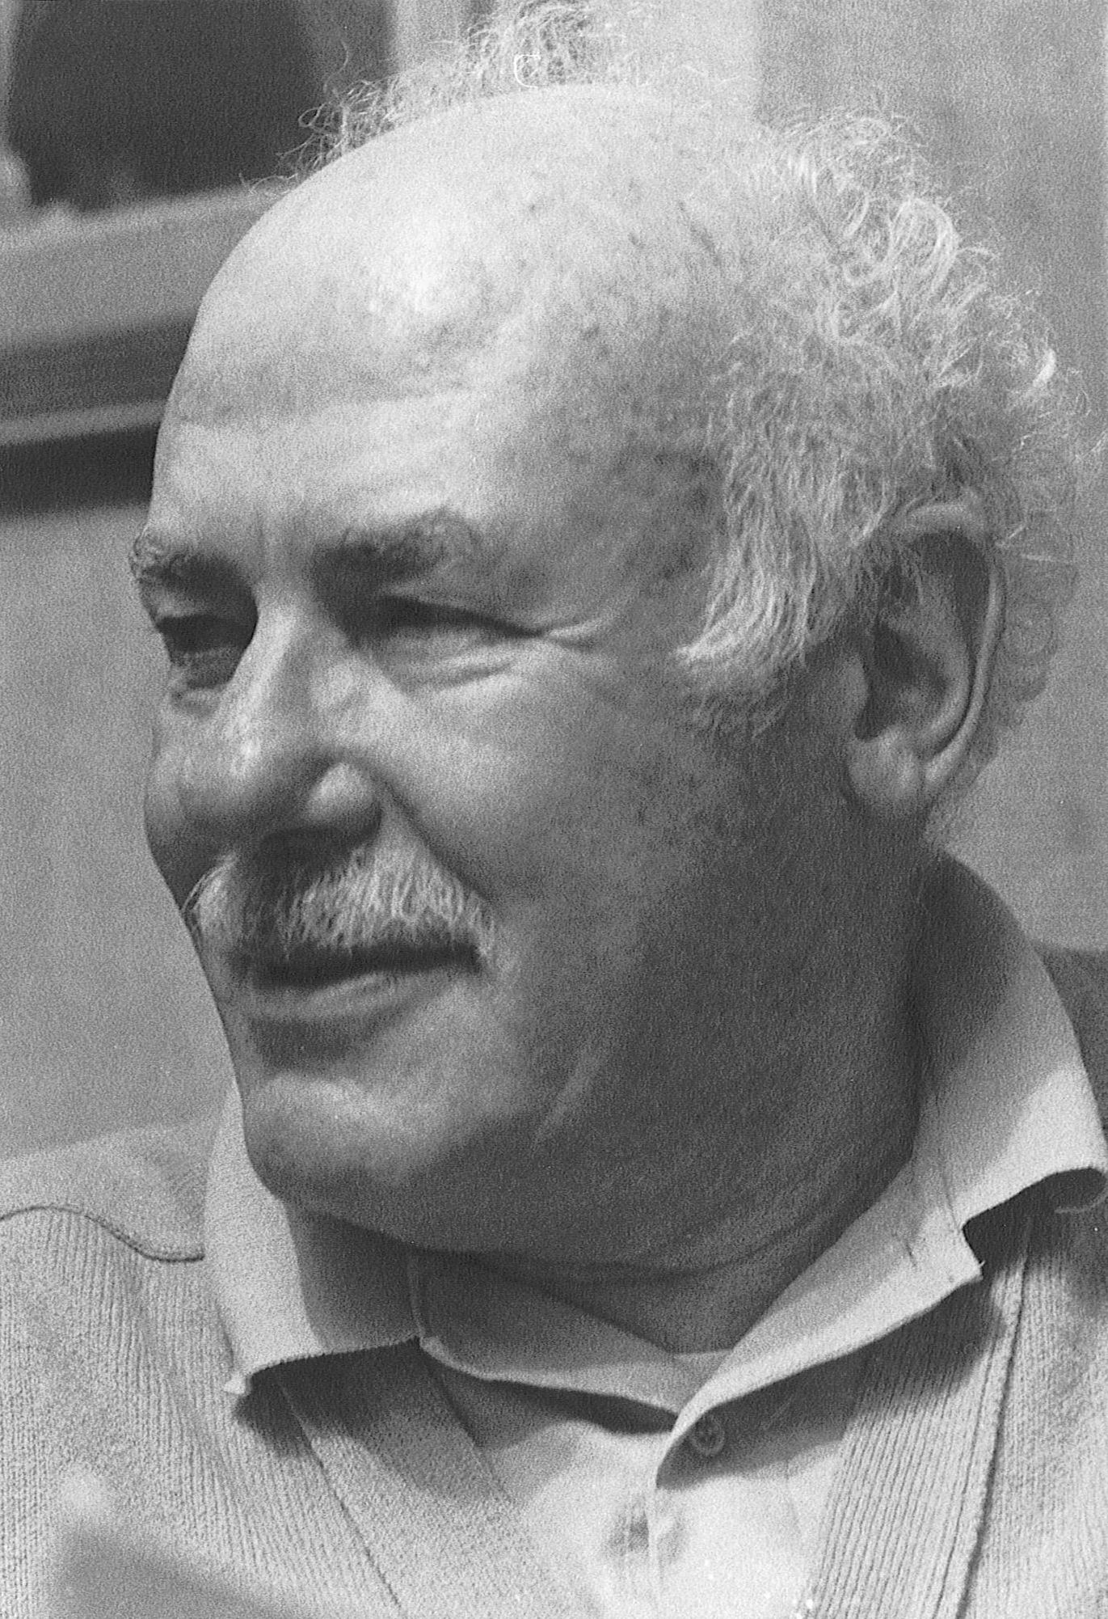
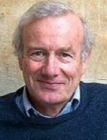
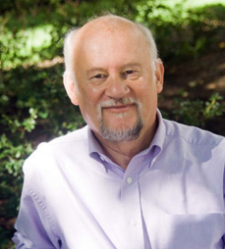
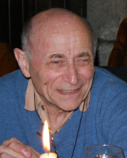
Spectroscopy of Mesons
``The di-quark or meson-baryon puzzle: Why is the quark-quark interaction just enough weaker than the quark-anti-quark interaction so that di-quarks near the meson mass are not observed, but three-quark systems have masses comparable to those of mesons?” Harry Lipkin, 1973.
``For the region below 1 GeV, the debate centers on whether the phenomena are truly resonant or driven by attractive t-channel exchanges, and if the former, whether they are molecules or qq¯q¯q.” Frank Close, 2007.
``QCD predicts there should be a far richer spectrum, with states made predominantly
of glue, we call glueballs, tetra-quark states made of two quarks and two anti-quarks... For almost forty years we have been searching for these additional states. Indeed we may well have observed some of these, but there is little certainty of what has been found.” Michael Pennington, 2015.
``A simple picture for both mesons and baryons is inconsistent with any version of relativistic
field theory, where one can not exclude presence of an arbitrary number of virtual
quark-anti-quark pairs and/or gluons. Therefore, adequate description of any hadron should
use a Fock column, where lines correspond to particular configurations (but with the same
``global” quantum numbers, like I, J, P, C, and so on)..” Yakov Azimov, 2015.
6/2/2018
MESON 2018, Krakow, Poland, June, 2018
William Briscoe 28

Slide 29
Spectroscopy of Mesons
• Although it was light Hadron Spectroscopy that led the way to discovery of color degrees of
freedom & QCD, much of field remains poorly understood, both theoretically &
experimentally.
• Availability of pion & Kaon beams provide important opportunity to improve this
situation.
• Experimentally, Meson Spectroscopy can be investigated by using PWAs to determine quantum
numbers from angular distributions of final-state particle distributions.
• Chief areas of interest in Meson Spectroscopy are
light scalar mesons,
multiquark states,
glueballs, and
hybrids.
• Experimental effort with meson beams will complement the GlueX experiment at JLab,
which seeks to explore properties of hybrids with photon beam.
Forum for MAX-IV Ring, Lund, Nov 2011
6/2/2018
MESON 2018, Krakow, Poland, June, 2018
William Briscoe 29

Slide 30
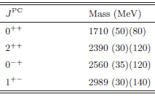
Status of search for Glueballs
• Quantum numbers for exotics: multiquark, glueball, or hybrid are
0⁻⁻, (odd)⁻⁺, and (even)⁺⁻.
• Lattice glueball spectrum below 3 GeV.
Y. Chen et al, Phys Rev D 73, 014516 (2006)
• Unfortunately, there are no glueballs have been
definitively identified.
• Promising earlier candidate called ξ(2200)
has not withstood careful analysis.
• At present, best candidate is f₀(1500)
[or possibly f₀(1710)], which appears as
supernumerary state in enigmatic scalar
meson sector .
C. Amsler and F.E. Close, Phys Rev D 53, 295 (1996)
6/2/2018
MESON 2018, Krakow, Poland, June, 2018
William Briscoe 30

Slide 31
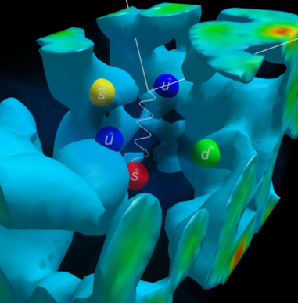
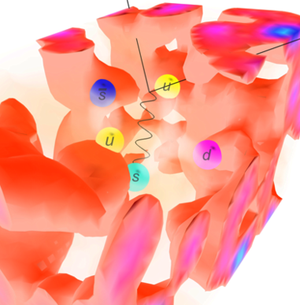
Lattice QCD
6/2/2018
MESON 2018, Krakow, Poland, June, 2018
William Briscoe 31

Slide 32
Lattice Computation of the Light Meson Spectrum
• Lattice QCD simulations for excited baryons are considerably more
complicated than for excited mesons due to signal-to-noise &
combinatorial problems of contractions of three quarks instead of two.
J.J. Dudek et al, Phys Rev D 88, 094505 (2013)
6/2/2018
MESON 2018, Krakow, Poland, June, 2018
William Briscoe 32

Slide 33
Physics Opportunities
• Current run plans at modern Hadron Facilities [J-PARC, HADES,
COMPASS, & PANDA] will greatly improve database; however, there
are no plans for polarized measurements.
• New Hadron Facility would need large-acceptance detector &
availability of polarized target.
• In particular, such dedicated facility should be able to provide
features listed in following, together with short summary of
key arguments made in White Paper:
Treasure box
Forum for MAX-IV Ring, Lund, Nov 2011
6/2/2018
MESON 2018, Krakow, Poland, June, 2018
William Briscoe 33

Slide 34
Electron Ion Collider
NSAC LRP 2015:
``Continue existing projects: CEBAF, FRIB, RHIC.”
``…a U.S.-led ton-scale neutrinoless double beta decay experiment.”
``…a high-energy high-luminosity polarized EIC as the highest priority for new facility construction following the completion of FRIB.”
``…small-scale and mid-scale projects and initiatives that enable forefront research at universities and labs.”
``A major experimental initiative continues to be the search
for the so-called `missing baryons’. If each of the three
quarks in a baryon interacted equally, one would predict the
existence of more baryons than observed by experiments.
The experimental data are, therefore, suggestive of a more
intricate manifestation of QCD in baryons...“
``For many years, there were both theoretical and
experimental reasons to believe that the strange sea quarks
might play a significant role in the nucleon's structure; a
better understanding of the role of strange quarks became
an important priority.”
6/2/2018
MESON 2018, Krakow, Poland, June, 2018
William Briscoe 34

Slide 35
Why EIC and Why at Jefferson Lab ?
• Large established user community in field.
• JLEIC Facility design meets experimental needs:
• Broad CM energy range.
• High luminosity.
• Wide range of ion species.
• Green Field new ion complex provide opportunity for modern design for highest performance.
• Low technical risk:
• EIC design largely based on conventional technologies.
• Meson Hadron Facility will allow keep longer JLab Ion Booster busy (to use much
more then ``several minutes” a day), which would be much more effective use of
JLEIC Facility, without significant increase of cost of JLab Ion Booster.
6/2/2018
MESON 2018, Krakow, Poland, June, 2018
William Briscoe 35

Slide 36
JLab Campus Layout
JLEIC:
• W = 15 – 65 GeV.
• Protons: 20 − 100 GeV.
• Luminosity:
10³³ to 10³⁴ cm⁻²s⁻¹ per IP.
• Circumference: 2.2 km.
Ion Booster:
• Protons: 8 GeV.
• Booster design based on
super-ferric magnet
technology.
• Circumference: 273 m.
Meson Hadron Facility
[good to have]:
• Pions:
< 3 GeV.
10⁷ s⁻¹.
Δp/p < 2%.
• Kaons:
< 2 GeV.
10⁵ s⁻¹.
CEBAF center
?
IP
JLEIC
IP
CEBAF
6/2/2018
MESON 2018, Krakow, Poland, June, 2018
William Briscoe 36

Slide 37
• We have outlined some of the physics programs that could be advanced
with Meson Hadron Facility.
• These include studies of baryon spectroscopy, particularly search for
``missing resonances” with hadronic beam data that would be analyzed
together with photo- & electroproduction data using modern
coupled-channel analysis methods.
• Meson Hadron Facility would also advance hyperon spectroscopy &
study of strangeness in nuclear & hadronic physics.
• Furthermore, searches for highly anticipated, but never unambiguously
observed, exotic states such as multiquarks, glueballs, & hybrids,
would be greatly enhanced by availability of Hadron Facility.
• Simply observing many of missing low-lying meson states would also
assist in constructing new models of emergent properties of QCD,
thereby improving our understanding of this strongly coupled
quantum field theory.
6/2/2018
MESON 2018, Krakow, Poland, June, 2018
William Briscoe 37

Slide 38
Strange Hadron Spectroscopy with Secondary KL Beam at GlueX
MESON 2018, Krakow, Poland, June, 2018

Slide 39
Aims of Jlab KLF Project
• KLF project has to establish secondary K_{L} beam line at
with flux of three order of magnitude higher than had
• for scattering experiments on both proton & neutron (first time !)
targets in order to determine differential cross sections &
self-polarization of strange hyperons with detector to
enable precise PWA in order to determine all resonances up to
3 GeV in spectra of Λ*, Σ*, Ξ*, & Ω*.
• In addition, we intend to do strange meson spectroscopy by studies of π-K interaction
to locate pole positions in I = 1/2 & 3/2 channels.
• KLF has link to ion-ion high energy facilities as & & will allow understand
formation of our world in several microseconds after Big Bang.
6/2/2018
MESON 2018, Krakow, Poland, June, 2018
William Briscoe 39

Slide 40
Hall D Beam Line Set up for K-longs
Electron
beam
I
No need in
tagging photons
LH₂/LD₂ -target
Flux Monitor
I_{e} = 5 μA W-radiator = 0.1 R.L. Be-target = 1.7 R.L.
• Electrons are hitting W-radiator at CPS.
• Photons are hitting Be-target at cave.
• K_{L}s are hitting the LH₂/LD₂ target within GLueX setting.
6/2/2018
MESON 2018, Krakow, Poland, June, 2018
William Briscoe 40

Slide 41
Expected Cross Sections vs Bubble Chamber Data
• GlueX measurements will span cosθ from −0.95 to 0.95 in CM above W = 1490 MeV.
• K_{L} rate is 10⁴ K_{L}/s = 2500 x
• Uncertainties (statistics only) correspond to 100 days of running time for:
K_{L}p→K_{S}p
K_{L}p→π⁺Λ
Expected
GlueX Data
BC Data
6/2/2018
MESON 2018, Krakow, Poland, June, 2018
William Briscoe 41

Slide 42
Why We Have to Measure
Double-Strange Cascades in JLab
• Heavy quark symmetry (Isgur−Wise symmetry) suggests that
multiplet splittings in strange, charm, & bottom hyperons
should scale as approximately inverses of corresponding quark
masses:
1/m_{s} : 1/m_{c} : 1/m_{b}
N. Isgur & M.B. Wise, Phys Rev Lett 66 1130 (1991)
• If they don’t, that scaling failure implies that structures of corresponding states are anomalous,
& very different from one another.
• So far only hyperon resonance multiplet, where this scaling can be ``tested” & seen is lowest
negative parity multiplet:
Λ(1405)1/2⁻−Λ(1520)3/2⁻, Λ_{c}(2595)1/2⁻−Λ_{c}(2625)3/2⁻, Λ_{b}(5912)1/2⁻−Λ_{b}(5920)3/2⁻
• It works approximately (30%) well for those Λ-splittings.
It would work even better for Ξ, Ξ_{c}, Ξ_{b} splittings,
& should be very good for Ω, Ω_{c}, Ω_{b} splittings.
• can do double cascade spectrum.
As is doing double charm cascade spectrum.
Ξ_{c}(2790)1/2⁻−Ξ_{c}(2815)3/2⁻
Courtesy of Dan-Olof Riska, 2017
R. Aaij et al, Phys Rev Lett 119, 112001 (2017)
6/2/2018
MESON 2018, Krakow, Poland, June, 2018
William Briscoe 42

Slide 43
Why We Have to Focus
on Kπ Scattering with Regards to κ Meson in JLab
• KLF proposal will have very significant impact
in our knowledge of Kπ scattering amplitudes
in scalar I = ½ channel.
• It will reduce by more than factor of two
uncertainty in mass determination
& by factor of five uncertainty on its width
(& therefore on its coupling) of controversial
k(800).
• Neutral kaon beam scattering on both proton
& neutron targets at low t-Mandelstam will
allow to produce & identify
all four isospin partners of κ(800).
Expected KLF result
MESON 2018, Krakow, Poland, June, 2018

Slide 44
Hyperon & Strange Meson
Spectroscopy
• 203 researchers from
61 institutes
are co-authors.
• Full Proposal was submitted for JLab PAC46 .
6/2/2018
MESON 2018, Krakow, Poland, June, 2018
William Briscoe 44

