Slide 1
K⁰L CPS Meeting Nov 28’2022
P. Degtiarenko

Slide 2
Conceptual Design Update
Updated conceptual design is ready
10 mm diameter beam line
Decrease cascade intensity in the beam line
Hall D operations after KL
Magnets taken out of high magnetic field
Introduce beam interaction chamber in the absorber (20 mm dia)
Decreases cascade intensity in the beam line
Charged particle trap after the second magnet
The HD magnet (3.56 m, 0.23T) as the second stage of beam cleanout
Shielding adequate (but not optimized)

Slide 3
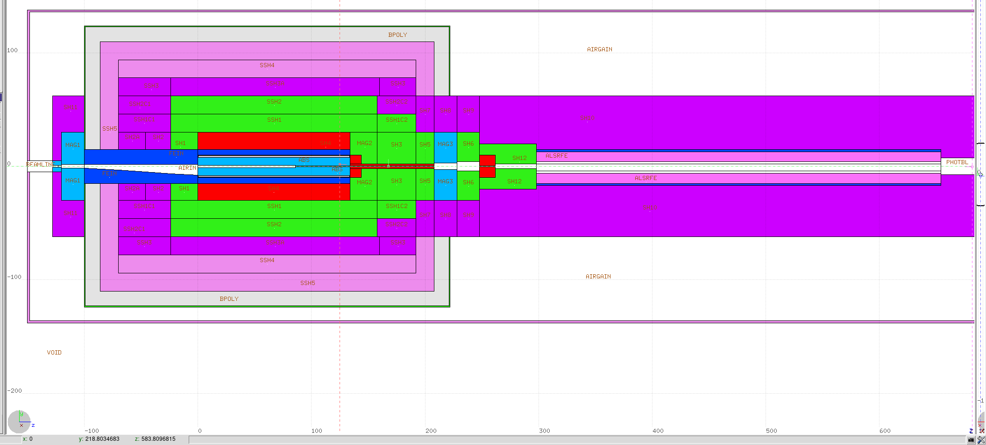
CPS Conceptual Model, Nov. 28 2022
Color corresponds to material density
Water, Borated Poly, Concrete, Barite, Iron, Copper, W powder, Cu20W80

Slide 4
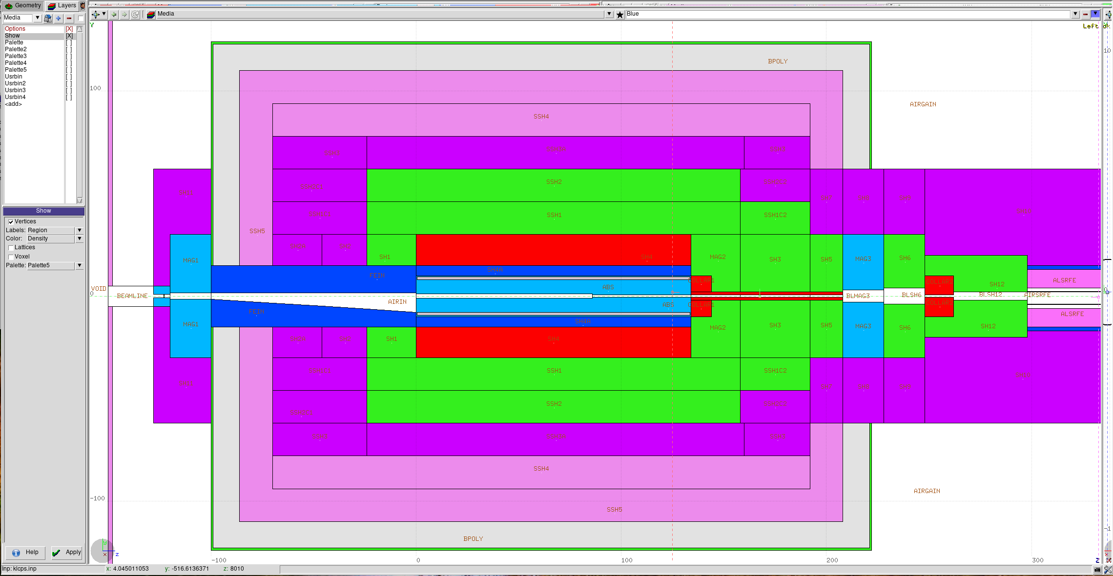
CPS Detail

Slide 5
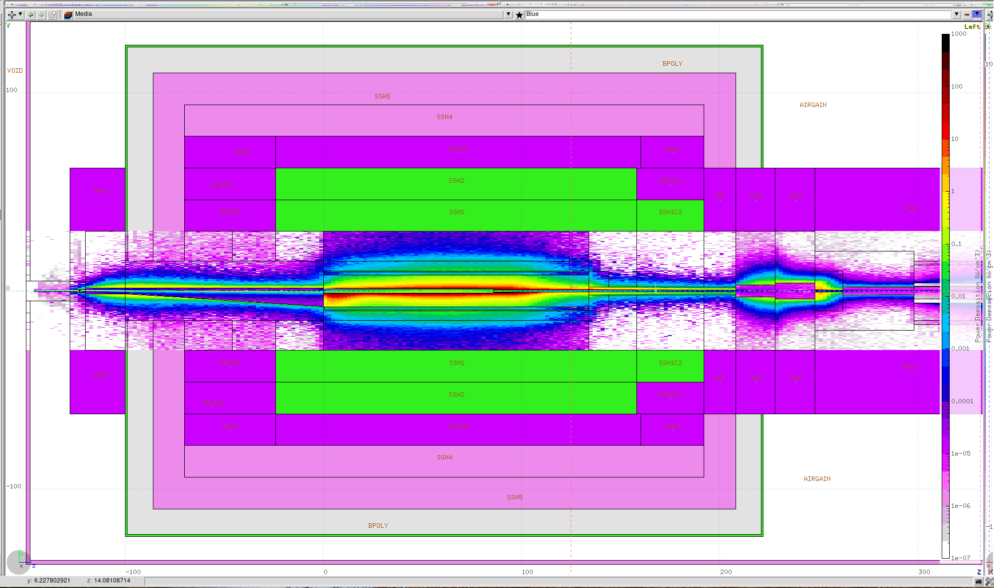
Power deposition in the central core (W/cm³)

Slide 6
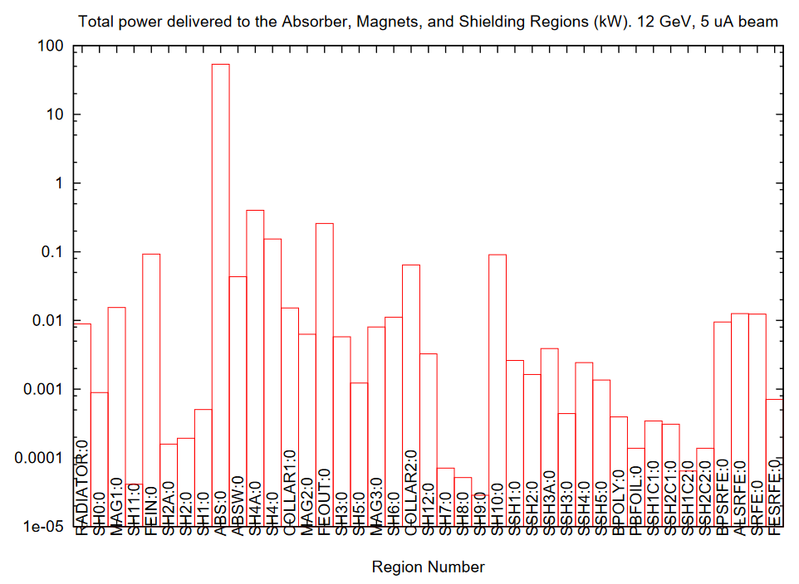
53.711 kW
Total in CPS: 54.941 kW
0.401 kW
0.258 kW

Slide 7
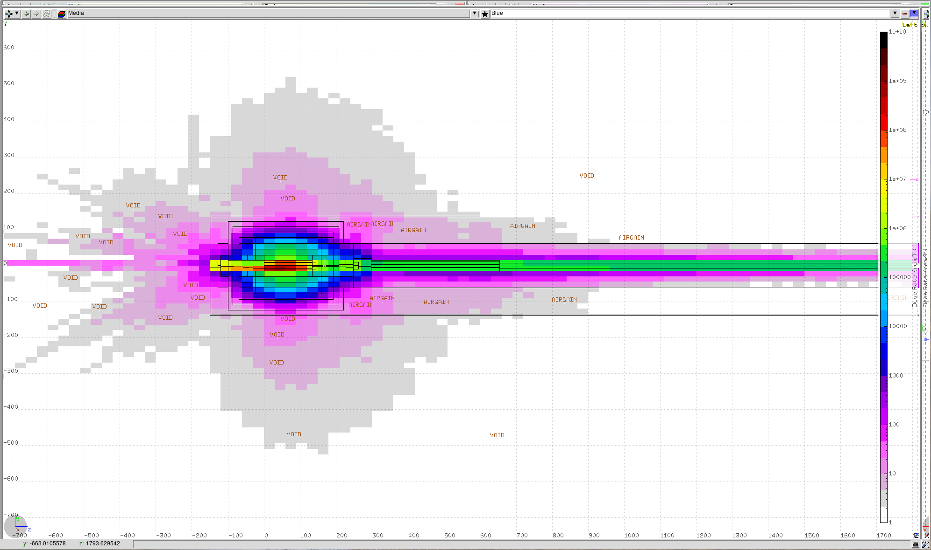
Dose Rates in the Tagger Enclosure

Slide 8
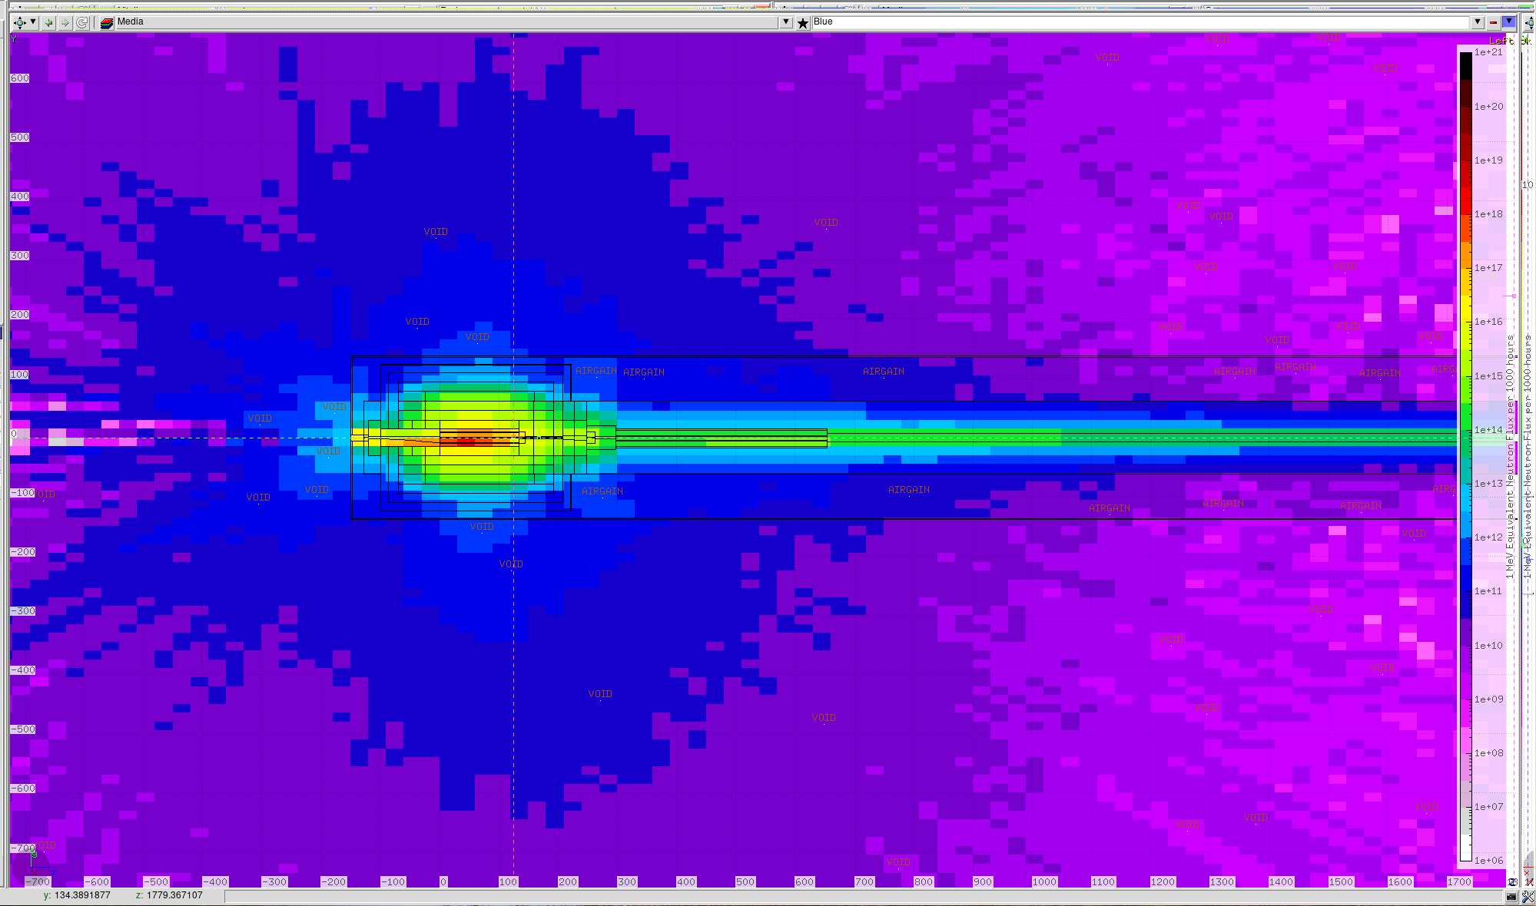
1 MeV Neutron Equivalent flux in the Tagger Enclosure

Slide 9
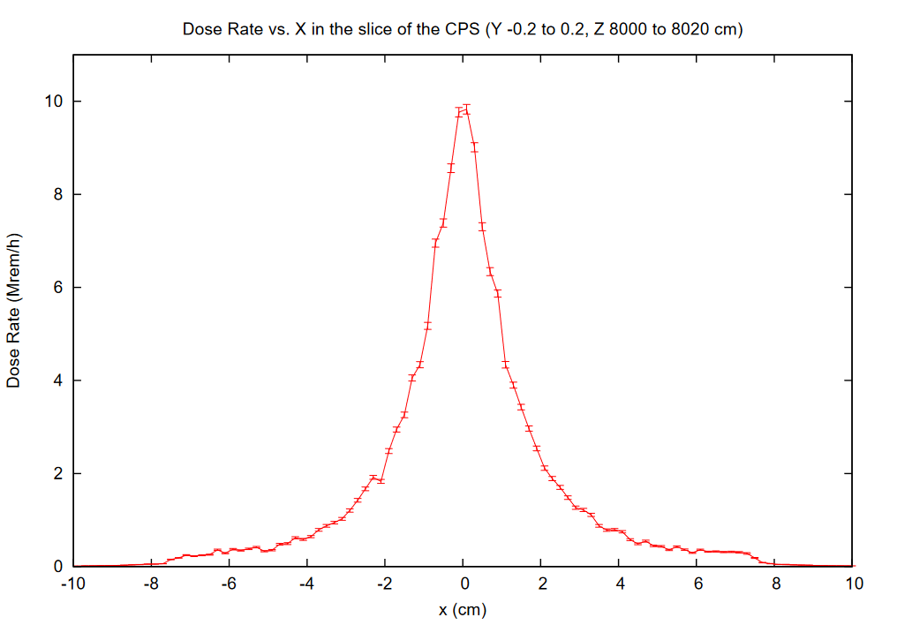
Cave Entrance:

Slide 10
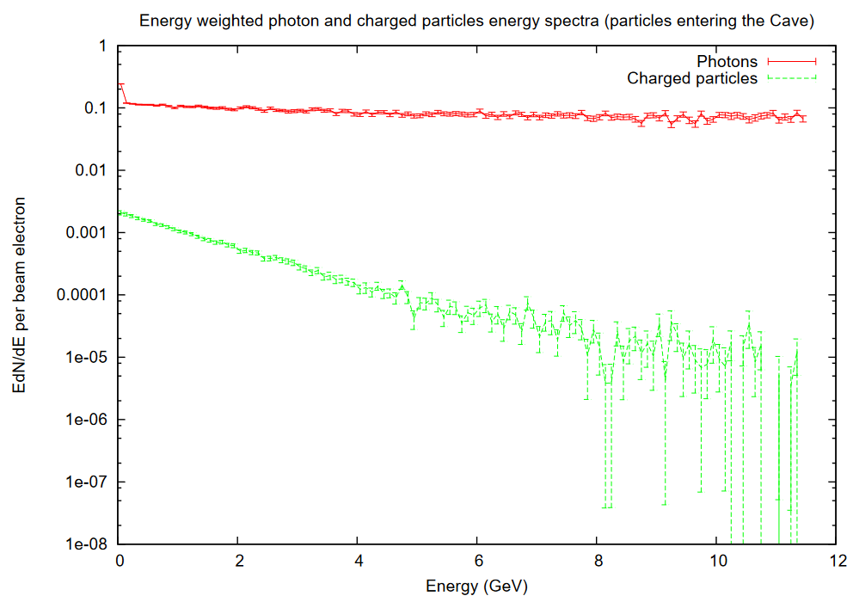
Cave Entrance:

