Slide 1
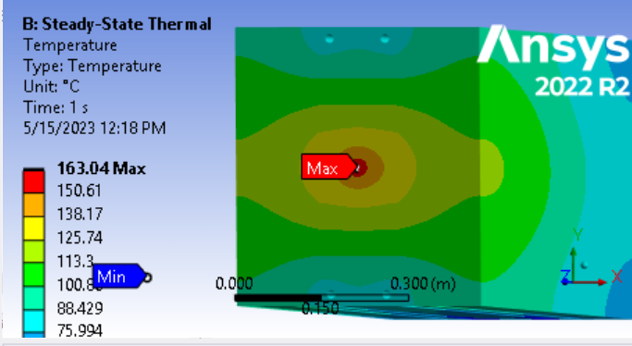
Vitaly bent coil, 47KW, copper, steel, lead center section, 45C water, perfect conduction

Slide 2
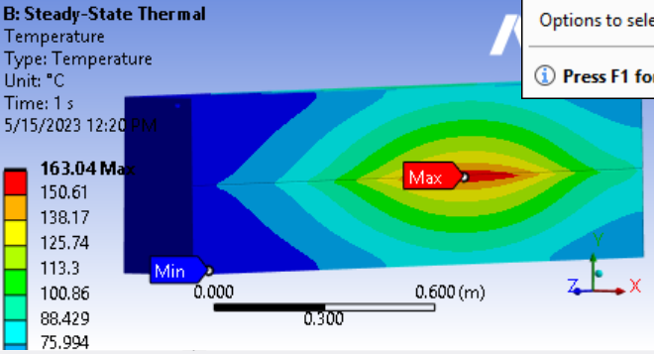
Vitaly bent coil, 47KW, copper, steel, lead center section, 45C water, perfect conduction

Slide 3
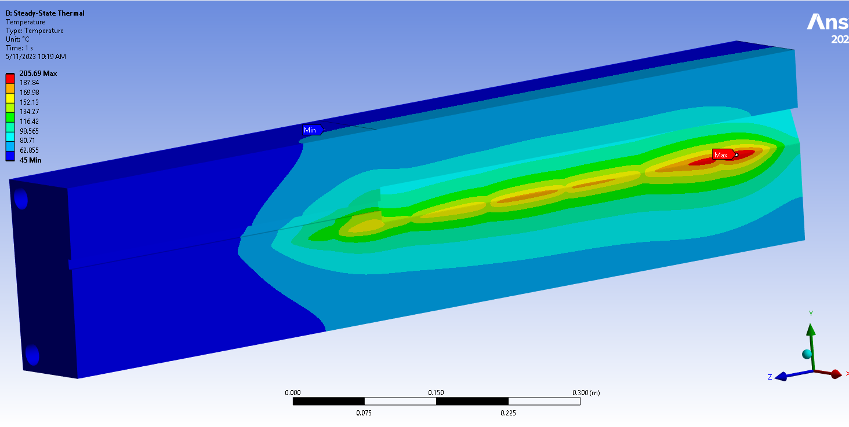
Pavel 64, 55KW

Slide 4
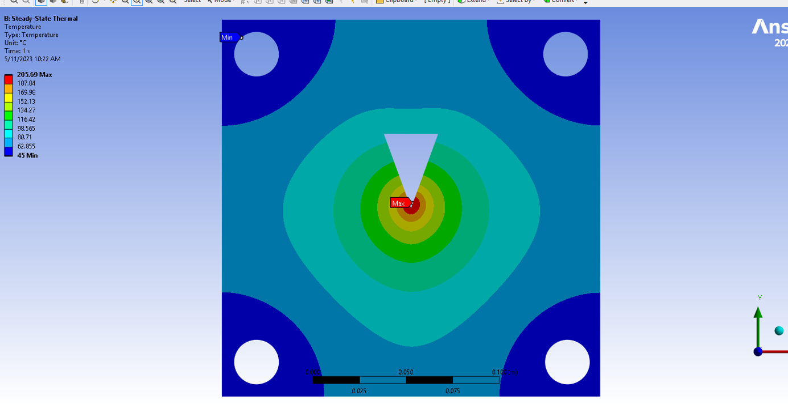
Pavel 64, 55KW

Slide 5
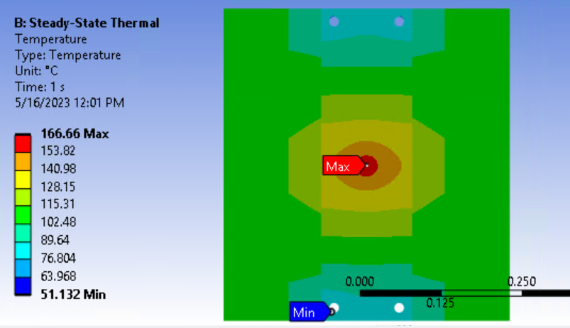
Vitaly bent coil, 47KW, copper, steel, lead center section, 45C water, 100 um air between bodies

Slide 6
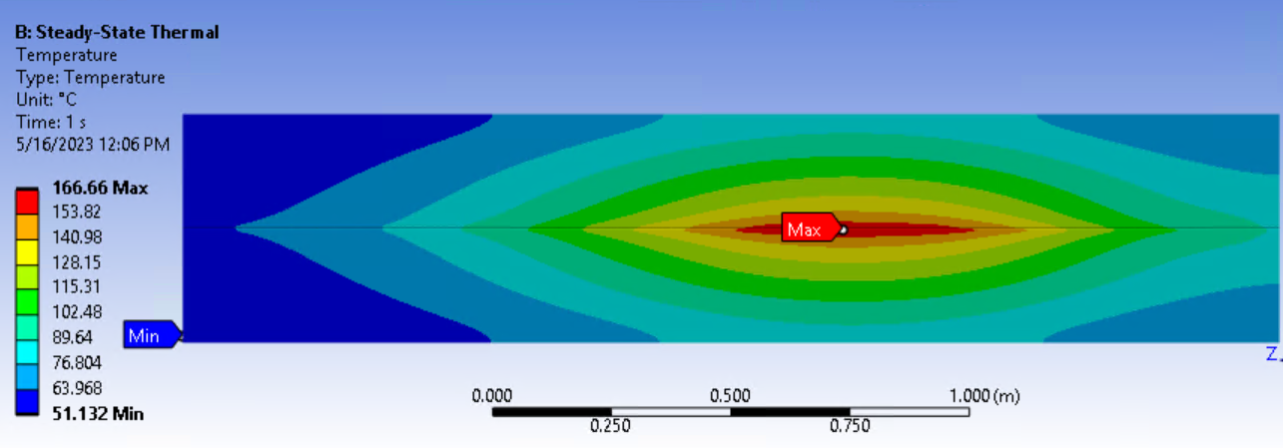
Vitaly bent coil, 47KW, copper, steel, lead center section, 45C water, 100 um air between bodies

Slide 7
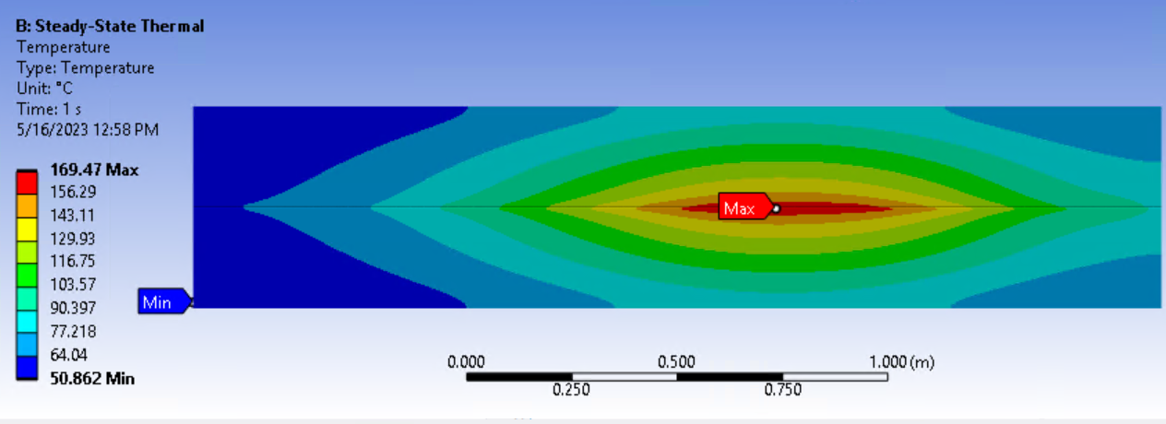
Vitaly bent coil, 47KW, copper, steel, lead center section, 45C water, 1 cm air between cu and steel,100 um air between steel and lead

Slide 8
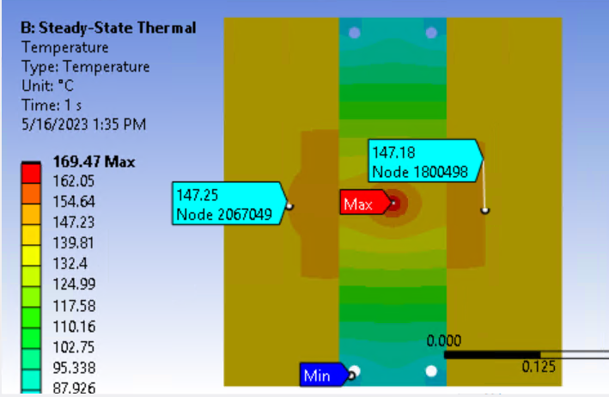
Vitaly bent coil, 47KW, copper, steel, lead center section, 45C water, 1 cm air between cu and steel,100 um air between steel and lead

Slide 9
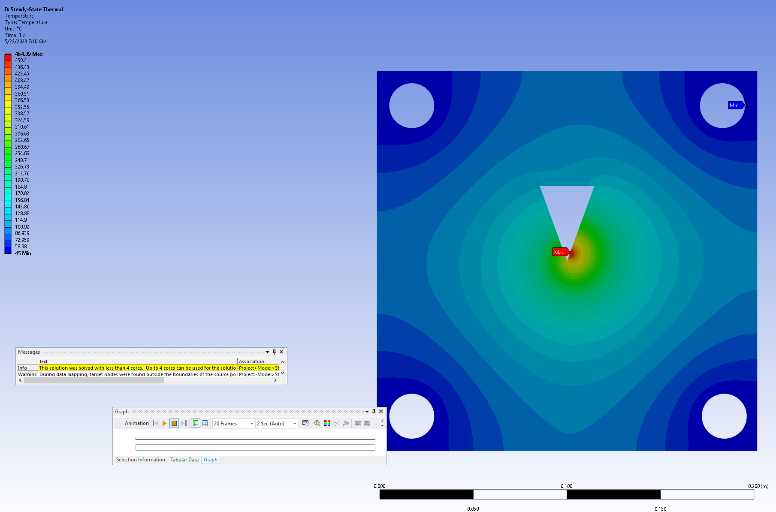
Pavel 64, 54KW, 1mRad off

Slide 10
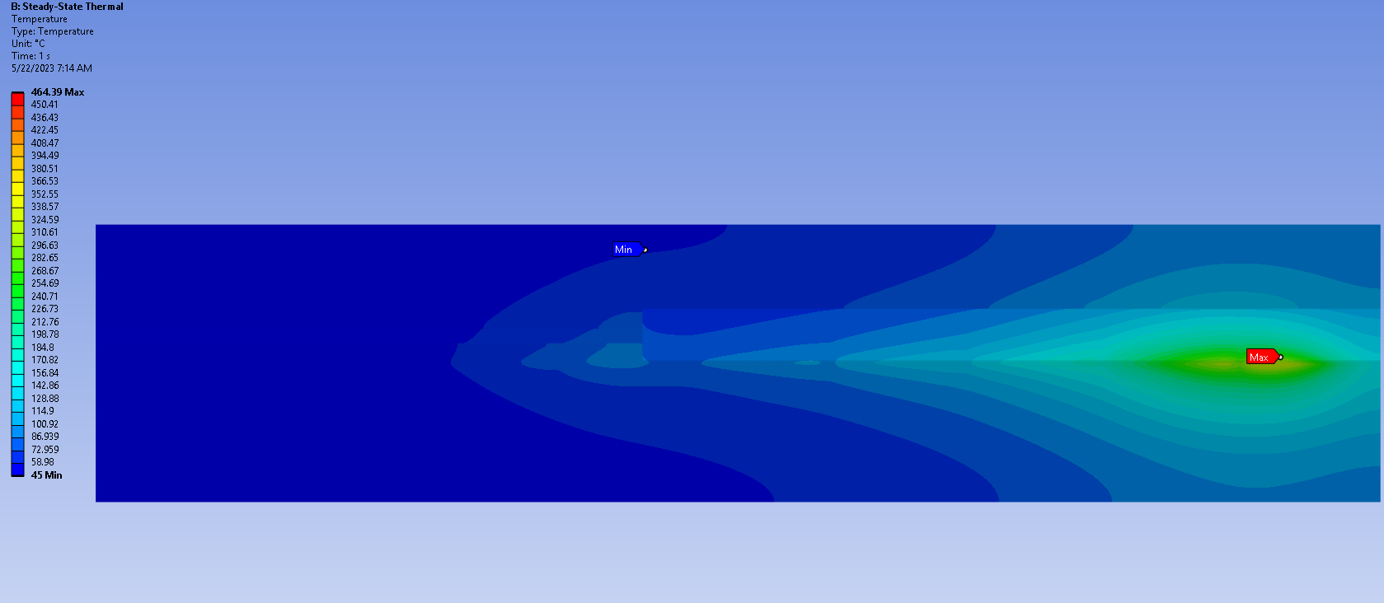
Pavel 64, 54KW, 1mRad off

Slide 11
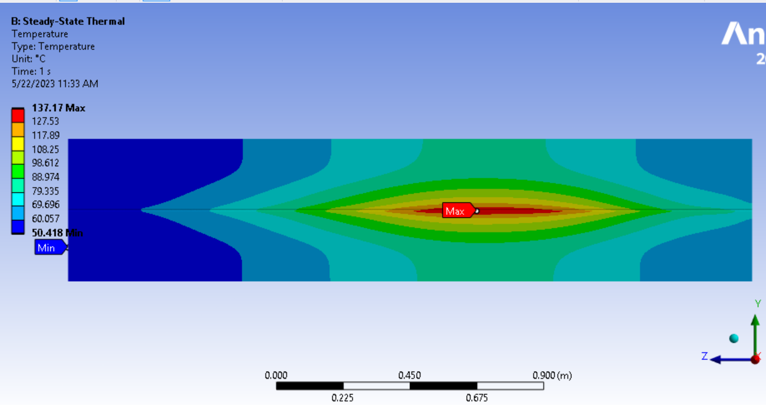
Vitaly bent coil, 47KW, copper, steel, lead center section, 45C water, 100 um air between bodies, water holes 13cm from center

Slide 12
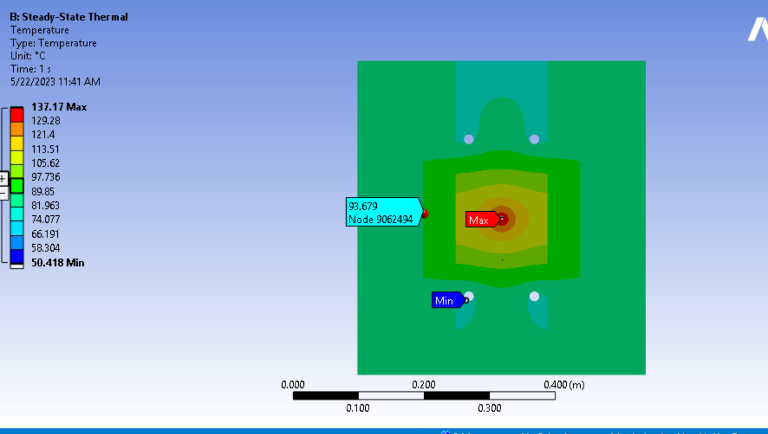
Vitaly bent coil, 47KW, copper, steel, lead center section, 45C water, 100 um air between bodies, water holes 13cm from center

