Slide 1
K⁰L CPS Meeting Dec 12, 2022
P. Degtiarenko

Slide 2
Original Features
First magnet is away from high radiation
Distance to allow main beam to get away from the photon line
Beam entry chamber, direct cascade products not visible in the photon line
Second magnet not used
Essentially full energy absorption in the dump
Dense CuW shielding material to minimize total weight
New Features
Shorter design with higher BdL in the first magnet
Wedge shape of the beam entry chamber to better dissipate beam power
Combination of the shielding materials to optimize between the cost and weight (lower densities result in larger total weight)

Slide 3
Absorber Design Update
The proposed solution for the Absorber combines:
The entrance chamber in the shape of a wedge
The main beam energy deposition is along the tip of the wedge
The first part of the photon beam channel follows the wedge chamber
First-order E-M cascade products in the dump chamber cannot go along the photon channel, limiting the radiation streaming along the channel
Suggested to be built out of two left/right symmetric half-cylinders
The entrance cavity and the photon line machined out of flat surfaces
When assembled, the absorber operates similarly to JLab beam dumps
Absorbs bulk of the power (currently over 98% of all CPS power)

Slide 4
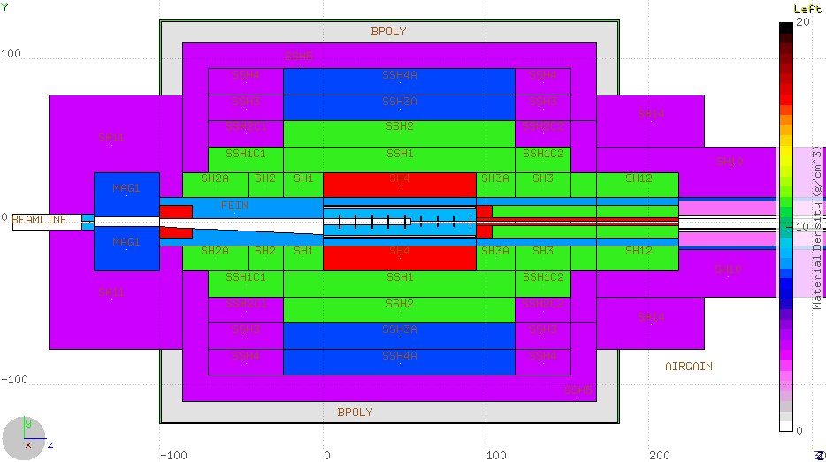
Conceptual Design Update: CPS Shorter by ~50%
Density Color Map WPowder Iron Barite Sr/Fe/O/Al
Lead
Stainless
Iron
Copper
CuW alloy
Water
Borated Poly
1m
1 m

Slide 5
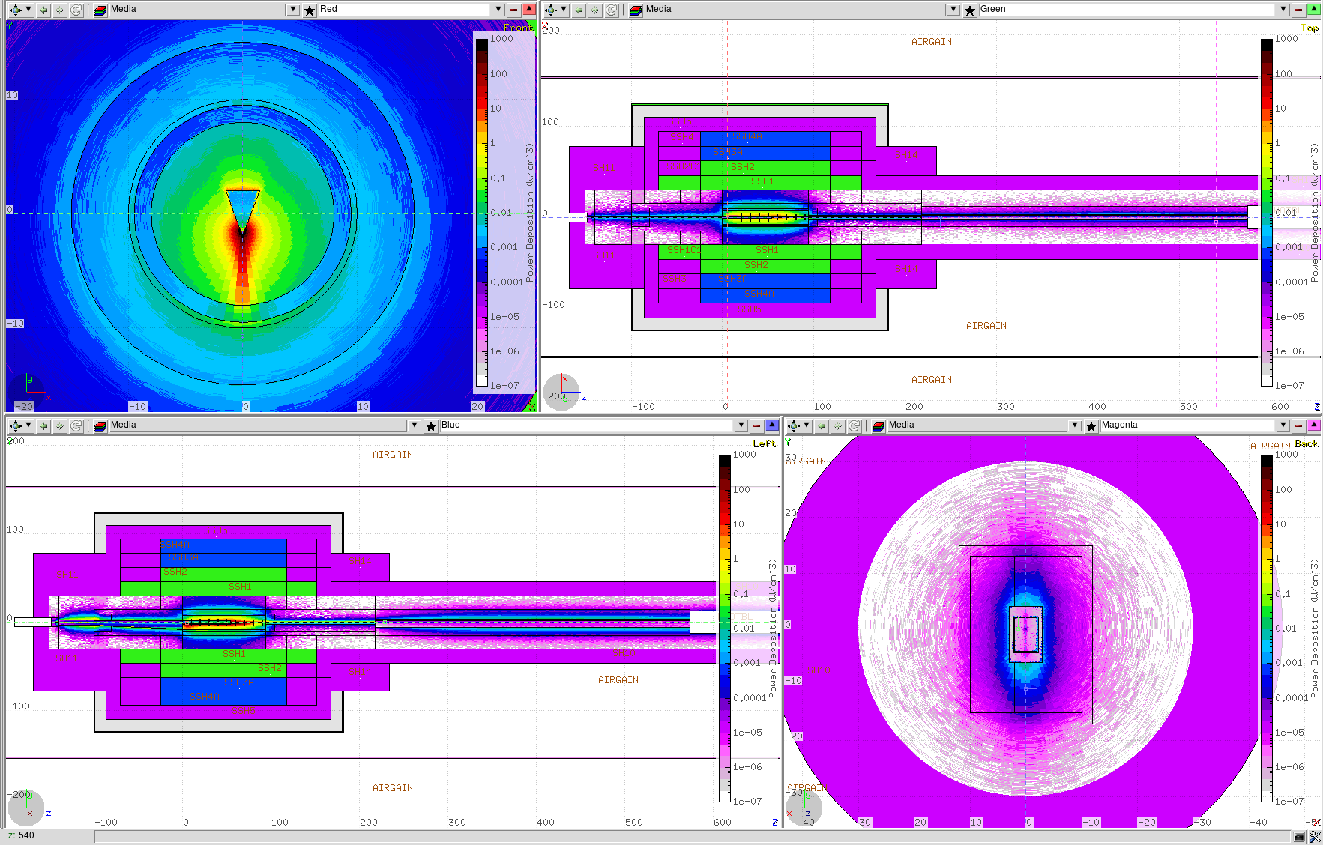
Dose Rates Inside the CPS
Power deposition along the CPS core

Slide 6
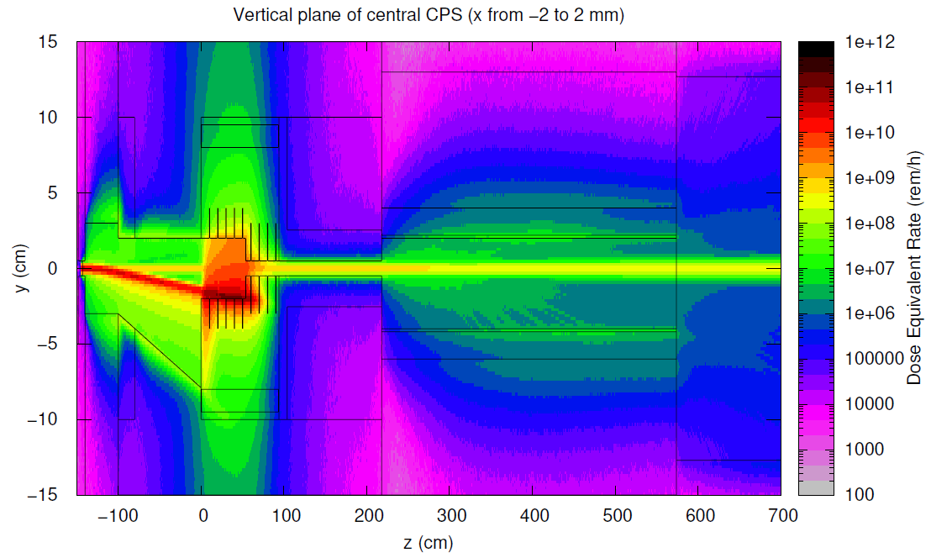
Dose Rates inside the CPS along Beam

Slide 7
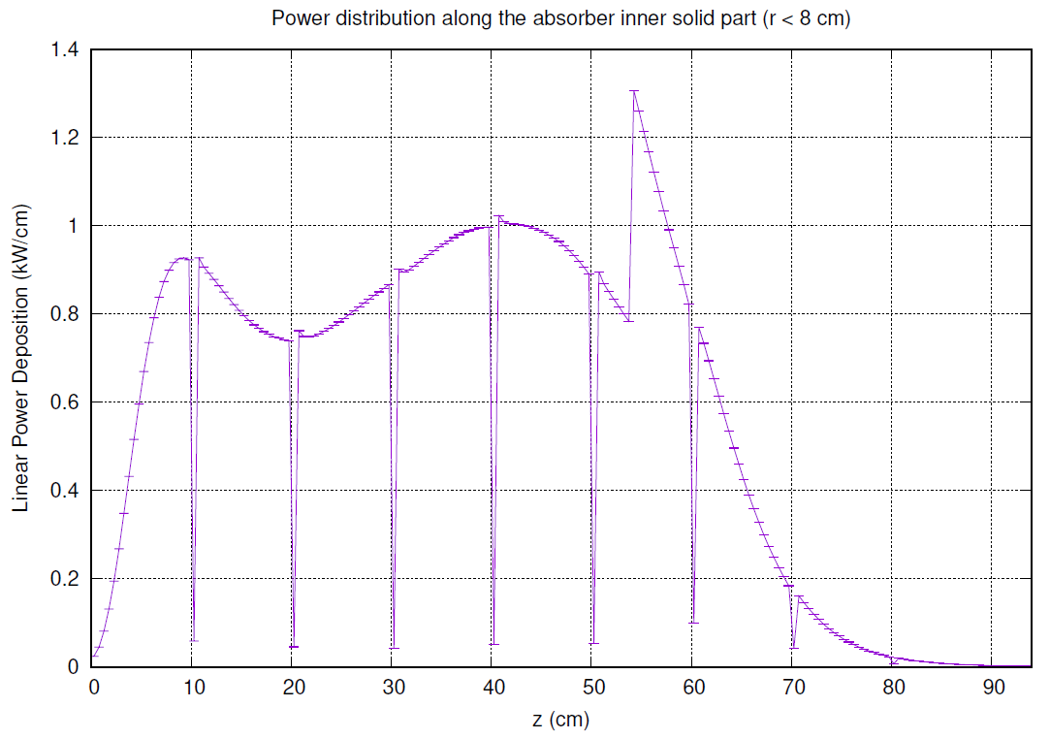
Over 98% of the full CPS power left in absorber
~Uniform along z
Concentrated at the wedge tip
No first-order cascade products go along the photon beam line
Symmetric power deposition in x,y below and around the tip

Slide 8
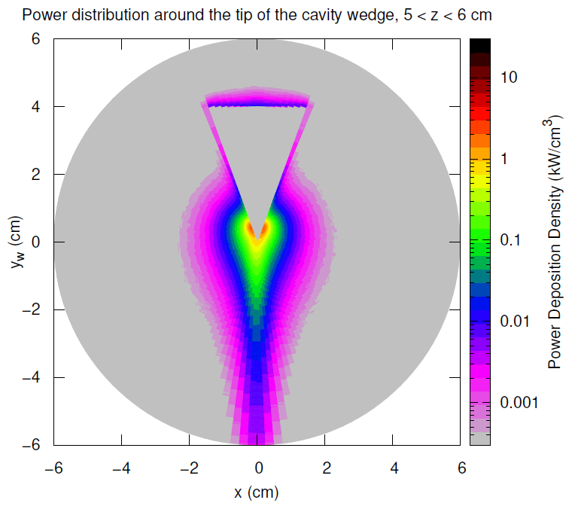
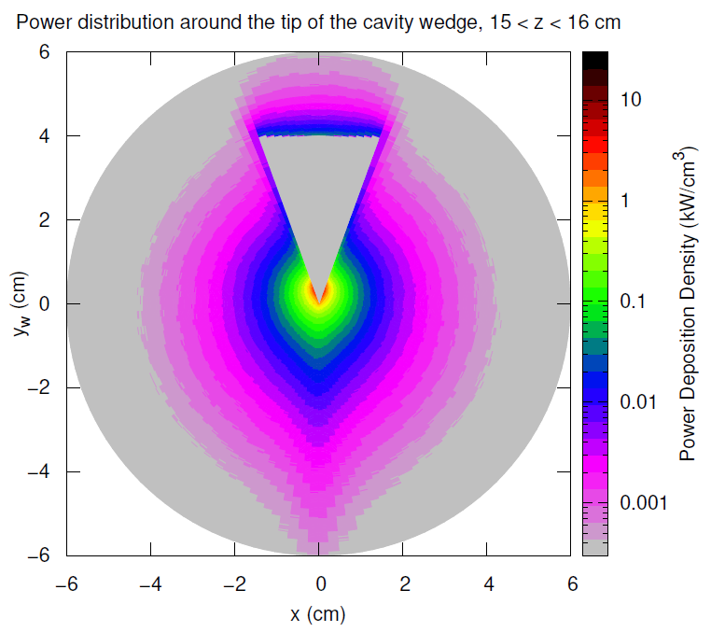
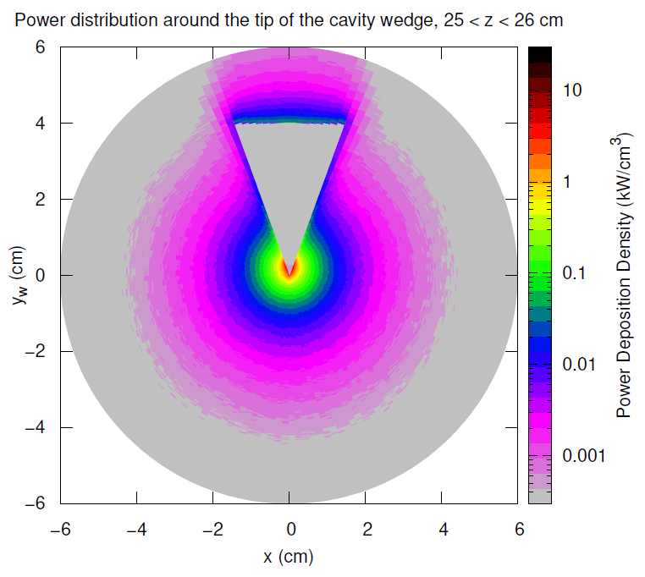
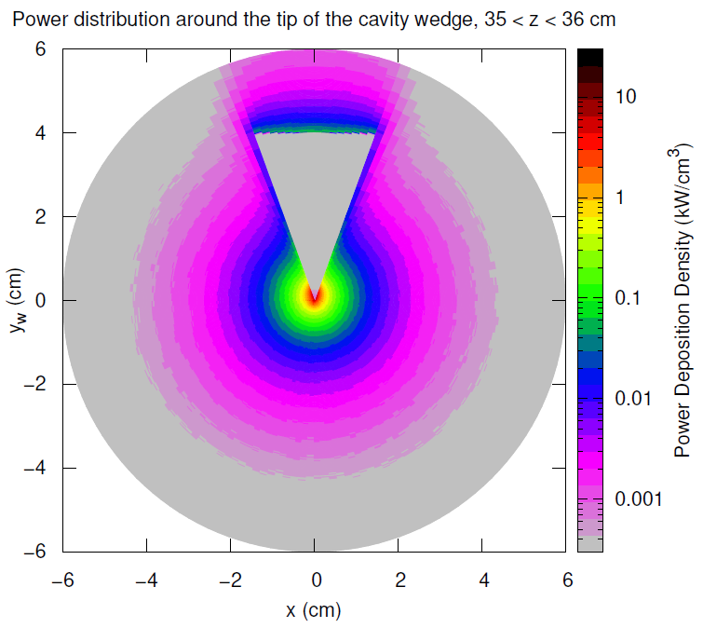
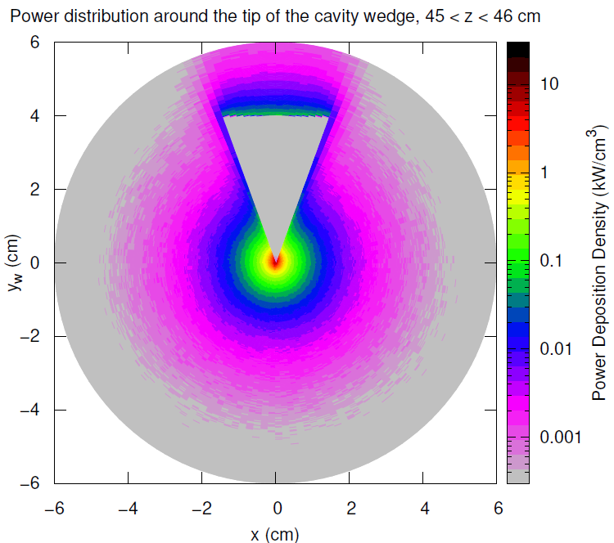
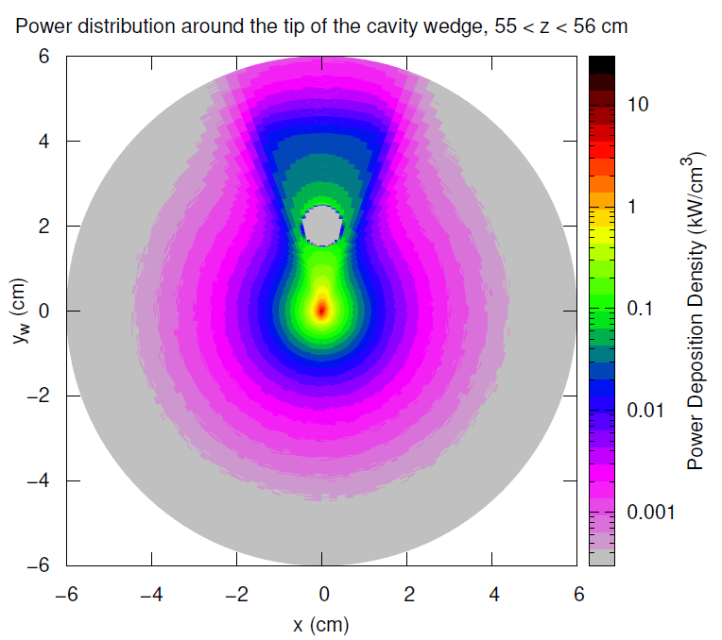
Power density around the tip of the wedge
Max power density at the tip ~7 kW/cm³
Z = 5 cm
Z = 15 cm
Z = 25 cm
Z = 35 cm
Z = 45 cm
Z = 55 cm

Slide 9
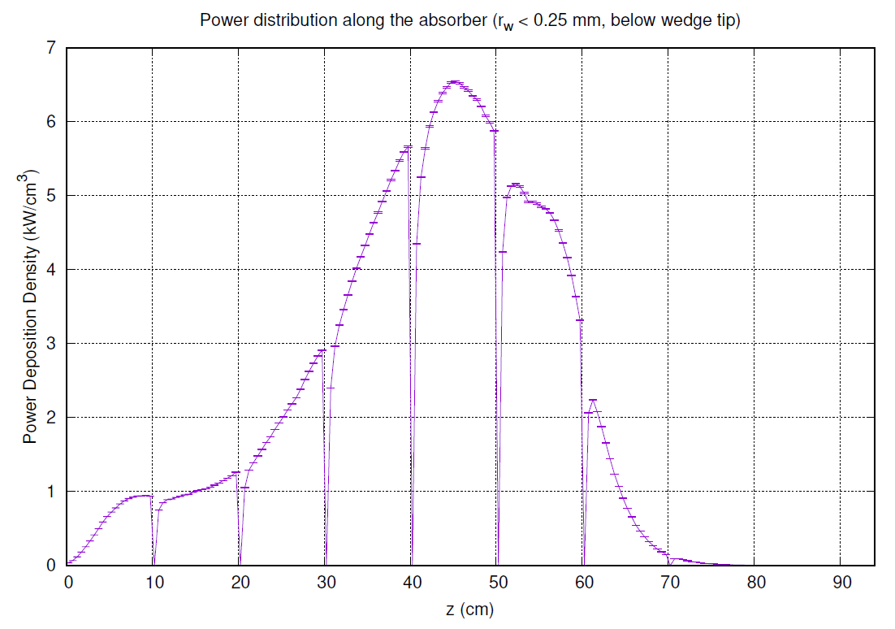
Maximum power density, y < -2 cm , r_{w} < 0.25 mm
Max ~7 kW/cm³
Location z ~45 cm
Radial (around the wedge tip) distribution can be used for the temperature evaluation

Slide 10
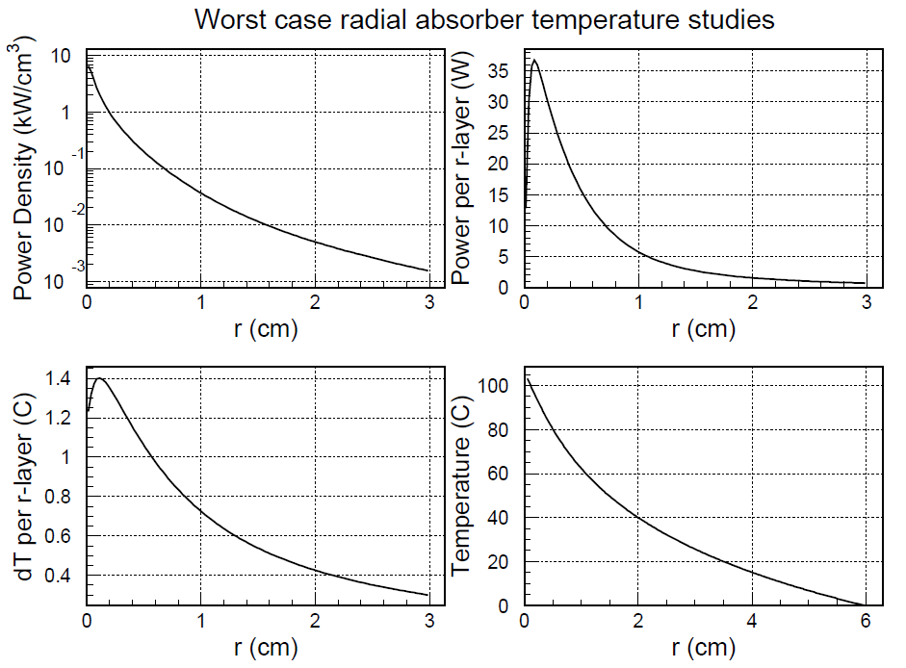
Worst case temperature evaluation
(a) Radial power density distribution
(b) Power per radial layer of 1 cm length
(c) Change in temperature in the neighboring layers assuming cumulative power inside
(d) Full temperature rise from outside to the center
(a)
(b)
(c)
(d)

Slide 11
Online tool at https://thermal.mayahtt.com
Using the thermal conductivity of copper:
k = 385 W/(m K)

Slide 12
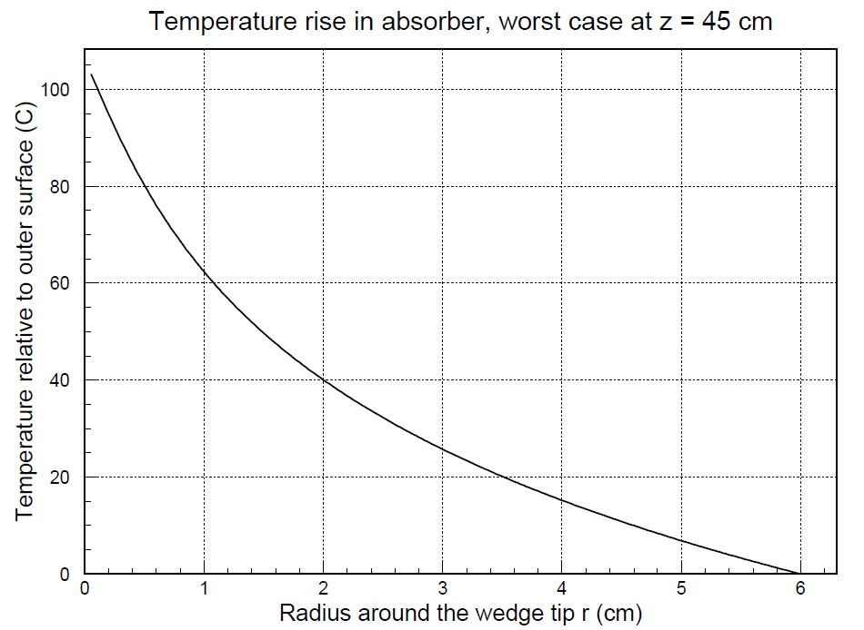
Worst case temperature evaluation
Full temperature rise from outside to the center

Slide 13
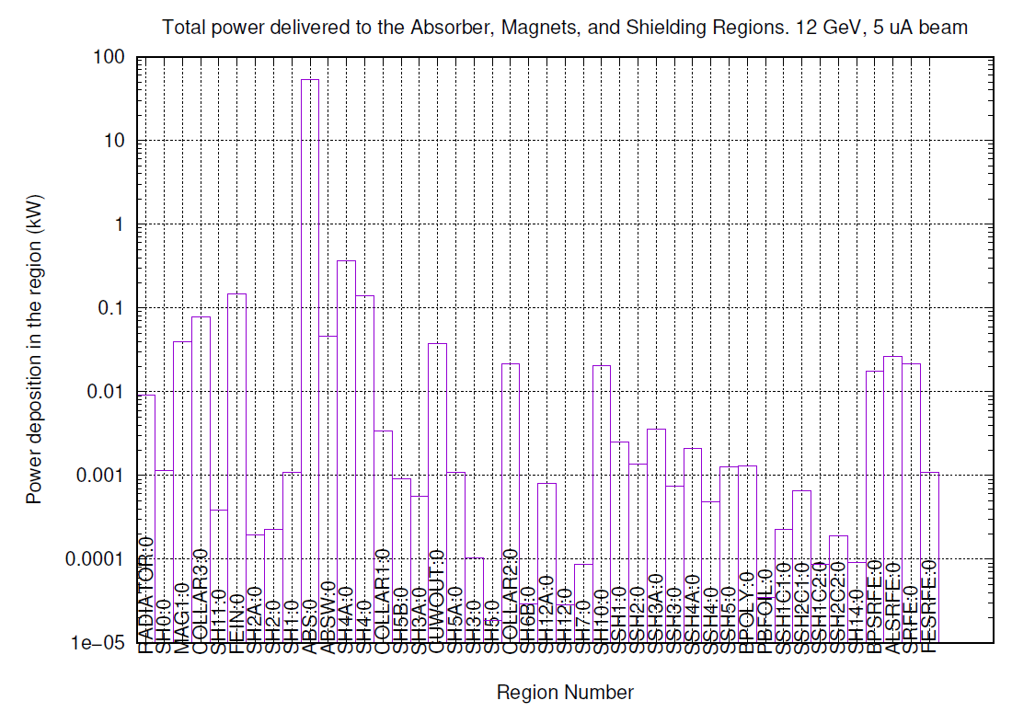
Bulk of power in CPS stays in Absorber (98%)
Absorber: 53.86 kW
Total: 54.85 kW
Plate under absorber: 368 W
In line: 147 W
Next shielding layer: 139 W

Slide 14
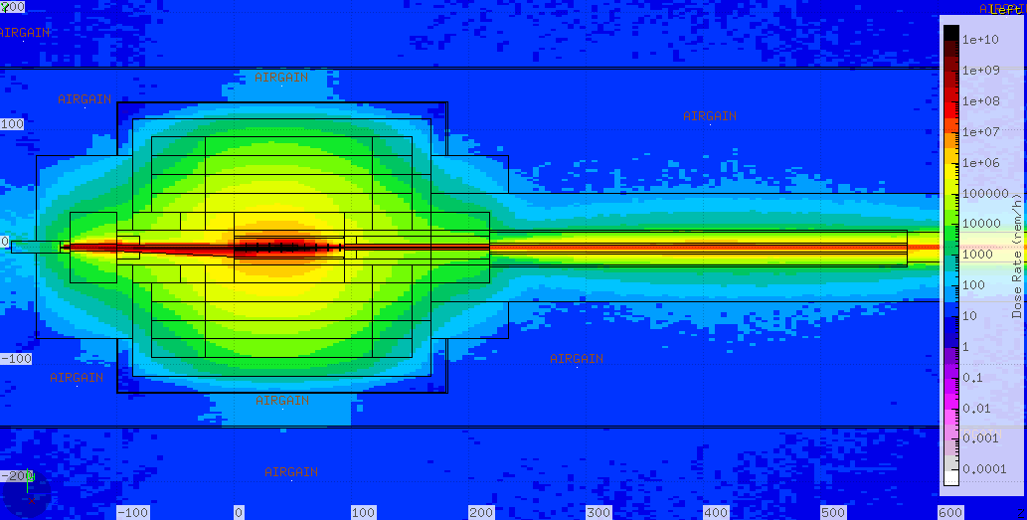
Prompt Dose Eq. Rates around the CPS

Slide 15
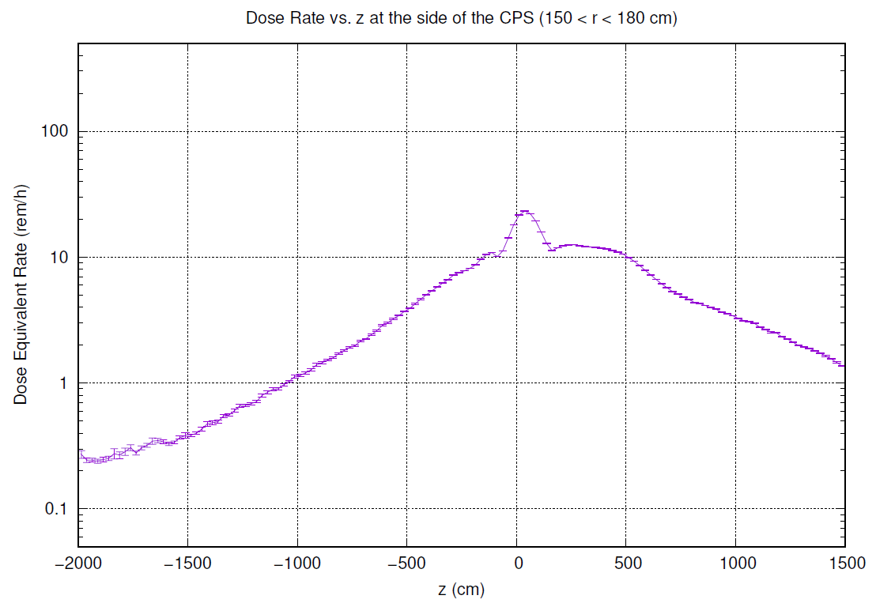
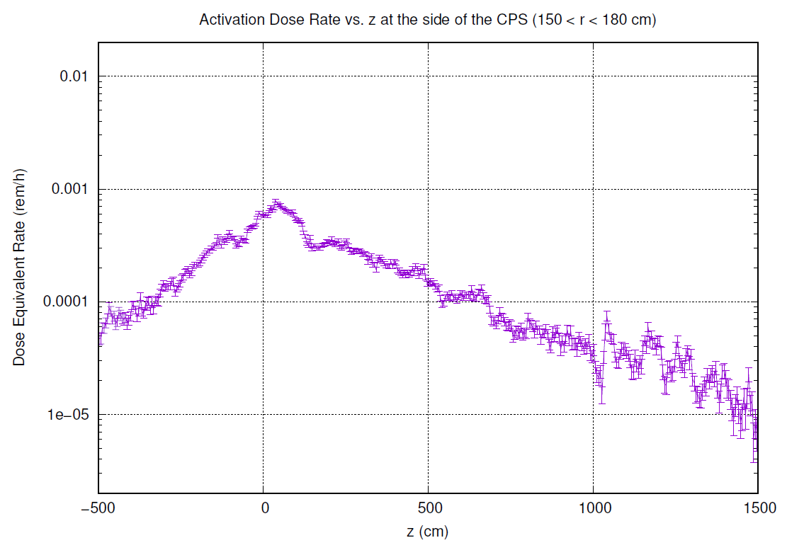
Dose Eq. Rates around the CPS
Prompt
Activation, 1 hour

Slide 16
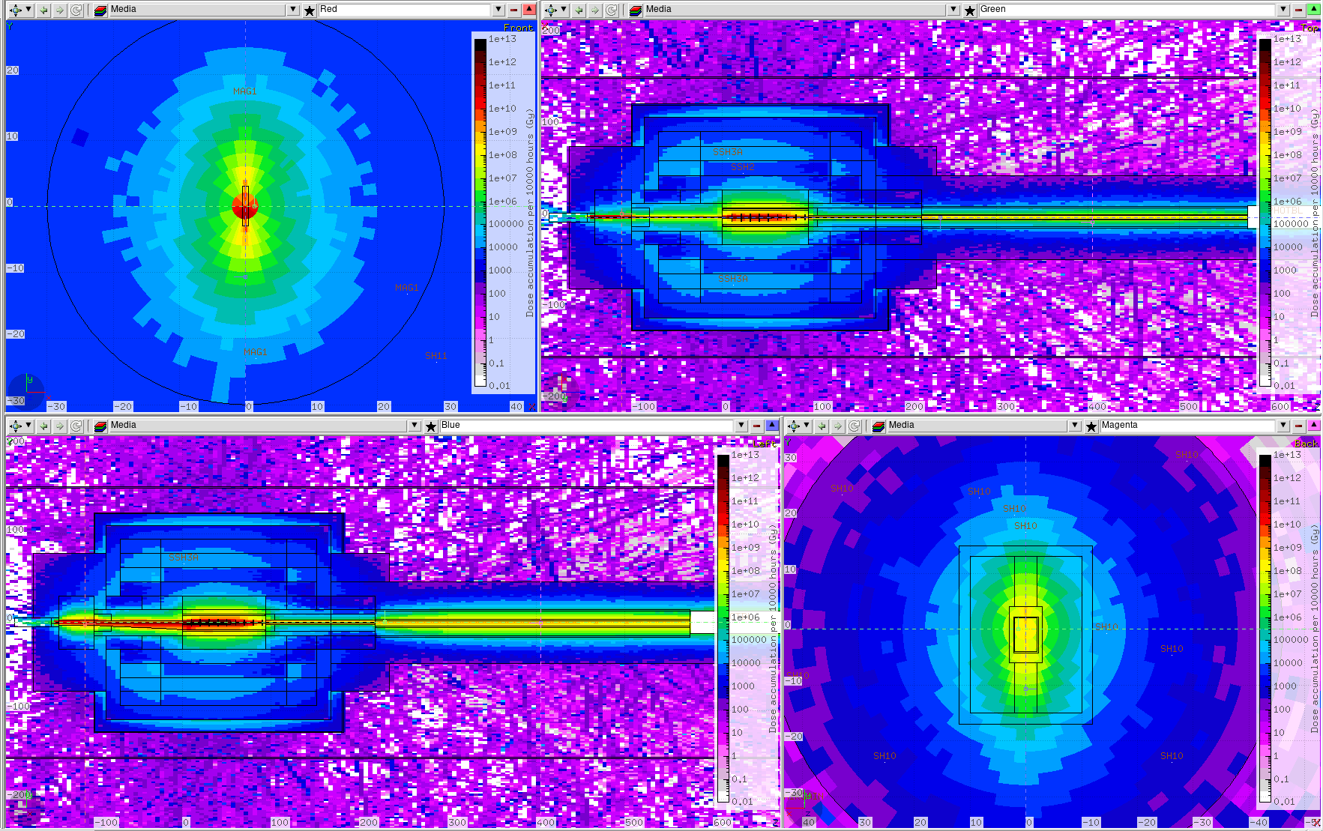
Accumulated Doses around the CPS (10000 h)
Under 10⁵ Gy at 10 cm from the beam, first magnet
Under 10⁷ Gy at the strontium ferrite for the permanent magnet

Slide 17
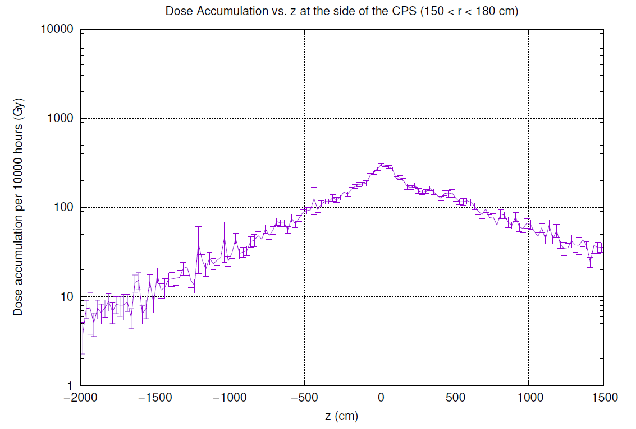
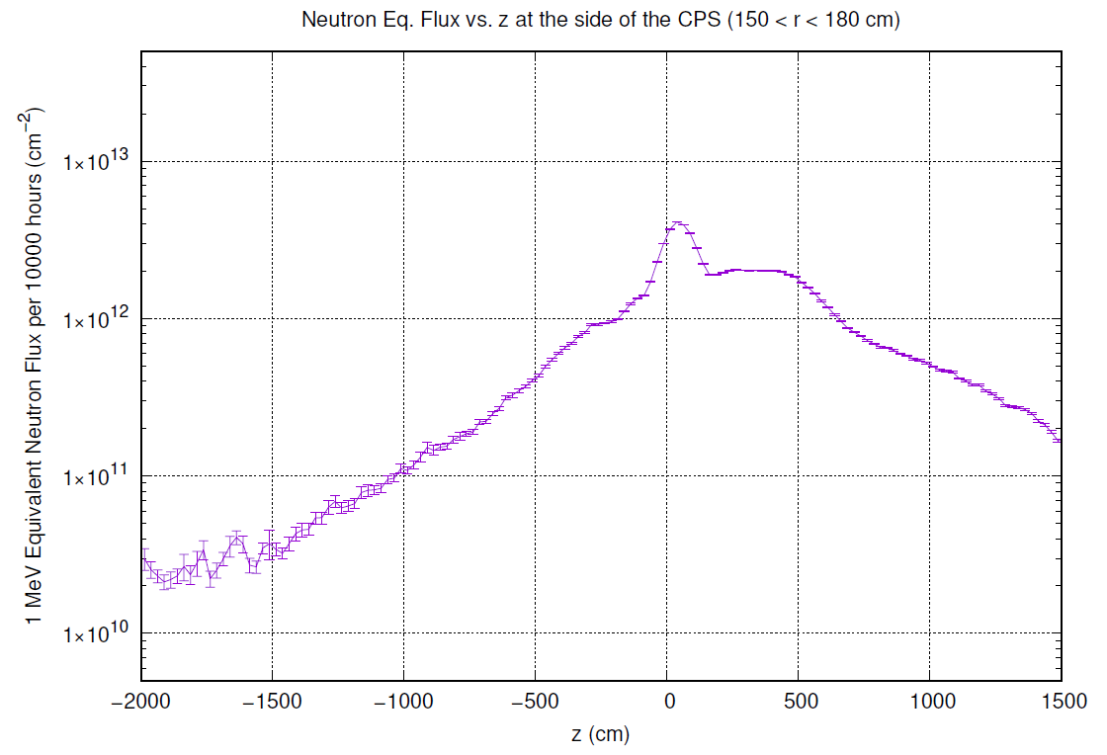
Dose Accumulation 1-MeV Neutron Eq. Flux

Slide 18
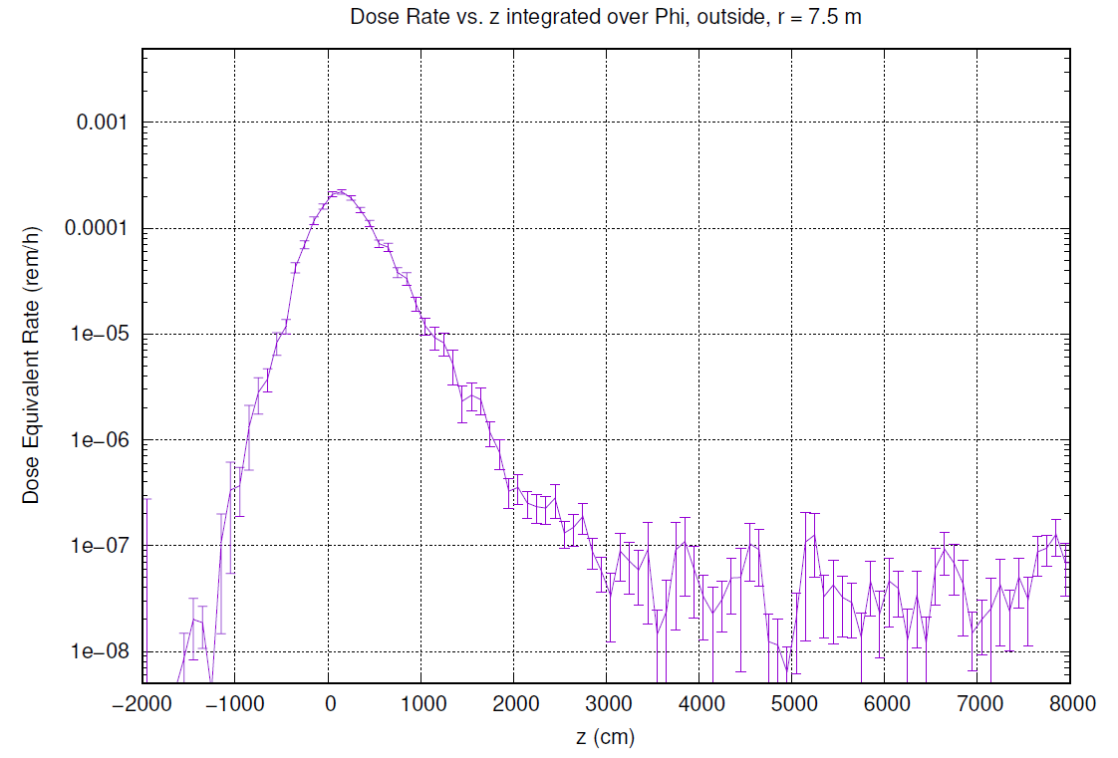
Prompt Dose Eq. Rates Outside
Very approximate model for the berm above the photon pipe

Slide 19
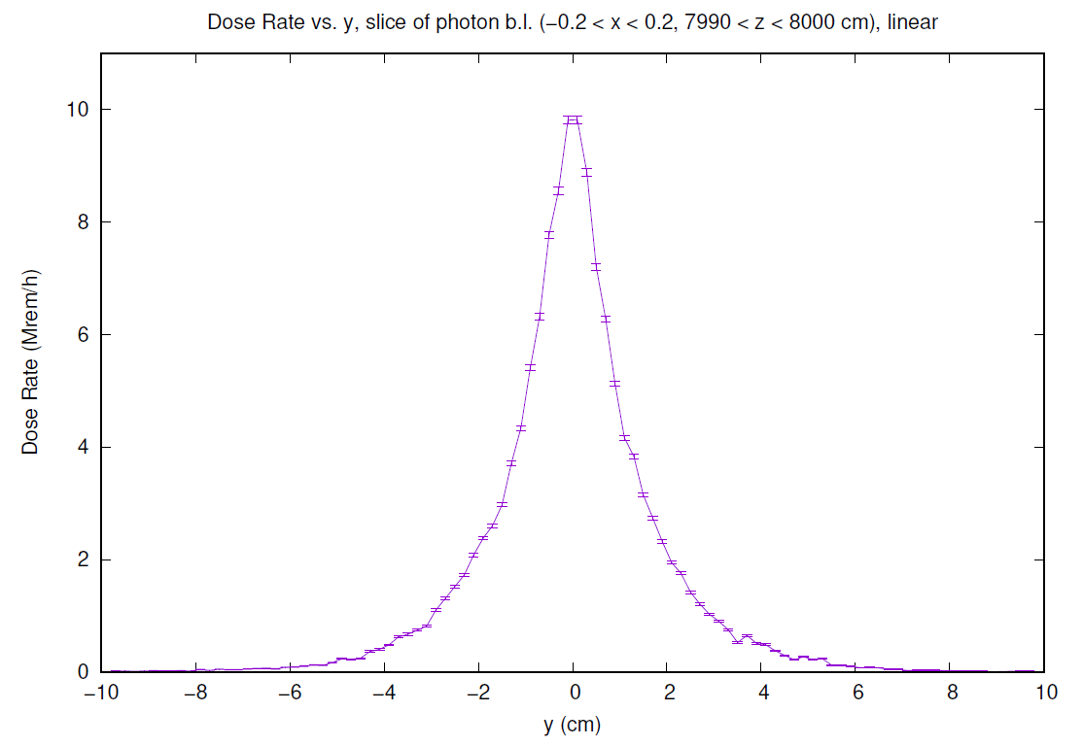
Photon Beam Quality at 80 m
Presented as the dose eq. rate function of Y in a slice of X

Slide 20
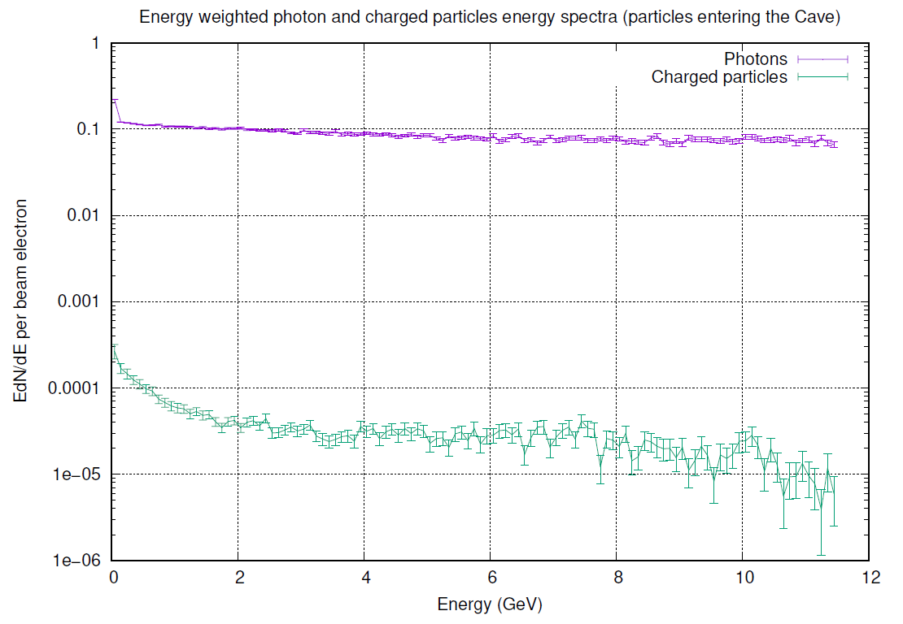
Energy-weighted spectra of photons and e⁺/e⁻

