Slide 1
K⁰L CPS Meeting May 15, 2023
P. Degtiarenko

Slide 2
Design Update – May 2023
Implemented Hovanes’ design of the magnet and the field map
Increased outer shielding layer to achieve the goal of having the prompt dose rates below 10 rem/h 1 foot from the CPS
Reintroduce the lead skin at the outer surface to limit the dose rates due to activation to the level below 1-5 mrem/h
Ran few simulations to check the power deposition pattern as a function of magnetic field
Slight modification of the electron beam line after the magnet to make lower energy electrons cascade further in the entry chamber
Minor optimization of the photon beam line
Adding some Pb skin to firther limit the activation radiation

Slide 3
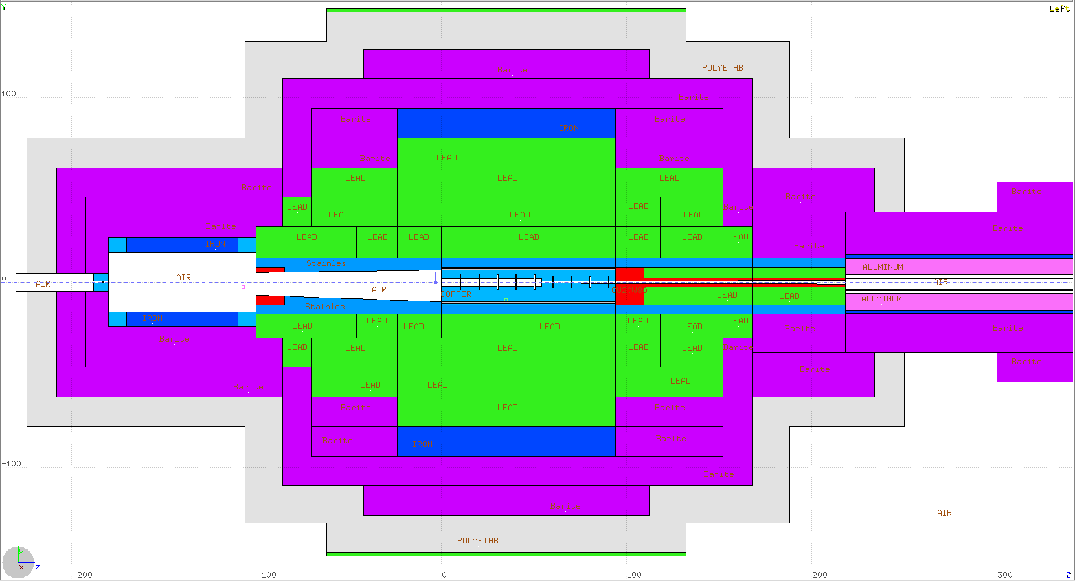
May’2023 Conceptual Design Update
Density Color Map Lead Iron Barite Sr/Fe/O/Al
Lead
Stainless
Magnet
Copper
CuW alloy
Water
Borated Poly
1m
1 m

Slide 4
Runs with Varying Beam Parameters, v.64
klcps64/fld90/ → Magnet field at 90% nominal value
fld110/ → Magnet field at 110% nominal value
fwhm2500/ → Gaussian beam with FWHM at 2.5 mm (standard)
fwhm250/ → Gaussian beam with FWHM at 0.25 mm
xrt0.1/ → Standard beam, shifted by +1 mm in X
yup0.1/ → Standard beam, shifted by +1 mm in Y
ydwn0.1/ → Standard beam, shifted by -1 mm in Y
xar1mr/ → Standard beam, angle in X shifted by 1 mrad
yau1mr/ → Standard beam, angle in Y shifted by 1 mrad
yad1mr/ → Standard beam, angle in Y shifted by -1 mrad

Slide 5
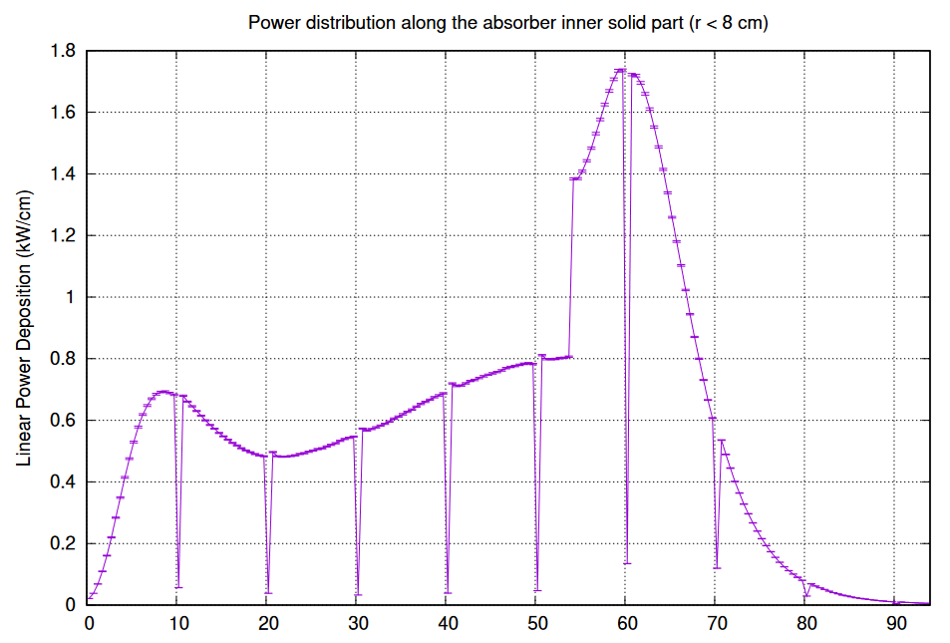
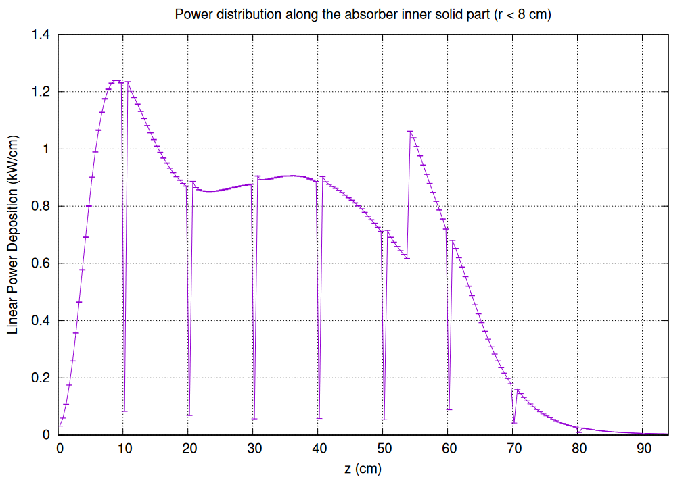
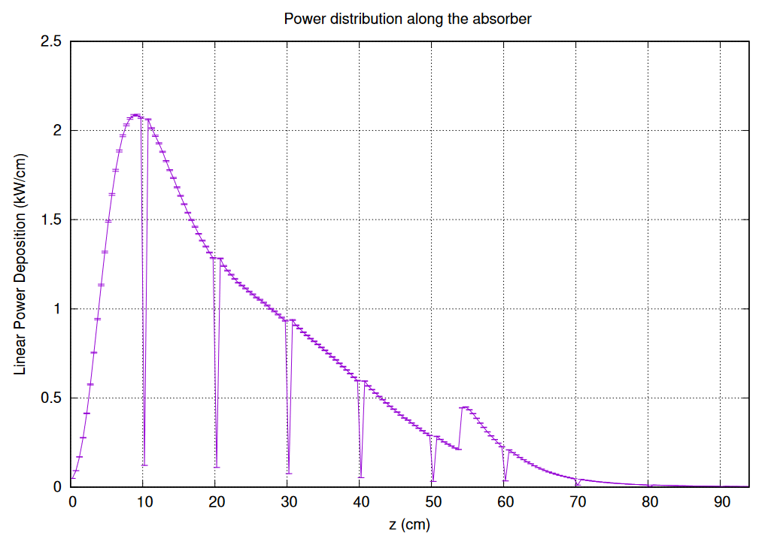
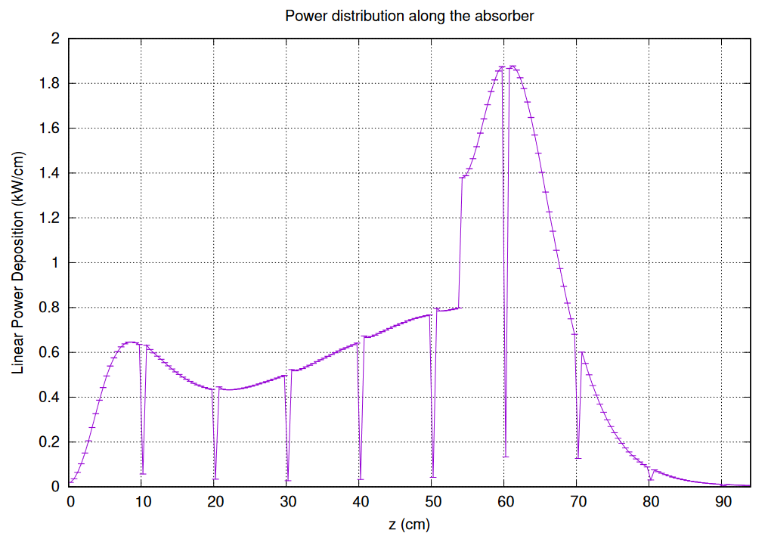
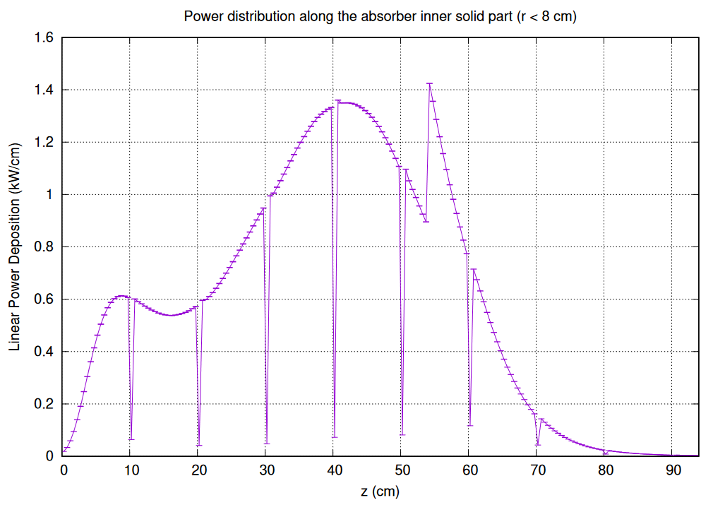
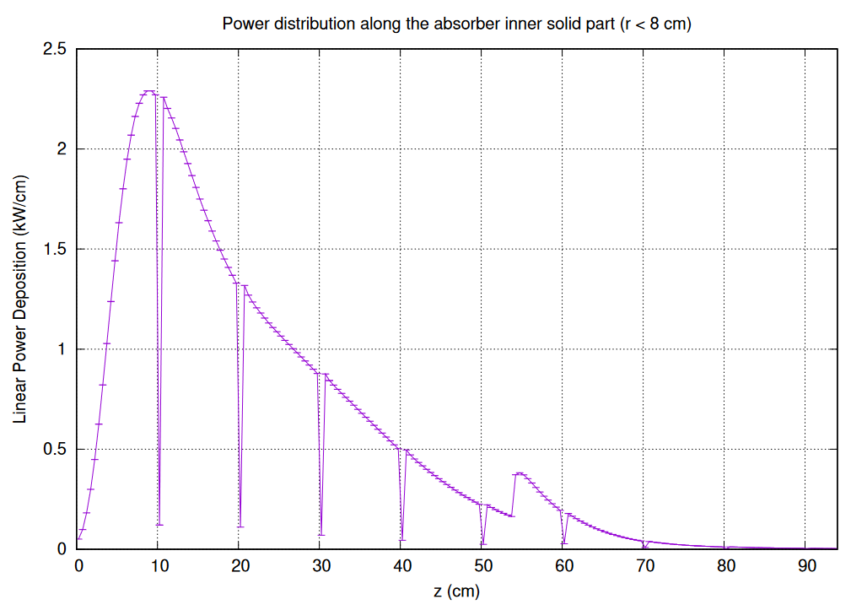
Linear Power Distribution in Absorber in kW/cm
Mag.Fld.90%
Mag.Fld.100%
Mag.Fld.110%
Beam Y angle at +1 mrad
FWHM at 0.25 mm
Beam Y angle at -1 mrad, similar to beam X angle at +1 mrad

Slide 6
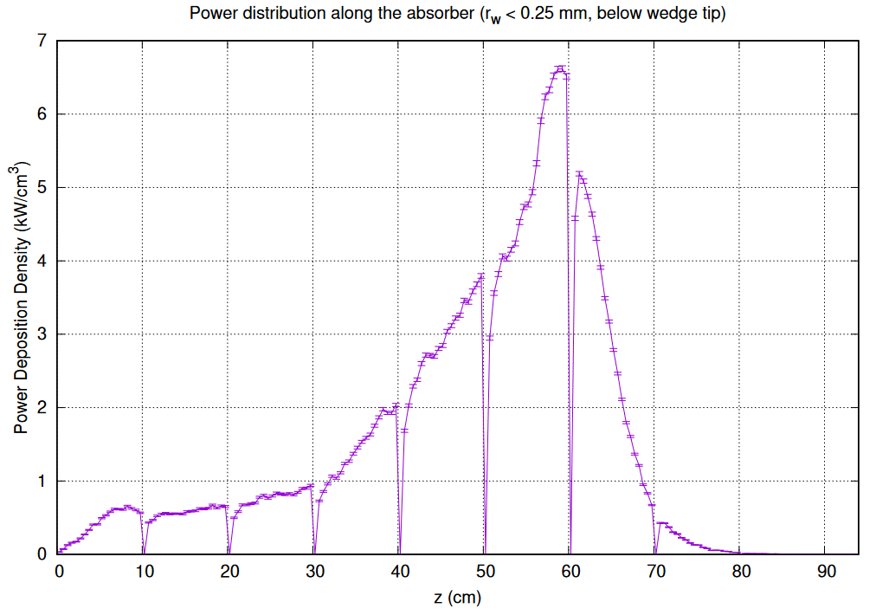
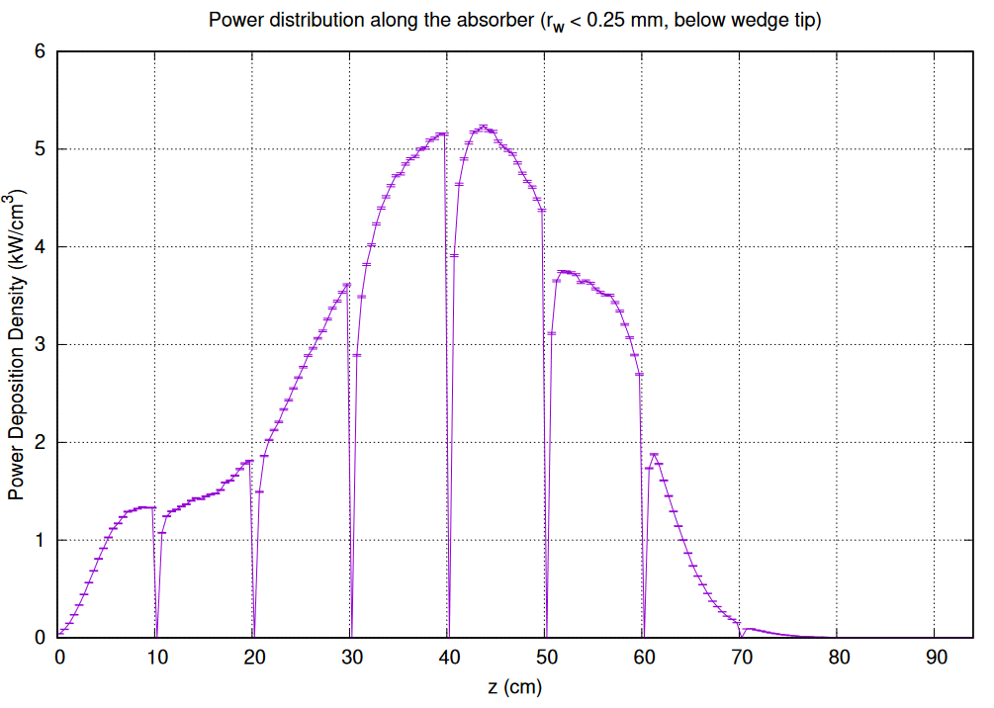
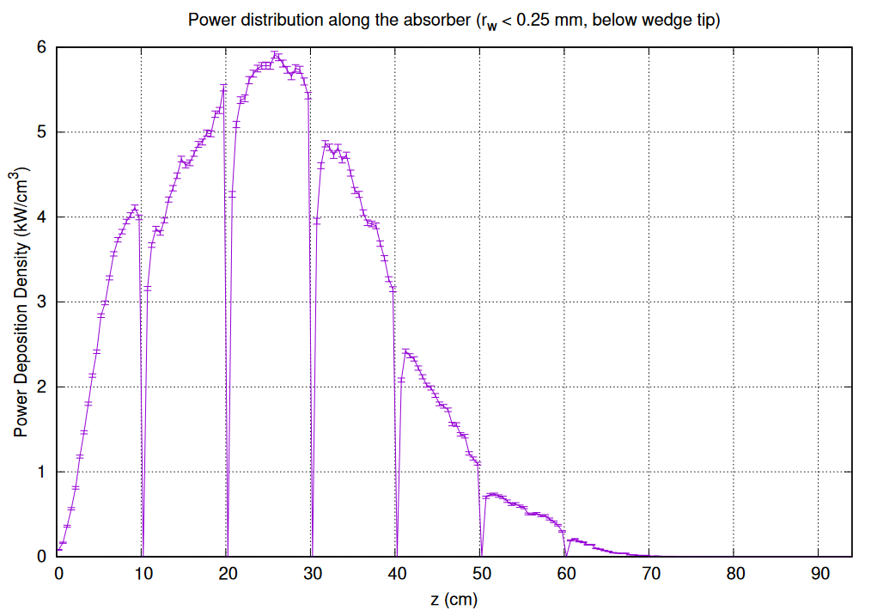
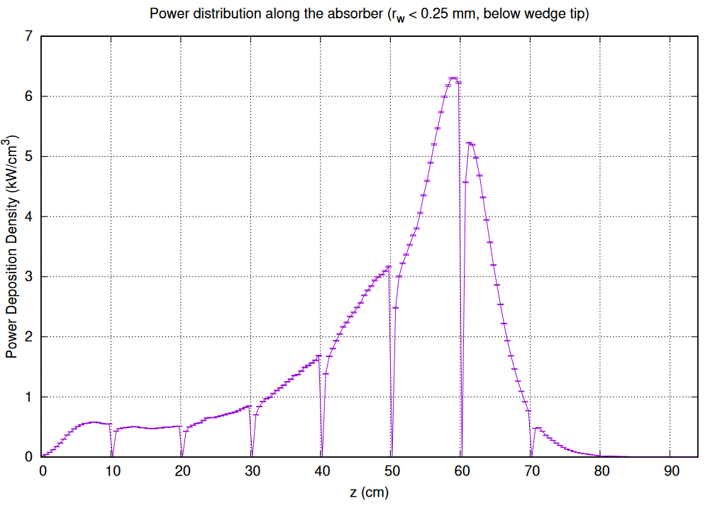
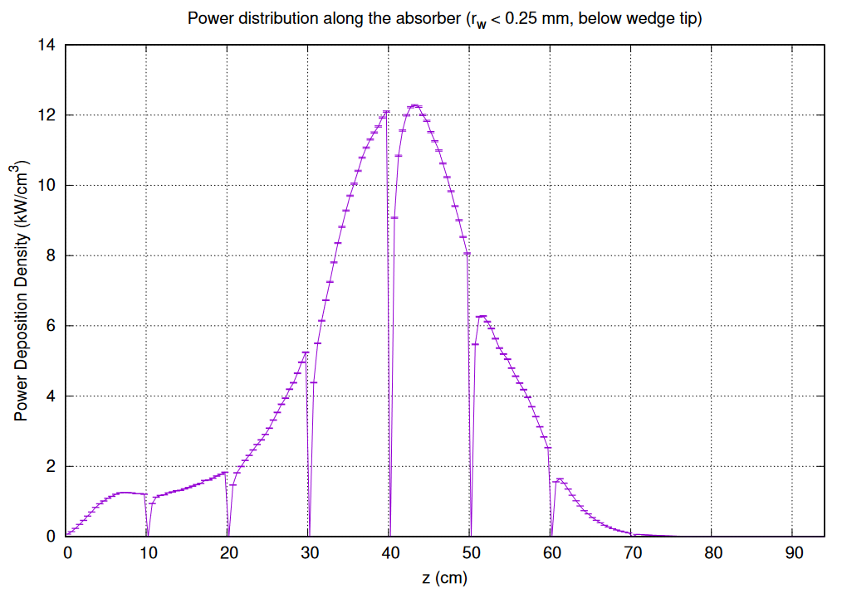
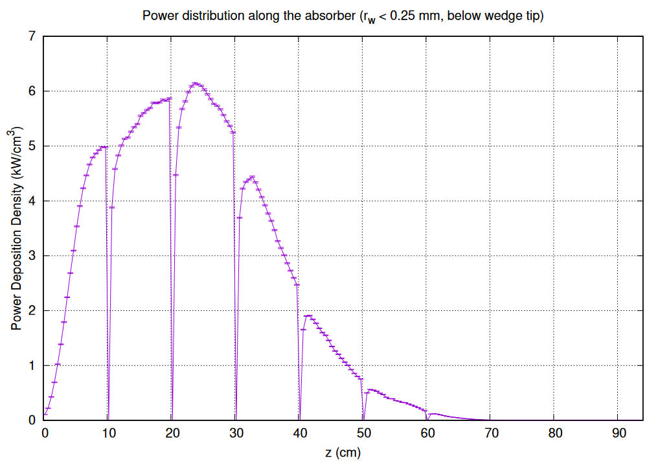
Max Power Density vs. Z in Absorber (kW/cm³)
Mag.Fld.90%
Mag.Fld.100%
Mag.Fld.110%
Beam Y angle at +1 mrad
FWHM at 0.25 mm
Beam Y angle at -1 mrad, similar to beam X angle at +1 mrad

Slide 7
Runs with Varying Beam Parameters, v.65
klcps65/fwhm2500/ → Standard configuration, v.65, large statistics
f2500_r20/ → Radiator thickness at 20%

Slide 8
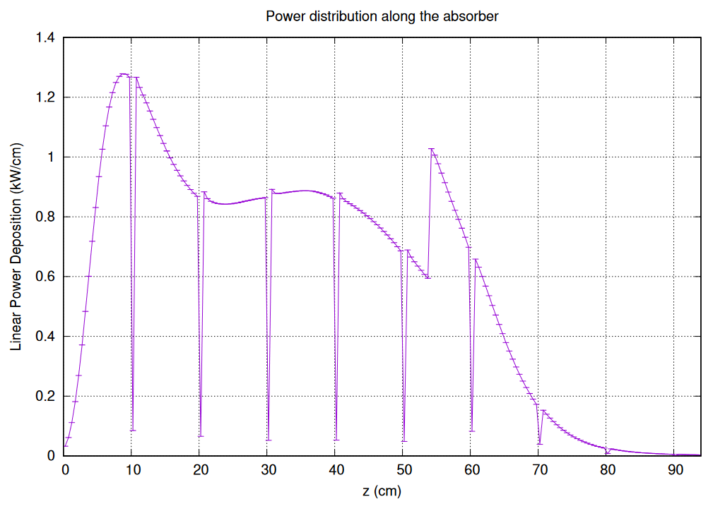
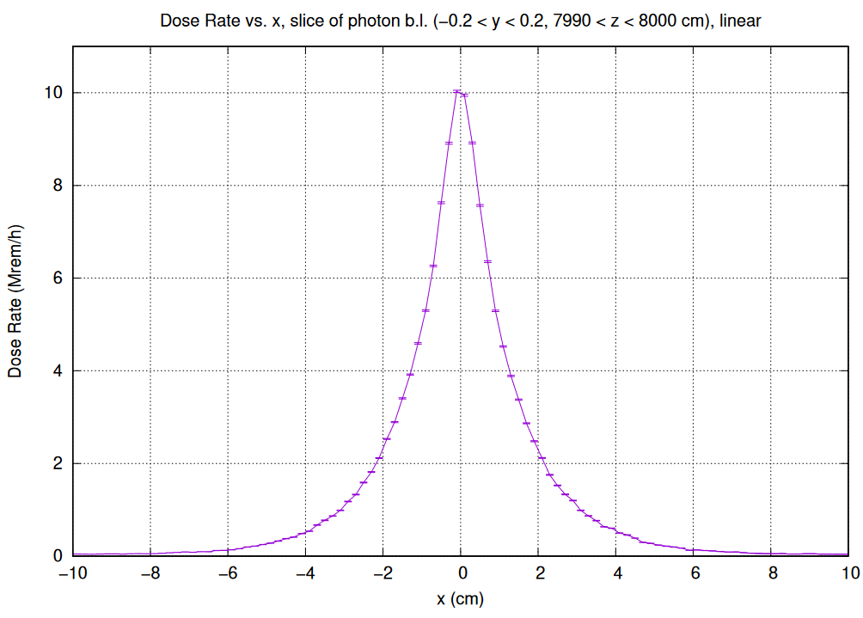
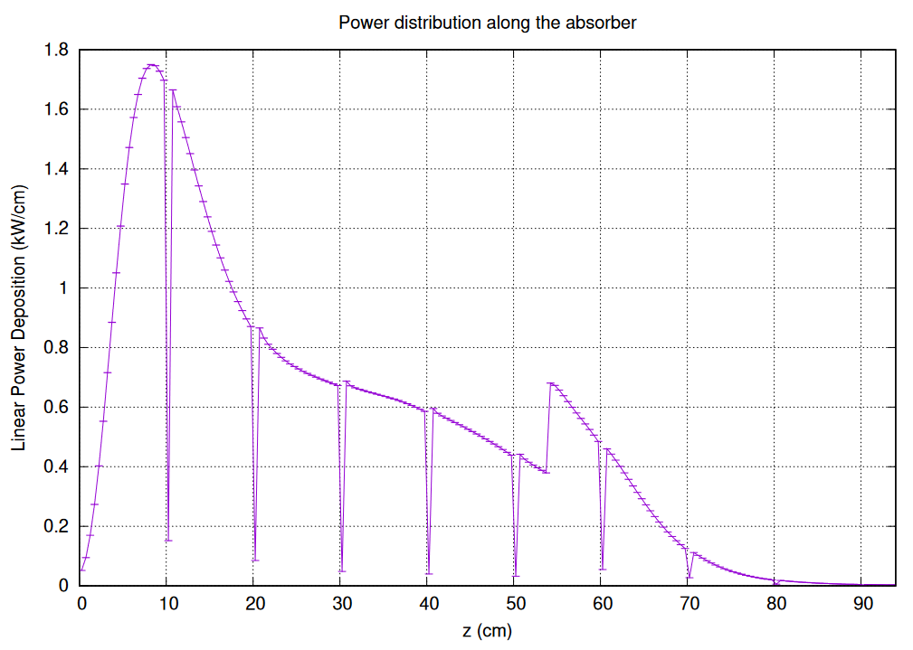
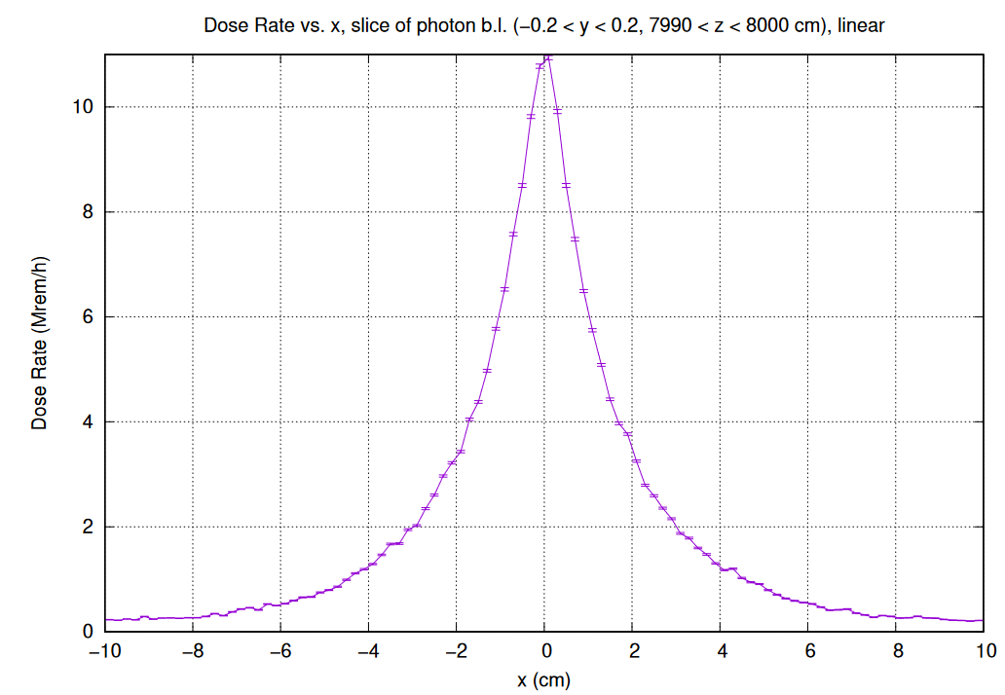
Influence of the Radiator thickness
Radiator at 10% r.l.
Radiator at 20% r.l.
More power in low energy electrons
Larger angular spread of photons

Slide 9
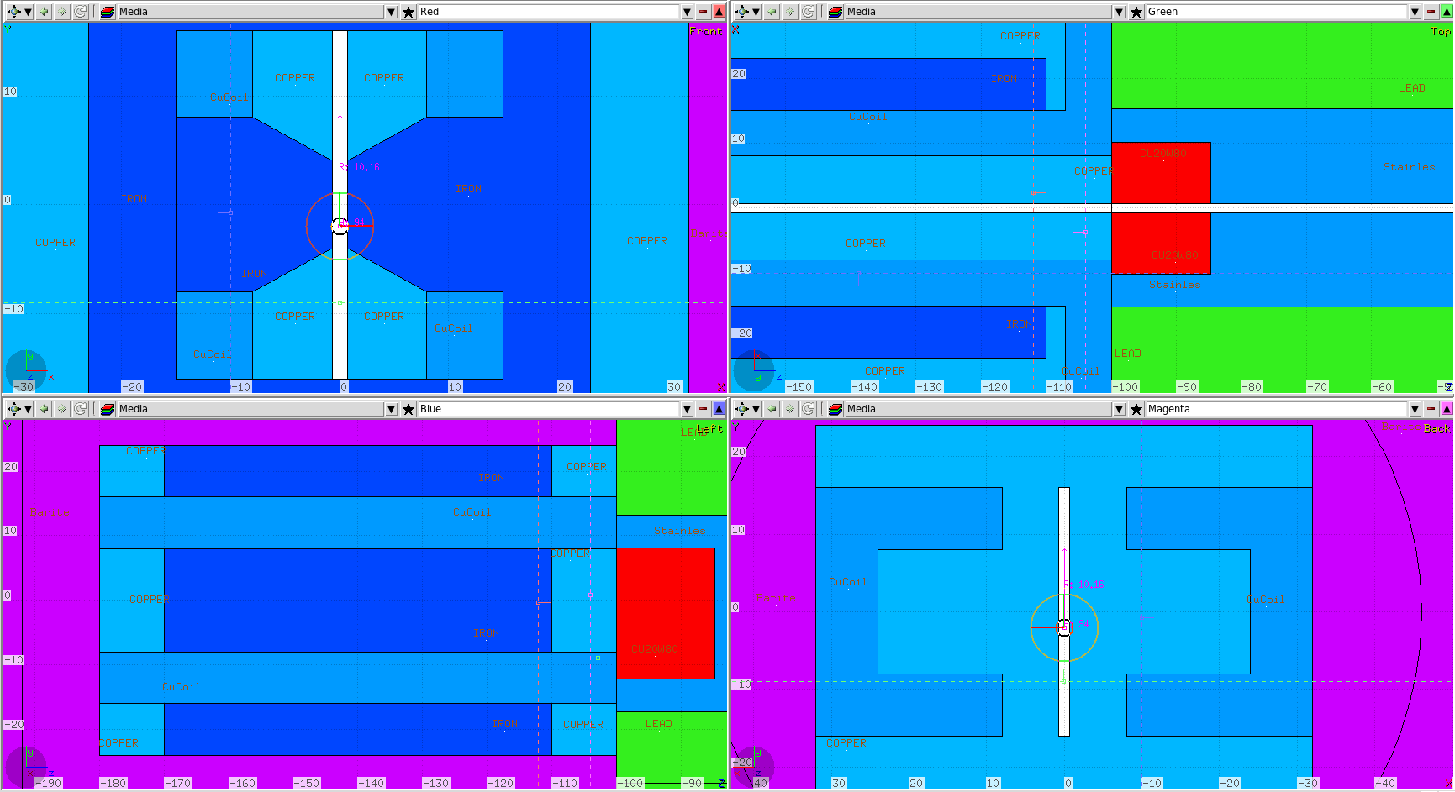
Magnet: Details

Slide 10
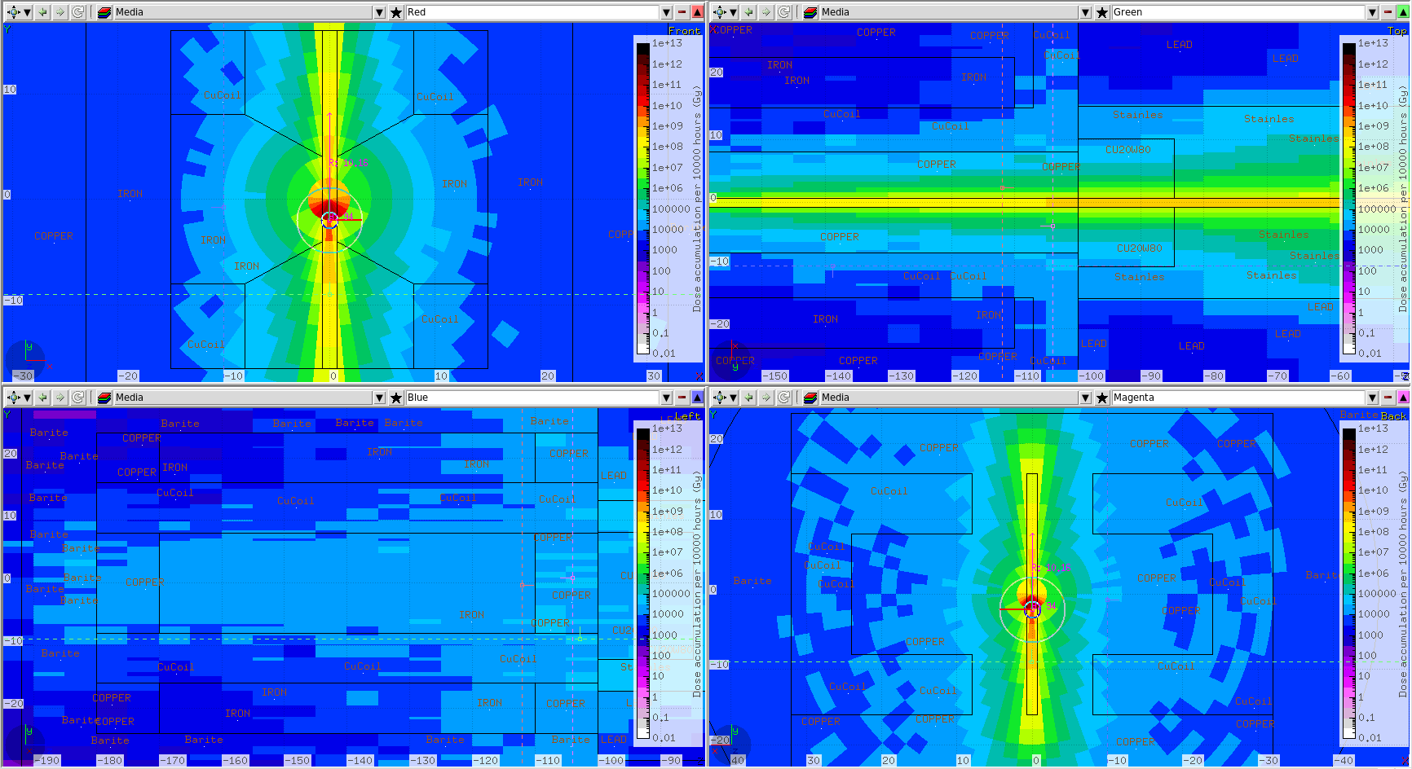
Coil Dose Accum, 10000 beam hours, under 10⁵ Gy

