Slide 1
K⁰L CPS Meeting Dec 05’2022
P. Degtiarenko

Slide 2
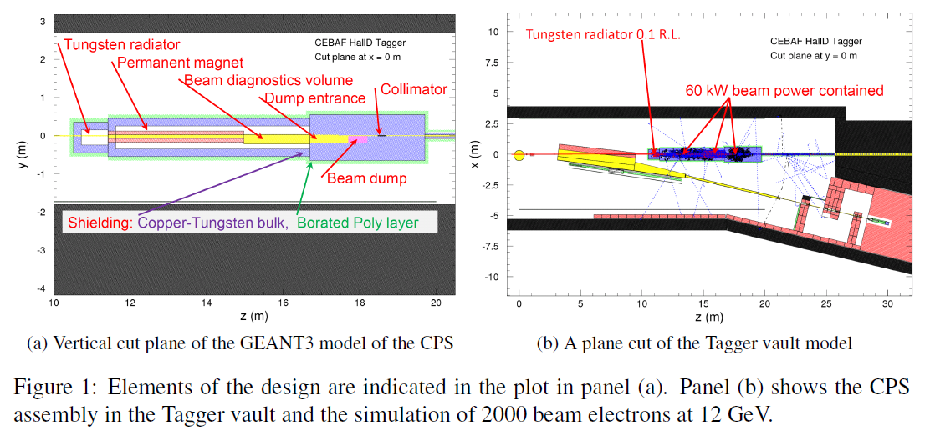
Historical Perspective
The conceptual design has been available for 5+ years already: HIPS2017 Mini-Proceedings, arXiv:1704.00816, April 5, 2017

Slide 3
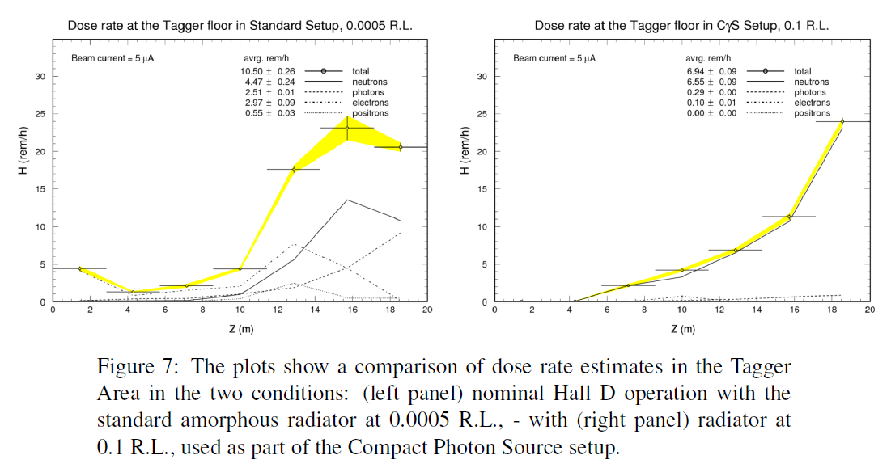
Original Features
First magnet is away from high radiation
Distance to allow main beam to get away from the photon line
Beam entry chamber, direct cascade products not visible in the photon line
Second magnet not used
Essentially full energy absorption in the dump

Slide 4
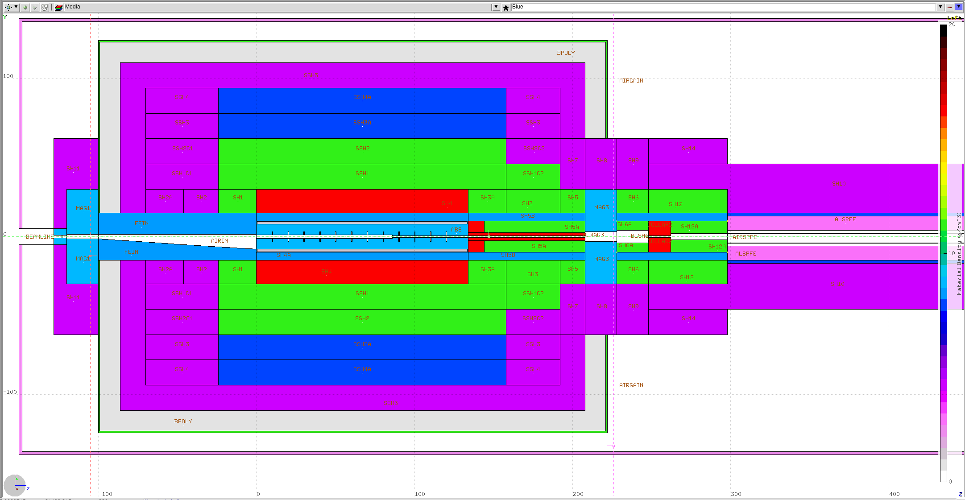
Proposed Update
Expanding on the original proposal, including essentially the same parts

Slide 5
Conceptual Design Update
The proposed solution for the Absorber combines:
The entrance cavity
The Beam Dump
The first part of the photon beam channel
Suggested to be built out of two symmetric half-cylinders
The entrance cavity and the photon line machined out of flat surfaces
When assembled, the absorber operates similarly to JLab beam dumps
Absorbs bulk of the energy (currently over 98%)
The second magnet is present, but if the entrance cavity is made larger there is a chance it may be removed

Slide 6
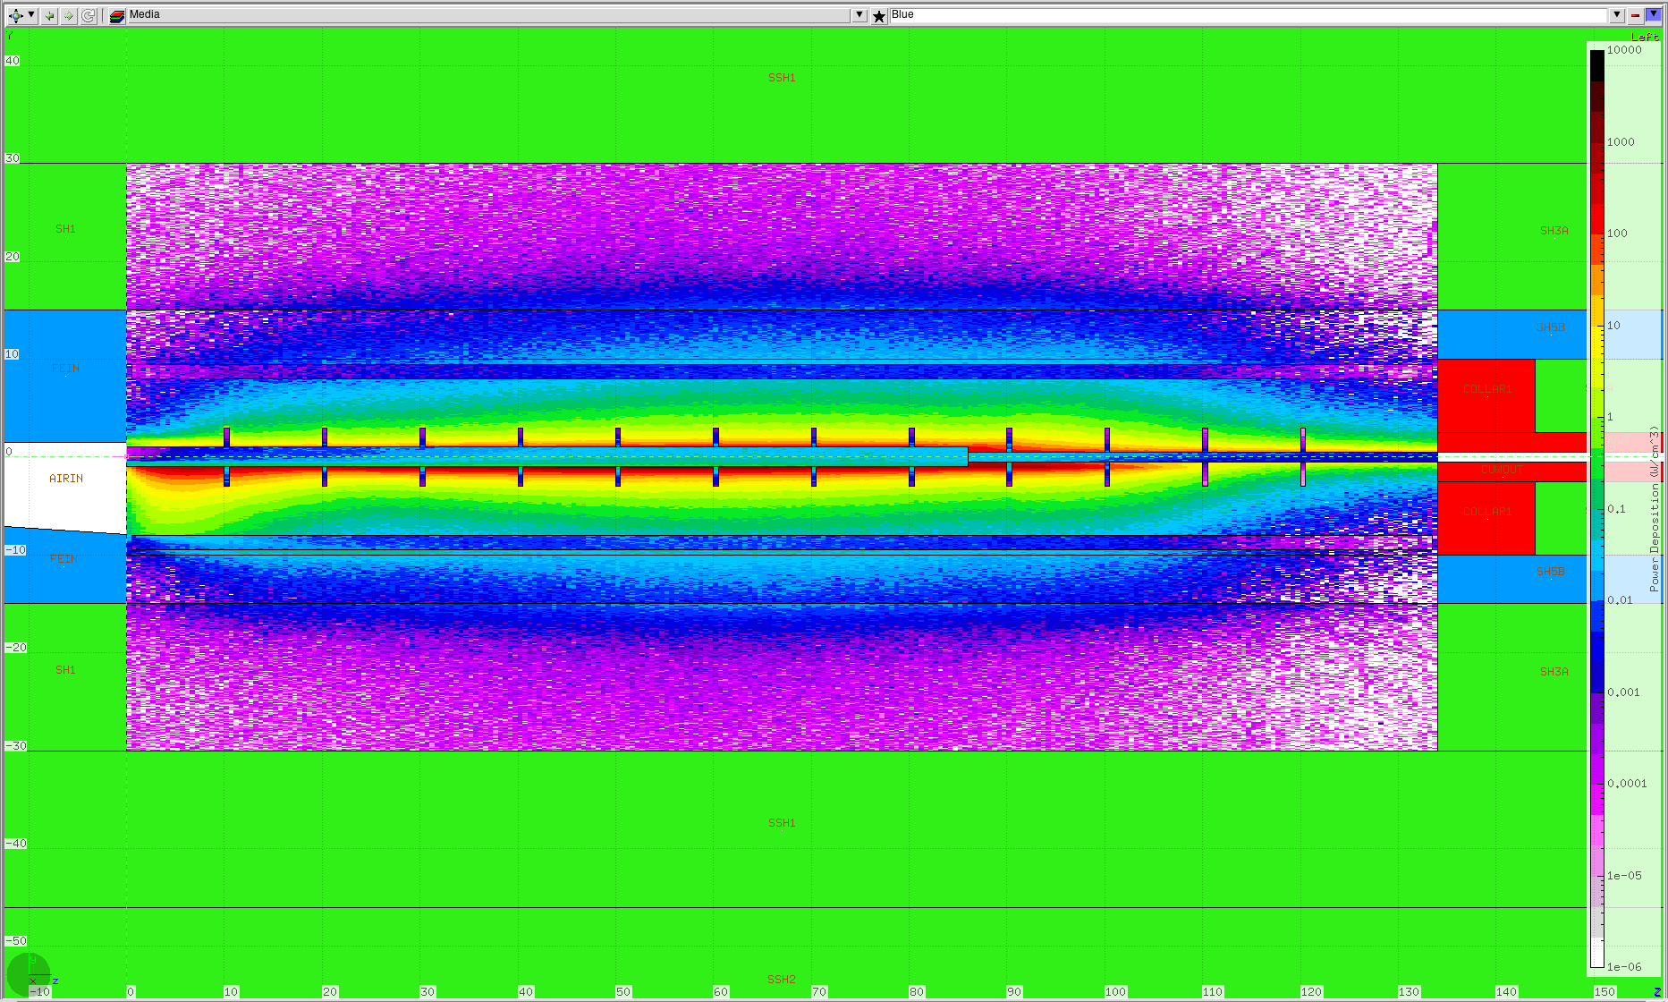
Conceptual Design Update
The power distribution is approximately uniform over a meter

Slide 7
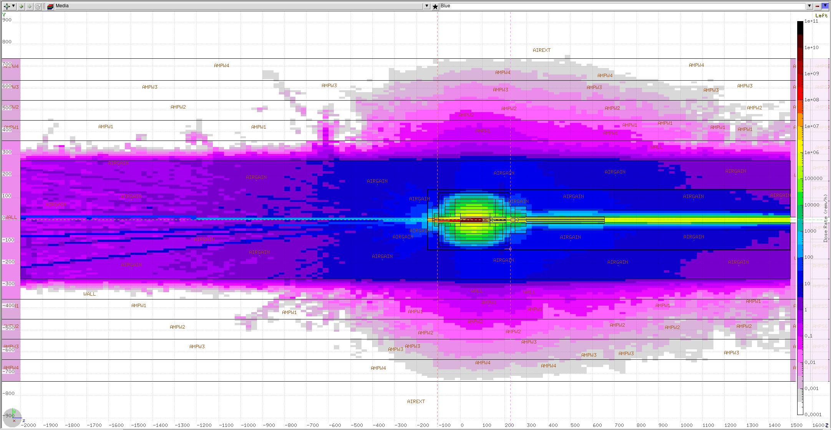
Expected Dose Rates Acceptable

Slide 8
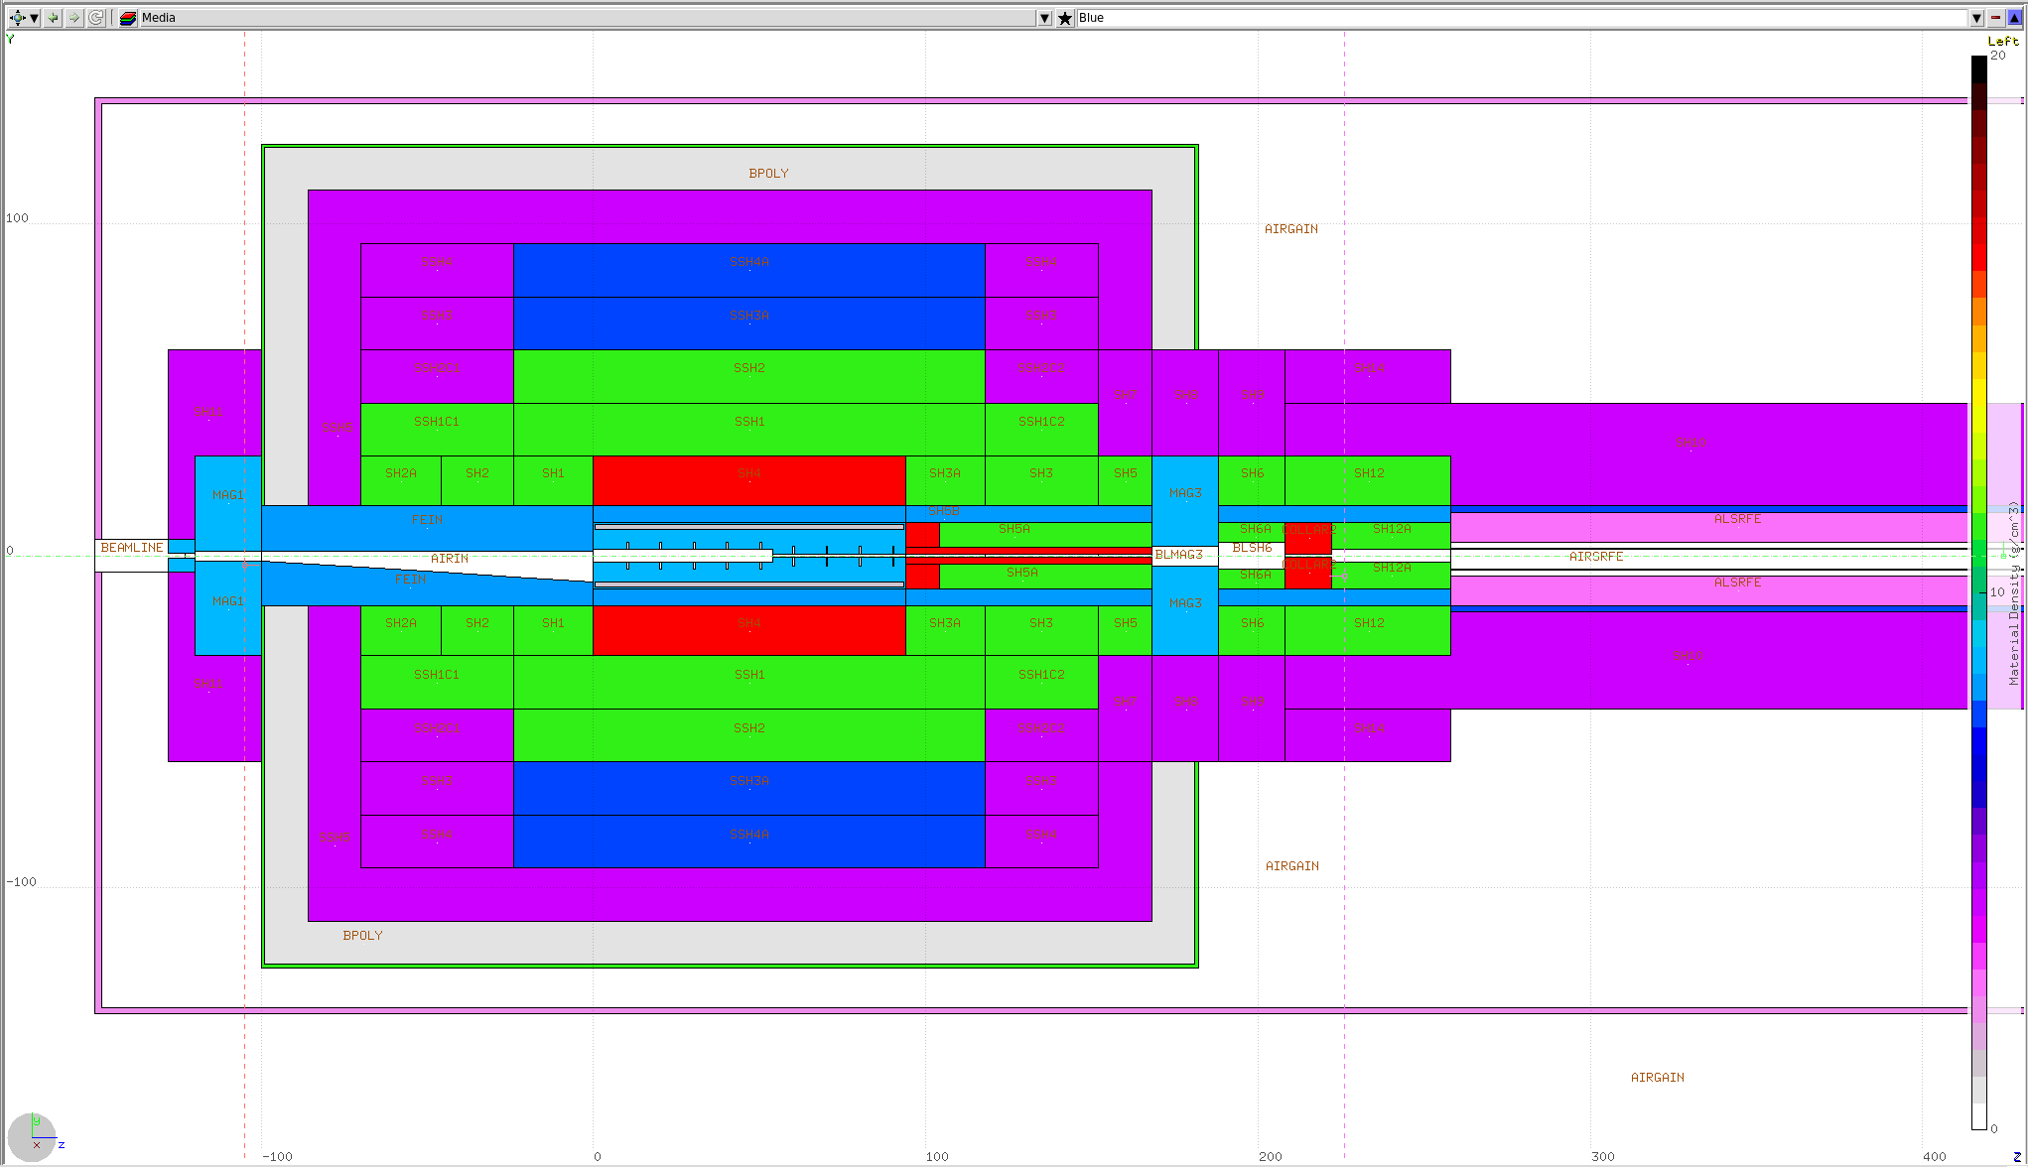
Shorter Design with higher BdL in Mag.1

