Slide 1
$$K_{L}p→K^{+}n$$
Mikhail Bashkanov

Slide 2
Timeline
Generation of events - done (with both fortran and Nick’s generator)
GEANT processing – done
MC settings (Magnetic field)?
Events reconstruction and analysis – in progress
Only $K^{+}$ reconstruction (missing mass)
Also neutron detection (KinFit)
Statistics reduction
Neutron efficiency problem
higher purity
higher resolution

Slide 3
Geant for K_L
Standard magnetic field for all K_L simulations
Acceptance, efficiency
Standard beam bunch structure.
Can not be changed in GEANT cards
Need Updated in ccdb database
Beam_bucket_period_ns /PHOTON_BEAM/RF/beam_period
Standard JANA_CALIB_CONTEXT for KL simulations
Need to fix bucket_period 45/60/90 ns?

Slide 4
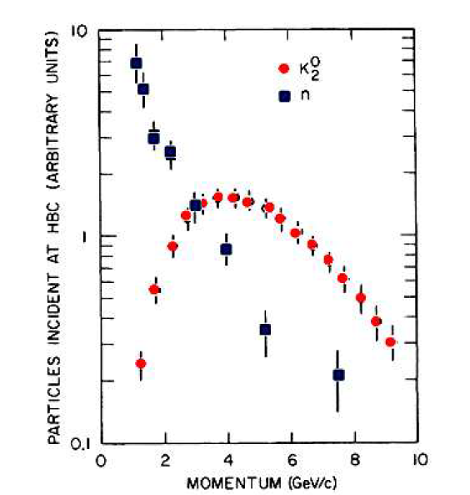
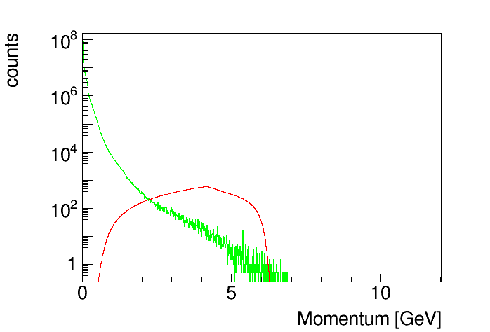
Possible backgrounds
Neutron (fig21) and K_L momentum spectra, fig15.
Neutron and K_L momentum spectra from SLAC measurements, fig22.

Slide 5
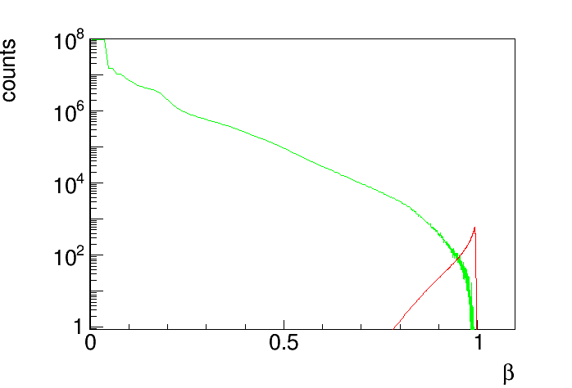
Neutrons and K_L’s as a function of$β$

Slide 6
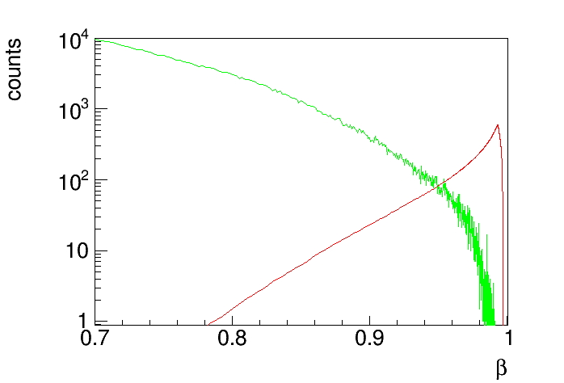
Neutrons and K_L’s as a function of$β$

Slide 7
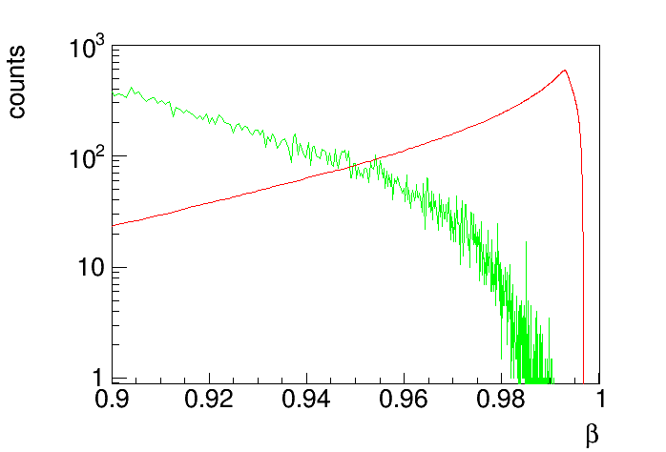
Neutrons and K_L’s as a function of$β$
$K^{+}$threshold

Slide 8
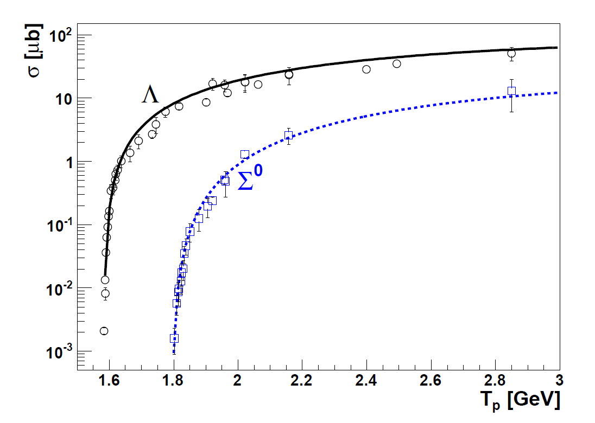
$K^{+}$production in NN collisions
$$pp→pK^{+}Λ$$
$$pp→pK^{+}Σ^{0}$$
Phys. Rev. C 84, 055207 (2011)

Slide 9
$K^{+}$production in NN collisions
Phys. Rev. C 84, 055207 (2011)
$$\frac{σ\left(pp→pK^{+}Λ\right)}{σ(pn→nK^{+}Λ)}\sim 2$$
At $β=0.95$, $E_{n}^{kin}=2.1 GeV$, $E_{K_{L}}^{kin}=1.1 GeV$
$K^{+}$ x-section energy dependence from nucl-th/0512059 (EPJA 27(2006) 269)
$σ(K_{L}p→K^{+}n)$ assumed to be 10mb

Slide 10
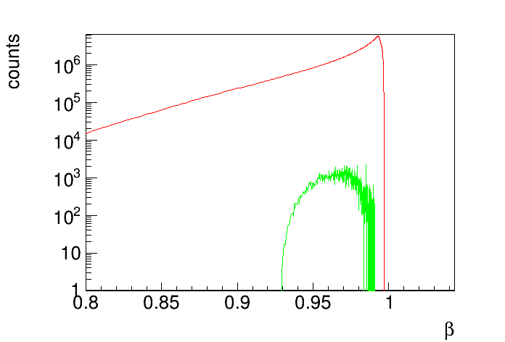
$K^{+}$ countrate from N and K_L’s
$K^{+}$threshold

Slide 11
Sources of background
$np→K^{+}X$ – not a problem
the x-section and a flux is too small to be a problem.
$np→π^{+}X$
$σ\left(np→π^{+}X\right)\sim {10}^{3}σ\left(np→K^{+}X\right)$
If pions are misidentified as Kaons might become dangerous

