Slide 1
KL Flux Monitoring
Mikhail Bashkanov

Slide 2
$K_{l}$ flux monitor location

Slide 3
$K_{l}$spectrum

Slide 4
$K_{l}$ decays
 | Br, %
$$K_{l}→π_{}^{±}e^{∓}ν_{μ}$$ | 40.55
$$K_{l}→π_{}^{±}μ^{∓}ν_{μ}$$ | 27.04
$$K_{l}→π_{}^{+}π_{}^{−}π_{}^{0}$$ | 12.54
$$K_{l}→π_{}^{0}π_{}^{0}π_{}^{0}$$ | 19.52

Slide 5
$K_{l}$ in-flight decay

Slide 6
10deg
10deg
1deg
4deg

Slide 7
$K_{l}F$ Monitor
Plastic scintillators
trackers

Slide 8
Phi displacement
$φ^{′}=\frac{l⋅z⋅0.3⋅B}{p⋅cos⁡(Θ)}$; $l∼1m, \left|z\right|=1;B=1$; $φ^{′}[rad]=\frac{0.3}{p[GeV/c]⋅cos⁡(Θ)}$

Slide 9
$$πμν$$
$$πeν$$
$$π^{+}π^{−}π^{0}$$
TOF
$$MM^{2}$$
magnetic
Kaon momentum [GeV]

Slide 10
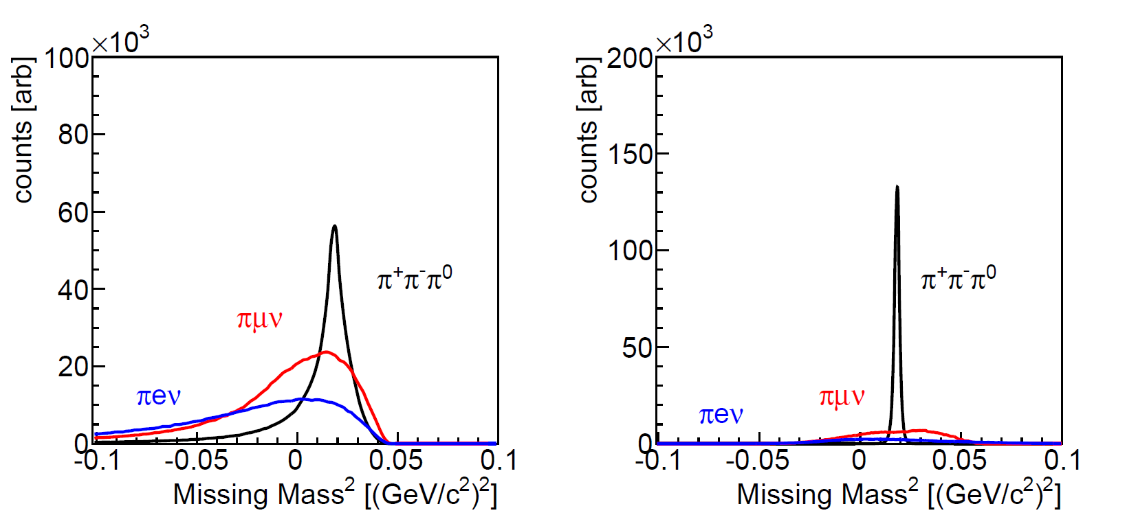
$K_{l}$ FM resolution

Slide 11
$K_{l}→π_{}^{±}μ^{∓}ν_{μ}$reaction kinematics

Slide 12
Monitor requirements
Simple, uniform geometry
Complicated acceptance would not allow accurate flux determination
Cylindrically symmetrical
To avoid acceptance induced +/- asymmetries
Simplifies analysis
Magnetic field (solenoid)
Good timing for ToF $K_{l}$measurement
Position determination

Slide 13
$K_{l}F$ Monitor
Magnet, 1m long, 50 cm diameter
1000mm
5deg
1deg
2000mm
4deg
10deg
5deg
5deg
10deg
Plastic scintillator
1 barrel, 2 end-cap Pizzas
3 trackers (MicroMeGaS)

Slide 14
$K_{l}F$ Monitor
Plastic scintillators
trackers
At least 2 double-hits in trackers
Accurate position determination
2 or 3 time information per track
2 side readout for the barrel
6 or 7 time stamps per event
Momentum vs TOF particle id
No $K_{l}→K_{s}$ converter
$πμ$ kinematics + TOF -> precise $K_{l}$ momentum reconstruction
Consider 2nd barrel outside magnet for better $π/μ$ separation
10-20 deg $φ$ displacement at 1T field
better tracker <-> smaller field
Better than 10 MeV $ΔW$ resolution
Goal $\sim 1\%$ flux accuracy

Slide 15
“Simple” KL Flux Monitor

Slide 16
“Simple” monitor
No magnet
1 double layer tracker instead of 3
Enough in absence of magnetic field
Precise TOF
6 time stamps per track
12 time stamps per event
2” Hamamatsu H6533 assembly (R4998 PMT) 50ps time resolution, 1.6kGBP
$\frac{50ps}{\sqrt{12}}=14.5ps$
Possible use of MCP-PMT for one layer (price 10x H6533), time resolution 12ps of single MCP-PMT
Absorber for $μ/π$ separation

Slide 17
$K_{l}F$ Monitor
Plastic scintillators
Trackers
absorber
Accurate position determination
6 time information per track
2 side readout for the conical barrels
$πμ$ kinematics + TOF -> precise $K_{l}$ momentum reconstruction
absorber for better $π/μ$ separation
Better than 10 MeV $ΔW$ resolution
No $±$separation
No CP violation measurements

Slide 18
Conclusion
Dedicated $K_{l}$Flux Monitor with uniform acceptance and small magnetic field is achievable
CP-violations
Sterile neutrino searches
“Simple” version
cheap & simple
No superconducting magnet
Only one tracker
Same acceptance

