Slide 1
K⁰L CPS Meeting November 27, 2023
P. Degtiarenko

Slide 2
Design Update – Oct-Nov 2023, “KLCPS78”
The “78” model
Converging to a ‘nominal’ model setup with a choice between Barite concrete and Magnetite concrete shielding layer inside
Added 200 micron vertical slit in the absorber at the bottom of the entrance cavity to ease thermal stress
Use 2 inch outer lead layer (diminishing the iron thickness by 1 inch) to make the thickness standard, but increasing the total weight somewhat.
The difference between Barite and Magnetite concrete in the central layer is not significant in terms of the dose rates and activation.
I believe we can use any type of affordable heavy concrete (density over 3.6 g/cm³).
Important is to measure the chemical composition of a sample, and ask the manufacturer to keep it the same for the bulk order.

Slide 3
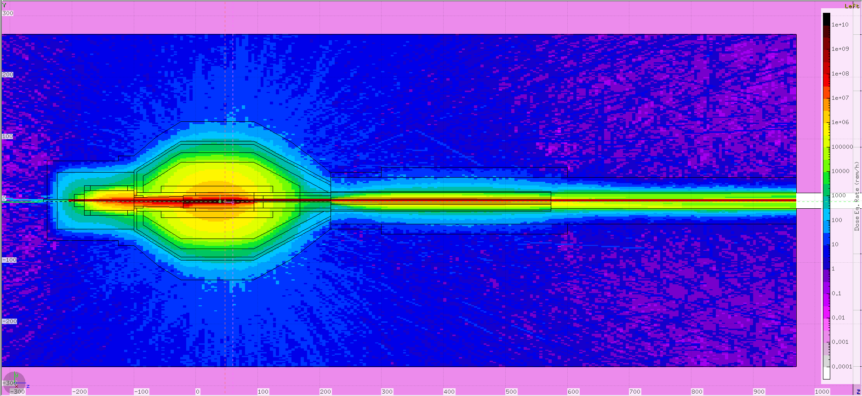
Klcps78, Prompt Dose Equivalent Rates
3 m
20-30 Rem/h

Slide 4
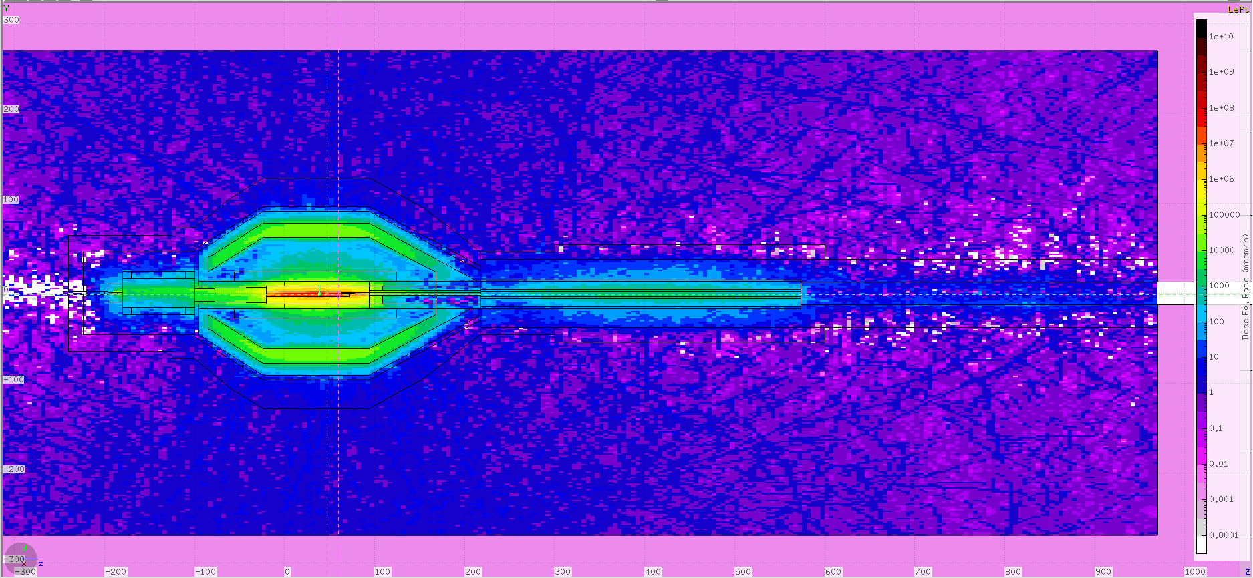
Activation Dose Equivalent Rates, 1h after 10000 h beam
3 m
2-4 mrem/h

Slide 5
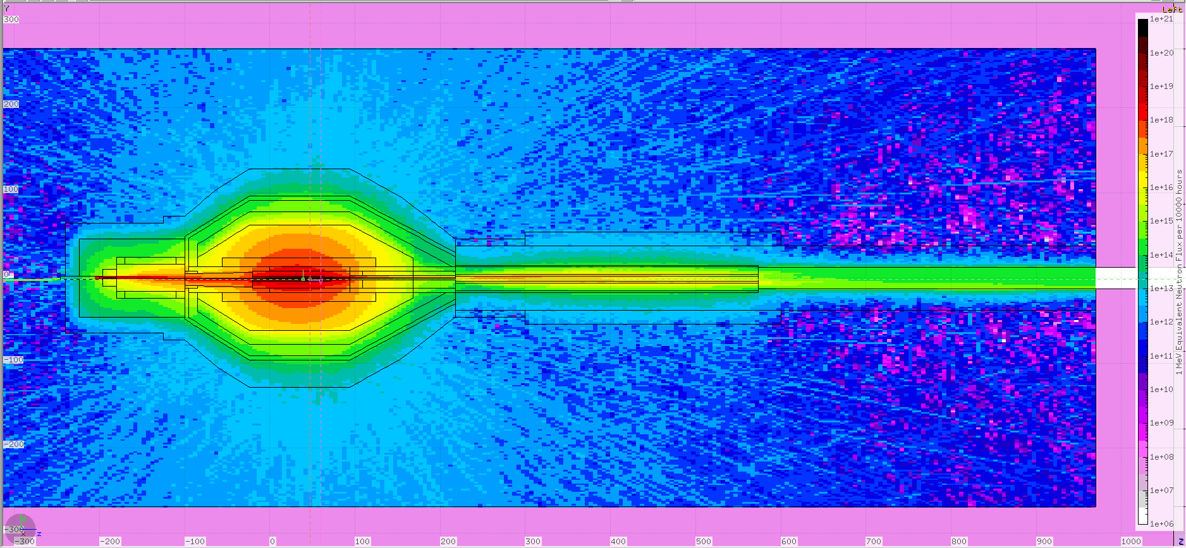
1-MeV-Equivalent neutron fluence accum. in 10000 h
3 m
3-7 E12 n/cm²

Slide 6
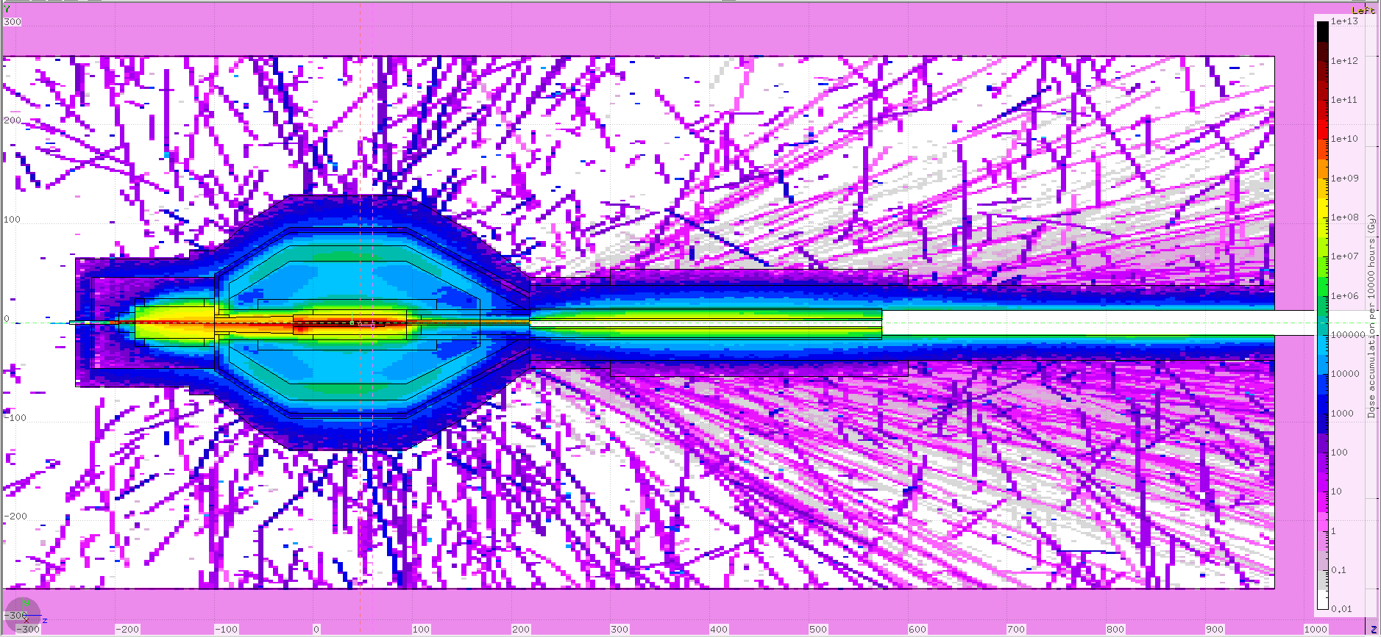
Dose accumulation during a 10000 hour run
100-200 Gy
3 m

Slide 7
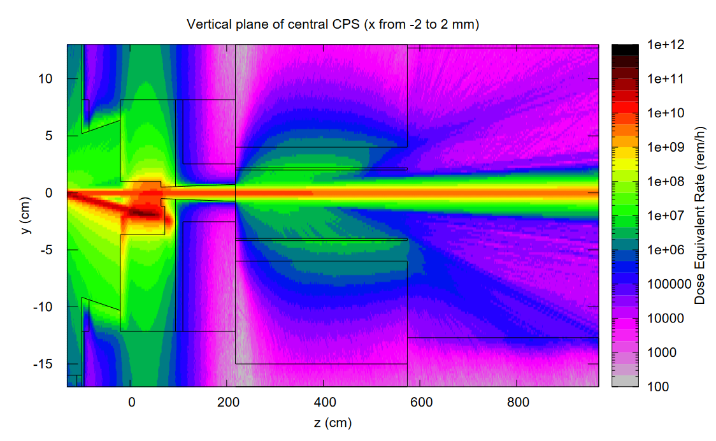
Dose Eq. y-z Map along z (nominal)

Slide 8
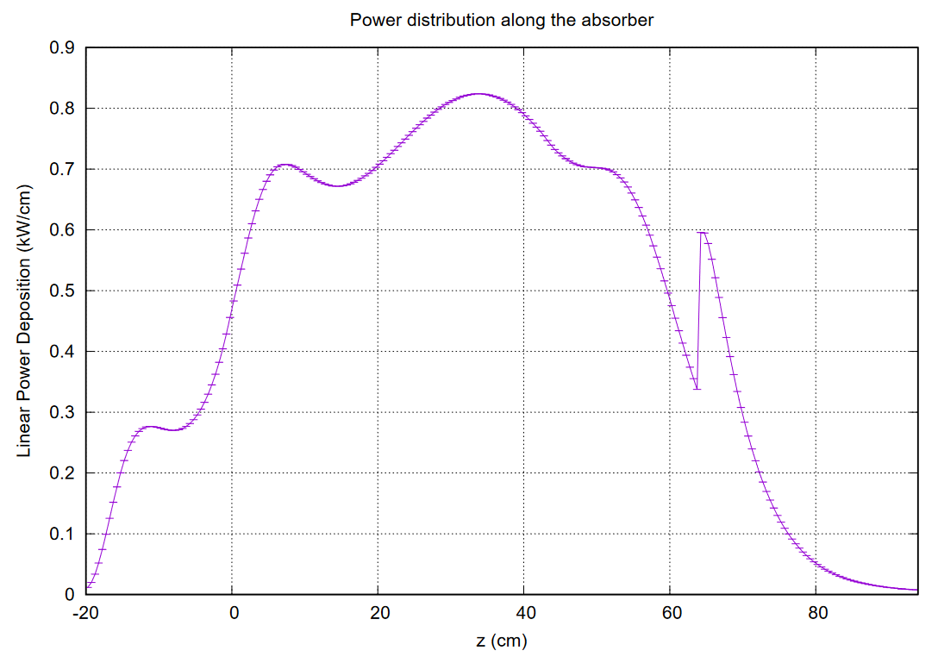
Power Distribution along Z (nominal)

Slide 9
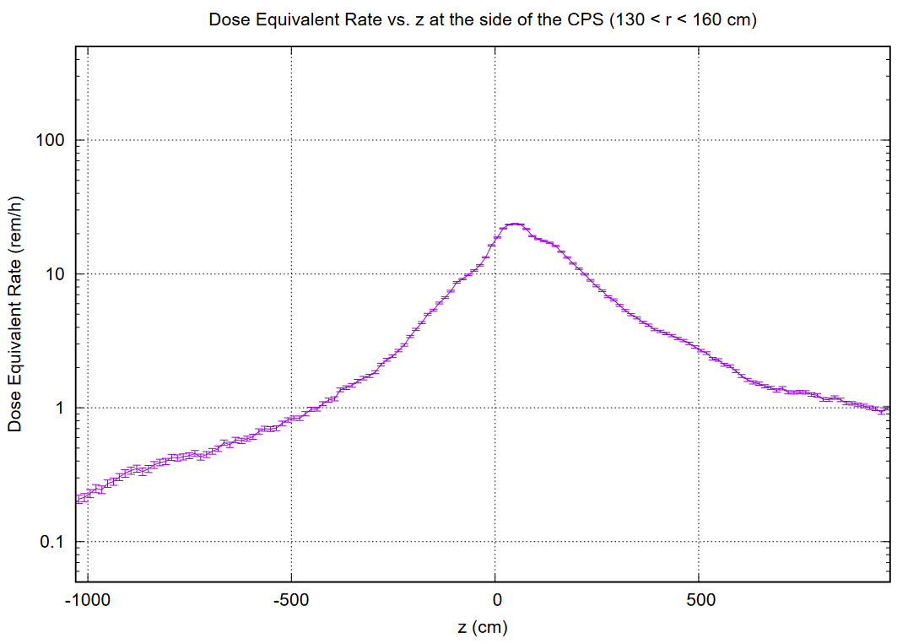
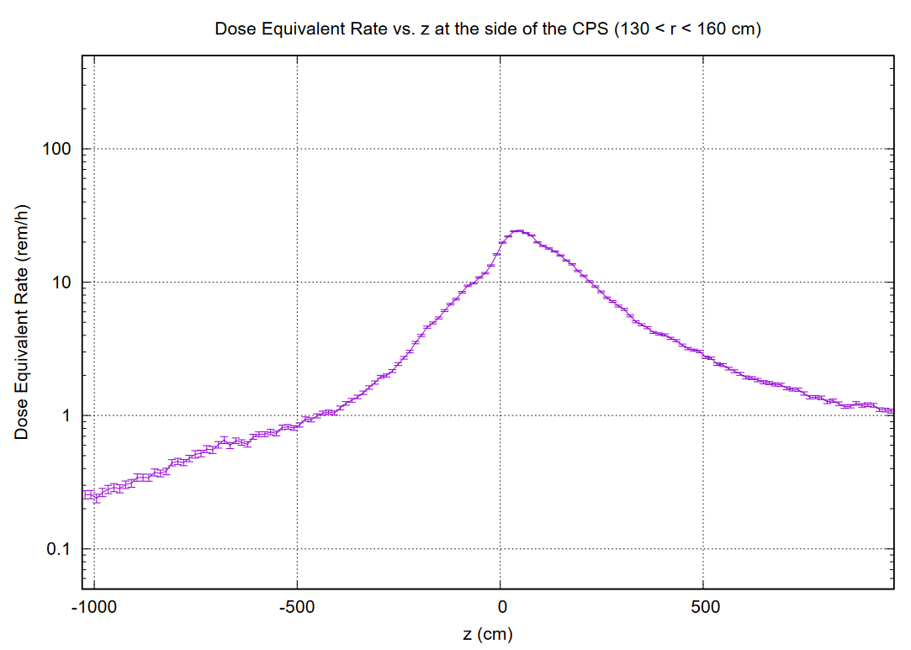
Dose Equivalent Rate along Z
Barite Concrete
Magnetite Concrete

Slide 10
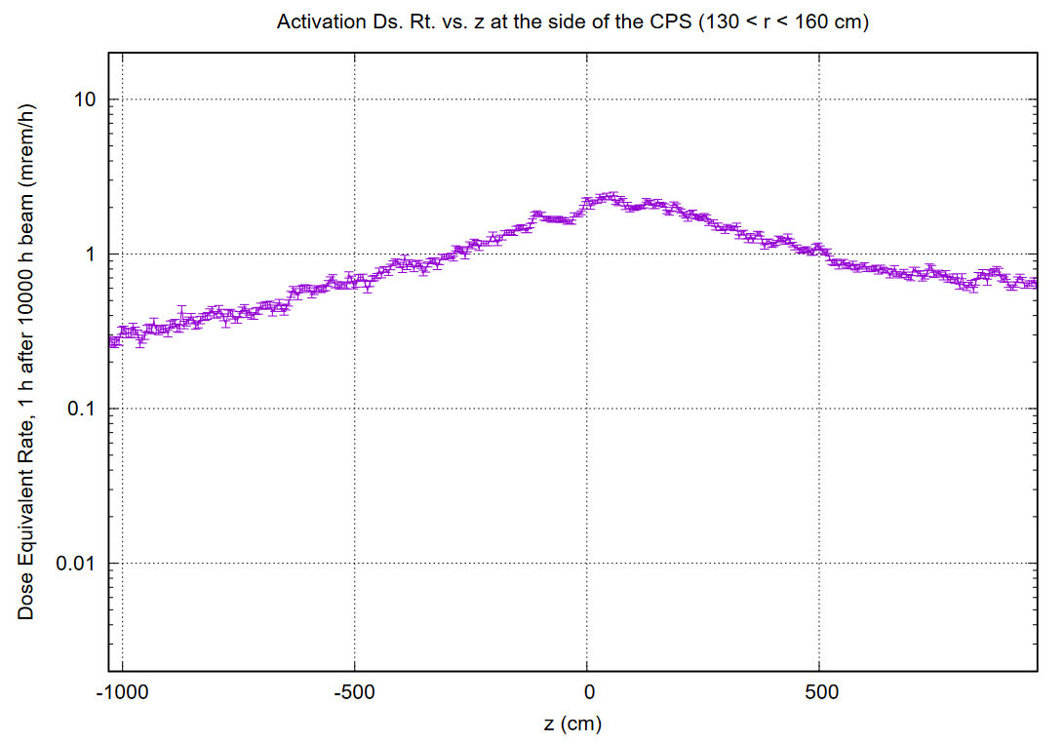
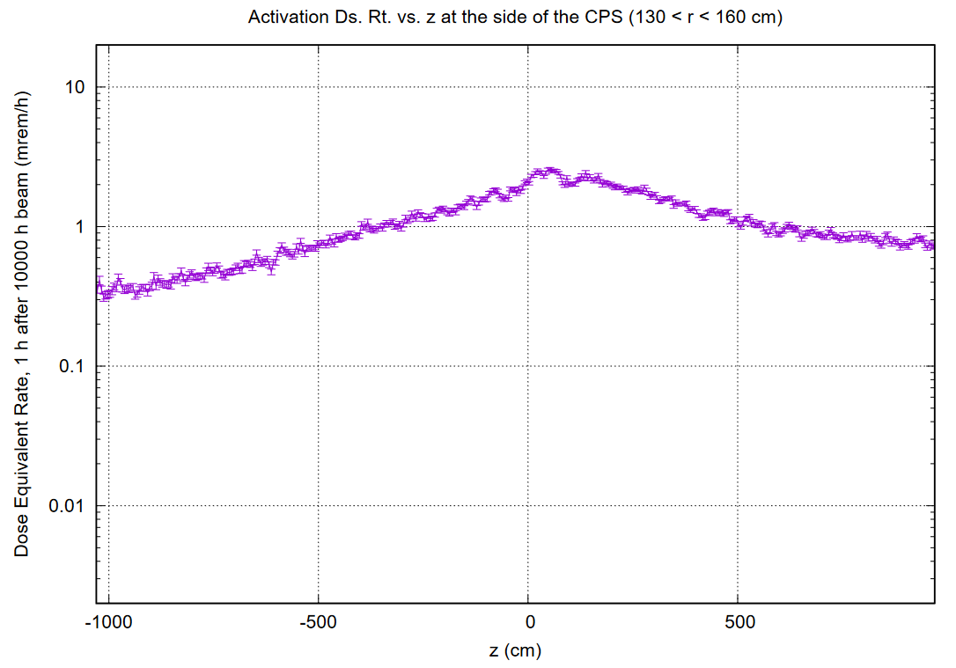
Activation Dose Equivalent Rate along Z
Barite Concrete
Magnetite Concrete

Slide 11
List of relevant illustrative plots: https://userweb.jlab.org/~pavel/projects/KLCPS/klcps78/nom_BaCo.2/
 | zyDsRt_X0.pdf | 2023-11-27 11:41 | 1.0M
 | r1hDsRt_maxZ.pdf | 2023-11-27 11:41 | 8.5K
 | rDsRt_maxZ.pdf | 2023-11-27 11:41 | 8.2K
 | zDsAc_cpsS.pdf | 2023-11-27 11:41 | 9.9K
 | zNFlx_cpsS.pdf | 2023-11-27 11:40 | 16K
 | zDsRt_cpsS.pdf | 2023-11-27 11:40 | 8.4K
 | z1hDsRt_cpsS.pdf | 2023-11-27 11:40 | 16K
 | zPow_Full.pdf | 2023-11-27 11:40 | 11K
 | EdNdE_spectra.pdf | 2023-11-27 11:40 | 10K

