Slide 1
KLF Design Meeting September 6, 2024
P. Degtiarenko

Slide 2
CPS Model Update – August 2024, “KLCPS81”
No major changes since previous report
In progress: details of the beam line exiting the Tagger Hall
Expecting the optimization for the magnetic shield around the radiator
In progress: optimization for the CPS outer lead shielding layer
Technically challenging.
Considering options for working without it, compensating by the increasing inner lead layer. Its main function is to shield the activation dose rates in the vicinity of CPS during accesses.
A trade off could be a local shielding at locations that would be needing access more frequently, and fencing the main CPS body as a “High Radiation Area”, similar to how it’s done around high power targets in Halls A & C

Slide 3
KLF Model Update – Sept. 2024, “KLCPS82”
Toy model for the CPS beam entering the Cave and HD to cross-check HD background rates’ calculations
Crude cylindrically symmetric model for the Cave and Hall D
Scoring rates and spectra of photons, neutrons, and K_{L} in the Hall
The results are consistent with other models’ results, though may differ in details. Generally most particles entering Hall are strongly collimated around the beam line.
Photon rates at the target are evaluated to be 1.6 GHz +/- 10%, mostly low energies below 20 MeV, peaked at 3-5 MeV
Neutron rates at the target generate dose rates around few rem/h, the “damage function” estimate shows that the 1 MeV neutron equivalent accumulation in 10000 beam hours does not exceed 10¹² cm⁻²
FLUKA K_{L} spectra and rates (~8 kHz) at the target are consistent with the ones from the proposal. Optimization is challenging and may require larger CPU power.

Slide 4
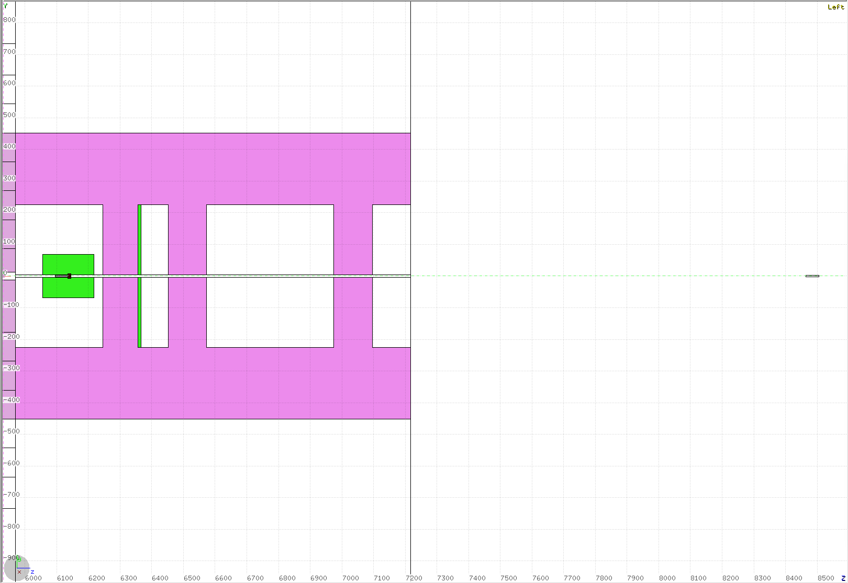
KLCPS82 Z-Y Plane
Concrete Cave and labyrinth
Beam line from CPS
Lead shielding
Liq.H2 target
Beryllium target
Tungsten beam dump

Slide 5
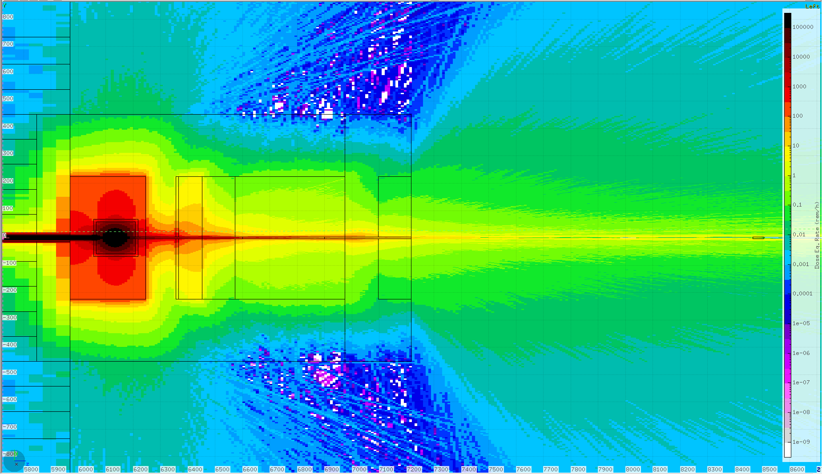
Total Dose Eq. Rates

Slide 6
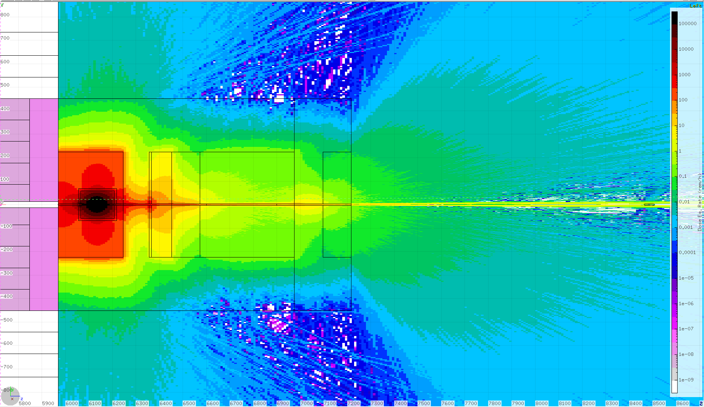
Neutron Dose Eq. Rates

Slide 7
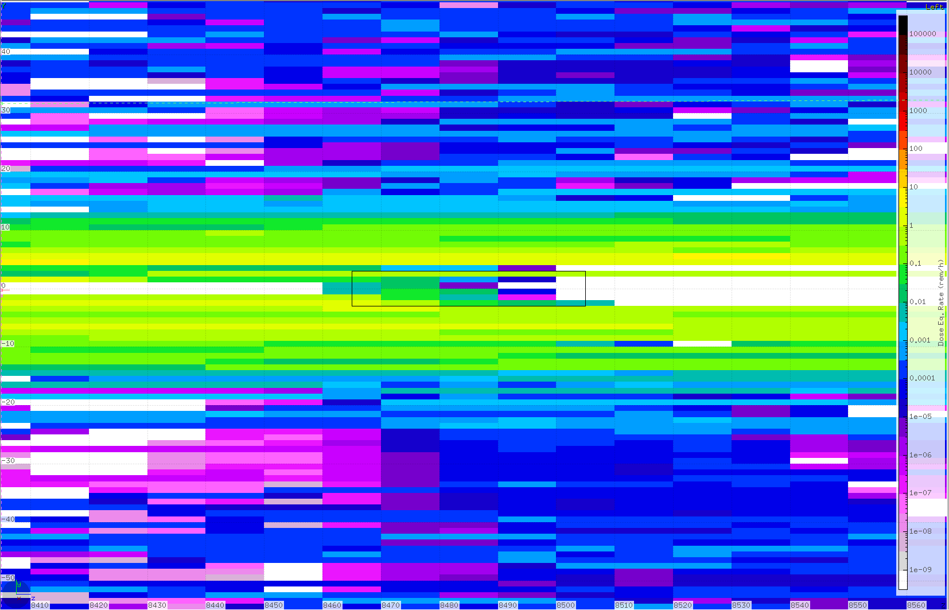
Neutron Dose Eq. Rates around HD target

Slide 8
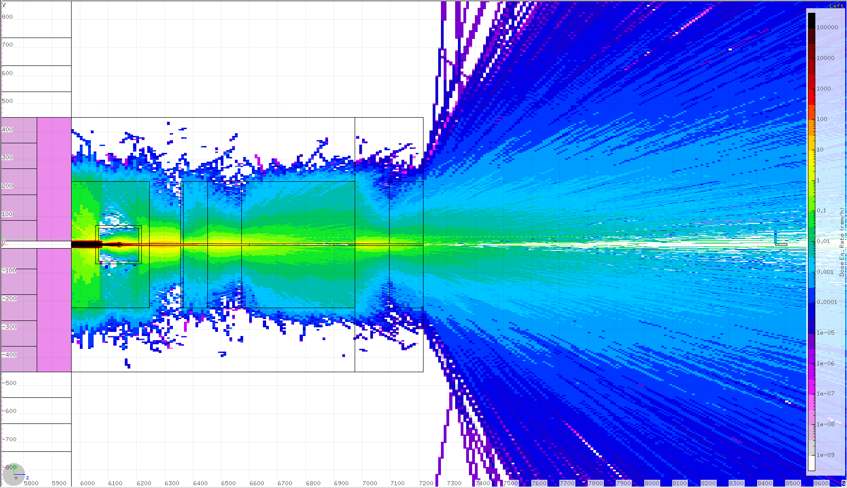
Photon Dose Eq. Rates

Slide 9
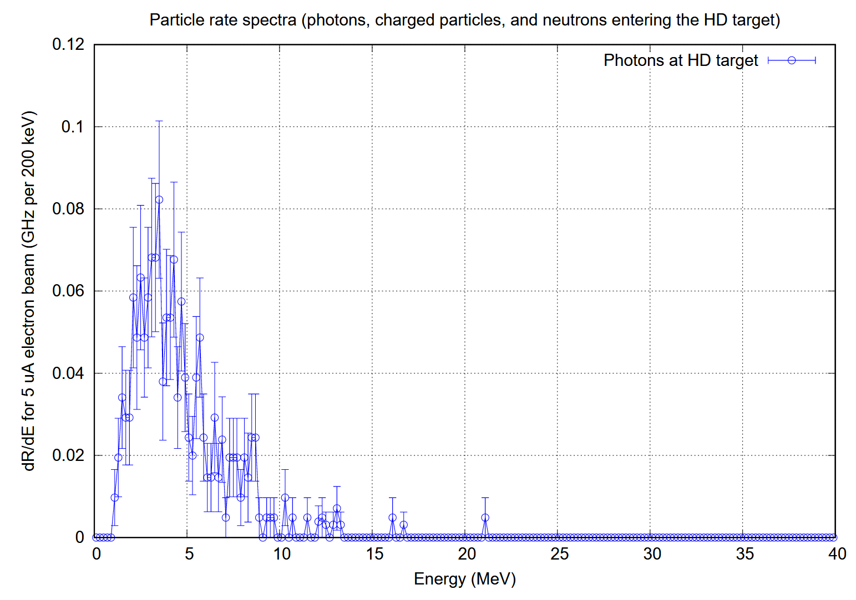
Photon Spectra
Total rate 1.6 GHz +/- 10%

Slide 10
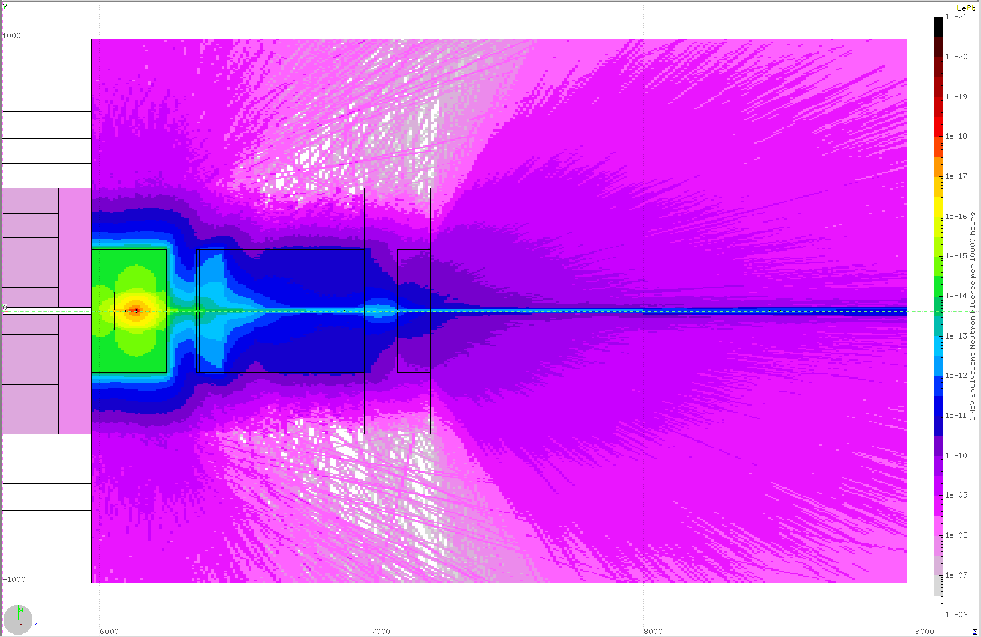
1 MeV Eq. n flux in 10000 hours

Slide 11
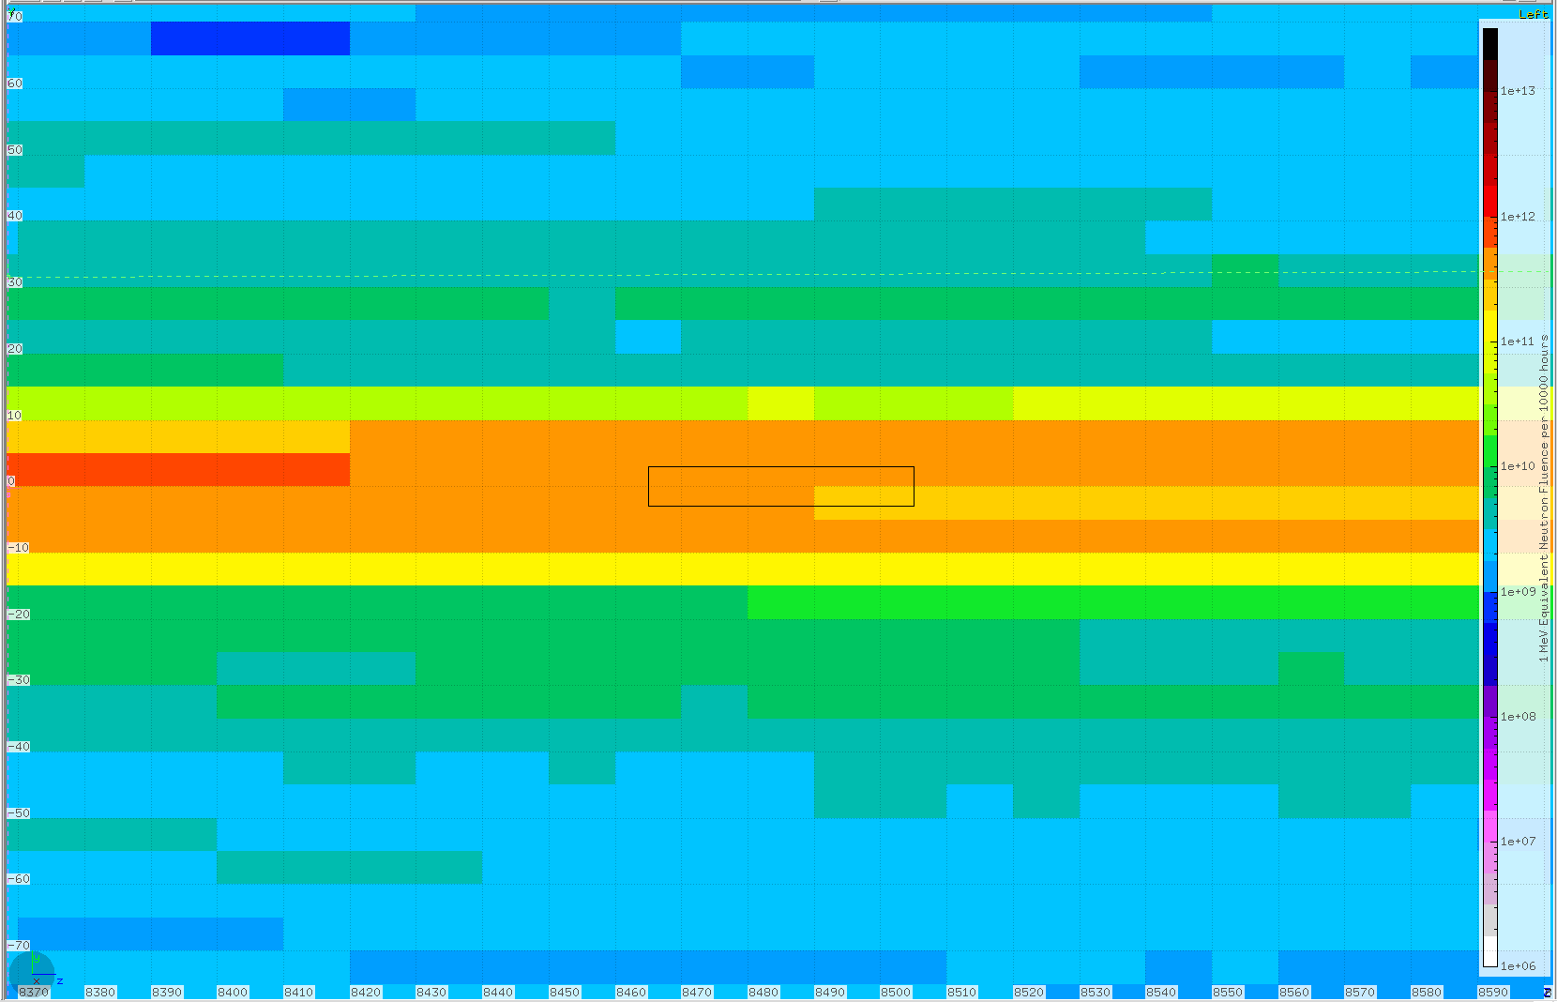
1 MeV Eq. n flux in 10000 hours, near HD target

Slide 12
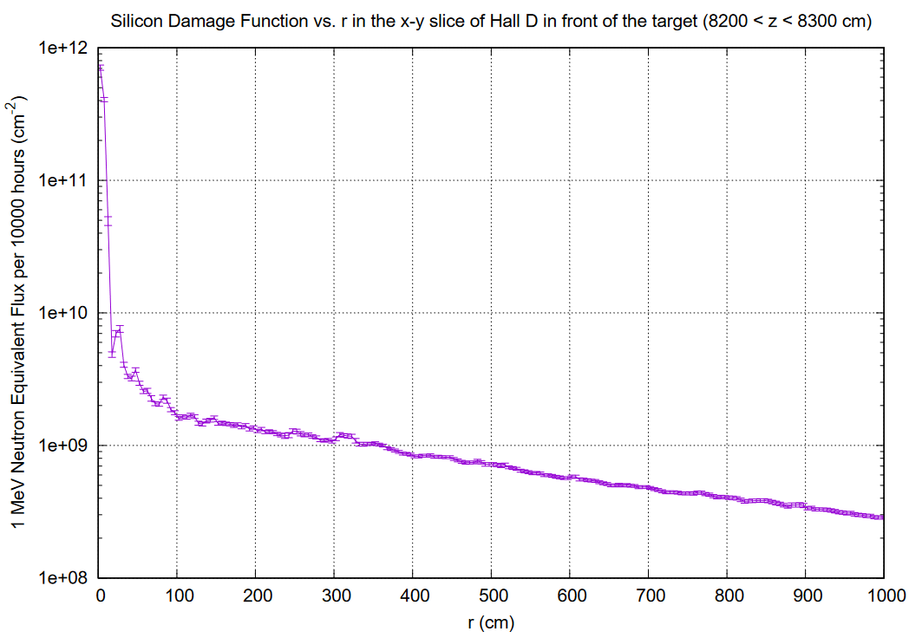

Slide 13
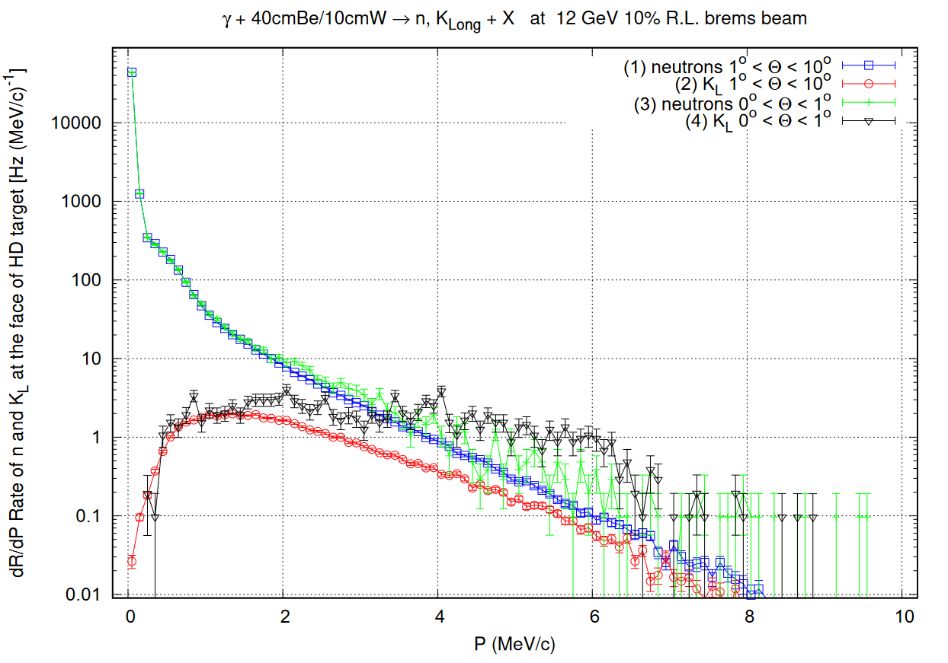
K_{L} and neutron Rates Source Term Calcs, Low Threshold
P (GeV/c)

Slide 14
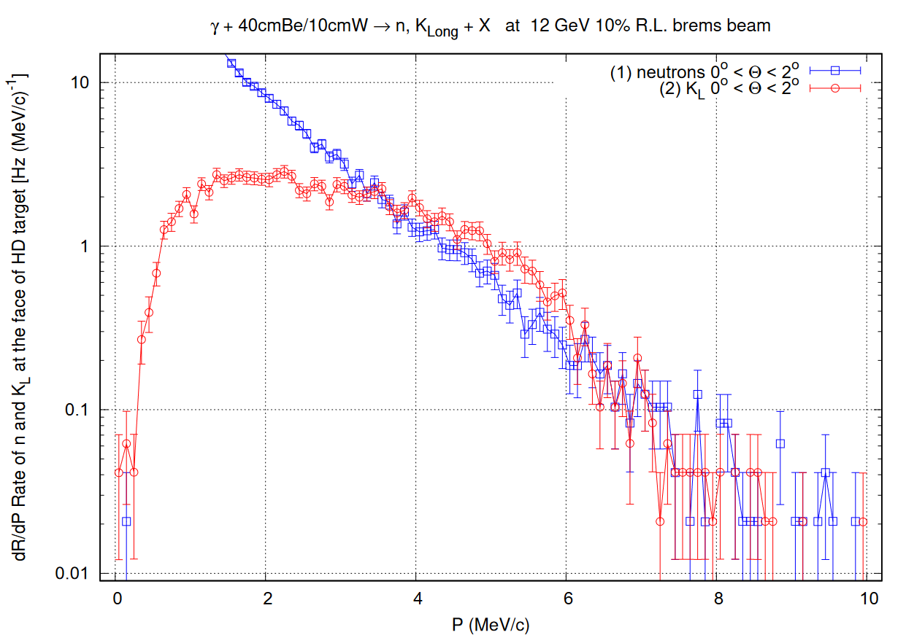
K_{L} and neutron Rates Source Term Calcs, High Threshold
About 8 kHz Total K_{L} On Target
P (GeV/c)

Slide 15
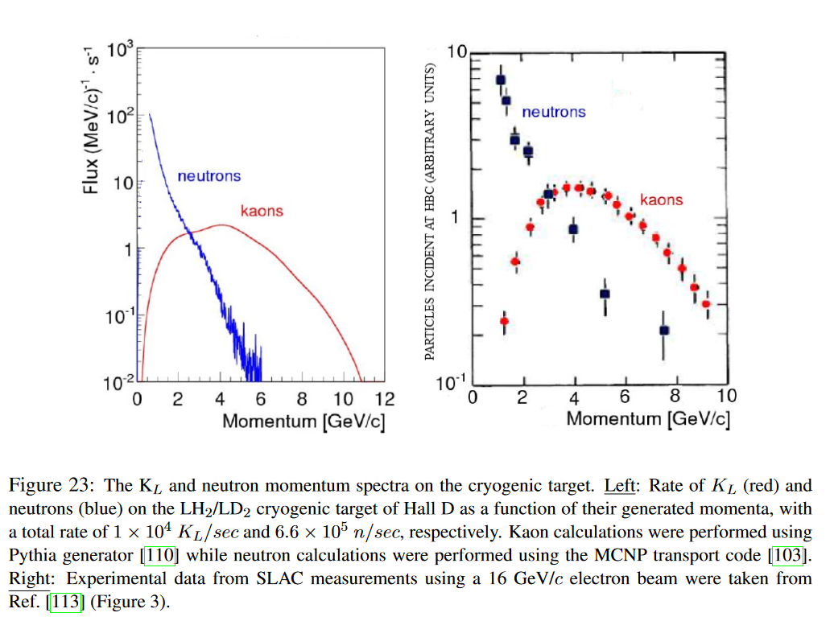
K_{L} and neutron Rates from the Proposal
x5
x100

Slide 16
Highlights – September 6th, 2024
CPS model tune up
Toy cylindrically symmetric model for the Cave and Hall D
Scoring rates and spectra of photons, neutrons, and K_{L} in the Hall
The results are consistent with other models’ results, though may differ in details. Generally most particles entering Hall are collimated around the beam line.
Photon rates at the target are evaluated to be 1.6 GHz +/- 10%, low energies below 20 MeV, peaked at 3-5 MeV
Neutron rates at the target generate dose rates around few rem/h, the “damage function” the 1 MeV n eq. accumulation in 10000 beam hours below 10¹² cm⁻²
FLUKA K_{L} spectra and rates (~8 kHz) at the target are consistent with the ones from the proposal.
High energy neutron rates at the target are higher than in the proposal
Optimization is challenging and may require larger CPU power.

