Slide 1
K⁰L CPS Meeting May 8, 2023
P. Degtiarenko

Slide 2
Design Update – May 2023
Implemented Hovanes’ design of the magnet and the field map
Increased outer shielding layer to achieve the goal of having the prompt dose rates below 10 rem/h 1 foot from the CPS
Reintroduce the lead skin at the outer surface to limit the dose rates due to activation to the level below 1-5 mrem/h
Ran few simulations to check the power deposition pattern as a function of magnetic field

Slide 3
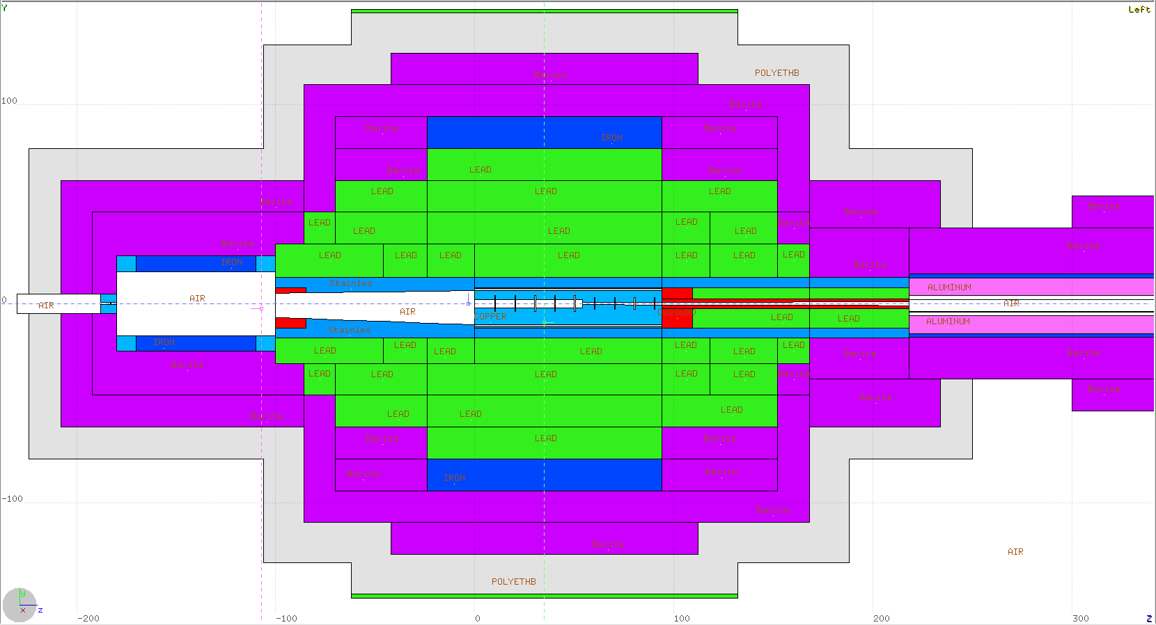
May’2023 Conceptual Design Update
Density Color Map Lead Iron Barite Sr/Fe/O/Al
Lead
Stainless
Magnet
Copper
CuW alloy
Water
Borated Poly
1m
1 m

Slide 4
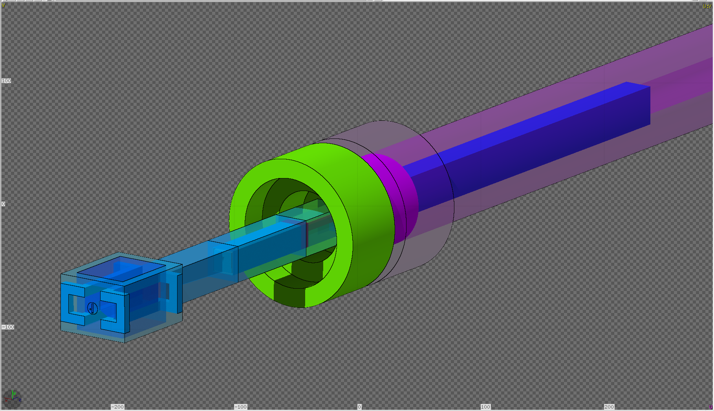
KL CPS magnet model and core assembly

Slide 5
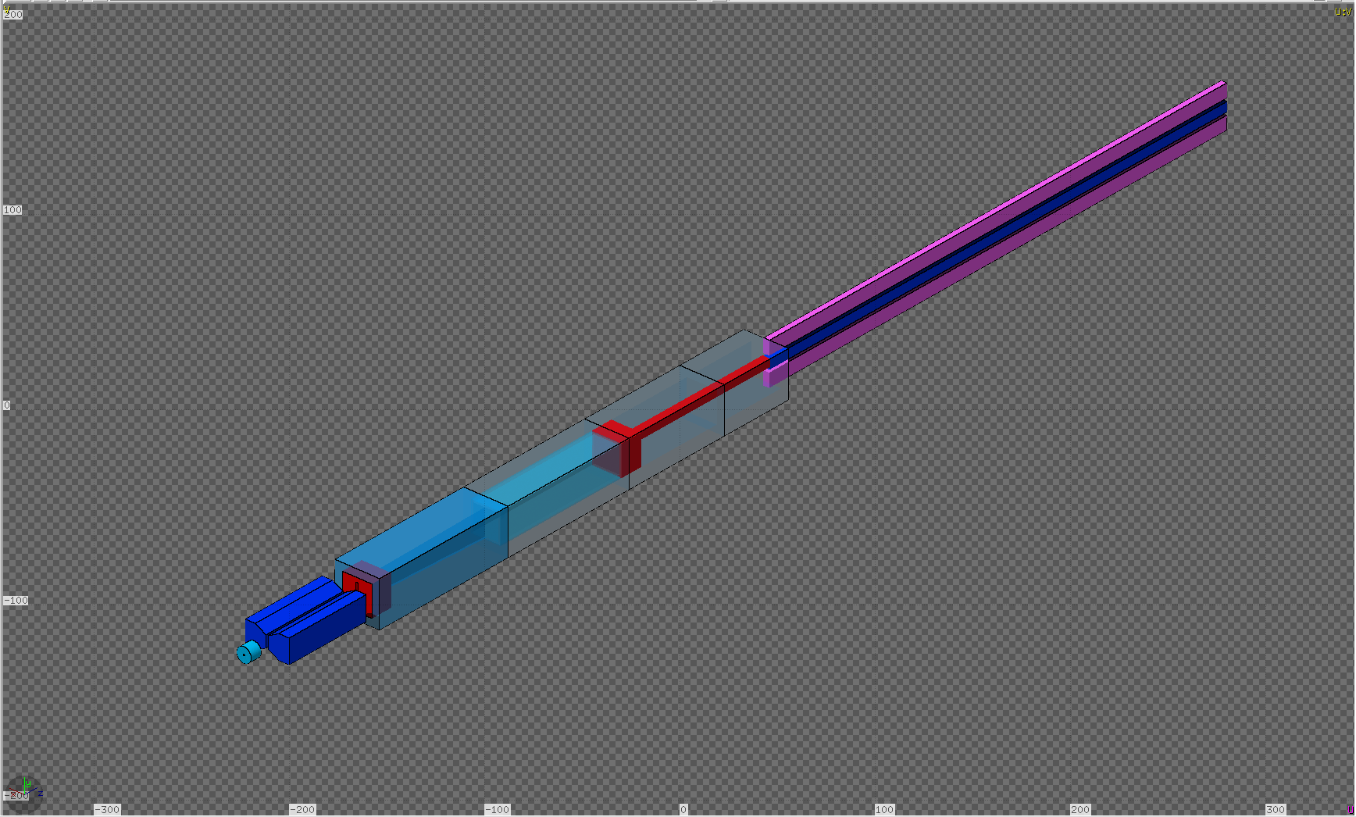
CPS Assembly: Beam Line + Core Layers

Slide 6
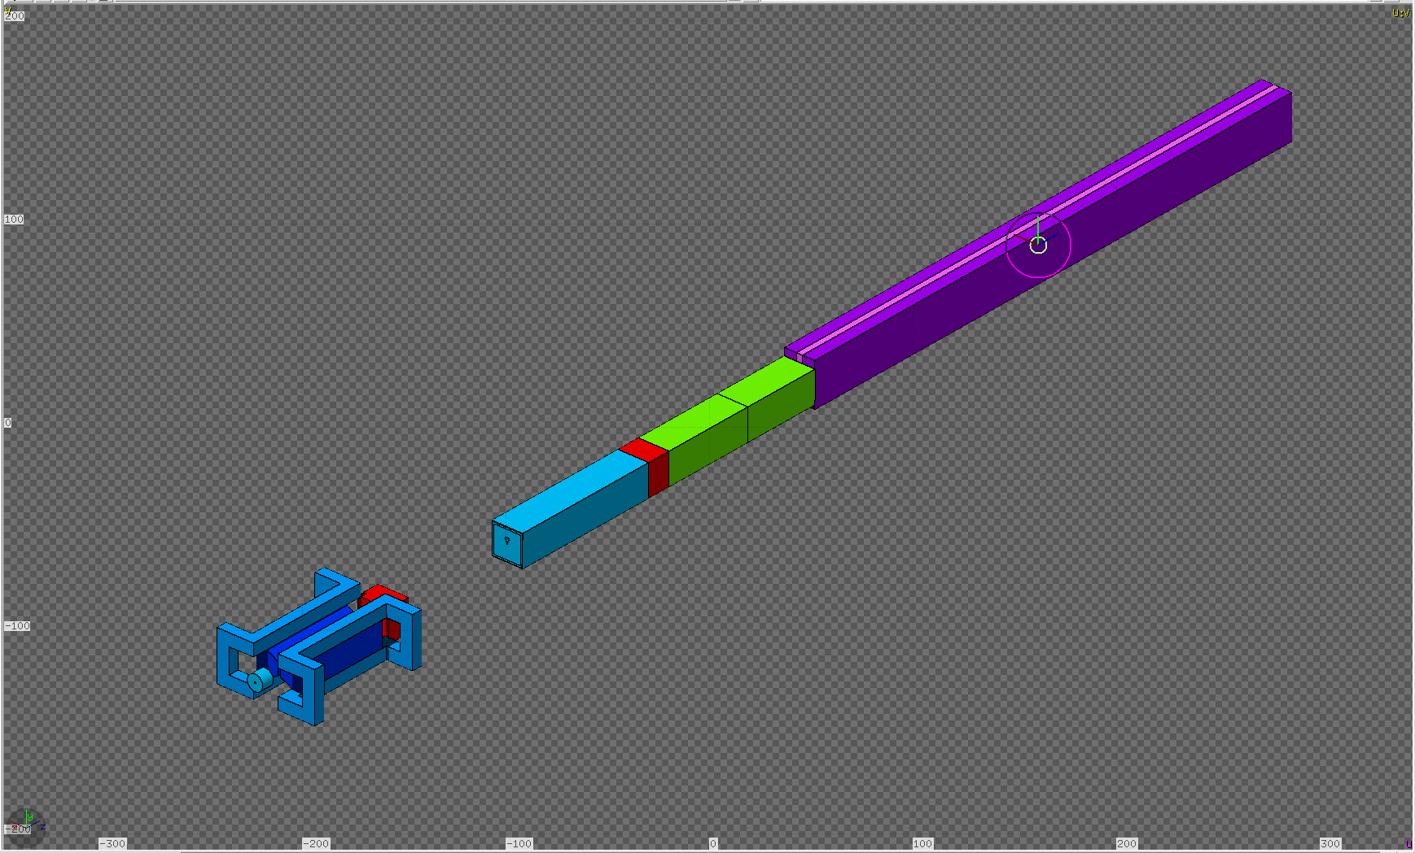
CPS Assembly: Beam Line + Core Layers

Slide 7
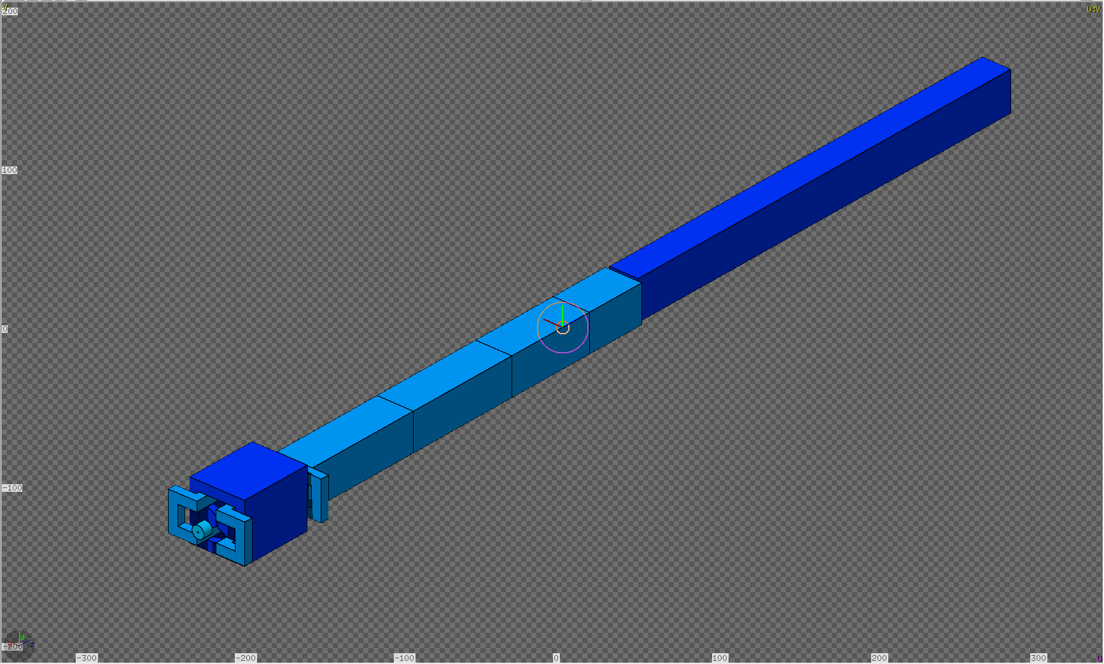
CPS Assembly: Beam Line + Core Layers

Slide 8
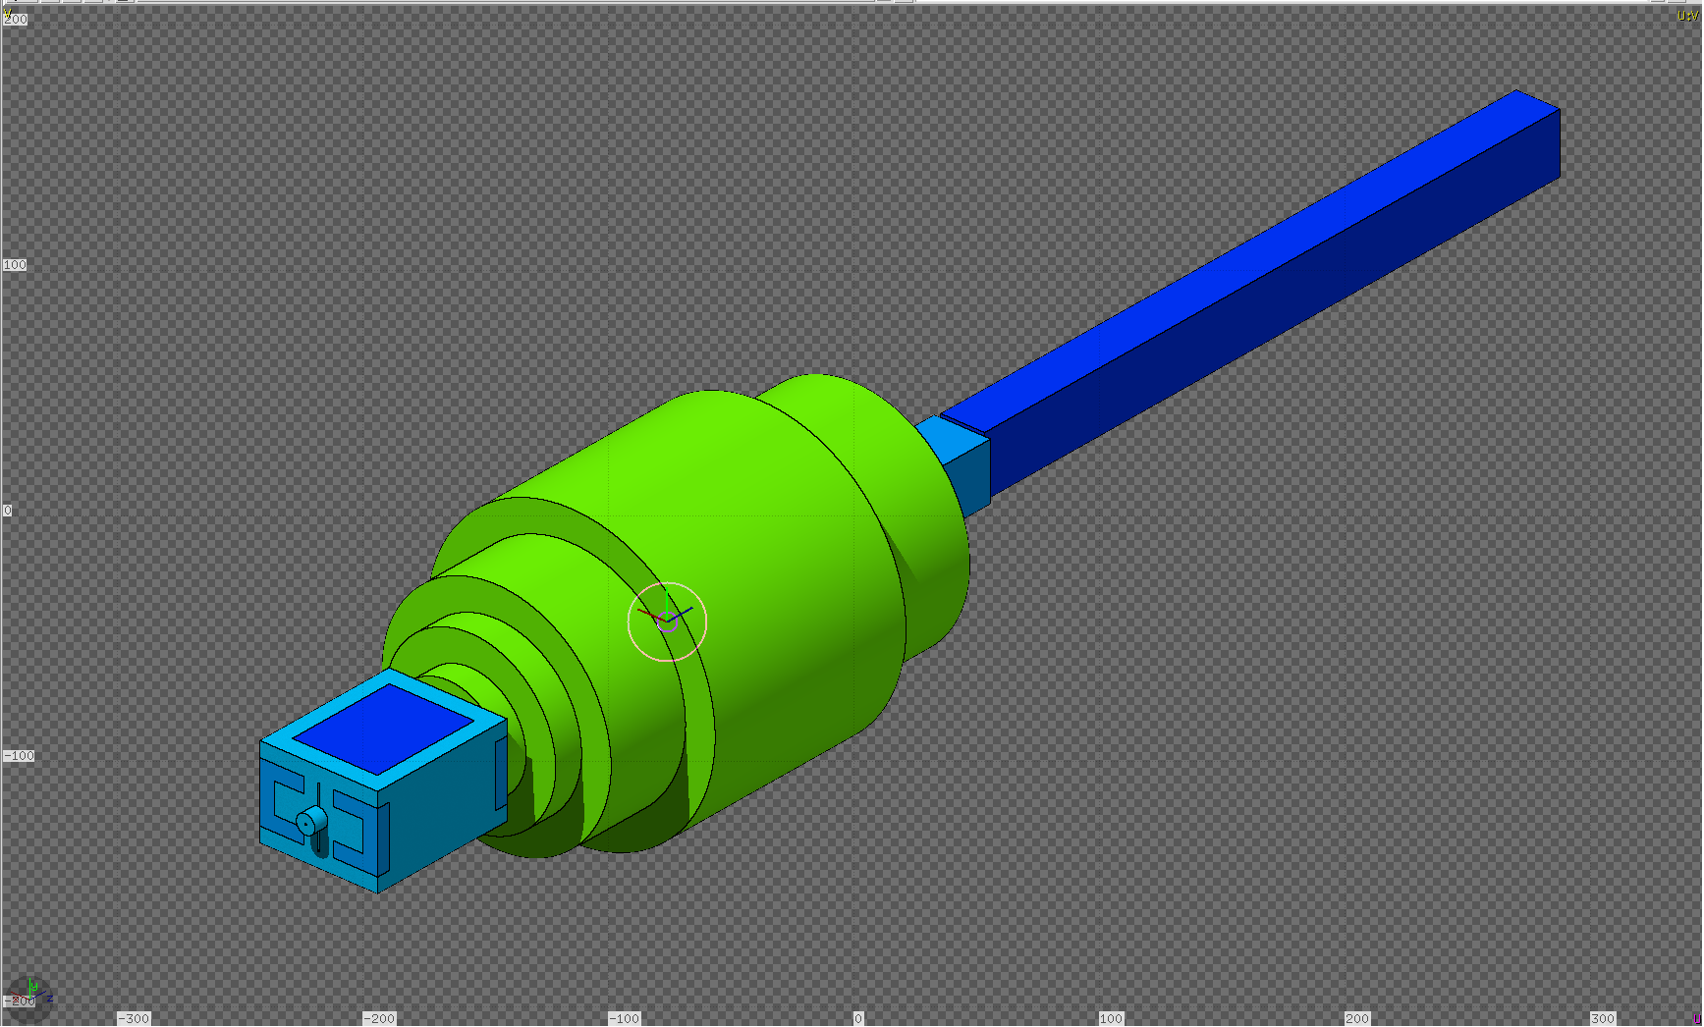
CPS Assembly: Beam Line + Core Layers

Slide 9
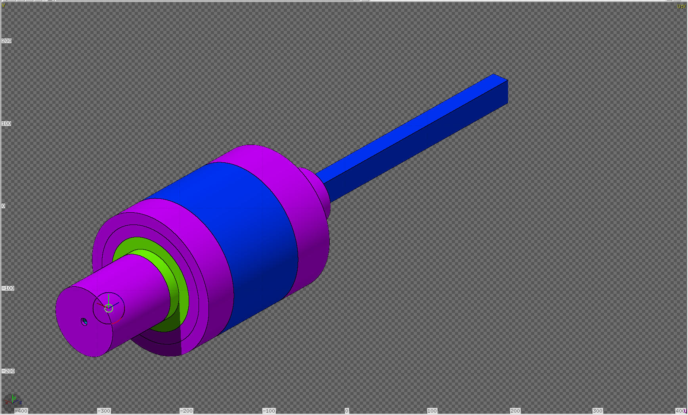
CPS Assembly: Beam Line + Core Layers

Slide 10
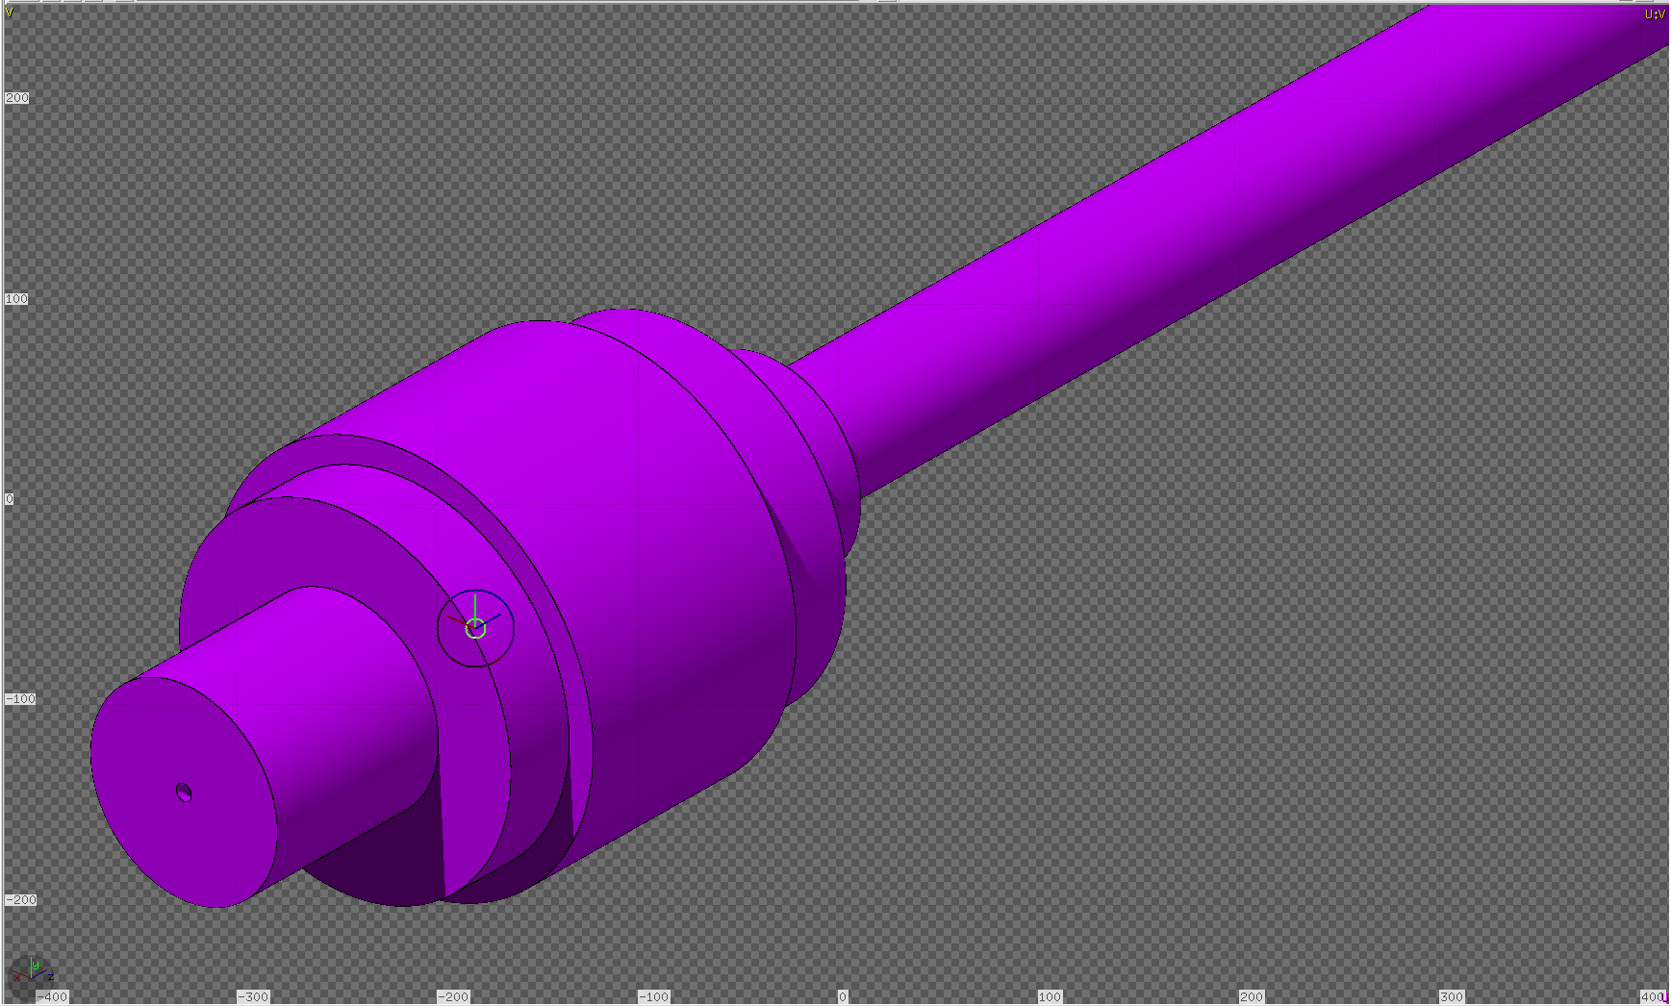
CPS Assembly: Beam Line + Core Layers

Slide 11
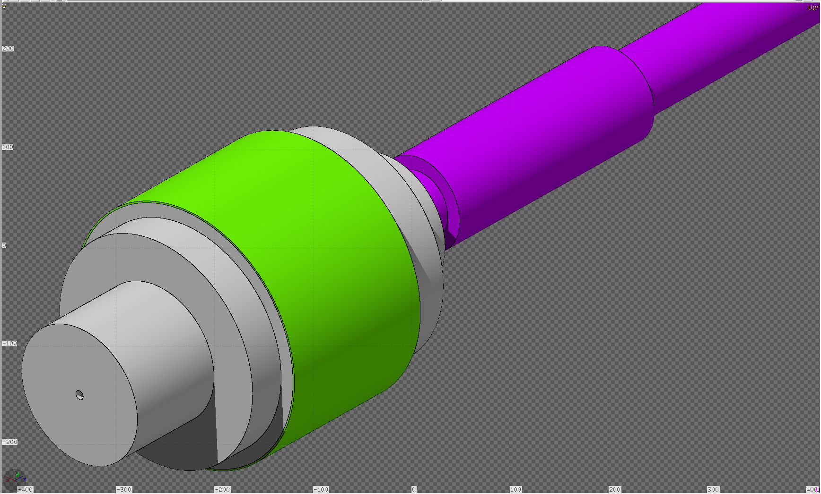
CPS Assembly: Beam Line + Core Layers

Slide 12
Beam propagation at mag.field at 0%

Slide 13
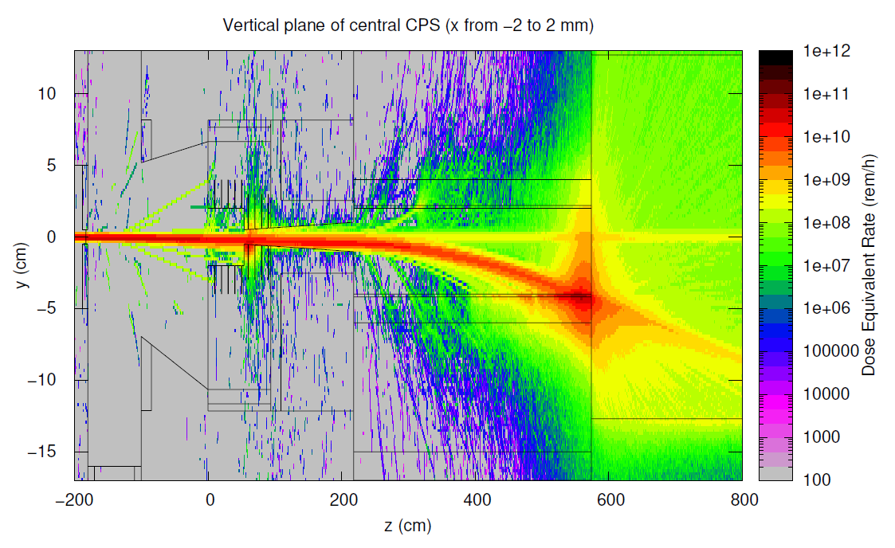
Beam propagation at mag.field at 10%

Slide 14
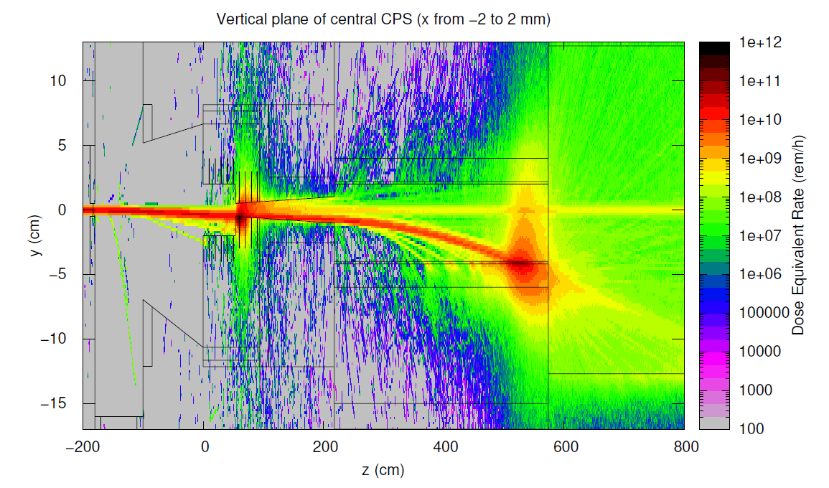
Beam propagation at mag.field at 20%

Slide 15
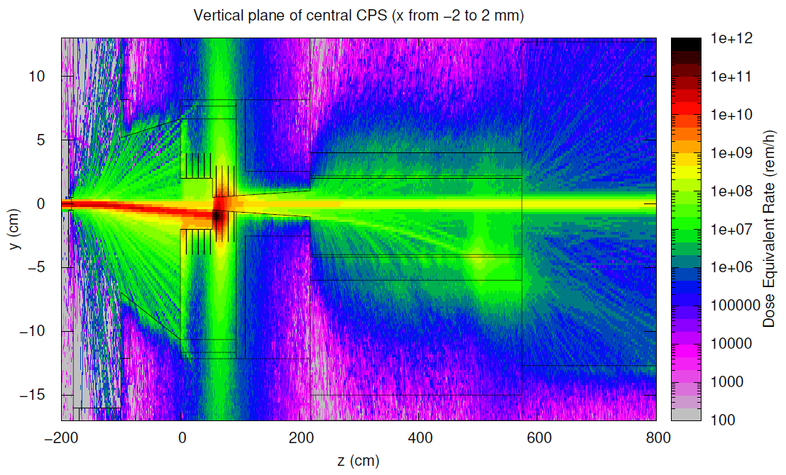
Beam propagation at mag.field at 40%

Slide 16
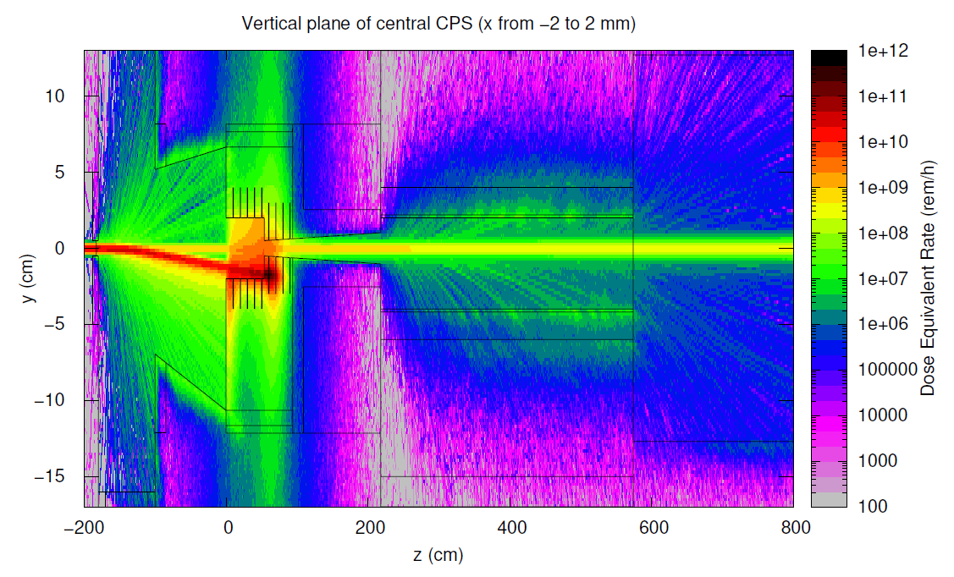
Beam propagation at mag.field at 80%

Slide 17
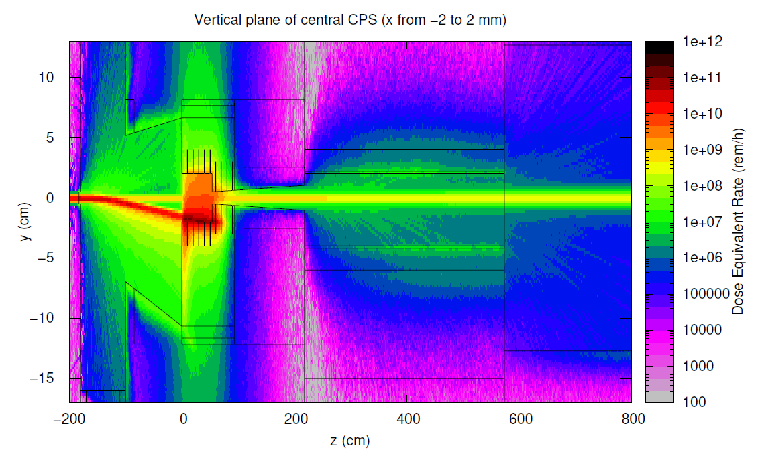
Beam propagation at mag.field at 100%

Slide 18
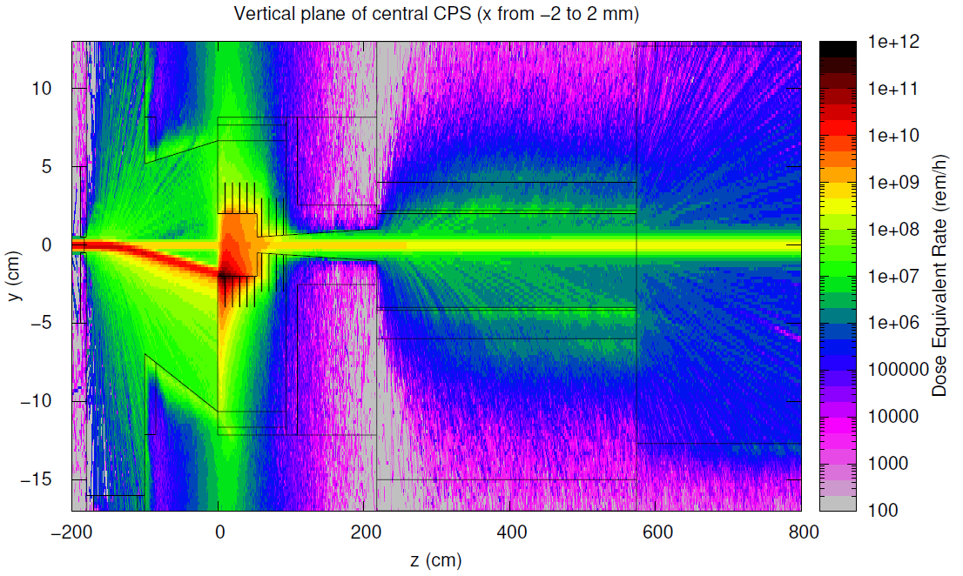
Beam propagation at mag.field at 120%

Slide 19
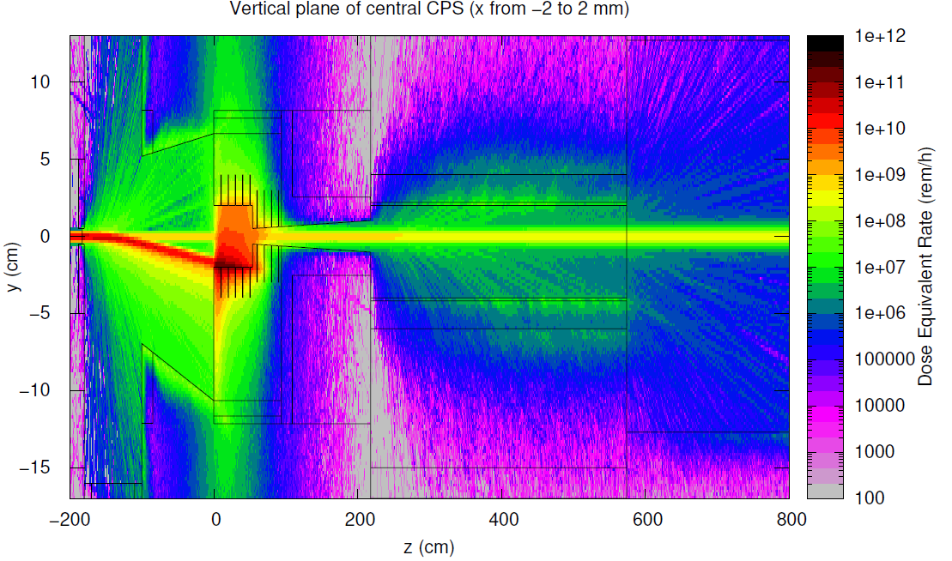
Beam propagation at mag.field at 110%

Slide 20
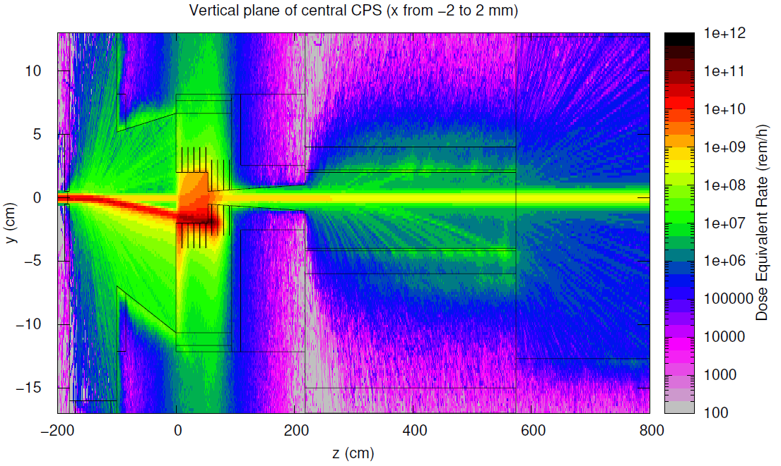
Beam propagation at mag.field at 90%

Slide 21
Beam propagation at mag.field at 110%

