Slide 1
KLF Beamline Meeting August 9, 2024
P. Degtiarenko

Slide 2
Calibration Photon Beam: CPS Design Changes
Low intensity photon beam may be needed for Hall D detector calibrations
The photon beam for calibrations from CPS should be comparable with typical Hall D operations (5.e-4 R.L. radiator at 200 nA beam)
The task wasn’t considered up to now
The choice for the beam line exit vacuum window was the cheapest (relatively thick Al)
The placement of the radiator along Z was rather arbitrary, and the Nitrogen gas fill inside the CPS represented a ~2.e-3 R.L. radiator in the straight section before the magnet
After removing the main 10% Copper radiator the CPS was still producing the photon beam too intense
Design optimization to minimize the residual photon beam:
Use Beryllium exit window (350 micron = 1.E-3 R.L.)
Shorten the straight section for the beam going through Nitrogen: move the CPS Collimator block as close to the magnet poles as possible (shorten the path to ~1.E-3 R.L.)
Utilize the photon beam collimator in the Cave to further limit the intensity as needed

Slide 3
CPS Model Update – August 2024, “KLCPS81”
New features compared to KLCPS80:
Updated magnetic field
Beam Displacement Monitoring System implemented
CPS entry collimator moved downstream 10 cm to contact the magnet poles
The upstream shielding edges also moved making the overall CPS length shorter
~350 micron or thinner Beryllium vacuum exit window suggested
Design of a mu-metal wrap for the entry beam line started, to be evaluated
New sketch design for the entrance collimator and the radiator target ladder
Use of Tungsten collimator in the Cave with appropriate diameter of the hole
After several design iterations, the result seems to be workable
The simulated low intensity photon spectra are presented here
Further tune up will be based on the feedback from the Hall D detector group

Slide 4
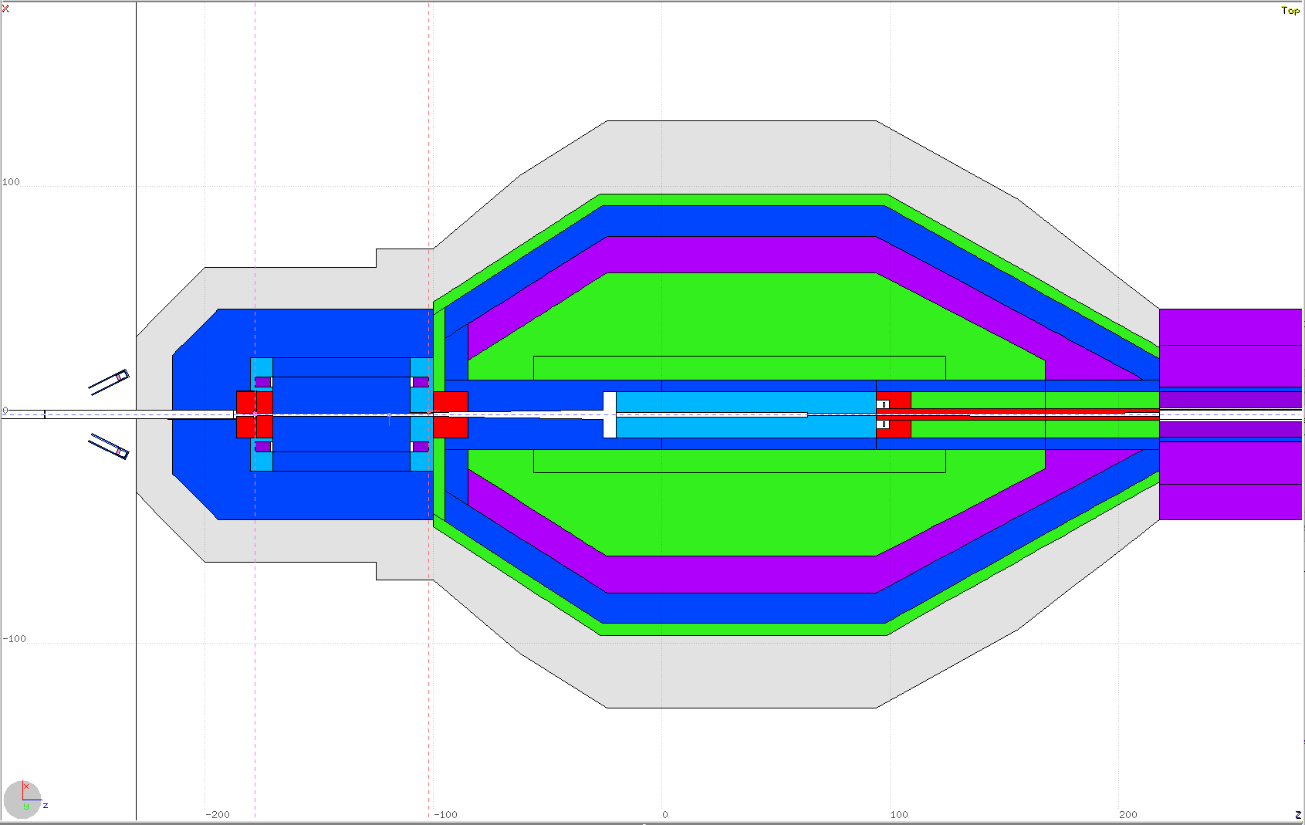
KLCPS81 Z-X Plane

Slide 5
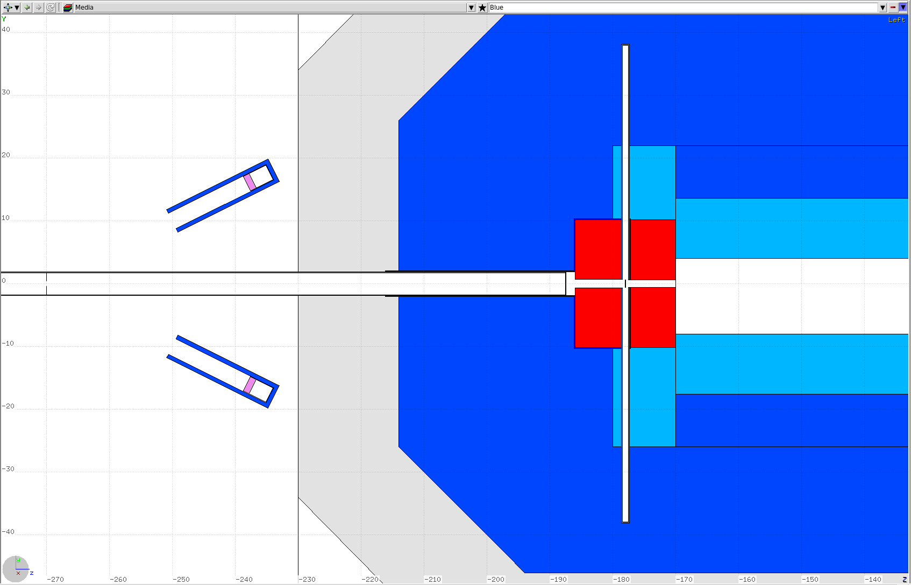
KLCPS81 Z-Y Plane
Radiator target ladder shaft
Mu-metal wrap
Vacuum window
BDM
Radiator
Collimator

Slide 6
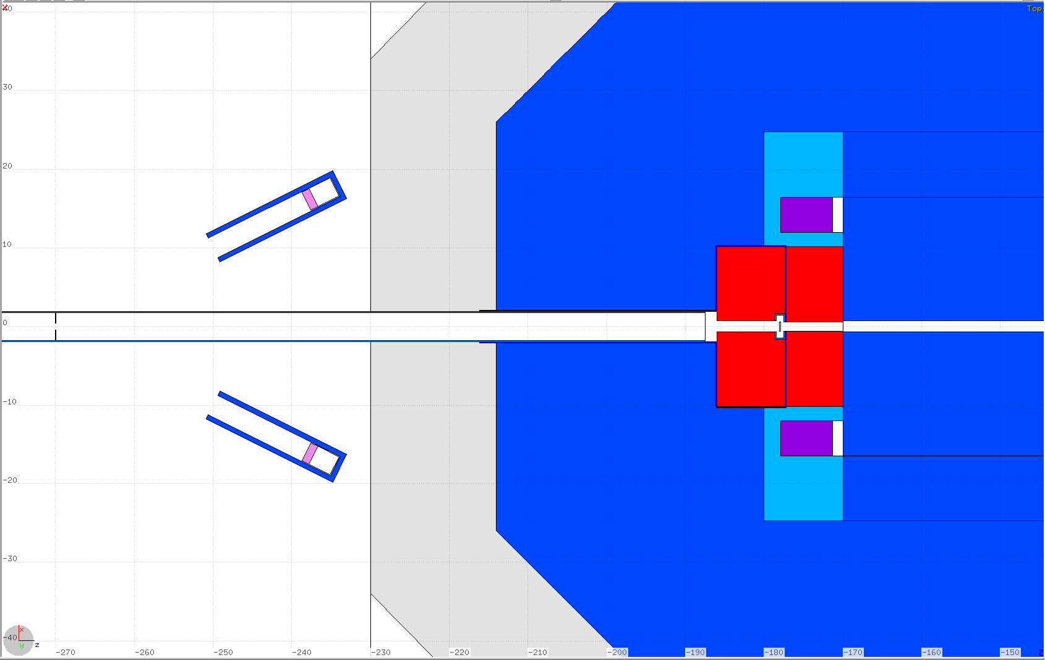
KLCPS80 Z-X Plane
Mu-metal wrap
Radiator target ladder shaft
Vacuum window
BDM
Radiator
Collimator

Slide 7
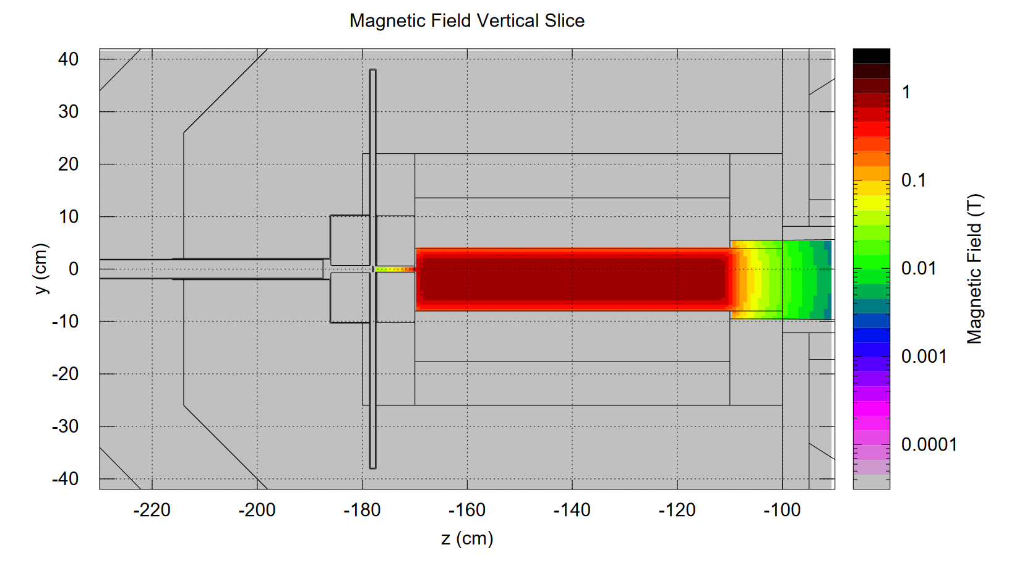
KLCPS81 Z-Y Plane

Slide 8
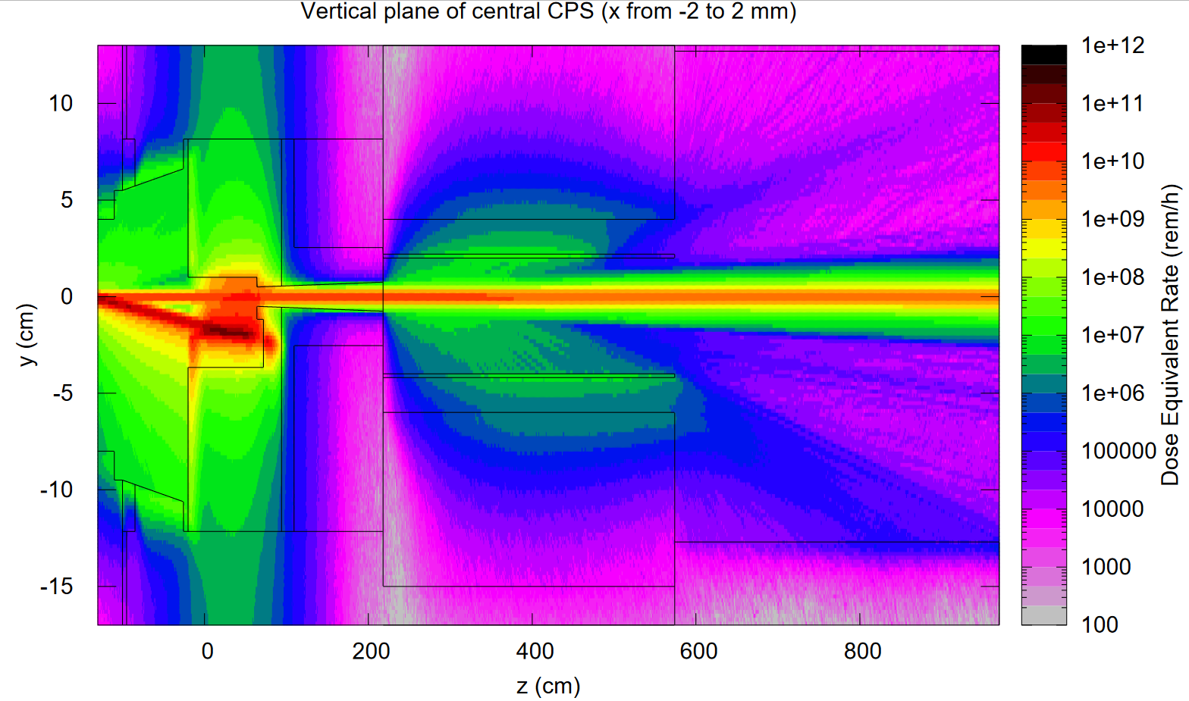
KLCPS81 Z-Y Plane
10% Radiator

Slide 9
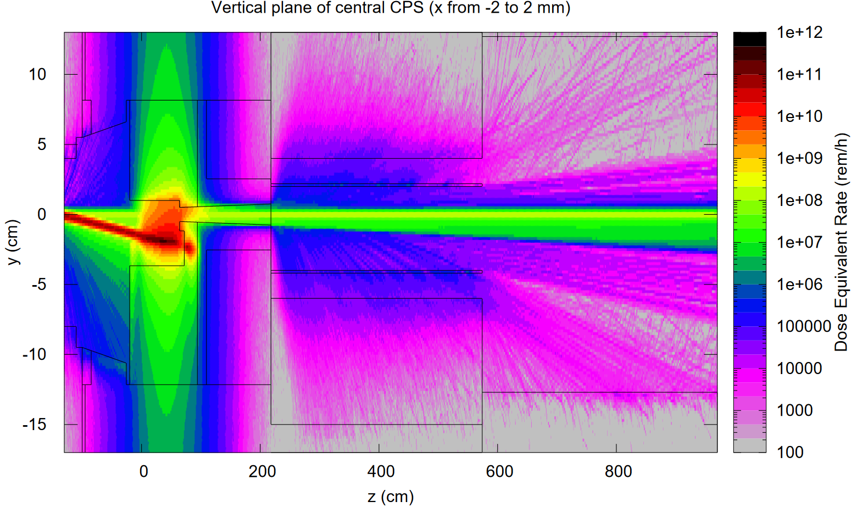
KLCPS81 Z-Y Plane
0.2% Radiator

Slide 10
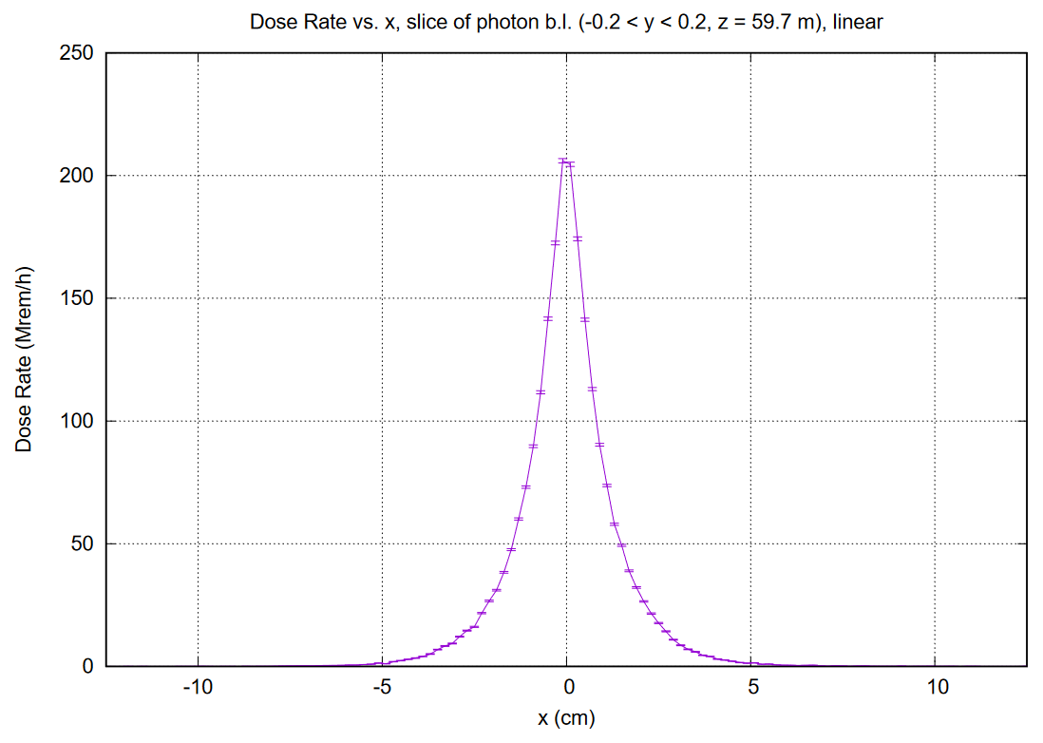
10% Radiator
Horizontal Profile

Slide 11
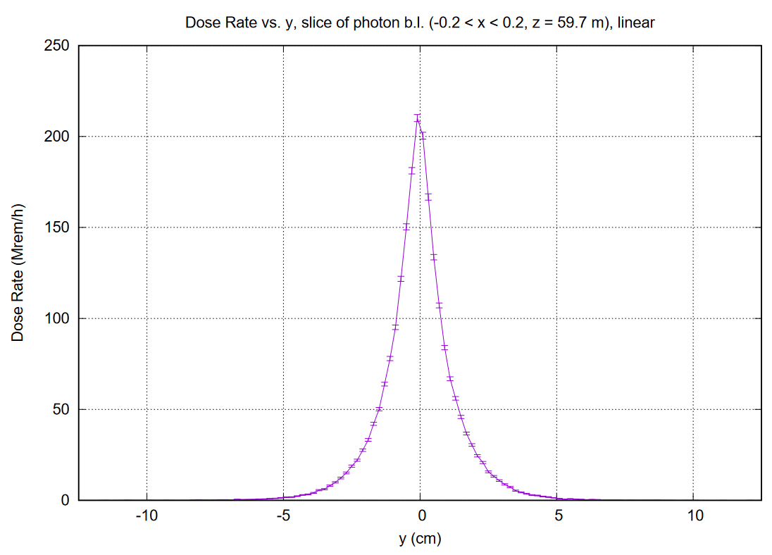
10% Radiator
Vertical Profile

Slide 12
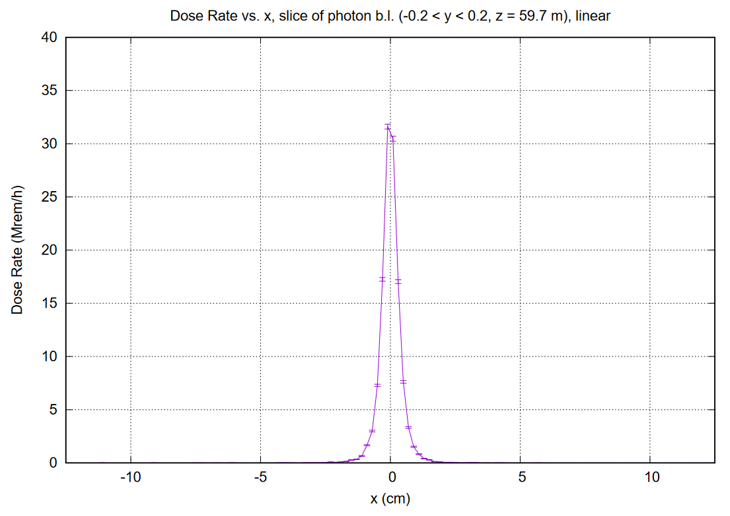
0.2% Radiator
Horizontal Profile

Slide 13
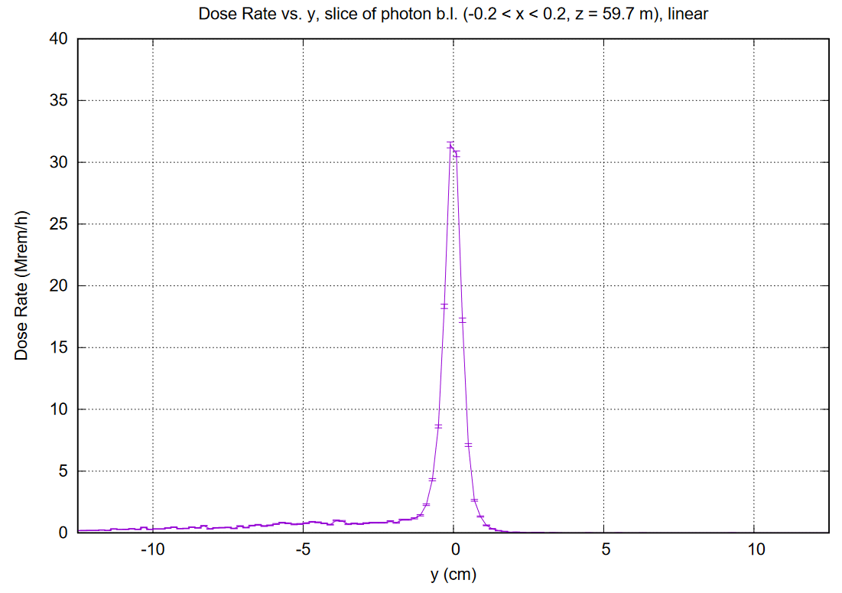
0.2% Radiator
Vertical Profile

Slide 14
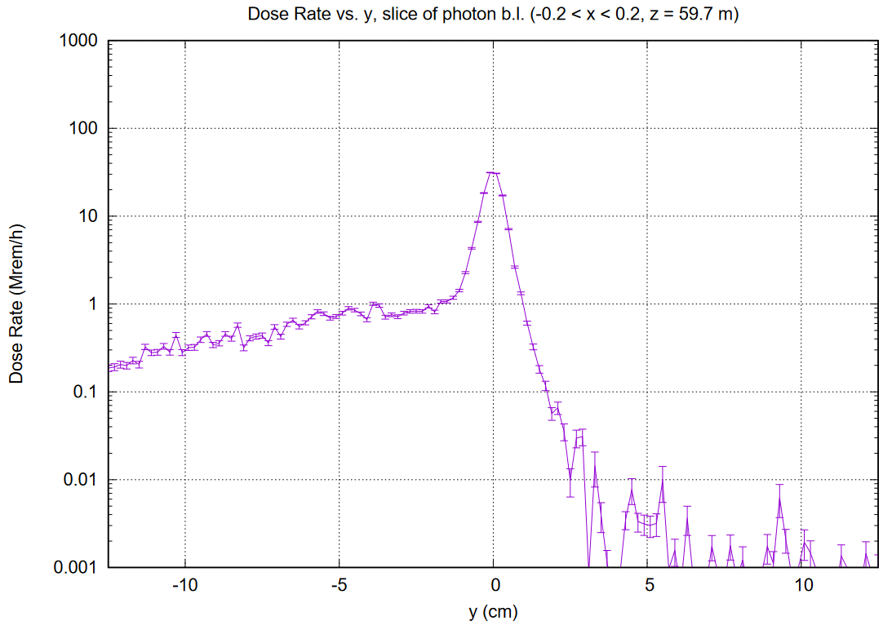
0.2% Radiator
Vertical Profile

Slide 15
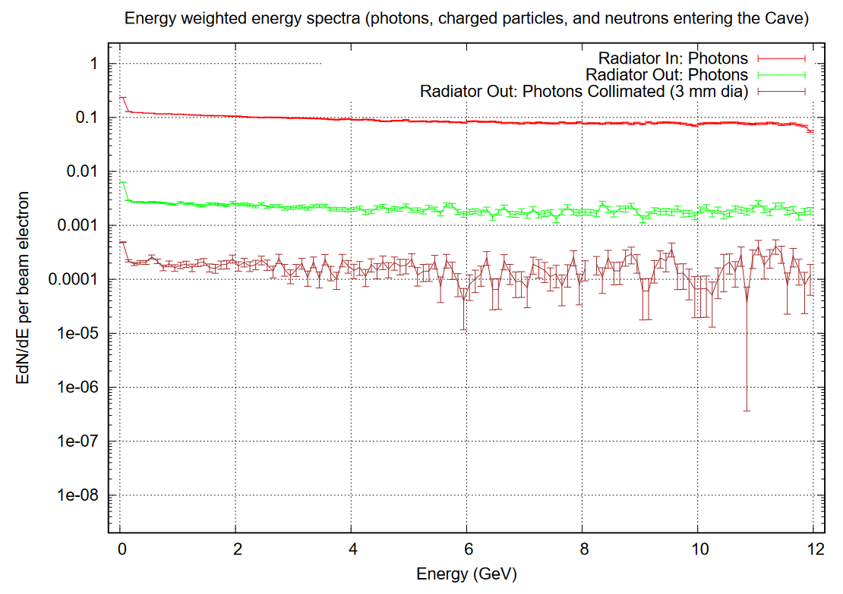
EdN/dE spectra
Energy-weighted photon energy spectra in the Cave
10% Radiator: Cu
~0.2% Radiator: Be + N₂
3 mm collimation applied
(equivalent to ~0.02% Radiator)

Slide 16
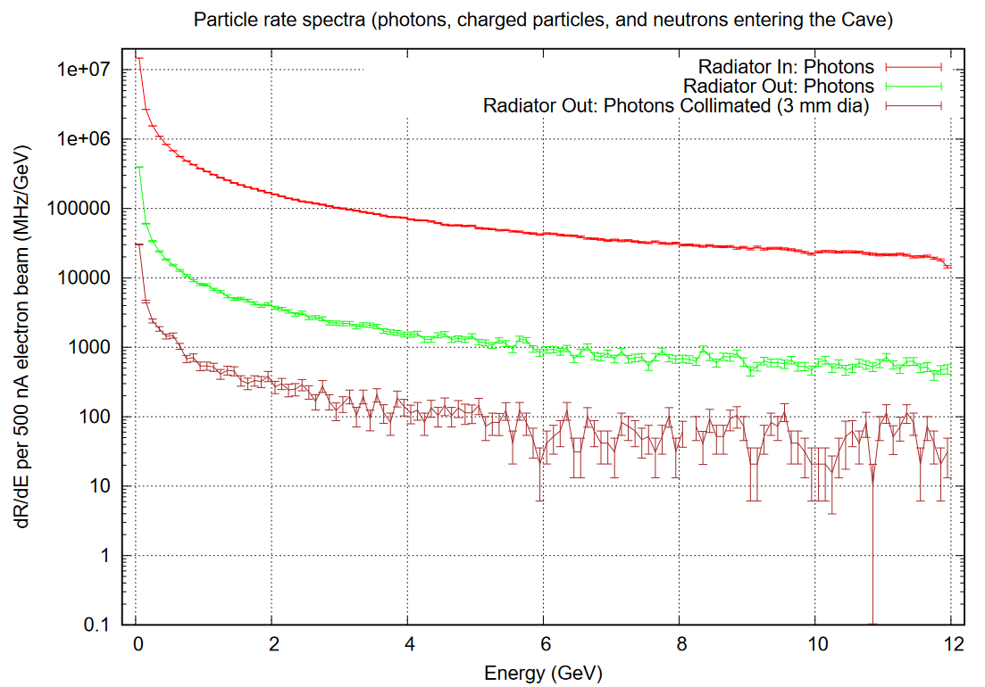
dR/dE spectra
Photon Rates per interval energy in the Cave
10% Radiator: Cu
~0.2% Radiator : Be + N₂
3 mm collimation applied
(equivalent to ~0.02% Radiator)

Slide 17
Highlights – August 9th, 2024, “KLCPS81”
Repeat: new features compared to KLCPS80:
Updated magnetic field
Beam Displacement Monitoring System implemented
Entry collimator moved downstream 10 cm to contact the magnet poles
The backward shielding edges also moved making the overall CPS length shorter
350-micron Beryllium vacuum exit window suggested
Need in a mu-metal wrap for the entry beam line should be evaluated
New sketch design for the entrance collimator and the radiator target ladder
Use of Tungsten collimator in the Cave with appropriate diameter of the hole
Other intermediate configurations checked, including Al vacuum window, Helium as the fill gas, steering by the mag. field, varying collimator diameter
After several design iterations, the result seems to be workable
The CPS photon beam intensity can be lowered appropriately to match the data taking and calibration requirements

