Slide 1
K⁰L CPS Meeting August 7, 2023
P. Degtiarenko

Slide 2
Design Update – August 2023, “KLCPS76”
Suggested improvements to the model
Front extension of the Absorber to include tapered entrance part
Elongation of the electron absorption cavity to use back of the Absorber better
Making 1 mm vertical slits (in x-y plane) every 2 cm along z for tension relief
Making one long 0.2 mm gap in y-z plane under the cavity tip for tension relief
Switch places between Iron and Barite concrete shielding layers: decreased prompt dose rates and activation dose rates (likely will increase back with the new coming FLUKA version)
Increased the entrance collimation opening to 12 mm diameter to decrease halo interactions.

Slide 3
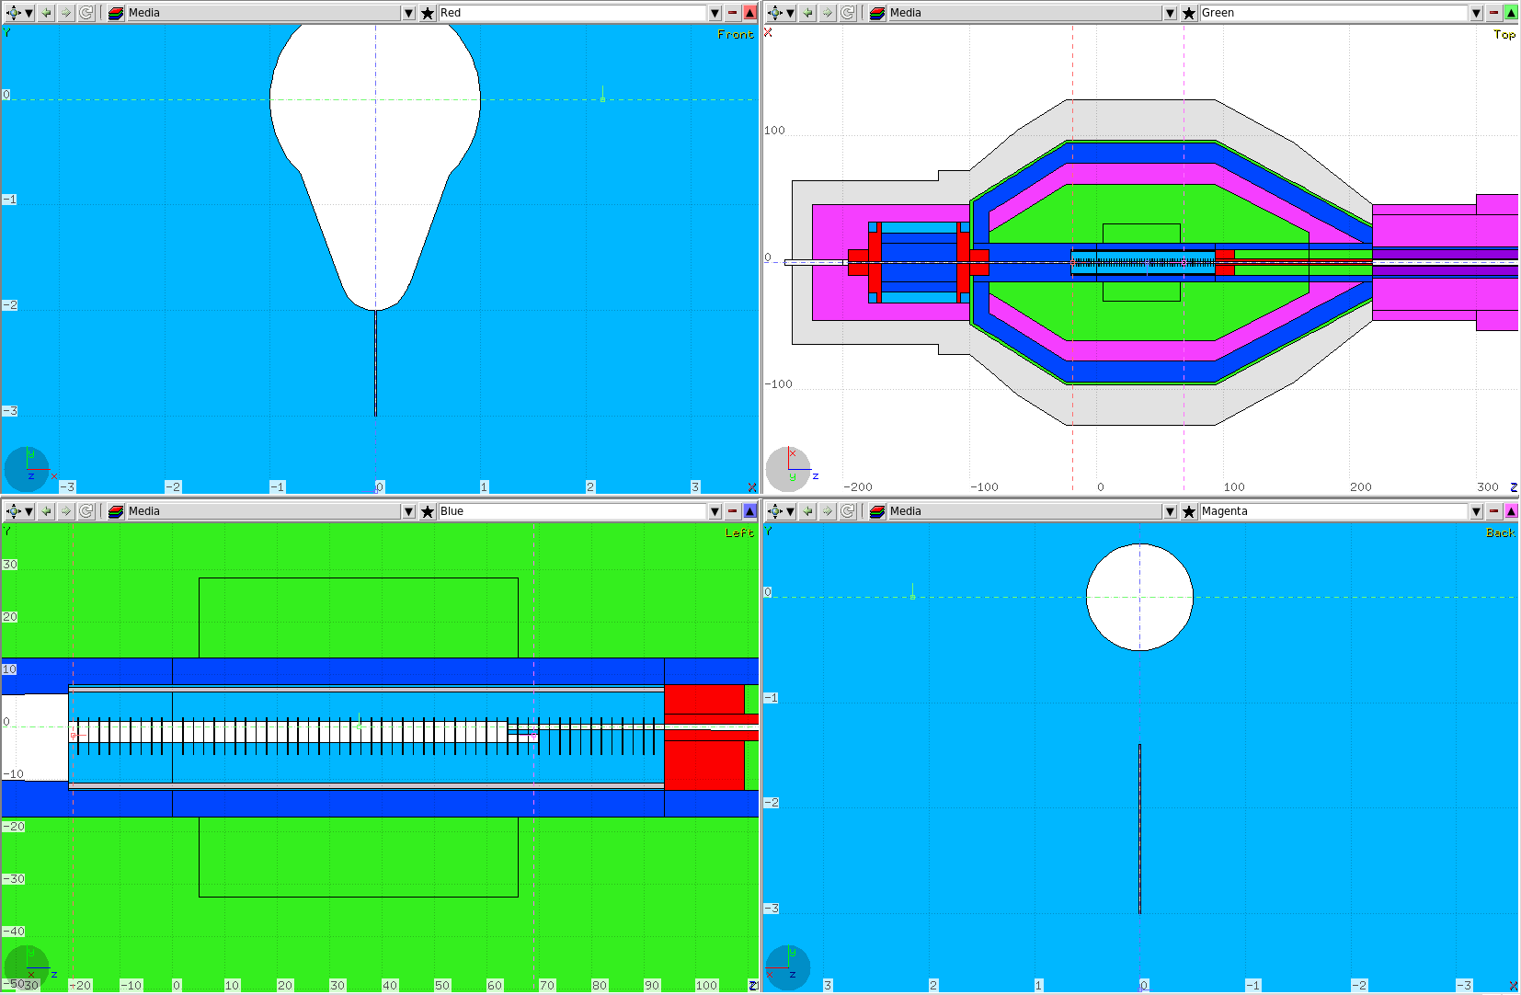
CPS#76 Geometry
2 cm
5 m
1 m
1 cm

Slide 4
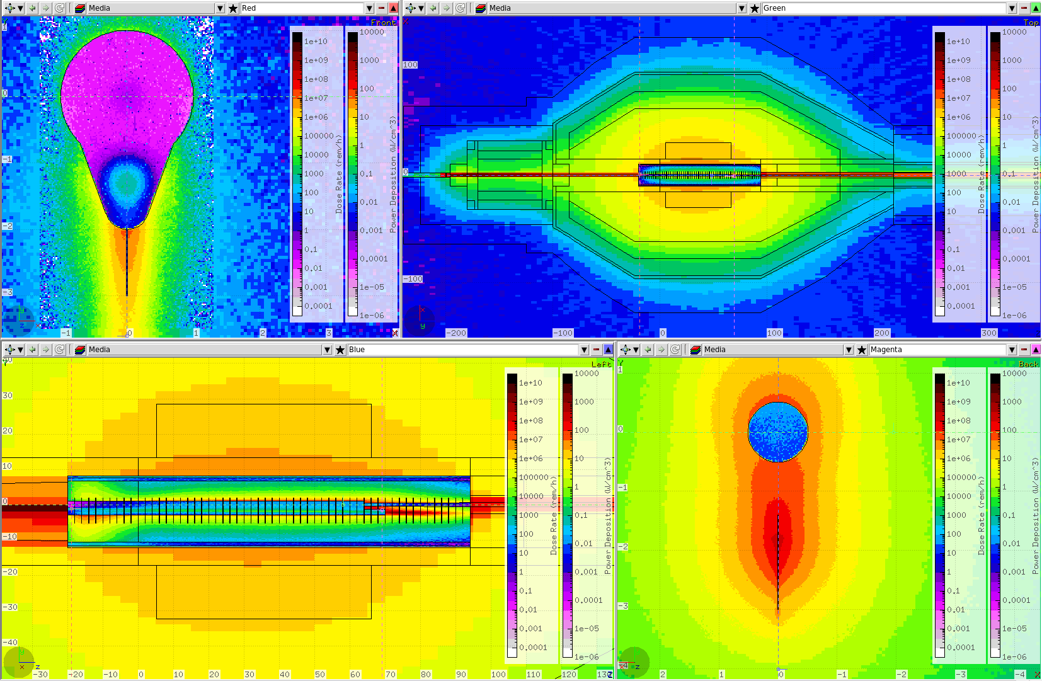
Power in the Core, and Dose Eq. Rate
2 cm
4 m
1 m
2 cm

Slide 5
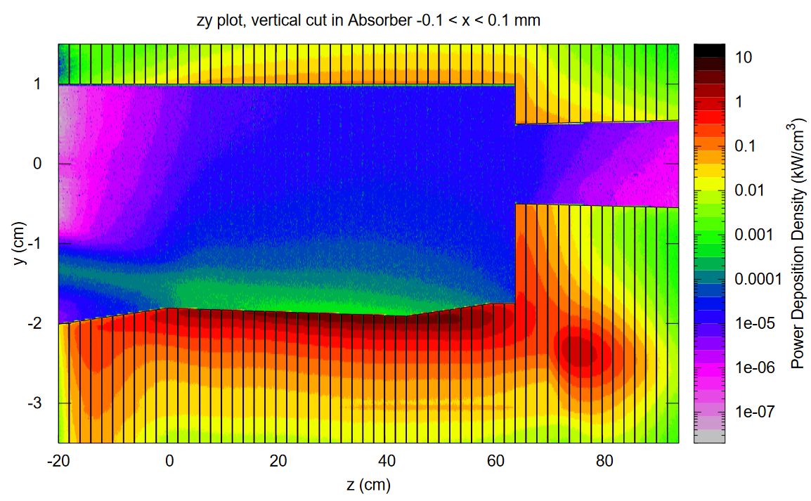
Power in the Core, Vertical Cut at X = 0.15 mm

Slide 6
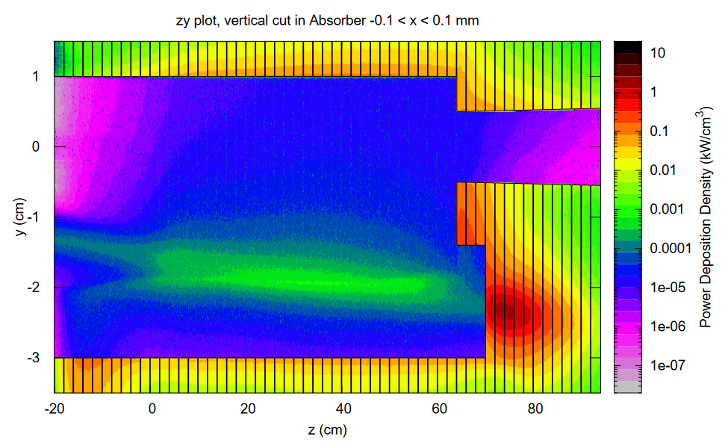
Power in the Core, Vertical Cut

Slide 7
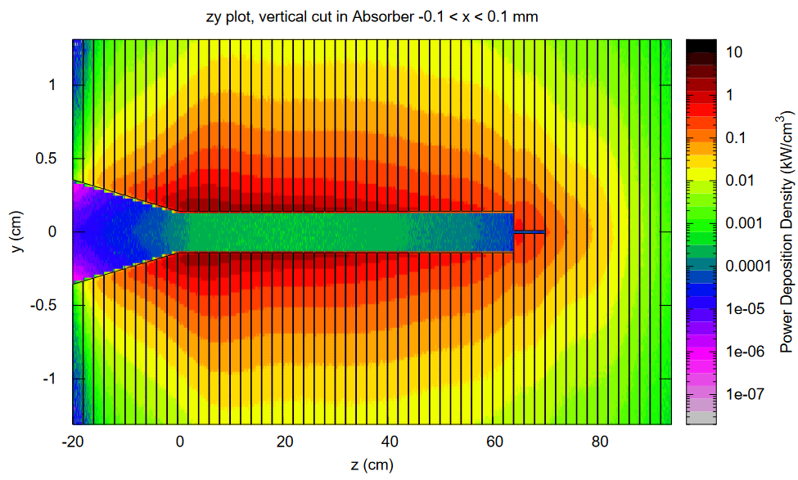
Power in the Core, Horiz. Cut at Y = -1.7 cm

Slide 8
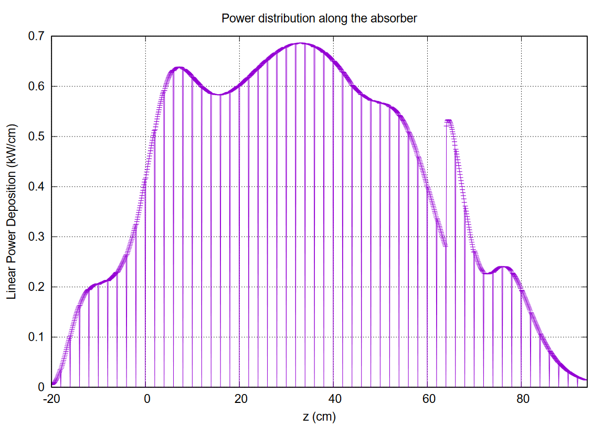
Linear Power in the Absorber Core along Z

Slide 9
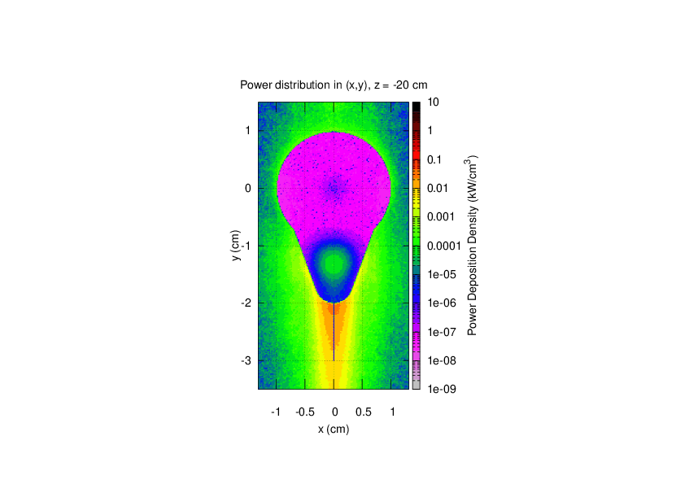
Power in the Core, Vertical Cut along Z

Slide 10
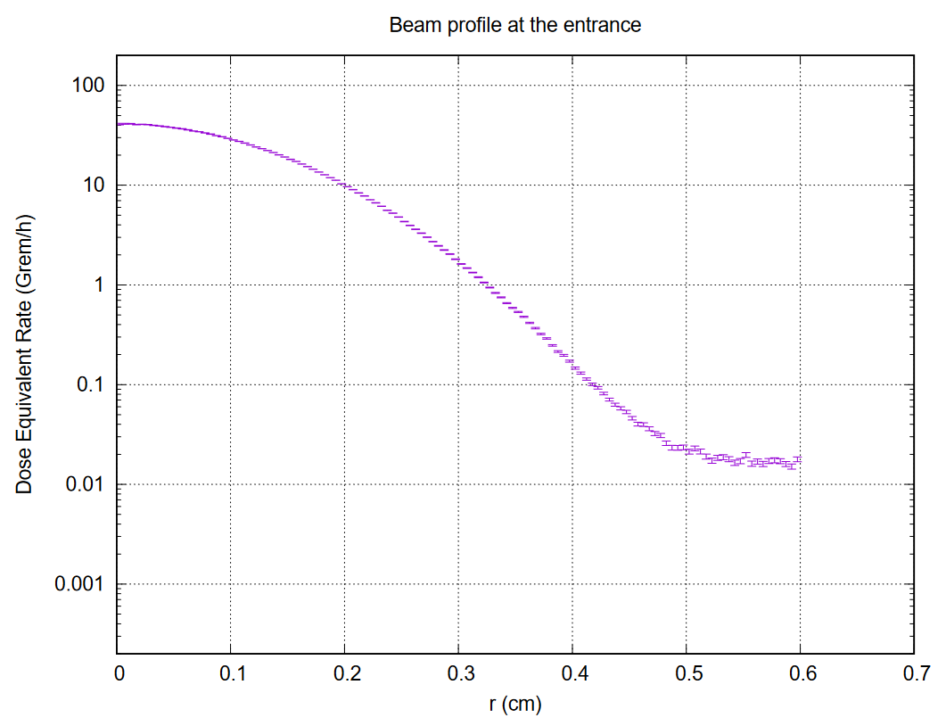
Beam Profile at the Entrance

Slide 11
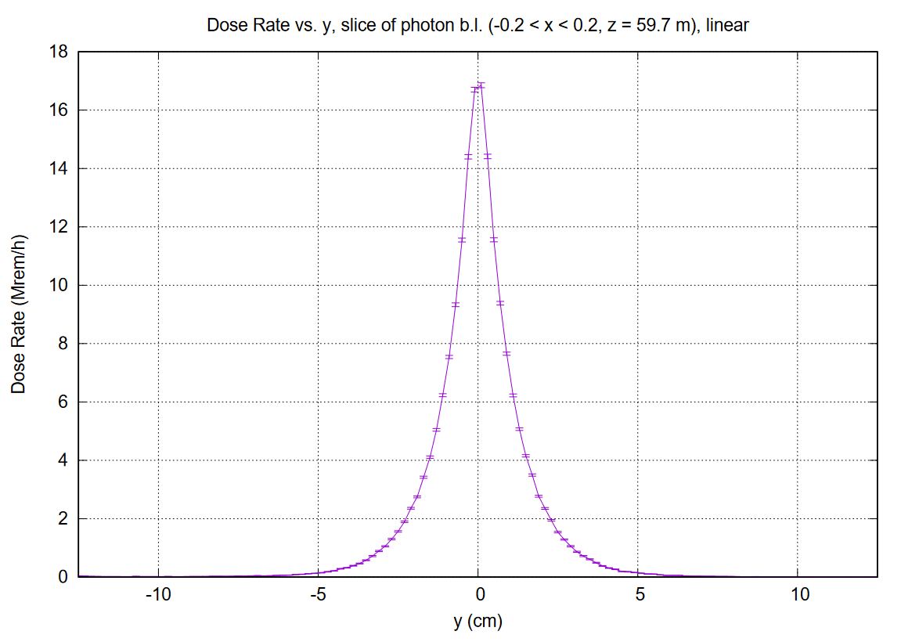
Beam Profile at the Beryllium target

Slide 12
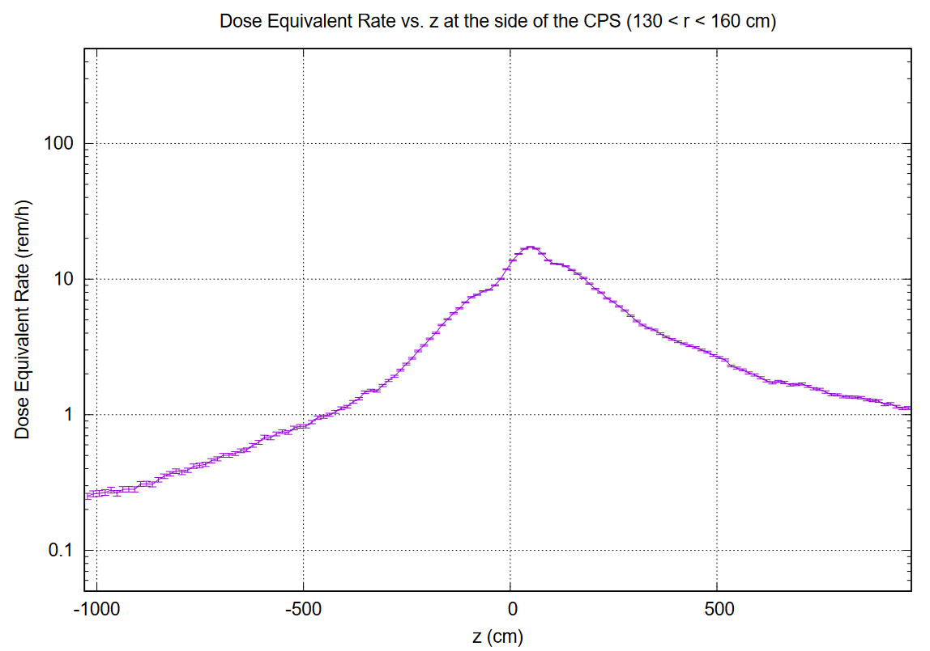

Slide 13
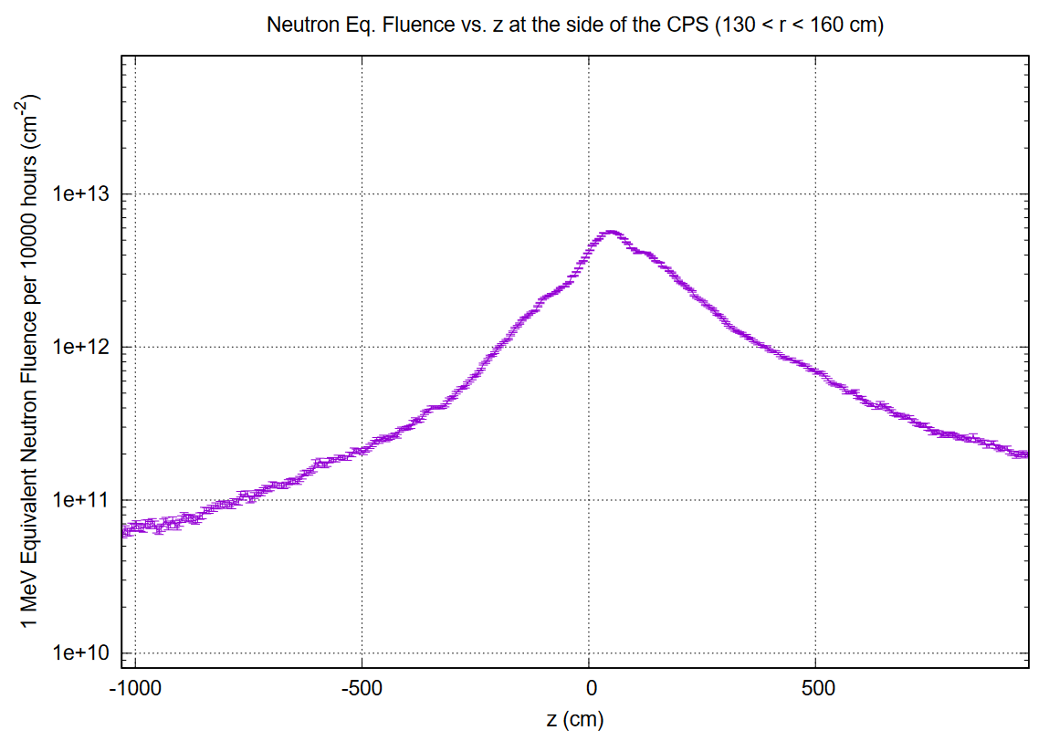

Slide 14
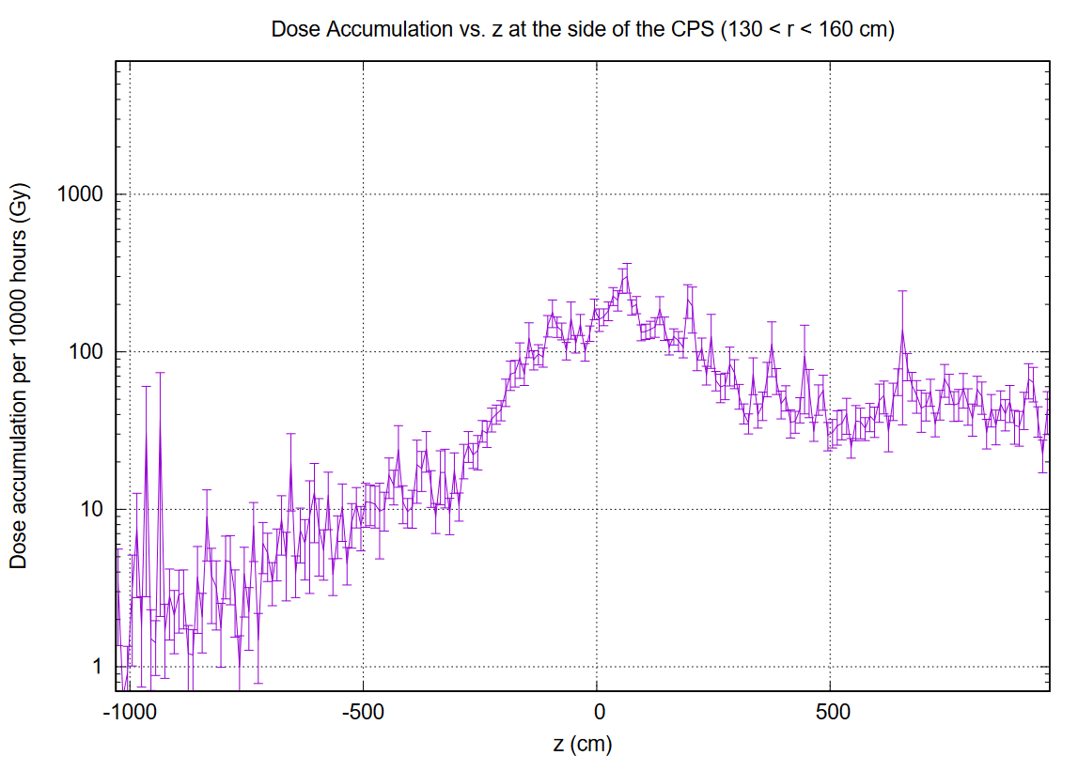

Slide 15
