Slide 1
KLF Design Meeting November 21, 2024
P. Degtiarenko

Slide 2
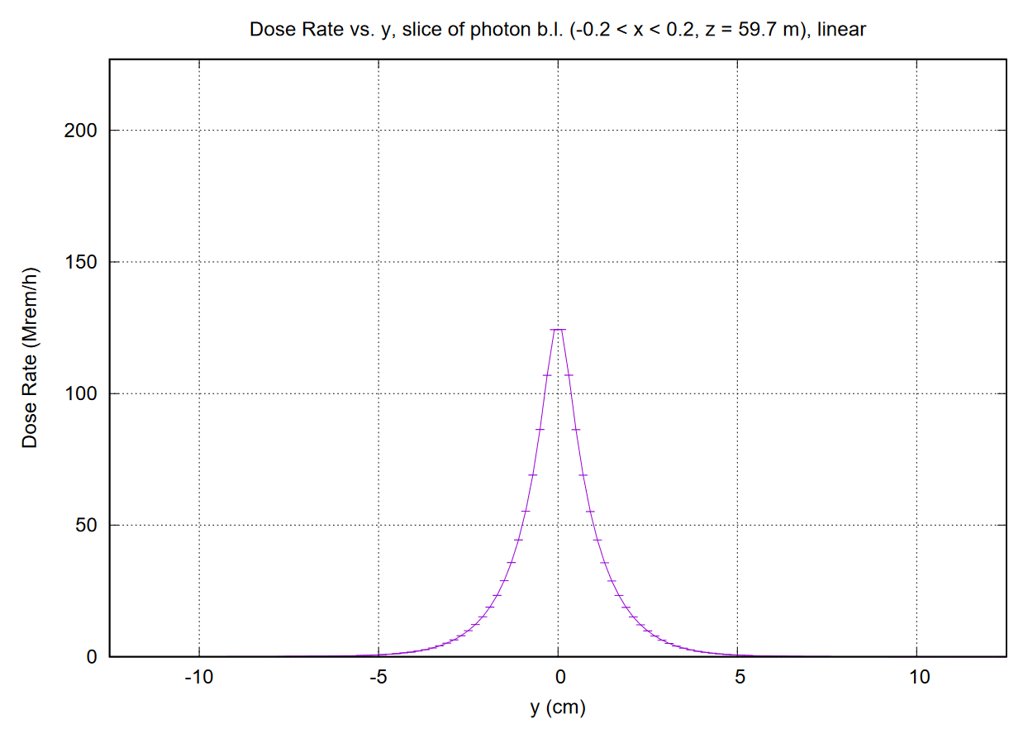
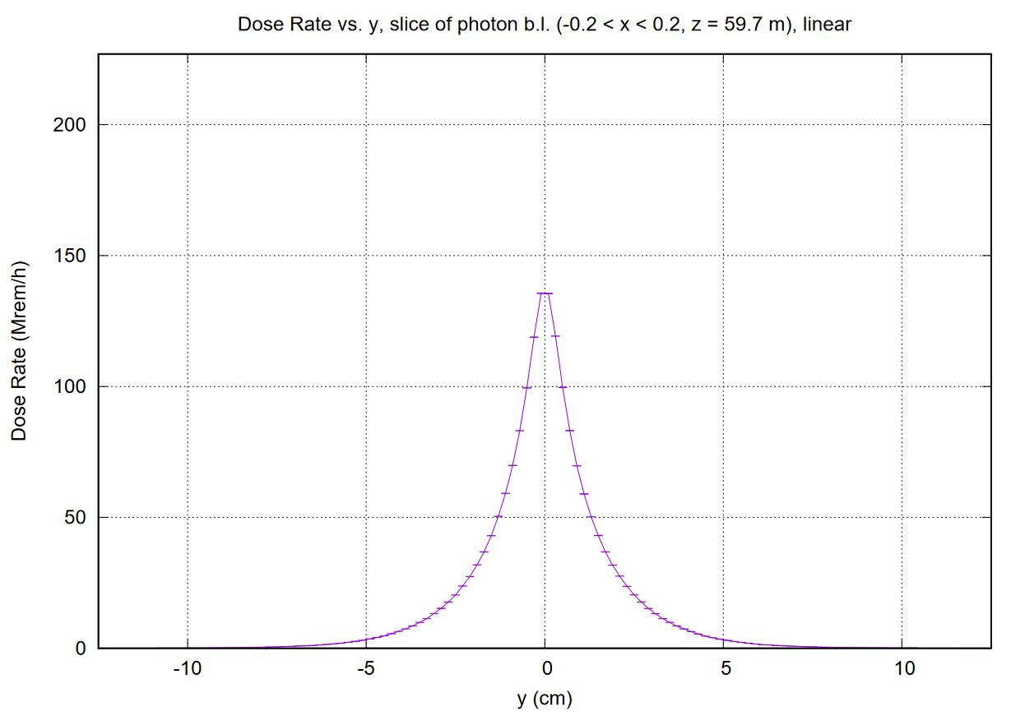
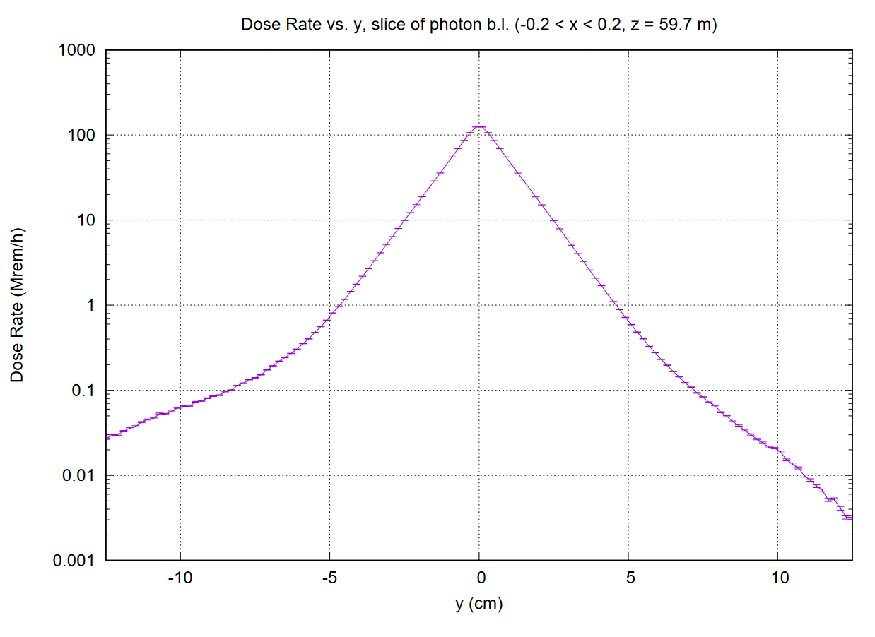
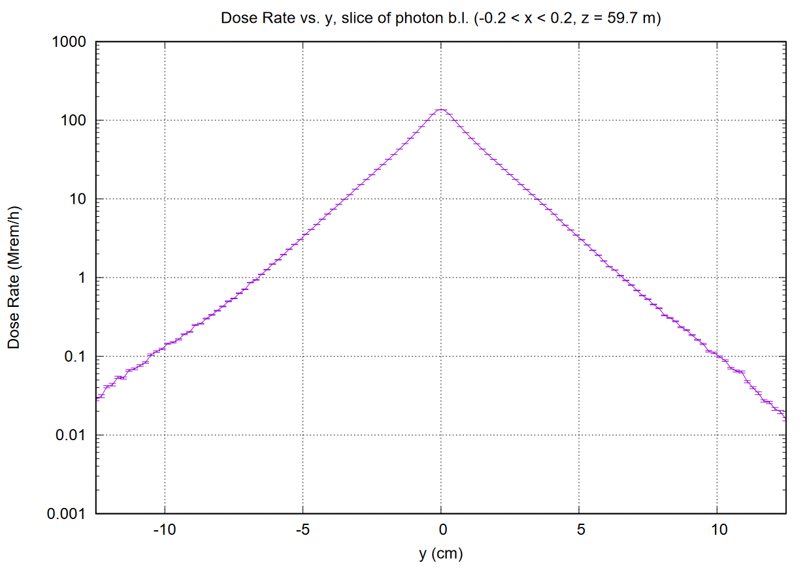
10% Radiator 20% Radiator

Slide 3
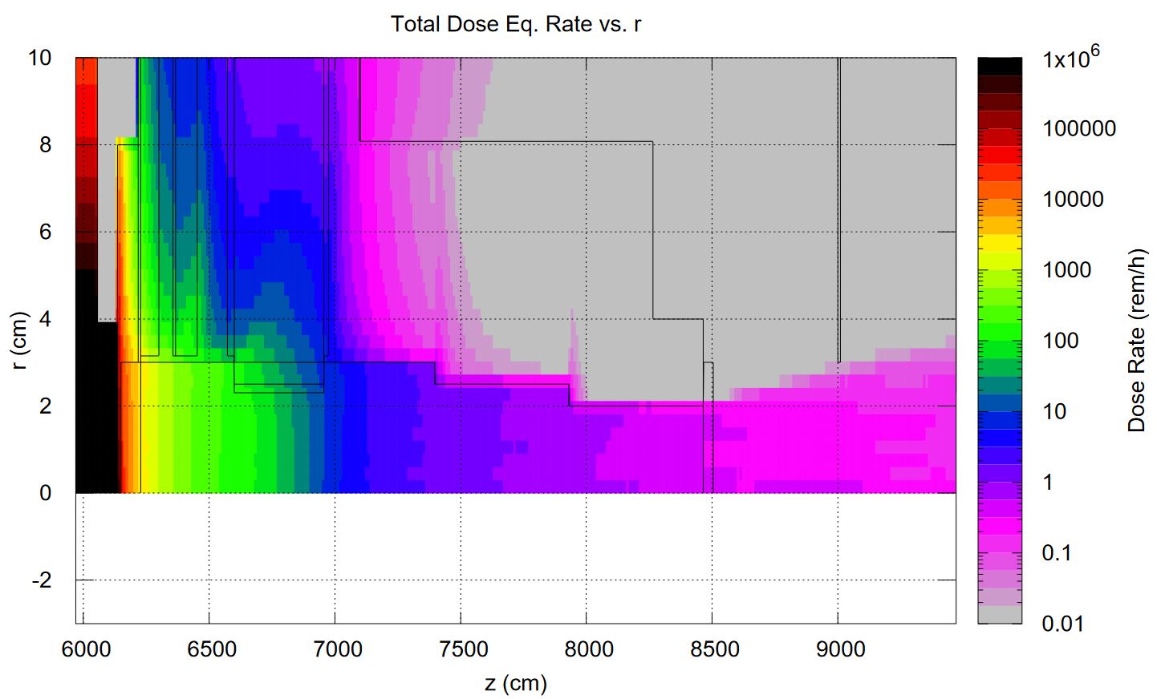
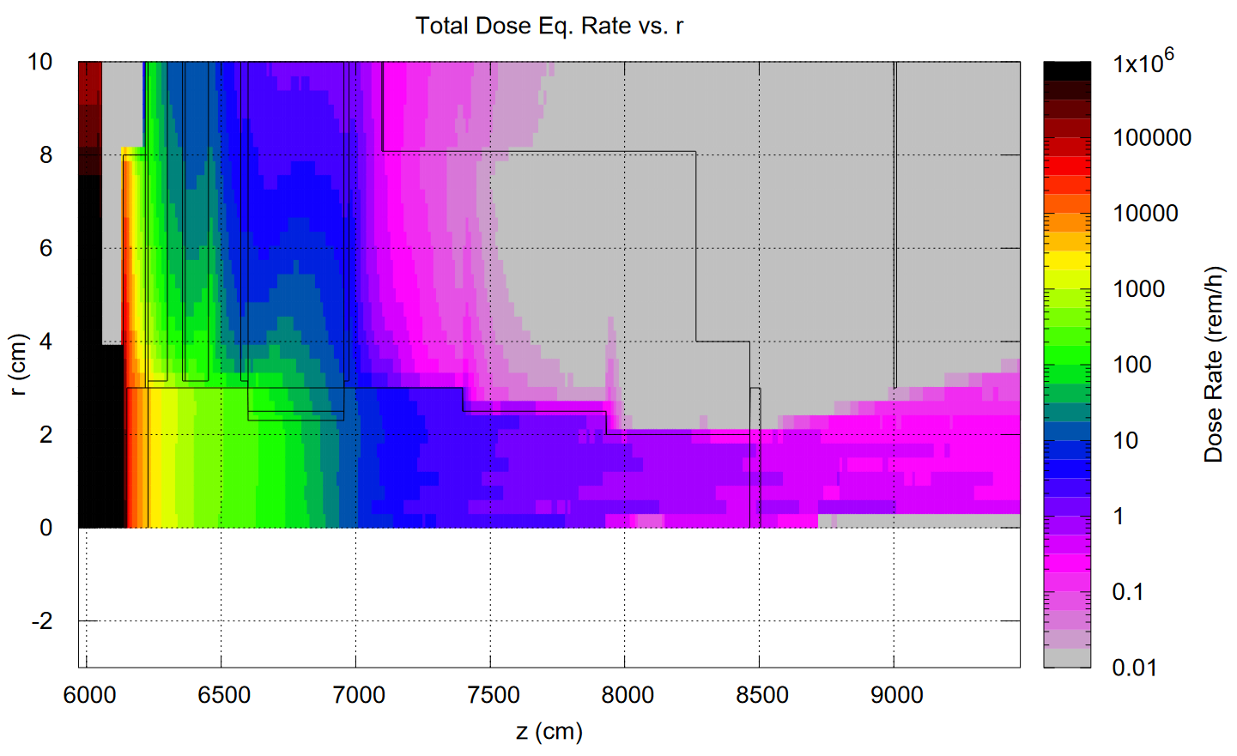
10% Radiator 20% Radiator

Slide 4
High threshold, CuW 14 cm, BL Shielding, 20%

