Slide 1
Optics and Diagnostics Update
Edith Nissen
KLF Beamline meeting
June 14 2024

Slide 2
Contents
Beam Optics changes since last summer
Current beam optics
Diagnostics issues
Going forward

Slide 3
Beam optics since last summer
Beam Parameter | @ CPS radiator | @ KPT entrance
Beam current | 50 nA ≤ IB ≤ 5 μA | N/A
Beam spot size | σxy = 1.2 mm, (0.8 mm ≤ σx,y ≤ 1.5 mm) | σx,y ≤ 1 cm
Beam position stability (@ 1 Hz) | σx,y ≤ 0.2 mm | σx,y ≤ 2 mm
Beam halo (halo-to-peak) | < 10−4 at r ≥ 5σx,y | N/A
Beam excursion limits in FSD | Δx,y ≥ 1 mm | Δx,y ≥ 1 cm
Main change is having a more detailed idea of the position of the CPS
About 33cm (13”) from the position I had been assuming

Slide 4
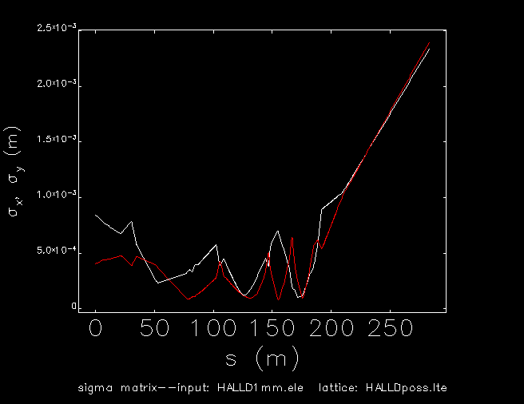
Updated Optics based on new data
That change in position made the optics easier
All of the quads are reasonable values, but one is right at the top of the reasonable range
At the CPS radiator face 𝛔_{x}=1.244mm and 𝛔_{y}=1.232mm
At the target in Hall D 𝛔_{x}=2.332mm and 𝛔_{y}=2.391mm

Slide 5
Diagnostics
Currently looking at moving diagnostic girder from the dump to just in front of the CPS
I’ve started talking with people, no showstoppers so far, but everyone I’ve talked to would like more info, and an idea of the schedule

Slide 6
Going forward
Make sure there aren’t any unforeseen issues with the optics
Will need to develop convergence tools like we currently have for GlueX
  Might be a good subject for a beam study during the upcoming run to test the new optics
Continue working on moving the diagnostics, but knowing the schedule is important
  The diagnostics move would likely be one of the last things done since GlueX needs it to run

