Slide 1
K_{L} + p ➔ Λπ⁺
EVENT GENERATOR
Secure Codes from Simon, Nick
Modified Simon’s kShort fortran code to Λπ⁺
Manage/run Nick’s Λπ⁺ c++ code
Phase-space event-generator

Slide 2
K_{L} + p ➔ Λπ⁺
DETECTOR SIMULATION
ASCII convert to HDDM
HDGEANT
setenv JANA_CALIB_CONTEXT "variation=mc”
control.in
ROOT converting (hddm-root)
lambdapip_smeared.hddm
lambdapip_smeared.root

Slide 3
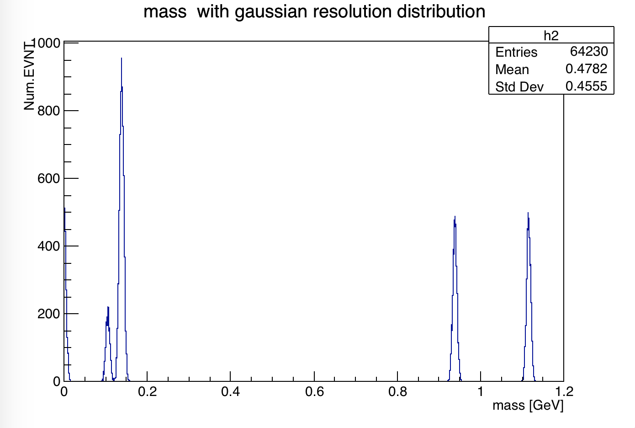
K_{L} + p ➔ Λπ⁺
DETECTOR RESOLUTION
5MeV mass resolution
Λ
p
π^{+/-}

Slide 4
K_{L} + p ➔ Λπ⁺
RECONSTRUCTION
Working on “reconstruction event” (FUTURE)
- Check fundamental reconstructed event distribution
Estimate event accumulation / channel efficiency
…

