Slide 1
$$K_{L}p→K^{+}n$$
Mikhail Bashkanov

Slide 2
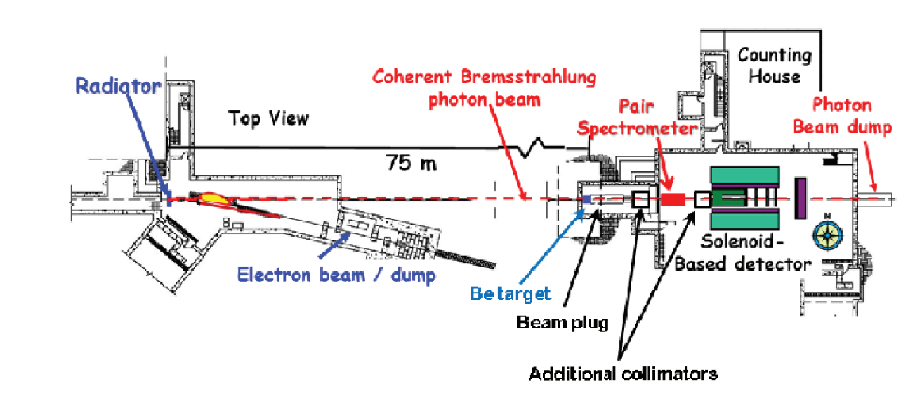
K_Long beamline

Slide 3
Experiment
Be Target
Hydrogen Target
$$γ$$
$$K_{S}$$
$$K_{L}$$
40cm
16m
40cm
$$γBe→φ+X$$
$$φ→K_{L}K_{S}$$
$$K_{L}p→K^{+}n$$

Slide 4
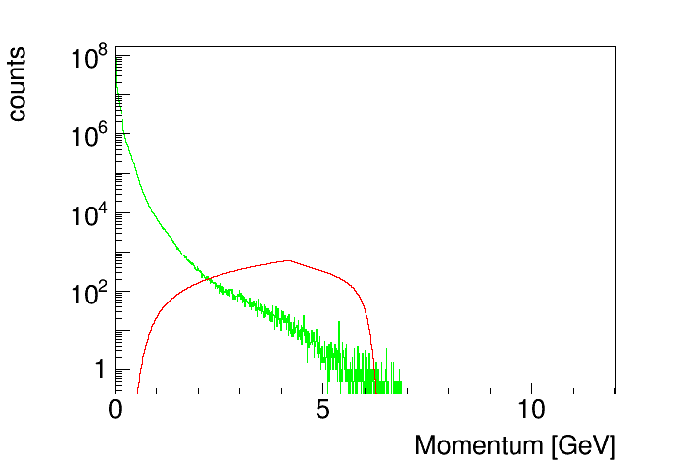
Possible backgrounds
Neutron (fig21) and K_L momentum spectra, fig15.
Neutron and K_L momentum spectra from SLAC measurements, fig22.

Slide 5
Neutrons and K_L’s as a function of$β$

Slide 6
Neutrons and K_L’s as a function of$β$

Slide 7
Neutrons and K_L’s as a function of$β$
$K^{+}$threshold

Slide 8
$K^{+}$production in NN collisions
$$pp→pK^{+}Λ$$
$$pp→pK^{+}Σ^{0}$$
Phys. Rev. C 84, 055207 (2011)

Slide 9
$K^{+}$production in NN collisions
Phys. Rev. C 84, 055207 (2011)
$$\frac{σ\left(pp→pK^{+}Λ\right)}{σ(pn→nK^{+}Λ)}\sim 2$$
At $β=0.95$, $E_{n}^{kin}=2.1 GeV$, $E_{K_{L}}^{kin}=1.1 GeV$
$K^{+}$ x-section energy dependence from nucl-th/0512059 (EPJA 27(2006) 269)
$σ(K_{L}p→K^{+}n)$ assumed to be 10mb

Slide 10
$K^{+}$ countrate from N and K_L’s
$K^{+}$threshold

Slide 11
Sources of background
$np→K^{+}X$ – not a problem
the x-section and a flux is too small to be a problem.
$np→π^{+}X$
$σ\left(np→π^{+}X\right)\sim {10}^{3}σ\left(np→K^{+}X\right)$
If pions are misidentified as Kaons might become dangerous

Slide 12
Signal

Slide 13
$K_{L}$beam resolution
$$P_{K_{L}}^{true}−P_{K_{L}}^{measured}$$
$P_{K_{L}}^{true}$[GeV]

Slide 14
$K_{L}$beam resolution
$${σ(P}_{K_{L}}^{true}−P_{K_{L}}^{measured})$$
$P_{K_{L}}^{true}$[GeV]

Slide 15
$K_{L}$beam resolution

Slide 16
$K^{+}$missing mass ($K_{L}p→K^{+}n$)
$MM(K^{+})$ [GeV]

Slide 17
$K^{+}$missing mass ($K_{L}p→K^{+}n$)
$MM(K^{+})$ [GeV]

Slide 18
$K_{L}$time resolution
Vertex time
Beryllium target
$Δt$ [ns]

Slide 19
Reconstruction efficiency

Slide 20
$K^{+}$reconstruction

Slide 21
$K^{+}$reconstruction
Pions

Slide 22
$K^{+}$reconstruction
Protons

Slide 23
$K^{+}$reconstruction efficiency
One charged track
Identified $K^{+}$
Detected neutron
$P_{K_{L}}^{true}$[GeV]

Slide 24
$K^{+}$reconstruction efficiency
$K^{+}$
$$proton$$
$π^{+}$
$P_{K_{L}}^{true}$[GeV]

Slide 25
Neutron detection efficiency
$P_{K_{L}}^{true}$[GeV]

Slide 26
To do
Neutron detection efficiency
Energy
Threshold
Kfit (with/without neutrons)
W-resolution

