Slide 1
K⁰L CPS Meeting October 16, 2023
P. Degtiarenko

Slide 2
Design Update – October 2023, “KLCPS78”
The “78” model
Repeat ‘nominal’ model setup with few variants of shielding materials
Reasonable results gives the setup with a thick Barite Concrete layer including the previously modeled iron layer, plus a Boron Carbide Concrete layer replacing the Borated Poly layer in the previous model. The illustrations are below

Slide 3
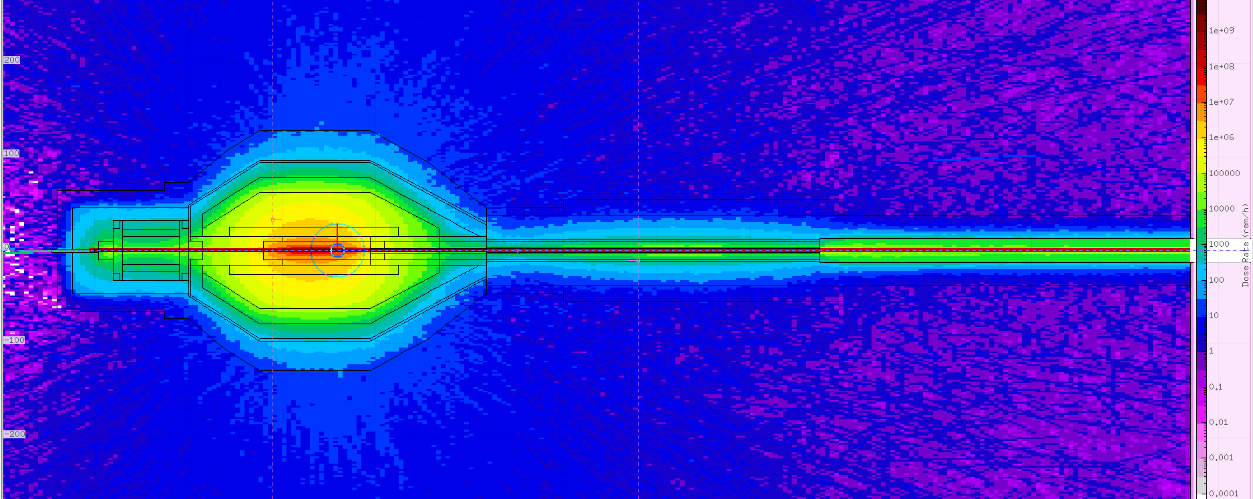
Klcps78, Prompt Dose Equivalent Rates
3 m

Slide 4
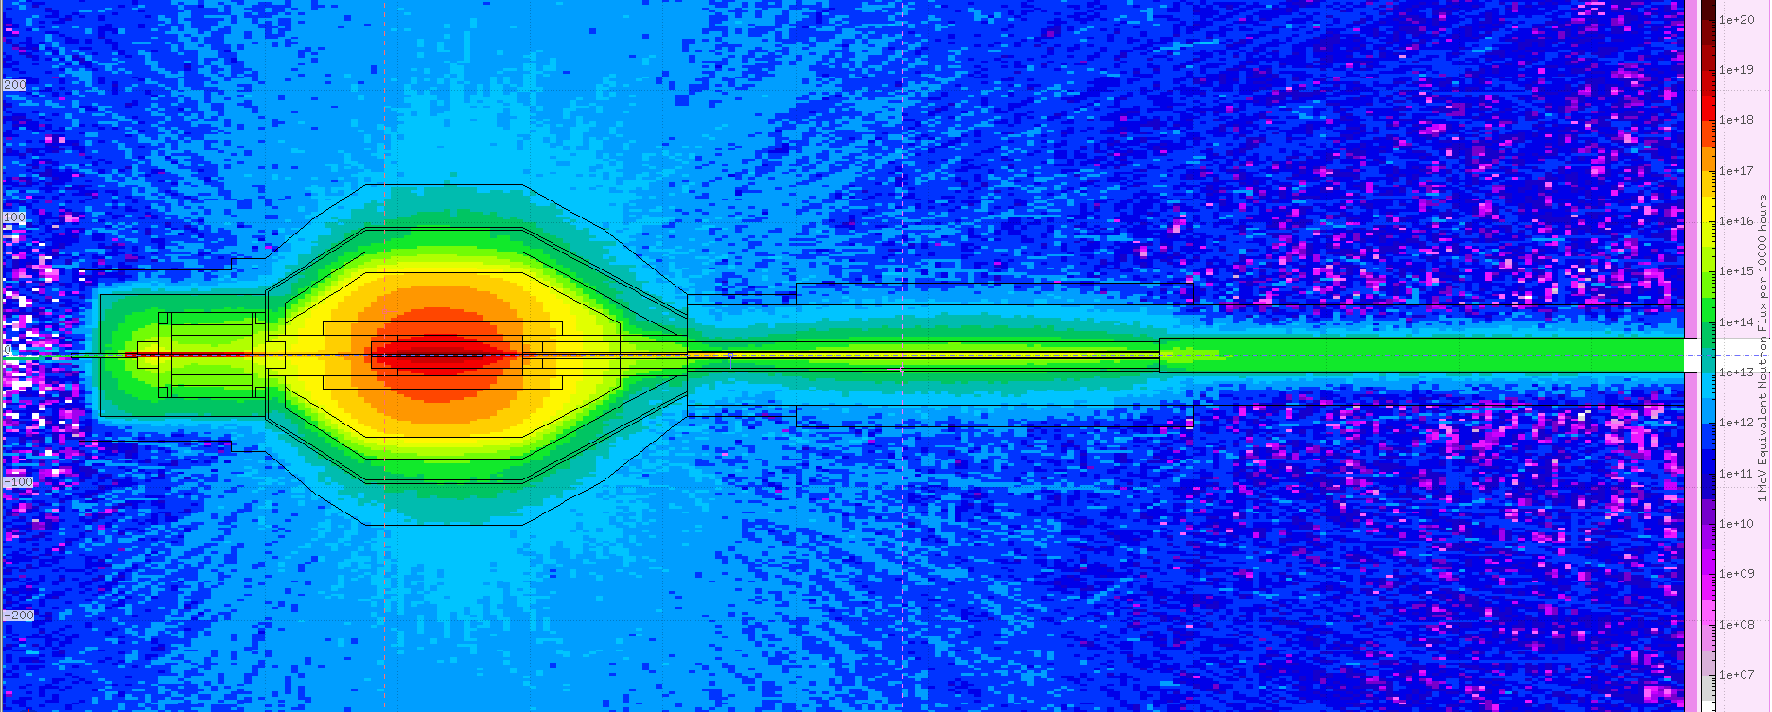
1-MeV-Equivalent neutron fluence accum. in 10000 h
3 m

Slide 5
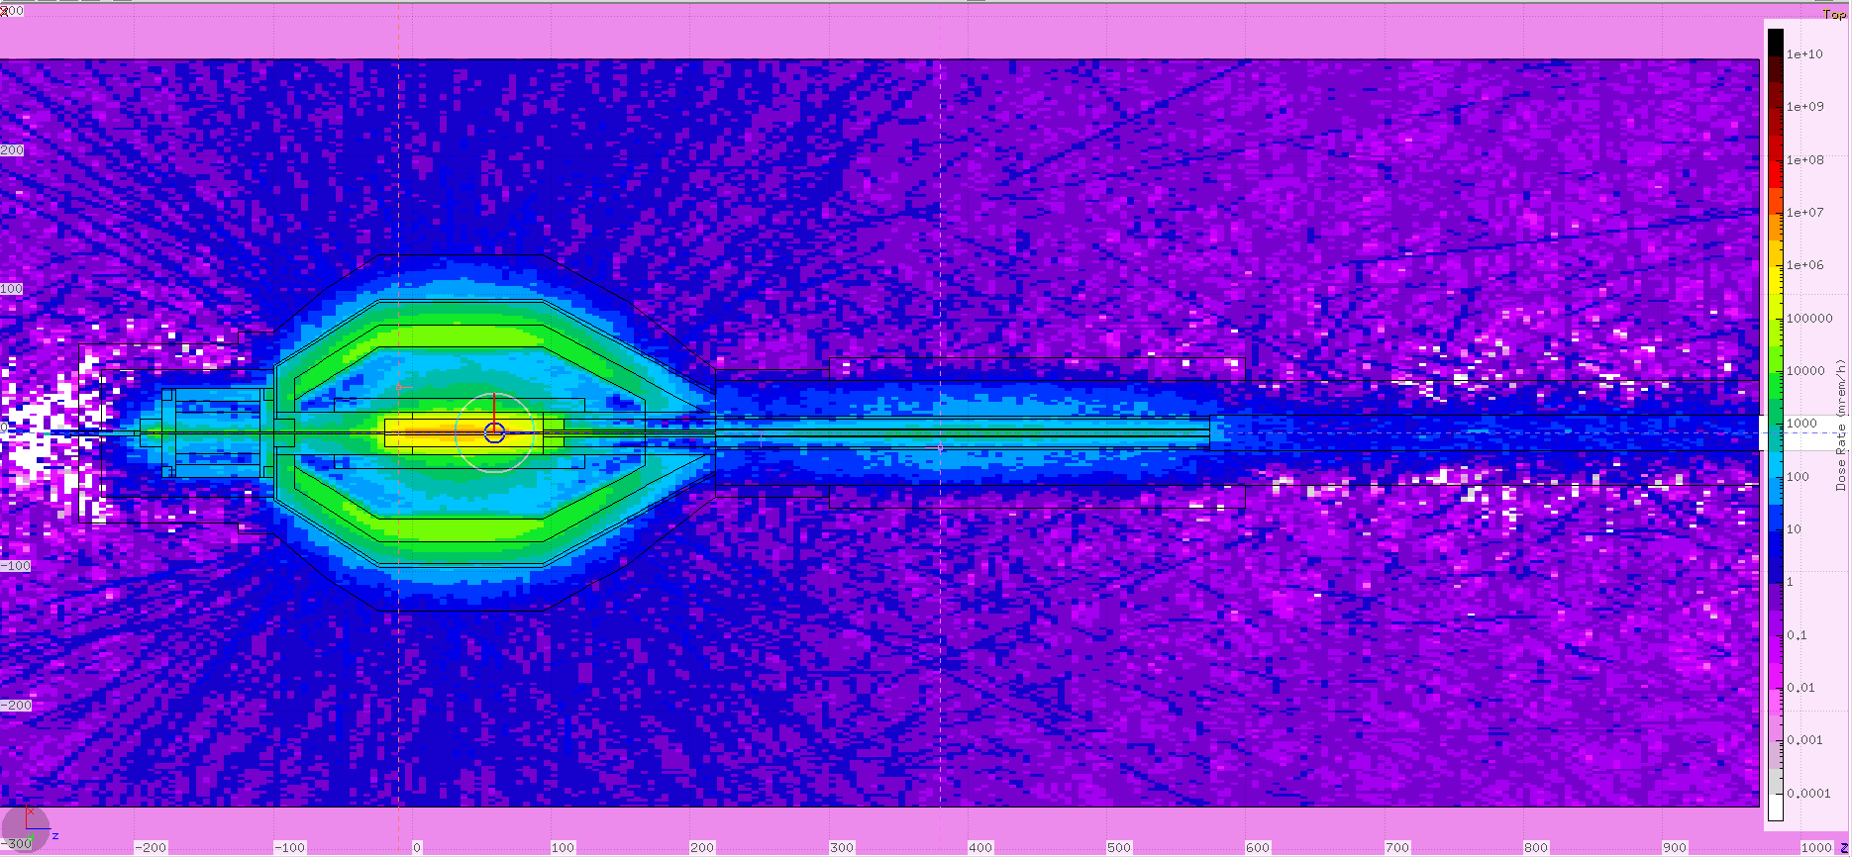
Activation Dose Equivalent Rates, 1h after 10000 h beam
3 m

Slide 6
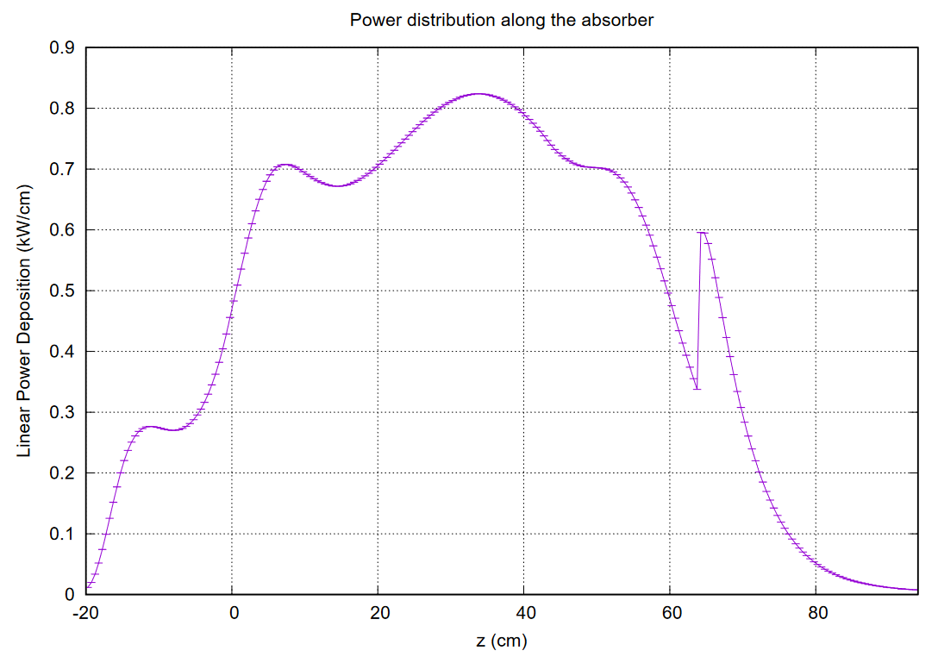
Power Distribution along Z (nominal)

Slide 7
List of relevant illustrative plots: https://userweb.jlab.org/~pavel/projects/KLCPS/klcps78/nom_BaCo2_PbB4C/
 | zyDsRt_X0.pdf | 2023-10-16 13:18 | 1.0M
 | zPow_Full.pdf | 2023-10-16 13:18 | 10K
 | zNFlx_cpsS.pdf | 2023-10-16 13:18 | 17K
 | zDsAc_cpsS.pdf | 2023-10-16 13:18 | 9.8K
 | z1hDsRt_cpsS.pdf | 2023-10-16 13:18 | 17K
 | yDsRt_Z60m_pbl.pdf | 2023-10-16 13:18 | 7.9K
 | xyProfile.pdf | 2023-10-16 13:18 | 7.3K
 | xyPow28_zp34.pdf | 2023-10-16 13:18 | 184K
 | xDsRt_Z60m_pbl.pdf | 2023-10-16 13:18 | 7.9K
 | rNFlx_maxZ.pdf | 2023-10-16 13:18 | 8.2K
 | rDsAc_maxZ.pdf | 2023-10-16 13:18 | 8.4K
 | r1hDsRt_maxZ.pdf | 2023-10-16 13:18 | 8.6K
 | r1dDsRt_maxZ.pdf | 2023-10-16 13:18 | 8.6K
 | Power_Distr.pdf | 2023-10-16 13:18 | 6.1K
 | EdNdE_spectra.pdf | 2023-10-16 13:18 | 11K

