Slide 1
$K_{L}$ Flux Monitor
Mikhail Bashkanov

Slide 2
Outlook
Why?
$K_{L}$flux monitoring
How?
Basic principles
FM Design
2

Slide 3
$K_{l}$ flux monitor location
Be target
LH2/LD2 target
24 m
Flux Monitor
Kaon flux on LH2/LD2 target
Kaon flux measured by Flux Monitor
3

Slide 4
$K_{L}$ decays
 | Br, %
$$K_{l}→π_{}^{±}e^{∓}ν_{μ}$$ | 40.55
$$K_{l}→π_{}^{±}μ^{∓}ν_{μ}$$ | 27.04
$$K_{l}→π_{}^{+}π_{}^{−}π_{}^{0}$$ | 12.54
$$K_{l}→π_{}^{0}π_{}^{0}π_{}^{0}$$ | 19.52
~ 21% of kaons decays in flight
Any decay with charged particles can be used
4

Slide 5
$K_{L}$ monitoring
$$T_{2}$$
$$π,μ,e$$
$$T_{1}$$
$$π^{0},ν$$
$$T_{start}$$
$$T_{stop}$$
Be target
$$T_{1}$$
$$π,μ,e$$
$$T_{stop}−T_{start}=TOF→β→p_{K_{L}}$$
$$T_{2}$$
5

Slide 6
$K_{l}→π_{}^{±}μ^{∓}ν_{μ}$reaction kinematics

Slide 7
$K_{l}$ flux monitor location

Slide 8
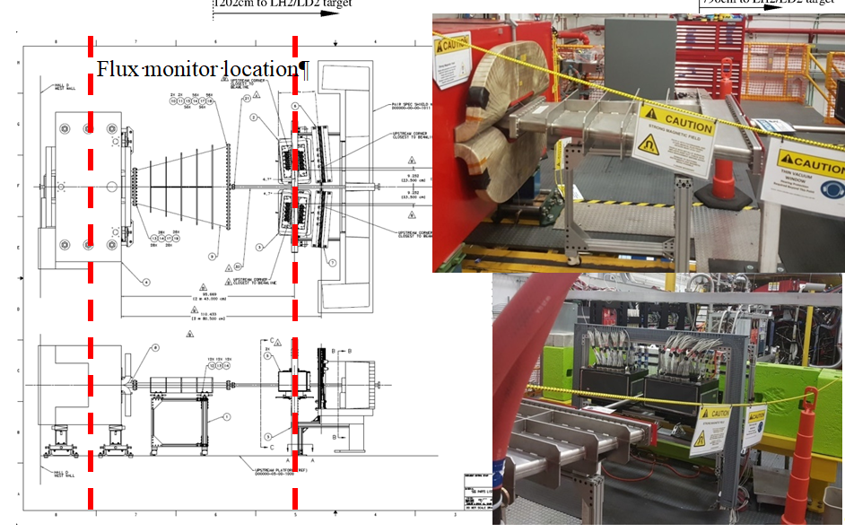
Flux monitor location

Slide 9
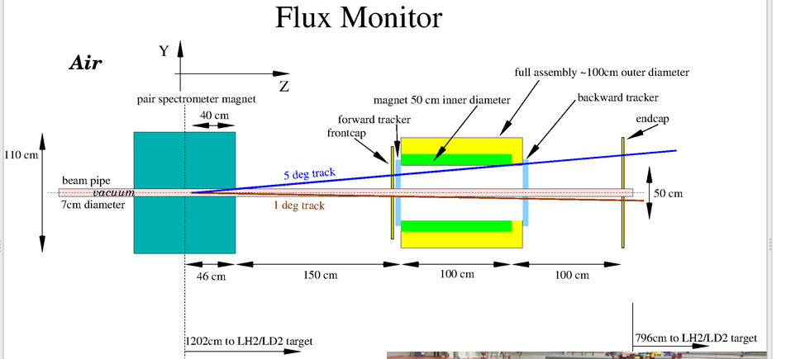
$K_{l}F$ Monitor
Magnet, 1m long, 50 cm diameter

Slide 10
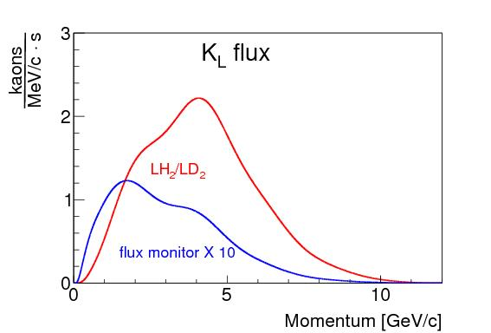
$K_{L}$ spectrum
10

Slide 11
$K_{l}$ in-flight decay

Slide 12
Phi displacement
$φ^{′}=0.5\frac{l⋅z⋅0.3⋅B}{p⋅cos⁡(Θ)}$; $l∼1m, \left|z\right|=1;B=1$; $φ^{′}[rad]=\frac{0.15}{p[GeV/c]⋅cos⁡(Θ)}$

Slide 13
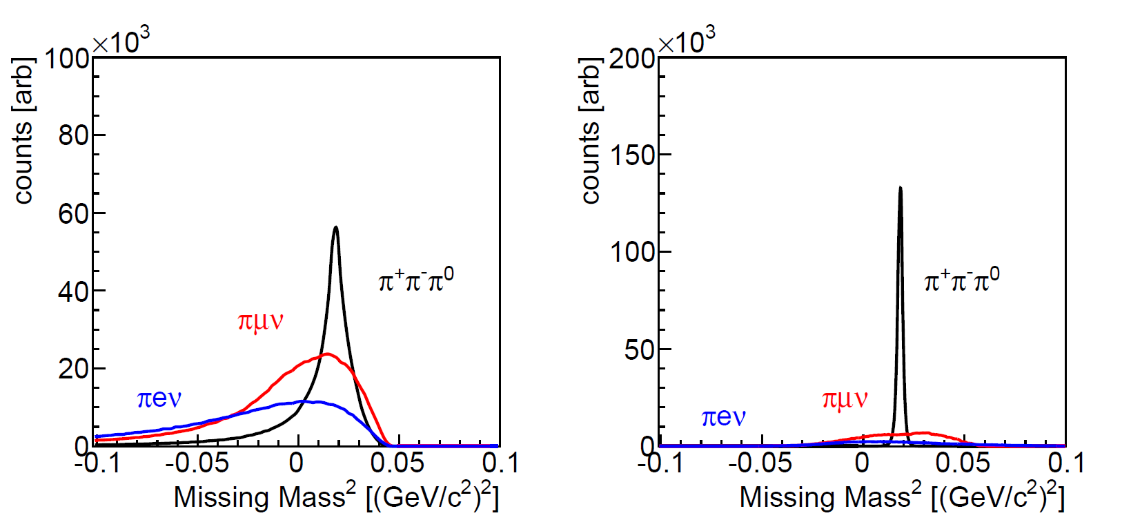
$K_{l}$ FM resolution
TOF reconstruction
Magnetic reconstruction

Slide 14
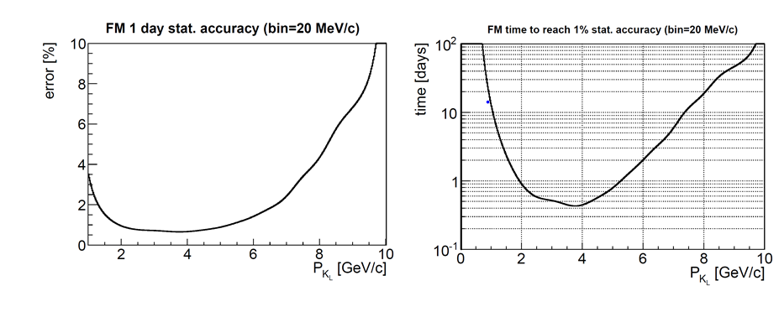
Expected stat accuracy

Slide 15
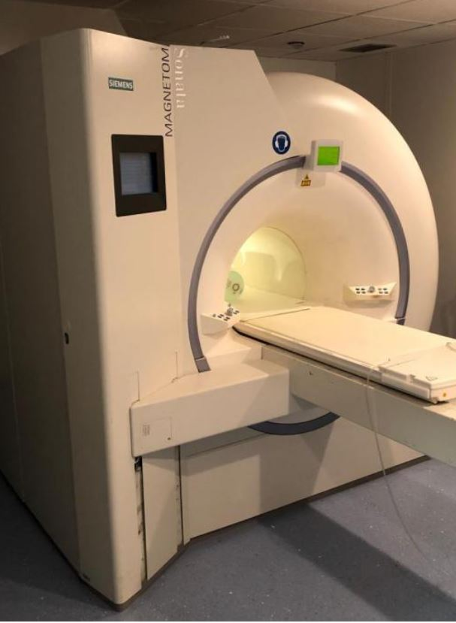
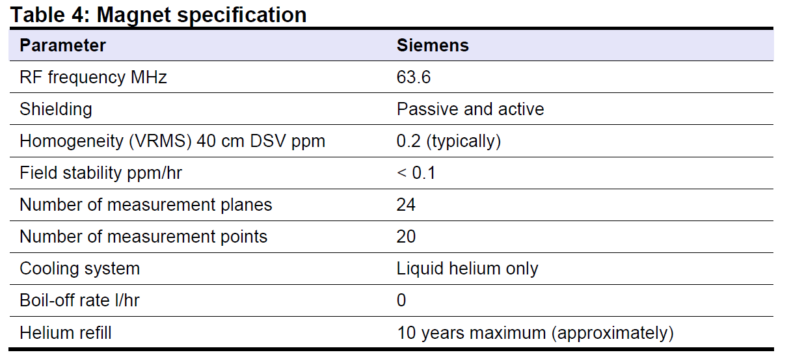
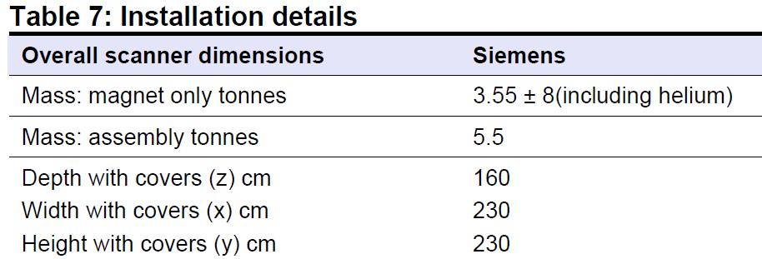
Possible magnet
Siemens Magnetom 1.5T used MRI
~70kEuro+delivery

Slide 16
Other possible options
No-magnet FM
cheap,
2x less trackers
Background discrimination?
KL in flight decay in front of the LH/LD target measured with GlueX?
Systematics?
16

Slide 17
To do
Simulations of “other” designs
Construction of ToF prototypes (achievable ToF resolution )
17

Slide 18
Conclusion
18

