Slide 1
K⁰L CPS Meeting October 2, 2023
P. Degtiarenko

Slide 2
Design Update – August 28th 2023, “KLCPS77”
The “77” model
Front extension of the Absorber to include tapered entrance part
Elongation of the electron absorption cavity to use back of the Absorber better
Assume the standard beam FWHM at 2.8 mm
Increased the entrance collimation opening to 12 mm diameter to decrease halo interactions.
-- The changes bring the temp. down and allow removal of all the slits
-- In the process of power distribution calculations. Few setting are done (see below)
Excluding Barite Concrete from the consideration makes radiation conditions worse. Need to consider other materials and/or thickness change
Variants of shielding materials: Barite, Iron, Iron Concrete, B4C Concrete: to do
Study the long term core activation
Bare core activation too high, dose rates in hundreds of mrem/h after 5 year decay
Implementing lead box protection permanently attached to the core makes it acceptable
Checked if the Tungsten layer around the core would work both for better shielding and for lighter core removal jacket. It will, but too expensive

Slide 3
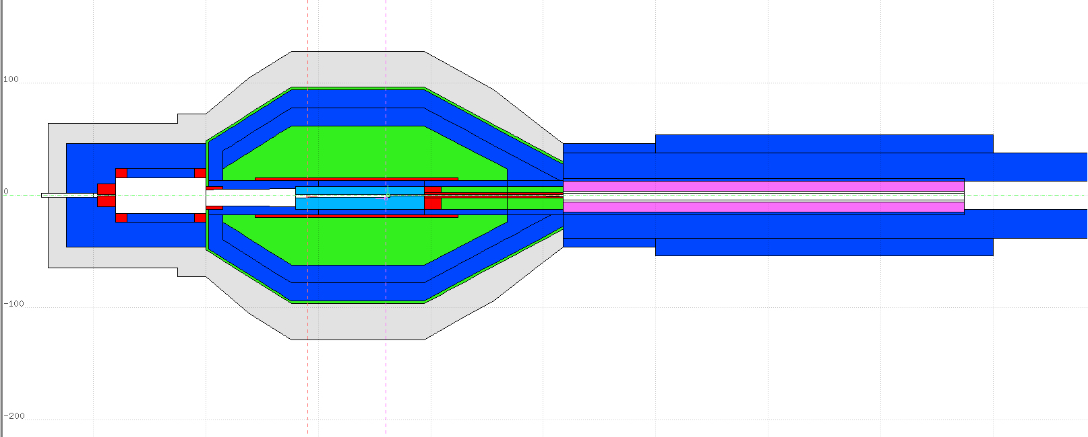
Klcps77 model geometry
One-inch-thick tungsten box around the steel base enclosure ~1 ton
3 m

Slide 4
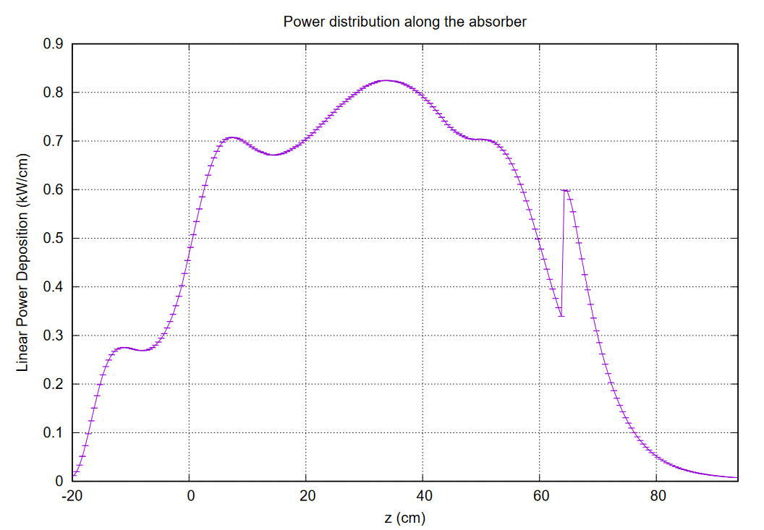
Power Distribution along Z (nominal)

Slide 5
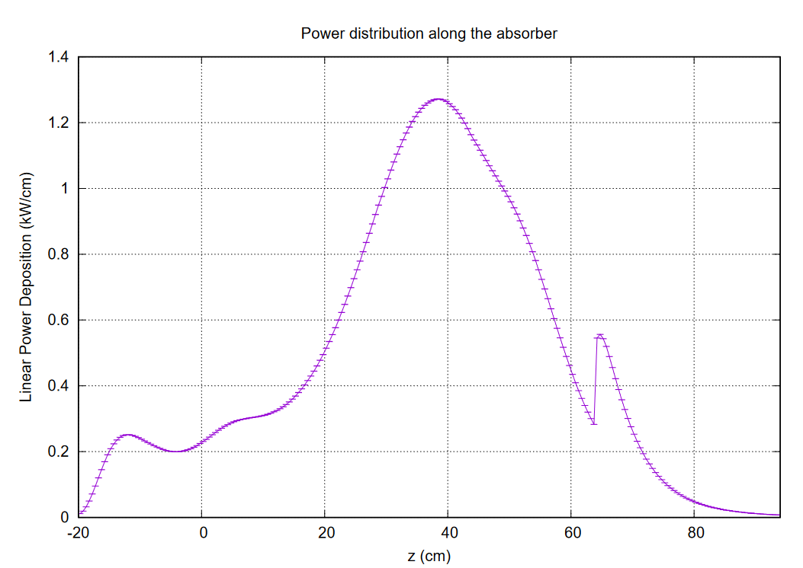
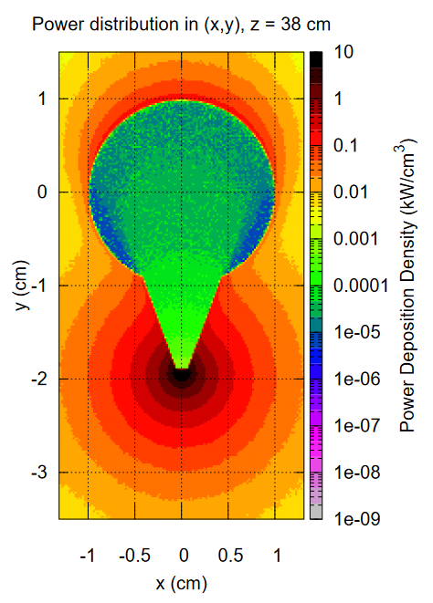
Power Distribution along Z (FWHM = 0.6 mm)

Slide 6
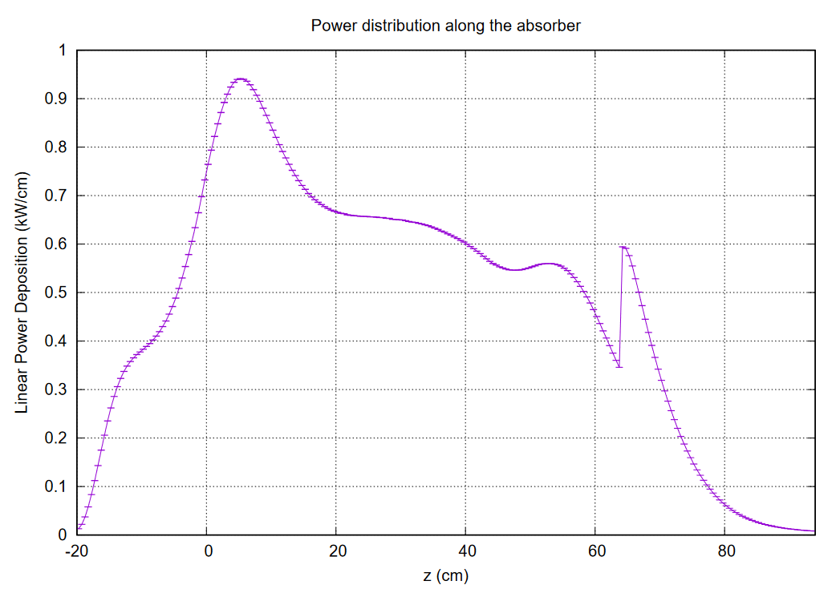
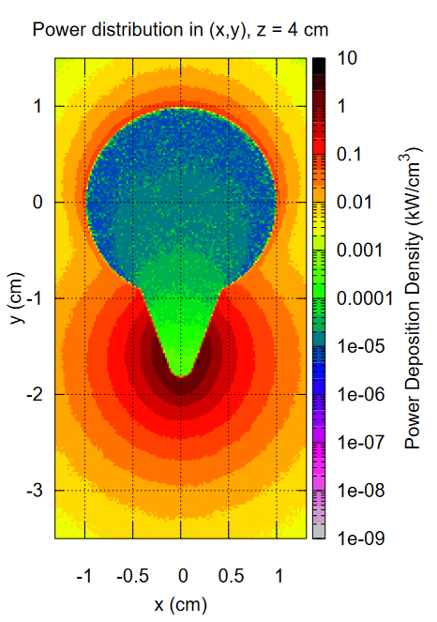
Power Distribution along Z (FWHM = 4 mm)

Slide 7
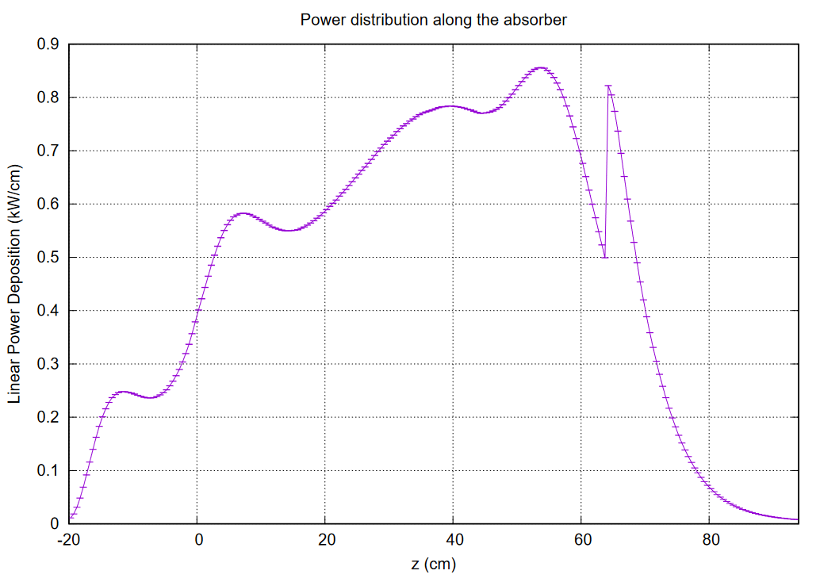
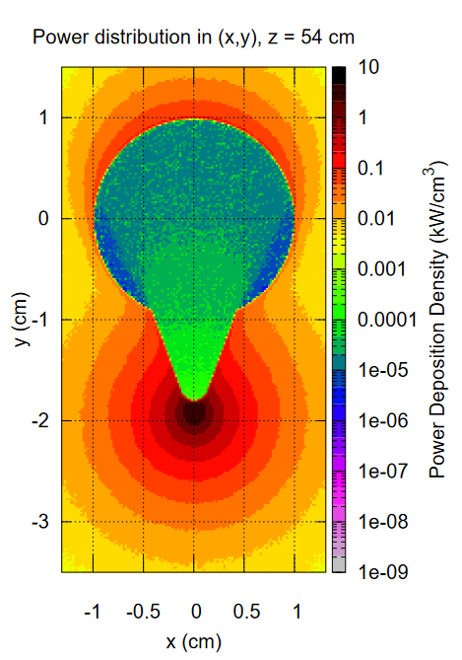
Power Distribution along Z (Mag.Field: -3%)

Slide 8
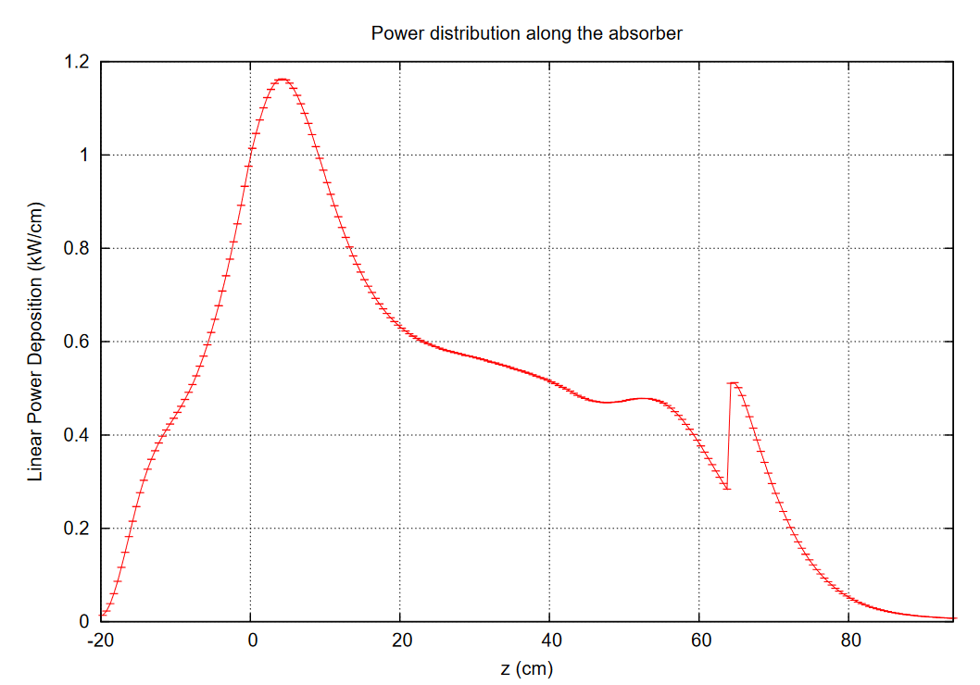
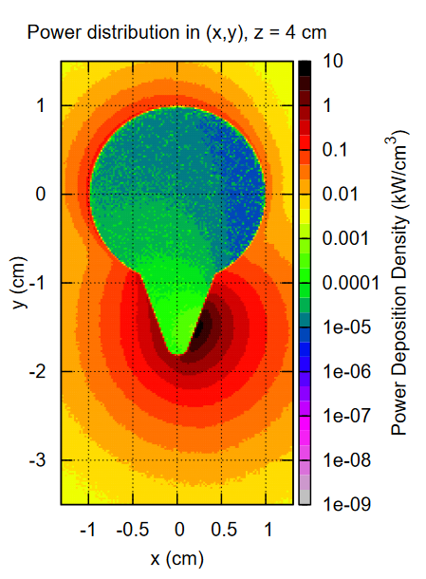
Power Distribution along Z (Beam X at + 2mm)

Slide 9
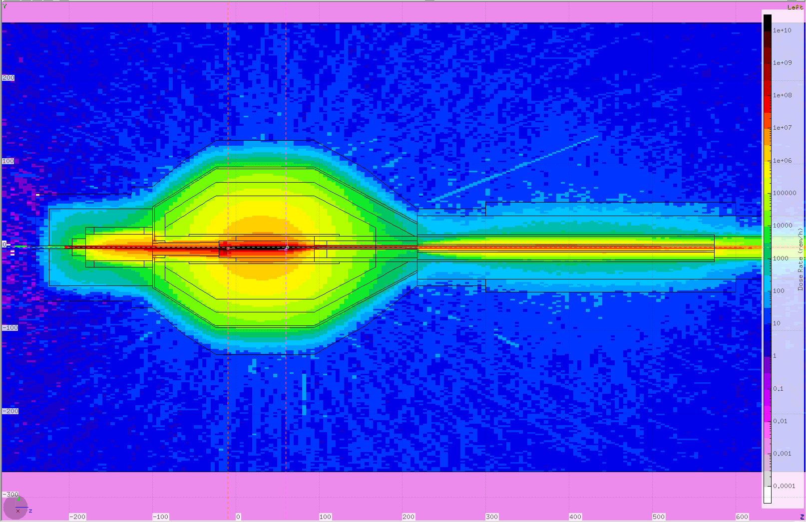
Klcps77 Model Prompt Dose Rate, Nominal

Slide 10
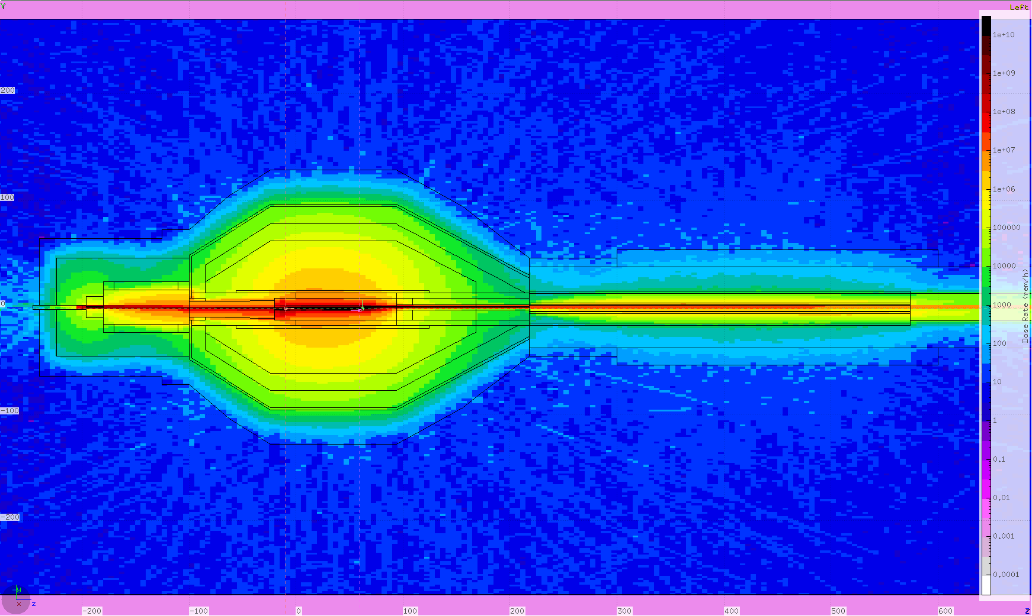
Klcps77 Model Prompt Dose Rate, FWHM=4mm

Slide 11
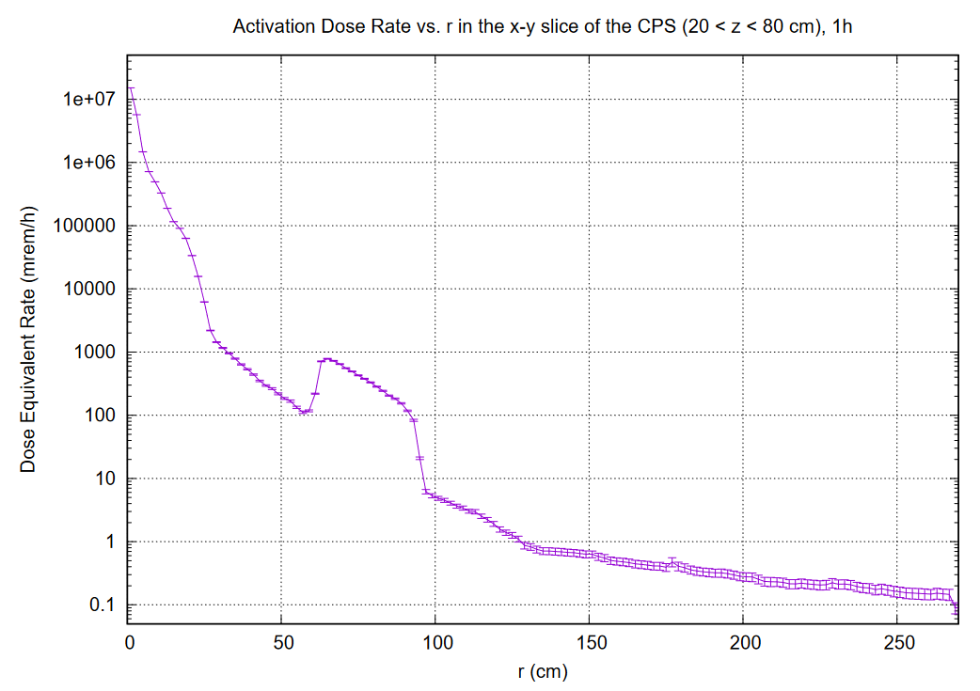
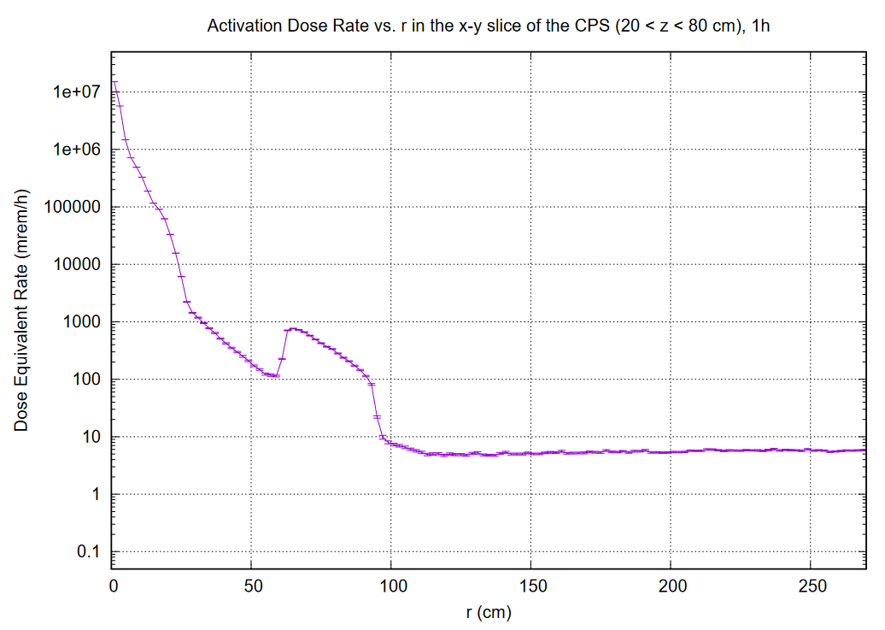
Contribution from the concrete walls in the hall
5-7 mrem/h
1 mrem/h
Tagger Hall Concrete wall absent
Tagger Hall Concrete wall present
With 1 inch Tungsten layer around the core

