Slide 1
KLF Beamline Meeting July 26, 2024
P. Degtiarenko

Slide 2
CPS Model Update – July 2024, “KLCPS80-dev”
Several iterations for the BDM design:
A thin radiator ring inside the beam pipe in front of the CPS
Radius 4.5-5.5 mm, just intercepting tails of the FWHM 2.8 mm beam
Materials: Carbon, Beryllium, Copper
Detectors:
Original in-vacuum fused silica cylinder detecting electrons exiting backwards: good sensitivity, but a significant back-streaming radiation from the CPS collimator
Moving the detectors out into the shadow of the CPS shielding, forward direction, still in-vacuum. Seems to be too complex
https://userweb.jlab.org/~pavel/projects/KLCPS/klcps80/Beam_Displacement_Monitoring/BPos_C_1mm/BPos_C_1mm_ZX_Geom.png
Using higher Z copper ring and place the detectors in the air outside the beam line, forward direction. Several iterations on the ring thickness and detector position
Current configuration seems to be acceptable
https://userweb.jlab.org/~pavel/projects/KLCPS/klcps80/Beam_Displacement_Monitoring/BDM_Images/Geometry01.png

Slide 3
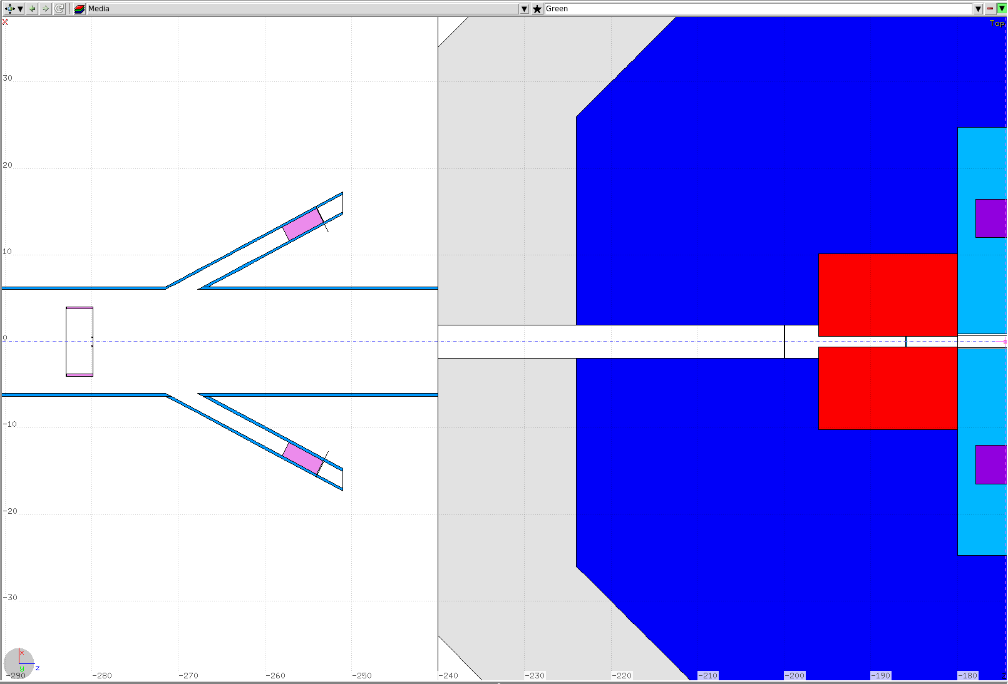
First Take on the BDM Design

Slide 4
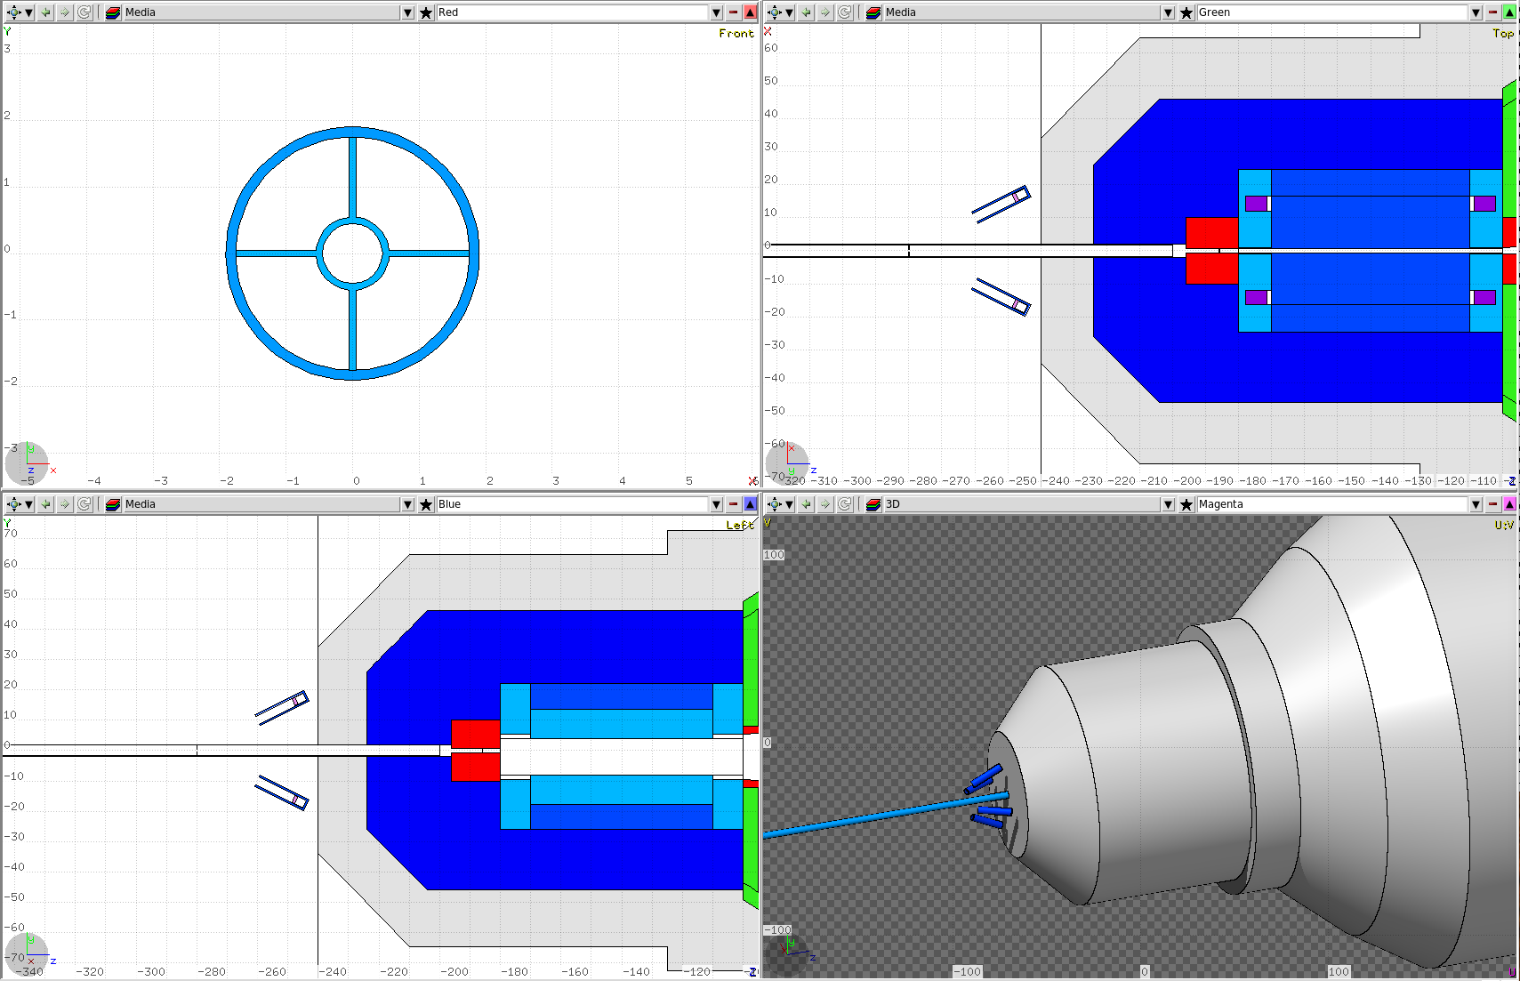
Current BDM Model
Copper ring 0.5 mm thick, 1 mm radial thickness, four 1 mm wide stokes, made out of a copper plate
Four 1 inch diameter PMTs with 1 cm fused silica Cherenkov radiator, inside of the steel pipes, with mu-metal wrap-around

Slide 5
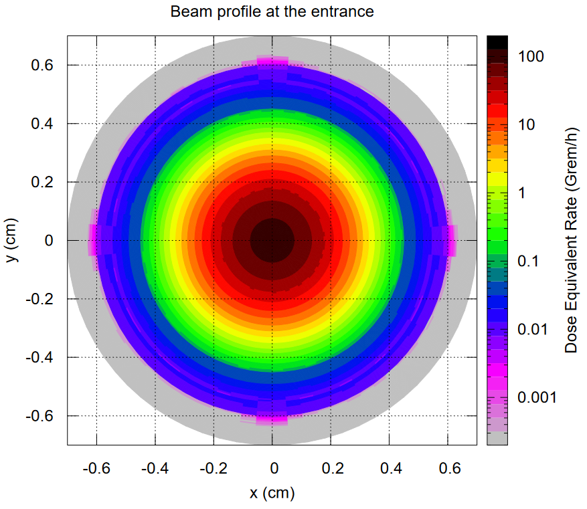
Beam Profile, Nominal Conditions
Copper ring 0.5 mm thick, 1 mm radial thickness, four 1 mm wide stokes, made out of a copper plate

Slide 6
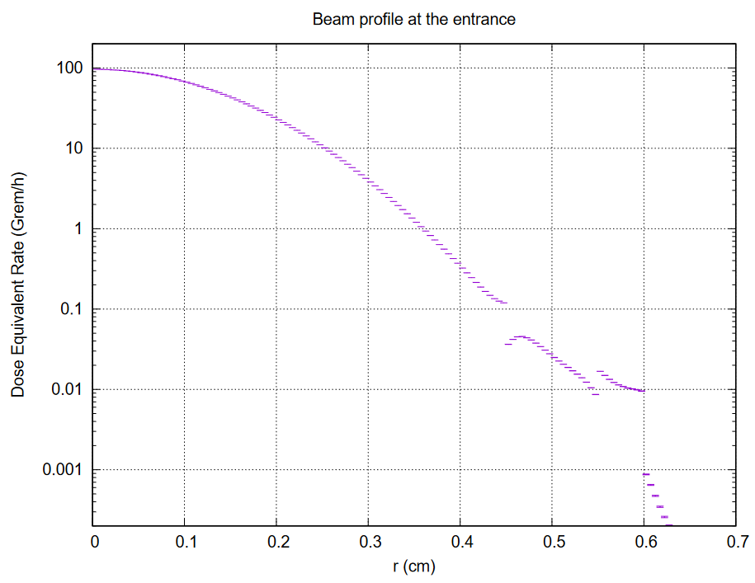
Beam Profile, Nominal Conditions
Copper ring 0.5 mm thick, 1 mm radial thickness, four 1 mm wide stokes, made out of a copper plate

Slide 7
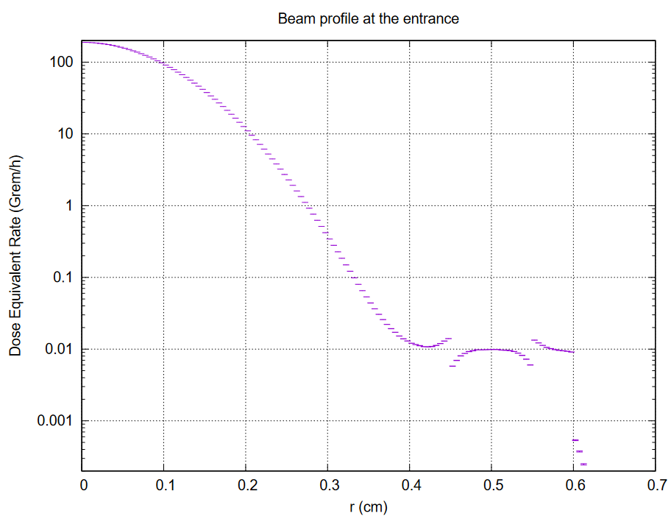
Beam Profile, FWHM = 2.0 mm
Copper ring 0.5 mm thick, 1 mm radial thickness, four 1 mm wide stokes, made out of a copper plate

Slide 8
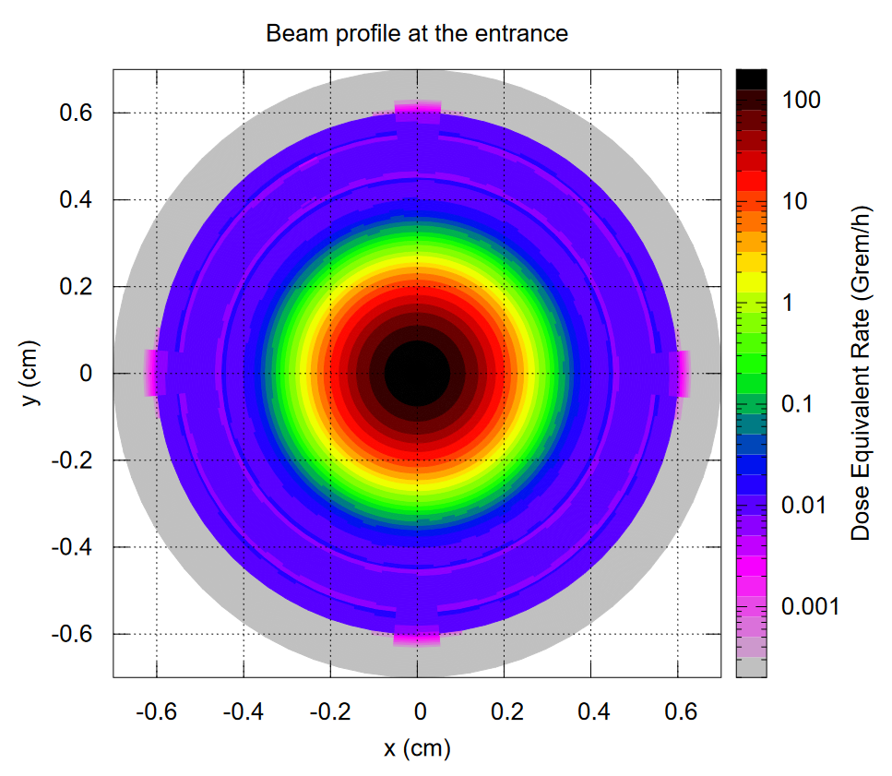
Beam Profile, FWHM = 2.0 mm
Copper ring 0.5 mm thick, 1 mm radial thickness, four 1 mm wide stokes, made out of a copper plate

Slide 9
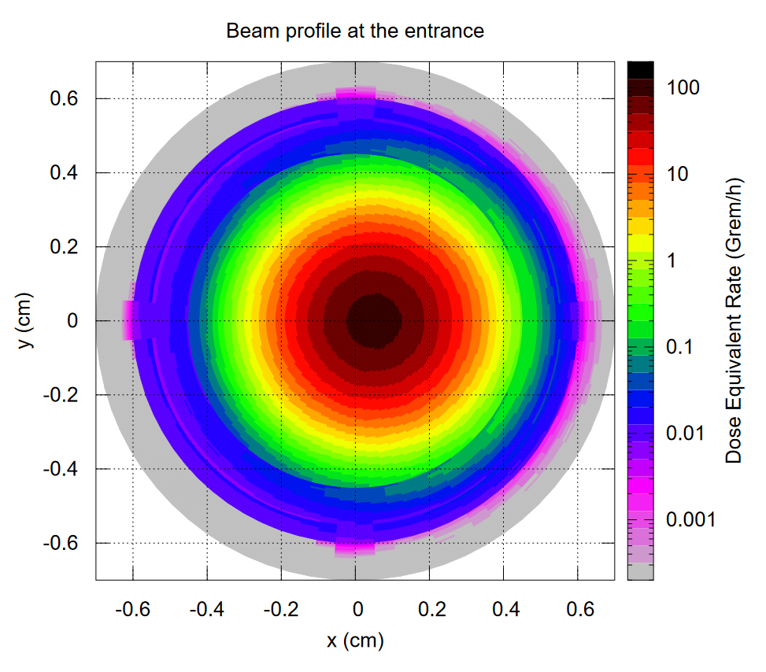
Beam Profile Beam Displacement dX = 0.5 mm
Copper ring 0.5 mm thick, 1 mm radial thickness, four 1 mm wide stokes, made out of a copper plate

Slide 10
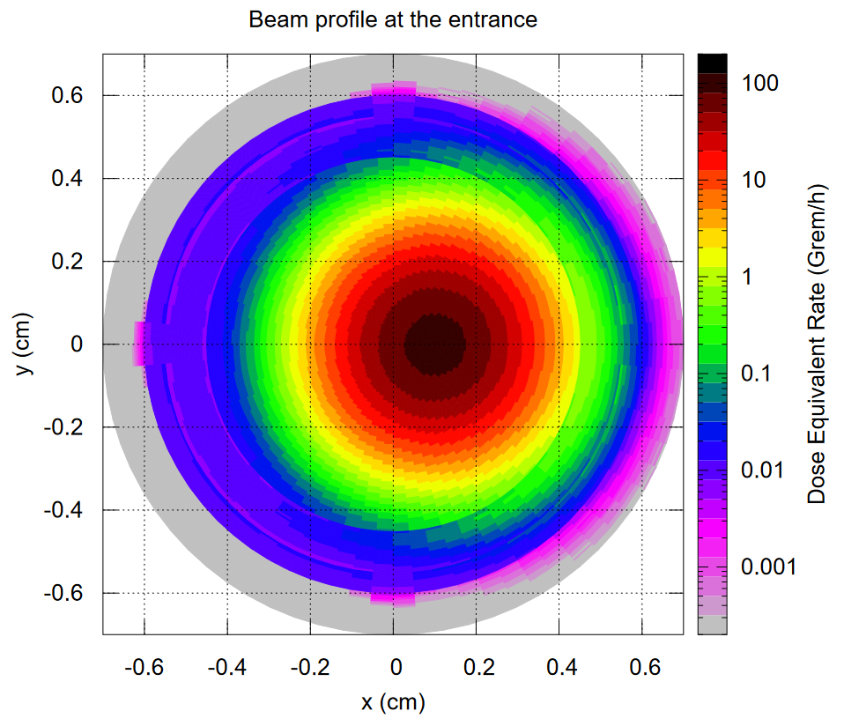
Beam Profile Beam Displacement dX = 1.0 mm
Copper ring 0.5 mm thick, 1 mm radial thickness, four 1 mm wide stokes, made out of a copper plate

Slide 11
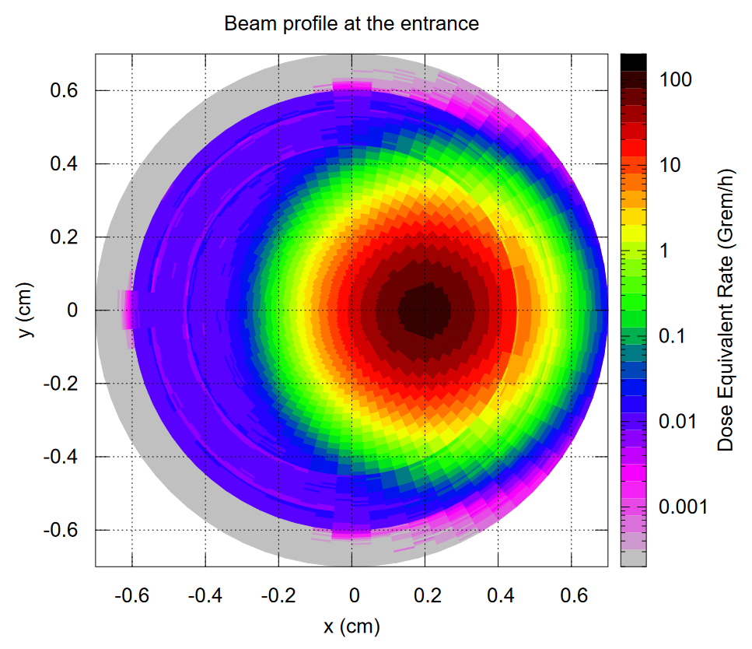
Beam Profile Beam Displacement dX = 2.0 mm
Copper ring 0.5 mm thick, 1 mm radial thickness, four 1 mm wide stokes, made out of a copper plate

Slide 12
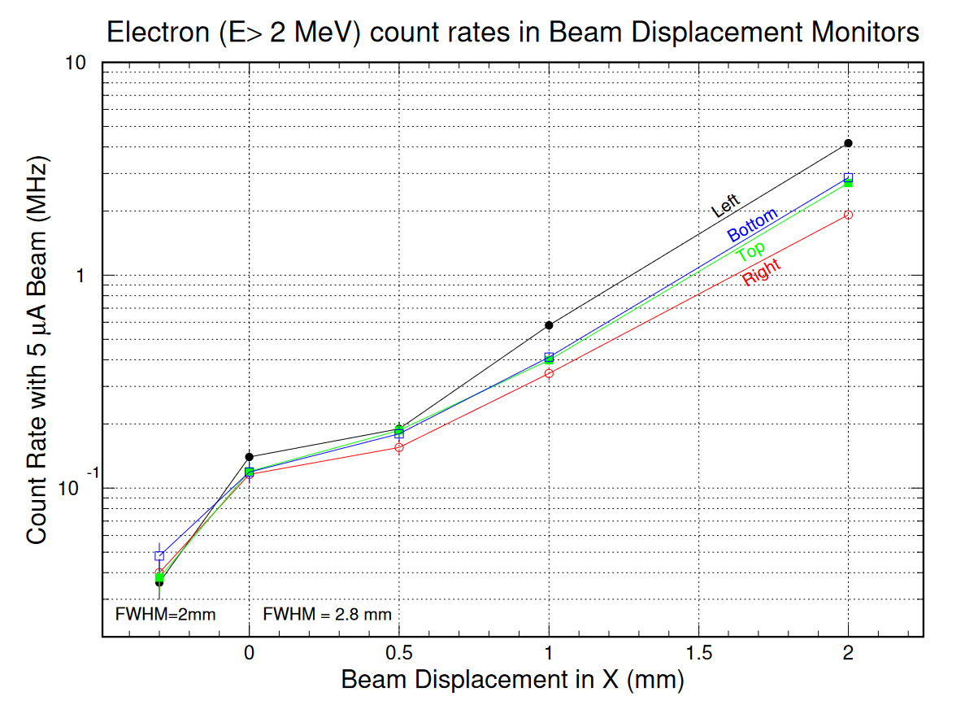
BDM Detectors Count Rates
Copper ring 0.5 mm thick, 1 mm radial thickness, four 1 mm wide stokes, made out of a copper plate

Slide 13
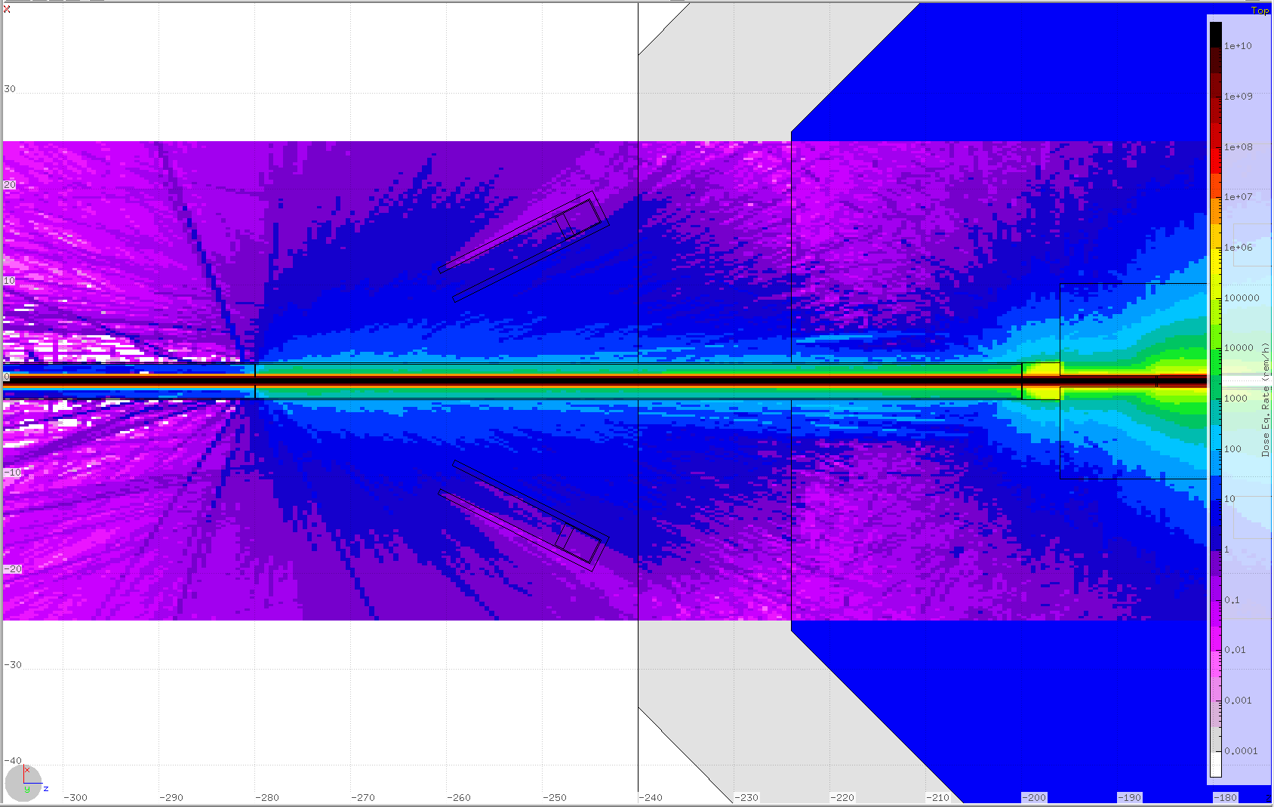
Prompt Dose-Eq Rates for Electrons Nominal Conditions

Slide 14
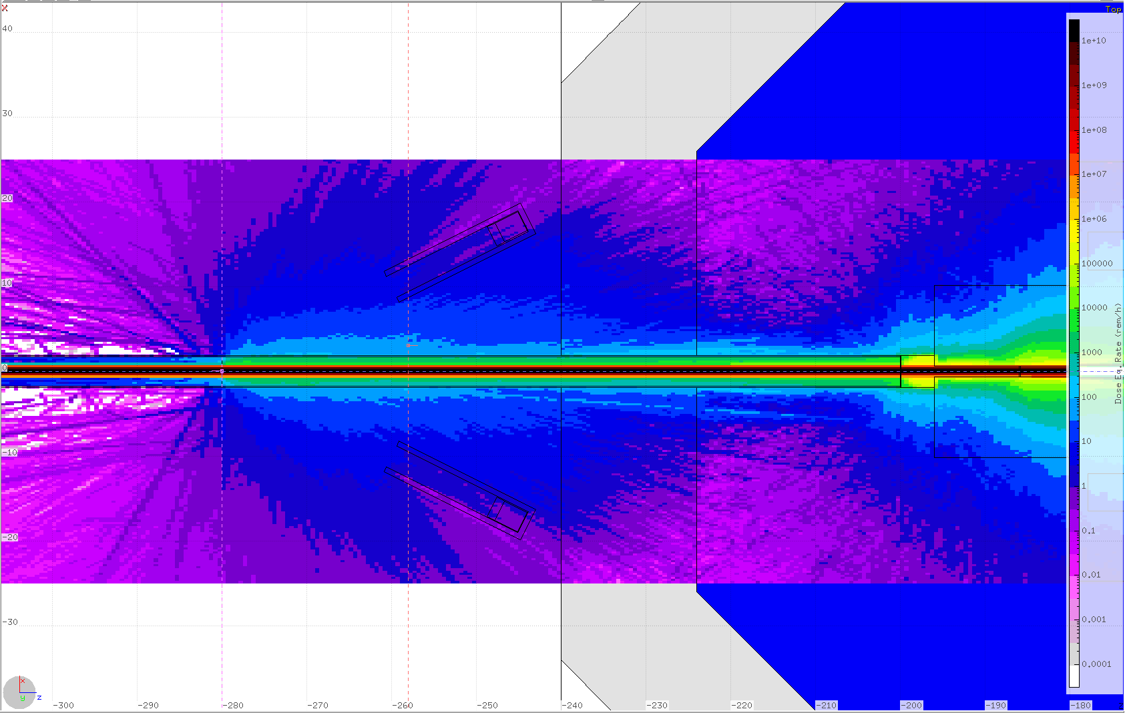
Prompt Dose-Eq Rates for Electrons Beam Displacement dX = 0.5 mm

Slide 15
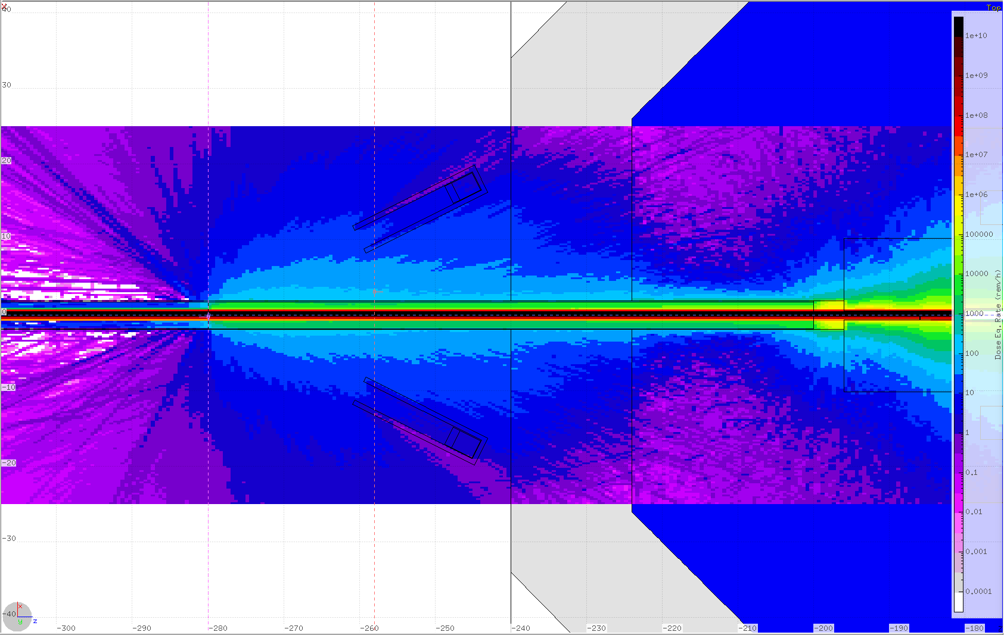
Prompt Dose-Eq Rates for Electrons Beam Displacement dX = 1 mm

Slide 16
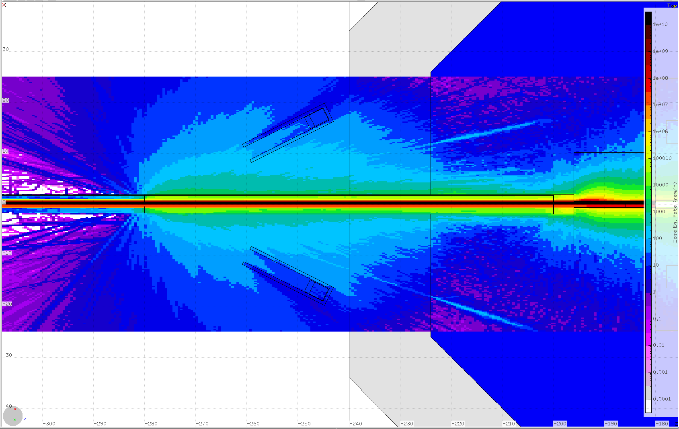
Prompt Dose-Eq Rates for Electrons Beam Displacement dX = 2 mm

Slide 17
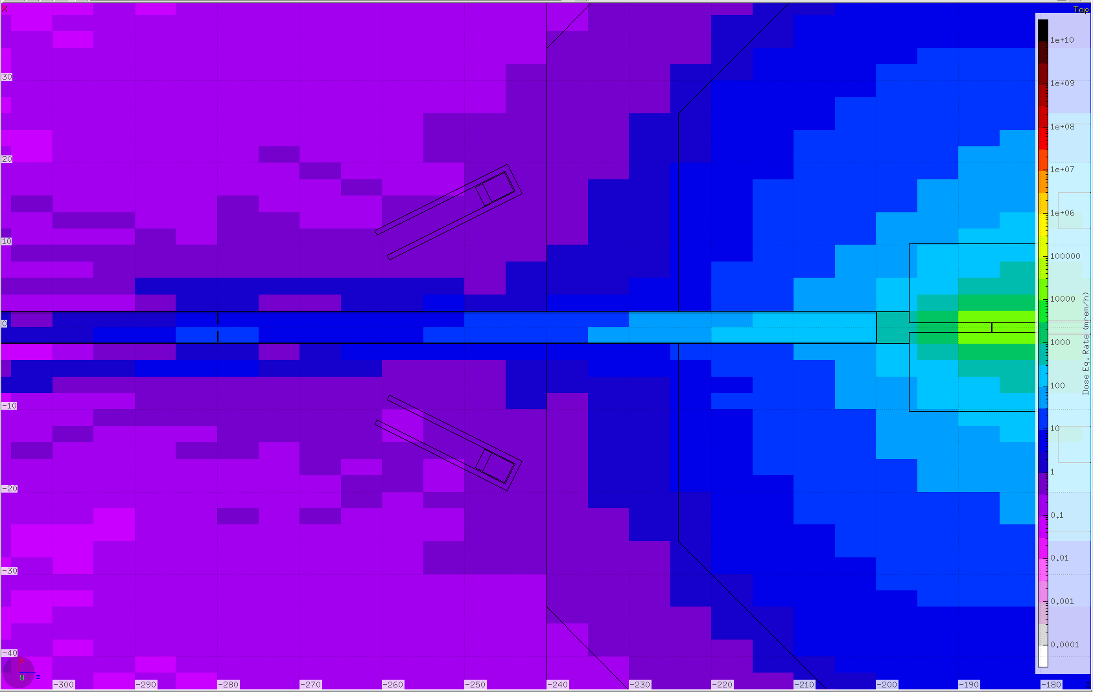
Activation Dose-Eq Rates Nominal Conditions
1 Hour after a Long Run

Slide 18
CPS Model Update – July 2024, “KLCPS80-dev”
Latest BDM design seems to be functional and doable
Extra radiation environment due to BDM acceptable
Adjustable parameters:
Thresholds
Angle and distance
Extra shielding
PMT selection
Slight modification for the beam line and magnet shielding in the model
New magnetic field will be in the next version

