Slide 1
KL Flux Monitoring
Mikhail Bashkanov

Slide 2
$K_{l}$ flux monitor location

Slide 3
$K_{l}$ flux monitor location

Slide 4
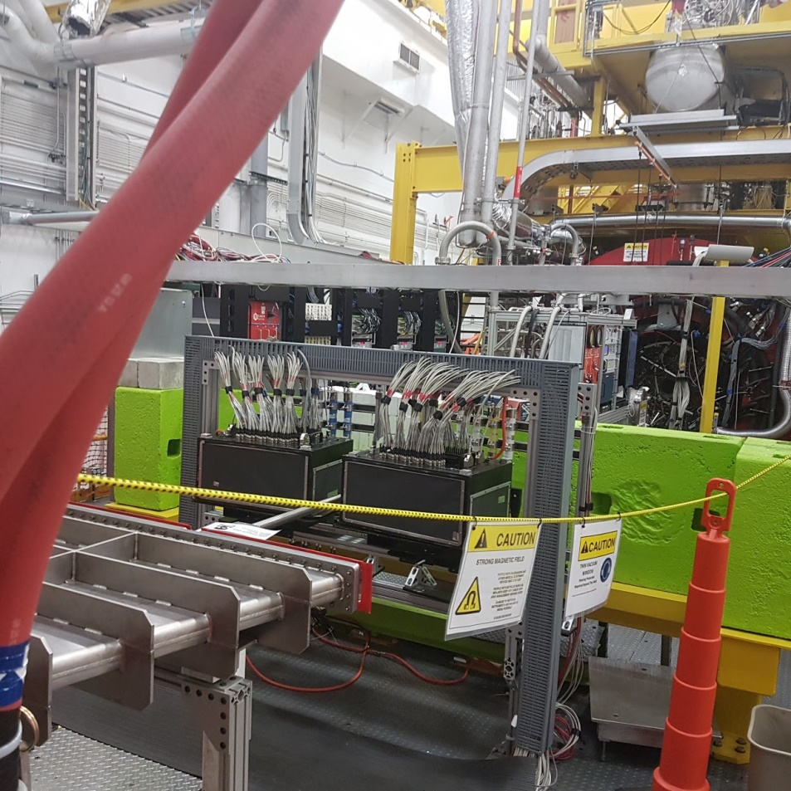

Slide 5
$K_{l}$spectrum

Slide 6
$K_{l}$ decays
 | Br, %
$$K_{l}→π_{}^{±}e^{∓}ν_{μ}$$ | 40.55
$$K_{l}→π_{}^{±}μ^{∓}ν_{μ}$$ | 27.04
$$K_{l}→π_{}^{+}π_{}^{−}π_{}^{0}$$ | 12.54
$$K_{l}→π_{}^{0}π_{}^{0}π_{}^{0}$$ | 19.52

Slide 7
$K_{l}$ in-flight decay

Slide 8
$K_{l}$momentum resolution

Slide 9
$K_{l}$momentum resolution

Slide 10
$K_{l}F$ Monitor
Plastic scintillators
trackers

Slide 11
Phi displacement
$φ^{′}=\frac{l⋅z⋅0.3⋅B}{p⋅cos⁡(Θ)}$; $l∼1m, \left|z\right|=1;B=1$; $φ^{′}[rad]=\frac{0.3}{p[GeV/c]⋅cos⁡(Θ)}$

Slide 12
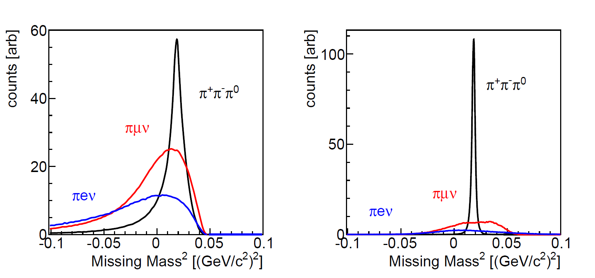
$K_{l}$ FM resolution
TOF only
Magnet only

Slide 13
$K_{l}F$ Monitor position resolution
1.2m
5 cm between planes
$Θ$ only,
$φ→$momentum
$$Θ,φ$$

Slide 14
$K_{l}F$ Monitor position resolution
$r$ resolution (transversal plane) $∼2⋅d$
$z$ resolution (beam direction) $∼20⋅d$
X-Y resolution $∼d$
$K_{L}$ flux distribution as a function of momentum and position can be extracted.
Need to be extrapolated to LH2/LD2 position
Flux monitor covers $∼4$ times the solid angle of LH2/LD2 $→$ safe extrapolation is possible (inner part of spectra at flux monitor == full range at LH2/LD2)

