Slide 1
PRad II/X17/pi0TFF Meeting JLab work Update
By: Erik Wrightson

Slide 2
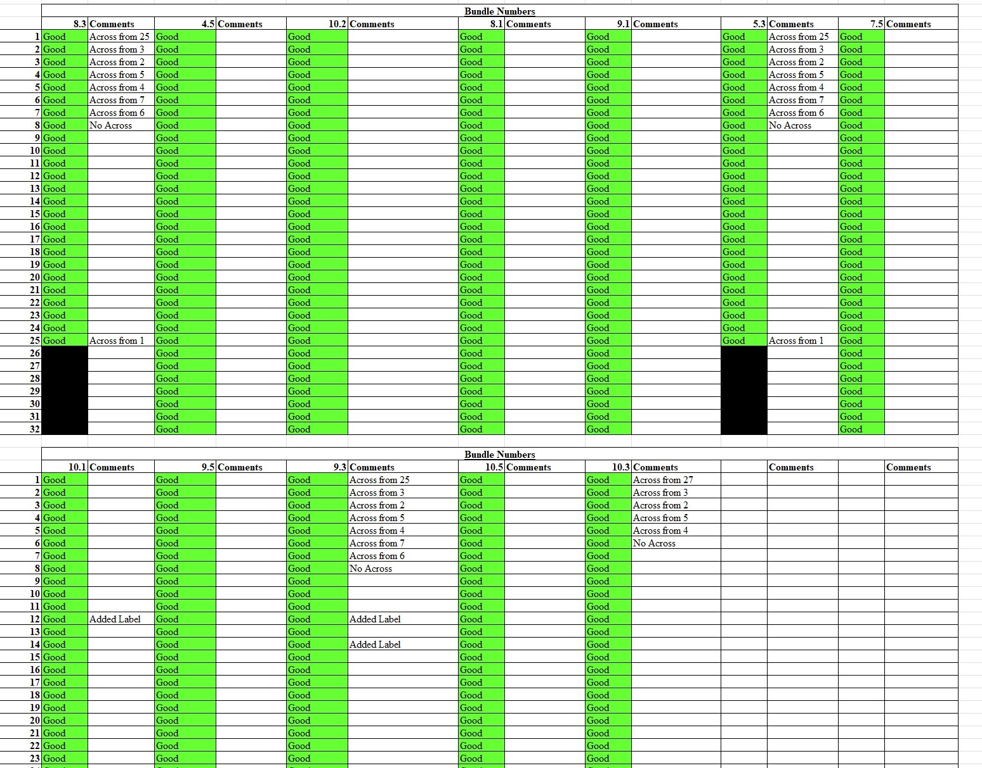
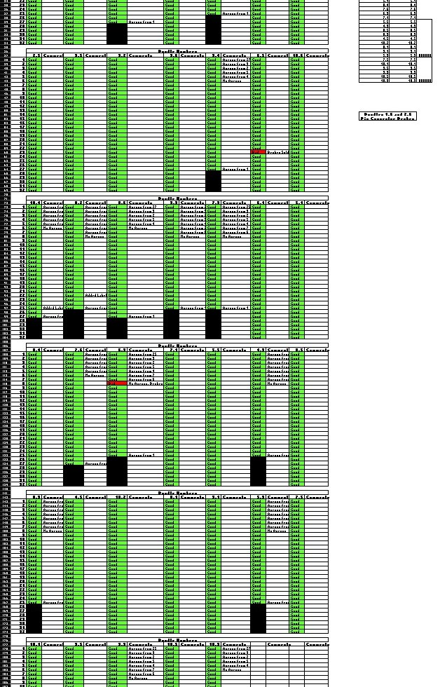
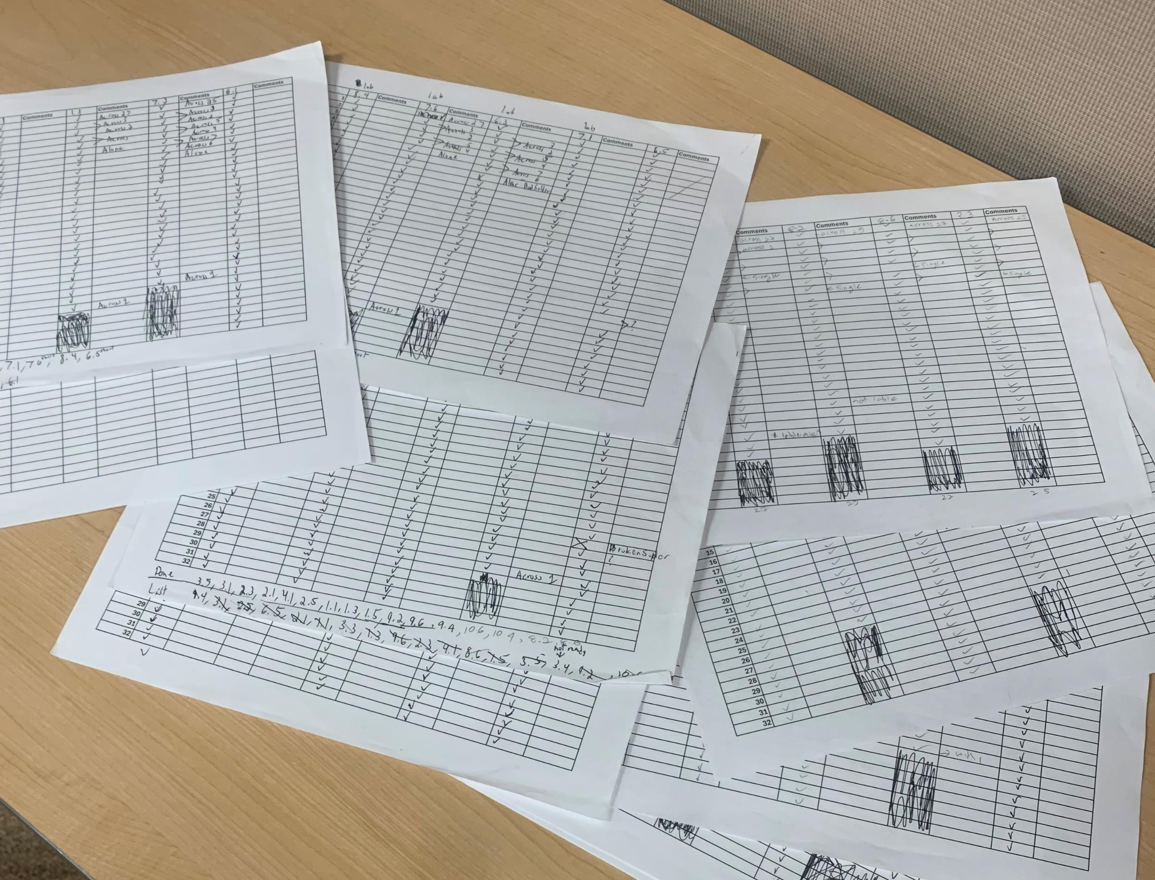
Current Progress – Cable Testing
Finished Testing and Labeling 40 Bundles (20 Left)
This was all the available bundles
Completed –
1.1, 1.3, 1.5
2.1, 2.3, 2.5
3.1, 3.3, 3.5
4.1, 4.3, 4.5
5.1, 5.3, 5.5
6.1, 6.3, 6.5
7.1, 7.3, 7.5, 7.6
8.1, 8.2, 8.3, 8.4, 8.5, 8.6
9.1, 9.2, 9.3, 9.4, 9.5, 9.6
10.1, 10.2, 10.3, 10.4, 10.5, 10.6
Added individual cable labels that were missing.

Slide 3
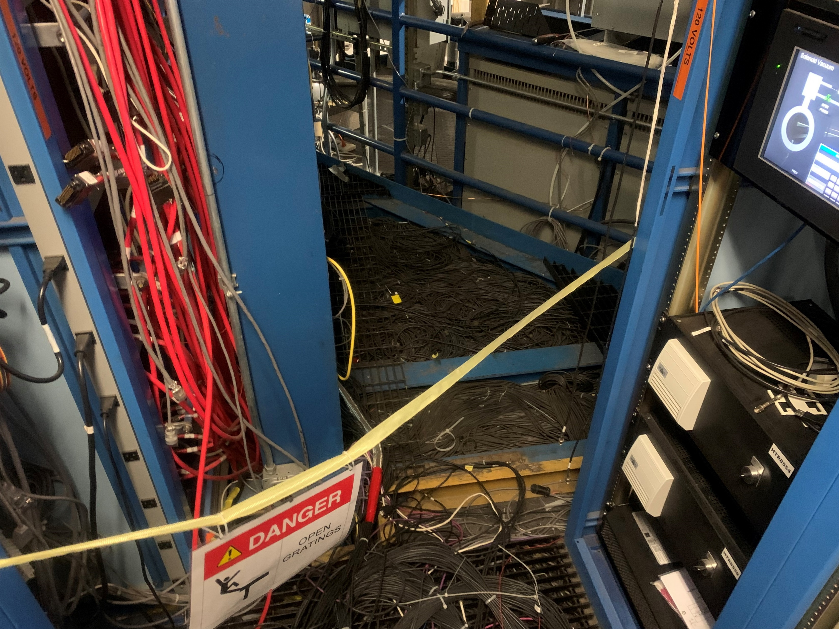
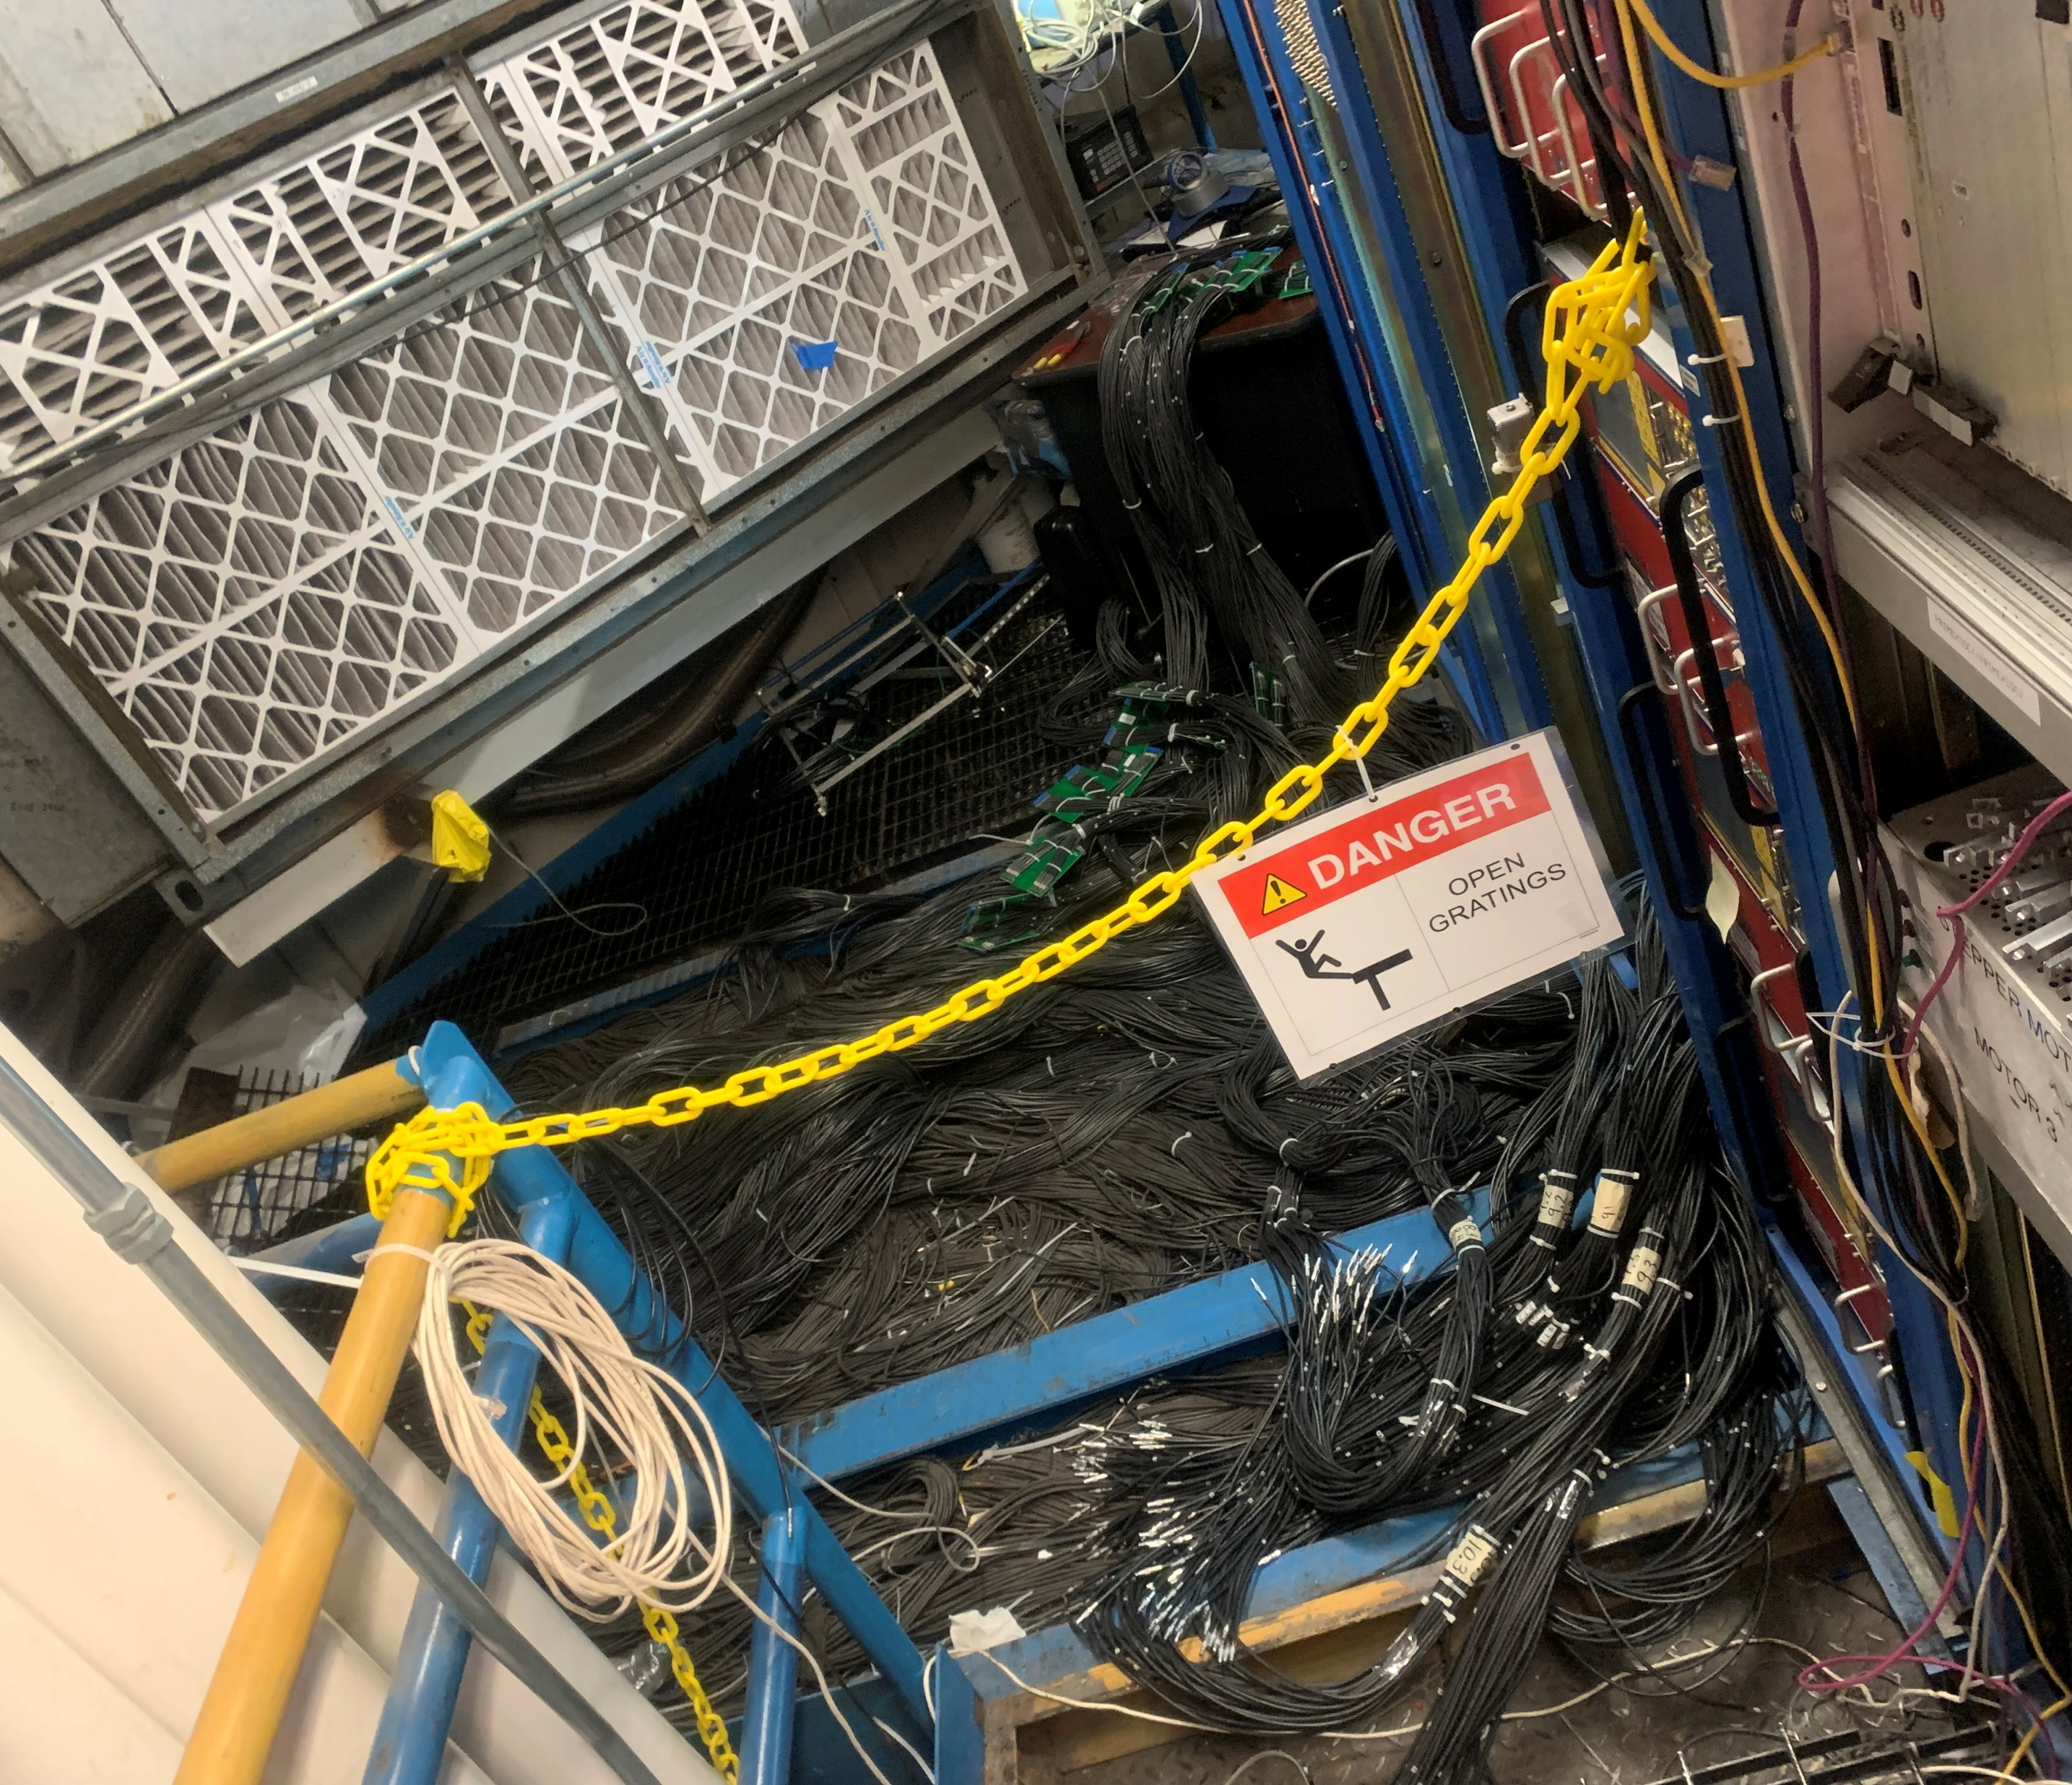
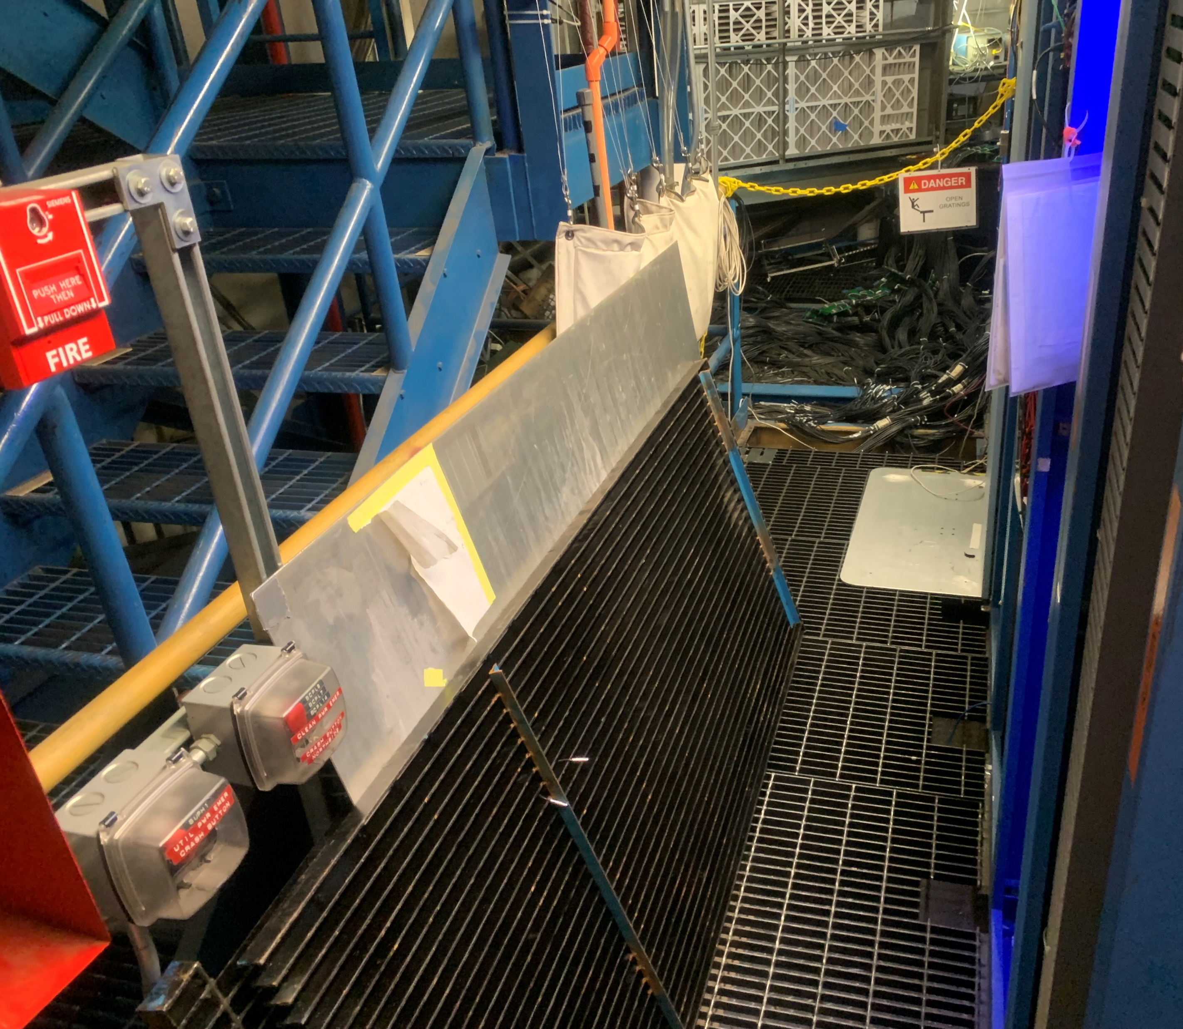
Techs removed grates to allow for accessing final bundles.

Slide 4
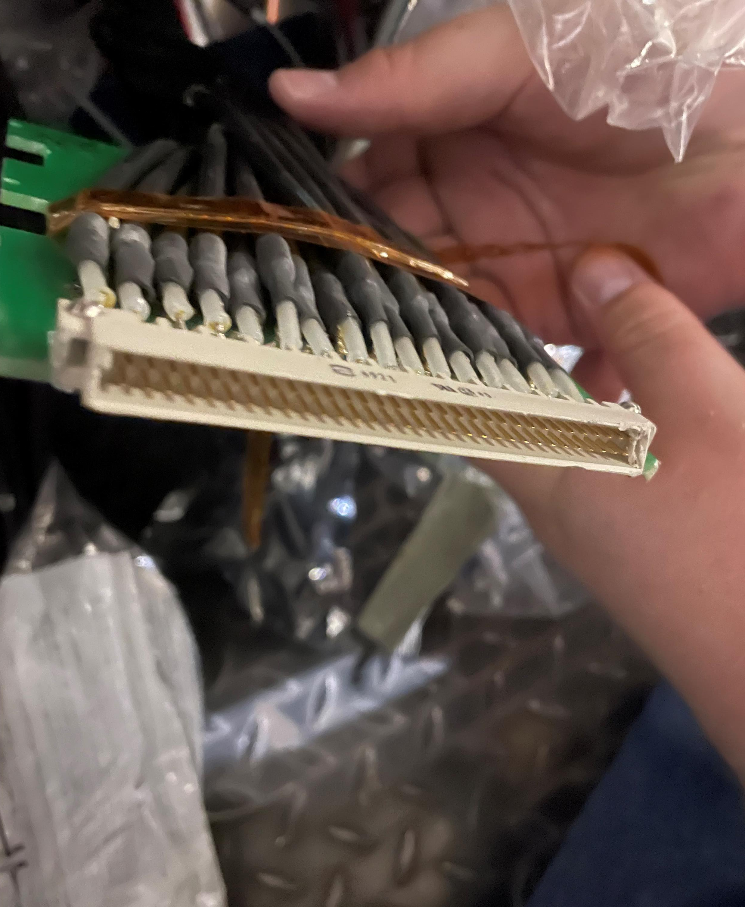
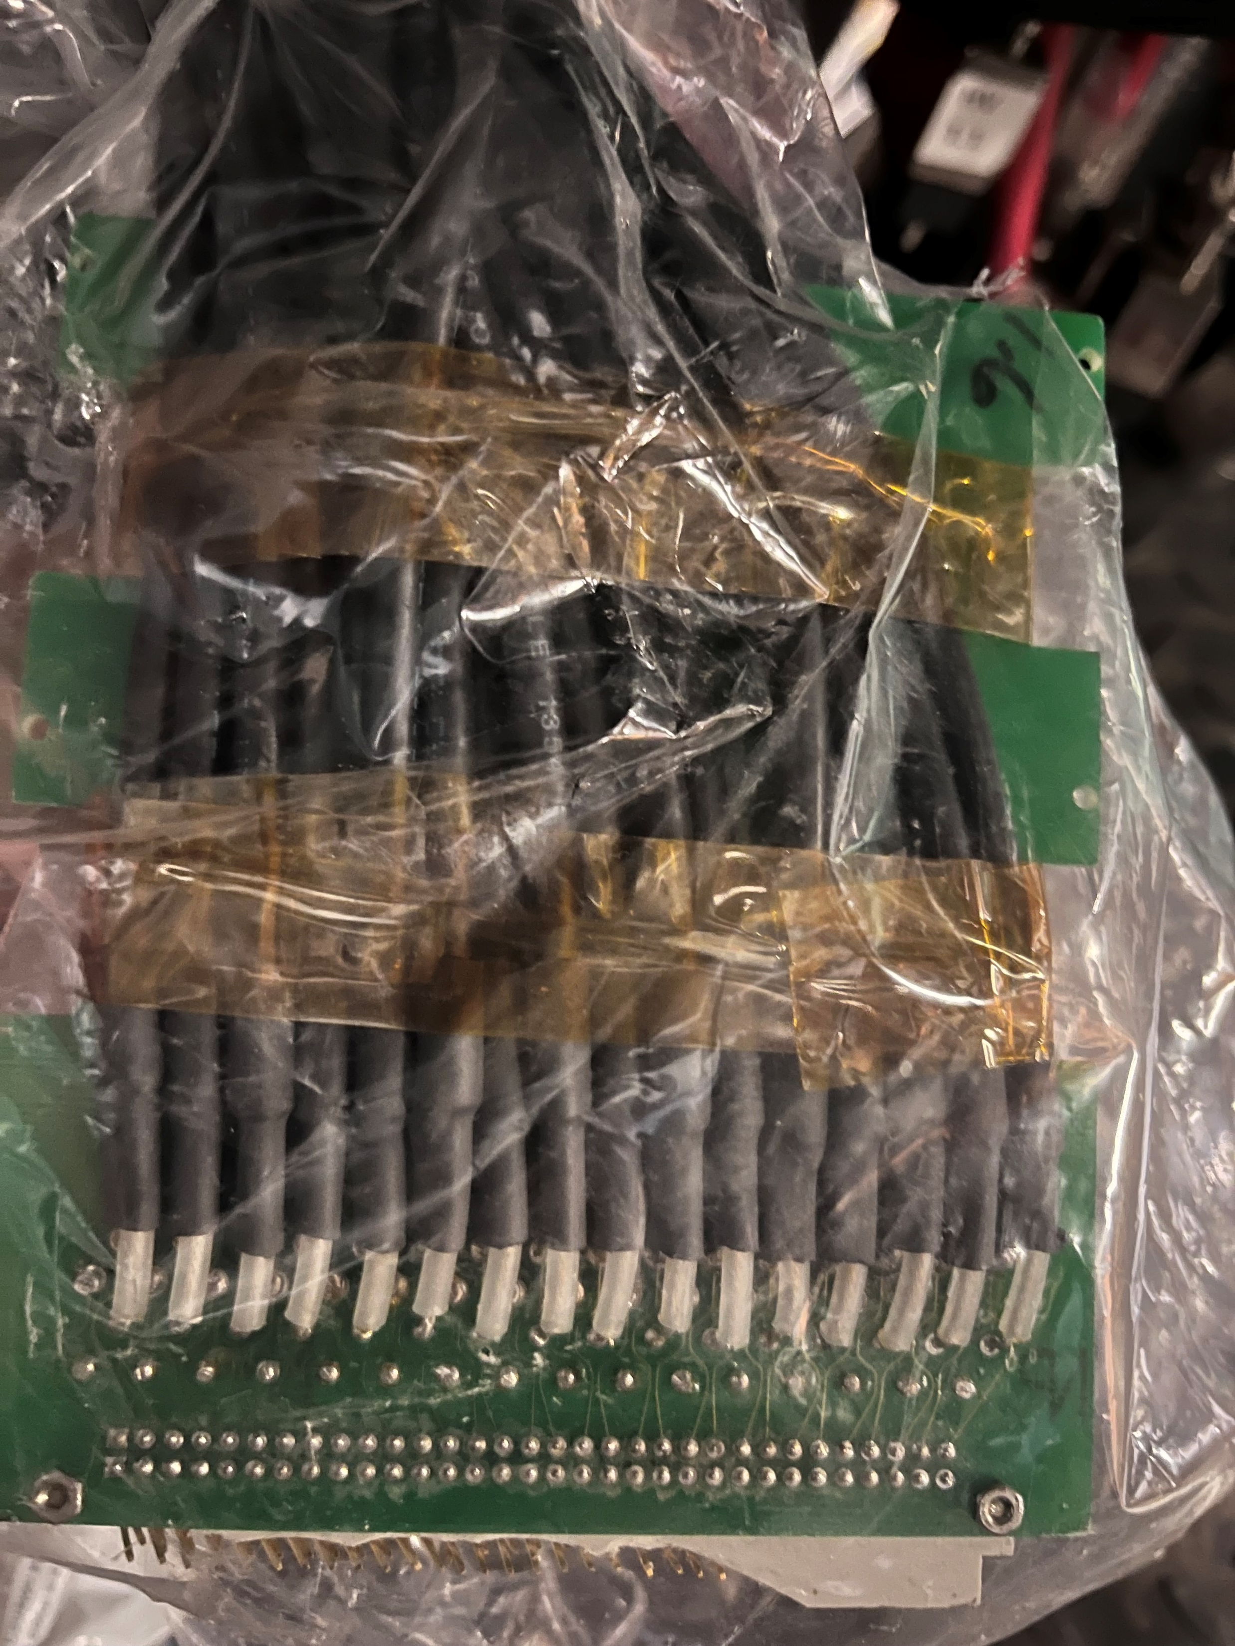
Issues so far
Bundle Board 1.6
Bundle Board 2.6
Bundles 1.6 and 2.6 have chipped/broken pin connectors.
Bundle 6.5 cable 23 and Bundle 6.3 cable 8 have a broken solder to the board.
Due to configuration of cables under the grates we will be able to give a few feet of slack for finishing adding the LEMO connectors.
However, there may not be enough to get up to all the FADC boards. We will need to have the cables pulled and reordered to be able to reach.

Slide 5
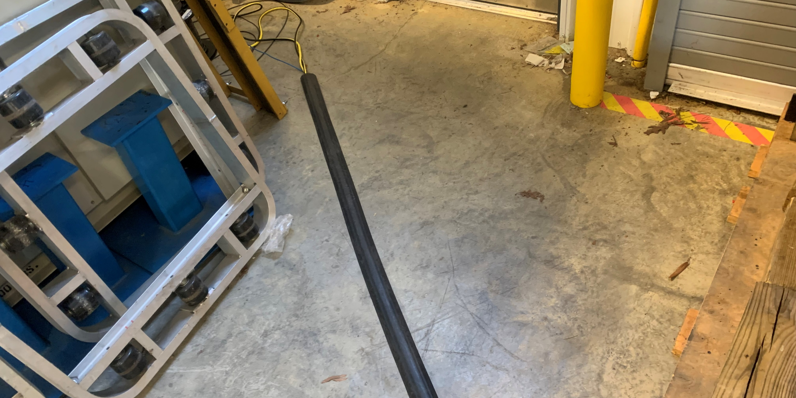
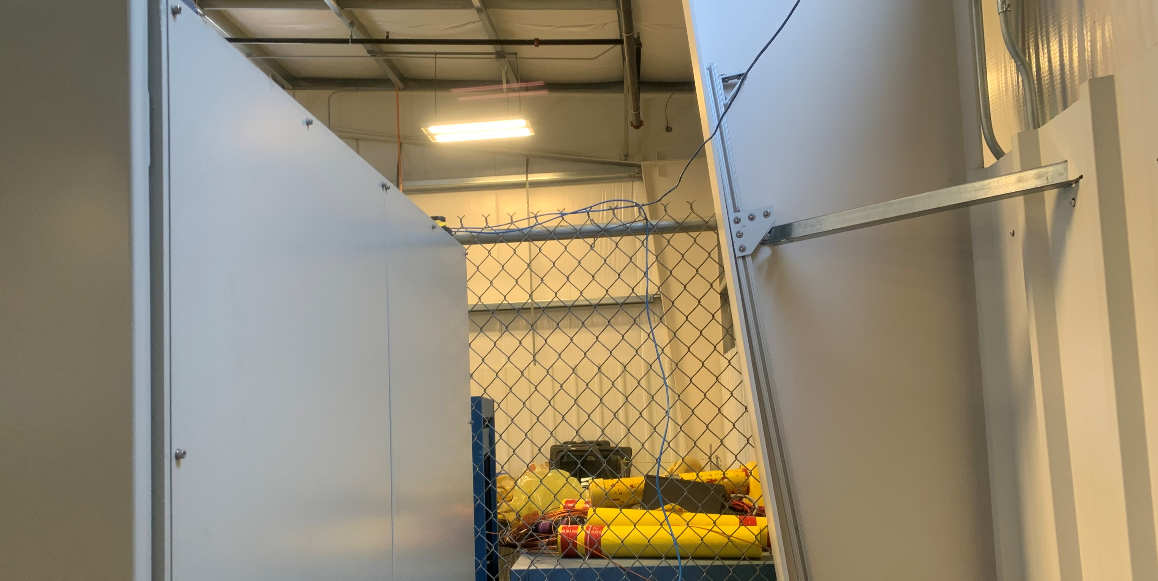
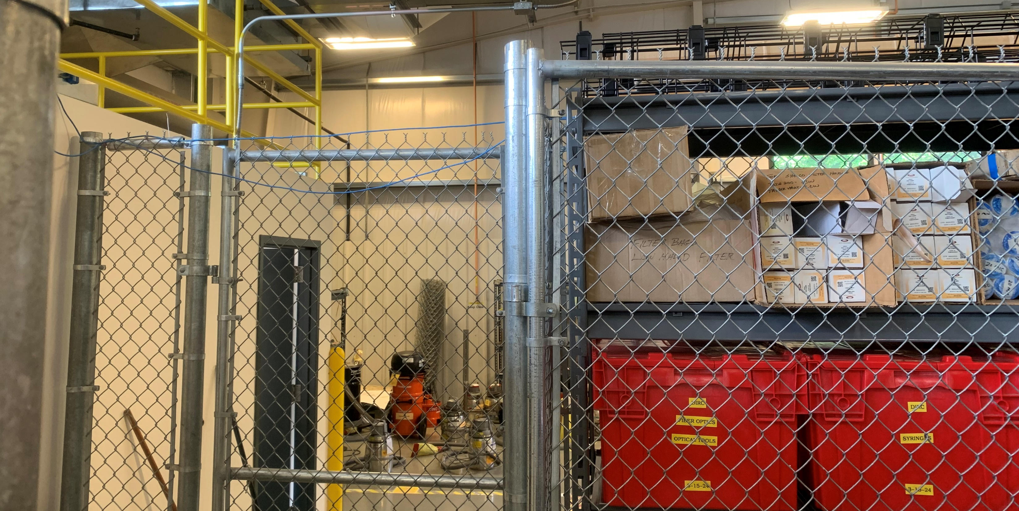
Current Progress – HyCal Testing
On Monday, Andrew from the computer center brought over a network cable and unlocked the networking switch panel for us.
On Tuesday, a group of us ran the networking cable along from the panel above the bathroom, down the fence line, and then along the ground (with cable covers) to the HyCal rack.

Slide 6
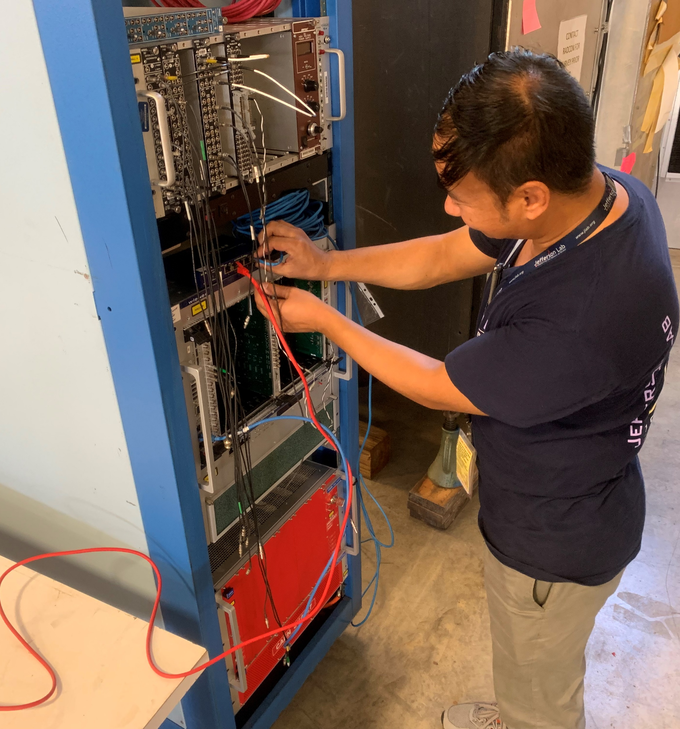
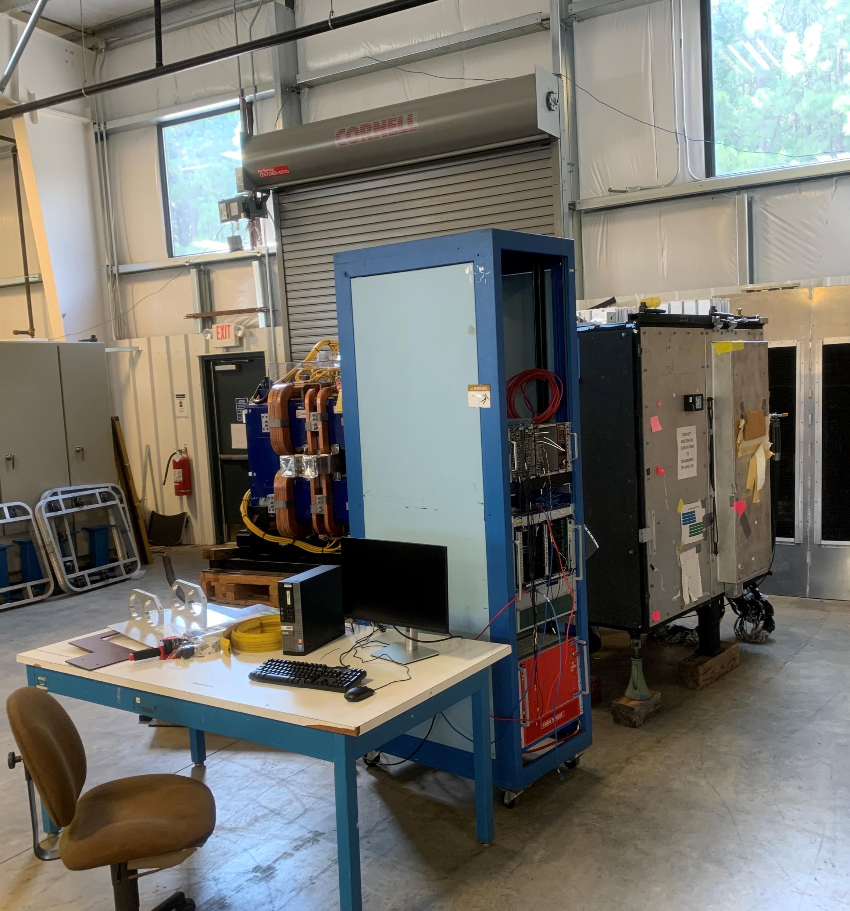

Slide 7
Going Forward
Cable Testing in Hall B
Allowing techs to finish pulling cable slack from under the grates.
Let Jim get the final 20 bundles done.
Still need to figure out high voltage testing with Mark
HyCal Testing in ESB
We just need the actual testing components and then to get started
Scintillator Testing
We need to order light guides and PMTs for testing
NOTE: I have been logging all these updates. However, I cannot log into the wiki for some reason if someone can give me access that would be greatly appreciated.

