Slide 1
PRad Collaboration Meeting - HyCal work Update
By: Erik Wrightson

Slide 2
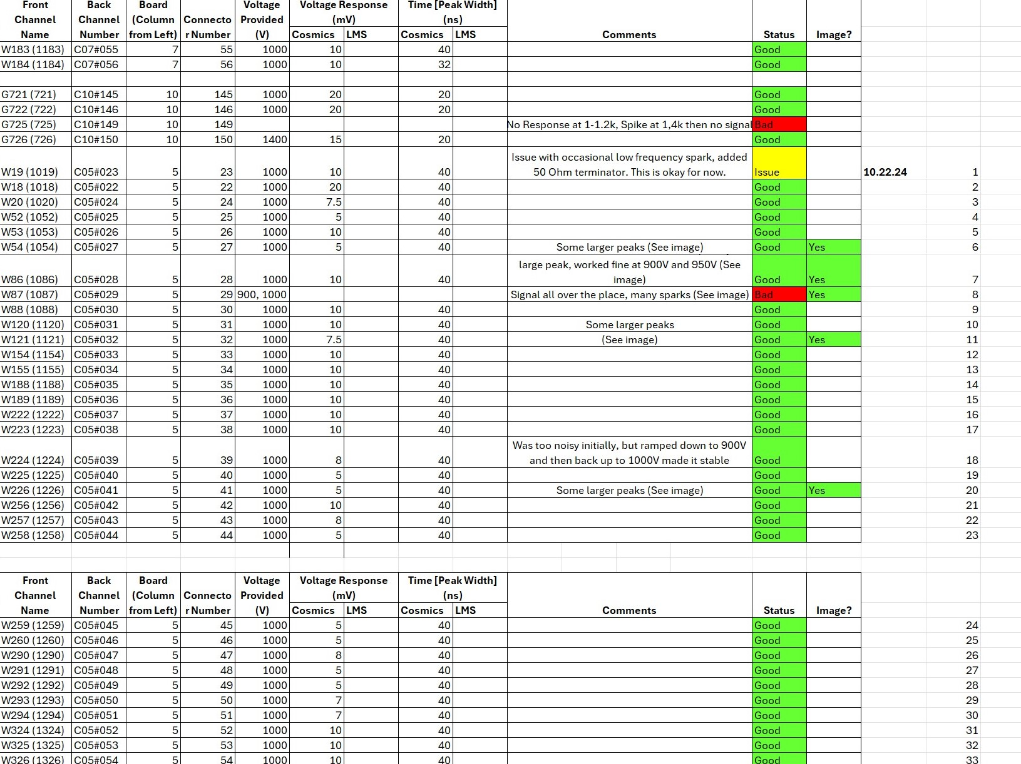
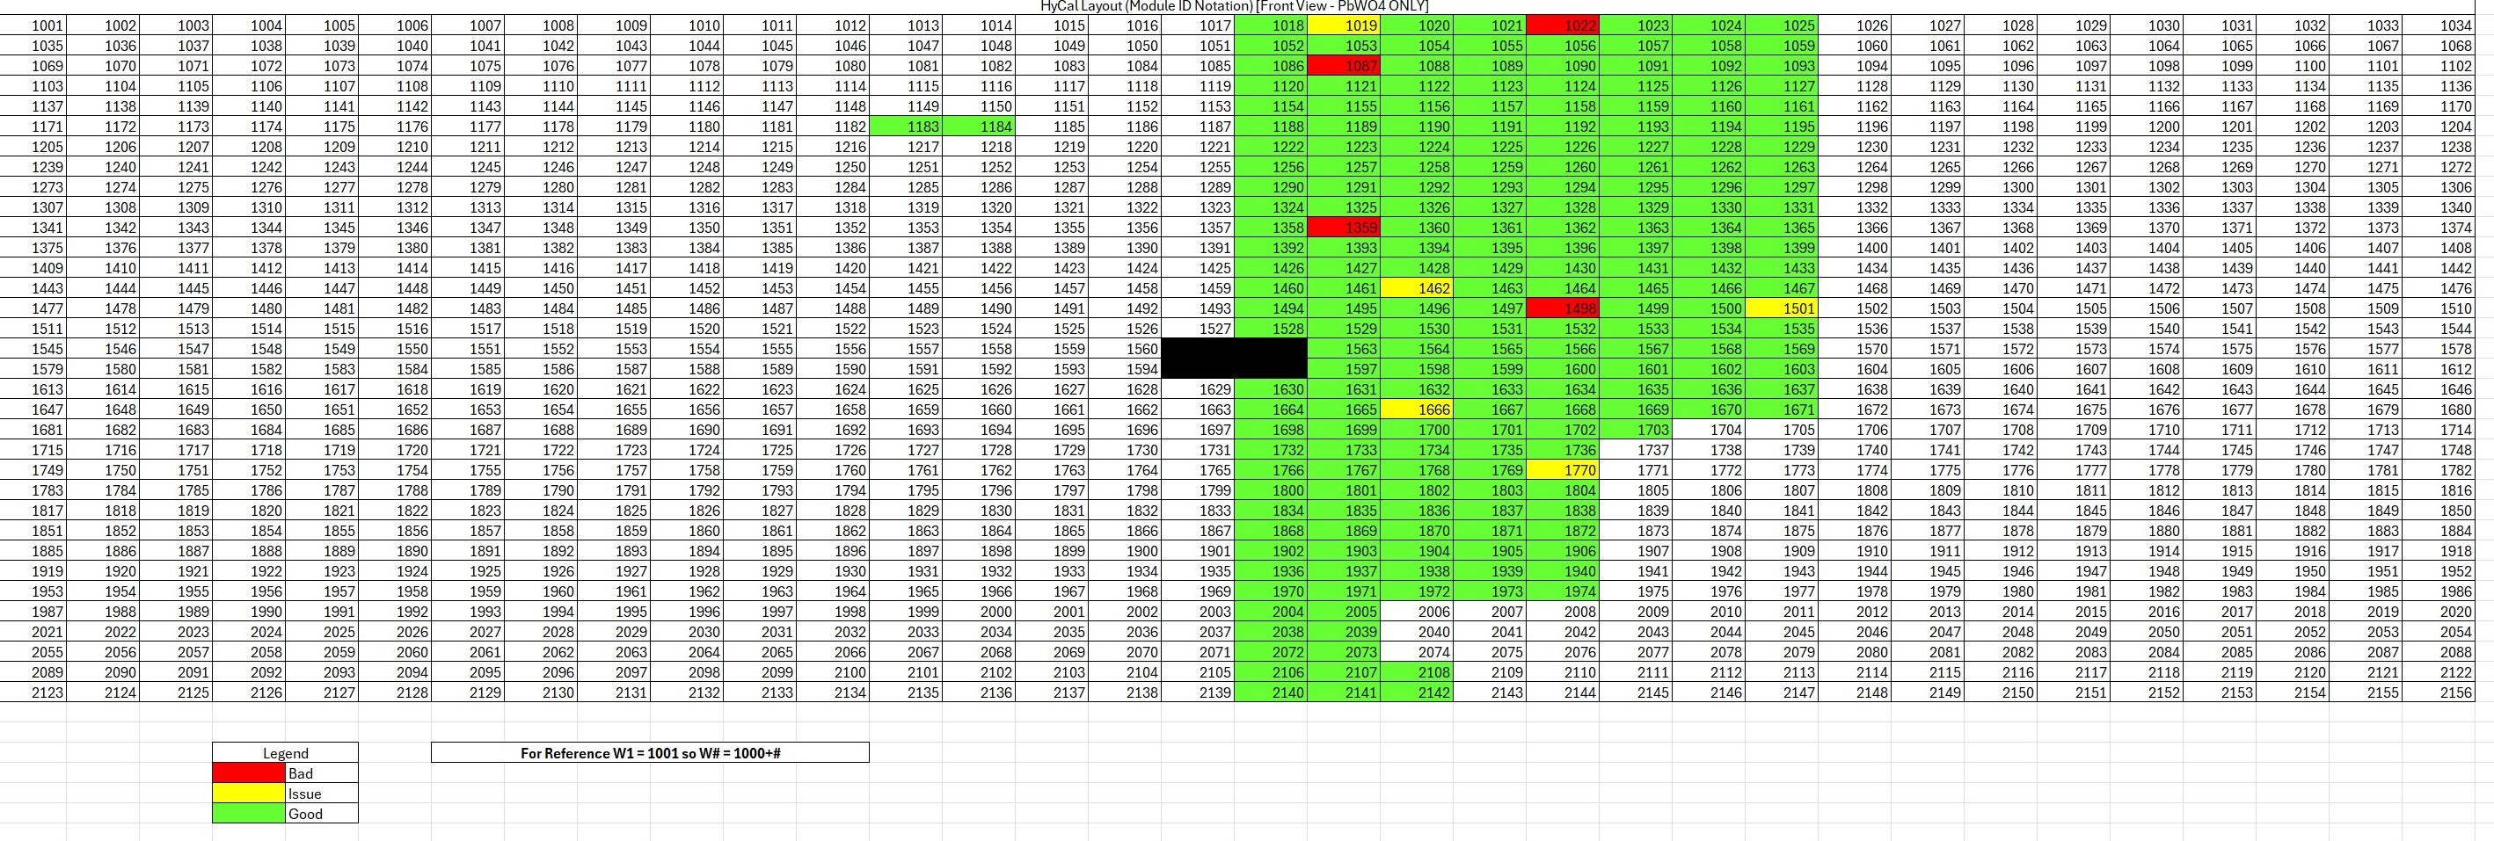
PMt Electrical Tests

Slide 3
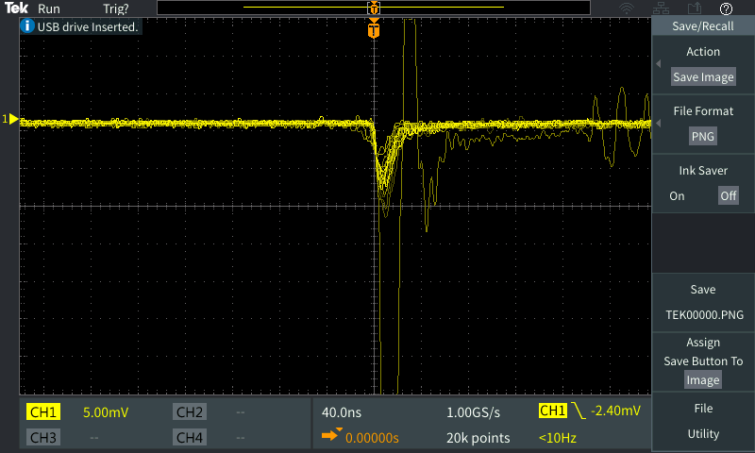
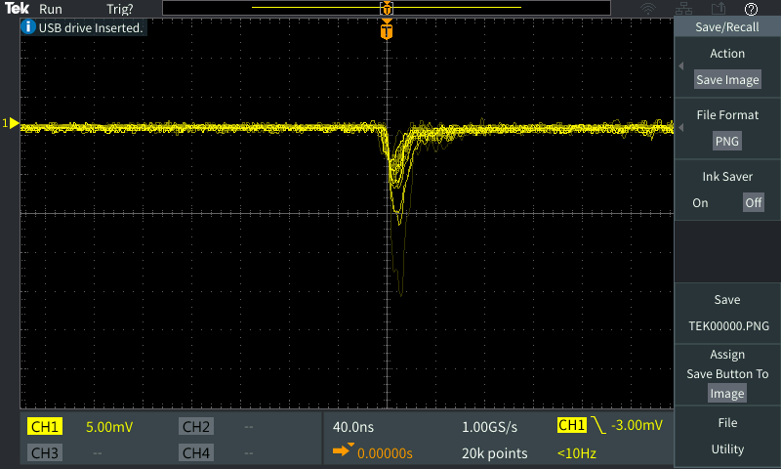
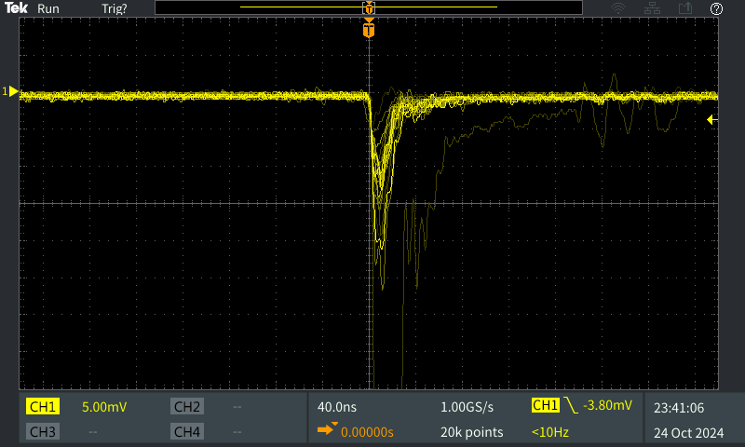
Most Signals are good

Slide 4
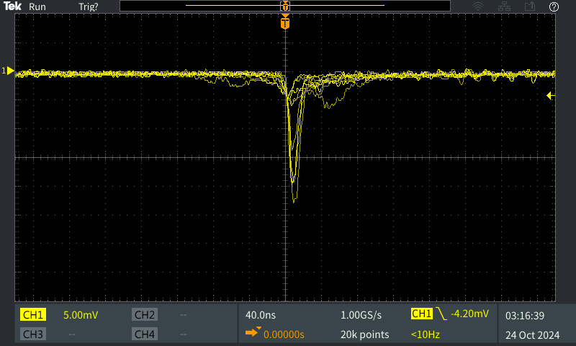
Some have minor issues to recheck later

Slide 5
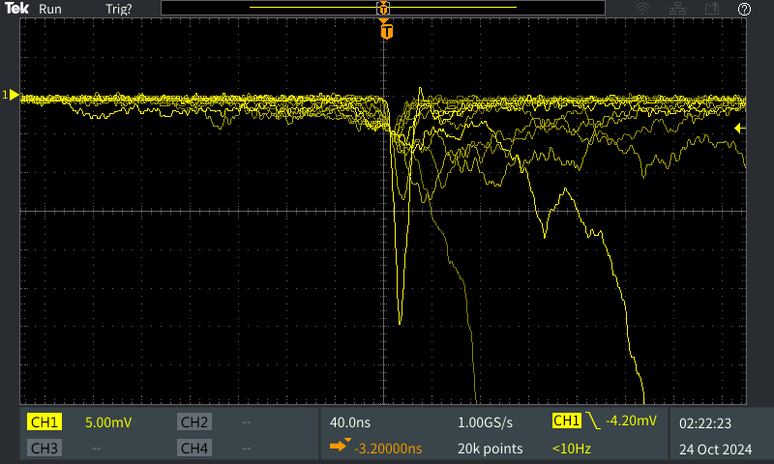
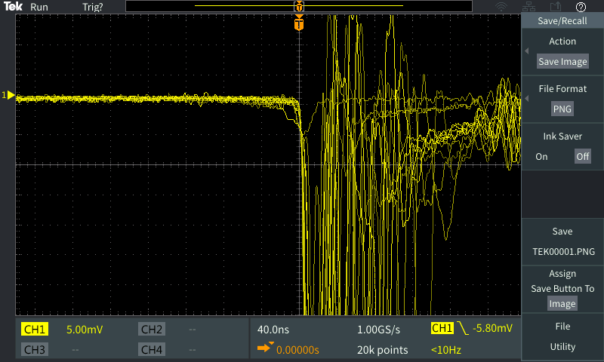
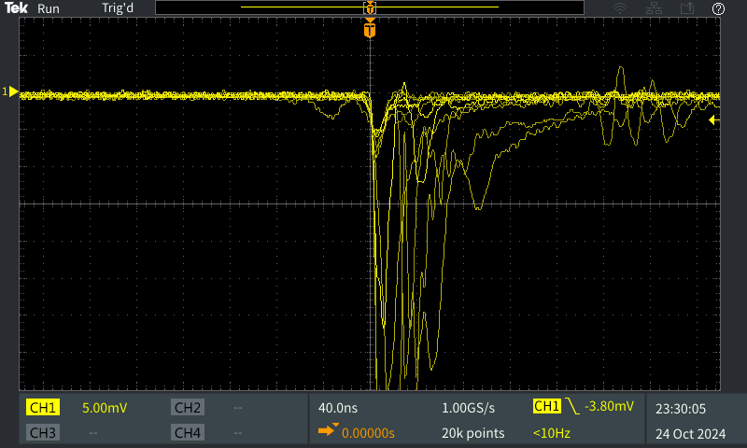
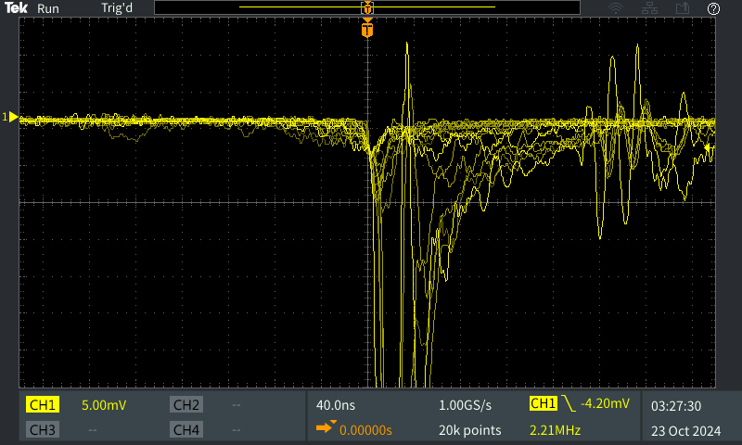
4 have been labeled Bad so far (still will rechecked)
The issues in these persisted even after multiple re-ramps and checks.
C05#081
C05#029
C04#026
C05#058

Slide 6
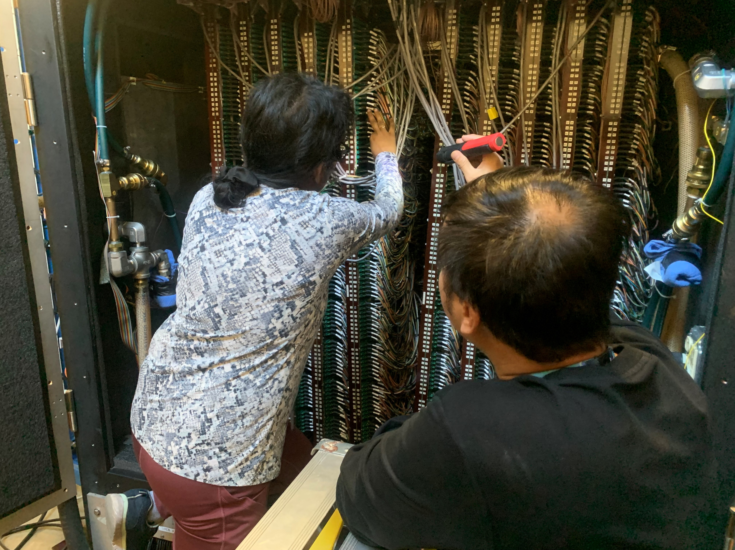
Overall Progress (As of 10/24)
37 modules checked on 10/22
71 modules checked on 10/23
106 modules checked on 10/24
214 Modules Checked Total
4 Bad Modules
5 Issue Modules
838 Modules Remaining

Slide 7
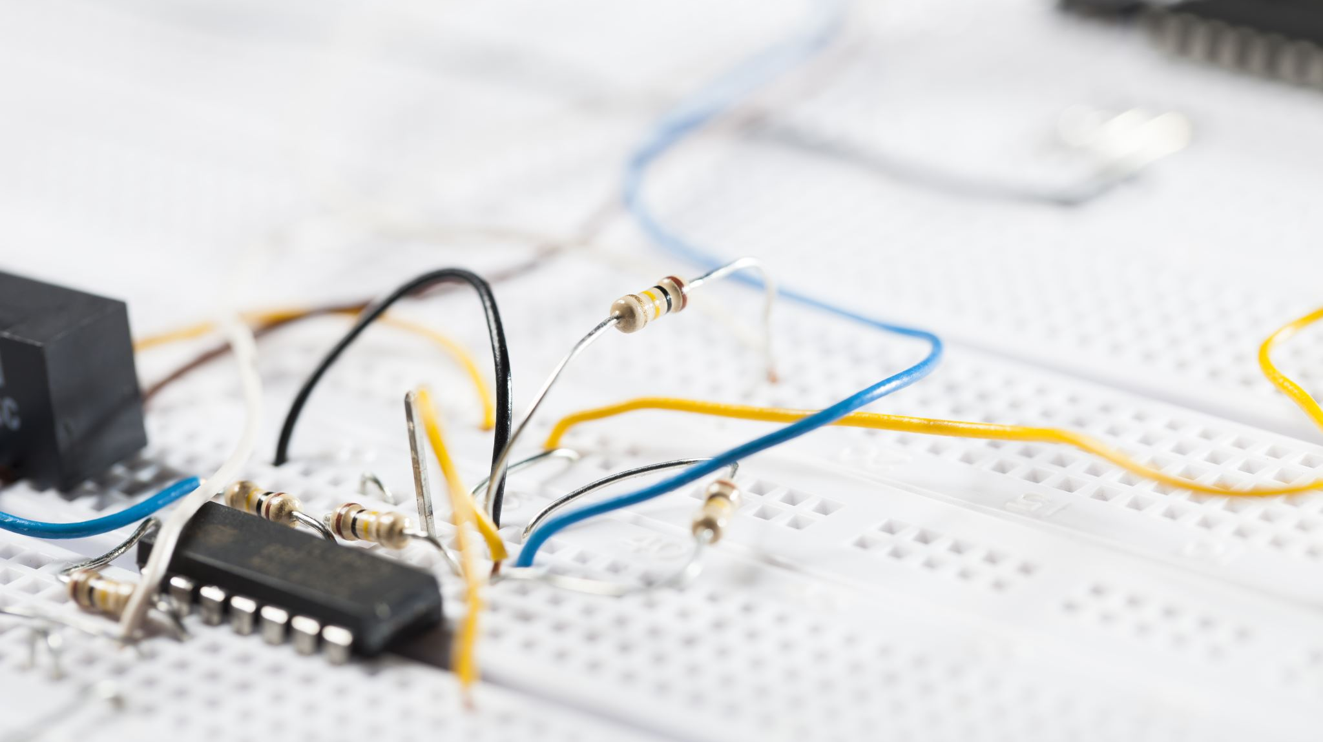
LMS Work So far
LMS does not have an easily swappable setup for putting in a different light module.
It would require removing the LMS (without damaging the fiber bundle that goes into HyCal).
We attempted to see if we could get any signal from using the present pulse generator.
It does not reach a high enough voltage for even weak pulsing.
We have confirmed that the filter can still move between its preset positions.
We still need a 100 V pulse generator.
We checked one of the LMS PMTs with its attached radiation source and that gives a good consistent signal.

Slide 8
As always, find daily updates on the PRad Logbook and I update the PRad module test maps each day on the Wiki.

