Slide 1
PRad II/X17/pi0TFF Meeting HyCal Cable Update
By: Erik Wrightson

Slide 2
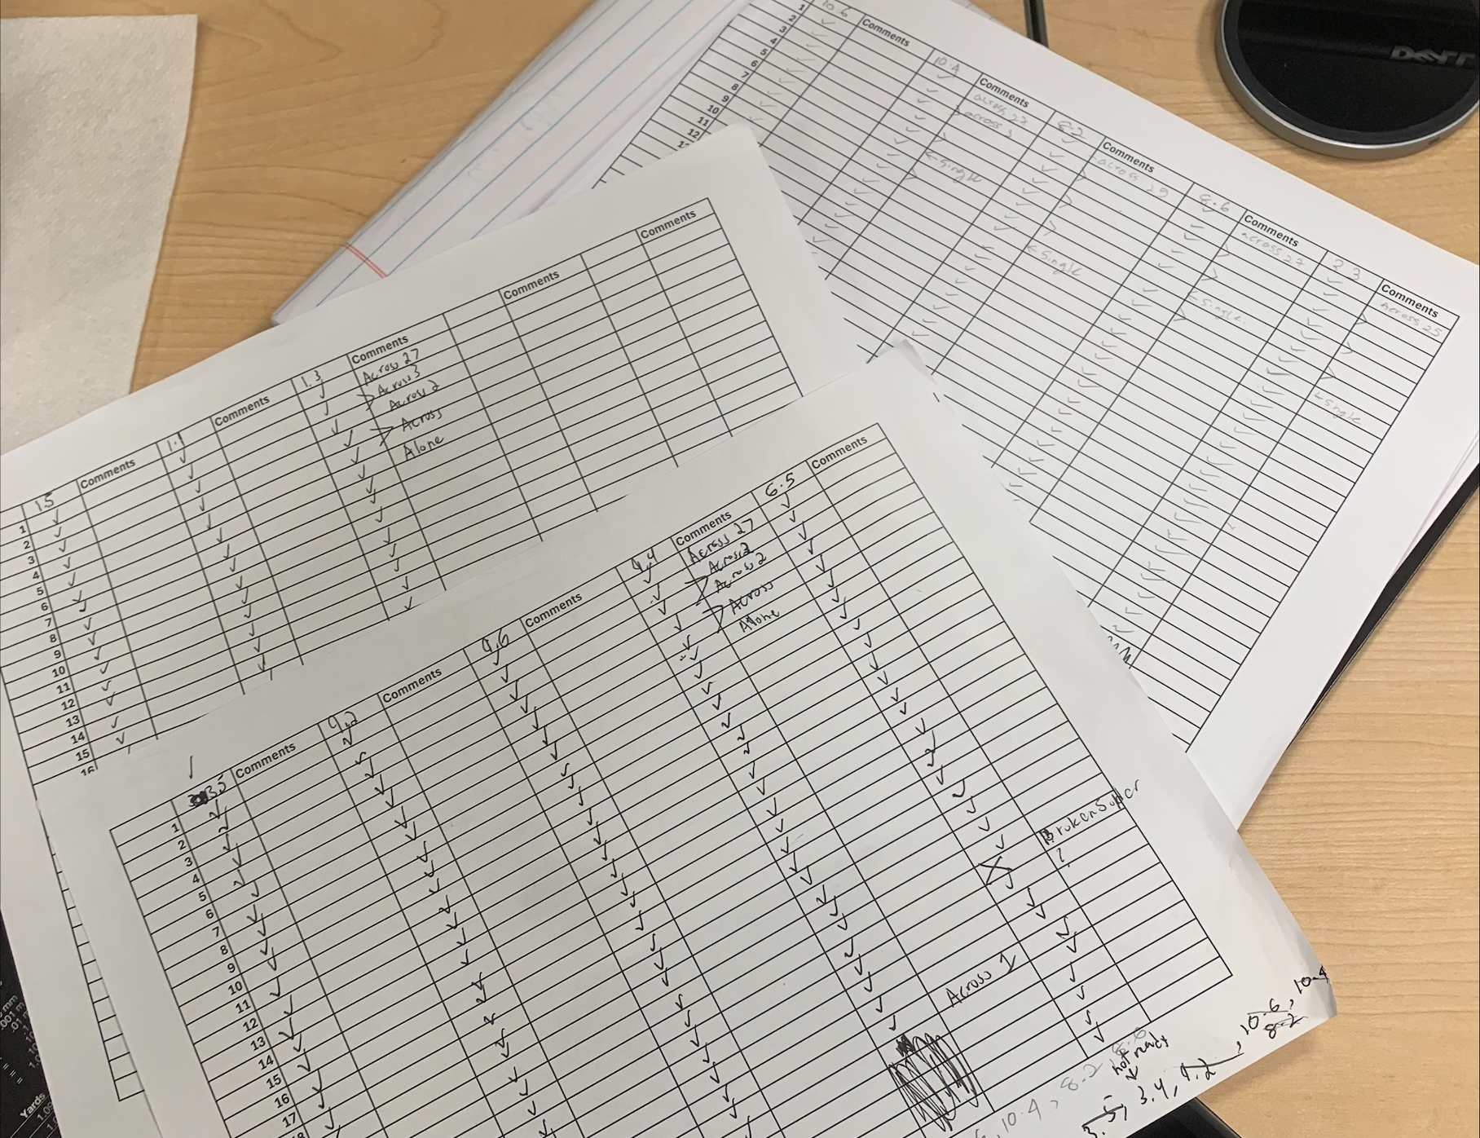
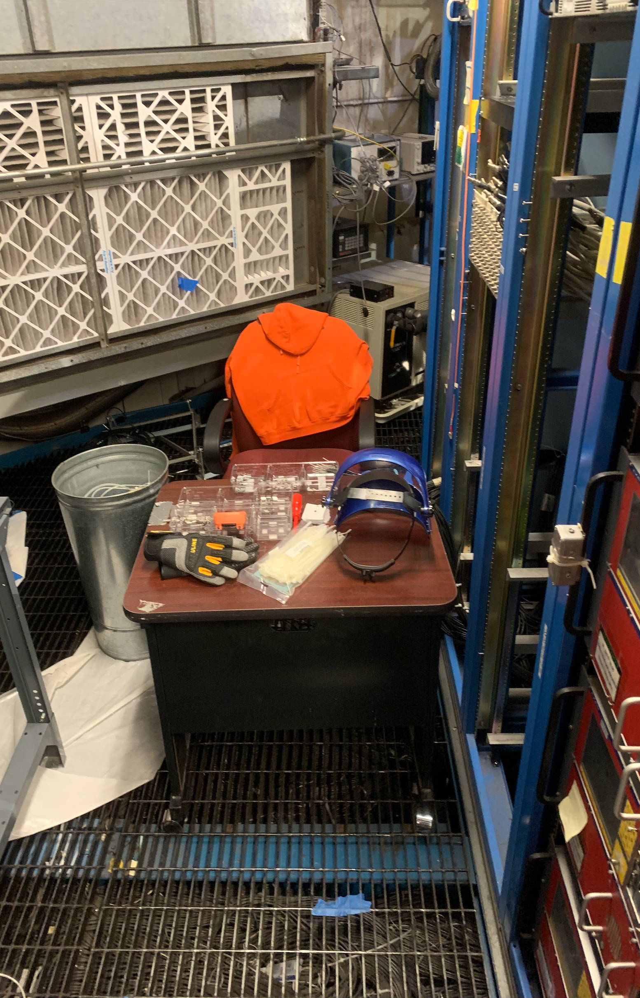
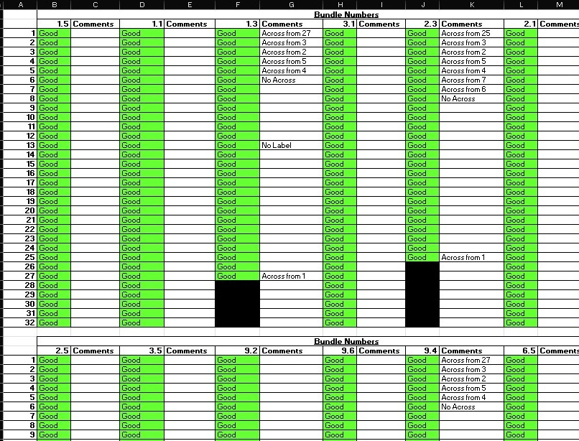
Current Progress
Finished Testing and Labeling 18 Bundles
This was all the available bundles
We take hard copy notes and I digitize them at the end of each day.
Completed –
1.1, 1.3, 1.5
2.1, 2.3
3.1, 3.3, 3.5
4.1,
6.5,
8.2, 8.6
9.2, 9.4, 9.6
10.4,10.6
Bundles made of 1-16 then 17-last respectively.
X.X.1 (Cables 1-16)
X.X.2 (Cables 17-last)

Slide 3
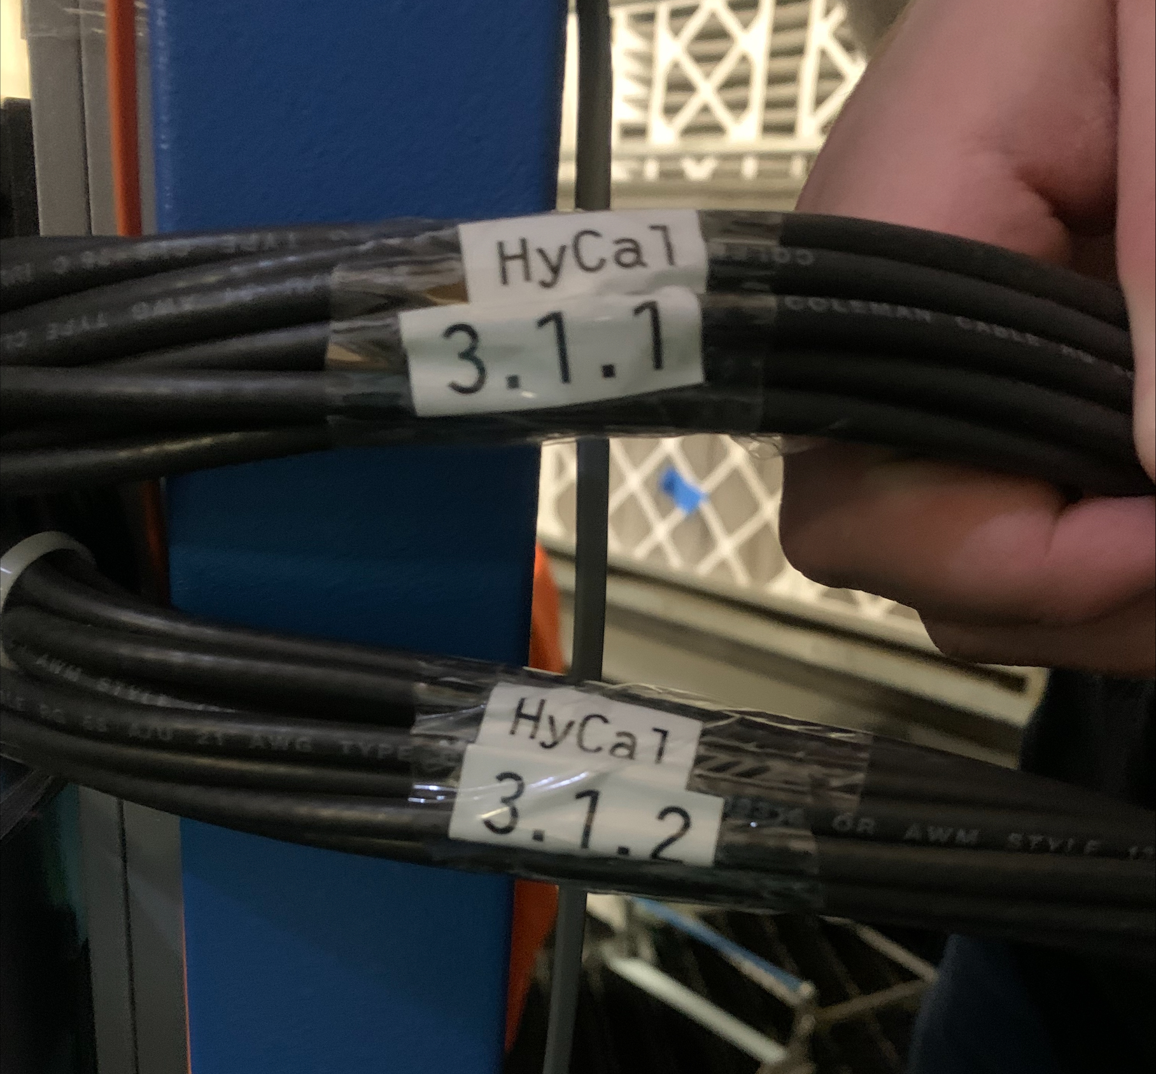
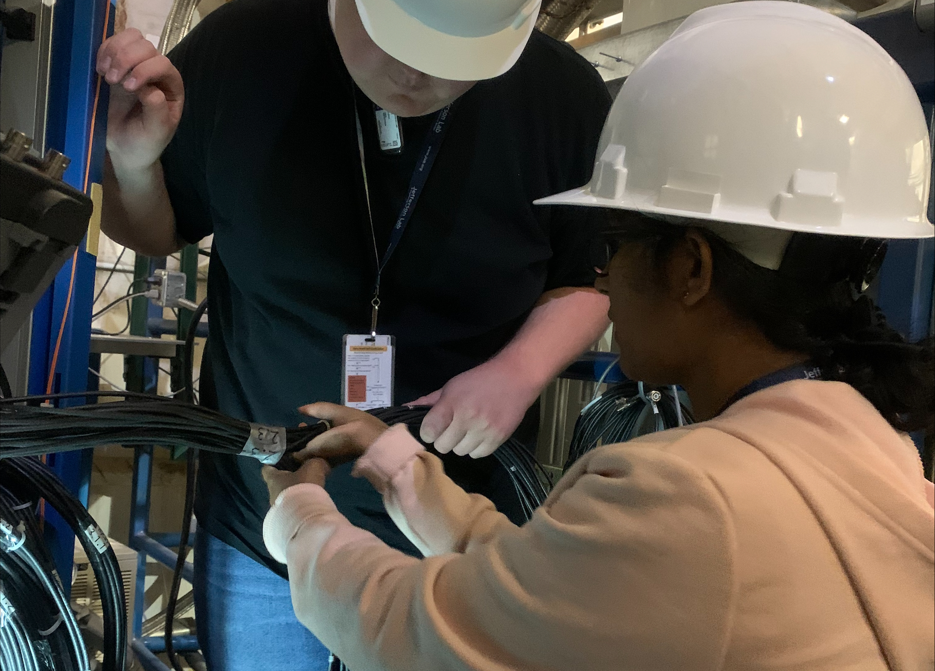
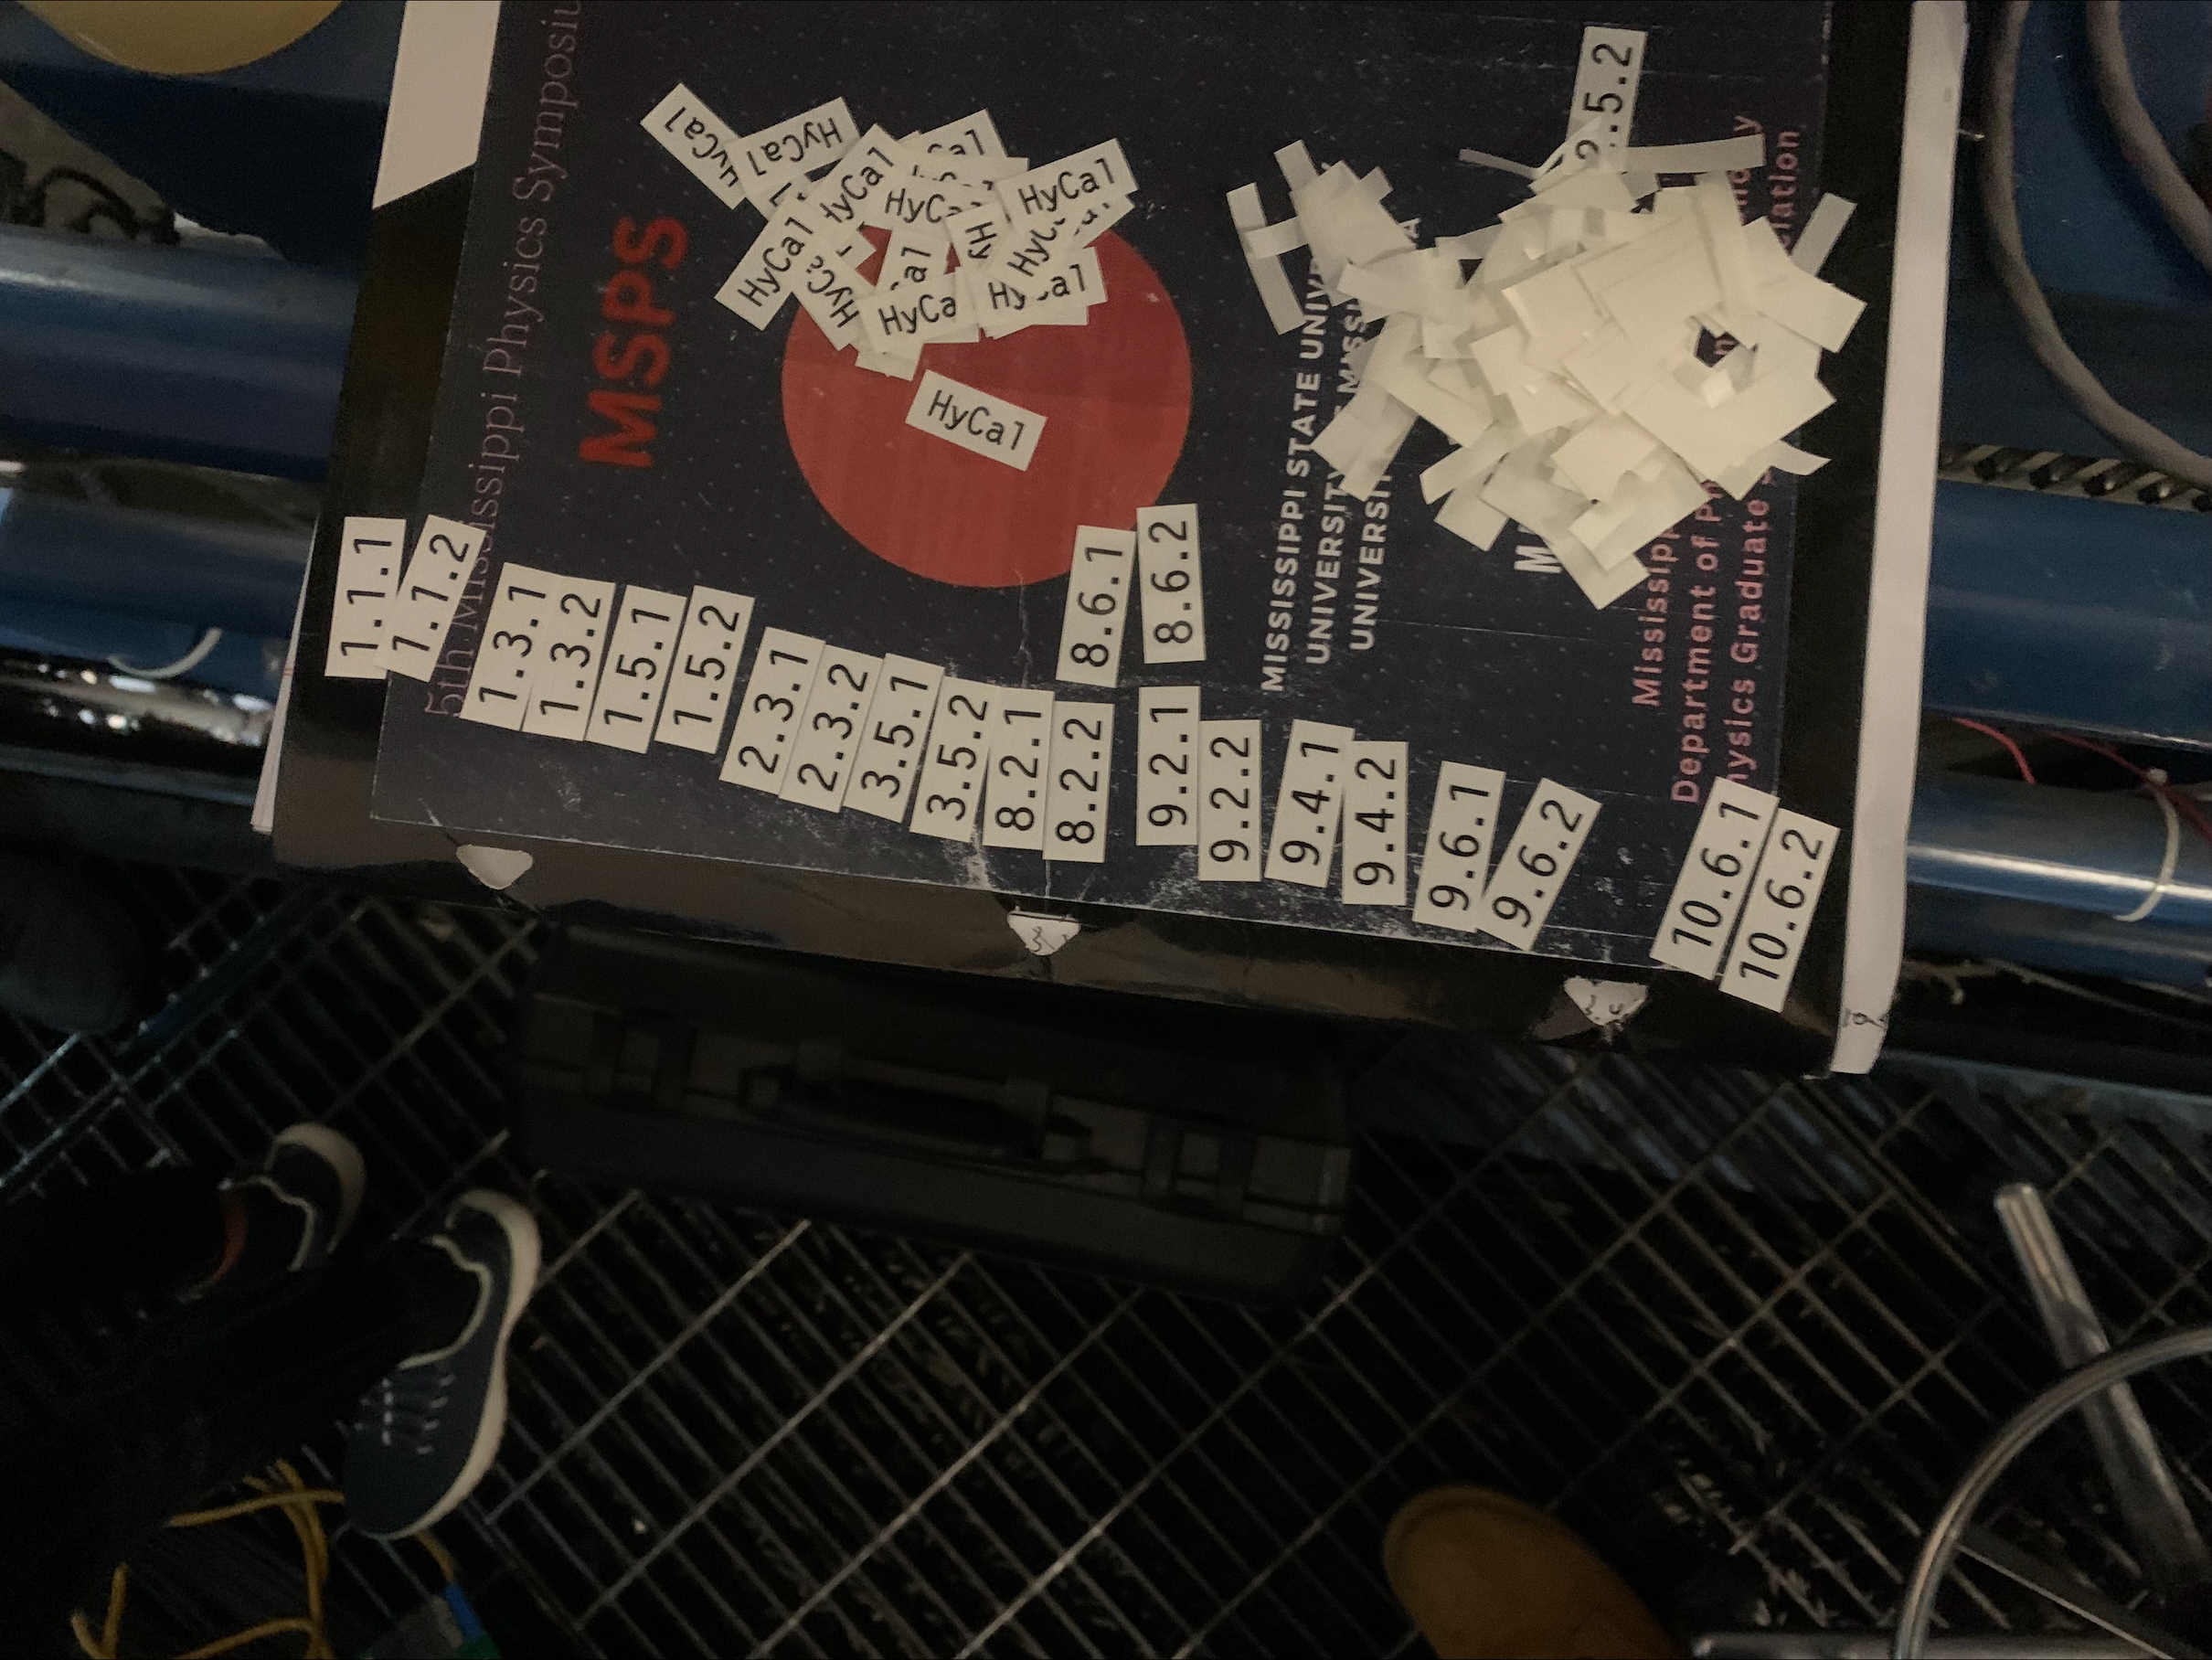

Slide 4
3-types of bundles
1 | 3 | 5 | 7 | 9 | 11 | 13 | 15 | 17 | 19 | 21 | 23 | 25 | 27 | 29 | 31
2 | 4 | 6 | 8 | 10 | 12 | 14 | 16 | 18 | 20 | 22 | 24 | 26 | 28 | 30 | 32
32-Cable Bundles:
1 | 3 | 5 | 7 | 9 | 11 | 13 | 15 | 17 | 19 | 21 | 23 | 25
27 | 2 | 4 | 8 | 10 | 12 | 14 | 16 | 18 | 20 | 22 | 24 | 26 | 6
27-Cable Bundles:
1 | 3 | 5 | 7 | 9 | 11 | 13 | 15 | 17 | 19 | 21 | 23
25 | 2 | 4 | 6 | 10 | 12 | 14 | 16 | 18 | 20 | 22 | 24 | 8
25-Cable Bundles:

Slide 5
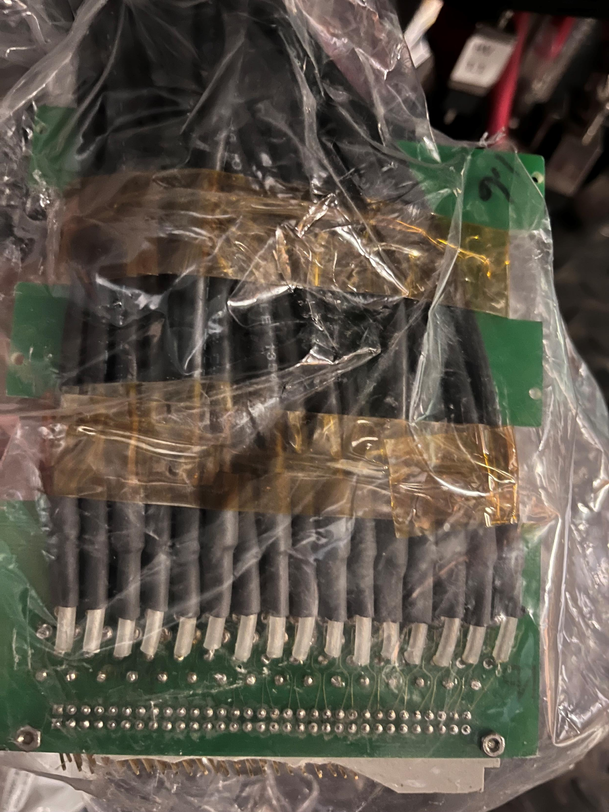
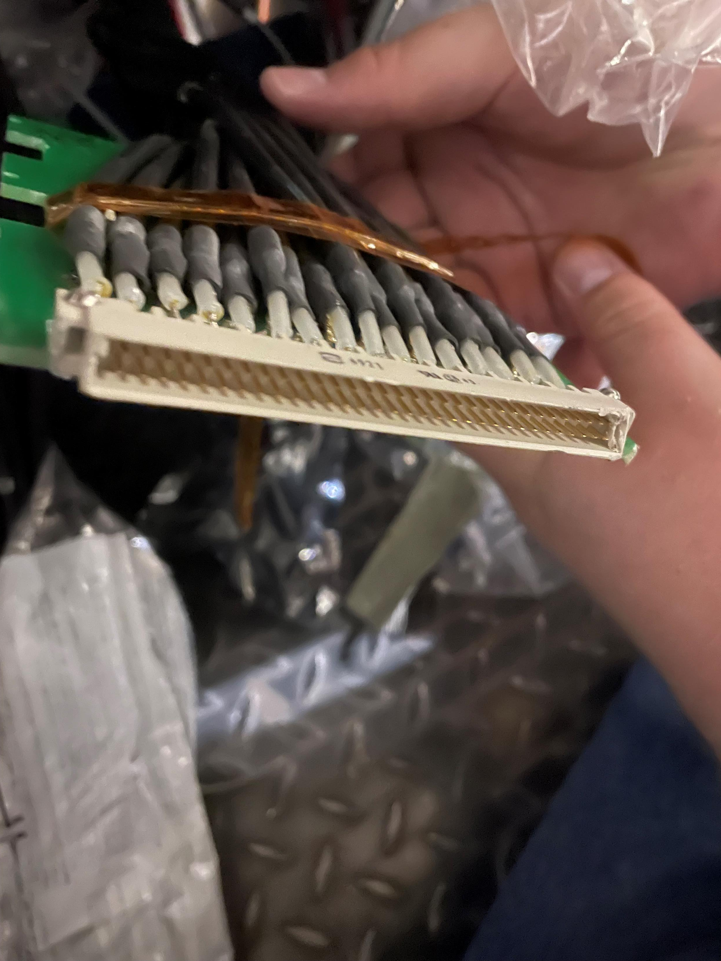
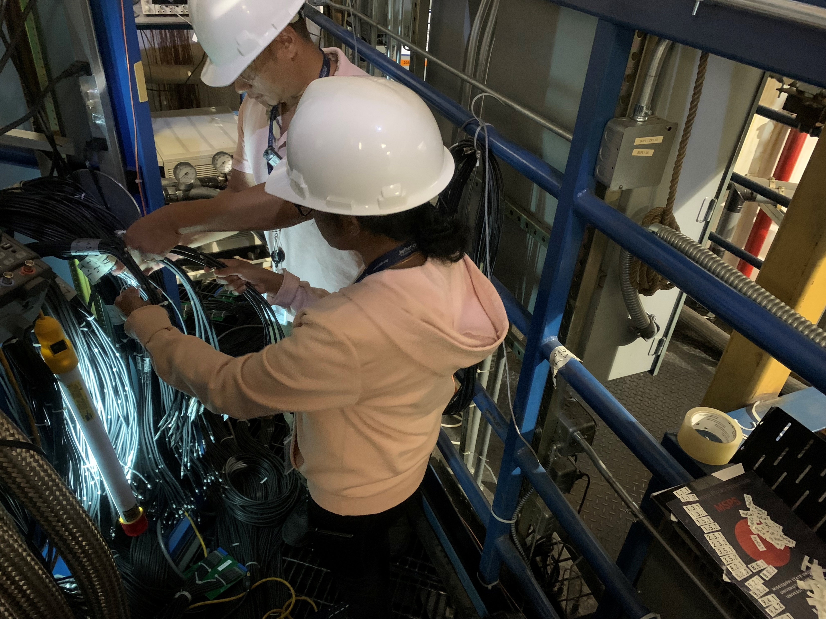
Issues so far
Bundle Board 1.6
Bundle Board 2.6
Bundles 1.6 and 2.6 have chipped/broken pin connectors.
Bundle 6.5 cable 23 has a broken solder to the board.
Mark was made aware of these issues.

Slide 6
Going Forward
Letting Jim get ahead with some more bundles.
Will send us an updated list of new bundles ready for testing on Monday.
Will go back down to hall on Tuesday.
Jim will let us know when he has completed all accessible bundles before we need to remove the floor grates to give more slack for remaining bundles.
I would be happy to put the digital cable check sheets on a wiki or something if that would be helpful, or feel free to ask and I can share it with you.

