Slide 1
0.7 GeV Beam-on-target Simulation for Scintillator
Yuan Li
2024/11/10

Slide 2
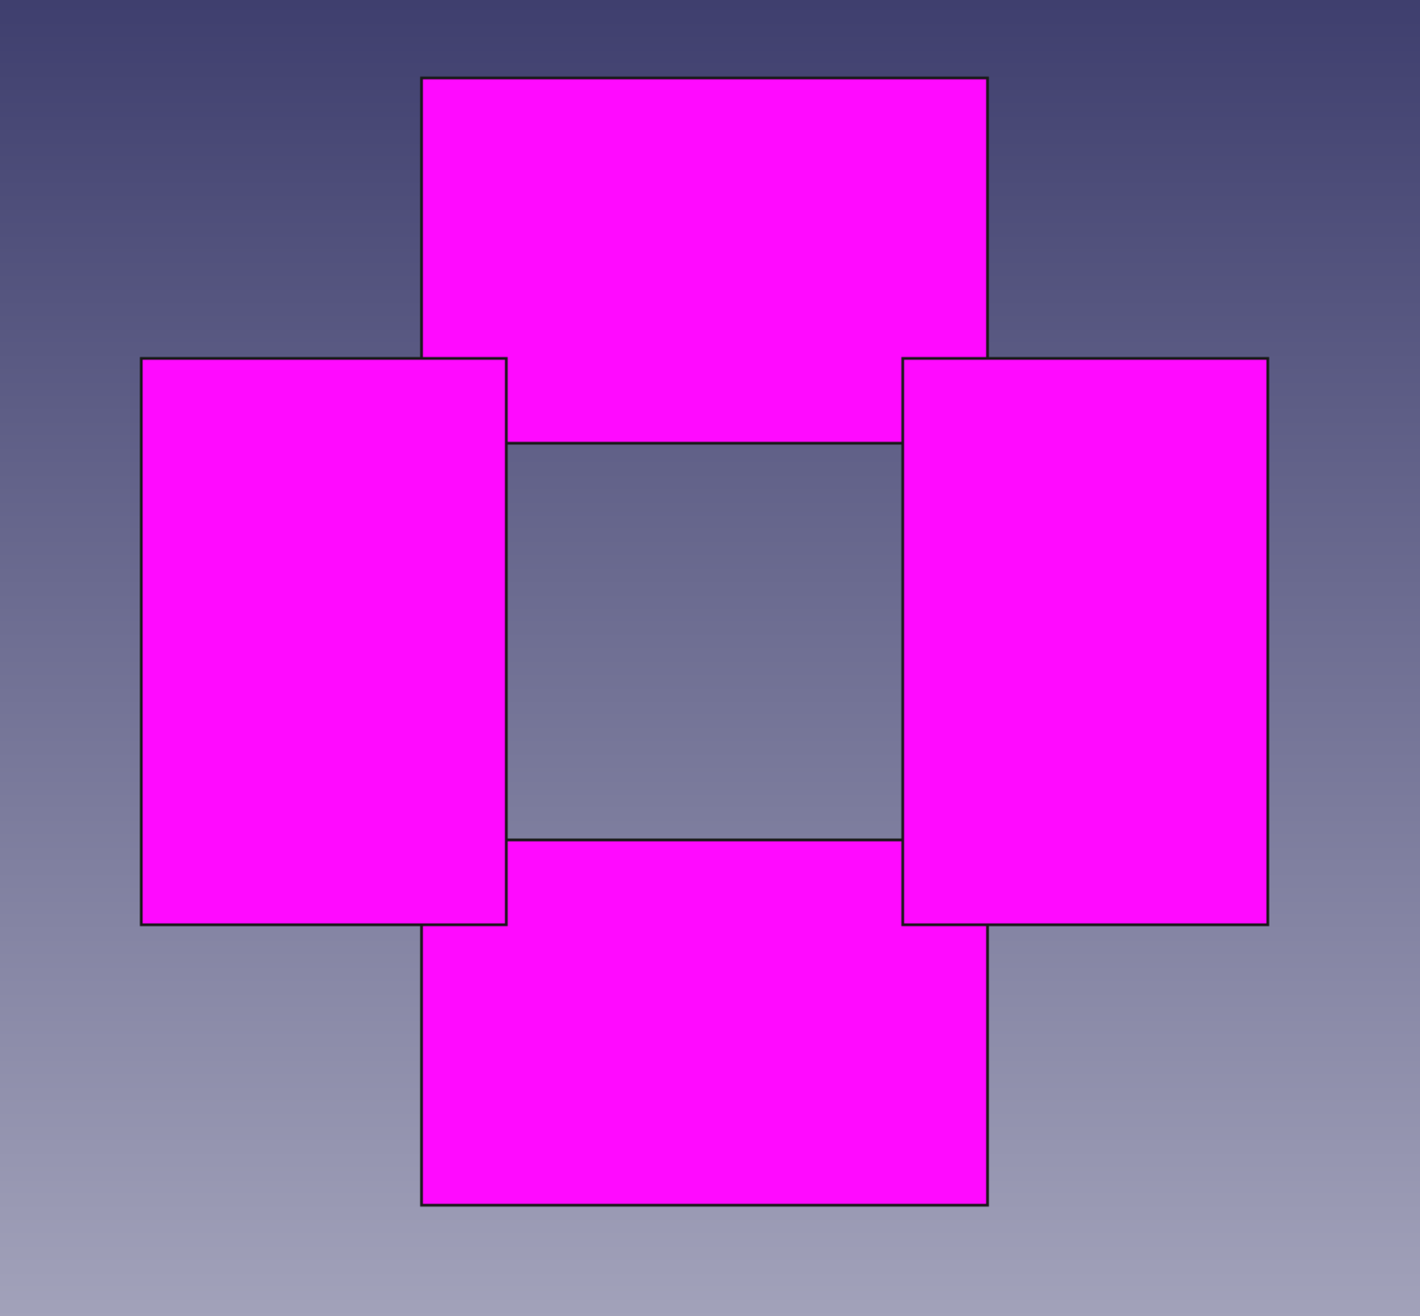
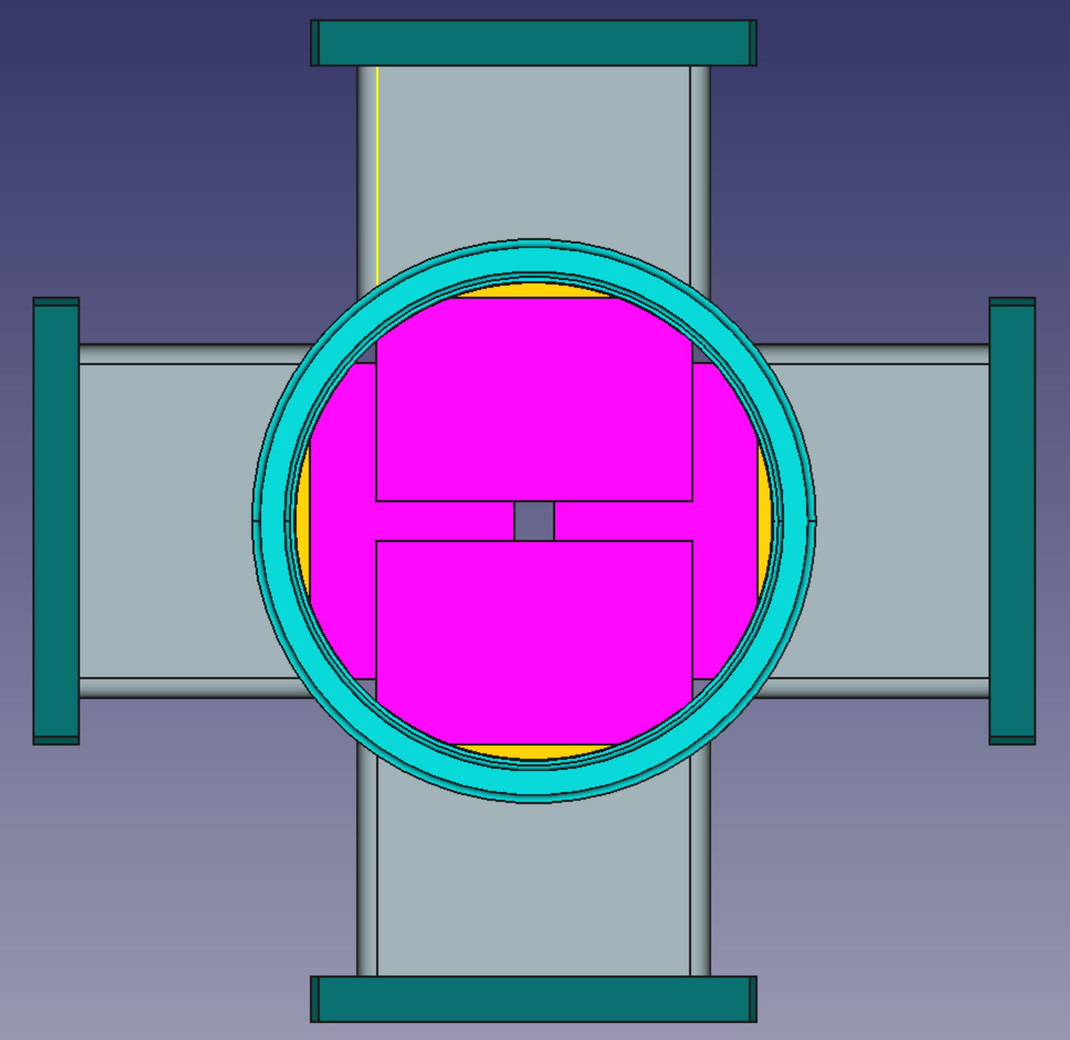
Scintillator Detector
The front face of the scintillator is 31.3 cm from the center of the target.
Dimensions of scintillators are 65mm X 100mm X 5mm, size of hole are 70mm X 70mm for “operation”, 6.4mm X 6.4mm for “calibration”.
Angle acceptance is about 6deg to 10deg for “operation” , and 1.6deg to 10deg for “calibration”.
Detect electrons of e-e scattering at 0.5deg to 0.8deg to separate them with e-p scattering electrons
Operation
Calibration

Slide 3
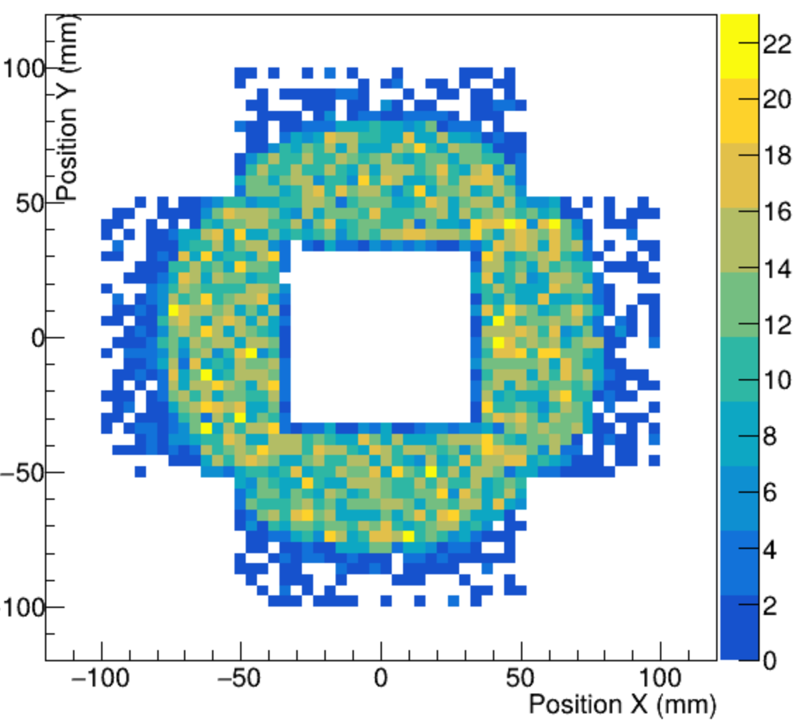
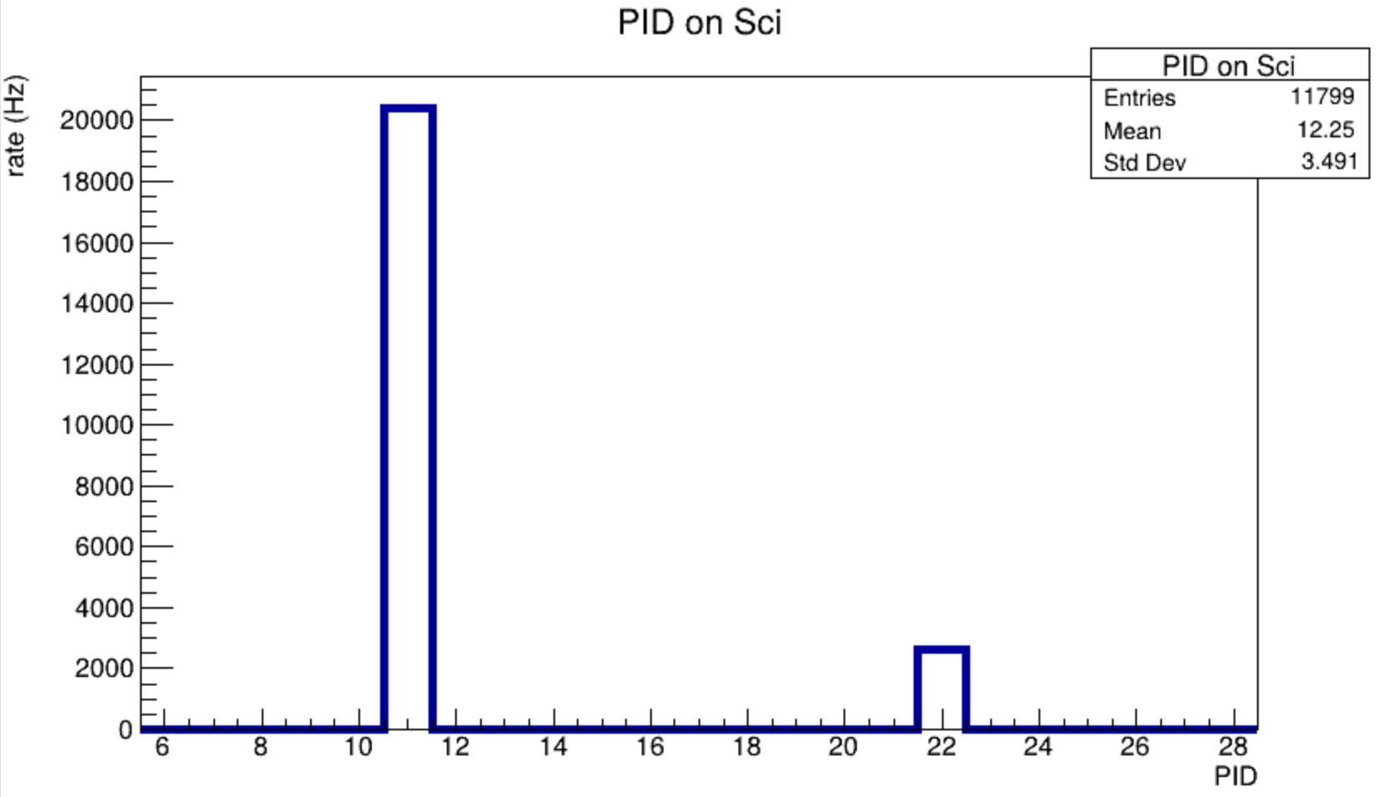
The hit position of all particle hit on the scintillators
Recorded by the virtual detector cling to scintillator planes front surface
The Particle ID on the scintillator and its rates
About 86% electron, 14% photon

Slide 4
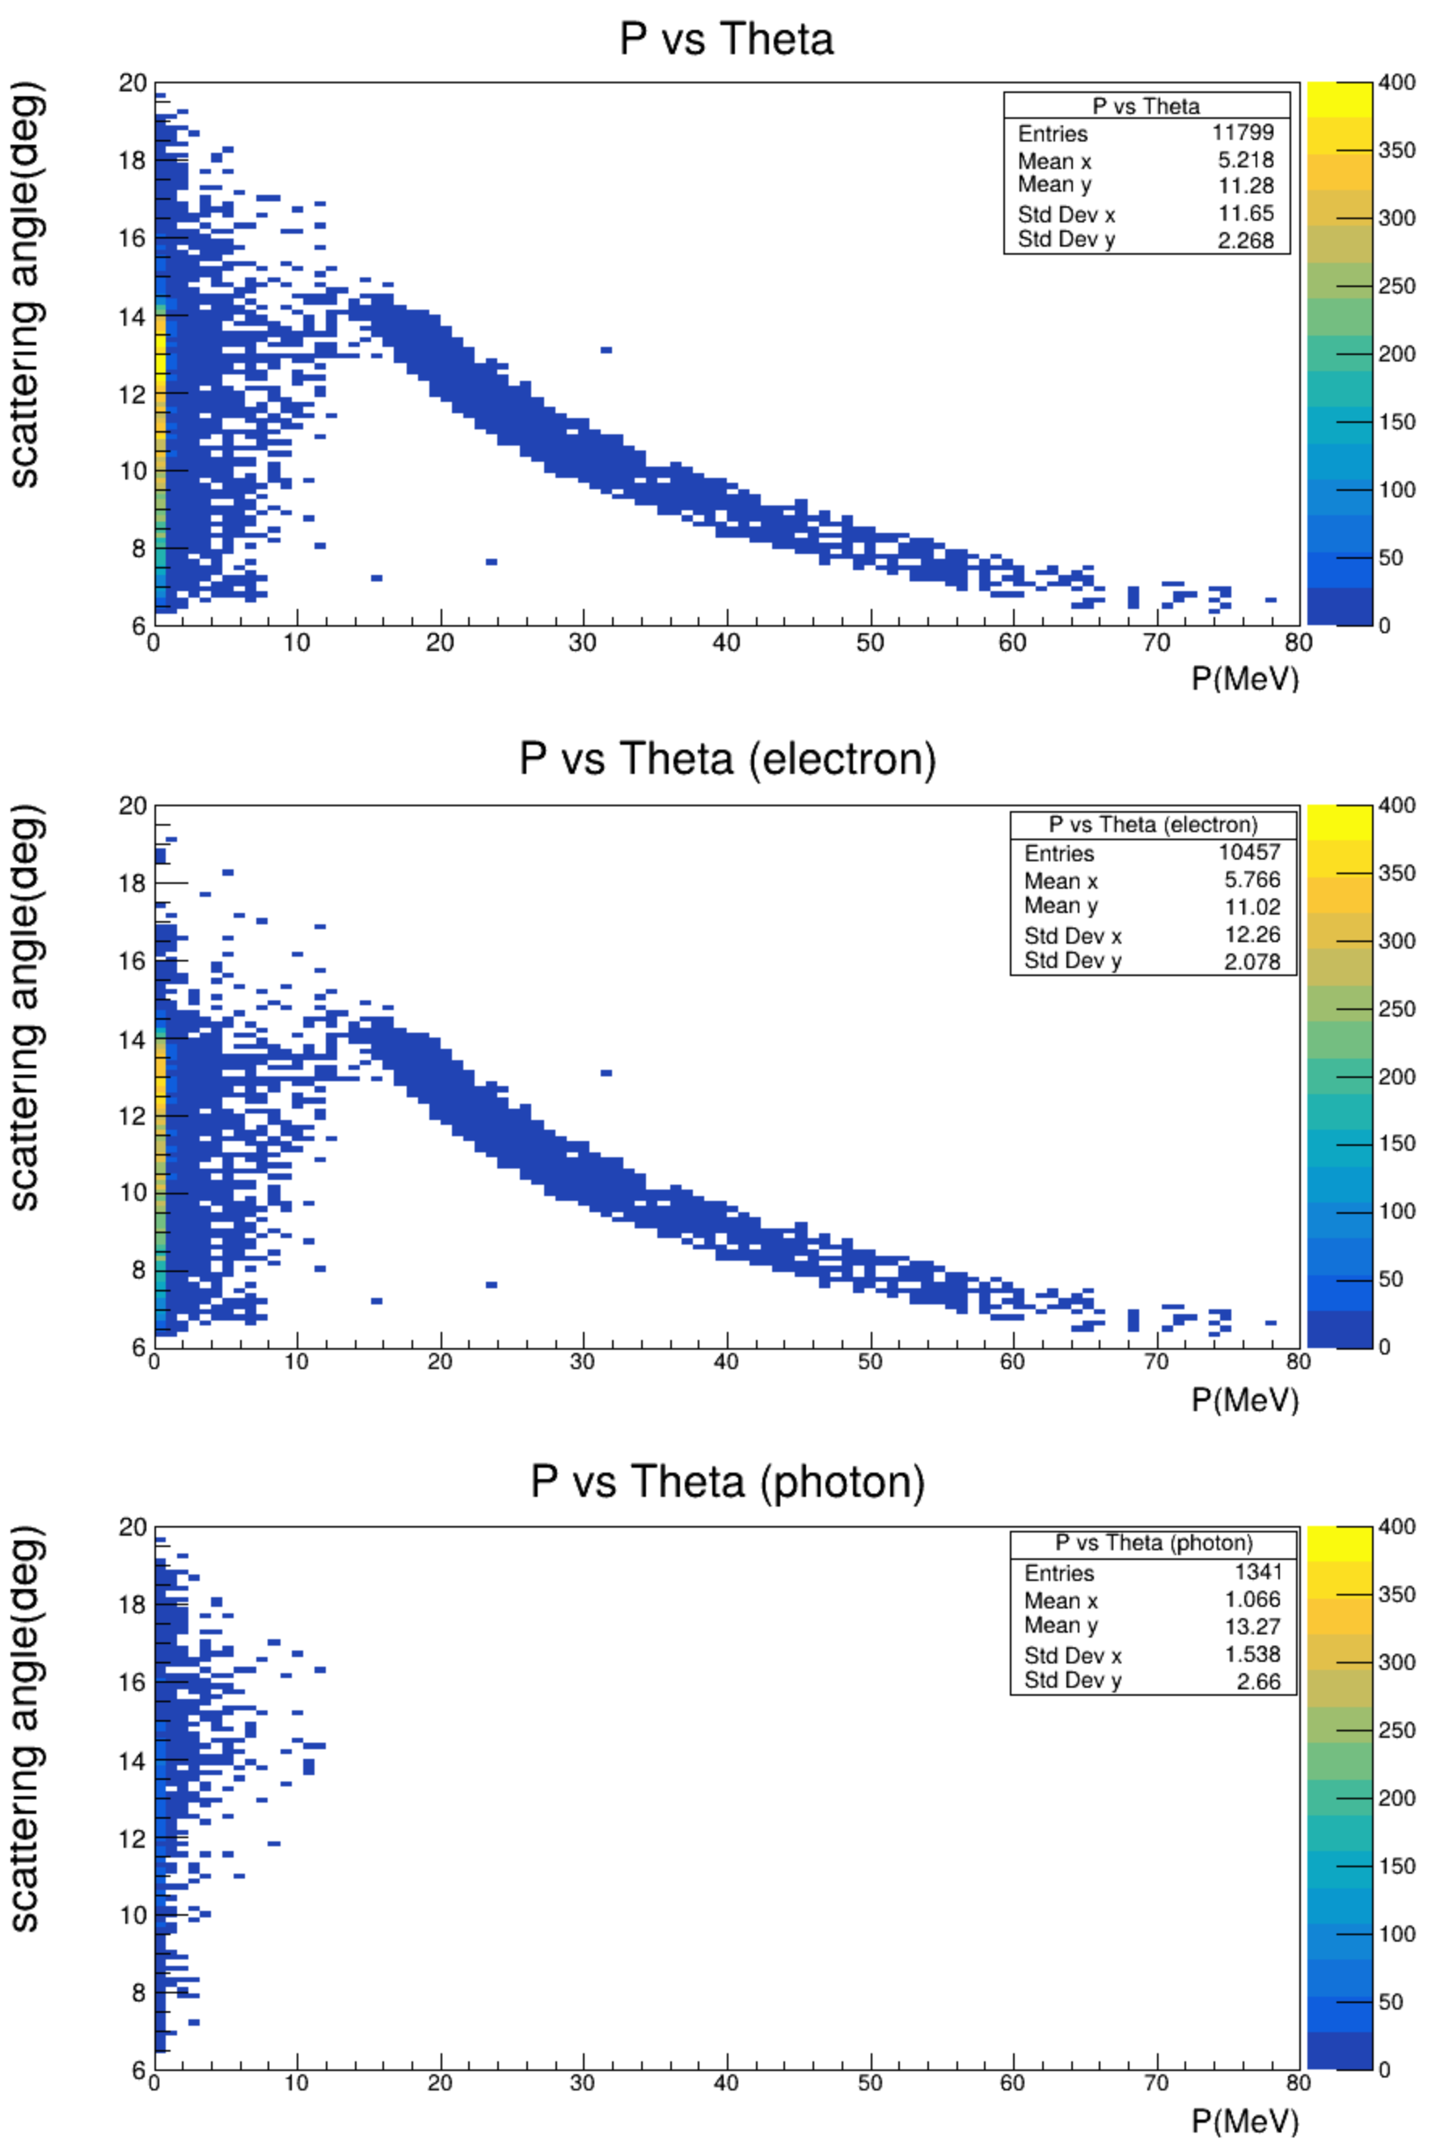
The 2-D hist of momentum vs scattering angle
Recorded by virtual detector tight to scintillator planes.
The first figure is all particle, the second and the third is only electron and only photon respectively
We can clearly see the e-e signal, but also a lot of low energy electrons background

Slide 5
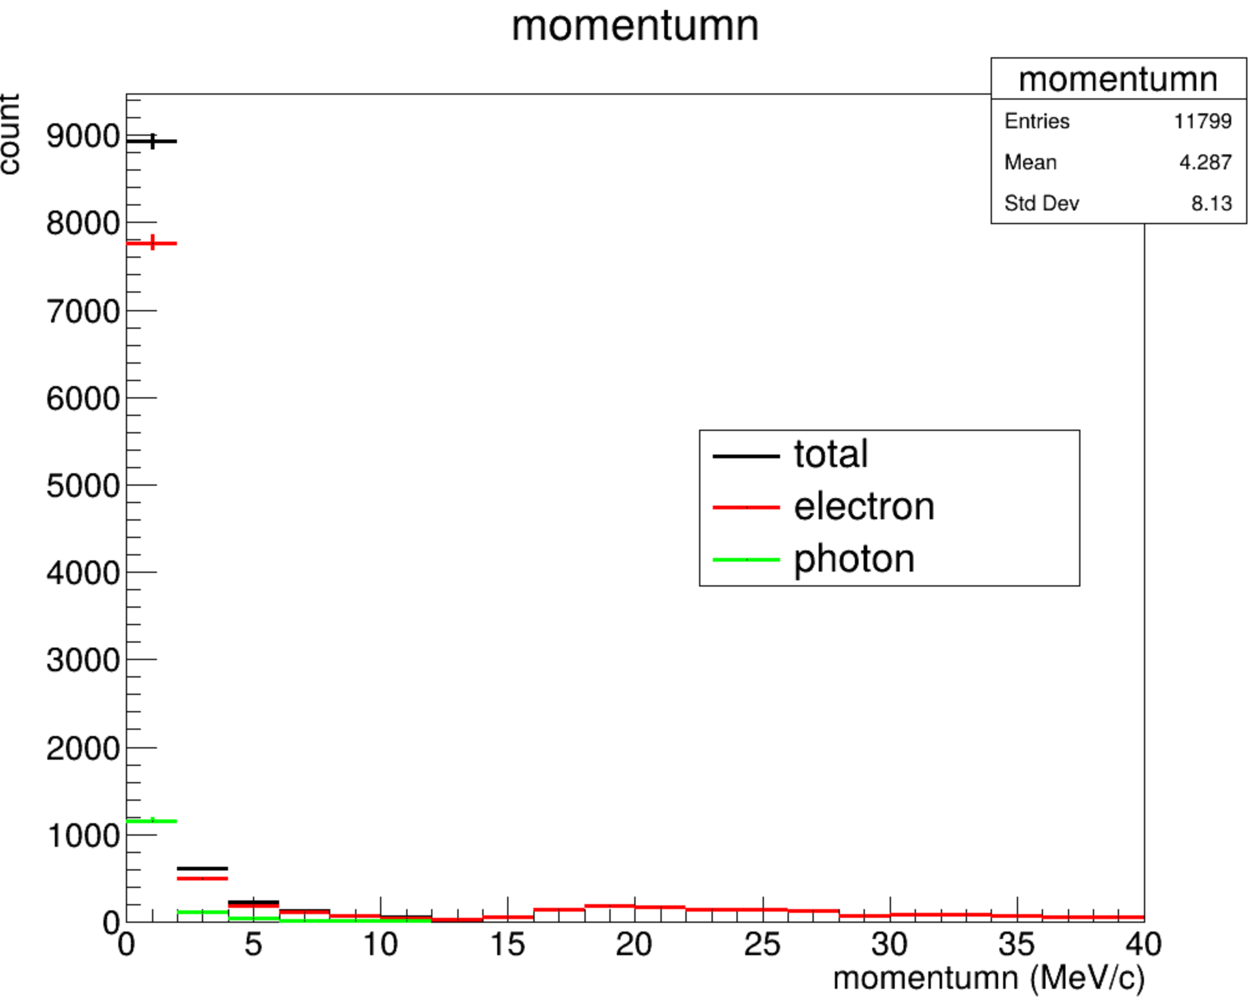
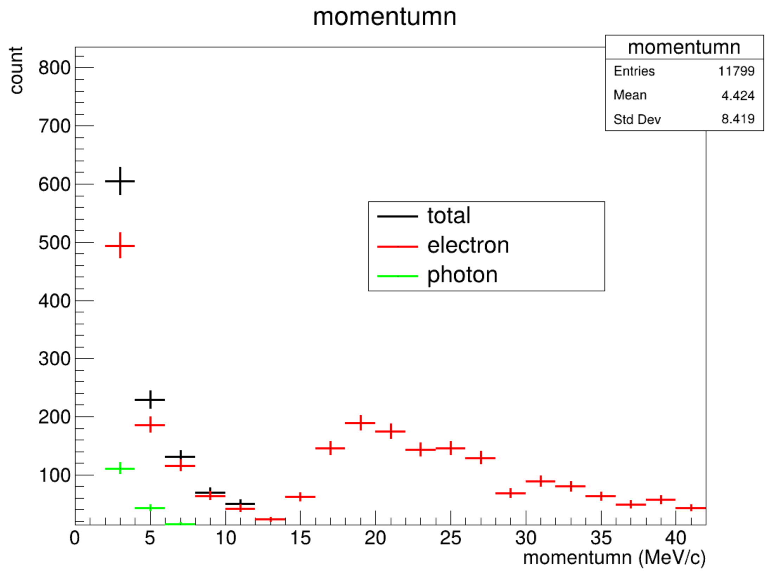
The 1-D hist of the momentum distribution
In the first bin, 0~1MeV, a lot of background
A small e-e scattering peak at about 20 MeV/c .
Same plot removing the first two bins

Slide 6
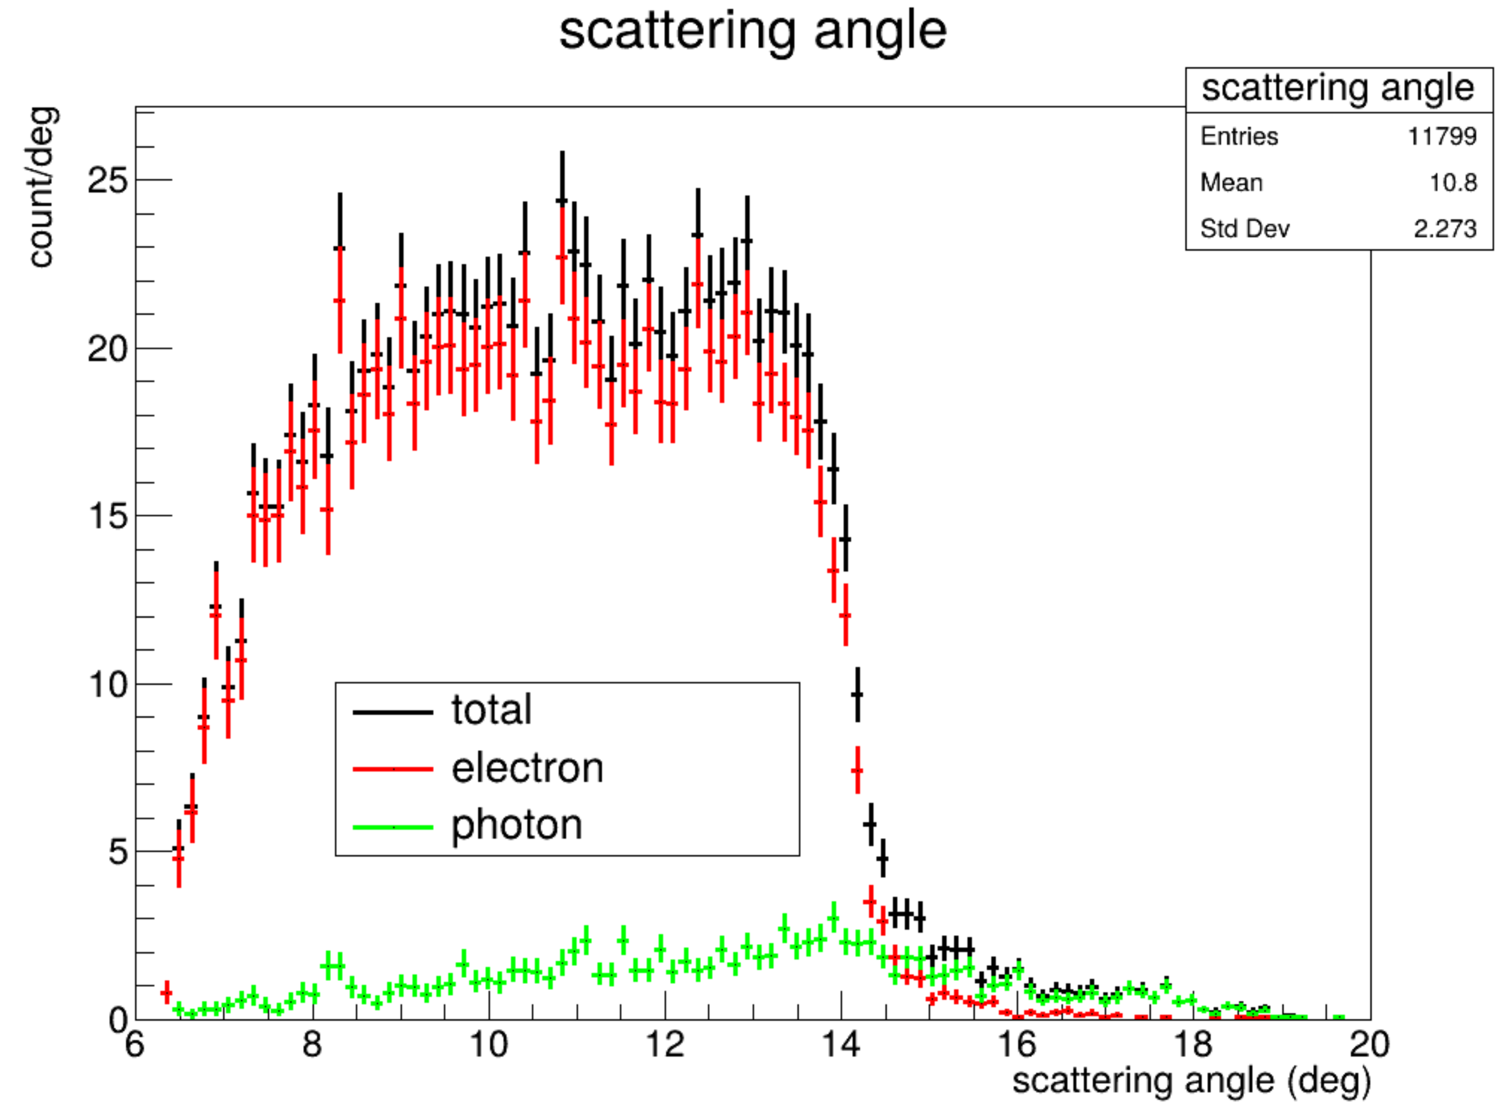
1-D hist of scattering angle distribution on the scintillators

Slide 7
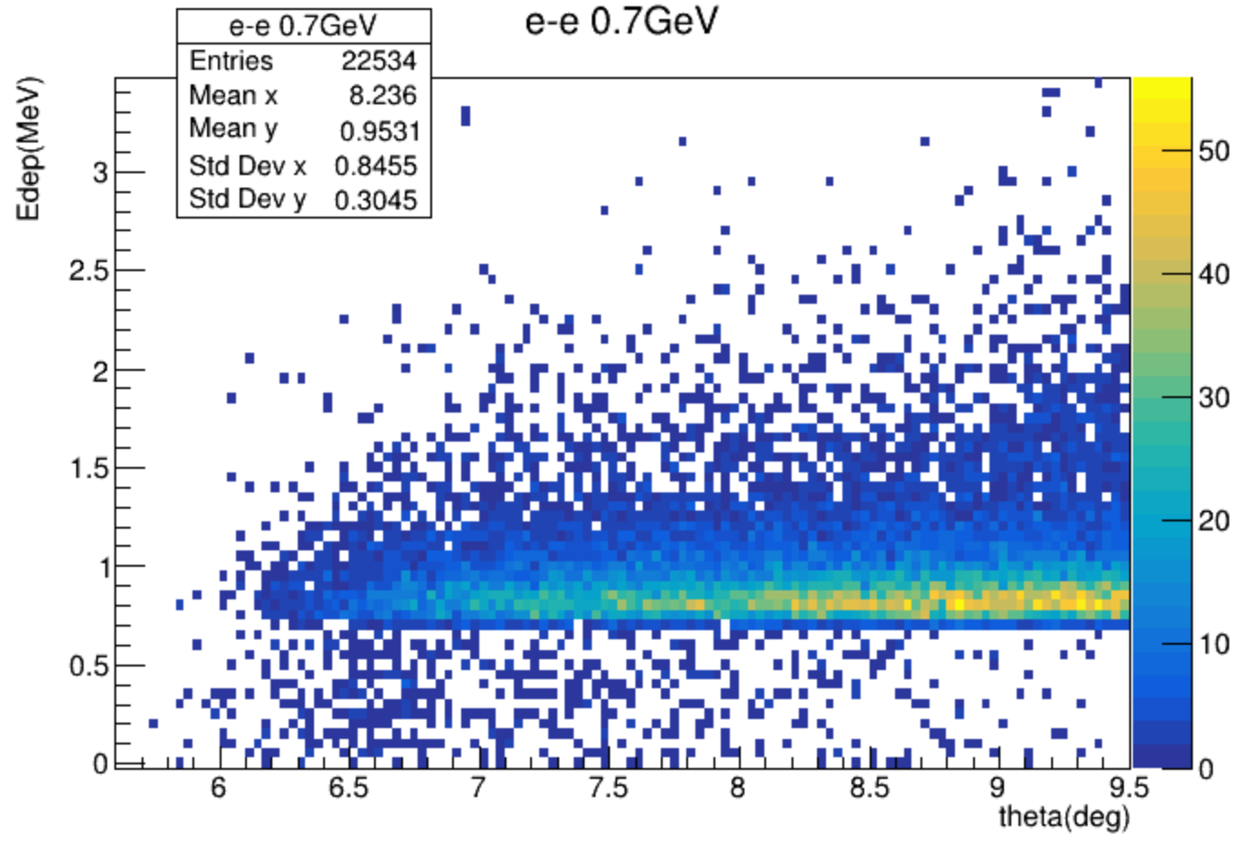
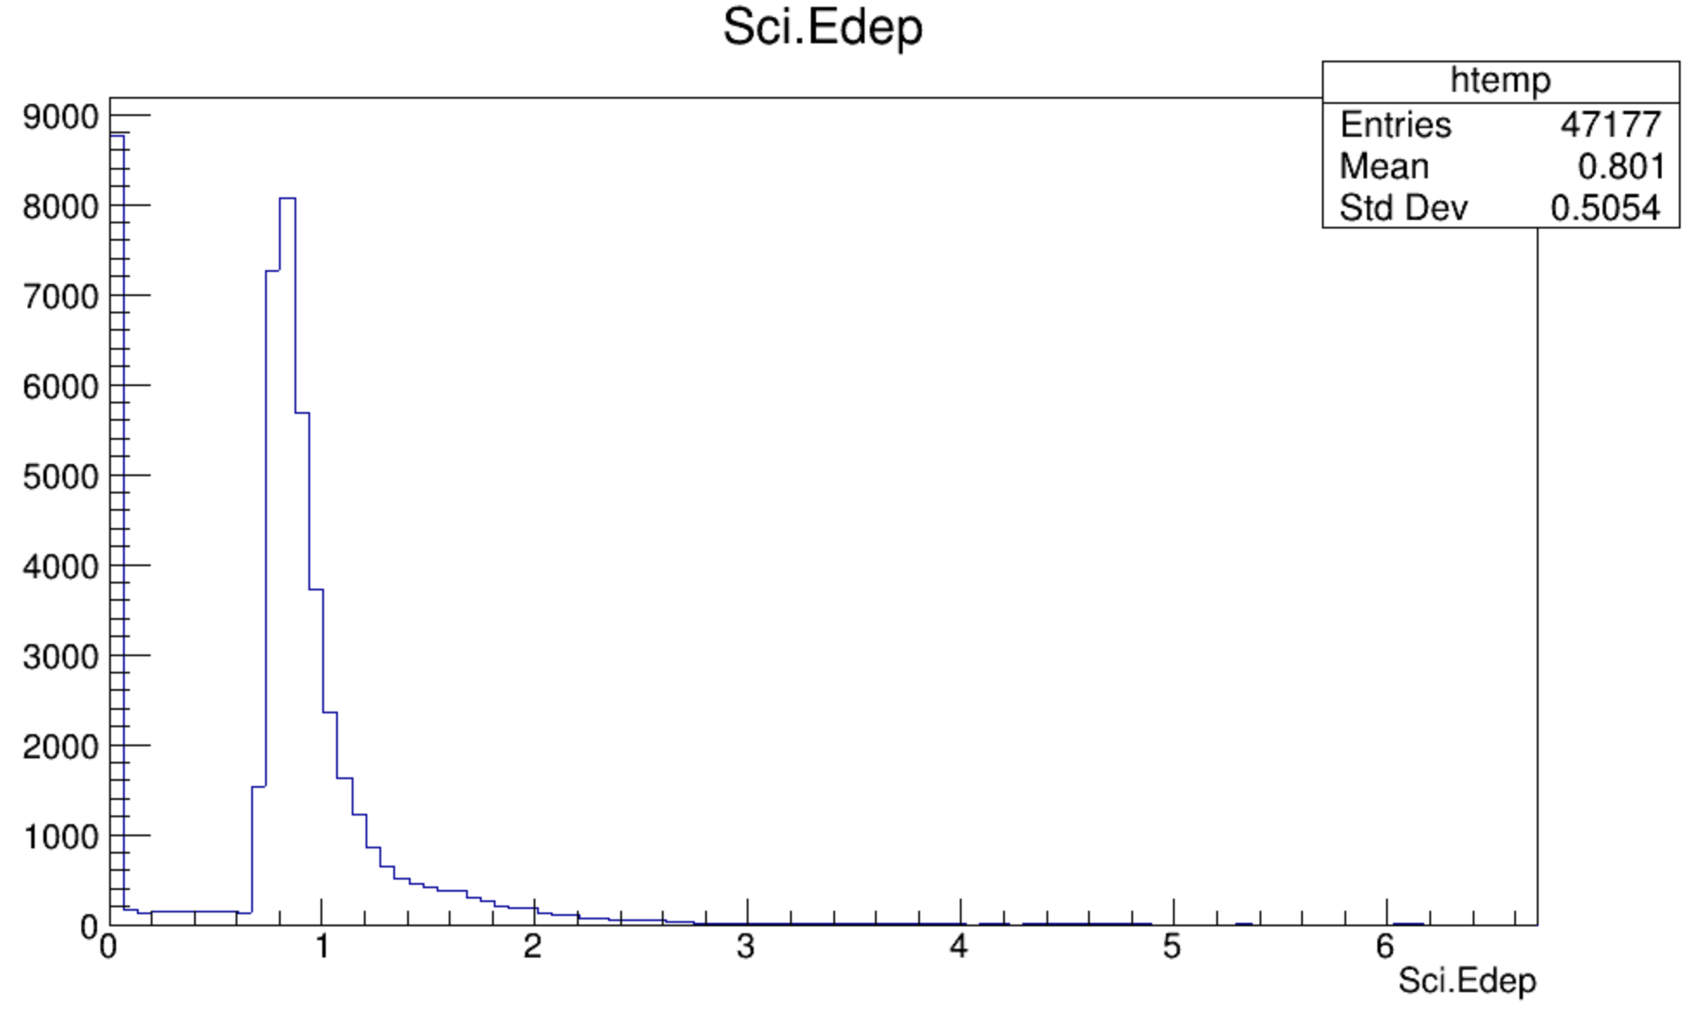
Using Moller generator do simulation, not beam-on-target
The 1-D hist of electron’s energy deposition in scintillator
The 2-D hist of electron’s energy deposition VS scattering angle(select the electrons that Track ID == 1, so it does not include the low energy background at Page 4)
count
MeV

Slide 8
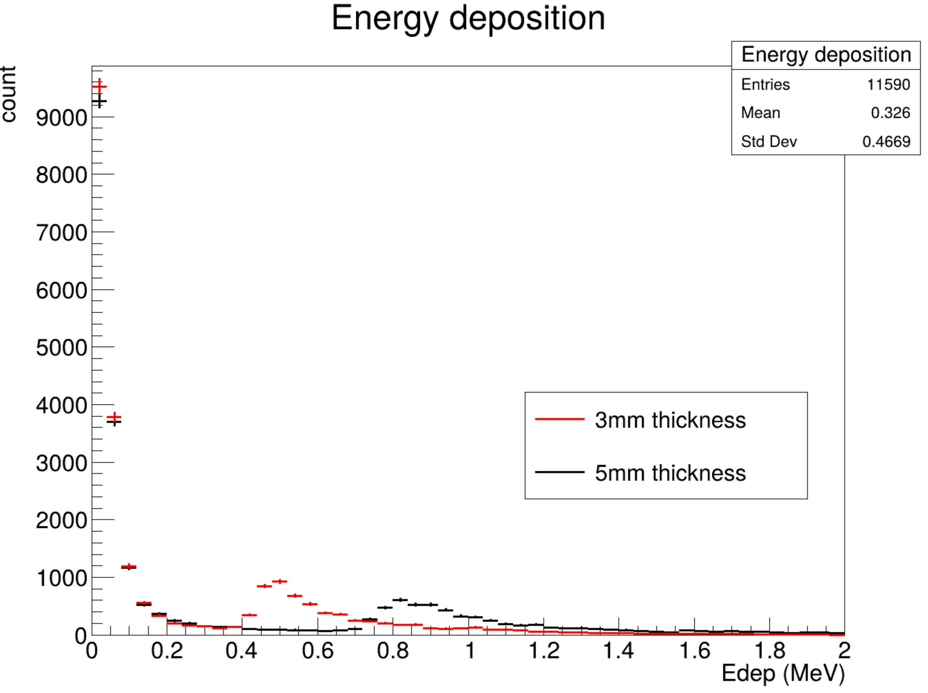
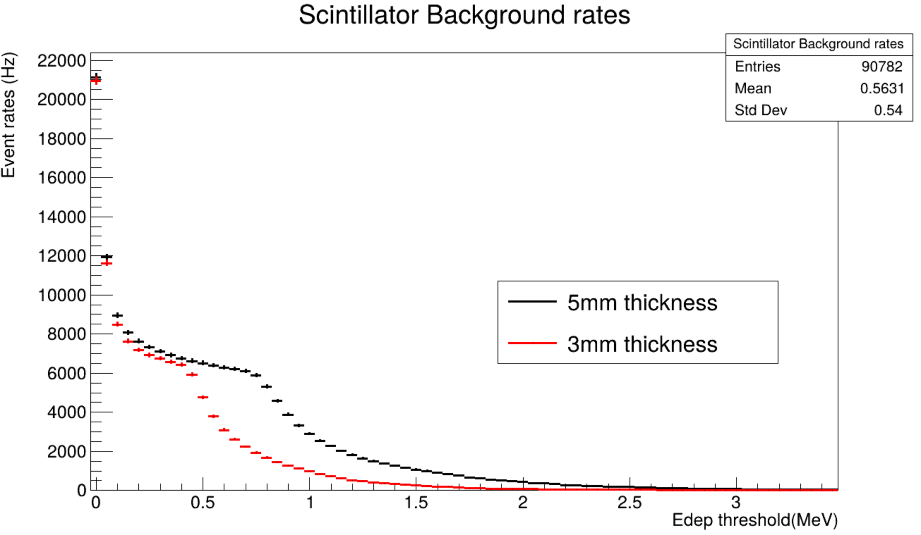
The total energy deposition of all particle in scintillator every event
3mm and 5mm thickness of scintillator
The peak of 3mm thickness is at the left of the 5mm thickness peak
The event rates of scintillator
Adding a energy cut on total Edep
Event rates of 3mm and 5mm VS the cut threshold
The first bin is no cut, all events that hit on scintillator

Slide 9
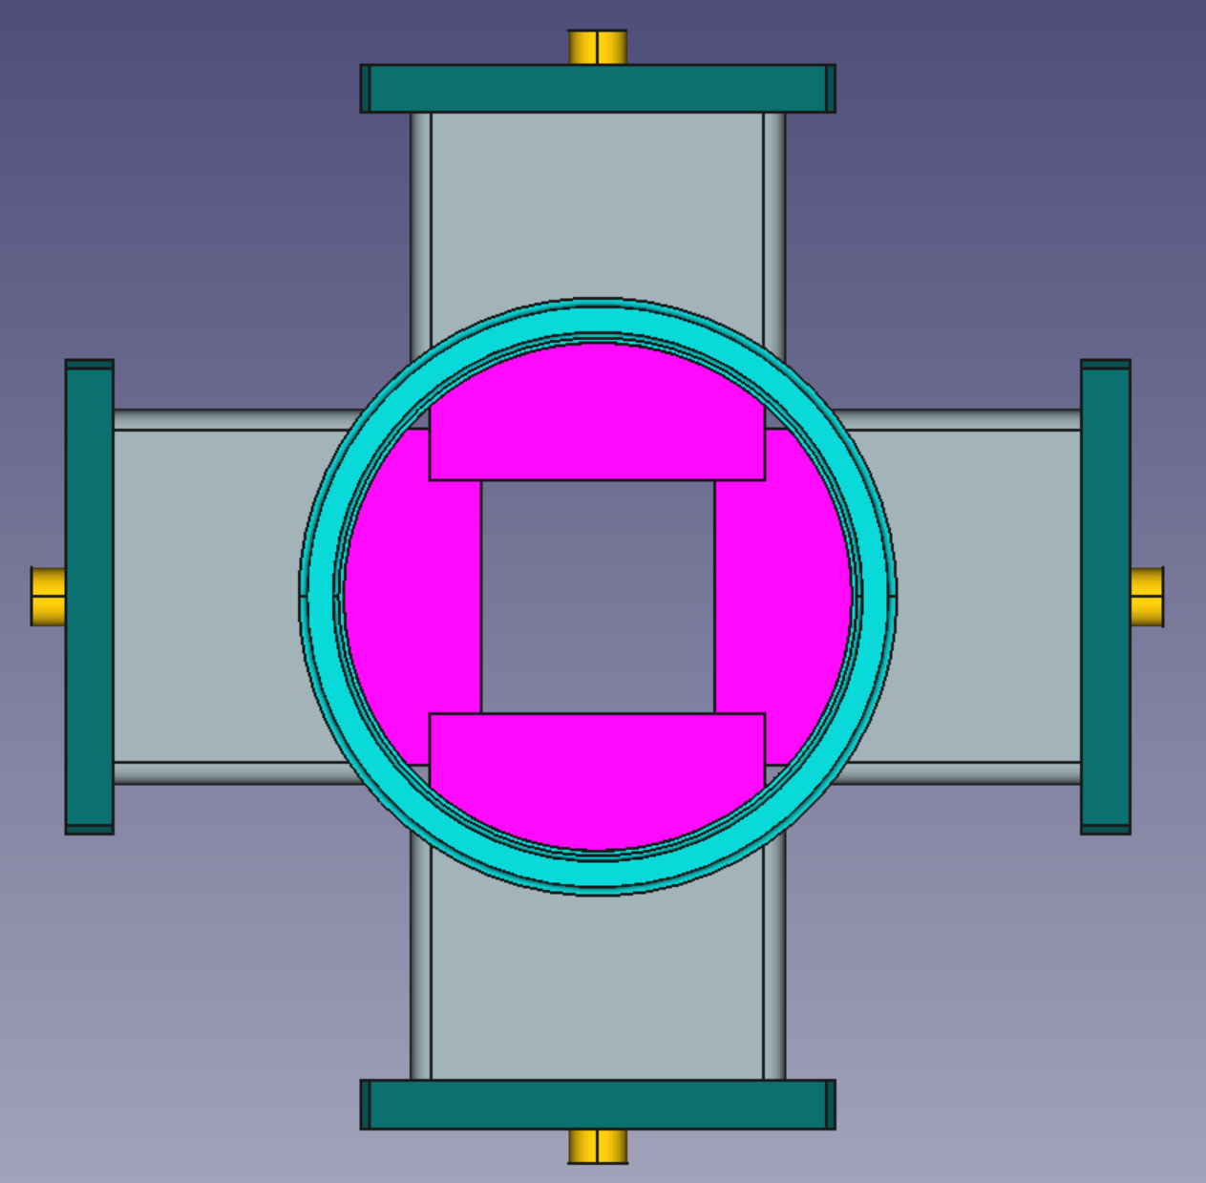
This simulation is using the version of calibration, beam energy 700MeV
See the events on the virtual detector tight to the 1st GEM
The particles on the virtual detector including photon, e-, e+.
Most of them are photon , then e-.
calibration
operation

Slide 10
PRad Ⅱ Experiment Overview
Main updates from PRad:
Use three beam energy, 0.7GeV, 2.2GeV, 3.5GeV
Extreme lowest forward angles 0.5°
Unprecedented low $Q^{2}$ (~${10}^{−5} {GeV}^{2}$)
Two GEM chamber
A new scintillator detector
New flash-ADC for DAQ
Gas Hydrogen target
Scintillator Detector
GEM
HyCal
Vacuum chamber
About 6 meters

Slide 11
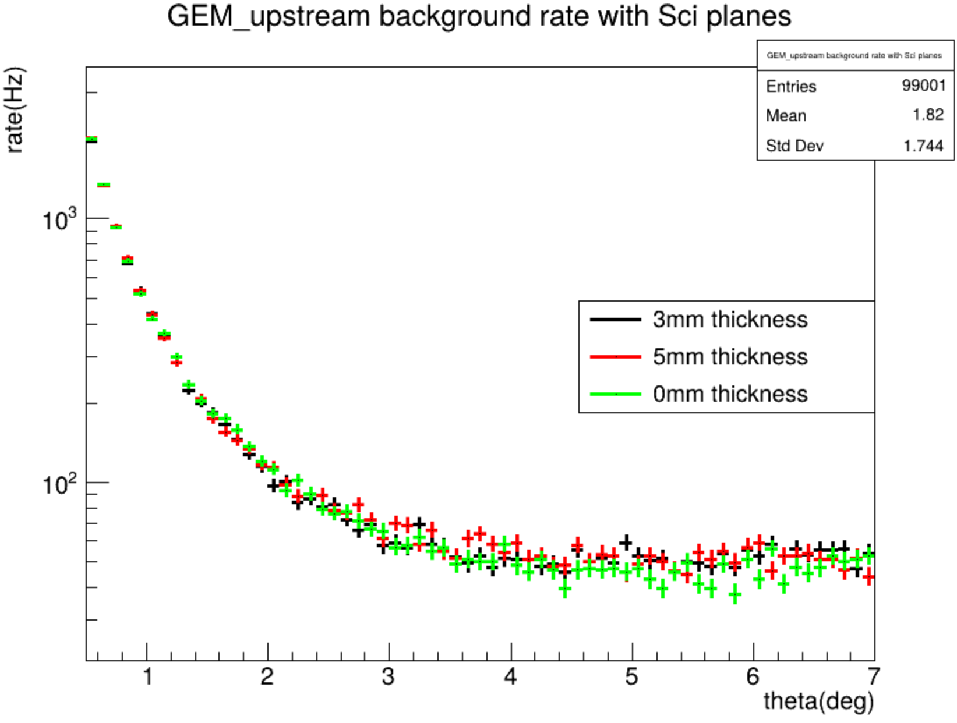
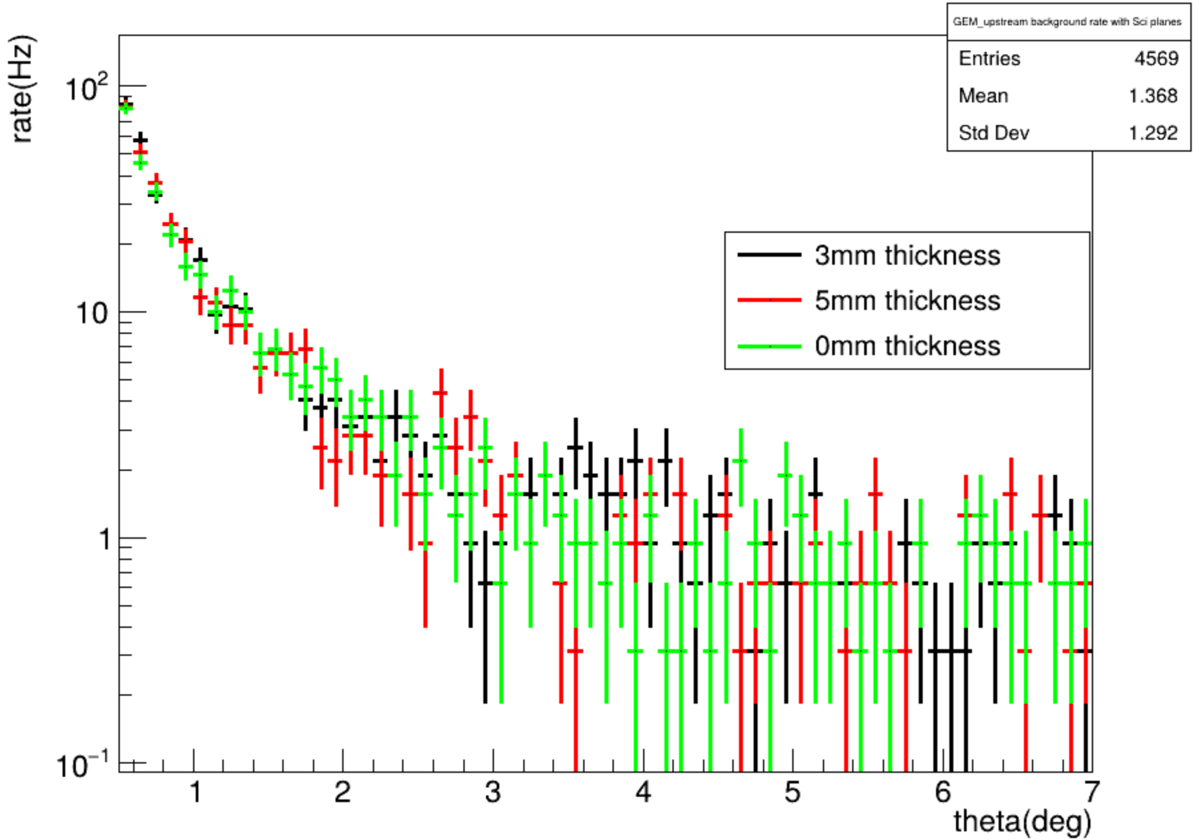
The angle distribution of e- and e+,
We can see that they are almost same
e+
e-

Slide 12
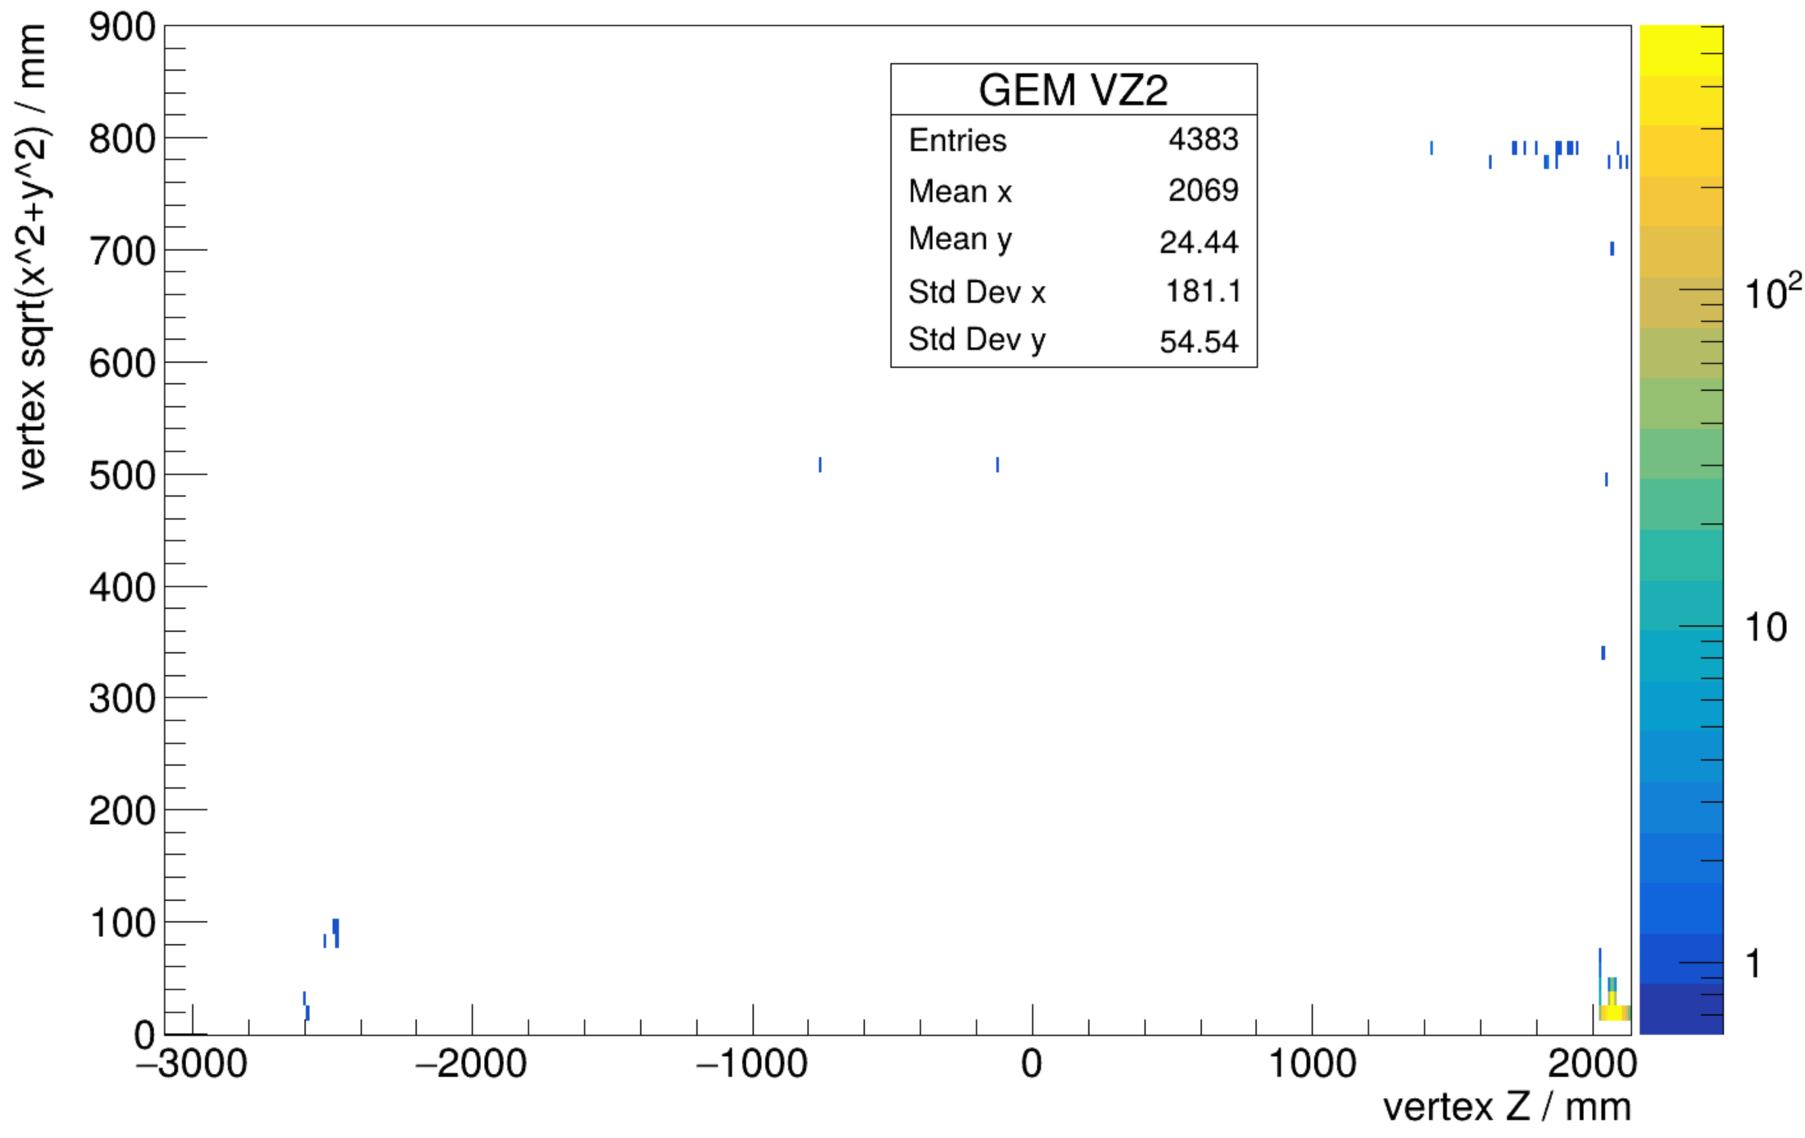
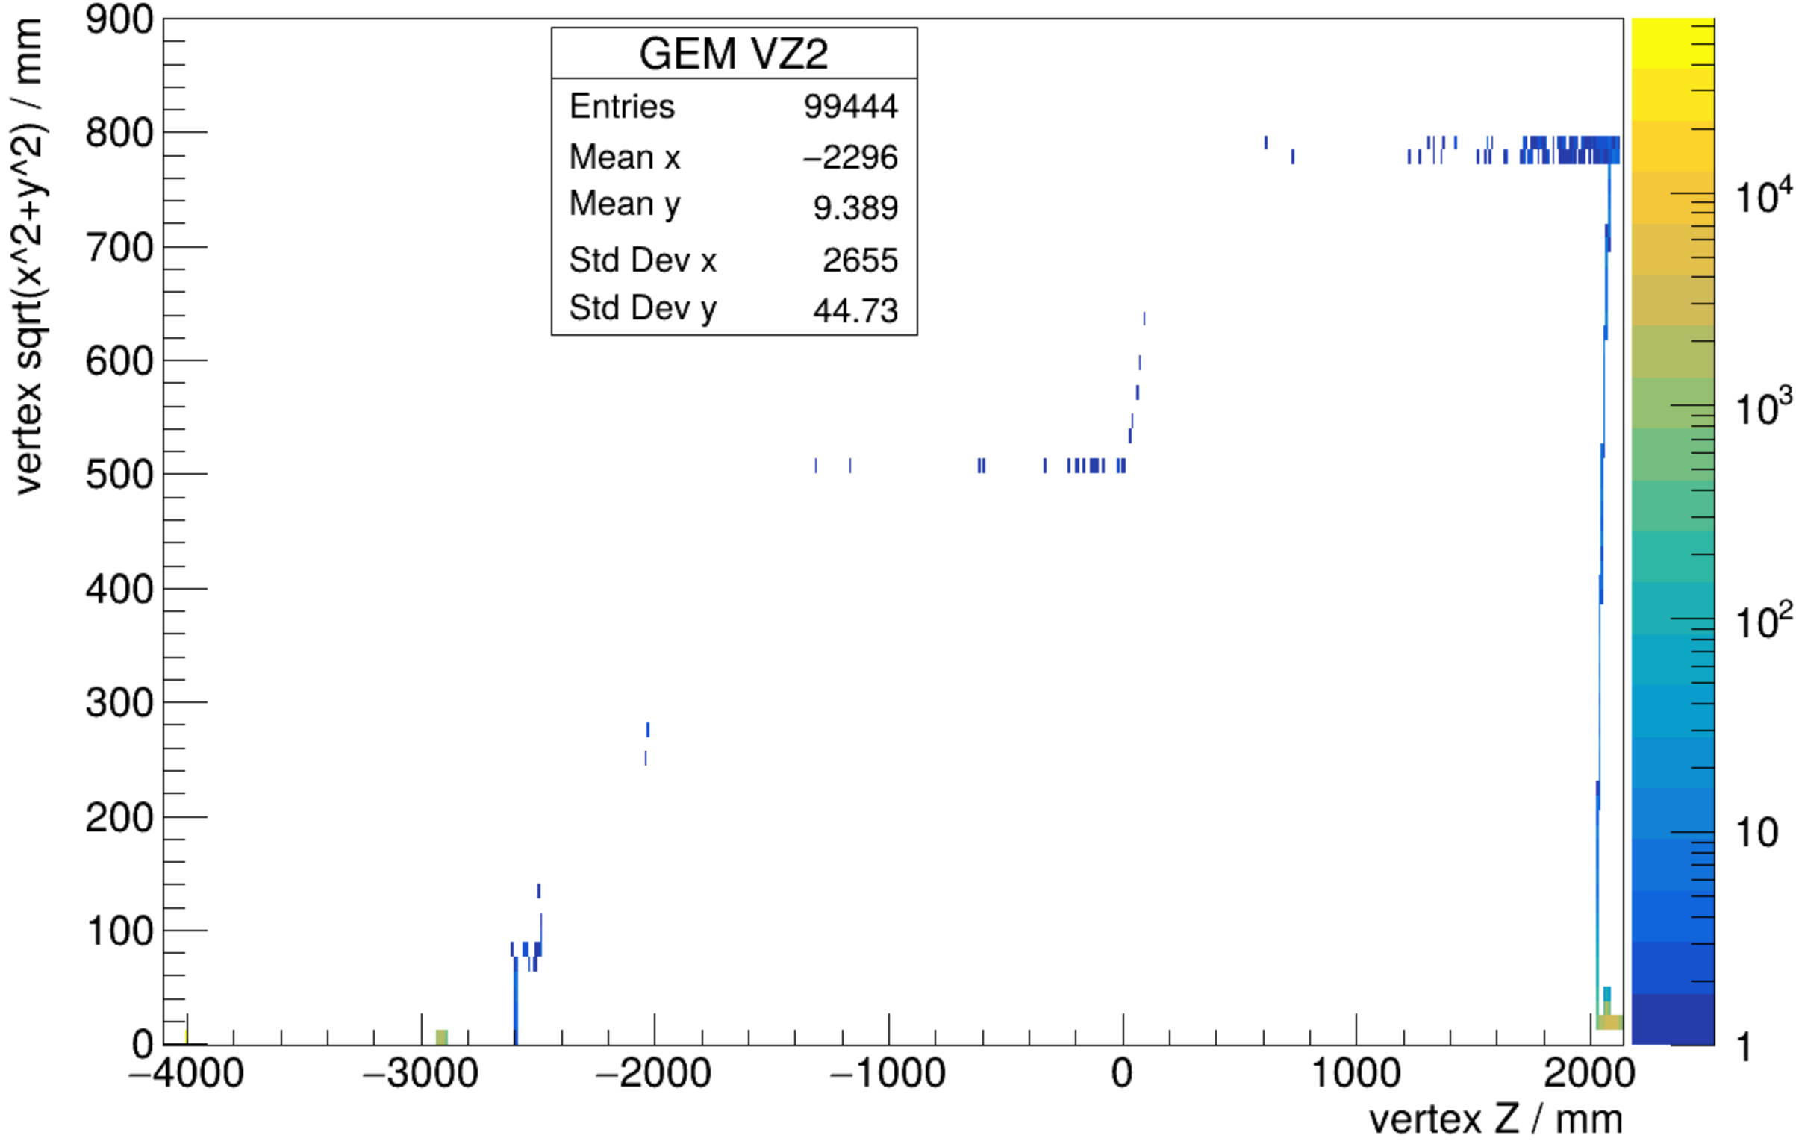
The vertex position of e+ and e-
They are mostly coming from the flange of the beam pipe connecting the vacuum chamber, but not the scintillators.
Vertex of e+
Vertex of e-

Slide 13
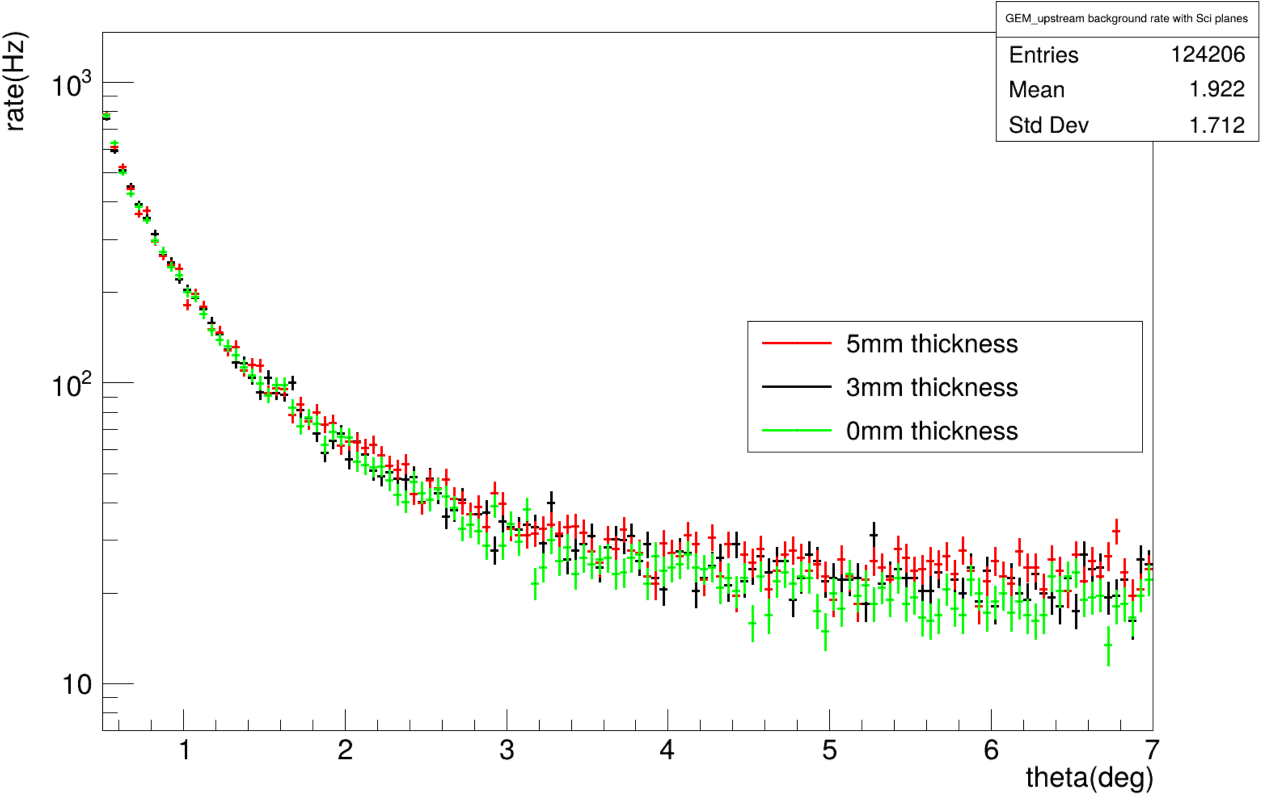
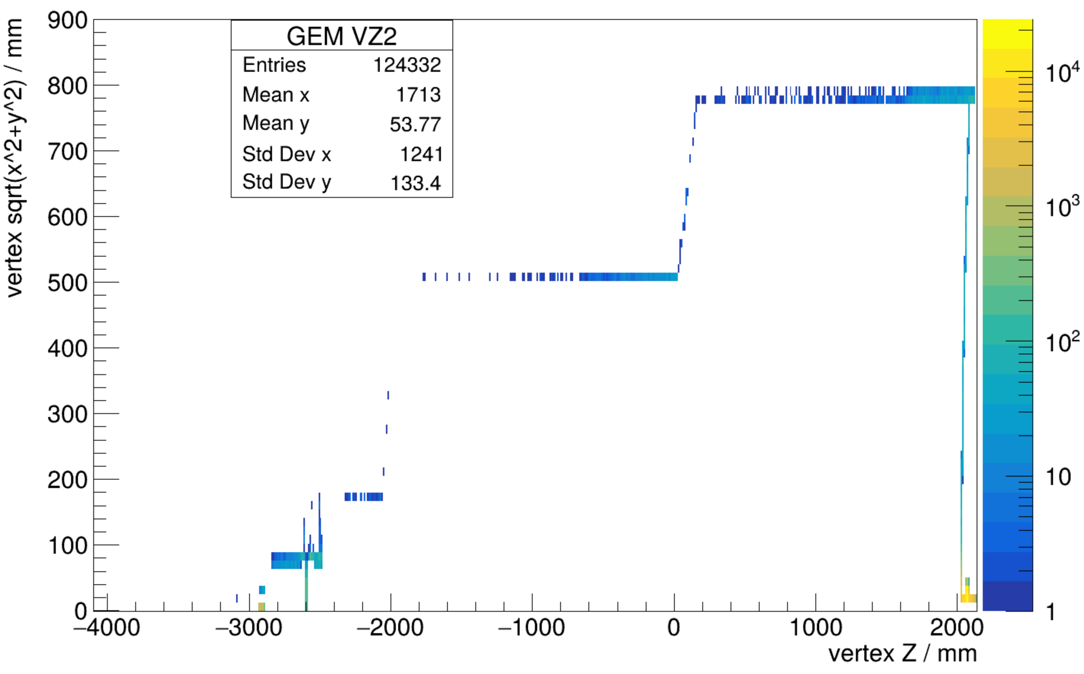
The angle distribution of photons,
5mm and 3mm are slightrly bigger at large angles
The vertex position of photons
photon
Select events from scintillator by vertex Z

Slide 14
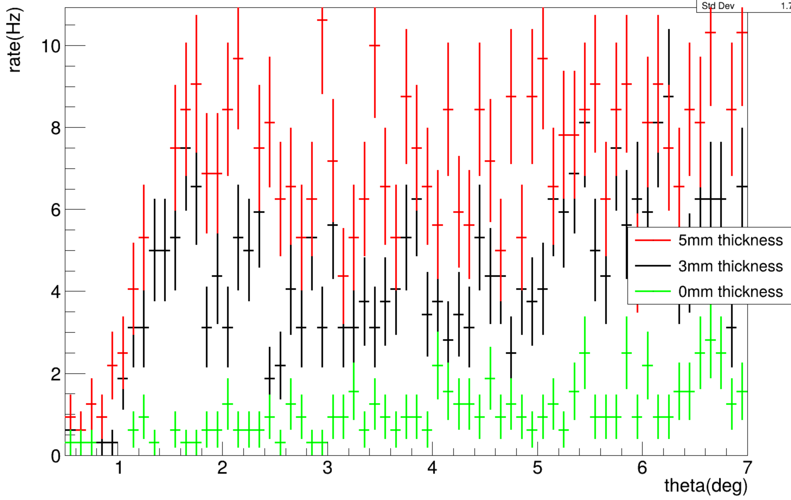
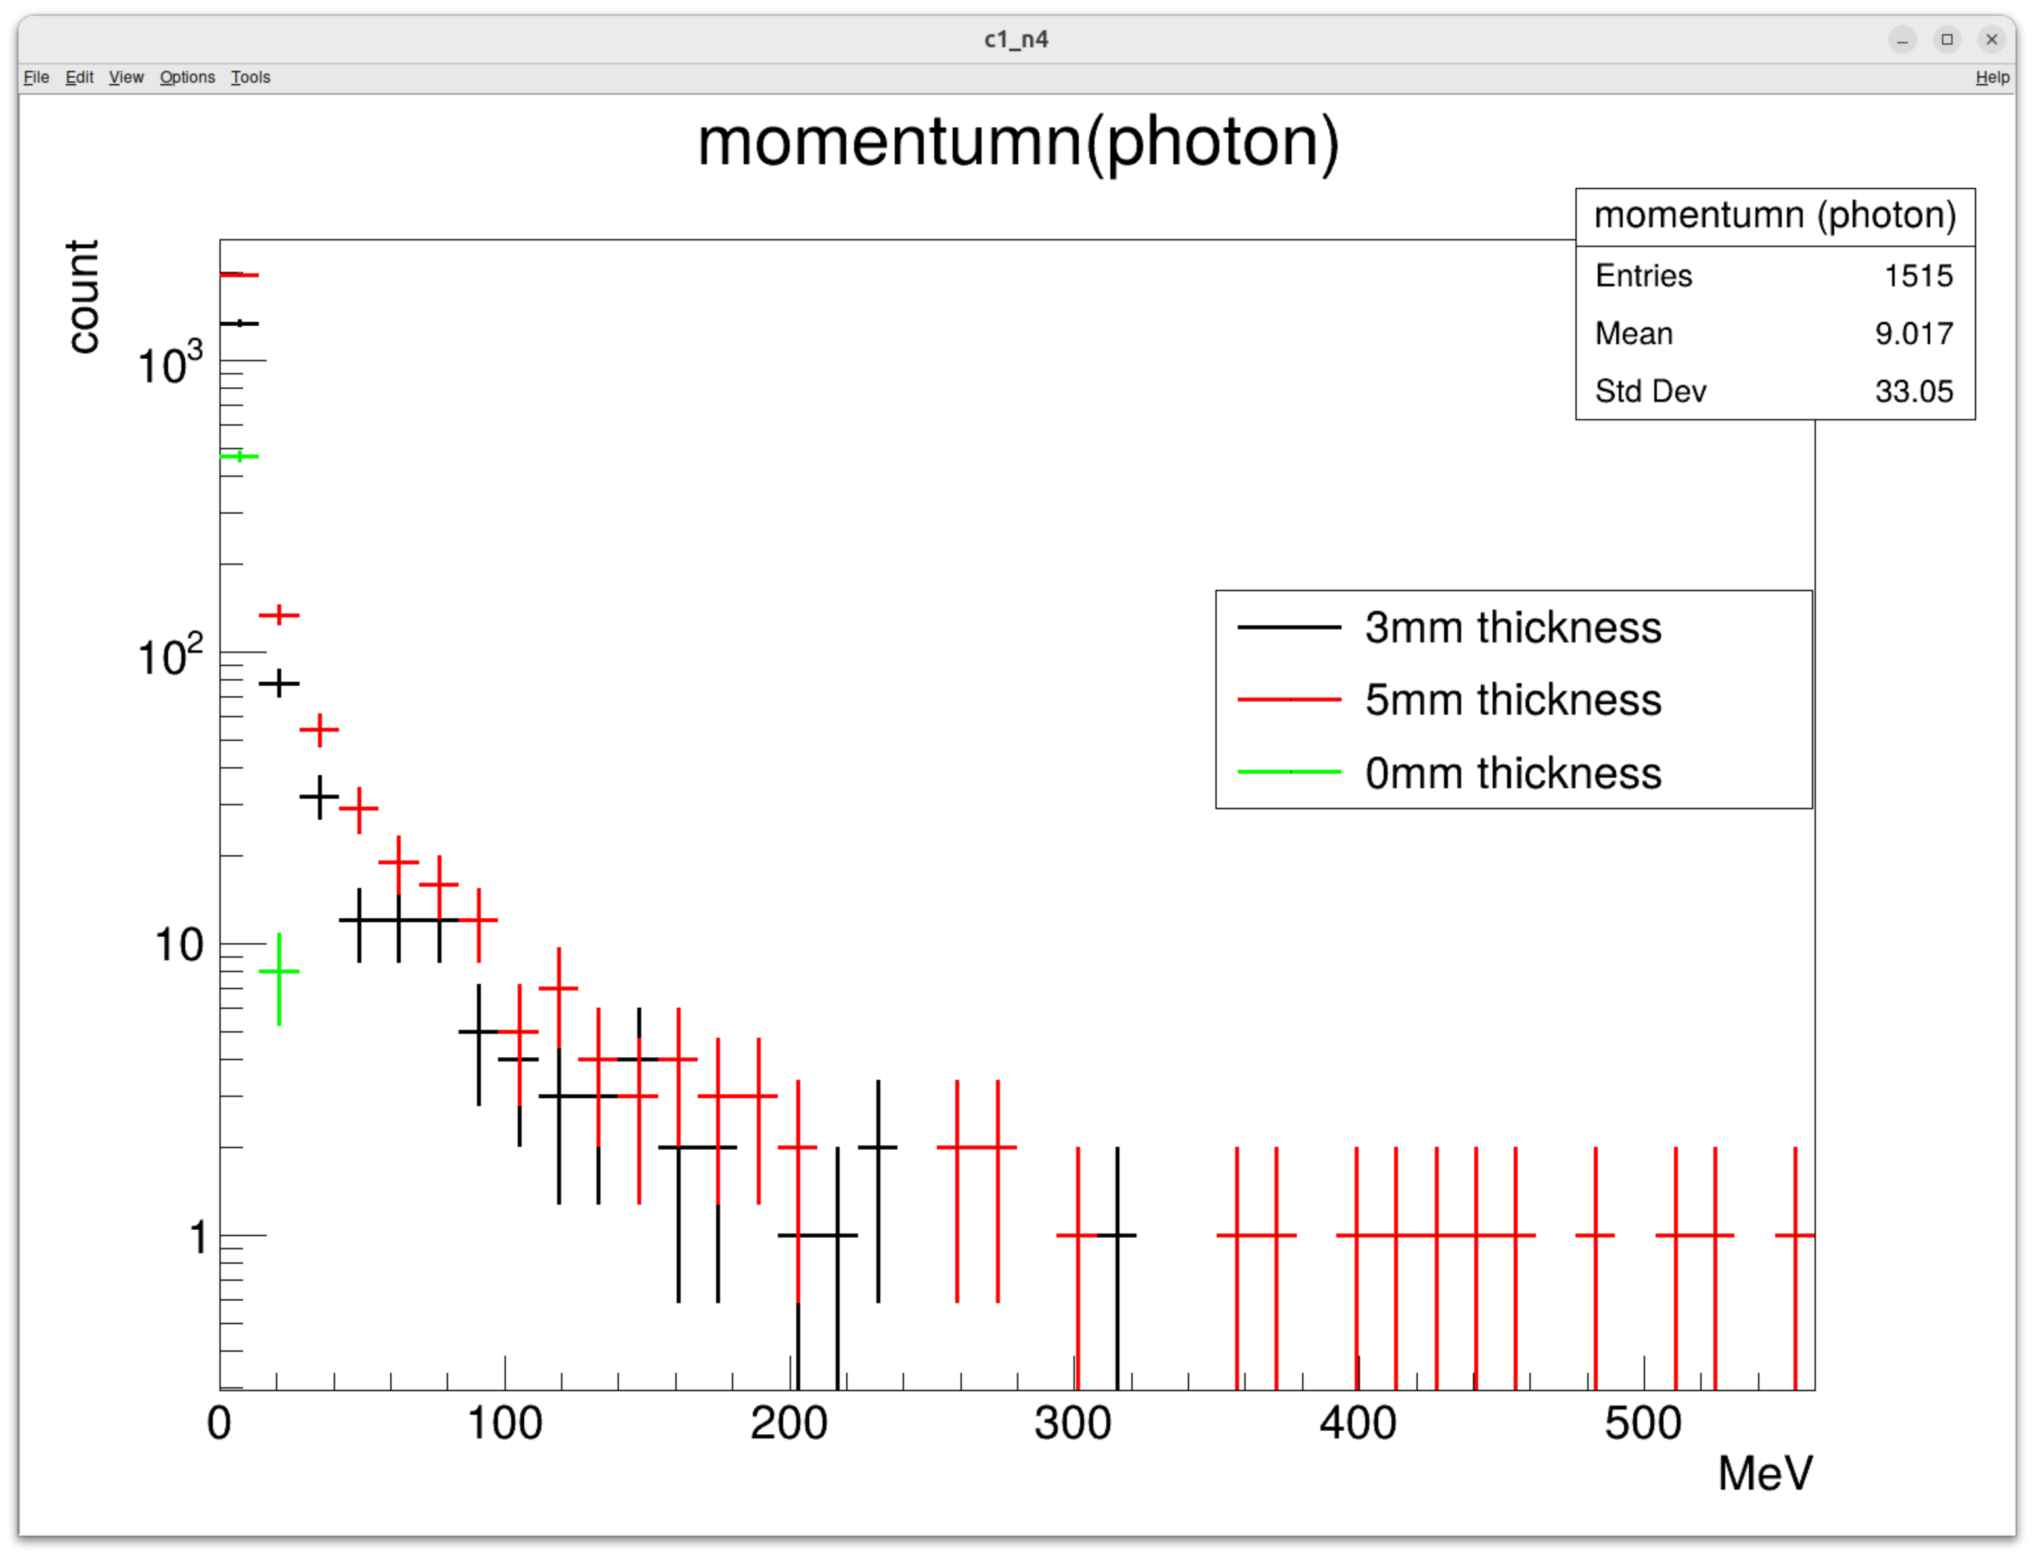
The selected events(photons) that comes from scintillators.
The energy of photons from scintillator are small.
For calibration version.
Angle distribution (left) and energy(right) of selected photons
Beam time 3 seconds

