Slide 1
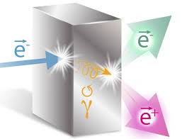
Jefferson Lab Positron Working Group (PWG) Announces JPos17
The International Workshop on Physics with Positrons at Jefferson Lab (JPos17) will be held September 12 – 15, 2017 at Jefferson Lab, Newport News, Virginia.
This workshop will explore the physics potential offered by a polarized positron beam in the context of CEBAF 12 GeV, a Positron-Ion Collider, and Low-Energy Positron Applications. The workshop proceedings are planned to inform a White Paper for a positron physics program at Jefferson Lab.
JPos17 Topics
John Arrington, Charles Hyde Interference Physics
Yulia Furletova, Wally Melnitchouk Charged Current Physics
Marco Battaglieri, Xiaochao Zheng Tests of the Standard Model
Tony Forest, Farida Selim Low Energy Positron Applications
Joe Grames, Vasiliy Morozov Positron Source and Beam Physics
For more information or to submit and abstract please visit:
https://www.jlab.org/conferences/JPos2017/

