Slide 1
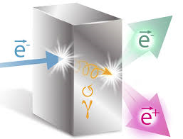
Jefferson Lab Positron Working Group
JLab PWG Announcement – JPos17
The JPos17 International Workshop will be held in Summer/Fall 2017 at Jefferson Lab, Newport News, Virginia. It will cover innovative ideas and experimental projections that can take advantages of the unique positron source PEPPo at Jefferson Lab featuring 100 nA-10µA (CW) polarized positrons
JLab PWG Topics and Subgroups
Joe Grames (grames@jlab.org) & Eric Voutier (voutier@ipno.in2p3.fr)
John Arrington, Charles Hyde - Interference Physics
Yulia Furletova, Wally Melnitchouk - Charged Current Physics
Marco Battaglieri, Xiaochao Zheng - Test of the Standard Model
Tony Forest, Farida Selim - Positron Applications
Joe Grames, Vasiliy Morozov - Positron Source and Beam Physics
http://wiki.jlab.org/pwg pwg@jlab.org

