Slide 1
Tritium Weekly meeting Nov/28/2016
Dien Nguyen
Hall A coordinators system
Offset from detector misspoint, beam, and target
Bulleyes scan for beam convention
Angle and vertex calibration Gmp optics data Oct, 2016

Slide 2
1.1 Hall Coordinators system: (HCS)
Xlab
Ylab:
X: positive : Left
X: negative : right
Y: positive: up
Y: negative: Down
Beam
Zlab
Z: positive: Downstream
Z: Negative: upstream

Slide 3
1.2 Target coordinators system for Both arms Ideal case
Xlab
Xlab
LHRS
Ztg
Ytg
Ytg
Zlab
Floor marks
HC
Ztg
HC
Zlab
RHRS
LHRS: Convention
Ztg: positive: Downstream
Ztg: negative : Upstream
Ytg: positive: Upstream
Ytg: Negative: Downstream
Xtg: positive: pointing down
RHRS : Convention
Ztg : positive: Downstream
Ztg: negative: upstream
Ytg: positive: Downstream
Ytg: negative: upstream
Xtg: positive: pointing down

Slide 4
2. Offset in Ytg from spectromispoint, beam offset, target offset LHRS
a. Spectromisspoint
b. Beam offset
Xlab
Xlab
ytg
Ytg
Specoff
Floor marks
Floor marks
xbeam
HC
Zlab
HC
Zlab
Ytg
c. Target offset
Offset convention:
Specoff: + : upstream - : downstream
Xbeam: + :Left - : Right (HCS)
Tg_off: + : downstream - : upstream (HCS)
Xlab
Ytg
Ytg
Floor marks
=> Expected value for Ytg :
HC
Zlab
Ytg = - specoff - Tg_off *sin + xbeam* cos
Tg_off

Slide 5
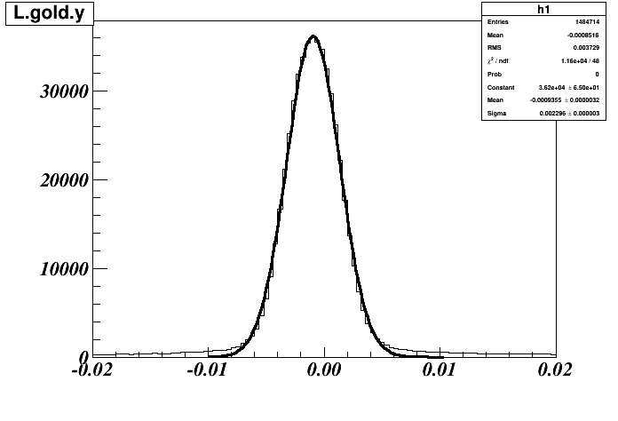
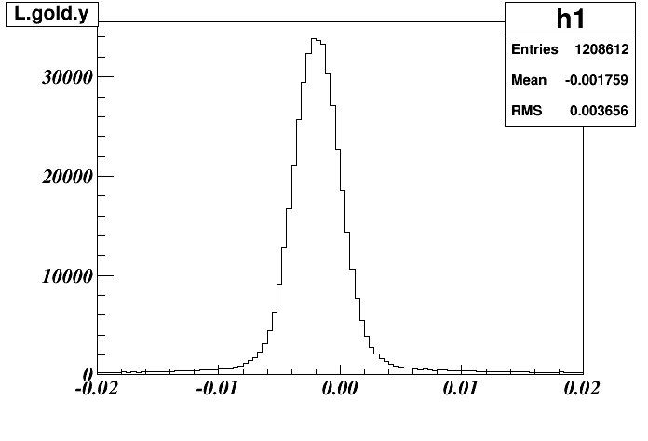
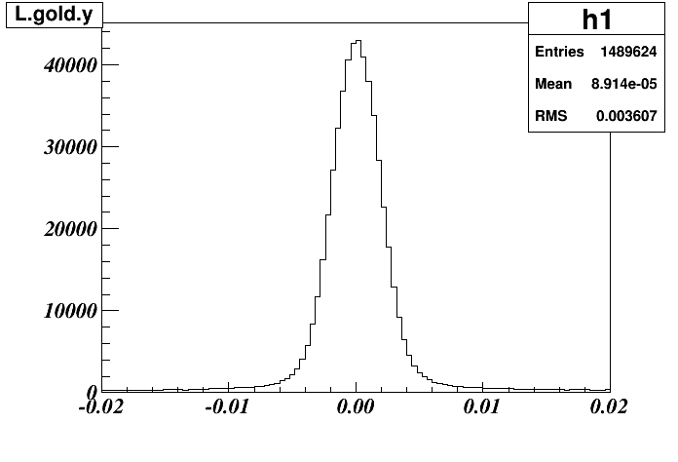
3. Bulleyes Scan for beam convention
Run3882 Nominal beam
BPMA: X = 0.689 mm
BPMB: X = -1.5 mm
Ytg ~ -0.9 mm
Run3880: Xbeam +1mm
BPMA: X = 1.48 mm
BPMB: X = -0.57 mm
Ytg ~ -1.8 mm
Run3881: Xbeam -1mm
BPMA: X = -0.12 mm
BPMB: X = -2.49 mm
Ytg ~ 0
We keep everything the same accept Xbeam changed : if follow hall convention for beam:
Ytg(3880) = Ytg(3882) +Delta_X *cos (theta) here theta = 25
=>Delta_X ~ -1 mm This is opposite to BPM convention

Slide 6
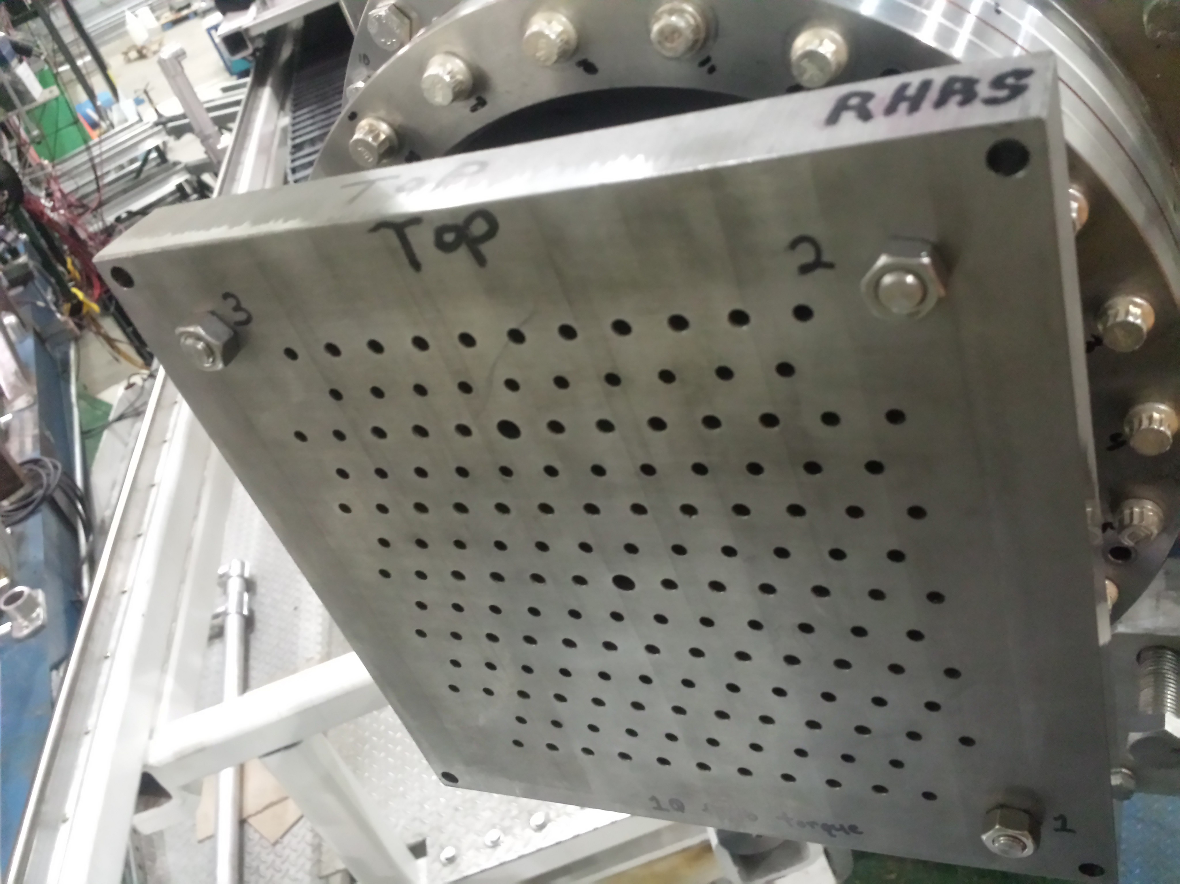
3. GMP optics data Oct 2016 for RHRS
Run Number for angle and vertex calibration:
22828, 22829, 22830, 22831, 22832, 22833, 22834.
2. Kinematic setting:
Angle : 48.75 , E_{beam} = 2.217 GeV, P0 = 1 GeV, Sieve in
3. Target: Multiple carbon foils:
9 foils cover 20 cm along the beam -10cm ->10cm
4. Sieve:
New Sieve 26 rows, 7 columns
5. Optics matrix:
Initial optics data base: GmP spring 2016

Slide 7
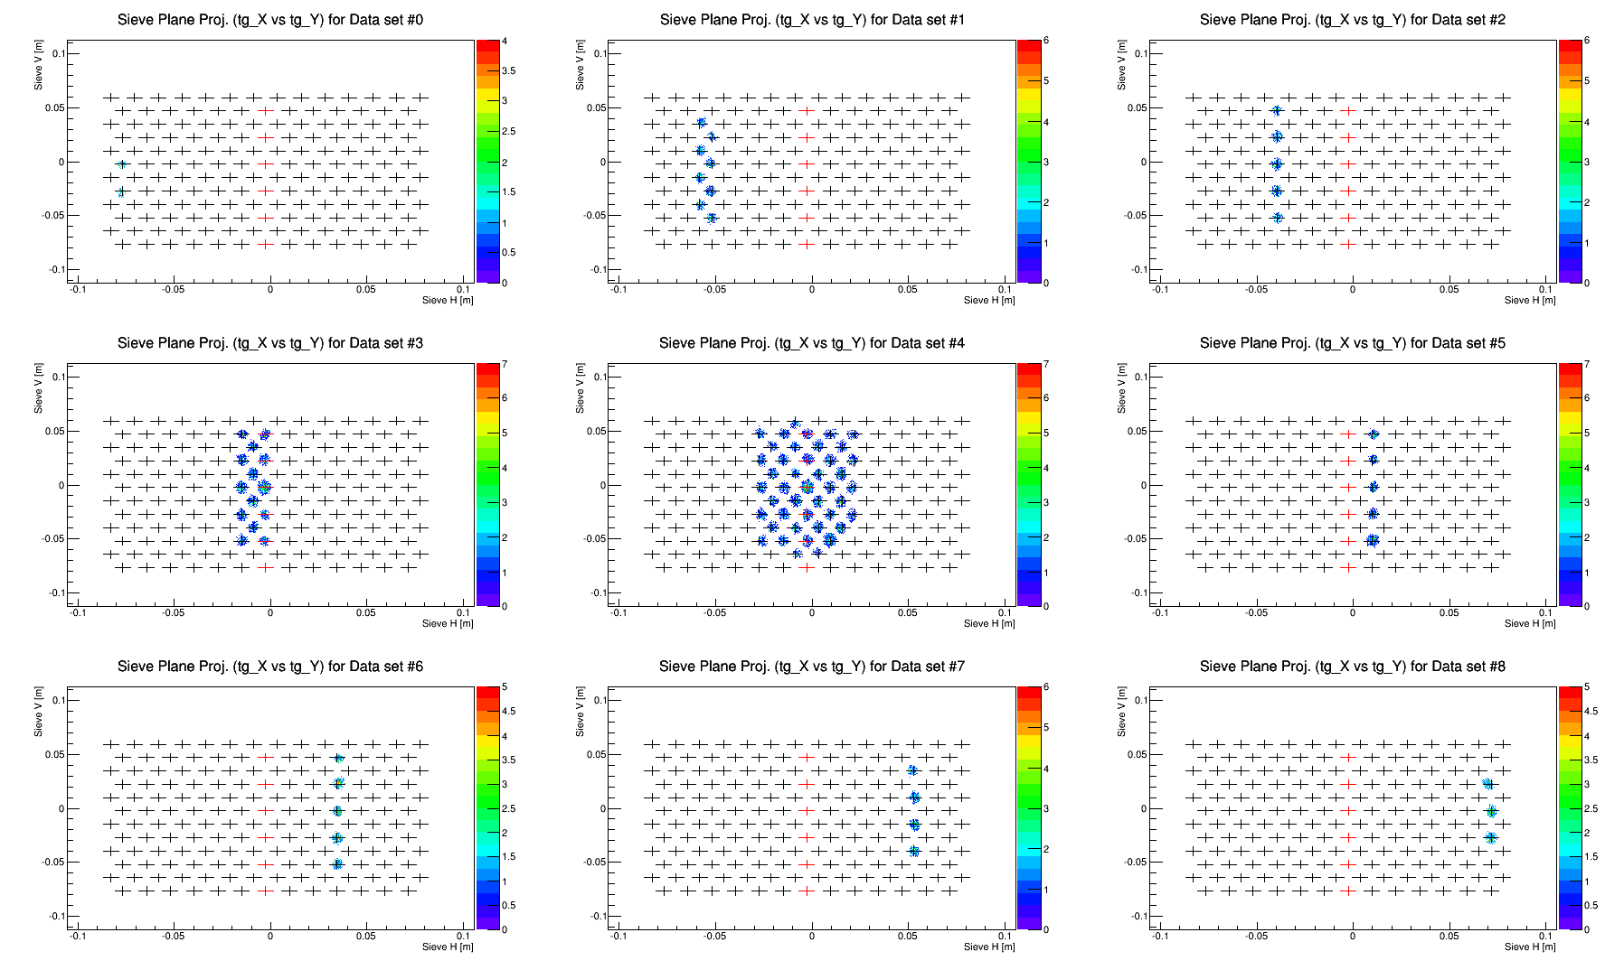
Sieve plots Using the Initial optics matrix

Slide 8
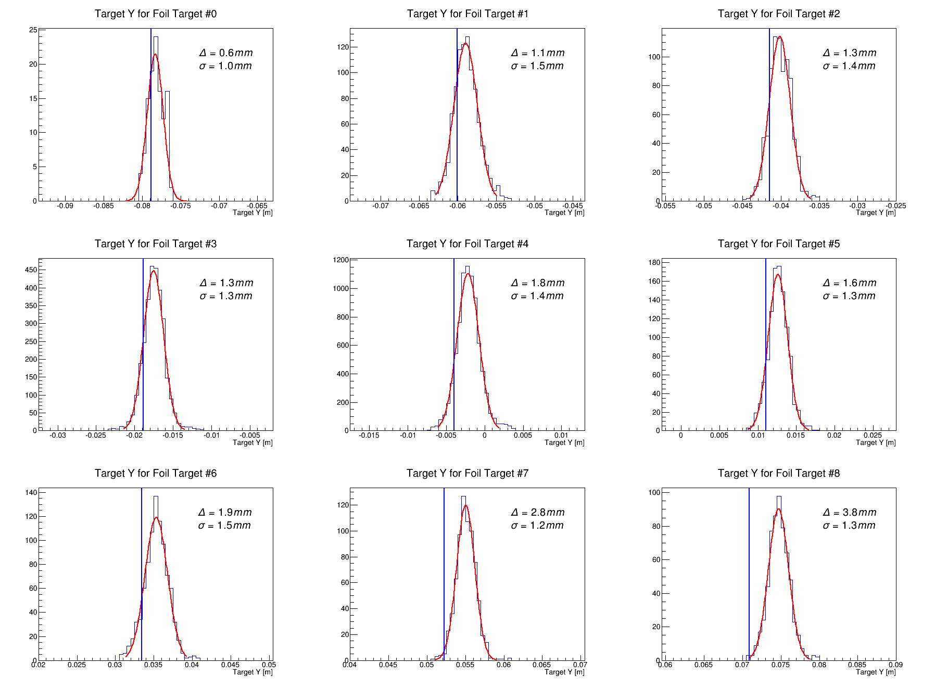
Vertex plot using initial optics Matrix

Slide 9
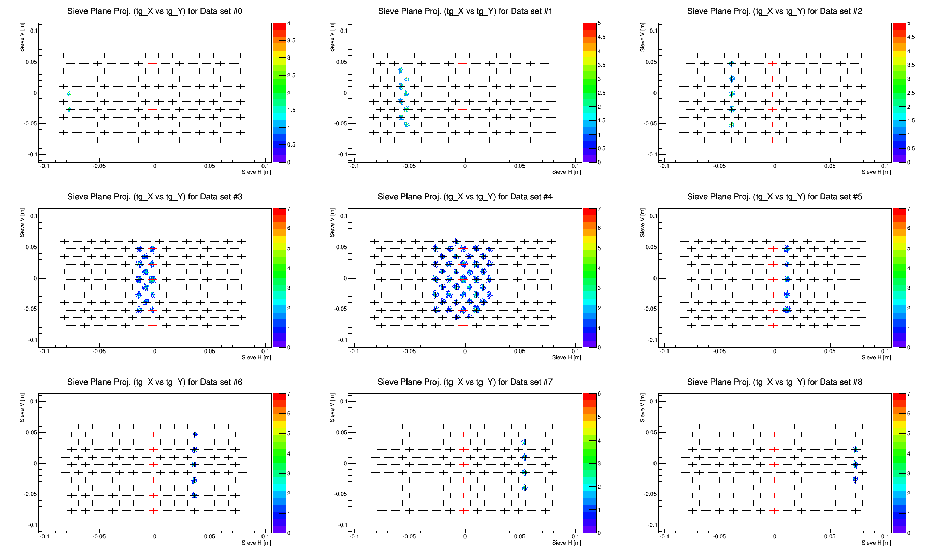
Angle Calibration: after optimization

Slide 10
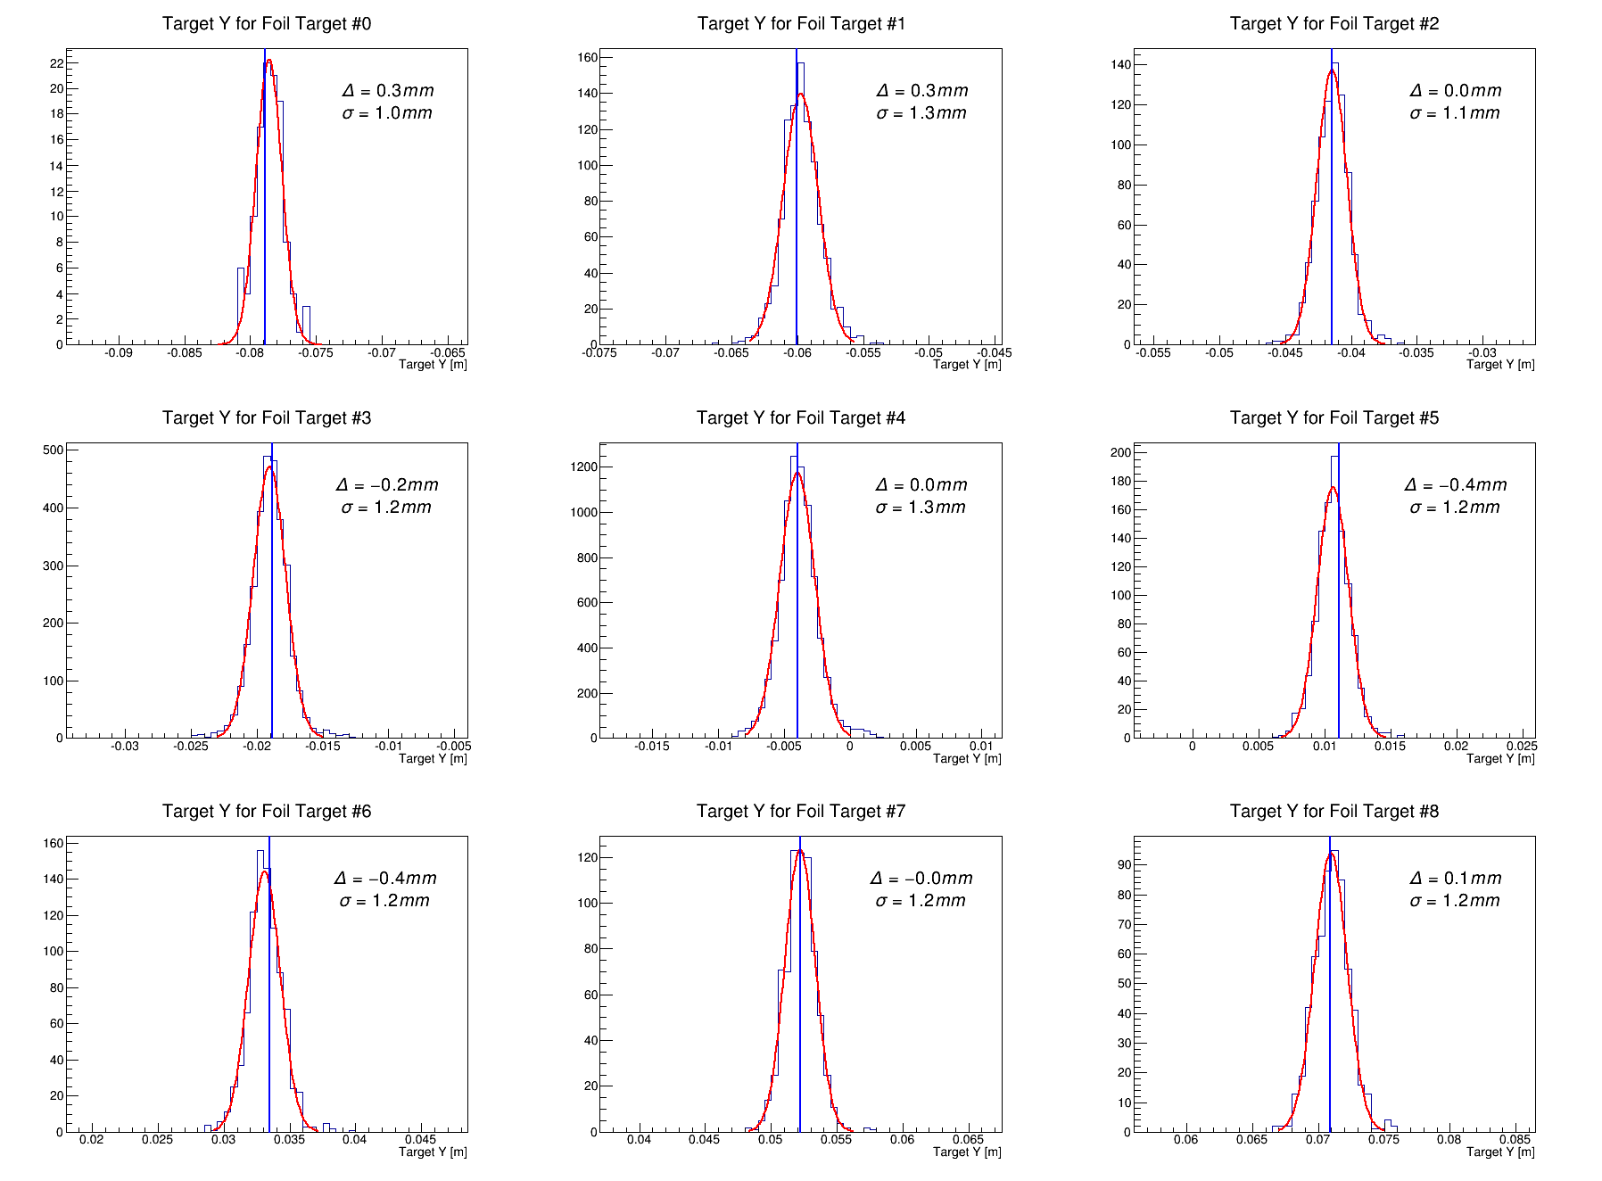
Vertex calibration: After optimization

Slide 11
Discussion:
Next step: finish Dp calibration in RHRS
Take a look at the LHRS optics as well
Testing the optics: ->Need some suggestion about what can be test to make sure the optics is good

