Slide 1
Michael Nycz
Update to BCM Calibration
1/31/17

Slide 2
What I’ve done
Based on the general overview of the calibration procedure
Wrote a program that calculates BCM coefficients without needed to making “timing cuts” by time for each run
Still requires some slight editing and a sanity check after running to confirm results

Slide 3
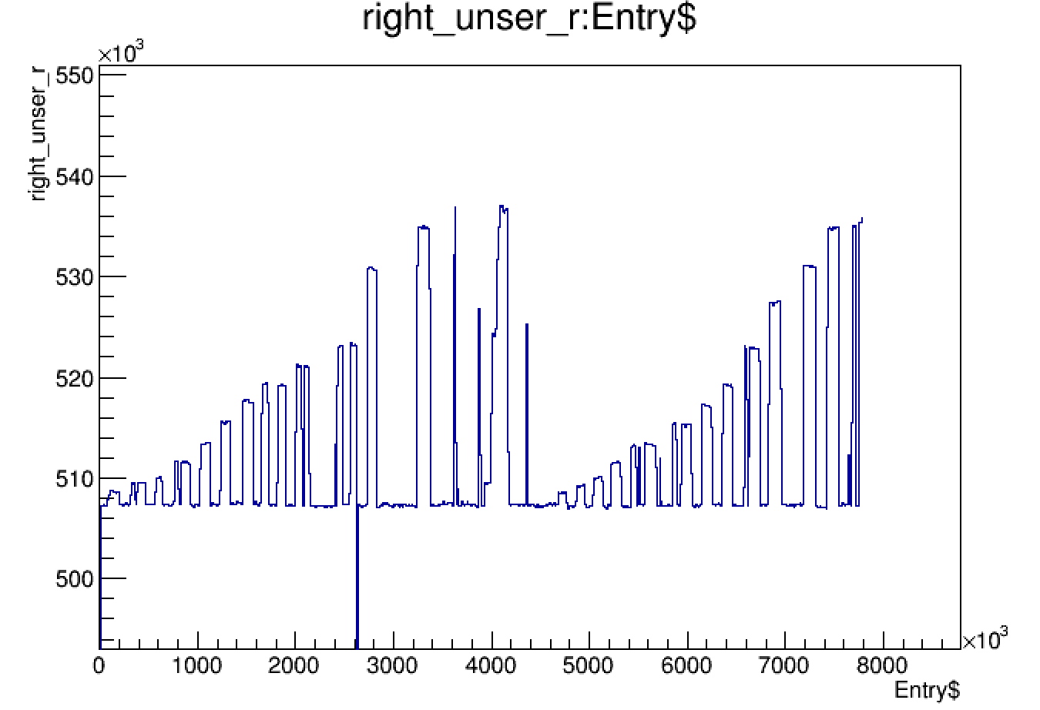
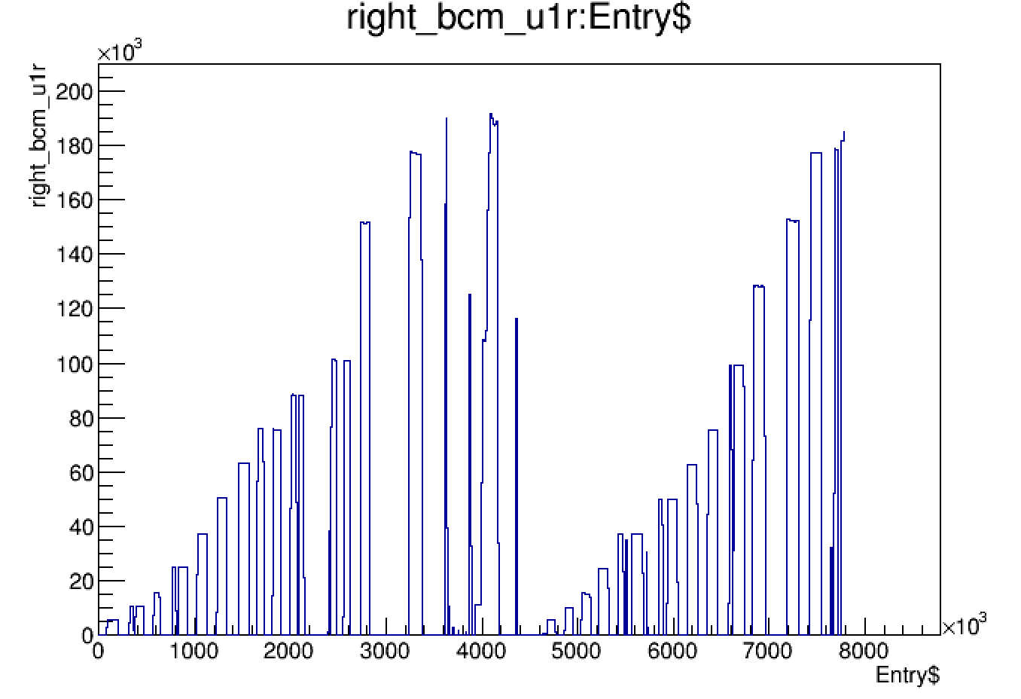
General Procedure
Have to subtract the pedestal value from the Unser frequency
Unser Current = Subtracted Unser_freq * gain factor
BCM receivers : negligible pedestal

Slide 4
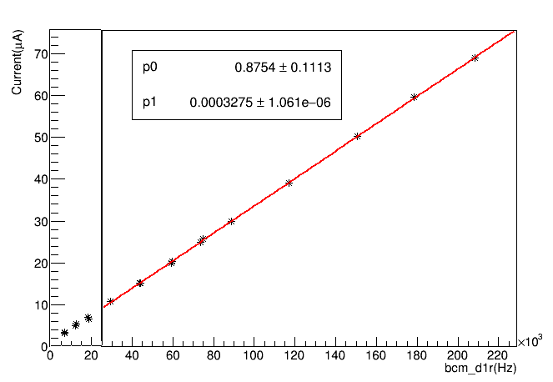
Unser current vs. BCM frequency

Slide 5
BCM Calibration run 22790 October 2016
Receiver | Gain (p1) | Offset (p0)
u1r | 383.6e-6 +/-1.1e-6 | 1.05 +/- 0.10
d1r | 327.5e-6 +/- 1.06e-6 | 0.875 +/- 0.11
d3r | 958e-05 +/- 0.27e-6 | 0.27 +/- 0.08
d10r | 330.2e-6 +/- 0.25e+/-e-6 | 0.15 +/- 0.12
Receiver | Gain (p1) | Offset (p0)
u1r | 383.2e-6 +/- 0.9e-6 | 1.04 +/- 0.09
d1r | 328e-6 +/- 0.77e-6 | 0.47 +/- 0.09
d3r | 954e-05 +/- 0.18e-6 | 0.35 +/- 0.07
d10r | 33.2e-6 +/- 0.27e+/-e-6 | 0.15 +/- 0.11

Slide 6
BCM Calibration run 22476 April 2016
Receiver | Gain (p1) | Offset (p0)
u1r | 349.1e-6 +/- 1.3+/e-6 | 0.66 +/- 0.15
d1r | 319.5e-6+/- 1.4 +/ e-6 | 0.50 +/- 0.17
d3r | 92.9e-6 +/- .30e-6 | 0.17 +/- 0.12
d10r | 31.4e-6 +/- .29e-6 | 0.27 +/- 0.13
Receiver | Gain (p1) | Offset (p0)
u1r | 348.7e-6 +/- 0.96+/e-6 | 0.65 +/- 0.11
d1r | 319.1e-6 +/- 0.88+/e-6 | 0.19 +/- 0.11
d3r | 92.7e-6 +/- 0.22+/e-6 | 0.19 +/- 0.09
d10r | 31.4e-6 +/- 0.28+/e-6 | 0.28 +/- 0.14

Slide 7
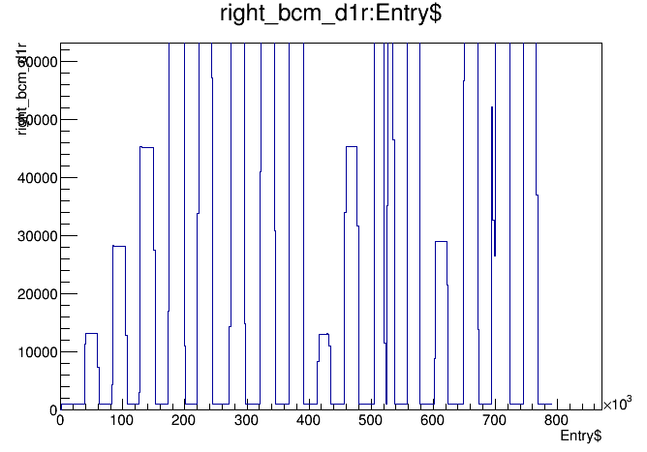
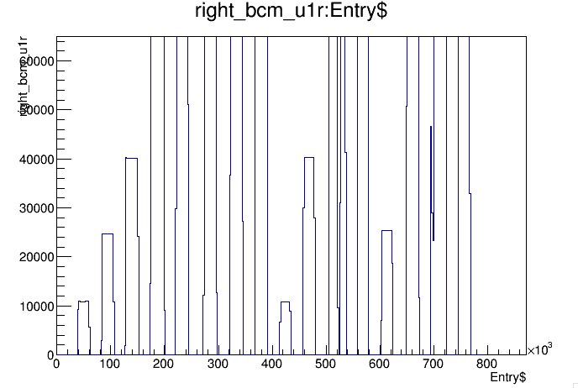
Possible explanation?
Is closer to ~ 1000
Nominally around 0.0
around~ 50

Slide 8
BCM Calibration run 22790 October 2016
Receiver | Gain (p1) | Offset (p0)
u1r | 383.6e-6 +/-1.1e-6 | 1.05 +/- 0.10
d1r | 328.0 e-6 +/- 1.03e-6 | 0.51 +/- 0.12
d3r | 958e-05 +/- 0.27e-6 | 0.27 +/- 0.08
d10r | 330.2e-6 +/- 0.25e+/-e-6 | 0.15 +/- 0.12
Receiver | Gain (p1) | Offset (p0)
u1r | 383.2e-6 +/- 0.9e-6 | 1.04 +/- 0.09
d1r | 328 e-6 +/- 0.77e-6 | 0.47 +/- 0.09
d3r | 95.49e-05 +/- 0.18e-6 | 0.35 +/- 0.07
d10r | 331.8e-6 +/- 0.27e+/-e-6 | 0.15 +/- 0.11

Slide 9
BCM Calibration run 22476 April 2016
Receiver | Gain (p1) | Offset (p0)
u1r | 349.1e-6 +/- 1.3+/e-6 | 0.66 +/- 0.15
d1r | 319.1e-6+/- 1.1 +/ e-6 | 0.18 +/- 0.13
d3r | 92.9e-6 +/- .30e-6 | 0.17 +/- 0.12
d10r | 31.4e-6 +/- .29e-6 | 0.27 +/- 0.13
Receiver | Gain (p1) | Offset (p0)
u1r | 348.7e-6 +/- 0.96+/e-6 | 0.65 +/- 0.11
d1r | 319.1e-6 +/- 0.88+/e-6 | 0.19 +/- 0.11
d3r | 92.7e-6 +/- 0.22+/e-6 | 0.19 +/- 0.09
d10r | 31.4e-6 +/- 0.28+/e-6 | 0.28 +/- 0.14

Slide 10
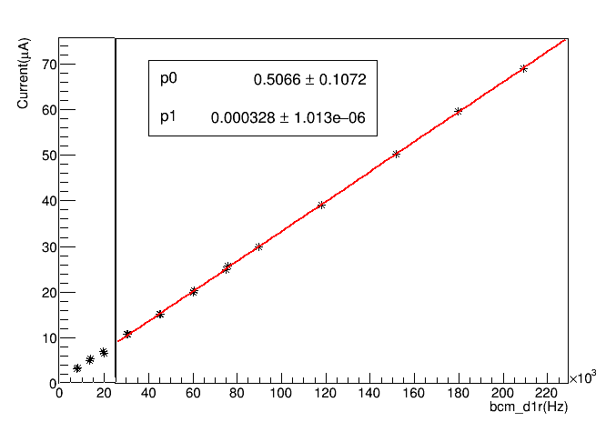
Run 22790 Receiver d1r
Below 10 microAmps the receiver is nonlinear

