Slide 1
BCM Calibrations
Mike Nycz
11/29/16

Slide 2
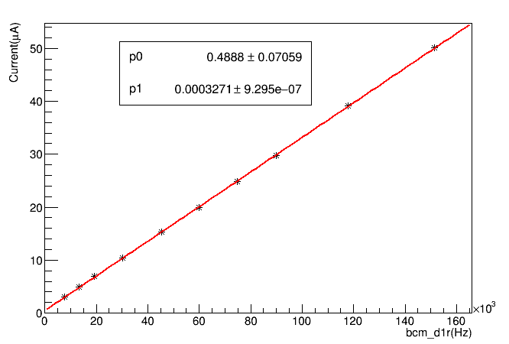
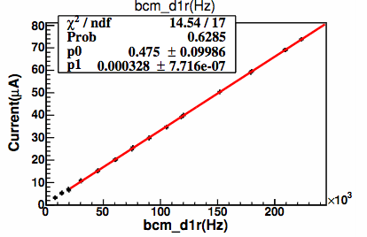
BCM Calibrations Run # 22791 (not 22790)
BCM: D1r

Slide 3
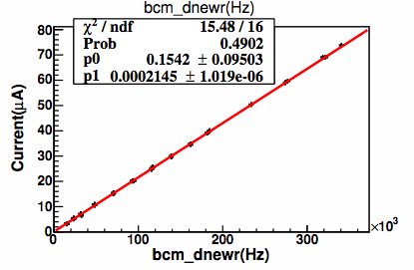
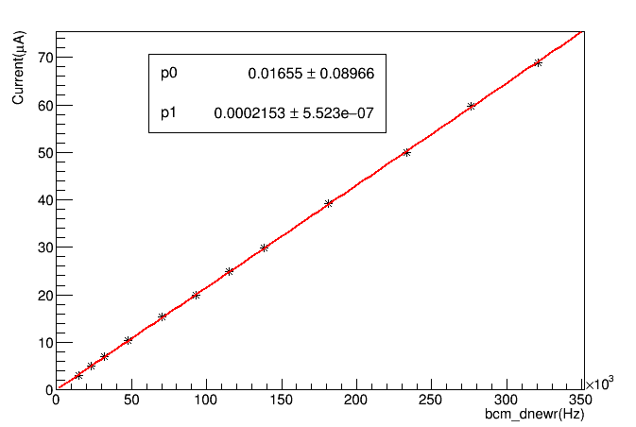
BCM : DNewr

Slide 4
Comparison between Spring 2016 and Fall 2016 Coefficients

