Slide 1
Tritium Experiment Readiness Review Prepared By: Jessie Butler
Charge #3 – Installation / De-Installation Scheduling & Planning

Slide 2
7 Major Components
Summer Installation (4/14 – 10/1/16)
Full Run (10/1 – 12/22/2016)
Winter Installation (12/22 – 2/17/17)
Tritium Spring Run (2/17 – 5/8/17)
Summer Accelerator Down (5/8 – 10/03/17)
Tritium Fall Run (10/3 – 12/21/17?)
Tritium De-Installation (12/21/17?)

Slide 3
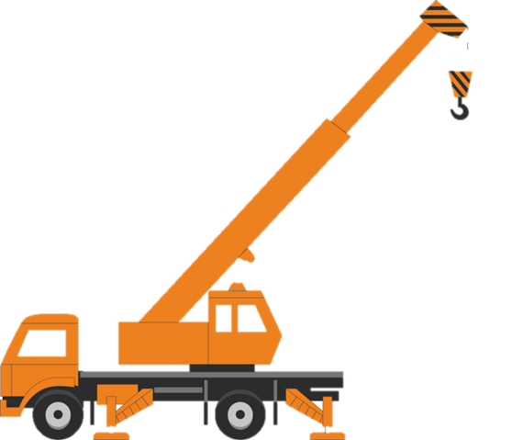
Summer Installation (4/14 – 10/1/16)
Hall Infrastructure Improvements
During the summer 2016 installation we’ll focus on improving infrastructure in the hall that will be use to support Tritium and other future experiments.

Slide 4
Summer Installation (cont.)
4 Major Parts Of The Summer Installation:
Preliminaries
Right HRS Changes
Left HRS Changes
Final Preparations

Slide 5
Summer Installation (cont.)
Preliminaries – These are routine activities that we would typically preform at the beginning of most installation period.
Examples: post run survey, post run checklist, warm-up the cryogenic system, bleed-up vacuum systems, etc.…

Slide 6
Summer Installation (cont.)
Right HRS
Left HRS

Slide 7
Summer Installation (cont.)
Right HRS
Changes
Remove magnet from HRS
Install adjustable mounts
Move magnet to L-HRS
Install new resistive magnet on R-HRS
Remove old Q1 power supply from platform
Install new power supply in it’s place
***Please note: This evolution will be done in accordance with an approve JAB Lift Plan.

Slide 8
Summer Installation (cont.)
Left HRS
Changes
Remove magnet from HRS
Install quad from RHRS on LHRS
Remove old Q1 power supply from platform
Install Big Box power supply on platform
***Please note: This evolution will be done in accordance with an approve JAB Lift Plan.

Slide 9
Summer Installation (cont.)
Final Preparations – These are routine activities that we would typically preform at the end of most installation period.
Examples: cryogenic cooldown & cleanup, vacuum system pump down & leak check, power supply testing, etc.…

Slide 10
Full Run (10/1 – 12/22/16)
Accelerator Beam Time (DVCS Experiment)

Slide 11
Winter Installation (12/22 – 2/17/17)
Preliminaries
Uninstall DVCS
Rotate Target Chamber
Install Pivot Platform
Remove Moeller Target
Support Target Group Installation
Install Perimeter Fencing
Final Preparations

Slide 12
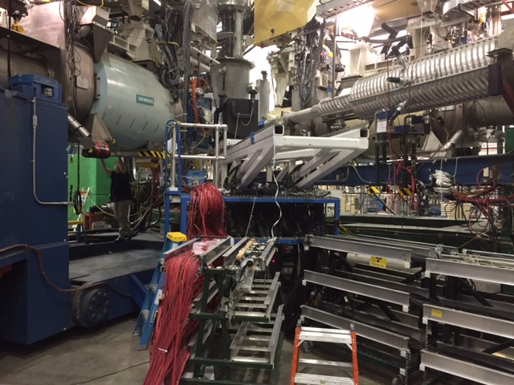
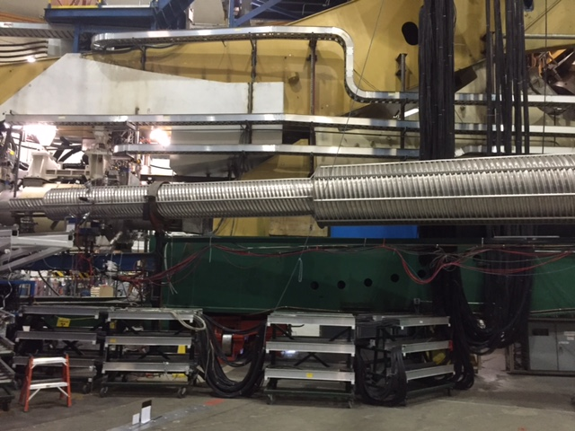
Winter Installation (cont.)
DVCS Calorimeter
DVCS Cables

Slide 13
Pivot Area and Target Chamber Work
Winter Installation (cont.)
Warm up target and bleed up target can
Remove target
Rotate target chamber into position
Rotate left HRS into position
Install target platform on pivot area
Pivot and Target area will be turned over to target group for Tritium target install.

Slide 14
Moeller Magnet Removal
Winter Installation (cont.)
*** We will be removing the Moeller magnet and installing a new section of beamline in its place…

Slide 15
Winter Installation (cont.)
For the remaining man hours of the installation period, the Hall A staff will be supporting Target Group’s schedule, installing the target chamber perimeter fence and final preparations.

Slide 16
Spring Run (2/17 – 5/8/17)
Accelerator Beam Time (Tritium Experiment)

Slide 17
Summer Accelerator Down (5/8 – 10/03/17)
Post beam surveys and checks
No major work activity will be done in Hall A
All work will at a minimum require a HAList and a TOSP for work inside of boundary fence.
Hall A techs will spend the majority of the down working in the Test Lab (APEX/PREX/CREX and SBS)
Pre-beam Checklist

Slide 18
Fall Run (10/3 – 12/21/17)
Accelerator Beam Time (Tritium Experiment)

Slide 19
Winter Installation 2017
Post beam surveys and checks
Install target platform on pivot
Once Tritium target has been removed, install next experiment…

Slide 20
Procedures
Standing Procedures:
Pre-Beam Checklist
Post-Beam Checklist
Install/Remove External Sieves (in-progress)
Valve Changeout/Calibration for Distribution Can and Q2s (in-progress)

Slide 21
Any Questions?

