Slide 1
Radiological Readiness for Tritium Experiments
March 16, 2016
Keith Welch, MS, CHP
RadCon Deputy Manager

Slide 2
Overview
Work-area and environmental monitoring
Personnel monitoring
Training
Operational controls
Target shipping/receipt/storage
Documentation
External communications/Public affairs

Slide 3
Work area and environmental monitoring
Continuous air monitoring (CAM)
Ambient hall air
Two redundant systems
At least one monitor must be operational when target is in hall
Audible alarm, interlocked to exhaust, FSD
Will base setpoint on HTO DAC
Detection is ~0.005% of target escaping to the hall (over few hours or less)
Target chamber vacuum exhaust
With 40 lpm purge, expect up to 1E-5 uCi/ml
Operator alarm but not FSD
Response time < 20 seconds

Slide 4
Work area and environmental monitoring
Continuous air monitoring (CAM)
Status and plans
Use existing sample lines for ambient monitoring (retain existing monitoring of activation gases)
Existing instrument checkout underway
One channel ambient, one channel vac exhaust
RFQ in on second instrument (~$20k)
Need to do:
New sample lines for vac exhaust (summer)
Installation (fall)
Interface to ventilation, EPICS, FSD (fall)

Slide 5
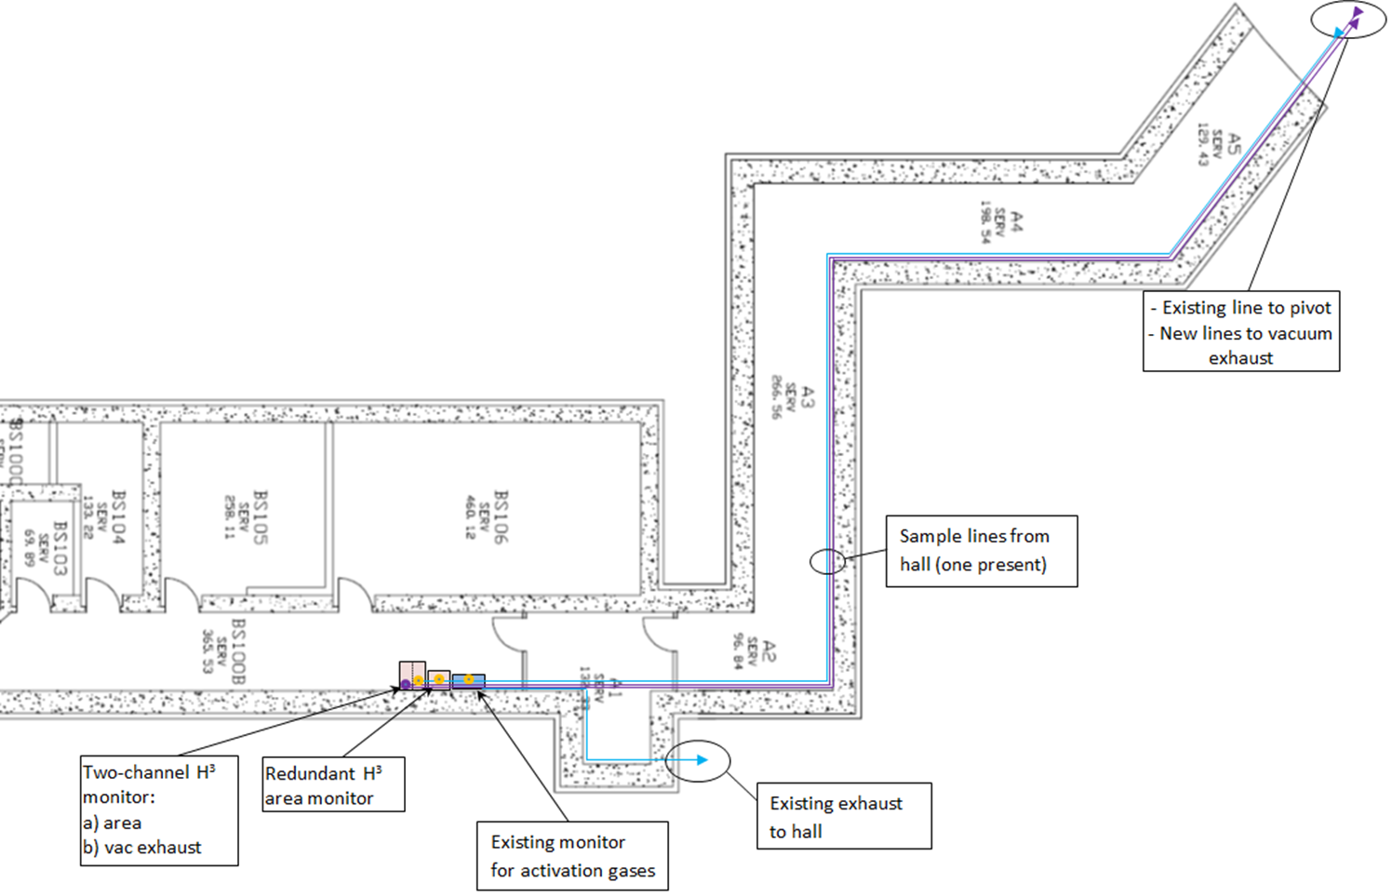
Work area and environmental monitoring
Continuous air monitoring (CAM)

Slide 6
Work area and environmental monitoring
Other Monitoring
Portable air samplers used for receipt, during all target handling, and for any target chamber work
Verbal agreement from SRS for loan
Goal to have on site by October
Passive air sampling in adjacent spaces
Diffusion vials (simple, inexpensive)
Hall will be routinely surveyed for H³ on surfaces
Routine monitoring of discharges, surface waters and groundwater
Equipment and procedures for contamination and environmental samples in place

Slide 7
Personnel monitoring
Bioassay
Bioassay screening to be conducted
Not a monitoring program
Selected personnel from target group, hall workers, controls
Expected number of workers ~ 10
Occ Med to collect, ship samples
Status and plan
Evaluating offerings by SRS and vendors
Cost is comparable
Plan to have baseline sampling in place ~October

Slide 8
Training
Two-level training planned
Level 1 for all personnel who can enter the hall
General awareness training, response to alarms,
Hall walkthrough (given by Hall A personnel)
Level 2 for workers with access to “tritium zone”
Focus on work practices, COO
RadCon and target group to develop objectives
RadCon will prepare and publish training
Target date for completion October

Slide 9
Operational Controls
Radiation Work Permits
Established process, formal approvals, archived
Target receipt sampling
Work in hall
Cover general hall access and target area work
Can be tied to CANS system
Effluent controls
Floor drain sump will be placed in manual mode
Admin configuration control on pumps

Slide 10
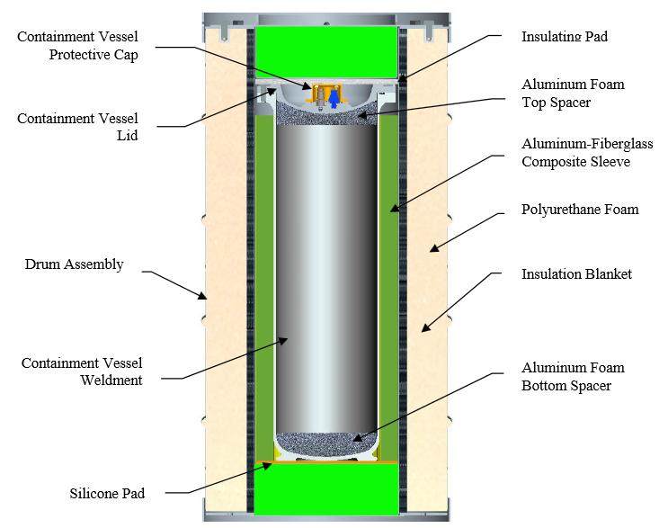
Target Shipping/Receipt/Storage
Target to be shipped in DOT Type B container (BTSP)
Approved for 1.5 MCi
Trained SRS personnel conduct shipment both to and from JLab
DOE Orders and guides provide specific allowances for materials stored in certified Type B containers (exempt from emergency hazard assessments, nuclear facility inventories, etc.)
Container should be considered acceptable to meet all JLab containment requirements; design exceeds all local containment/confinement capabilities

Slide 11
Target Shipping/Receipt/Storage
Receipt
Receipt surveys required (per CFR)
Maintain target in BTSP within hall upon receipt until ready to install
Open BTSP in Hall remove secondary container to Hut
Follow SRS procedures for sampling upon opening
Storage
Use BTSP for all interim storage (weather emergencies, summer SAD, etc.)
Consider using small “mover box” for enhanced security when in storage
Maintain continuous air monitoring when target is in the hall

Slide 12
Documentation
RadCon documentation process
Work Permits
RWPs are used to implement 10 CFR 835 requirements for work authorizations in radiological areas. They also satisfy work-control document requirements in the ES&H Manual. Online RWP system defines and requires management authorizations, provides a permanent, secure record.
RWPs will be used to define scope of initial access procedures for ARMs and RadCon Techs (both of these procedures already exist), and to cover tasks involving receipt testing of target container and any work in the Hall involving the target chamber when H³ target is installed.
Technical basis documents (TBDs)
TBDs are used within the RadCon Department to define requirements for radiological program elements and document analyses used to justify rationale for a given technical approach. This is appropriate for documentation of such items as instrumentation configuration, assumptions used for emergency response, etc. TBDs are internally peer reviewed and approved by (at least) the RadCon Manager.
Health Physics Implementing procedures (HPPs)
HPPs cover routine tasks such as instrument calibration, lab analyses, surveys, etc.
All of these document types require review and authorization, have revision control and tracking and are permanently archived. All are audited as part of the DOE-approved Radiation Protection Program.

Slide 13
Documentation
Status
TBDs | Status/target date
- Stack height to limit dose to the public | Complete
- Bioassay screening (rev existing TBD) | 7/30/16
- Accident/emergency response guidelines | 7/30/16
- Configuration of fixed air samplers | 5/31/16
- Deployment of passive monitors (rev existing TBD) | 7/30/16
Procedures
- Calibration and response checks of fixed monitors | 7/30/16
- Receipt of Type A quantity (existing doc) | Complete
- Operations of portable air monitors (SRS) | 9/30/16
- Leak-checking shipping container (SRS) | 9/30/16
Other
- Emergency Response Guidebook update | 9/30/16
- Public Affairs media package | 7/30/16
- Briefing for first responders | 7/30/16
- FSAD hazard analysis revision | 7/30/16
- RSAD (draft) | 9/30/16

Slide 14
External Communications/Public Affairs
Strategy for public communication being developed in collaboration with Emerg. Mgmt and Pub Affairs
Two-tiered strategy adopted
Proactive for first responders; brief NNFD on implications of accident (almost none), and modify online first responder’s guide
Reactive for public in event of accident or media inquiry; prepare media packets and statements
Documents under development, should be complete by summer

