Slide 1
Hall A Configuration and New Quadrupole Magnet
Robin Wines
Tritium Experiments ERR
March 2016

Slide 2
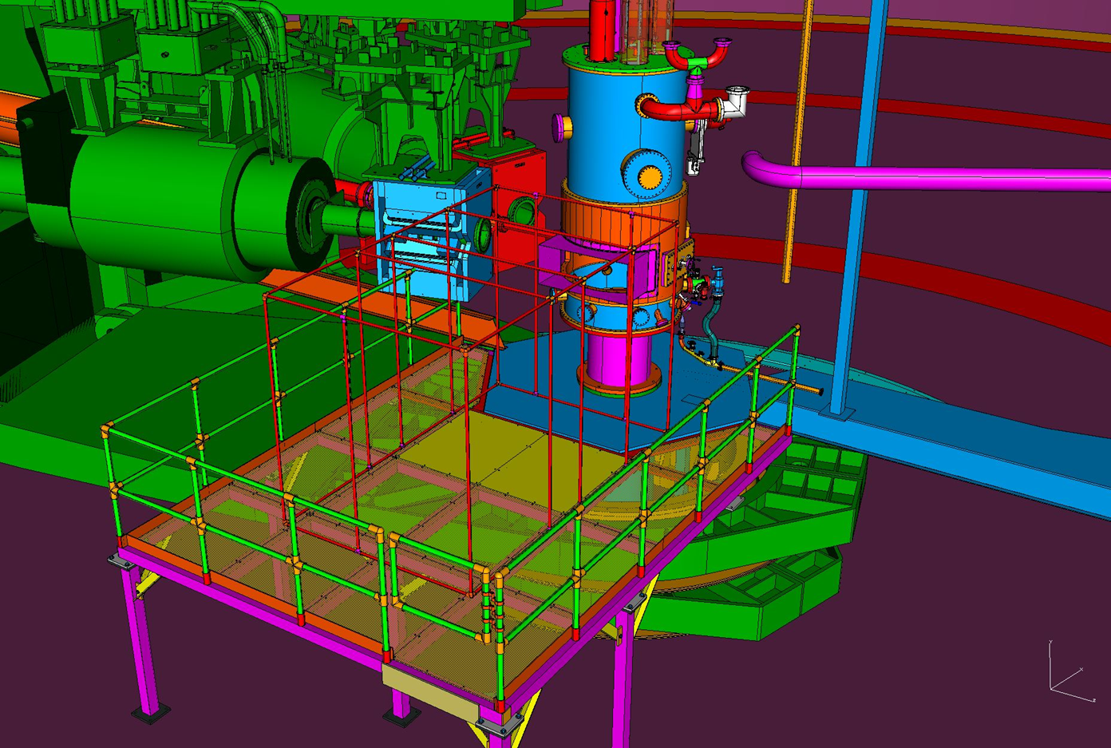
Hall A Configuration
Existing and New Resistive Q1 Magnets
Target Chamber
Target Access Platform

Slide 3
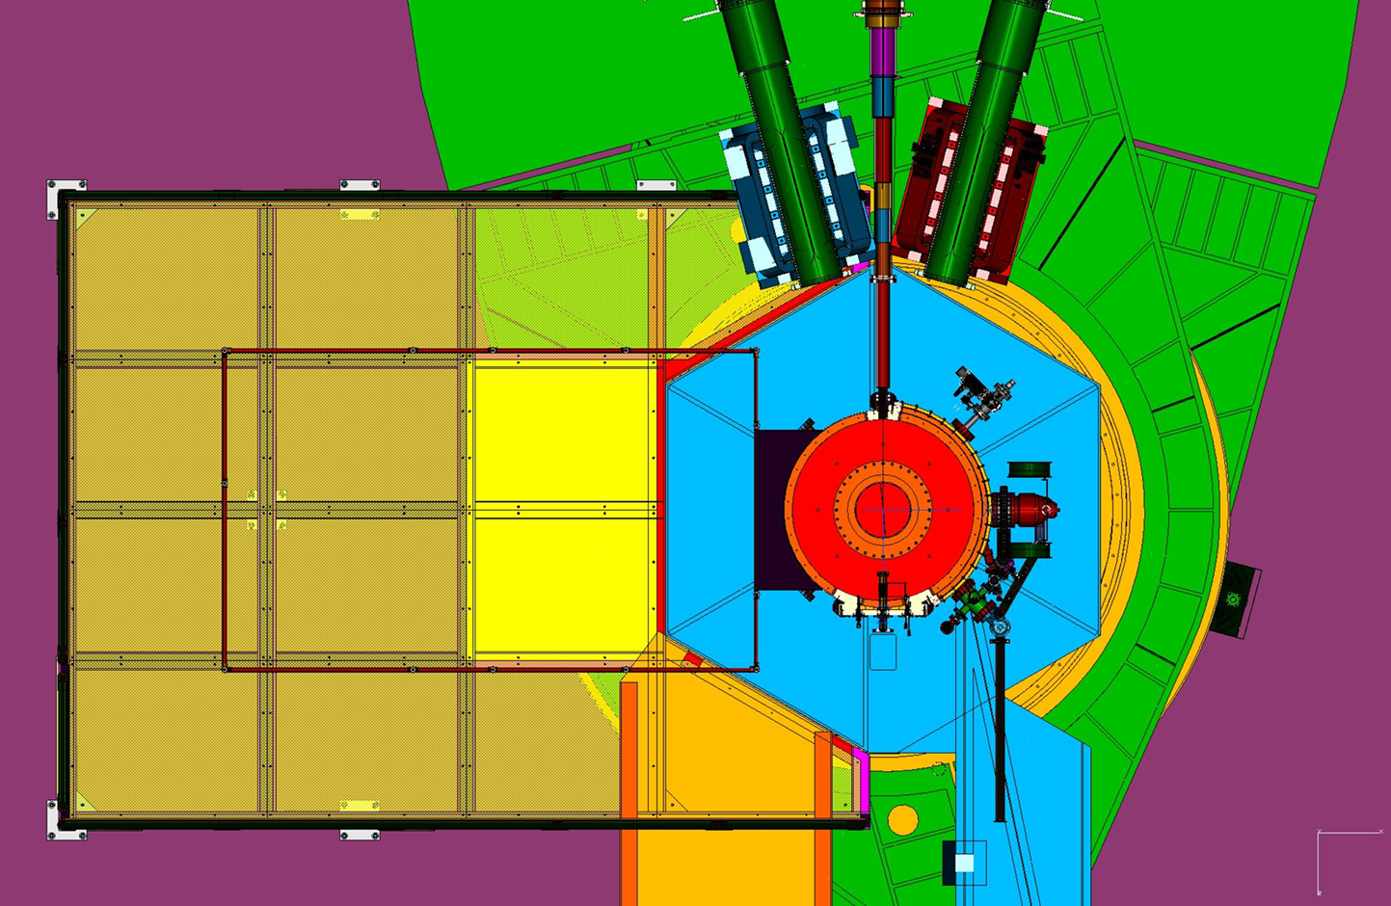
Hall Configuration
Differences, other than target:
Experiments utilize both HRS arms, configured for angles of 15 to 70 degrees.
Platform can be in place from 15 to 26 degrees setting of HRS-L.
Support brackets to be modified to allow new and existing resistive Q1 magnets to be installed upstream of present position.
Install fence barrier for target area.

Slide 4
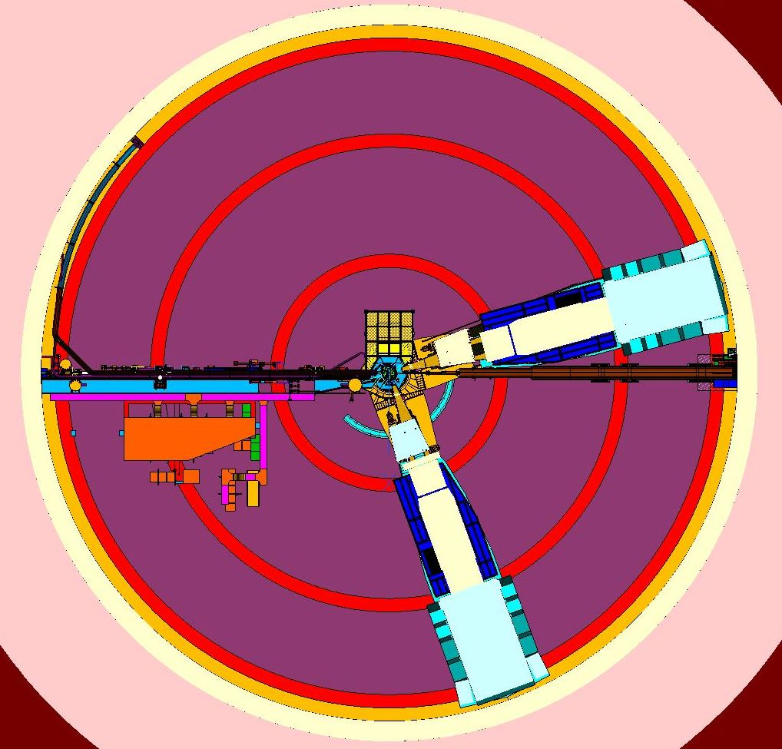
Fence Barrier
Retractable fence rotates with each HRS arm
Stationary fence upstream of target
Inner ring 25 feet in diameter
Underpass restricted by fence on each HRS arm

Slide 5
New Quadrupole Magnet
HRS-R Q1 has been replaced by the resistive SOS Q1 magnet. Tested and operable to 1000 A for 1.2 Tesla field at the pole tips.
HRS-L Q1 will be replaced by a replica of the SOS Q1.
The New SOS Q1 is in fabrication and scheduled to be delivered by June 15th, 2016.
Testing procedures are in place for arrival of the magnet in June as were used for the present SOS Q1.
The HRS-R Q1 is being powered by the existing BB power supply. The power supply for the new HRS-L Q1 is in the procurement process, with delivery scheduled for July 1, 2016.
The Hall LCW allows for 200 GPM. The two resistive SOS Q1 magnets require maximum of 23 GPM each . The Hall currently has sufficient LCW.

Slide 6
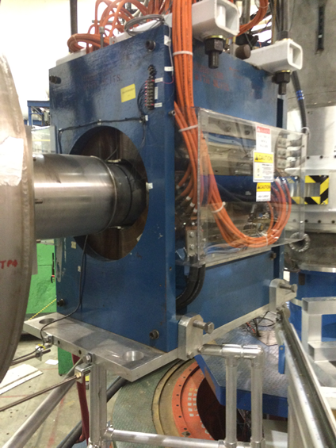
New Quadrupole Magnet
Tritium experiments require HRS-L and HRS-R to operate at minimum angle of 15 degrees each, with center of target to center of Q1 to be distance of 187 cm. This requires the Q1 magnets to be relocated upstream of their present position.
The existing mounting brackets for the Q1 magnets will be removed in June and modified to allow the position change. Modified drawings for the brackets exist.

Slide 7
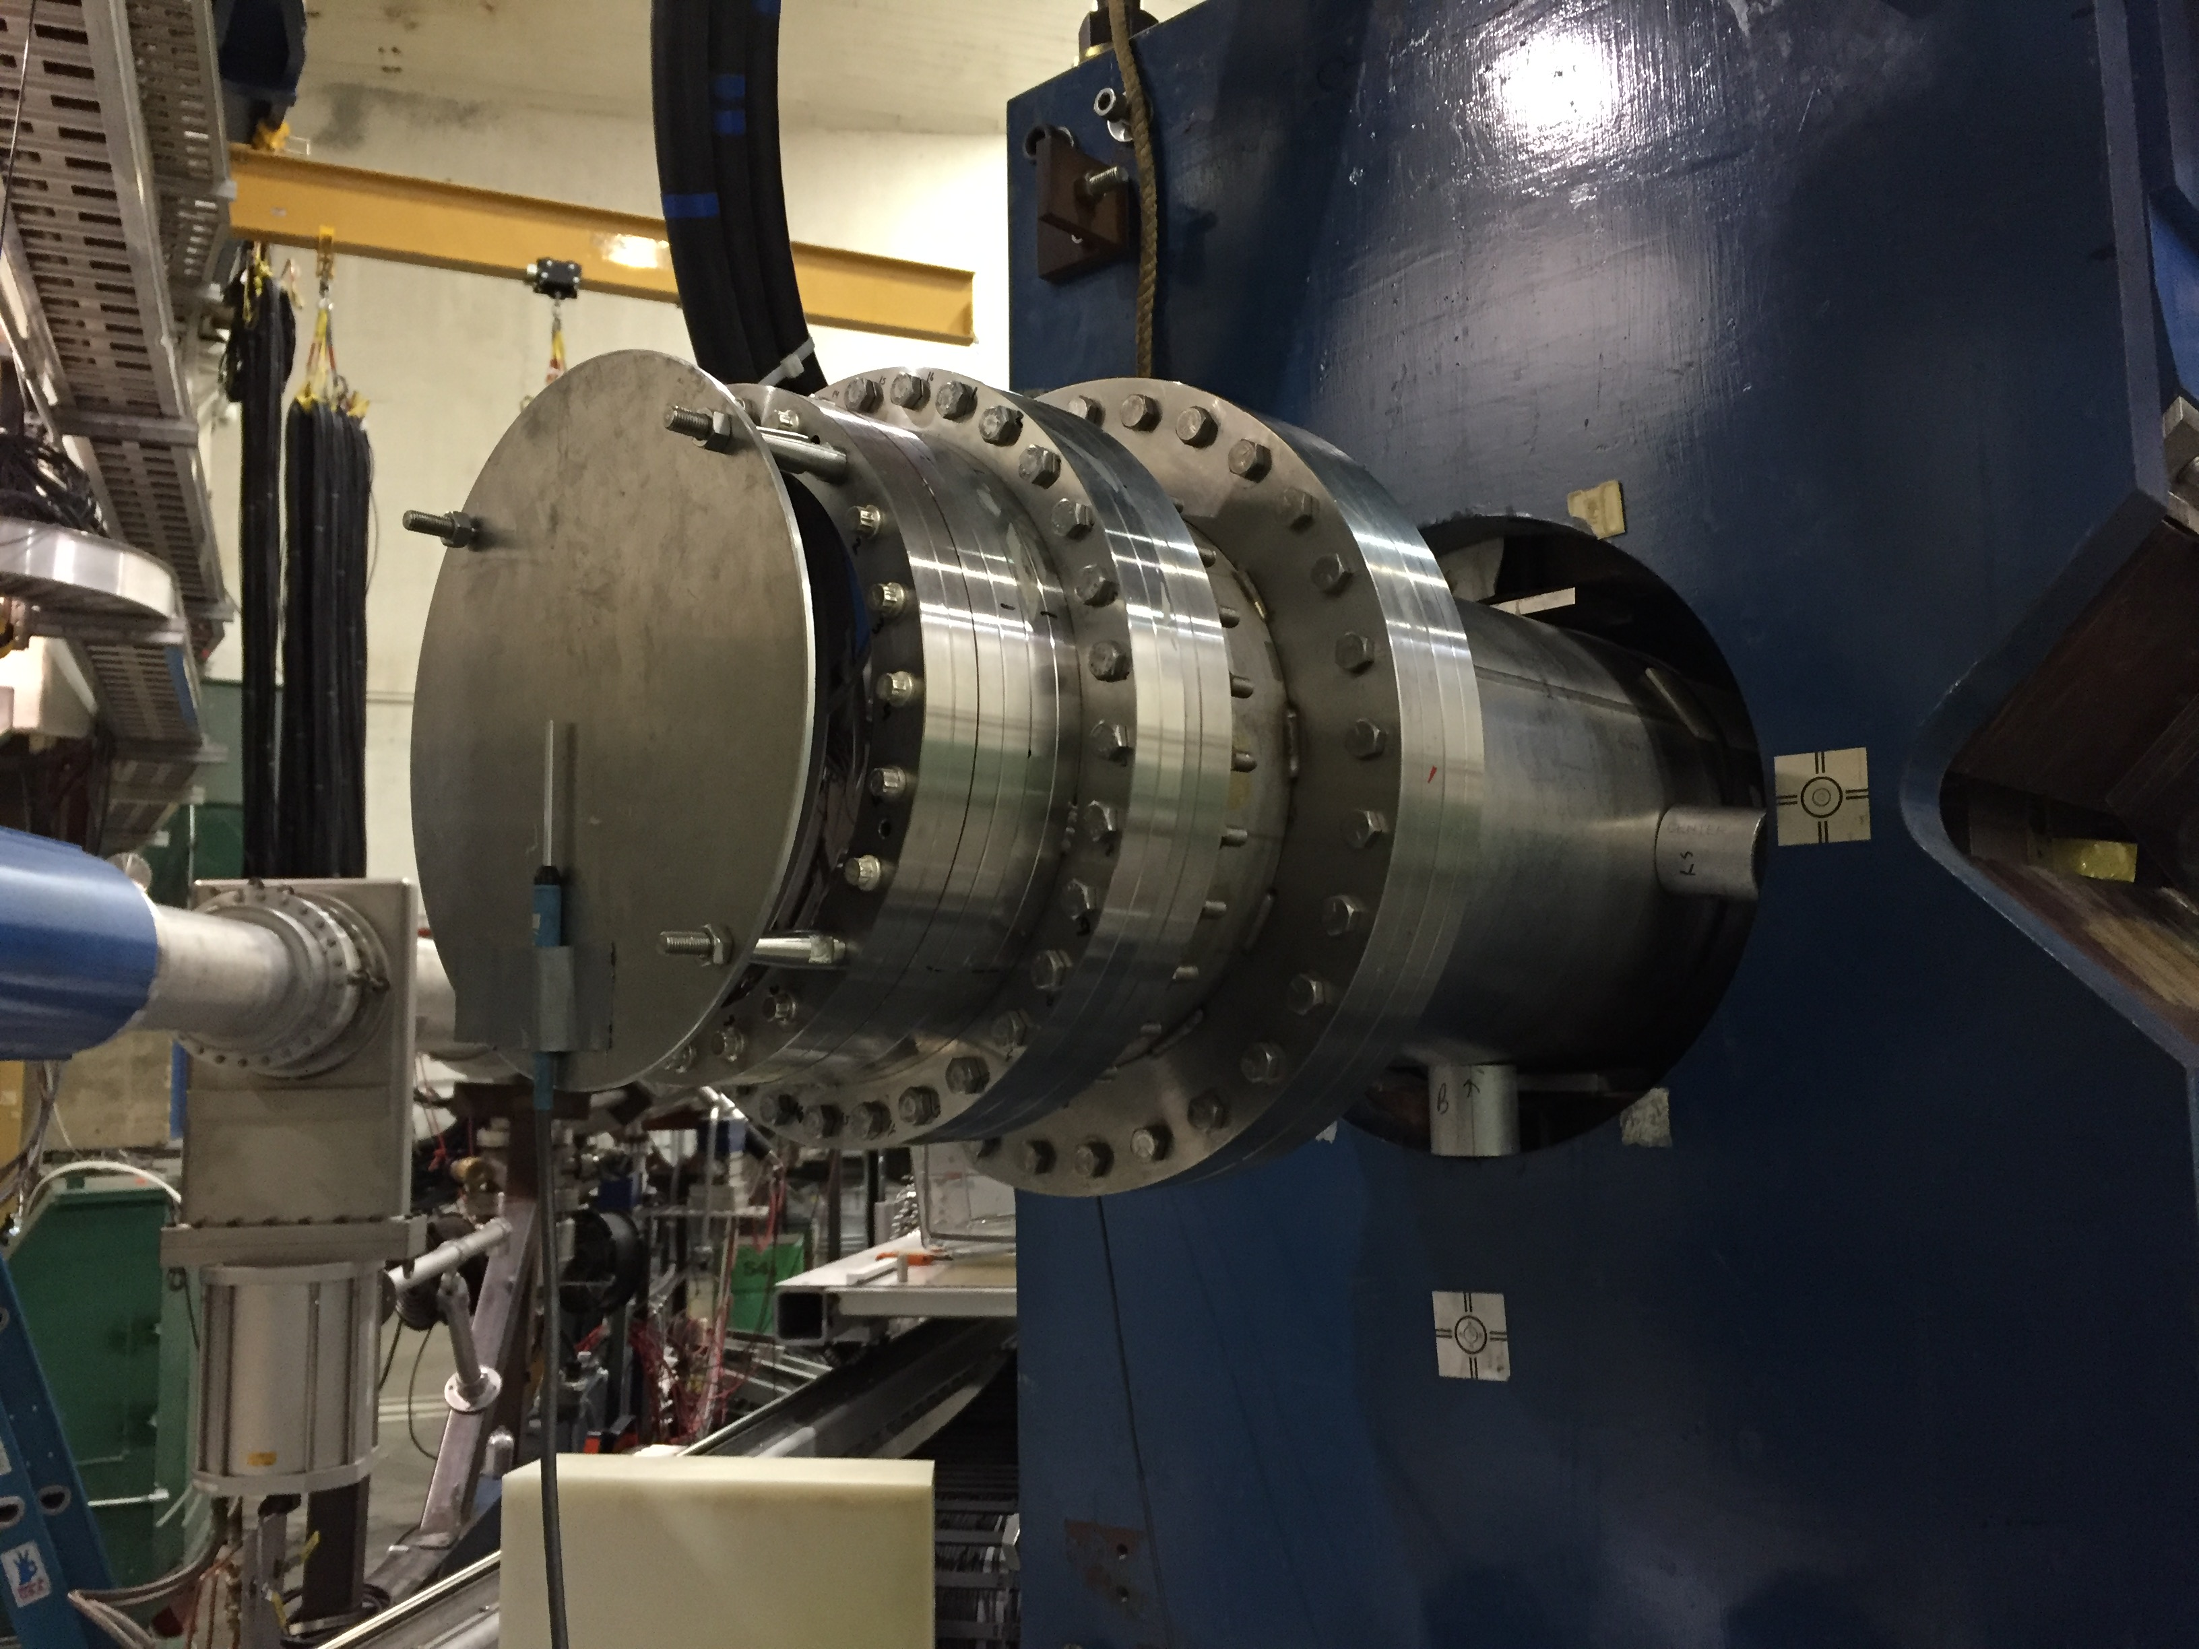
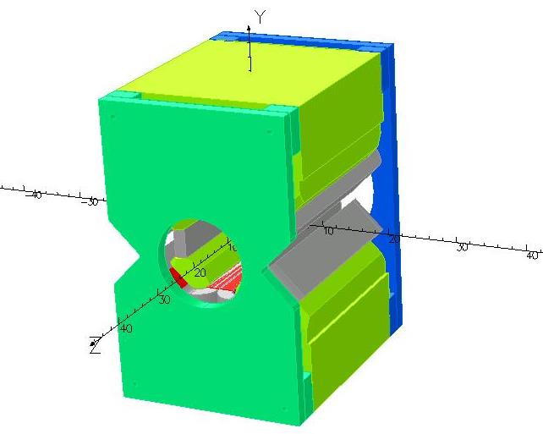
New Quadrupole Magnet
Measured field data : Field falls off to 2.5 Gauss at 6.5” from face of the magnet (at the window flange) and 5 Gauss at 3’ from sides of magnet iron. Areas in Hall to be marked accordingly.
Tosca magnet simulation in progress to confirm field profiles of magnet.

Slide 8
In summary,
Design activities are complete and Hall Configurations are known.
Refer to Installation presentation for scheduling of activities. (Jessie)
Refer to Target presentation for integration with target. (Dave)
Questions ?

