Slide 1
Quad Move Study
Larry Weinstein
(work done by Erez Cohen)

Slide 2
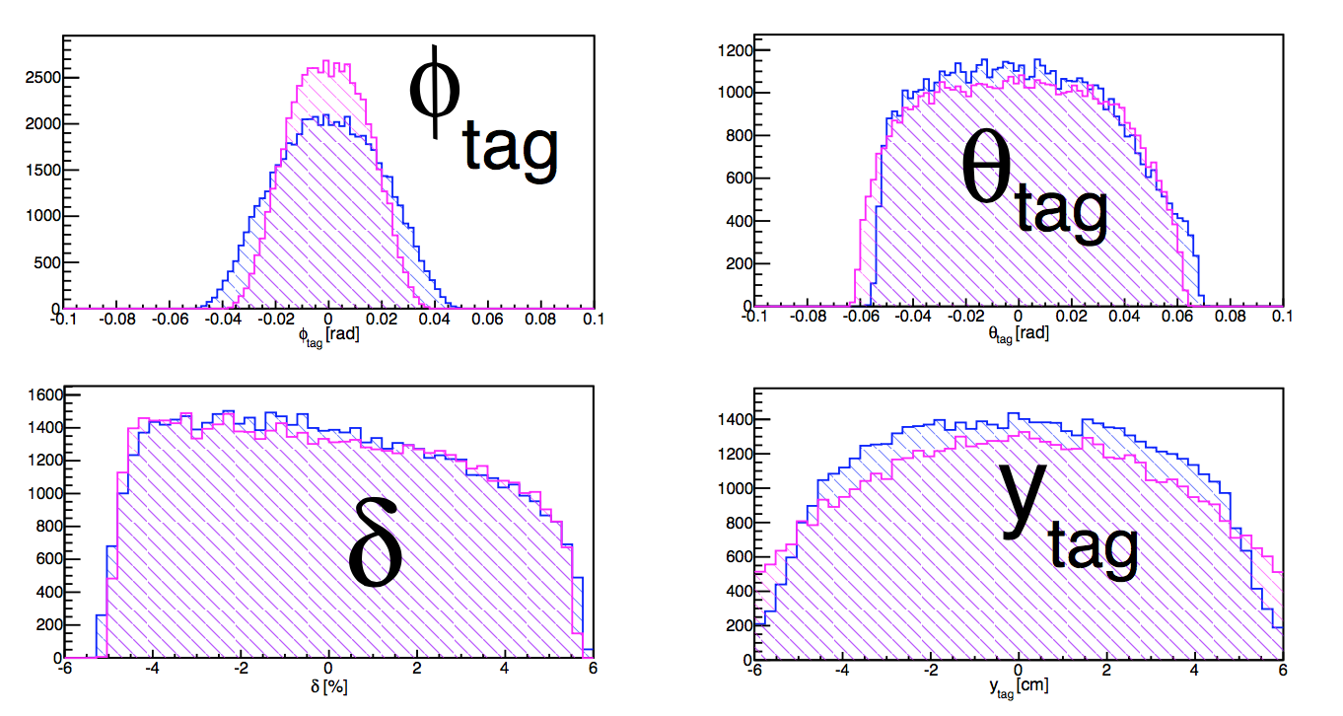
Quad move 30 cm: acceptance
Nominal
+30cm

Slide 3
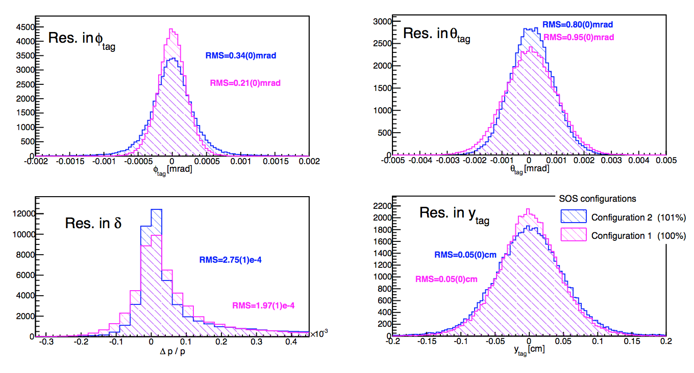
Quad +30cm: resolution
Nominal
θ_{target}
Φ_{target}
+30cm
δ
y_{target}

Slide 4
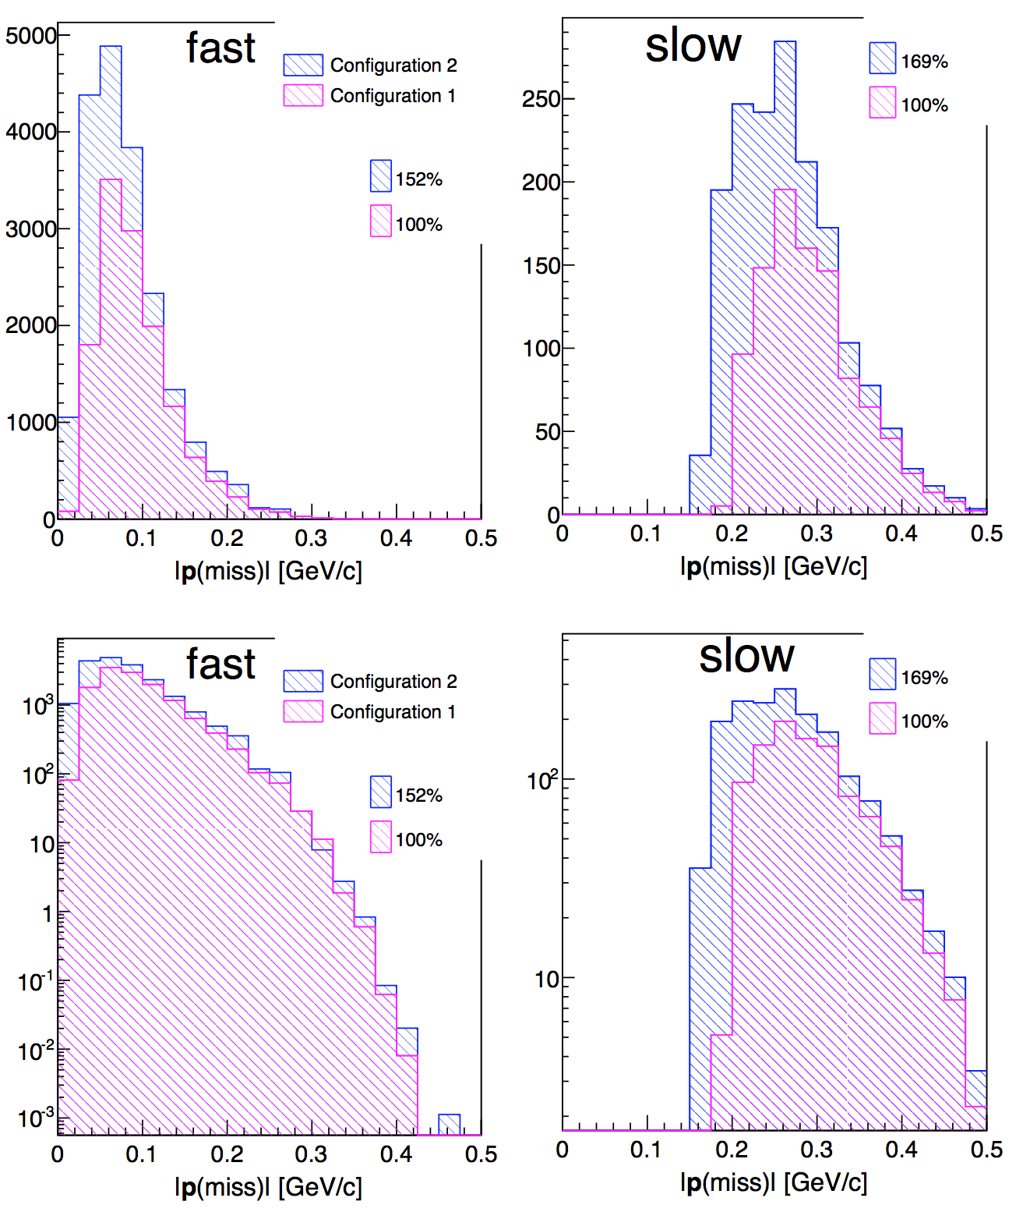
³A(e,e’p) counts
+30cm
Nominal

Slide 5
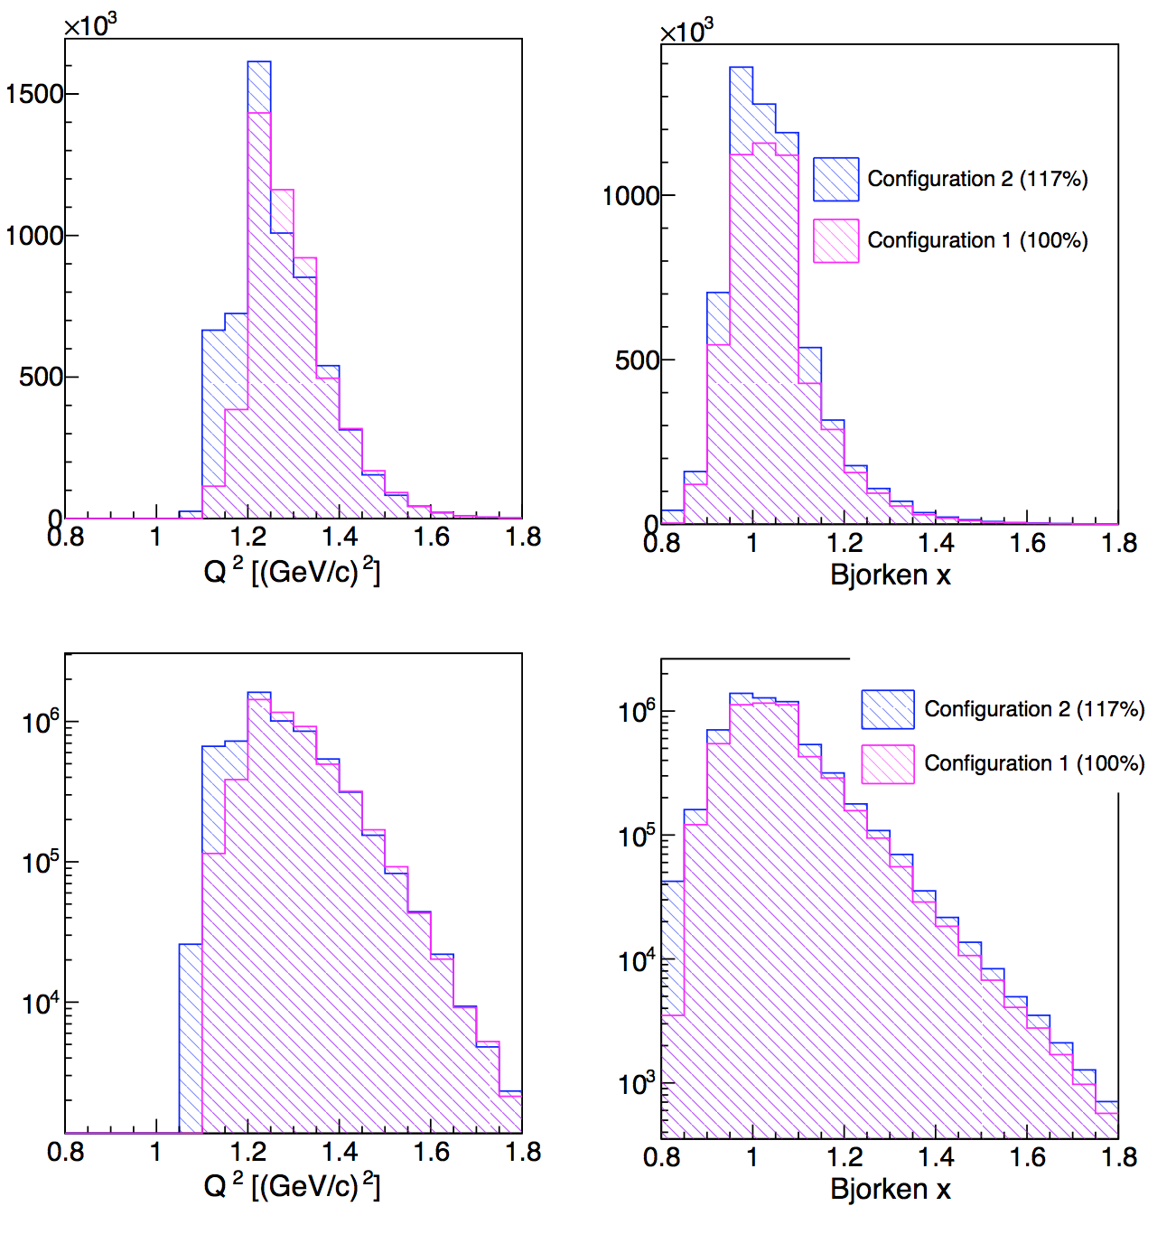
³A(e,e’) x > 1 counts
+30cm
Nominal

