Slide 1
Boiling Target Study
Sheren Alsalmi
Kent State University
Supervisors:
Dr. Makis Petratos & Mina Katramatou

Slide 2
Motivation:
Discuss a previous analysis work on “Boiling Target” using two targets: LH2 and Carbon. The analysis was done using GMP boiling target runs (Spring 2015).
Methods:
Charge yield vs. Beam current
Scaler counts vs. Beam current

Slide 3
Physics of Boiling Target Study:
When the beam passes through the target, the local temperature fluctuations could cause a variation in the target density. This density variation is called “Boiling”, and it increases with increasing current.
The target density changes with current as follows:
where I is the beam current, B is the target boiling factor, and ρ₀ is the nominal target density at I = 0.

Slide 4
Analysis Steps:
Calculate “Live Time”
Apply cuts:
PID cut
One track cut ( select events only with one track in VDCs)
Cut on target length
Beam trip cut ( was not applied during this study, but applied later with no significant changes in the results)
Check the efficiency of each cut
Extract the number of “good events” after all the above.
Calculate and Plot the normalized charge yield vs. current for each run. If it is equal to 1 => no boiling, and if it is less than 1 => the target is boiling.

Slide 5
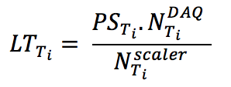
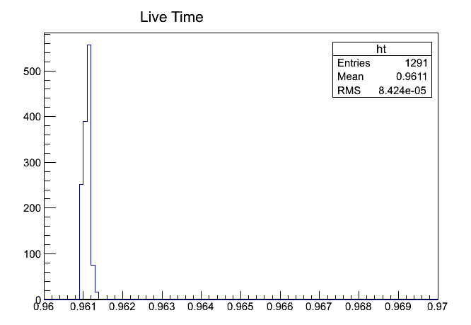
1. Calculating the Live Time:
where PS_{Ti} is the pre-scaler factor of the trigger i, N^{DAQ} and N^{scaler} are total numbers of trigger events and scaler counts respectively for the trigger i.

Slide 6
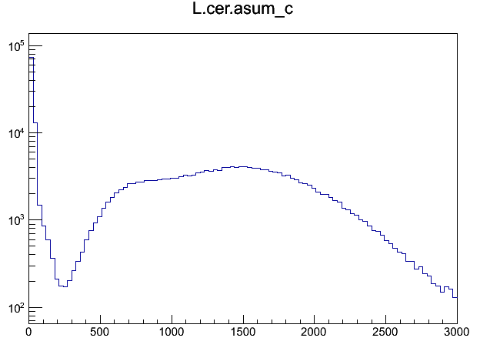
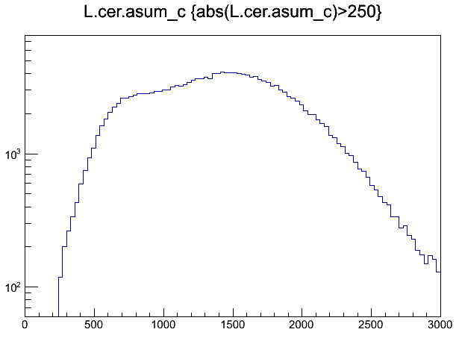
2. Applying the Cuts:
Cerenkov cut:
Before cut
After cut

Slide 7
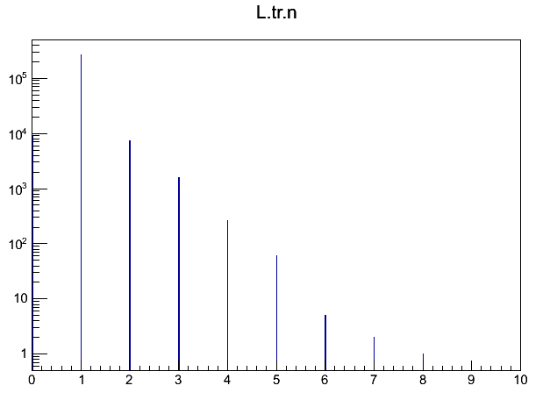
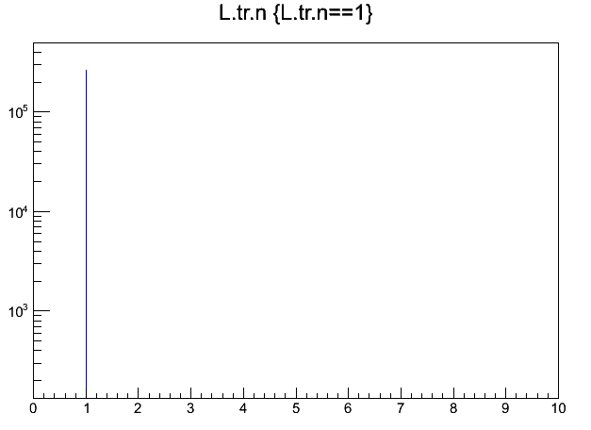
2. Applying the Cuts:
One-Track cut:
Before cut
After cut

Slide 8
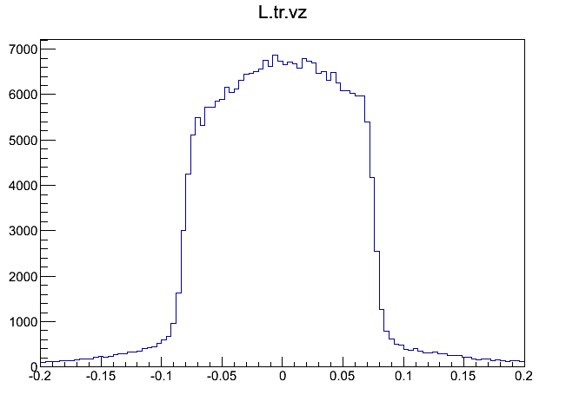
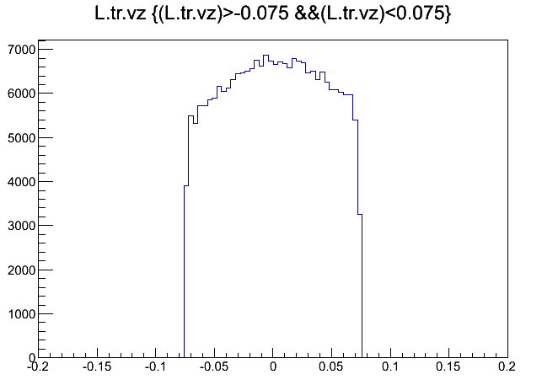
2. Applying the Cuts:
The cut on target length:
Before cut
After cut

Slide 9
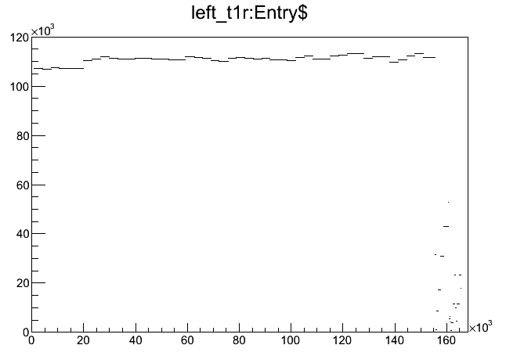
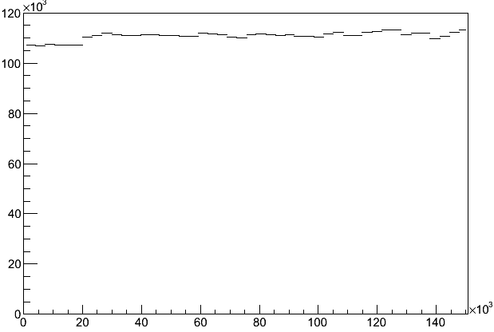
2. Applying the Cuts:
As mentioned before, the beam trip cut was NOT applied during this study. However, I got rid of the events when the beam was tripping. Results did not change after applying beam trip cut.
Before cut
After cut

Slide 10
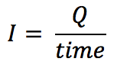
Calculating the Charge Yield:
After applying the appropriate cuts, and checking the efficiencies, we can calculate the total charge using:
where Q is the charge, a & b are constants. Then one can calculate the current using:
and the charge yield is given by:

Slide 11
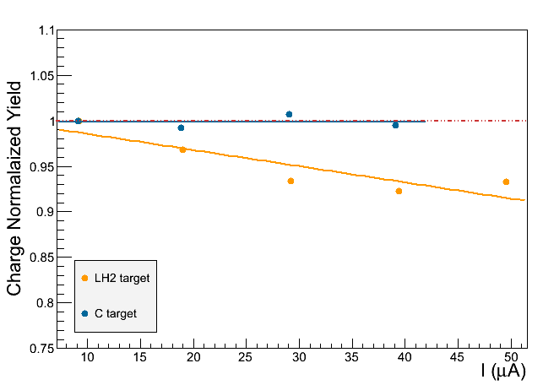
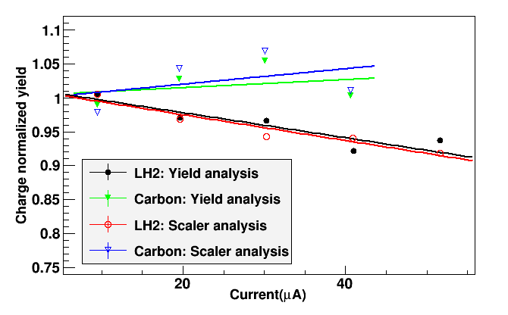
Results:
By: Sheren Alsalmi
By: Thir Gautam
(GMP)

Slide 12
Great thanks to David Meekins for his help and supervising this study, and to Thir Gautam for sharing his results.

