Slide 1
Tritium Target Task List and Installation Plan
Dave Meekins
3/16/2016

Slide 2
T2 Target System Project Overview
JLAB System DA: Dave Meekins
JLAB System Owner: Dave Meekins
Systems approach to the project
  Includes tritium target affected subsystems
    Beamline FSD
    Radiological detectors
    Procedures/training
    Access controls
    Shipping/handling/storage of T2 cell
    Safety systems/certifications
    Exhaust system …
Over 200 tasks associated with project
  13 Task groups
  Each task group has responsible individual assigned
  Each task has resources assigned to complete the task
  Trimmed down from original project file

Slide 3
Task Subgroups
Task Name | Start | Finish | % Complete | Resp Ind
Preliminary design and feasibility study | 6/1/10 | 6/10/10 | 100%
Target ERR | 9/16/15 | 10/1/15 | 100%
System documentation | 9/1/15 | 12/1/16 | 29% | Dave Meekins
Target and Scattering Chamber | 10/1/15 | 1/10/17 | 24% | Dave Meekins
Controls | 3/14/16 | 2/3/17 | 2% | Chris Keith
Electrical | 9/15/15 | 10/1/16 | 9% | Chris Keith
SRS | 10/1/15 | 1/30/18 | 47% | Joe Novajosky
Exhaust system | 10/1/15 | 9/15/16 | 36% | Dave Meekins
RadCon | 4/1/16 | 1/10/18 | 3% | Keith Welch
Installation | 1/3/17 | 2/9/17 | 0% | Dave Meekins
Summer down | 6/4/17 | 6/12/17 | 0% | Dave Meekins
Fall 2017 Install | 9/1/17 | 10/3/17 | 0% | Dave Meekins
Removal of target system | 12/22/17 | 2/1/18 | 0% | Dave Meekins

Slide 4
Project Personnel
Name | Name | Name
Mark Hoegerl | Bill Rainey | Joe Novajosky
Dave Meekins | Gina Roemer | R. Lee Nigg
Paul Hood | Mike Martin | Ashley Allisondo
Chris Keith | Keith Welch | Mike Morgan
James Brock | Vashek Vylet | Greg Howard
Chris Carlin | George Kharashvili | Trent Edwards
Dave Griffith | Dave Hamlette | Paul Blanton
James Maxwell | Maya Keller | Larry Hancock
Jenord Alston | Tom Renzo | Patty Hunt
Roy Holt | Dave Kausch | ATS Lab
Tom O'Neal | Ed Douberly | JLAB Shop
Jim Roerbach | Carrol Jones | JLAB PA
Robin Wines | FML Contractor | Miller
Joyce Miller | Yves Roblin | Outside Machine Shop
Hall A Tech | Tommy Michaelides | Ouside crane comp
Ed Folts | Acc designer | Crane
Whit Seay | Acc Electrical | Reisbach
Tim Whitlatch | Acc installer | T. Scott Mcgee
Sue Witherspoon | Alignment

Slide 5
MS Project used to manage
All tasks defined and listed
Resources are allocated for each task
Responsible individual/owner assigned to each task group
PDF is available on wiki

Slide 6
Installation Plan Overview
Two phases
  Phase 1 (Summer 2016)
    ~June 1 to Oct 1
  Phase 2 (Jan 2017)
    ~ December 19 to Feb 9
Target and scattering chamber must be installed in shorter Phase 2
Summer 2016
  Exhaust system including stack
  Electrical installation
  Detector/monitor install
By December:
  Extensive documentation
    Procedures
    OSP for target
    Completion of target construction

Slide 7
T2 Target System Project Overview
12 days
100%
Sep 16 - Oct 1
Target ERR
328 days
System documentation
Sep 1 - Dec 1
29%
334 days
Oct 1 - Jan 10
24%
Target and Scattering Chamber
201 days
Mar 14 - Dec 19
2%
Controls
196 days
Jan 1 - Oct 1
9%
Eletrical
264 days
Nov 2 - Nov 3
42%
ASTM G168 testing
141 days
Oct 1 - Apr 14
94%
Hut
23 days
Jan 1 - Feb 1
Cell operations
251 days
Oct 1 - Sep 15
36%
Exhaust system
28 days
Jan 3 - Feb 9
Installation
131 days
Apr 1 - Sep 30
RadCon
1 day
Feb 3
Hot Checkout
3 days
Feb 3 - Feb 7
T2 cell installation
6 days
Jun 4 - Jun 12
Summer down
23 days
Sep 1 - Oct 3
Fall 2017 Install
20 days
Sep 1 - Sep 28
Hot Checkout
30 days
Dec 22 - Feb 1
Removal of target system
17 days
End Phase 1 Install
Jan 10 - Feb 1
Cell Removal
Oct 1
End Phase 2 Install
Dec 26
2015
2016
2017
Sep
Dec
Mar
Jun
Sep
Dec
Mar
Jun
Sep
Dec
2018
2015
Today
Jun 8
Dec 19
Start Phase 1 Install
Start Phase 2 Install

Slide 8
Target Fabrication and Assembly
142 days
Design
Oct 1 - Apr 15
60%
267 days
Oct 26 - Nov 1
20%
Fabrication
45 days
Feb 1 - Apr 1
90%
Cell fabrication
9 days
Apr 5 - Apr 15
0%
Mounts
9 days
Apr 5 - Apr 15
10%
HX
6 days
100%
Oct 26 - Nov 2
JT valves
110 days
Feb 1 - Jul 1
20%
Cryo piping
57 days
Apr 15 - Jul 4
Testing/Examination/Inspection
34 days
Apr 15 - Jun 1
cell welding
22 days
Jun 2 - Jul 1
cell leak testing
1 day
Jul 4
Welding
1 day
Jul 4
Leak testing
131 days
Feb 1 - Aug 1
25%
Chamber
152 days
Jan 1 - Aug 1
50%
Platform
145 days
Jun 1 - Dec 20
Non-T2 cell filling
111 days
Jun 1 - Nov 2
T2 Cell
12 days
Jun 1 - Jun 16
assemble cells
11 days
Jul 1 - Jul 15
perform leak testing
11 days
Jul 18 - Aug 1
clean cells
4 days
Aug 2 - Aug 5
pump/purge
2 days
Nov 1 - Nov 2
ship to SRS
2015
2016
2015
Oct
Dec
Feb
Apr
Jun
Aug
Oct
Dec
2017
Today

Slide 9
Vacuum System Fabrication and Assembly
160 days
Vacuum System
Jun 1 - Jan 10
6 days
Jan 3 - Jan 10
Install Getter
6 days
Jan 3 - Jan 10
Install getter interlocks and controls
67 days
Alter H2 exhaust near storage tanks
Jun 1 - Sep 1
30%
67 days
Alter pump exhaust for sampling
Jun 1 - Sep 1
67 days
Pipe run for exhaust to top of Hall
Jun 1 - Sep 1
50%
22 days
Sep 1 - Sep 30
Test pump exhaust run
2016
2017
2016
Jun
Jul
Aug
Sep
Oct
Nov
Dec
Jan
2017
Today

Slide 10
Exhaust System
251 days
Exhaust system
Oct 1 - Sep 15
175 days
Design
Oct 1 - Jun 1
80%
110 days
Nov 2 - Apr 1
90%
Interior hut piping
56 days
Jan 15 - Apr 1
50%
Damper box
1 day
20%
Mar 14
Pad
42 days
Jan 15 - Mar 14
100%
Blower
142 days
Stack design
Oct 1 - Apr 15
70%
85 days
Jan 2 - Apr 30
70%
Calcs
23 days
May 2 - Jun 1
Review
76 days
Apr 1 - Jul 15
Fabrication
76 days
Apr 1 - Jul 15
Adapters
76 days
Apr 1 - Jul 15
Stack
76 days
Apr 1 - Jul 15
Damper box
99 days
May 1 - Sep 15
Installation
66 days
May 1 - Aug 1
Mech interior
34 days
Aug 1 - Sep 15
Mech exterior
34 days
Aug 1 - Sep 15
Electrical exterior
2015
2016
2015
Oct
Nov
Dec
Jan
Feb
Mar
Apr
May
Jun
Jul
Aug
Sep
2016
Today

Slide 11
235 days
Controls and Electrical
Mar 14 - Feb 3
Controls
15 days
Mar 14 - Apr 1
Define signals
197 days
Apr 4 - Jan 3
Target control software
197 days
Apr 4 - Jan 3
Interlock software interface
1 day
Jan 4
Complete software
22 days
Jan 5 - Feb 3
Test software/debug
274 days
Sep 15 - Oct 1
Eletrical
90 days
May 1 - Sep 2
Target electronics
89 days
May 1 - Sep 1
Target internal intrumentation
90 days
May 1 - Sep 2
Breakout boxes
90 days
May 1 - Sep 2
cables
45 days
May 1 - Jul 1
FSD Electronics
253 days
Sep 15 - Sep 1
50%
Access Controls
89 days
May 1 - Sep 1
Exhaust system
89 days
May 1 - Sep 1
Alarm signals
89 days
May 1 - Sep 1
Fan controls/Power
110 days
May 1 - Oct 1
Alarms and interlocks
89 days
May 1 - Sep 1
T2 alarms
89 days
May 1 - Sep 1
Interlocks
110 days
May 1 - Oct 1
Indicator boxes and switches
2015
2016
2017
2015
Sep
Nov
Jan
Mar
May
Jul
Sep
Nov
Jan
2017
Today

Slide 12
2017
2017
Jan
Feb
2017
28 days
Today
Installation
Jan 3 - Feb 9
1 day
Jan 4
Post Run survey
1 day
Jan 5
Disconnect cryo target
1 day
Jan 6
Remove cryo target to stand
Jan 2017 Installation Period
1 day
Jan 9
Install hut platform
1 day
Jan 9
Bring T2 to Hall
4 days
Jan 9 - Jan 12
Prep T2 target
1 day
Jan 12
Lift T2 target to pivot
4 days
Jan 12 - Jan 17
connect piping
4 days
Jan 12 - Jan 17
connect eletrical
1 day
Jan 17
ring out
1 day
Jan 18
alignment
9 days
Jan 18 - Jan 30
Hot Checkout
3 days
Jan 18 - Jan 20
FSD testing
2 days
Jan 23 - Jan 24
Interlock testing
1 day
Jan 25
verify CANS access
1 day
Jan 26
Exhaust system
2 days
Jan 27 - Jan 30
Test vacuum
4 days
Jan 25 - Jan 30
T2 detector/monitor faults
3 days
Feb 3 - Feb 7
T2 cell installation
1 day
Feb 3
attach adapter to chamber
1 day
Feb 3
install hut
1 day
Feb 6
test/certify hut
1 day
Feb 7
install cell
1 day
Feb 7
Close chamber
1 day
Feb 7
installation complete
1 day
Feb 8
Target cool down
1 day
Feb 9
Remove platform

Slide 13
Shipping Plan
Use Bulk Tritium Shipping Package (MTV)
  New version will allow user packaging
Use Miscellaneous Tritium Vessel (MTV)
Package is certified for Type B quantities of T2
  150 g of T2 in various forms (Up to 120 lbm Gross)
  T2 target has 0.11 g of T2
  Must fit into CV
  Possibly could fit into an inner vessel (if 3 levels of containment required)
  If rack is acceptable (2 levels of containment) then design is simple
MTV must be designed by June 6
Sealed and shipped by trained/certified personnel from SRS/SRNL

Slide 14
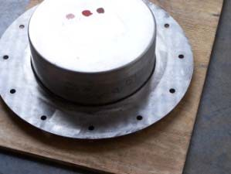
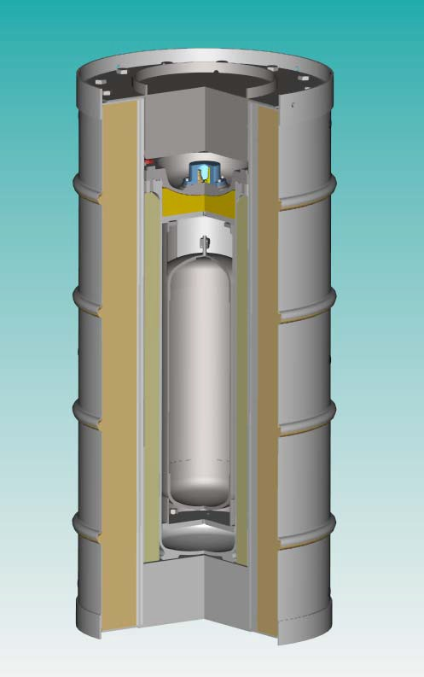
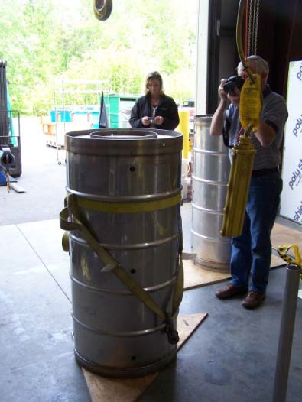
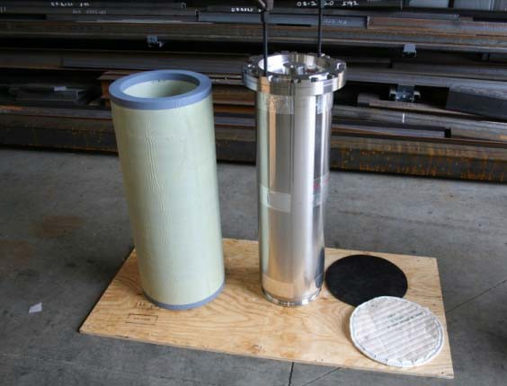
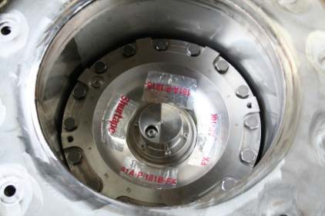
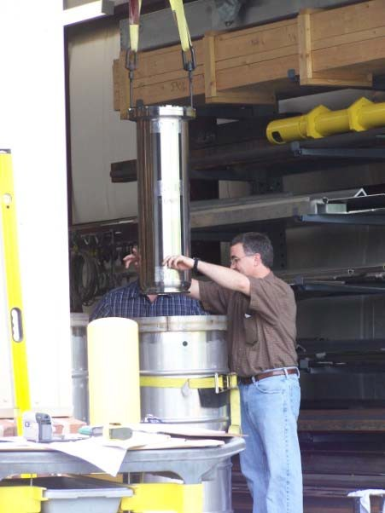
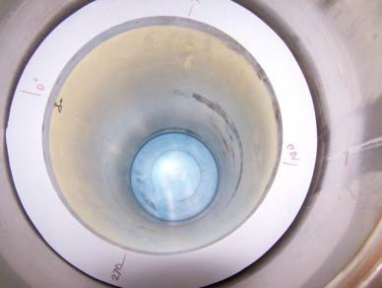

BTSP-1 Prototype Production
Major Tool & Machine, Inc.
DRUM
Drum Lid TR-19
CV, Honeycomb Spacer, Silicone & Thermal Pads
CV Lid
CV
Lifting
CV
Honeycomb
P. Blanton

Slide 15
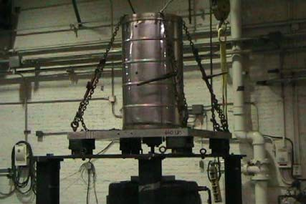
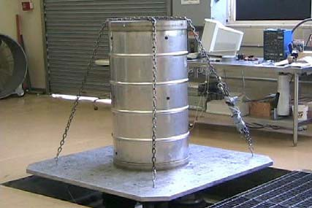
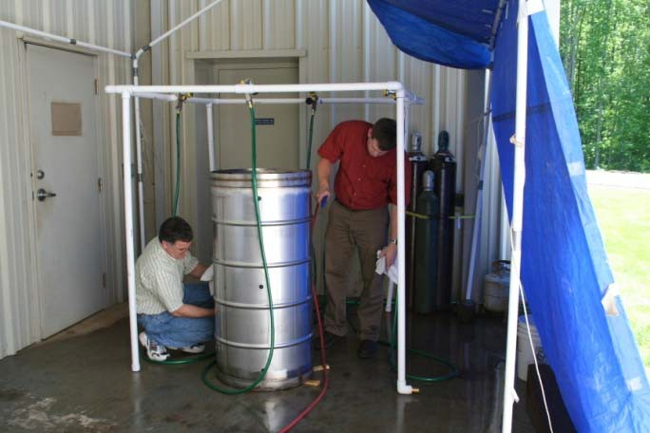
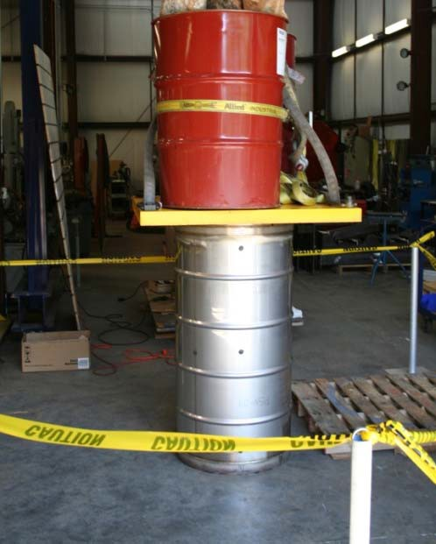
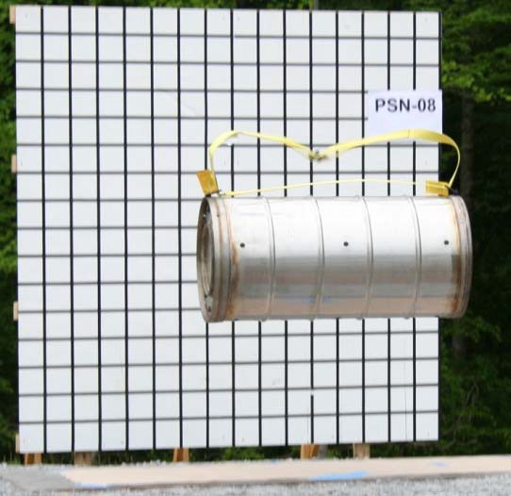
BTSP-1 Normal Condition of Transport (NCT) Tests
Low and High Frequency
VIBRATION
WATER SPRAY
BTSP
4-FT FREE DROP
STACKING
Penetration, Heat/Cold Tests not shown
22
P. Blanton

Slide 16
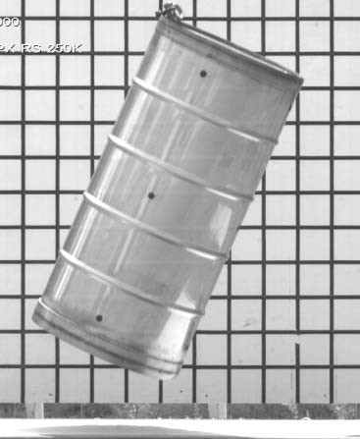
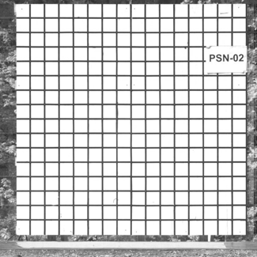
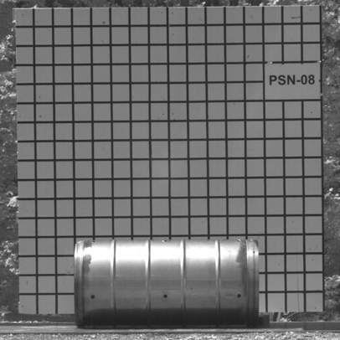
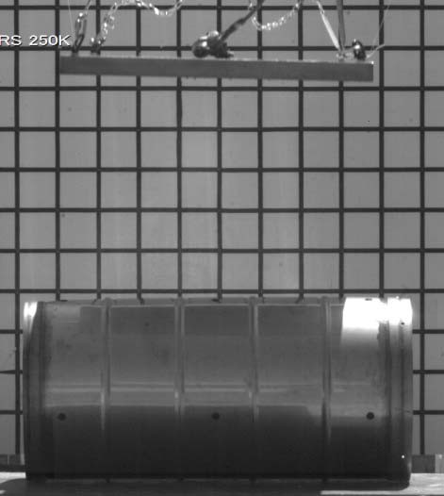
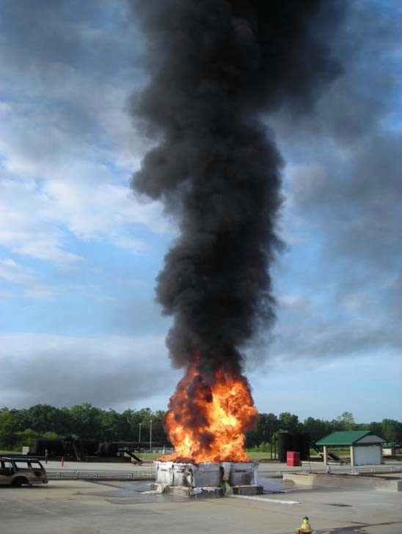
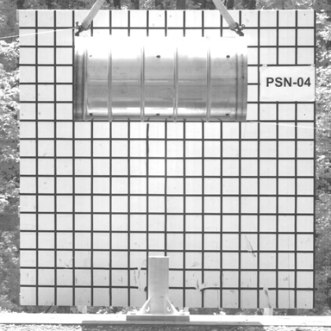
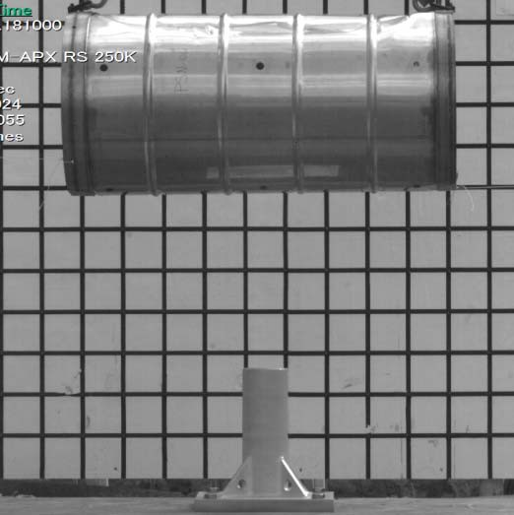
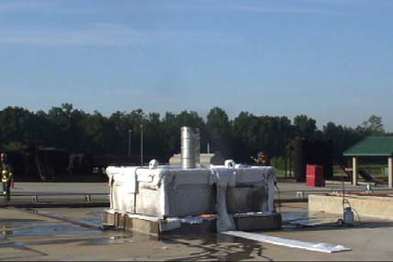
BTSP-1 Hypothetical Accident Condition (HAC) Tests
30-FT DROP
CRUSH
BTSP
30-MIN
1,475ºF FIRE
PUNCTURE
Immersion test not shown
23
P. Blanton

Slide 17
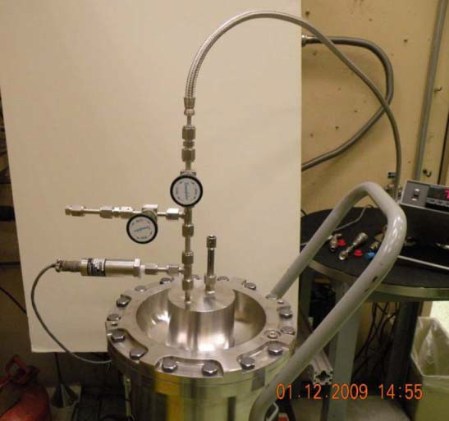
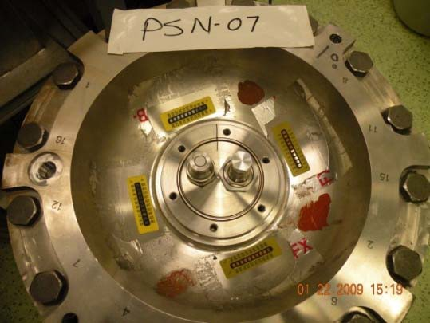
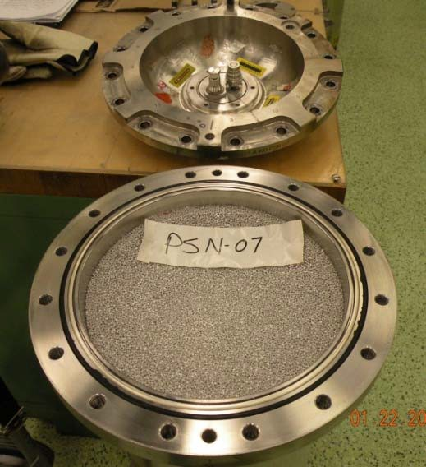
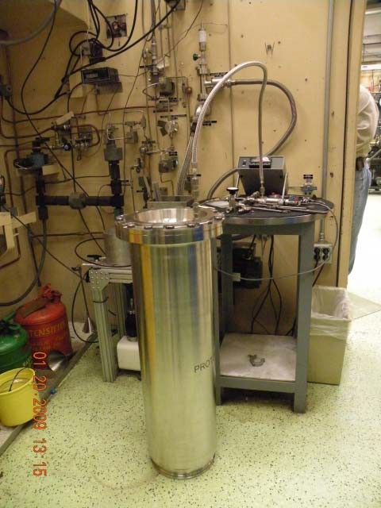
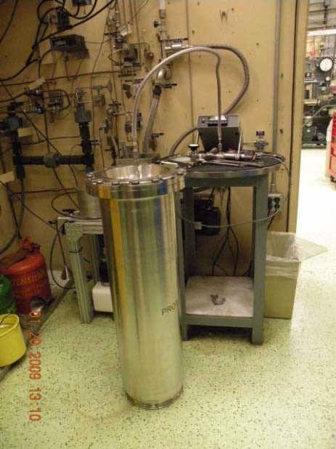
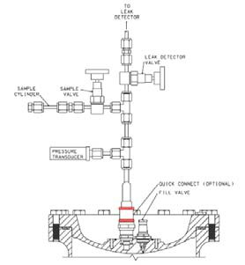
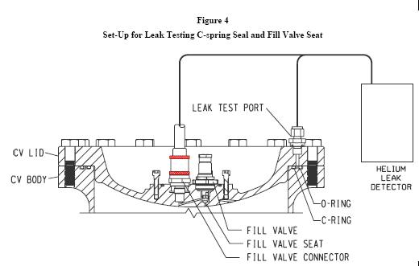
BTSP -1 Post-HAC: Helium Leak Testing
VALVE CAP
BELL JAR
CAP LEAK TEST
CV COMPONENTS
CV FLANGE C-RING TEST
BTSP
FLANGE C-RING
CV VALVE LEAK TEST
CV
P. Blanton

Slide 18
Transport Safety Checkout
Decontamination of cell after fill
Use of T2 leak testing equipment to ensure leak tightness
Procedures/training for packaging
Use of BTSP
  Leak test of BTSP prior to shipment
Shipping by authorized carrier
Receipt by JLAB RadCon/Target Group
  Leak testing of BTSP/CV/MTV prior to cell removal
BTSP exceeds all requirements
Sealed and shipped by trained/certified personnel from SRS/SRNL

Slide 19
Pre-installation Safety Checkout
Hot Checkout of Hall
  FSD system checkout
  T2 monitor and alarm checkout
  Exhaust system checkout
  Vacuum system checkout
  Access controls checkout
Hot checkout includes certification testing
  Two signatures to complete checklists
  Logged in HALOG/TargetLog
Installation of Hut

Slide 20
Installation Safety Checkout
Perform successful dry runs
Specific training for all personnel
Hot checkout complete
RadCon coverage of job
  Includes TAMs
Controlled Access for cell installation
Only essential personnel allowed in Hall
  Target group/RadCon
Exhaust system on low speed and attached to Hut
  Certify flow with calibrated ADM
Move CV to Hut
  Test CV for T2
  Remove Cell from CV
Detailed procedures for installation of the cell
Close chamber after cell installation

Slide 21
Operational Safety Checkout
Hot Checkout of Hall Performed Prior to Run Start
  FSD system checkout
  T2 monitor and alarm checkout
  Exhaust system checkout
  Vacuum system checkout
  Access controls checkout
Hot checkout includes certification testing
  Two signatures to complete checklists
  Logged in HALOG/TargetLog
  Multiple levels of signature for READY state
Continuous monitoring of vacuum, vacuum exhaust, Hall A air
FSD
  Raster, motion, ion chambers, current, T2 monitor, vacuum, H2 coolant (Be), He coolant, Temps
Access controls in place at all times
  CANS on ALL doors
  Tritium keep out zone near target and between spectrometers
Training and procedures for all activities

Slide 22
Removal Safety Checkout
Specific training for all personnel
Hot checkout complete
RadCon coverage of job
  Includes TAMs
Controlled Access for cell removal
Only essential personnel allowed in Hall
  Target group/RadCon
Exhaust system on low speed and attached to Hut
  Certify flow with calibrated ADM
Move CV to Hut
  Remove cell and decon/measure activation
  Place in MTV
Move CV to BTSP and store
Seal BTSP (trained personnel form SRS only)
  Exception for emergencies
Close chamber after cell installation

Slide 23
Task list for documentation/procedures
System documentation | Tue 9/1/15 | Thu 12/1/16 | Dave Meekins
System P&ID | Fri 1/1/16 | Fri 4/1/16 | Dave Meekins | Dave Meekins
Interlock/FSD Diagram | Fri 4/1/16 | Fri 4/1/16 | Dave Meekins | Dave Meekins
NEPA analysis/letter | Tue 9/1/15 | Wed 6/1/16 | Patty Hunt | Dave Meekins,Bill Rainey,Keith Welch,Patty Hunt
Procedures | Tue 9/15/15 | Thu 12/1/16 | Dave Meekins | Dave Meekins
Task specific procedures | Tue 9/15/15 | Thu 12/1/16 |  | Dave Meekins
Target OSP | Fri 4/1/16 | Thu 12/1/16 |  | Dave Meekins
Document Reviews | Wed 6/1/16 | Thu 12/1/16 |  | Ed Folts,ATS Lab,Carrol Jones,Chris Keith,Dave Meekins,Ed Douberly,Greg Howard,Jenord Alston,Joyce Miller,Keith Welch,Mark Hoegerl,Mike Morgan,Patty Hunt,Robin Wines,Tim Whitlatch,Tom Renzo,Tommy Michaelides,Vashek Vylet,Whit Seay

Slide 24
Target Fabrication Task List
Target and Scattering Chamber | Thu 10/1/15 | Tue 1/10/17 | Dave Meekins
Design | Thu 10/1/15 | Fri 4/15/16 | Dave Meekins
Calcs | Mon 2/1/16 | Thu 3/3/16 |  | Dave Meekins
Review | Thu 3/3/16 | Fri 4/1/16 |  | Robin Wines,Tim Whitlatch
Cell | Mon 2/1/16 | Mon 2/1/16 |  | Dave Meekins
Mounts | Tue 3/1/16 | Fri 4/15/16 |  | Dave Meekins
HX | Tue 3/1/16 | Fri 4/15/16 |  | Dave Meekins
JT valves | Thu 10/1/15 | Fri 10/30/15 |  | Dave Meekins
Cryo piping | Mon 11/2/15 | Fri 4/1/16 |  | Dave Meekins
Fabrication | Mon 10/26/15 | Fri 4/15/16 | Dave Meekins
Cell fabrication | Mon 2/1/16 | Fri 4/1/16 |  | Jim Roerbach
Mounts | Tue 4/5/16 | Fri 4/15/16 |  | Jim Roerbach,James Brock,Mark Hoegerl,Paul Hood
HX | Tue 4/5/16 | Fri 4/15/16 |  | Jim Roerbach,James Brock,Mark Hoegerl,Paul Hood
JT valves | Mon 10/26/15 | Mon 11/2/15 |  | Jim Roerbach,James Brock,Mark Hoegerl,Paul Hood
Cryo piping | Mon 2/1/16 | Tue 2/16/16 |  | Jim Roerbach,James Brock,Mark Hoegerl,Paul Hood
Testing/Examination/Inspection | Fri 4/15/16 | Mon 7/4/16 | Dave Meekins
cell welding | Fri 4/15/16 | Wed 6/1/16 |  | Mark Hoegerl
cell leak testing | Thu 6/2/16 | Fri 7/1/16 |  | Paul Hood
Welding | Mon 7/4/16 | Mon 7/4/16 |  | Mark Hoegerl
Leak testing | Mon 7/4/16 | Mon 7/4/16 |  | Paul Hood
Chamber | Mon 2/1/16 | Mon 8/1/16 | Dave Meekins
Be window/collimator design | Mon 2/1/16 | Mon 3/14/16 |  | Joyce Miller,Dave Meekins
Be window/collimator fabrication | Tue 3/15/16 | Fri 7/1/16 |  | Jim Roerbach
Hut adapter design | Mon 2/1/16 | Tue 3/1/16 |  | Joyce Miller
Hut adapter fabrication | Sun 5/1/16 | Mon 8/1/16 |  | Mark Hoegerl
Platform | Fri 1/1/16 | Mon 8/1/16 | Robin Wines
Design | Fri 1/1/16 | Fri 4/1/16 |  | Joyce Miller
Review | Mon 4/4/16 | Mon 4/4/16 |  | Whit Seay
Fabrication | Sun 5/1/16 | Mon 8/1/16 |  | JLAB Shop
Non-T2 cell filling | Wed 6/1/16 | Tue 12/20/16 | Dave Meekins
assemble cells | Wed 6/1/16 | Thu 9/1/16 |  | Paul Hood
develop pump/purge rig | Wed 6/1/16 | Thu 9/1/16 |  | Chris Keith,James Brock
clean cells | Thu 9/1/16 | Thu 9/1/16 |  | Paul Hood
fill cells | Thu 12/1/16 | Tue 12/20/16 |  | Chris Keith,Dave Meekins,James Brock
T2 Cell | Wed 6/1/16 | Wed 11/2/16 | Dave Meekins
assemble cells | Wed 6/1/16 | Thu 6/16/16 |  | Paul Hood
perform leak testing | Fri 7/1/16 | Fri 7/15/16 |  | Paul Hood
clean cells | Mon 7/18/16 | Mon 8/1/16 |  | Paul Hood
pump/purge | Tue 8/2/16 | Fri 8/5/16 |  | Paul Hood
ship to SRS | Tue 11/1/16 | Wed 11/2/16 |  | Dave Meekins
Vacuum System | Wed 6/1/16 | Tue 1/10/17 | Dave Meekins
Install Getter | Tue 1/3/17 | Tue 1/10/17 |  | Paul Hood
Install getter interlocks and controls | Tue 1/3/17 | Tue 1/10/17 |  | Paul Hood,Dave Griffith
Alter H2 exhaust near storage tanks | Wed 6/1/16 | Thu 9/1/16 |  | Dave Meekins,James Brock,Mark Hoegerl,Paul Hood
Alter pump exhaust for sampling | Wed 6/1/16 | Thu 9/1/16 |  | Dave Meekins,James Brock,Mark Hoegerl,Paul Hood
Pipe run for exhaust to top of Hall | Wed 6/1/16 | Thu 9/1/16 |  | Dave Meekins,FML Contractor,James Brock,Mark Hoegerl,Paul Hood
Test pump exhaust run | Thu 9/1/16 | Fri 9/30/16 |  | Paul Hood

Slide 25
Controls/Electronics Tasks
Controls | Mon 3/14/16 | Fri 2/3/17 | Chris Keith
Define signals | Mon 3/14/16 | Fri 4/1/16 |  | Chris Carlin,Chris Keith,Dave Meekins,James Brock
Target control software | Mon 4/4/16 | Tue 1/3/17 |  | Sue Witherspoon,Chris Keith
Interlock software interface | Mon 4/4/16 | Tue 1/3/17 |  | Sue Witherspoon
Complete software | Wed 1/4/17 | Wed 1/4/17
Test software/debug | Thu 1/5/17 | Fri 2/3/17 |  | Chris Carlin
Eletrical | Tue 9/15/15 | Sat 10/1/16 | Chris Keith
Target electronics | Sun 5/1/16 | Fri 9/2/16 | Chris Keith
Target internal intrumentation | Sun 5/1/16 | Thu 9/1/16 |  | Dave Griffith
Breakout boxes | Sun 5/1/16 | Fri 9/2/16 |  | Dave Griffith
cables | Sun 5/1/16 | Fri 9/2/16 |  | Dave Griffith
FSD Electronics | Sun 5/1/16 | Fri 7/1/16 | Tommy M
Access Controls | Tue 9/15/15 | Thu 9/1/16 | FML
Exhaust system | Sun 5/1/16 | Thu 9/1/16 | Dave Meekins
Alarm signals | Sun 5/1/16 | Thu 9/1/16 |  | Dave Griffith,Carrol Jones
Fan controls/Power | Sun 5/1/16 | Thu 9/1/16 |  | Dave Griffith,Carrol Jones,Reisbach
Alarms and interlocks | Sun 5/1/16 | Sat 10/1/16 | Dave Meekins
T2 alarms | Sun 5/1/16 | Thu 9/1/16 |  | Dave Griffith,Acc Jones,Ed Douberly,Hall A TechElectrical,Keith Welch,Carrol
Interlocks | Sun 5/1/16 | Thu 9/1/16 |  | Dave Griffith,Acc Electrical,Keith Welch,Carrol Jones,Ed Douberly,Hall A Tech,Reisbach
Indicator boxes and switches | Sun 5/1/16 | Sat 10/1/16 |  | Dave Griffith,Acc Electrical,Keith Welch,Carrol Jones,Ed Douberly,Hall A Tech

Slide 26
SRS Tasks
SRS | Thu 10/1/15 | Tue 1/30/18 | Joe Novajosky
Safetey Basis review | Mon 6/6/16 | Mon 6/6/16 | Joe Novajosky | Joe Novajosky
ASTM G168 testing | Mon 11/2/15 | Thu 11/3/16 | Mike Morgan
Load test samples | Mon 11/2/15 | Mon 2/29/16 |  | Mike Morgan
4 month check | Tue 3/1/16 | Tue 6/28/16 |  | Mike Morgan
8 month check | Wed 6/29/16 | Wed 10/26/16 |  | Mike Morgan
12 month check | Thu 10/27/16 | Thu 10/27/16 |  | Mike Morgan
Testing complete | Fri 10/28/16 | Thu 11/3/16 |  | Mike Morgan
Hut | Thu 10/1/15 | Thu 4/14/16 | Greg Howard
Design | Thu 10/1/15 | Wed 10/14/15 |  | Greg Howard
Fabrication | Thu 10/15/15 | Wed 12/9/15 |  | Greg Howard
Testing | Thu 12/10/15 | Wed 1/6/16 |  | Greg Howard
Ship to JLAB | Fri 4/1/16 | Thu 4/14/16 |  | Greg Howard
Cell operations | Sun 1/1/17 | Wed 2/1/17 | Joe Novajosky
Cell filling | Sun 1/1/17 | Sat 1/21/17 |  | T. Scott Mcgee
Shipping | Sun 1/22/17 | Wed 2/1/17 |  | T. Scott Mcgee
Shipping issues | Mon 2/1/16 | Tue 1/30/18 | Dave Meekins
Develop MTV | Mon 2/1/16 | Sun 5/1/16 |  | Paul Blanton
Drop test MTV/package | Thu 6/30/16 | Thu 6/30/16 |  | Dave Meekins
Shipping from JLAB to SRS | Thu 1/25/18 | Tue 1/30/18 |  | Paul Blanton

Slide 27
Exhaust system tasks
Exhaust system | Thu 10/1/15 | Thu 9/15/16 | Dave Meekins
Design | Thu 10/1/15 | Wed 6/1/16
Interior hut piping | Mon 11/2/15 | Fri 4/1/16 |  | Joyce Miller
Damper box | Fri 1/15/16 | Fri 4/1/16 |  | Joyce Miller
Pad | Mon 3/14/16 | Mon 3/14/16 |  | Joyce Miller
Blower | Fri 1/15/16 | Mon 3/14/16 |  | Joyce Miller
Stack | Thu 10/1/15 | Fri 4/15/16 |  | Joyce Miller
Calcs | Sat 1/2/16 | Sat 4/30/16 |  | Dave Meekins
Review | Mon 5/2/16 | Wed 6/1/16 |  | Tom Renzo
Fabrication | Fri 4/1/16 | Fri 7/15/16
Adapters | Fri 4/1/16 | Fri 7/15/16 |  | Mark Hoegerl
Stack | Fri 4/1/16 | Fri 7/15/16 |  | Mark Hoegerl,Dave Meekins,James Brock,Paul Hood
Damper box | Fri 4/1/16 | Fri 7/15/16 |  | Mark Hoegerl
Installation | Sun 5/1/16 | Thu 9/15/16
Mech interior | Sun 5/1/16 | Mon 8/1/16 |  | Paul Hood,Dave Meekins,Mark Hoegerl,James Brock,Hall A Tech
Mech exterior | Mon 8/1/16 | Thu 9/15/16 |  | Paul Hood,Dave Meekins,Mark Hoegerl,James Brock,Hall A Tech,Ouside crane comp
Electrical exterior | Mon 8/1/16 | Thu 9/15/16 |  | FML Contractor

Slide 28
RadCon Tasks
RadCon | Fri 4/1/16 | Wed 1/10/18 | Keith Welch
Tritium Detection/Monitoring | Fri 4/1/16 | Fri 9/30/16
Purchase WAM | Fri 4/1/16 | Wed 6/1/16 |  | Keith Welch
Install WAM | Wed 6/1/16 | Mon 8/1/16
Mount WAM | Thu 6/2/16 | Fri 7/1/16 |  | Keith Welch
Run tubing for WAM | Wed 6/1/16 | Mon 8/1/16 |  | Paul Hood,Dave Meekins,James Brock,Mark Hoegerl
Run tubing for stack monitor | Wed 6/1/16 | Mon 8/1/16 |  | Paul Hood,Dave Meekins,James Brock,Mark Hoegerl
Run tubing for storage location | Wed 6/1/16 | Mon 8/1/16 |  | Paul Hood,Dave Meekins,James Brock,Mark Hoegerl
Calibrate WAM | Wed 8/3/16 | Wed 8/3/16 |  | Keith Welch
Alarm signals | Thu 8/4/16 | Fri 9/30/16 |  | Keith Welch
Testing | Wed 6/1/16 | Fri 9/30/16 |  | Keith Welch
Connect to stack monitor | Wed 6/1/16 | Fri 9/30/16 |  | Paul Hood,Dave Meekins
Procedures and Training | Fri 4/1/16 | Thu 12/1/16
Develop tritium training | Fri 4/1/16 | Fri 9/30/16 |  | Keith Welch,Dave Meekins,Maya Keller
Alter Procedures for access | Fri 4/1/16 | Thu 12/1/16 |  | Keith Welch,Dave Meekins
Cell S/R and handling | Sun 1/1/17 | Wed 1/10/18
Receive T2 Cell | Sun 1/1/17 | Mon 1/30/17 |  | Dave Meekins,Keith Welch
Test for leakage | Sun 1/1/17 | Mon 1/30/17 |  | Dave Meekins,Keith Welch
Install cell coverage | Tue 2/7/17 | Tue 2/7/17 |  | Dave Hamlette
Remove cell coverage summer | Mon 6/12/17 | Mon 6/12/17 |  | Dave Hamlette
Install Fall 17 | Mon 10/2/17 | Mon 10/2/17
Remove cell coverage | Wed 1/10/18 | Wed 1/10/18 |  | Dave Hamlette

Slide 29
Installation Tasks
Installation | Tue 1/3/17 | Thu 2/9/17 | Dave Meekins
Post Run survey | Wed 1/4/17 | Wed 1/4/17 |  | Dave Meekins,Alignment
Disconnect cryo target | Thu 1/5/17 | Thu 1/5/17 |  | Dave Meekins,James Brock,Mark Hoegerl,Paul Hood
Remove cryo target to stand | Fri 1/6/17 | Fri 1/6/17 |  | Dave Meekins,James Brock,Mark Hoegerl,Paul Hood
Install hut platform | Mon 1/9/17 | Mon 1/9/17 |  | Dave Meekins,James Brock,Mark Hoegerl,Paul Hood
Bring T2 to Hall | Mon 1/9/17 | Mon 1/9/17 |  | Dave Meekins,James Brock,Mark Hoegerl,Paul Hood
Prep T2 target | Mon 1/9/17 | Thu 1/12/17 |  | Dave Meekins,James Brock,Mark Hoegerl,Paul Hood
Lift T2 target to pivot | Thu 1/12/17 | Thu 1/12/17 |  | Dave Meekins,James Brock,Mark Hoegerl,Paul Hood
connect piping | Thu 1/12/17 | Tue 1/17/17 |  | Dave Meekins,James Brock,Mark Hoegerl,Paul Hood
connect eletrical | Thu 1/12/17 | Tue 1/17/17 |  | Dave Meekins,James Brock,Mark Hoegerl,Paul Hood
ring out | Tue 1/17/17 | Tue 1/17/17
alignment | Wed 1/18/17 | Wed 1/18/17 |  | Dave Meekins,Alignment
Hot Checkout | Tue 1/3/17 | Mon 1/30/17
FSD testing | Tue 1/3/17 | Mon 1/30/17 |  | Tommy Michaelides
Interlock testing | Tue 1/3/17 | Mon 1/30/17 |  | Dave Griffith,Carrol Jones,Chris Carlin,Chris Keith,Dave Meekins
verify CANS access | Tue 1/3/17 | Mon 1/30/17 |  | Chris Carlin,Chris Keith,Dave Meekins
Exhaust system | Tue 1/3/17 | Mon 1/30/17 |  | Carrol Jones,Dave Meekins,Ed Douberly
Test vacuum | Tue 1/3/17 | Mon 1/30/17 |  | Paul Hood,Dave Meekins
T2 detector/monitor faults | Tue 1/3/17 | Mon 1/30/17 |  | Dave Meekins,Keith Welch
T2 cell installation | Fri 2/3/17 | Tue 2/7/17
attach adapter to chamber | Fri 2/3/17 | Fri 2/3/17 |  | Dave Meekins,James Brock,Mark Hoegerl,Paul Hood
install hut | Fri 2/3/17 | Fri 2/3/17 | 171 | Dave Meekins,James Brock,Mark Hoegerl,Paul Hood
test/certify hut | Mon 2/6/17 | Mon 2/6/17 | 172 | Dave Meekins
install cell | Tue 2/7/17 | Tue 2/7/17 | 173 | Dave Meekins
Close chamber | Tue 2/7/17 | Tue 2/7/17 | 174 | Dave Meekins,Hall A Tech,James Brock,Mark Hoegerl,Paul Hood
installation complete | Tue 2/7/17 | Tue 2/7/17 | 175
Target cool down | Wed 2/8/17 | Wed 2/8/17 | 176 | Chris Carlin,Chris Keith,Dave Meekins
Remove platform | Thu 2/9/17 | Thu 2/9/17 |  | Hall A Tech,James Brock,Mark Hoegerl,Paul Hood

